Slide 1
“Working Together to Improve and Sustain the Livelihoods of Military Veterans' Community” Presented by: Acting Director-General: DM Mgwebi (Lt Gen) (Ret) Date: 21 October 2020
1st QUARTERLY PERFORMANCE INFORMATION REPORT (FINANCIAL AND NON-FINANCIAL) (APRIL – JUNE 2020) Presentation to the PCODMV

Slide 2
PRESENTATION OUTLINE
Purpose of the presentation
Mandate of the Department
DMV Approved Budget Programme Structure
Executive Summary on Financial Performance
Spend vs Budget by Programme by Economic Classification
Overall Q1 Performance Analysis
2020/21 Performance Information
Performance against set targets per Programme
Programme 1: Administration
Programme 2: Socio-Economic Support (SES)
Programme 3: Empowerment and Stakeholder Management (ESM)
Human Resource Management

Slide 3
PURPOSE OF THE PRESENTATION
The purpose of the presentation is to appraise the PCODMV about the Department’s performance against the Annual Performance Plan 2020/21FY; on the progress of Q1 2020/21FY.

Slide 4
MANDATE OF THE DEPARTMENT
Legislative mandate derived from the Military Veterans Act 18 of 2011:
To provide national policy and standards on socio-economic support to military veterans and their dependants, including benefits and entitlements to help realise a dignified, unified, empowered and self-sufficient community of military veterans.

Slide 5
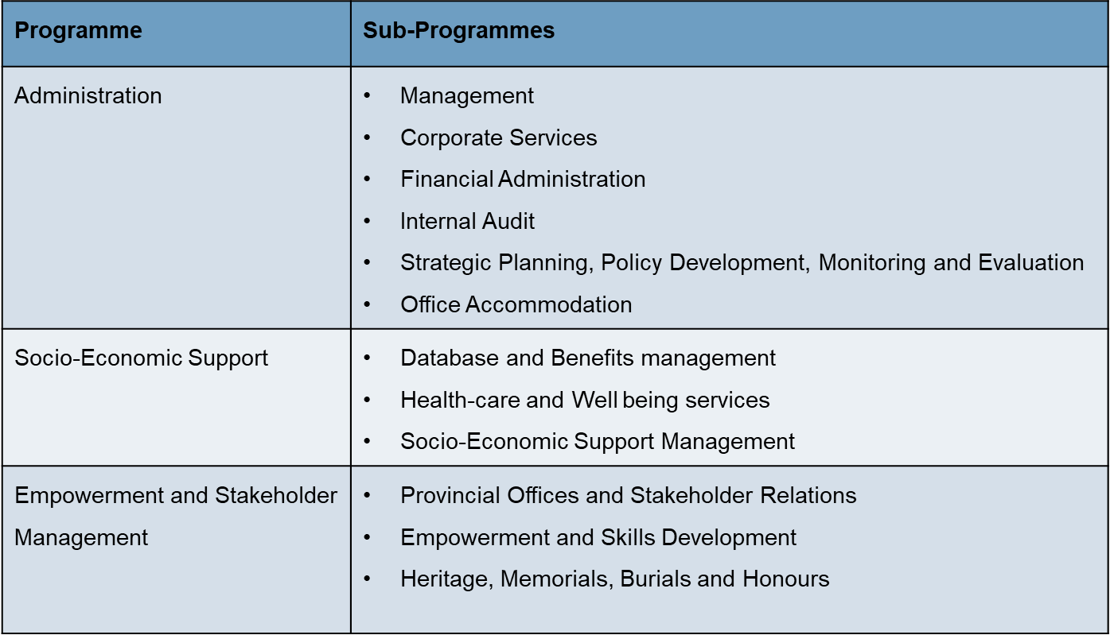
DMV APPROVED BUDGET PROGRAMME STRUCTURE

Slide 6
EXECUTIVE SUMMARY ON FINANCIAL PERFORMANCE
The budget of the Department reduced by R137 million from R683.1 million to R546.1 million due to the Government economic response to COVID-19 pandemic.
Q1 the total spending was R44.6 million vs a targeted spend of R 136.5 million from the allocation of R546.1 million
Quarter 1 spend of R44.6 million was 8.2% of the targeted spend of 25%.
Of the total spend of R44.6 million, R31.3 million was payment for Cost of Employment, R6.7 million for Goods and Services, R6.4 million for Transfers and Subsidies and only R127K was a payment for Capital Expenditure.

Slide 7
SPEND VS BUDGET BY PROGRAMME BY ECONOMIC CLASSIFICATION

Slide 8
SPEND VS BUDGET BY BRANCH BY ECONOMIC CLASSIFICATION - GRAPHICAL

Slide 9
2020/21FY Q1
PERFORMANCE INFORMATION

Slide 10
EXECUTIVE SUMMARY: OVERALL PERFORMANCE ANALYSIS
During Q1 the Department targeted 10 performance areas and 3 targets were achieved. This brought the overall achievement of targets against plan to 30% for Q1 with a variance of 80%. Underneath is the comparative analysis of the non-financial performance per programme during Q1 of the 2020/21FY.
 | Administration | SES | ESM | Total
Targets Planned | 3 | 3 | 4 | 10
Targets achieved | 2 | 0 | 1 | 3
Performance rating | 67% | 0% | 25% | 30%
Departmental Performance = No. of targets achieved x 100 Total no of targets = 3 x 100 10 = 30% DMV recorded 30% during Q1

Slide 11
DEPARTMENTAL OVERALL PERFORMANCE (TREND ANALYSIS Q1)

Slide 12
PERFORMANCE AGAINST SET TARGETS PER PROGRAMME

Slide 13
The Legend Colour Coding
Target achieved | 95% - 100%
Target partially achieved | 50% - 94%
Target not achieved | 0% - 49% (less than 50%)

Slide 14
Q1 PERFORMANCE ANALYSIS: PROGRAMME 1: ADMINISTRATION
Q1 Performance Summary: Administration
The Programme planned to achieve 3 targets in Q1 and 2 target were achieved which translate to 67%. There was only 1 target that was partially achieved.
Q1 Performance Analysis
 | Planned targets | Achieved targets | Targets not achieved
Targets | 03 | 02 | 01
Performance rating | 100% | 67% | 33%
Programme Performance = No. of targets achieved x 100 Total no of targets = 2 x 100 3 = 67% The Programme recorded 67% during Q1.

Slide 15
PROGRAMME 1: ADMINISTRATION PERFORMANCE INDICATORS AND TARGETS
Indicator ID | Output Indicators | Annual Target | Q1 Target | Quarter 1 Output – Validated | Deviation | Comments |  | Overall progress of indicator (Green, Amber or Red)
 |  |  |  |  |  | Reason for Deviation | Corrective Action
PPI: 101 | Unqualified audit opinion | Unqualified | - | - | - | - | - | No target planned for Q1
PPI: 102 | Percentage of legitimate invoices paid within 30 days | 90% | 90% | 69% | 21% | The variance was caused by the catch up on prior year payment on the travel account | DMV to speed up clearance of old travel invoices. This must be achieved by 31 August 2020.
PPI: 103 | Approved ICT Strategy | Approved ICT Strategy | Consultation with Stakeholders | The draft strategy has been developed and is currently being consulted with the business units of the Department | The Target was achieved as planned | Target Achieved | Target Achieved
PPI: 104 | Approved Human Resources Management Strategy | Approved Human Resources Management Strategy | Consultation with Stakeholders | 1st round of consultations under way within the Directorate | N/A | N/A | Target achieved as planned

Slide 16
Q1 PERFORMANCE ANALYSIS: PROGRAMME 2: SES
Q1 Performance Summary: Socio-Economic Support The Programme planned to achieve three (3) targets in Q1 and as a result no target was achieved as planned which translate to 0%. There was no partial achievement as all the targets were achieved below 50%.
Q1 Performance Analysis
 | Planned targets | Achieved target | Targets not achieved
Targets | 03 | 0 | 03
Performance rating | 100% | 0% | 100%
Branch Performance = No. of targets achieved x 100 Total no of targets = 0 x 100 3 = 0% The Programme recorded 0% performance during Q1.

Slide 17
Q1 PERFORMANCE ANALYSIS: PROGRAMME 2: SES
Indicator ID | Output Indicators | Annual Target | Q1 Target | Quarter 1 Output – Validated | Deviation | Comments |  | Overall progress of indicator (Green, Amber or Red)
 |  |  |  |  |  | Reason for Deviation | Corrective Action
PPI: 201 | Number of Military Veterans who are verified and captured on the National Military Veterans ’ Database. | 70 000 (5 325) | 64 675 (1 332) | 208 | -1 123 | The Department is using a manual system, therefore officials were not able to process applications due to Covid-19 Restrictions. | Facilitate the implementation of automated system.
*PPI: 202 | Number of Military Veterans provided with newly built houses per year | 710 | - | - | - | - | - | Not planned for the Quarter 1
*PPI: 203 | Number of Military Veterans approved for compensation | 200 | - | - | - | - | - | Not planned for the Quarter 1
*PPI: 204 | Number of Military Veterans approved for pension | 200 | - | - | - | - | - | Not planned for the Quarter1
*PPI: 205 | Number of Military Veterans approved for transport | 600 | - | - | - | - | - | Not planned for the Quarter 1
*PPI: 206 | Number of bursaries provided to Military Veterans and their dependants per year | 7 400 | - | - | - | - | - | Not planned for the Quarter 1
PPI: 207 | Total number of Military Veterans with access to health care services | 19 000 (1 000) | (18 250) 250 | 56 | -194 | Healthcare access impacted on by Covid-19 as all patients were advised to access healthcare when it’s absolutely critical to avoid burdening healthcare institutions as well as exposing patients who are already immune compromise to potentially contracting the virus. | Consider revising targets Fast track finalizing online claims processing with SAMHS Consider procurement of additional more safe PPI for paper claims processing while finalizing the online claims process
PPI: 208 | Number of Military Veterans and dependents provided with dedicated counselling and treatment. | 1 000 | 250 | 93 | -157 | Demand driven and demand decreased due to Covid-19 restrictions | Consider revising targets consider group counselling once lock down is lifted

Slide 18
Q1 PERFORMANCE ANALYSIS: PROGRAMME 3: ESM
Q1 Performance Summary: Empowerment & Stakeholders Management The Programme planned to achieve 4 targets during Q1 and only 1 target was achieved which translate to 25%. There was no partial achievement as all the targets were achieved below 50%.
Q1 Performance Analysis
 | Planned targets | Achieved targets | Targets not achieved
Targets | 04 | 01 | 03
Performance rating | 100% | 25% | 75%
ESM branch Performance = No. of targets achieved x 100 Total no of targets = 1 x 100 4 = 25% The Programme recorded 25% performance during Q1.

Slide 19
Q1 PERFORMANCE ANALYSIS: PROGRAMME 3: ESM (1)
Indicator ID | Output Indicators | Annual Target | Q1 Target | Quarter 1 Output – Validated | Deviation | Comments |  | Overall progress of indicator (Green, Amber or Red)
 |  |  |  |  |  | Reason for Deviation | Corrective Action
PPI: 301 | Number of Memorial activities coordinated for Military Veterans | 9 | Consultation with relevant stakeholders | 0 | Consultation with relevant stakeholders | Covid-19 lockdown posed as the challenge as the COVID Restrictions were in place | Dependent on the national disaster management response and resultant regulations by the government. Minimal catch up determined by government responses to the Covid-19 pandemic
PPI: 302 | Percentage of approved burial claims paid within 30 days | 100% | 100% | 100% | N/A | Target achieved as planned | Target achieved as planned
PPI: 303 | Number of Military Veterans and their dependants provided with skills development programmes | 1 000 | 250 | 0 | 250 | Covid-19 lockdown posed as a challenge as the nature of the roll-out of the benefit involves contact with clients in both walk-ins and outreach programmes in the provinces. | New work method will include more electronic processing of applications, initiation and implementation of integrated projects, and increased facilitation and coordination with other stakeholders.

Slide 20
Q1 PERFORMANCE ANALYSIS: PROGRAMME 3: ESM (2)
Indicator ID | Output Indicators | Annual Target | Q1 Target | Quarter 1 Output – Validated | Deviation | Comments |  | Overall progress of indicator (Green, Amber or Red)
 |  |  |  |  |  | Reason for Deviation | Corrective Action
PPI: 304 | Number of Military Veterans businesses provided with access to business facilitation programmes | 110 | 30 | 0 | 30 | Covid-19 lockdown posed as a challenge as the nature of the roll-out of the benefit involves contact with clients in both walk-ins and outreach programmes in the provinces. | Dependent on the national disaster management response and resultant regulations by the government. More engagement with Department of Small Business Development, especially Small Enterprise Finance Agency
PPI: 305 | Number of Military Veterans provided with employment opportunities | 20 | - | - | - | - | - | No target planned for Q1
PPI: 306 | Number of Military Veterans memorial sites erected per year | 3 | - | - | - | - | - | No target planned for Q1
^{[1]} DSBD: Department of Small Business Development
^{[2]} SEFA: Small Enterprise Finance Agency

Slide 21
HUMAN RESOURCE STATUS (1)
Transformation/Equity Statistics: Total permanent employees
Ser No |  |  | African |  | Coloured |  | Asian |  | White
 |  |  | Male | Female | Male | Female | Male | Female | Male | Female
1 | Race distribution of members |  | 69 | 58 | 2 | - |  | 1 | 3 | 2
2 | Gender distribution of members |  | 69 | 58 | 2 | - |  | 1 | 3 | 2
3 | Number of disabled members |  | 1 | - | - | - | - | - | 1 | -
4 | Number of members in the Programmes | P1 | 37 | 39 | - | - | - | 1 | 2 | 1
 |  | P2 | 10 | 11 | - | - | - | - | 1 | 1
 |  | P3 | 22 | 8 | 2 | - | - | - | - | -
5 | Total | 135 | 69 | 58 | 2 | - | - | 1 | 3 | 2
 | Comments/Deviations:
Transformation/Equity Statistics: Total contract employees
Ser No |  |  | African |  | Coloured |  | Asian |  | White
 |  |  | Male | Female | Male | Female | Male | Female | Male | Female
1 | Race distribution of members |  | 24 | 37 | - | - | - | - | - | -
2 | Gender distribution of members |  | 24 | 37 | - | - | - | - | - | -
3 | Number of disabled members |  | - | - | - | - | - | - | - | -
4 | Number of members in the Programmes | P1 | 8 | 24 | - | - | - | - | - | -
 |  | P2 | 13 | 9 | - | - | - | - | - | -
 |  | P3 | 3 | 4 | - | - | - | - | - | -
5 | Total | 61 | 24 | 37 | - | - | - | - | - | -
 | Comments/Deviations:

Slide 22
HUMAN RESOURCE STATUS (2)
Transformation/Equity Statistics: Total interns
Ser No |  |  | African |  | Coloured |  | Asian |  | White
 |  |  | Male | Female | Male | Female | Male | Female | Male | Female
1 | Race distribution of members |  | 15 | 14 | - | - | - | - | - | -
2 | Gender distribution of members |  | 15 | 14 | - | - | - | - | - | -
3 | Number of disabled members |  | - | - | - | - | - | - | - | -
4 | Number of members in the Programmes | P1 | 10 | 6 | - | - | - | - | - | -
 |  | P2 | 5 | 8 | - | - | - | - | - | -
 |  | P3 | - | - | - | - | - | - | - | -
5 | Total | 29 | 15 | 14 | - | - | - | - | - | -
 | Comments/Deviations: The department currently has 29 Interns, which is 12%, contrary to DPSA guidelines of 5%.

Slide 23
THANK YOU

