Slide 1
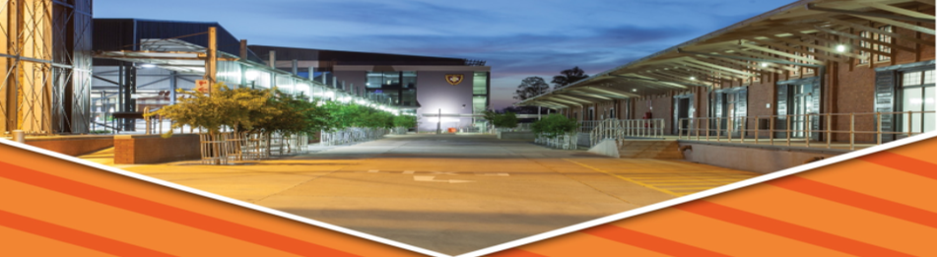

PROGRESS REPORT ON EXECUTIVE UNDERTAKINGS
Department of Public Works & Infrastructure
Select Committee on Petitions Executive Undertakings
21 October 2020

Slide 2

CONTENTS
SECTION A - Strategic Integrated Projects: SIP 25 Welisizwe Rural Bridges Programme & SIP 26 Rural Roads Programme
SECTION B - Social Facilitation Programme: Outline and Progress Report
SECTION C - SA’s Infrastructure Investment Plan Update Report: Detailed Implementation Modalities to Support the Economic Reconstruction and Recovery Plan
SECTION D - EPWP NSS: NPO Programme - Recruitment of participants for COVID 19 and GBV activities
Notes:
National Immovable Asset Management Standard 2017

Slide 3
SECTION A
Strategic Integrated Projects
SIP 25 Welisizwe Rural Bridges Programme
SIP 26 Rural Roads Programme

Slide 4
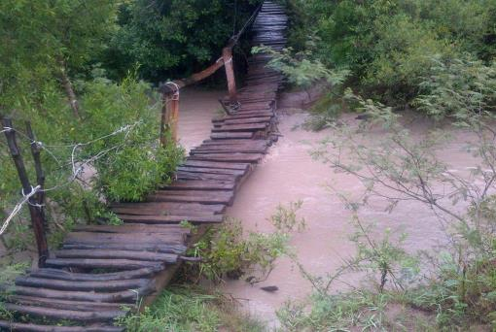
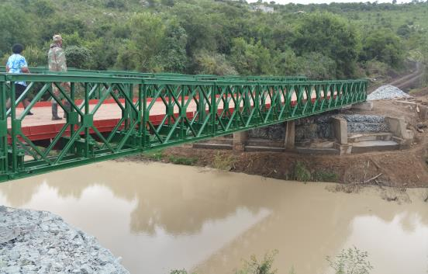
SPECIAL PROGRAMMES – GAZETTED ON 24 JULY 2020
Programmes for Immediate Job Creation: SIP 25 Welisizwe Rural Bridges Programme 1/3
The Department of Defence has committed capacity to deploy 2 160 members for the implementation of the Welisizwe Programme.
The erection of each bridge requires a team of up to 50 SANDF members.
This number is augmented by approximately 60 to 90 members from the communities through EPWP per construction site.
SANDF has capacity to implement 43 bridges concurrently.
The average duration for the implementation of each bridge from establishment to handover is about three months, thus each team is capable of rolling out four bridges per year.
In total, there is capacity to implement 172 bridges per year.
The short term requirement (by the end of the 2020/21 financial year) is to construct 33 bridges during this financial year.

Slide 5
SPECIAL PROGRAMMES – GAZETTED ON 24 JULY 2020
Programmes for Immediate Job Creation: SIP 25 Welisizwe Rural Bridges Programme 2/3
Budget Jobs (2020/21 FY) |  |  | Geographic Spread Programme Description |  | Presidential Job Creation & Protection Initiative Submission | Implementation Plan Timelines | Implementation Plan Action Items | Implementation Plan Social Facilitation / Localisation
SIP 25 Welisizwe Rural Bridges Programme | 1280 construction jobs 3840 operational jobs | R151,12 million | Eastern Cape, Free State and KwaZulu Natal | Improvement of safe river crossings to schools and other social facilities by building bridges.. These bridges erected in the rural areas provide communities with access to social infrastructure and economic opportunities. 400 bridges will be built over the MTEF period. Responsibility: DPWI, DOD | R151.12m applied for and approval awaited for 2020/21 FY Estimated for 28 September 2020 |  | The Modular Steel Bridges Technical Committee chaired by DPWI, consisting of DoT, COGTA and SANDF is evisaged to manage the process. The structure will be supported by the ISA Construction of 14 bridges by end March 2021 500 Personnel from the Artisan Programme Construction of 172 Bridges Construction of 400 Bridges within 3 Years Bridge maintenance programmes |  | As soon as the specific locations for the bridge have been determined, the stakeholder profiling will be undertaken. Identify the District and Local Champions Establishment of the Project Steering Committee as detailed Regular progress reporting to the SIP Steering Committee
0-6 MONTHS
6-12 MONTHS
+ 12 MONTHS

Slide 6
SPECIAL PROGRAMMES – GAZETTED ON 24 JULY 2020
Programmes for Immediate Job Creation: SIP 25 Welisizwe Rural Bridges Programme 3/3
PROGRESS
1. Completed bridges: Three (03) bridges completed – Eastern Cape Province
2. Planned construction for the 2020/21 Financial Year
Geographic spread : Free State , Eastern Cape , KwaZulu Natal and Limpopo
Number of bridges under construction for 2020/21: 14 bridges in KZN (already funded) / 2 Bridge in EC (already funded) (potential 17 more bridges awaiting funding in EC, FS,LP, KZN)
The targeted number for completion in the 3rd and 4th Quarter of 2020/21 is 33 Bridges (EC, FS, KZN, LP)
Skills Development: 605 Recruitment of Graduates underway
- 443 Graduates to be deployed to construction sites (Artisans Trainees)
- 162 Graduates to be deployed to 8 provinces for technical assessment
Expanded Public Works Programme : 906 EPWP Participants

Slide 7
SPECIAL PROGRAMMES – GAZETTED ON 24 JULY 2020
Programmes for Immediate Job Creation: SIP 26 Rural Roads Programme
Budget Jobs (2020/21 FY) |  |  | Geographic Spread Programme Description |  | Presidential Job Creation & Protection Initiative Submission | Implementation Plan Timelines | Implementation Plan Action Items | Implementation Plan Social Facilitation / Localisation
SIP 26 Rural Roads Programme | 4000 construction jobs 80 operational jobs | R701,5 million | Eastern Cape, Free State, Limpopo, North West and KwaZulu Natal | This is a programme for the development of a structure approach towards the improvement and upgrading of rural roads in South Africa. The five most suitable roads will initially be selected for implementation. After the pilot phase, the project will be implemented on a national basis. Responsibility- NDoT, COGTA and MISA ISA is Coordinating the Project | R701.5m applied for and approval awaited for 2020/21 FY Estimated for 28 September 2020 |  | With University of Stellenbosch, develop & finalise business case and specifications per area Determination and finalisation of the roads for upgrading |  | As soon as the roads have been determined, the stakeholder profiling will be undertaken. Identify the District and Local Champions Establishment of the Project Steering Committee as detailed Regular progress reporting to the SIP Steering Committee
0-6 MONTHS
6-12 MONTHS
+ 12 MONTHS
LOCALISATION IS CRITICAL
The specifications described above were developed over a wide range of materials, climate and traffic conditions and can be applied generally. It has, however, been found that they can be fine-tuned for local conditions but this can only be done with experience in certain areas. It is more important to ensure that certain aspects such as material homogeneity, stoniness, compaction and drainage are carefully controlled and supervised, during both construction and maintenance.

Slide 8
Progress Report on Executive Undertakings
SECTION B
Social Facilitation Programme
Outline and Progress Report

Slide 9
OUTLINE
1
What is Social Facilitation?
2
Objectives of Social Facilitation?
3.
Social Facilitation Implementation Example

Slide 10
SOCIAL FACILITATION
What is Social Facilitation?
SOCIAL FACILITATION, A MECHANISM FOR INCLUSIVE ENGAGEMENT
Social facilitation is a standardized community engagement process throughout the lifecycle of the infrastructure asset that refocuses and legitimizes implementation on measurable outcomes and achieve the Batho Pele Principles. It is a process that empowers the local community and enables inclusive, targetted development.
Social facilitation is underpinned by three critical pillars:
CO-CREATION - Consultative and inclusive process, where the community is engaged
from the onset and is part of the process in formulating the design of the solution.
Each stakeholder (community, business, government, labour etc.) engages
in the development of the solution.
CO-OWNERSHIP – Stakeholders roles and responsibilities are outlined in the
infrastructure project/programme and they must take responsibility.
This intervention further supports the promotion of localisation resulting
in the development of local skills and businesses.
ORGANIC - Creativity and innovation is encouraged, where the
community is able to identify its own unique strengths and how
they can be utilized to add value to the service delivery process.
COMMUNITY
Recipient Community
Local Businesses
Local Labour, etc.
PUBLIC
SECTOR
District & Local Champions
Government Departments
Municipalities, Entities
PRIVATE SECTOR
Local Contractors, Professional Service Providers, Financial Institutions, Investors, etc.

Slide 11
SOCIAL FACILITATION
Objectives of Social Facilitation?
Provide a measurable outcomes based standardized approach to community project engagement throughout the life-cycle of the infrastructure asset.
To support the District Development Model (DDM), as an embedded tool that can aid the District Champions in the implementation of the DDM Strategy.
To enhance social cohesion and a sense of community through co-created project solutions
To facilitate the establishment of a legitimate forum where all role players, stakeholders, including business, participate in the development of the area (forums are to be established as community forums and not political forums).
Promote community ownership of development initiatives
Provide support on local labour recruitment practices and processes
Coordinate Training & Capacity building activities
Programme marketing through lobby & advocacy support
Maximize potential project benefits
Mitigate social issues/risks that may have an adverse impact on the implementation of the project

Slide 12
SOCIAL FACILITATION IMPLEMENTATION
Social Facilitation Pilot Example
SIP 29 Comprehensive Urban Management Programme
Social facilitation will be utilized for the 12 Special Projects and upscaled and adopted for the other Strategic Integrated Projects.
COMPREHENSIVE
URBAN MANAGEMENT PROGRAMME
SIP 29.
Uses the District Delivery Model and works in partnership with COGTA & MISA
Will employ 52 000 workers over 3 years
Urban Management, including:
cleaning of parks;
cleaning of roads and pavements;
installation of rubbish bins in public areas;
maintenance of street-lights;
upgrading and maintenance of sidewalks;
planting trees and maintaining landscape;
closing drains and manholes;
providing designated safe and clean spaces for street trading
SOCIAL FACILITATION
IMPLEMENTATION PROGRAMME FOR SIP 29.
MoA between DPWI and COGTA
3 Year Programme oversight by ISA
Communication & Social Facilitation Programme
Roadshow with District & Local Champions & Provinces
Start in the three pilot DDM Districts:
  OR Tambo District Municipality – Eastern Cape,
  Waterberg District Municipality – Limpopo
  EThekwini Metropolitan Municipality , KZN
Source workforce from Social Development Database & Indigent Grant Database
Stakeholder Profiling
Urban Management Needs Assessment & Verification by the PSC where stakeholders are represented
IMPLEMENTATION
Upscale Comprehensive Urban Management Programme
STAKEHOLDER PROFILING:
3 PILOT DISTRICTS FIRST, THEN REPLICATED FOR THE OTHER DISTRICTS
Stakeholder Profiling
Determine UM baseline needs
Community engagement with District & Local Champions
Determine the Stakeholder Leads
Determine critical urban management priorities by the Project Steering Committee
Needs Assessment Verification

Slide 13
SECTION C
SA’s Infrastructure Investment Plan Update Report
Detailed Implementation Modalities to Support the Economic Reconstruction and Recovery Plan

Slide 14
Infrastructure South Africa
The Single-Entry Point for Infrastructure Investment & Implementation
The intent of the President in the 6th Administration is to centralise all infrastructure aspects under one banner and to ensure that there is consolidated capacity to drive infrastructure-led economic growth for South Africa.
Presidential Infrastructure Coordinating Commission (PICC) Council
Chaired by the President
Minister: Public Works & Infrastructure
Ms Patricia De Lille, MP
EXECUTIVE FOCAL POINT
Regulations for the Infrastructure Development Act, No 23 of 2014
Ensure the formulation of the National Infrastructure Plan
Oversight of the Strategic Infrastructure Project Pipeline and the IF in terms of the Presidential Proclamation.
Oversight and reporting of infrastructure development implementation targets – achievements, best practices, blockages, interventions, etc.
TECHNICAL FOCAL POINT
Central point of reference for strategic infrastructure planning, infrastructure and alignment.
Coordinate and align the work of the various structures responsible for both economic and social infrastructure.
Oversee the IF aimed at achieving blended financing of infrastructure.
Coordination of the monitoring and evaluation infrastructure development dashboard
Head: Infrastructure South Africa
Infrastructure Role-players
GTAC
BFI
DBSA
IFIU

Slide 15
Infrastructure South Africa
The Single-Entry Point for Infrastructure Investment & Implementation
This Infrastructure-Led Economic Growth and Recovery Plan has been developed within the context that Infrastructure South Africa or ISA will take up the responsibility of its overall co-ordination to ensure implementation. ISA has been envisaged within the context of the Infrastructure Development Act and so has
SA’s Infrastructure Investment Plan, in order to expedite delivery, job creation and to immediately kick-start our economy through infrastructure implementation and investment.
In executing SA’s Infrastructure Investment Plan, ISA will:
Work across all spheres of Government
Ensure that all projects:
  Have undertaken a comprehensive needs analysis;
  Interlinking and interdependent infrastructure networks are modelled, not individual projects;
  Infrastructure and related network resilience has been factored in;
  Infrastructure interdependencies (between assets and between networks) have been costed;
  Monitoring and identifying learnings.
Maintain good performance through planned maintenance and smarter use of assets.
Transform large-scale capital projects in terms of their planning, governance, financial management, investment, implementation and lifecycle management.
Facilitate long-term investment in infrastructure across the public and private sectors

Slide 16
Institutionalisation of Governance Models
Whole of Government-Approach and effective private sector participation
National Infrastructure Plan 2045
Reference Group Established
Comprised of Public and Private sector- infrastructure SOEs, key industry bodies such as BBC and BUSA
ESEID SOE Infrastructure Sub-Committee Established
CEOs of major Infrastructure SOEs, supported by ESEID Cluster co-chairs
Strategic Integrated Infrastructure Projects
SIP Implementation Committee
Committee in place. All nominations received. Expanded to include implementing agencies such as Coega Development Corporation, IPP Office and DBSA. All Departments critical ito Infrastructure Development Act included
Infrastructure Development Act governance structures activated
PICC Secretariat
PICC Management Committee
PICC Council
Development of robust infrastructure project pipeline
Eight Technical Working Groups established:
Social Infrastructure: GTAC, Coega Development Corporation
Municipal Infrastructure Finance: MISA, National Treasury
Agriculture & Agro-Processing: IDC, Land Bank
Human Settlements: DHS, DBSA
Digital Infrastructure: DCDT, DBSA
Transport: Transnet, Sanral
Water: DWS, DBSA
Energy: DMRE, DBSA
SIDS Steering Committee
Multilateral Development Banks, DFIs, Line Function DGs
Operationalisation of the Infrastructure Fund
Infrastructure Investment Committee
Public Sector: DPWI, NT, DTIC, DPE, ISA, MISA
Private Sector: BASA, BATSETA, ASISA, MDB Forum rep
Infrastructure Fund Strategic Advisory Committee
Public Sector: DBSA, NT, ISA
Private Sector: BASA, ASISA, BATSETA, SAICA

Slide 17
SECTION D
EPWP NSS: NPO Programme
Recruitment of participants for COVID 19 and GBV activities

Slide 18

Background
R771 m of the total amount of R1,6 billion that was reprioritised within the Department of Public Works (DPWI) baseline, under transfers and subsidies, was used under the Expanded Public Works Programme (EPWP) Non-State Sector (NSS) Non-Profit Organisations (NPOs) Programme for the recruitment of participants to deliver COVID-19 and Gender-Based Violence and Feminism (GBVF) services.
The DPWI as a member of the NatJoints, responded to combating the spread of COVID-19, in terms of the Disaster Management Act, No 57 of 2002, as stipulated in the National Joints Committee Containment Work Stream.
The DPWI identified the EPWP NSS NPO programme implemented by the Independent Development Trust (IDT) on its behalf, as the best response mechanism to COVID–19 in terms of public health matters in support and guided by the Department of Health (DOH).

Slide 19
Background
The DOH developed and distributed a National Public Hygiene Strategy in response to the COVID-19 pandemic.
This strategy sets out public hygiene measures to be implemented by various role players to delay, curb and prevent the spread of COVID-19.
The DOH identified the need to strengthen hygiene measures, regular cleaning and disinfecting of surfaces where the public converge and undertaking measures that include the monitoring and enforcing the wearing of masks in public health areas.
In terms of the project scope, the IDT was to ensure the delivery of services towards the EPWP COVID – 19 Response through the NPOs in various districts and metropolitans across the nine (9) provinces of the country, for the period of 12 April to 30 November 2020. The Programme targets 25 000 participants.

Slide 20
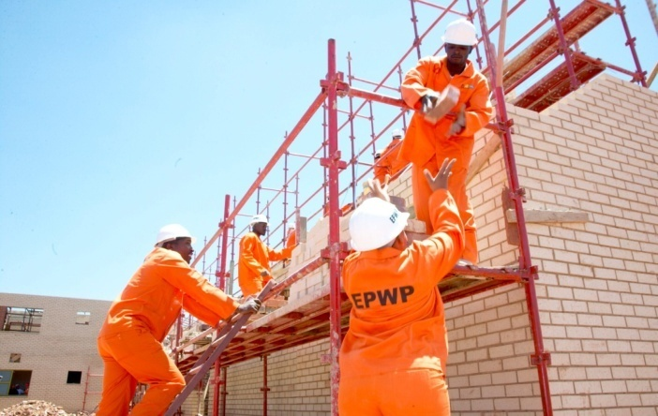
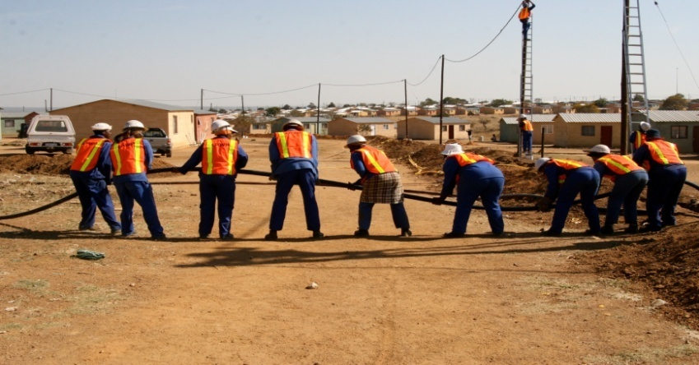
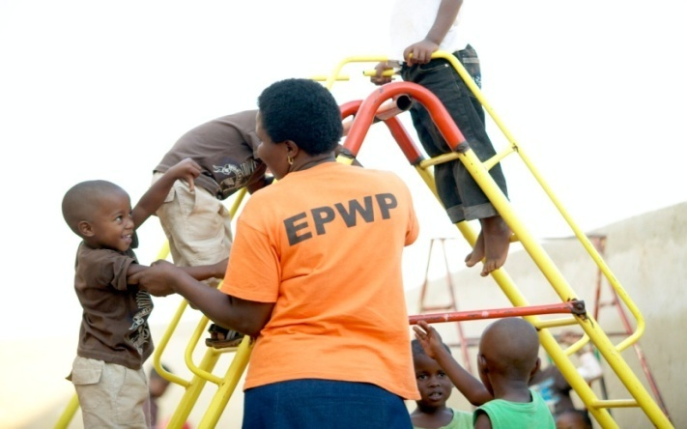
Progress Report on Undertakings
As at 09 October 2020:
20 536 EPWP participants were reported on the EPWP-Reporting System. Participants continued to be recruited in September 2020. The verification of these participants are underway and the number of participants reported is expected to increase. (Note: the EPWP-Reporting System closes on Monday, 19 October 2020).
Of the 20 536 participants reported to date, 923 EPWP participants have been deployed in four (4) provinces, that are, Eastern Cape, KwaZulu Natal, Gauteng and North West Provinces as part of the Gender Based Violence and Femicide (GBVF) interventions.

Slide 21
Progress Report on Undertakings
Table 1 below shows the total number of participants deployed for COVID-19 and GBVF service-delivery per province
Table 1. Participants Reported in the EPWP Reporting System as at 09/10/2020
Province | Deployed EPWP Participants – COVID-19 Intervention | Deployed EPWP Participants – GBVF Services
Eastern Cape | 2103 | 345
Free State | 2564 | 0
Gauteng | 5427 | 171
KwaZulu-Natal | 2171 | 383
Limpopo | 828 | 0
Mpumalanga | 1959 | 0
Northern Cape | 1245 | 0
North West | 2631 | 24
Western Cape | 1608 | 0
TOTAL | 20536 | 923

Slide 22
RECOMMENDATIONS
It is recommended that the Select Committee on Petitions and Executive Undertakings note the progress with regards to the executive undertakings made by the Minister during the Budget Debate session on 16 July 2020.
Notes:
National Immovable Asset Management Standard 2017

Slide 23

THANK YOU
END
National Department of Public Works and Infrastructure
Head Office: Public Works
CGO Building
Cnr Bosman and Madiba
Pretoria Central
Private Bag X65
Pretoria
0001
Website: http://www.publicworks.gov.za

