Slide 1
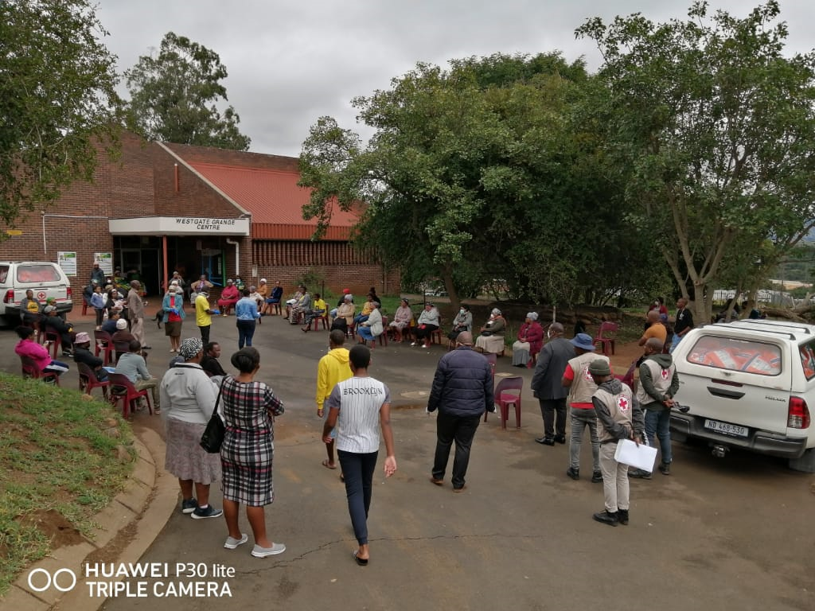
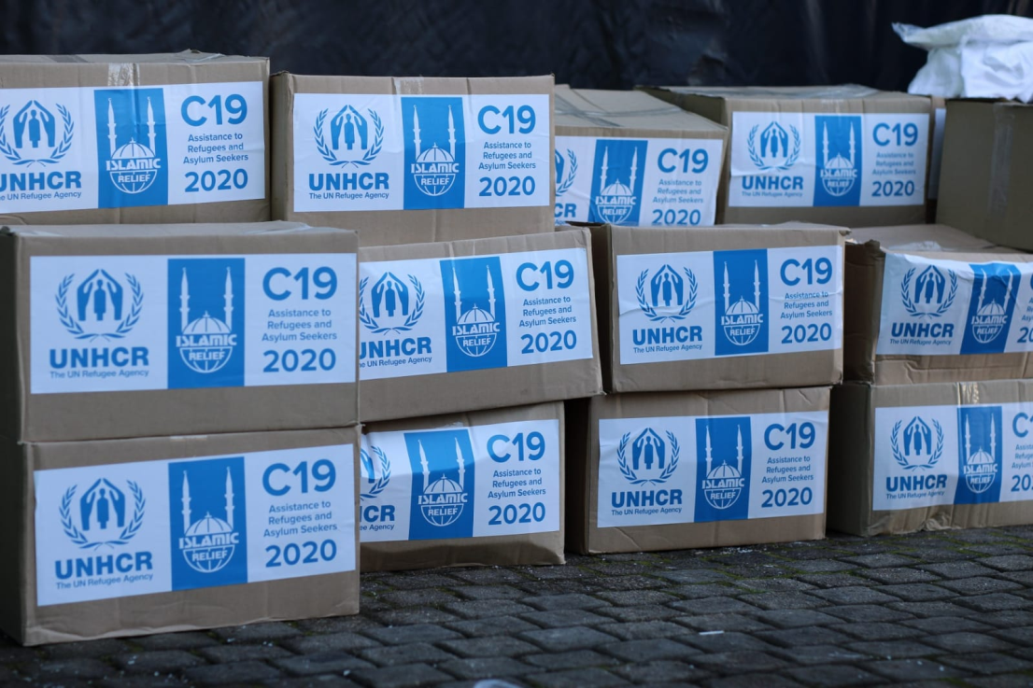
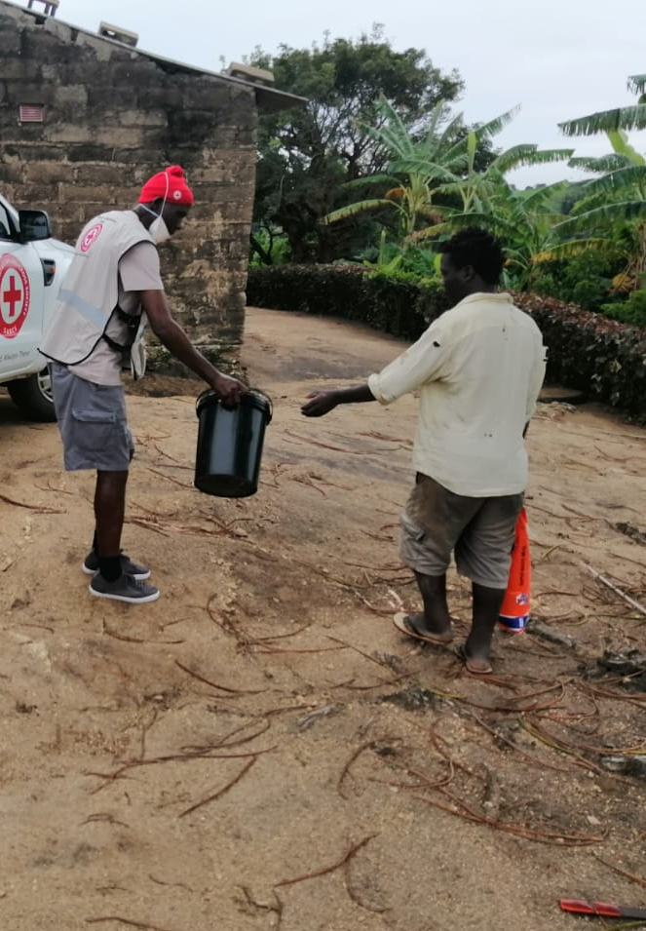
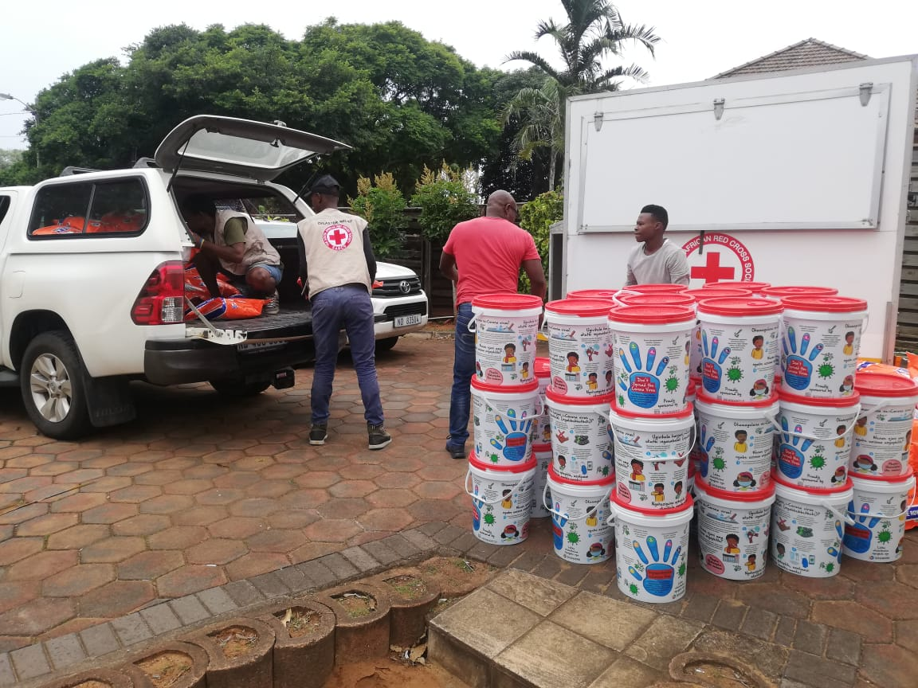
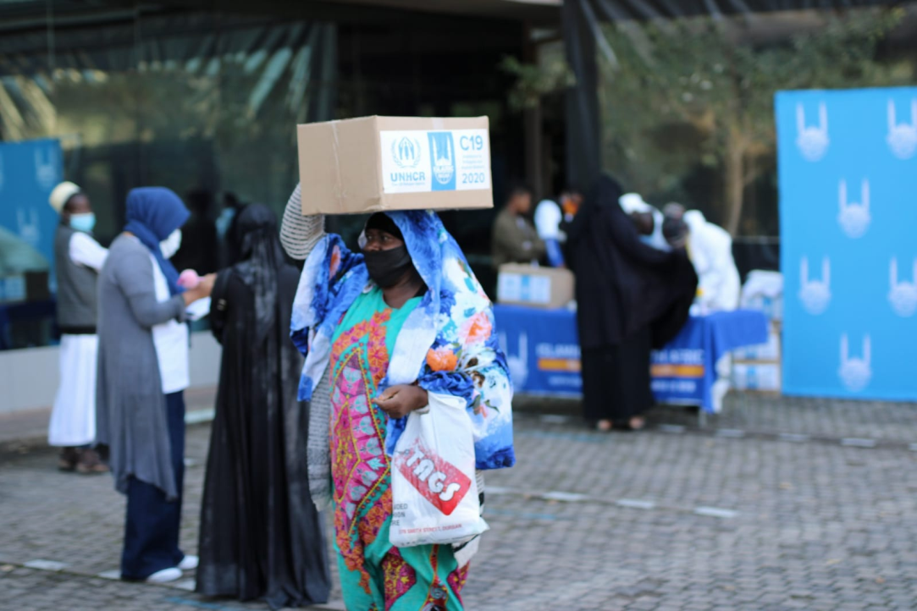
United Nations High Commissioner for Refugees (UNHCR) and Mandate
Presentation to the Portfolio Committee on Home Affairs
1 September 2020

Slide 2
UNHCR’s Mandate
UNHCR leads international action to protect people forced to flee their homes.
The work of UNHCR is:
Humanitarian
Non-Political
UNHCR’s persons of concern include asylum-seekers, refugees, returnees, IDPS and stateless persons
Notes:
The United Nations High Commissioner for Refugees and his Office (UNHCR) form a multilateral, intergovernmental institution, established by the United Nations General Assembly (GA) in the wake of the Second World War on 3 December 1949

Slide 3
UNHCR- The Main Functions
Ensure international protection to refugees
To seek durable solutions for the problem of refugees
To implement the supervisory responsibility of the 1951 UN Refugee Convention and offer technical support, guidance and coordination on refugee matters
To promote International Refugee and Statelessness Laws
Notes:
International protection; includes a range of concrete activities that ensure that all women, men, girls, and boys of concern to UNHCR have equal access to and enjoyment of their rights in accordance with international law. The ultimate goal of these activities is to help them rebuild their lives within a reasonable amount of time.
Durable Solutions; Voluntary repatriation, local integration, RST
Supervisory Responsibility; Assisting States to enact or revise national refugee legislation, including administrative instructions and operational guidelines, and to implement national refugee status determination procedures. Strengthening relevant administrative and judicial institutions, training staff of government and non-governmental agencies, and liaising with relevant human rights bodies.
Promoting accession to the 1951 Convention relating to the Status of Refugees and its 1967 Protocol, to the 1954 Convention relating to the Status of Stateless Persons and to the 1961 Convention on the Reduction of Statelessness. In 1999, UNHCR launched a campaign to promote accession to the 1951 Convention that culminated on its 50th anniversary in July 2001 and the Ministerial Meeting of States Parties to the 1951 Convention on 12 and 13 December 2001.

Slide 4
Basic Principles
Fundamental principles of International Protection
Respect for human rights
The Right of Admission and
The principle of Non-refoulement, the cornerstone of international refugee protection and law, which prohibits the expulsion of persons of concern to the frontiers of their country of origin where they would face serious harm.
The prohibition of refoulement applies to all refugees and to asylum-seekers whose status has not yet been determined, as this group may include refugees;
Notes:
Right of Admission - The starting point for international protection is the admission of people fleeing persecution and violence to a territory where they can seek asylum and find safety
Refouler - French word meaning - to push or force back . The only permissible exceptions to the principle of non-refoulement
*apply in two circumstances: if there are reasonable grounds for regarding an individual refugee as “a danger to the security of the country in which he [or she] is” or if he or she, “having been convicted by a final judgement of a particularly serious crime, constitutes a danger to the community of that country”.
In addition to these exceptions, the non-refoulement test is also subject to the larger purview of international human rights law, which includes the Convention Against Torture and the international customary law principles.

Slide 5
Working with States
International Protection
States have the primary responsibility for protecting refugees.
UNHCR works to support and provide technical expertise to help guide governments to take all actions necessary to protect refugees, asylum-seekers and other persons of concern who are on their territory or who are seeking admission to their territory.

Slide 6
Article 35: 1951 UN Convention
Co-operation of the national authorities with the United Nations
The Contracting States undertake to co-operate with the Office of the United Nations High Commissioner for Refugees, or any other agency of the United Nations which may succeed it, in the exercise of its functions, and shall in particular facilitate its duty of supervising the application of the provisions of this Convention.
In order to enable the Office of the High Commissioner or any other agency of the United Nations which may succeed it, to make reports to the competent organs of the United Nations, the Contracting States undertake to provide them in the appropriate form with information and statistical data requested concerning: (a) The condition of refugees, (b) The implementation of this Convention, and; (c) Laws, regulations and decrees which are, or may hereafter be, in force relating to refugees.

Slide 7
UNHCR Perspective
In line with its mandate, UNHCR calls for certain measures to be put in place, including respect for the institution of asylum and the principle of non-refoulement
States must not bar refugees and asylum-seekers having access to territory to seek international protection
Asylum-seekers and refugees must not be sent back to countries where their life or their liberty is at risk (including indirectly)
Durable solutions include a focus on local integration, voluntary repatriation when the situation permits safe and dignified return and resettlement for a small number of refugees with acute protection needs.
UNHCR recognises the necessity of managing borders and fighting against organised crime (including fighting against the trafficking of persons) while ensuring that access to asylum is part of a State’s protection response

Slide 8
UNHCR Activities
Ongoing support to asylum capacity management, including collaboration with DHA’s Asylum Seeker Management and support for a Backlog Project with the Refugees Appeal Authority of South Africa
Collaboration with Department of Social Development on social cohesion intervention, community engagements, working with local leaderships, training community members as change agents through dialogues-Targeted Areas-Atteridgeville, Thokoza and Katlehong,
Finalising MoU with SASSA on key collaborative activities and assistance
Ongoing collaboration with the SAHRC at national and provincial level,
UNHCR recently met with the Office of the Premiers for both WC and KZN to strengthen relations and identify areas of collaboration on refugee related matters,
UNHCR collaborates with the National Disaster Management Centre on many fronts
Support capacity building of civil society to deliver services to persons of concern
Notes:
Express gratitude to the and South African government in general for their inclusive policies on access to healthcare
Note the recent court case where asylum-seekers can now apply for COVID-19 R350 support grant

Slide 9
Cont’… UNHCR Activities
Article 2 of the 1951 UN Refugee Convention states that “Every refugee has duties to the country in which he finds himself, which require in particular that he conform to its laws and regulations as well as to measures taken for the maintenance of public order”.
Ongoing monthly meetings (WC and Gauteng) are held with refugee leaders from various communities to remind them of rights and duties and to discuss protection issues
UNHCR Partners and Refugee leaders have and continue to distribute food parcels in various communities to both locals and non-national as a show of solidarity in the fight against COVID-19
UNHCR funded a social cohesion project in the Western Cape through its partner to manufacture PPE equipment and distribute to refugees and local populations in under resourced communities and townships in a show of solidarity to high risk communities i.e. Khayelitsha (directly funded by UNHCR), Gugulethu, Nyanga, Phillipi, Cross roads and Weltevreden (Samora Machel) -10 000 face cloth masks distributed in Khayelitsha alone.
Together with South Africans, refugees who produced PPE equipment, addressed communities about risk communications and health messaging, strengthening solidarity and peacebuilding during distribution campaigns

Slide 10
COVID-19
Appreciation for the Government’s Public Health Care inclusion and access for persons of concern
Access to State Services and social grants
More than 30 000 persons of concern assisted with emergency support during the pandemic
Good coordination between all stakeholders and refugee and asylum-seeker communities
Need for strong social cohesion and risk communication, strengthened community engagement
Notes:
Express gratitude to the and South African government in general for their inclusive policies on access to healthcare
Note the recent court case where asylum-seekers can now apply for COVID-19 R350 support grant

Slide 11
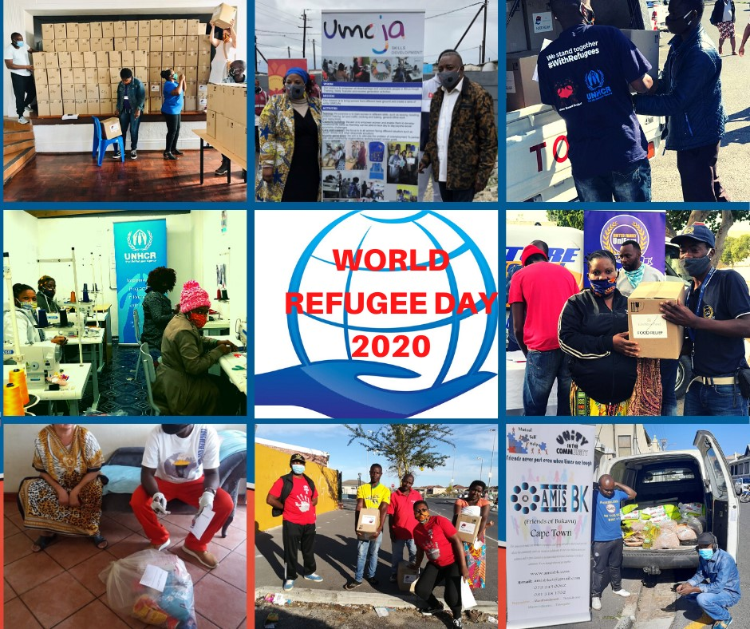

Slide 12
