Slide 1
2020 Provincial and Municipal Economic Review and Outlook
Budget Committee Presentation
MS Teams
Dr R Havemann
20 October 2020

Slide 2
Introduction
Socio-economic Intelligence
PERO/MERO publications developed amidst time of unprecedented uncertainty.
Ailing economy, load-shedding, credit-rating downgrades, service delivery protests, low consumer and business confidence, aggravated by COVID-19.
Navigating uncertainty through evidence-based planning to inform integrated planning and budgeting; fair, equitable and sustainable distribution of limited financial resources while supporting good governance, financial sustainability.
PERO: National and provincial perspective of economic statistics, trends and developments.
MERO: Disaggregates economic data to a district and local government level.
Trends highlighted in the PERO/MERO also reflect on the impact of implementation of provincial and municipal services and programmes.
Collaborative effort and contributions by departments and municipalities.
Provincial and Municipal Economic Review and Outlook 2020 | Budget Committee Presentation

Slide 3
Data Disclaimer
Stats SA Q2 data
Most recent published economic data available at national level.
Data not available at provincial/ municipal level.
Q2 data has been incorporated as part of the forecast.
Q3 data only expected in December 2020.
Regional level data
Most recent published data for 2018, released by Stats SA (March 2020).
Estimates for 2019 available on Quantec, used in MERO.
Economic Forecast data
Most recent published data at national level is from SARB (Sept 2020).
Used to forecast economic growth at provincial and municipal level.
Quantec to release forecast in October 2020, not used in the publications due to time constraints.
Provincial and Municipal Economic Review and Outlook 2020 | Budget Committee Presentation

Slide 4
Growth Outlook, 2020 – 2021, slower global and national growth
GDP growth rates |  | 2018 | 2019 | 2020(f) | 2021(f)
World output |  | 3.6 | 2.9 | -4.9 | 5.4
Advanced Economies |  | 2.2 | 1.7 | -8.0 | 4.8
Emerging and Developing Countries |  | 4.5 | 3.7 | -3.0 | 5.9
 | Sub-Saharan Countries | 3.2 | 3.1 | -3.2 | 3.4
South Africa |  | 0.8 | 0.2 | -9.8 | 3.3
 | Western Cape | 0.8 | 0.3 | -6.9 | 3.8
Provincial and Municipal Economic Review and Outlook 2020 | Budget Committee Presentation
Notes:
Global growth continued to contract, slowing from 3.6 per cent in 2018 to 2.9 per cent in 2019
Global economic growth was already moderating prior to the pandemic
The pandemic triggered a deep global economic recession as global industrial production was disrupted.
Growth in advanced economies declined from 2.2 per cent in 2018 to 1.7 per cent in 2019, continuing a trend that began 2017.
growth in emerging and developing economies slowed from 4.5 per cent in 2018 to 3.7 per cent in 2019. Growth in the Chinese economy slowed from 6.7 per cent in 2018 to 6.1 per cent in 2019

Slide 5
Risks to Outlook
Global
National and Provincial
A crisis such as the global COVID-19 pandemic brings a high level of uncertainty as full impact is unknown and predictions worsen as year progresses.
Sharp economic downturn expected to have the greatest adverse effect on low-income households, eroding world progress in reducing extreme poverty
Geopolitical and trade tensions- tensions between the US and China are ever-mounting recently compounded
The adverse economic climate due to downturn will result in an increase in unemployment and absolute poverty
Increased inequality due to the digital divide. People engaged in the retail, tourism, hospitality, and entertainment industries are most affected in the short run, due to lockdown measures
Unreliable and interrupted electricity supply and burden of failing SOEs - significant cost to production and the national fiscus.
Government debt levels are soaring and credit rating is deteriorating.
WC specific: negative impact of the COVID-19 response on the tourism and the wine industry
Provincial and Municipal Economic Review and Outlook 2020 | Budget Committee Presentation

Slide 6
Private services sector continues to drive growth
Percentage contribution to economic growth (avg)
Private services sector key driver of economic growth having grown by 2.2 per cent o average over the past decade; and accounts for 64.1 per cent of the WC economy
Provincial and Municipal Economic Review and Outlook 2020 | Budget Committee Presentation
Notes:
Private services’ sector grew on average with 2.2 per cent over the last decade, with all sub-sectors in the private services sector experiencing a positive growth over the past decade.
General government experienced a GVA growth of 2.4 per cent on average over the past decade.
Government expenditure most likely increased due to the growing population and due to increases in large construction projects over the last decade.
Construction sector grew on average by 2.6 per cent between 2010 and 2014.
Average growth in construction slipped to -0.3 per cent between 2015 and 2019, bringing the average growth over the last decade down to 1.1 per cent.
The decline in the construction sector can be attributed to the weak investor confidence and depressed economic growth nationally and provincially.

Slide 7
Key trends in regional sectors and industries
Agriculture and agri-processing
40.1 per cent of exports in 2019
WC contributes more than 90 per cent of national exports of blueberries, bulk wine and pears; and more than 80 per cent of table grapes, bottled wine and apples exports in 2019.
Tourism
The WC attracted 2 million tourists, increasing the number tourist arrivals in the Western Cape by 16 per cent in 2019
Contributed over R15.5 billion to Western Cape GVA in 2019.
Recorded 25.7 million bed nights, and employment creation amounted to a total of 174 982 direct jobs in 2019.
Construction
Construction is expected to increase at a slightly faster rate than it did between 2010 and 2019, at 2.0 per cent annually
Provincial and Municipal Economic Review and Outlook 2020

Slide 8
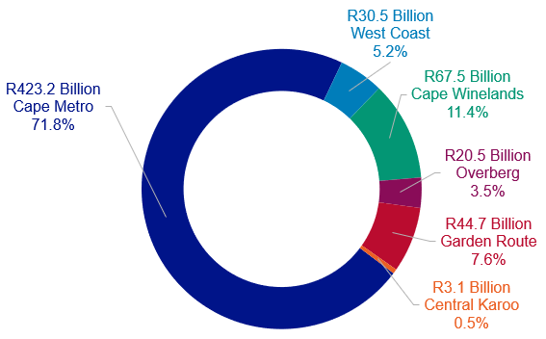
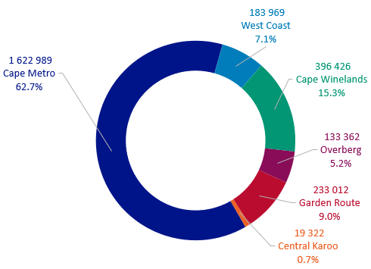
District GDPR and employment contribution
GDPR (current prices), 2018
Employment contribution, 2018
Provincial and Municipal Economic Review and Outlook 2020 | Budget Committee Presentation
Notes:
The economy of the WC is dominated by the Cape Metro area., that accounts for 71.8 per cent of the Province’s GDPR and 62.7% of employment. Followed by the Cape Winelands and Garden Route Districts. Conversely, the Central Karoo has the smallest contribution to the Province’s GDPR and employment. (There has been no significant change between the economic structure of the WC between 2017 and 2018).)

Slide 9
Real GDPR growth trend growth by sector and region, 2014-2018 (%)
 | Cape Metro | West Coast | Cape Winelands | Overberg | Garden Route | Central Karoo
Primary Sector | 1.5% | 1.3% | -0.4% | -1.0% | -0.7% | 0.1%
Agriculture, forestry & fishing | 1.4% | 1.3% | -0.4% | -1.0% | -0.8% | 0.1%
Mining & quarrying | 1.6% | 0.2% | 1.1% | 2.5% | 1.6% | 2.0%
Secondary sector | 0.2% | 1.4% | 0.3% | 1.9% | 0.4% | 1.0%
Manufacturing | 0.1% | 1.7% | -0.5% | 2.6% | 0.8% | 1.0%
Electricity, gas & water | -0.7% | -2.0% | 0.1% | -0.8% | -0.9% | 0.9%
Construction | 0.8% | 1.5% | 3.0% | 1.2% | -0.3% | 1.2%
Tertiary sector | 1.6% | 1.8% | 2.6% | 2.4% | 2.0% | 1.1%
Wholesale & retail trade, catering & accommodation | 1.0% | 1.9% | 2.5% | 2.3% | 1.1% | 0.0%
Transport, storage & communication | 1.5% | 0.2% | 2.6% | 2.9% | 2.3% | -0.2%
Finance, insurance, real estate & business services | 2.1% | 2.9% | 3.7% | 3.1% | 3.3% | 2.4%
General government | 1.3% | 1.1% | 0.5% | 0.5% | 0.2% | 1.7%
Community, social & personal services | 1.2% | 2.3% | 2.1% | 1.9% | 1.3% | 1.4%
Provincial and Municipal Economic Review and Outlook 2020 | Budget Committee Presentation

Slide 10
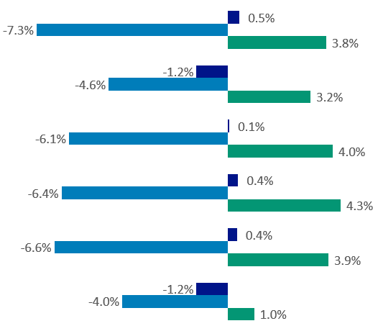
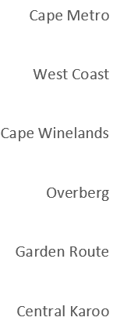
GDPR forecast
GDPR forecast per region, 2020 – 2021 (%)
2019e
2020
2021
Severe contraction in 2020 because of the COVID-19 pandemic. Economic recovery is only expected after 2021. West Coast and Central Karoo will remain under pressure due to weak economic performance prior to 2020.
Source: Urban-Econ based on SARB, Statistics SA & BFAP ,2020 (e denotes estimate, f denotes forecast))
Provincial and Municipal Economic Review and Outlook 2020 | Budget Committee Presentation

Slide 11
Labour Market Dynamics, WC 5-year performance, 2015-2020
Western Cape 5-year Performance, 2015 - 202
 |  | 2015Q1 | 2020Q1 | Change
 |  | Thousands | Thousands | Thousands | Per cent
WESTERN CAPE
 | Working-age population | 4 246 | 4 708 | 462 | 2.1 p.a.
 | Employment | 2 261 | 2 501 | 240 | 2.1 p.a.
 | Narrow unemployment | 600 | 662 | 62 | 2.1 p.a.
 | Narrow labour force | 2 861 | 3 163 | 302 | 2.0 p.a.
 | Non-searching unemployed | 88 | 163 | 75 | 15.8 p.a.
 | Narrow unemployment rate | 21.0% | 20.9%
SOUTH AFRICA |  | 26.4% | 30.1%
WESTERN CAPE YOUTH LABOUR MARKET (15-34)
 | Working-age population | 2 097 | 2 237 | 139 | 1.3 p.a.
 | Employment | 905 | 947 | 41 | 0.9 p.a.
 | Narrow unemployment | 387 | 405 | 18 | 1.0 p.a.
 | Narrow labour force | 1 292 | 1 352 | 60 | 0.9 p.a.
 | Non-searching unemployed | 55 | 104 | 49 | 14.9 p.a.
 | Narrow unemployment rate | 29.9% | 30.0%
Provincial and Municipal Economic Review and Outlook 2020 | Budget Committee Presentation
Notes:
The WC unemployment rate was estimated at 20.9 per cent in the first quarter of 2020
employment increased from 2.3 million in the first quarter of 2015 to 2.5 million in the first quarter of 2020. Narrow
the working-age population increased by 462 000 between the first quarters of 2015 and 2020, with a narrow labour force growth of 302 000.

Slide 12
Labour Market Trends
Shifts in labour market composition: Older, more educated, larger proportion of Africans
Western Cape workers more likely to express satisfaction with job
Youth:
Youth unemployment rate: 30.0 per cent
Rapid expansion of non-searching unemployed
Increase in share of unemployed supporting themselves through access to child support and foster care grants
25.4 per cent of the unemployed reside in households with no employed members
Provincial and Municipal Economic Review and Outlook 2020 | Budget Committee Presentation

Slide 13
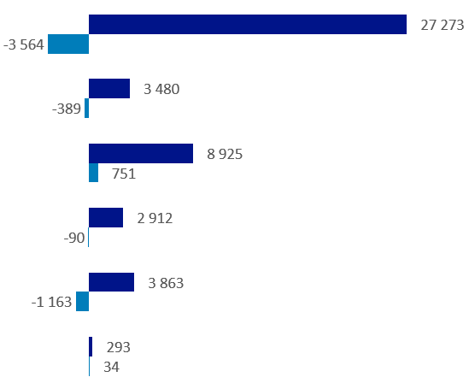
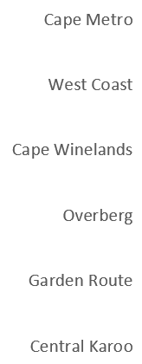
Employment creation
Employment change per region
2014 - 2018
2019e
Increased job shedding in regions of the Western Cape expected in 2020 due to poor economic performance.
Provincial and Municipal Economic Review and Outlook 2020 | Budget Committee Presentation

Slide 14
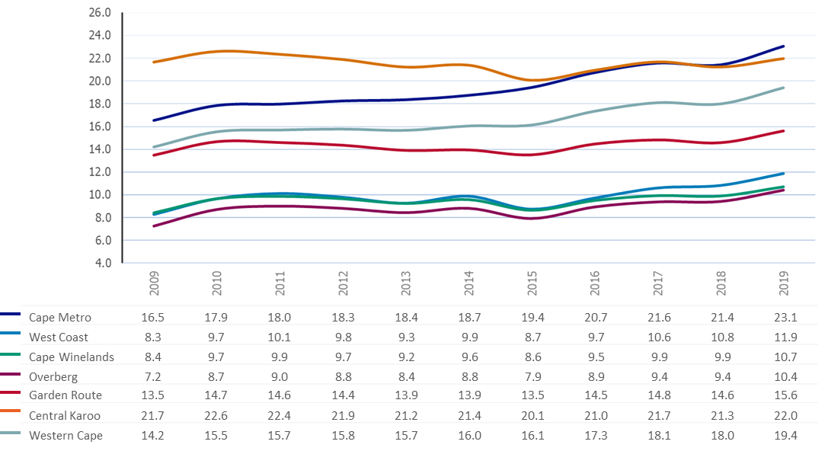
Unemployment rate per region, 2009 – 2019 (%)
Percentage
Provincial and Municipal Economic Review and Outlook 2020 | Budget Committee Presentation

Slide 15
Socio-economic analysis (Western Cape)
Summary of key socio-economic indicators
Population
Quality of Life
Education
Health
Increasing population and ho
Population estimated at 7.01 million people; largely driven by in-migration as fertility rate declines over time
Inequality has increased (0.621), but HDI (0.73) continues to increase
Overall improved systemic test scores across Grades between 2014 and 2019, but regression in performance noted in 2017 and 2018. WC had the third highest NSC results
Increase in life expectancy, maternal mortality in facility ratio/ mother –to-child transmission worsened in last year
Top causes of premature mortality in 2017 : Diabetes mellitus (4.8 per cent) leading cause of death; and HIV/AIDS (5.7 per cent)
Provincial and Municipal Economic Review and Outlook 2020 | Budget Committee Presentation

Slide 16
Socio-economic analysis (Western Cape)
Summary of key socio-economic indicators
Service Delivery
Crime
Increasing population and ho
Housing backlog continues to grow (550 889 registered)
Pace of basic service provision under pressure from rapid population growth,
Remains relatively high
Tik (29.0 per cent primary substance of abuse amongst patients admitted at state specialist treatment centres; followed by cannabis (26.0 per cent) and alcohol (20.0 per cent)
Increase in murder, attempted murder, sexual assault, but decline in drug-related crime and driving under the influence of drugs or alcohol
Provincial and Municipal Economic Review and Outlook 2020 | Budget Committee Presentation

Slide 17
Socio-economic analysis (Regional)
Summary of key socio-economic indicators
Population
Income
Education
Health
Increasing population and ho
Population of Cape Winelands expected to exceed 1.0 million by 2024.
Overstrand and Bitou have population growth rates exceeding 3% p.a
Kannaland, Oudtshoorn and Beufort West have declining population.
Average household income in the province is greater than in South Africa.
Declining trend in GDPR per capita.
Declining levels of household incomes.
Rising levels of income inequality.
Increasing learning enrolments.
Increase in learner retention in Cape Metro, West Coast, Cape Winelands, Overberg and Central Karoo.
Increase in matric pass rate in Cape Metro, Overberg and Garden Route
Declining trends in infant mortality rate and maternal death rate.
Increased rates of HIV virus suppression in Central Karoo.
Decline in TB client death rate in West Coast and Cape Metro.
Provincial and Municipal Economic Review and Outlook 2020 | Budget Committee Presentation

Slide 18
Socio-economic analysis
Summary of key socio-economic indicators (continued)
HDI
Dwellings
Crime
Indigent households
Increase HDI in all regions.
Low levels of HDI in areas of Central Karoo, West Coast and Cape Winelands.
Most households reside in formal dwellings.
Above average proportion of households in informal dwellings in Cape Metro, Knysna, Bitou and Stellenbosch.
Decline in drug-related crime in all areas.
Increase in murder date in Cape Metro, Cape Winelands, Overberg and Central Karoo
Increase in driving under the influence of drugs or alcohol in West Coast, Overberg and Garden Route
Indigent households expected to increase across all regions as a result of COVID-19.
Rising pressure on local municipalities in terms of revenue collection.
Provincial and Municipal Economic Review and Outlook 2020 | Budget Committee Presentation

Slide 19
Integrated Management Approach
Socio-economic Intelligence
Provincial Economic Review and Outlook (PERO)
Municipal Economic Review and Outlook (PERO)
Socio-economic Profiles (SEP-LG)
IDP
NDP
PSP
Holistic strategic vision
Budget allocations and linkages to A10 and SA9
Performance indicators in SA7
Eradicating poverty and reducing inequality
A safe WC where everyone prospers
Maximum Citizen Value
BUDGET
PTM/MM
Planning and Implementation
DCF
Planning and Governance
TIME
Governance and Implementation/Performance
SIME (LGMTEC)
Planning and budgeting
Joint District Approach/Support Plans as GOLDEN THREAD that ensures coherent planning, budgeting and implementation of service delivery projects in all districts by all three spheres of government.

Slide 21
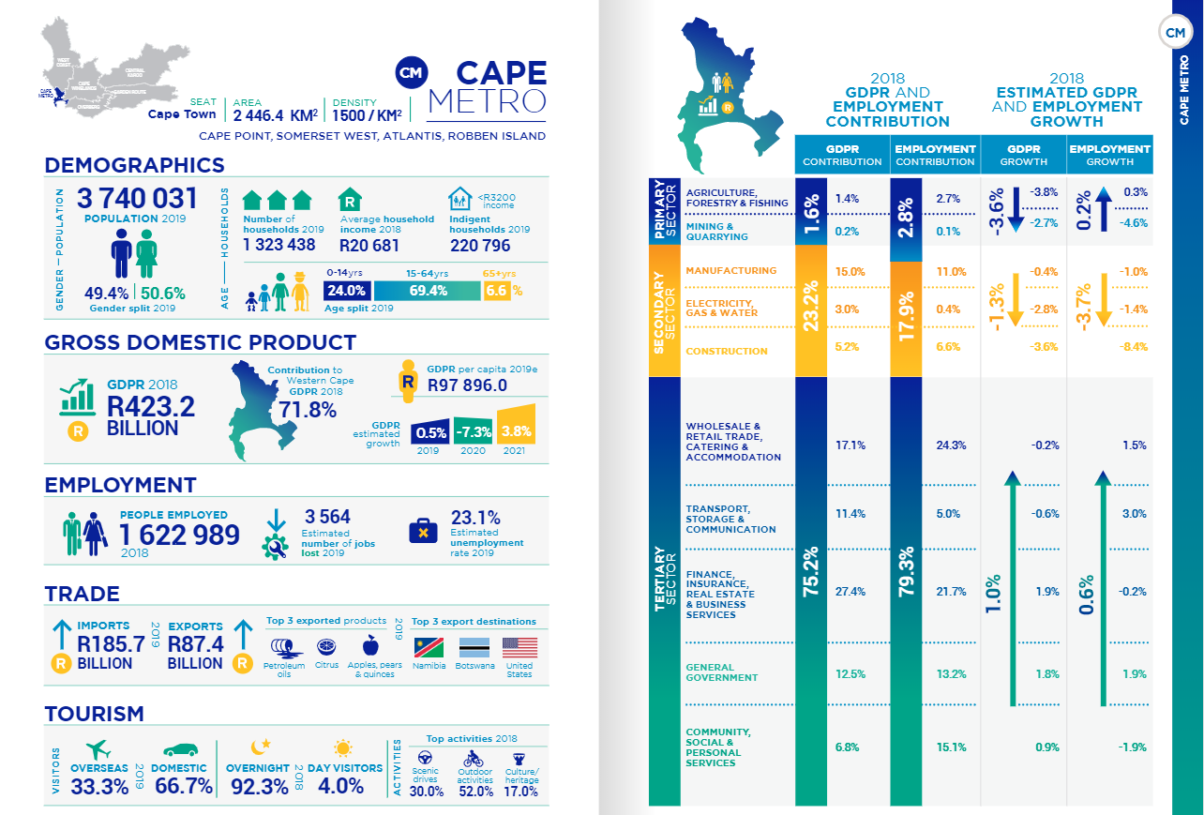

Slide 22
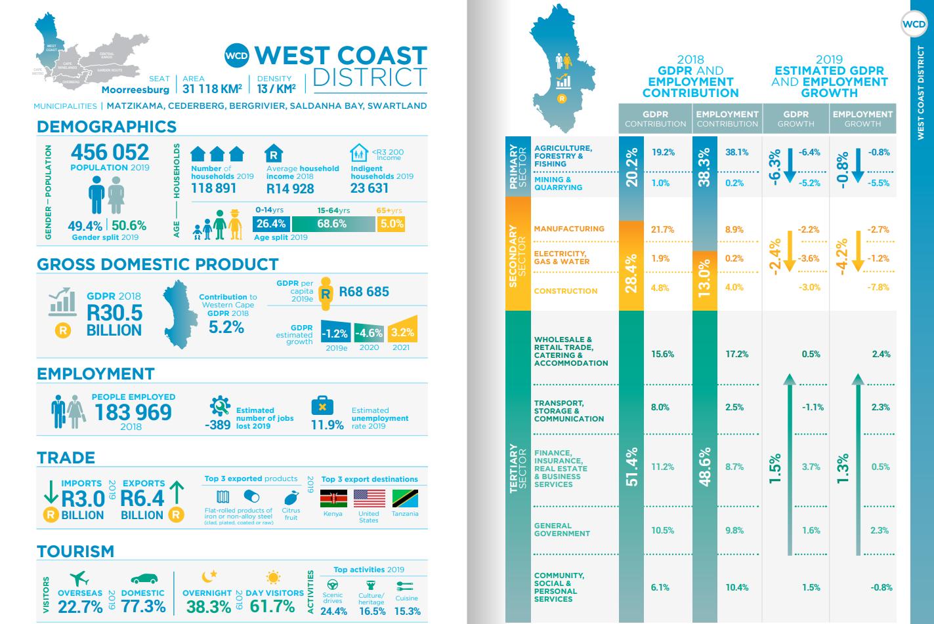

Slide 25
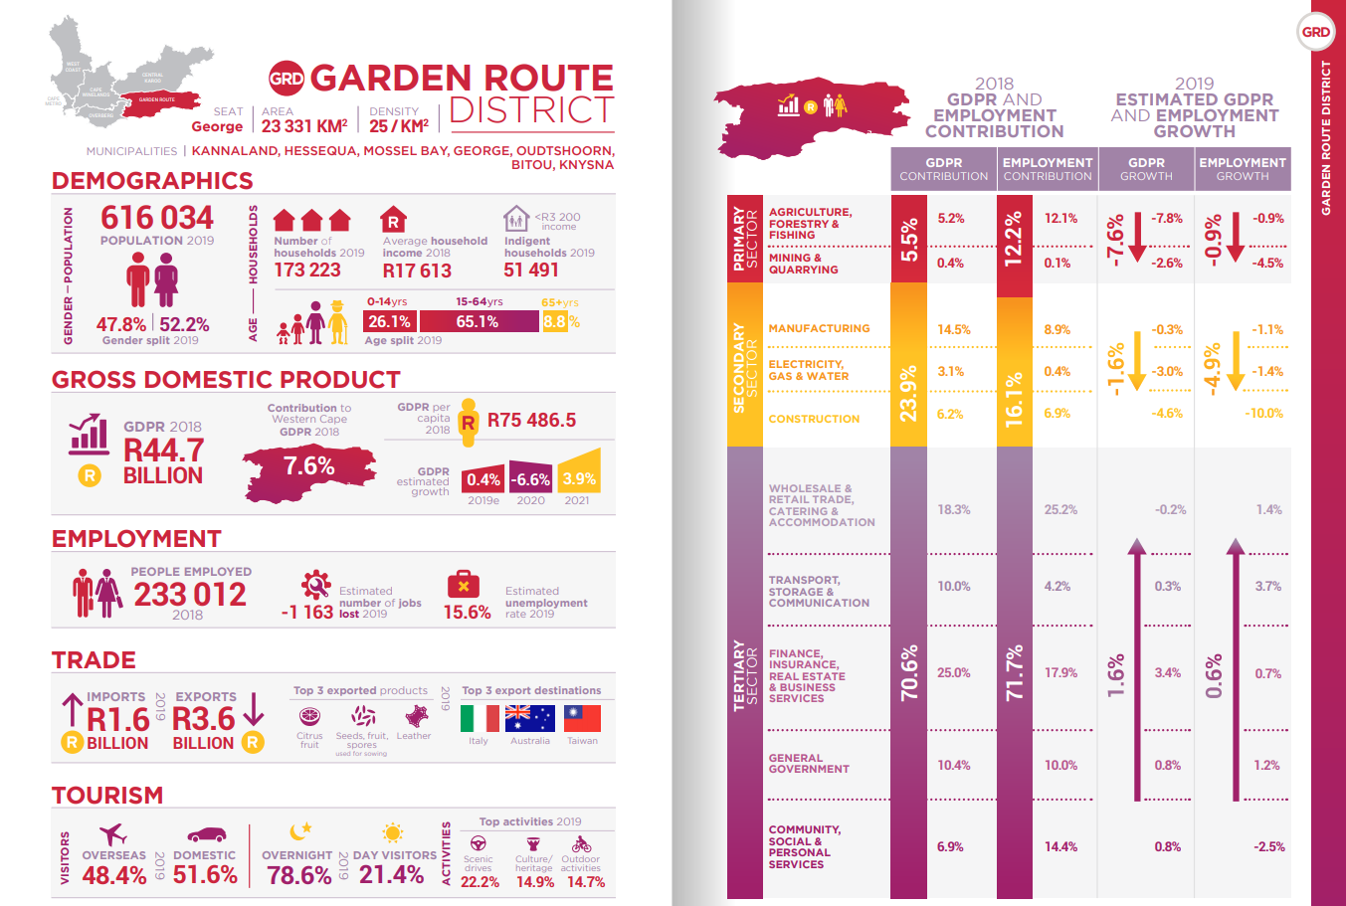

Slide 26
