Slide 1
AN UPDATE ON THE MIGRATION OF EARLY CHILDHOOD DEVELOPMENT (ECD) FROM THE DEPARTMENT OF SOCIAL DEVELOPMENT TO THE DEPARTMENT OF BASIC EDUCATION
Presentation to the Portfolio Committee on Basic Education
20 October 2020

Slide 2
OUTLINE OF THE PRESENTATION
Purpose of the presentation
Background
Progress on ECD Function shift:
Legislation and contracts
Human resources
Finance and budgets
Movable and immovable assets
Data, information, monitoring and evaluation
Communication and stakeholder engagement
2

Slide 3
PURPOSE OF THE PRESENTATION
To present to the Portfolio Committee on Basic Education, a joint status report on progress made regarding the migration of ECD from the Department of Social Development (DSD) to the Department of Basic Education (DBE).
3

Slide 4
INTRODUCTION
Definition of ECD:
ECD plays a critical role in preparing a child to thrive in primary and secondary school.
ECD can be grouped into three age-groups:
Conception to 2 years (first 1000 days) – Stronger health focus;
Children aged 3 – 5 years - Stronger Early Learning focus; and
Grade R – entrance to formal schooling.
The cognitive, emotional, physical, mental, communication, social and spiritual development of children.
4

Slide 5
STRATEGIC FOCUS
SDG: Target 4.2 of SDG 4:
“by 2030, all girls and boys have access to quality ECD, care and pre- primary education, so that they are [school] ready for primary education”.
The AU’s 2063 Agenda:
“Expand universal access to quality early childhood, primary and secondary education”.
National Development Plan:
“make ECD a top priority among measures to improve quality education and long term prospects of future generations”
Priority of the 6th Administration.
Priority in the Basic Education Sector plan and DSD MTSF.
5

Slide 6
CURRENT LANDSCAPE
6

Slide 7
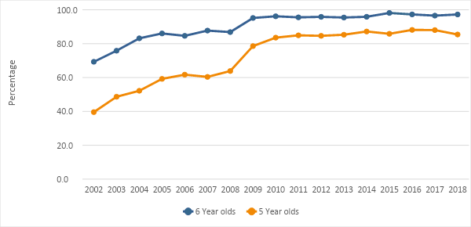
INCREASED ACCESS TO GRADE R
Percentage of 5 and 6-year-olds attending an educational institution
Based on the 2002 - 2018 General Household Surveys
Access to Grade R has increased dramatically over the past 15 years. In 2002 only 40% of 5-year-olds were attending an ELP and in 2018 this increased to 85% of 5-year olds.
7
Notes:
ELP: Early Learning Programme.

Slide 8
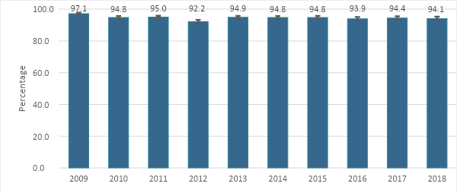
NEAR UNIVERSAL ACCESS TO GRADE R
Percentage of learners in Grade 1 who attended Grade R
Based on the 2009 - 2018 General Household Surveys
8

Slide 10
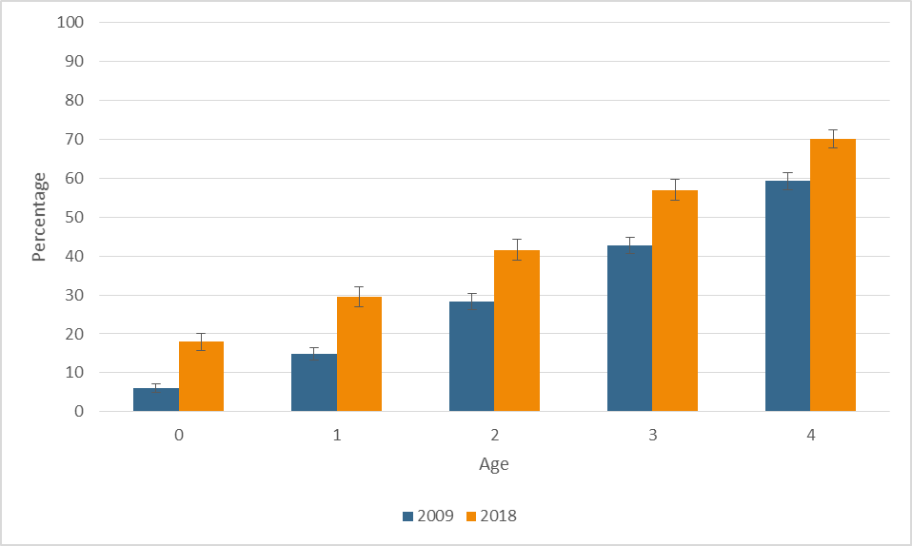
ACCESS TO EARLY LEARNING OPPORTUNITIES
Percentage of children in each age group that are participating in an ELP
Based on the 2009 and 2018 GHS
Access to Early Learning Programmes has increased over the past 10 years, with 69% of 4 year olds attend an ELP in 2018
Source: 2009 and 2018 General Household Surveys. Notes: The categories which were considered in the calculations are primary schools, Grade R, pre-schools, crèches and ECD centres.
10

Slide 11
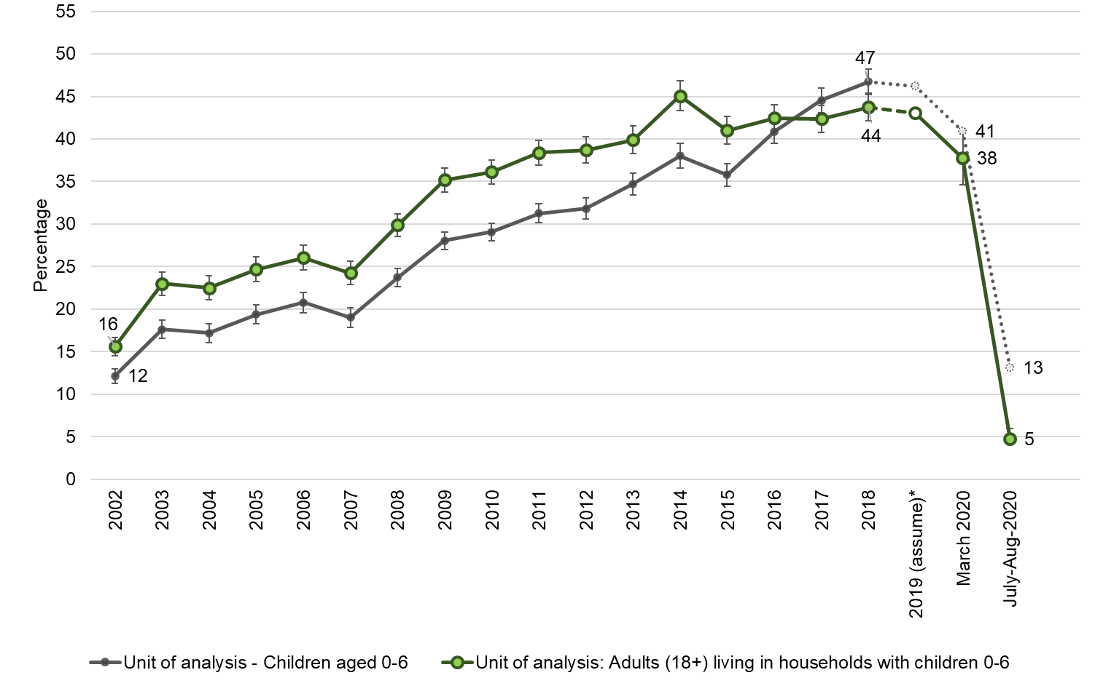
IMPACT OF COVID ON ECD ATTENDANCE
Percentage of children 0-6 years old that are participating in an ELP
Based on the wave 2 NIDS CRAM survey (August 2020)
In July/ August
Only 13% of children aged 0-6 were attending ECD programmes by mid-July to mid-August compared to 47% in 2018.
11

Slide 12
NATIONAL INTEGRATED ECD POLICY
12

Slide 13
NATIONAL INTEGRATED ECD POLICY PURPOSE
Provide an Overarching Multi-Sectoral enabling framework of ECD services, inclusive of national, provincial and local spheres of government;
Define a Comprehensive Package of ECD services and support, with identified essential components;
Identify the Relevant Role Players and their roles and responsibilities for the provision of the various components of ECD services; and
Establish National ECD Leadership and coordinating structure.
13

Slide 14
National Integrated ECD Policy Roles and Responsibility
PARENTS
GOVERNMENT DEPARTMENTS
Being Primary caregiver.
Creating nurturing environment for holistic development of children.
Contracted for relevant services.
Enter partnership with government departments.
National
Provincial:
District:
CIVIL SOCIETY
Delivery of services;
Effective co-ordination.
Planning, co-ordination, setting targets;
14

Slide 15
NATIONAL INTEGRATED ECD POLICY Responsibilities of Key Departments
DEPARTMENT | RESPONSIBILITY
Social Development | Ensuring universal availability and adequate quality of, and equitable access to, inclusive learning opportunities; and Development, delivery, regulation, registration, quality monitoring, improvement and evaluation of ECD programmes.
Health | Provision of health and nutrition programmes for pregnant women, infants and children, parenting support programmes, opportunities for learning and play through health facilities and home visits for children at risk of poor development outcomes.
Basic Education | Development of early learning curriculum; Continuity and synergy between early learning and Grade R; Integration of key health messages in school curriculum; Training, implementation and monitoring relating to curriculum implementation for birth to four-year-olds.
15

Slide 16
NATIONAL INTEGRATED ECD POLICY LEADERSHIP STRUCTURES
South African Inter-Sectoral Forum for Early Childhood Development
National Interdepartmental Committee
Inter-Ministerial Committee
National Training and Curriculum Sub-committee
Policy and Legislation Sub-committee
Infrastructure and Registration Sub-Committee
Monitoring and Evaluation Sub-committee
Communication and Advocacy Sub-committee
ECD Donor Sub-committee
16
16
Notes:
Structures to lead and coordinate the ECD Sector in South Africa. All headed by the DSD at this stage

Slide 17
PROGRESS ON ECD FUNCTION SHIFT
17

Slide 18
Governance Structures
An Inter-Departmental Project Steering Committee chaired by relevant DDGs from DSD and DBE has been established.
It is constituted by senior managers from DBE and DSD; and
It’s main responsibility is to provide strategic guidance for the function transfer process
An inter-departmental Project Management Team meets weekly.
Purpose: To manage the technical teams to ensure that there is alignment between the different technical teams; and
Officials from DBE and DSD tasked with coordinating the implementation of the function shift, along with the GTAC team of technical advisors.
18

Slide 19
Governance Structures
The following Inter-departmental technical teams have been set up and are meeting regularly
Team 1: Human resource management & labour relations;
Team 2: Finance and budgets;
Team 3: Movable and immovable assets;
Team 4: Data, information, monitoring & evaluation;
Team 5: Legislation, Policies, Contracts & Claims etc. ; and
Team 6: Stakeholder Management & Communication
The main responsibilities are of the Inter-departmental technical teams are:
To discuss and agree on criteria and contents of the function transfer in each area of work informed by the findings of the diagnostic report; and
Implement the business plan.
19

Slide 20
Time Lines
Inception Period
(Feb. 20)
ECD Diagnosis: What does the function entail?
(Mar-July 20)
Validation sessions: Are the findings of the diagnosis valid?
(Aug. 20)
Detailed Business Plan: What needs to be done by whom and by when?
(Oct 20)
Implementation of the business plan activities
(Oct. 20-Mar. 21)
Review Session: What does the diagnosis tell us about how we should transfer the function? (Oct - Nov 20)
Function shift concluded
(April 21)
Stakeholder Engagement
20

Slide 21
Current ECD functions at
National DSD
National Strategy: Include in the departmental strategy a comprehensive national strategy aimed at ensuring an appropriate spread of partial care facilities & securing a properly resourced, coordinated and managed ECD system;
Legislative and policy development;
Set national norms and standards for partial care facilities and ECD Programmes;
Promulgate regulations where relevant;
To provide support, guidance and capacity development opportunities to provincial departments on early childhood development services; and
To monitor the way in which provincial departments of social development implement national policies, norms and standards.
21

Slide 22
Current ECD functions at
Provincial DSD
Ensure that national policies, legislation, strategies and priorities are implemented within the means of the provincial department;
Develop Provincial strategy: Within the national strategy contemplated and provide for a provincial strategy to ensure an appropriate spread of partial care facilities and ECD Programmes in the province;
Record-keeping: Maintain a record of all the registered partial care facilities & ECD programmes in the province, indicating the types of partial care facilities and the number of each type of facility; and
Data for planning: Compile a provincial profile at the prescribed intervals in order to make the necessary information available for the development and review of the strategies.
22

Slide 23
Current ECD functions at
Provincial DSD
Inspections and enforcement: Conduct inspections at the prescribed intervals of partial care facilities in the province to enforce the provisions of this Act.
Provision and funding of partial care & ECD programmes:
Partial care facilities and ECD Programmes for the province may be funded from money appropriated by the relevant provincial legislature; and
To provide transfer payments for ECD services in line with the existing financing policies and guidelines.
Registration of partial care & ECD programmes:
Partial care facilities and ECD programmes must be registered with the provincial government of the province where that facility is situated; and
Keep a provincial register of all registered ECD services.
23

Slide 24
Current ECD functions at
Provincial DSD
Conditional registration: The registration or renewal of registration of a partial care facility & ECD programme may be granted on such conditions as the provincial head of social development may determine, including conditions.
Cancellation of registration: The provincial head of social development may cancel the registration or conditional registration of a partial care facility.
Appeal and review of certain decisions: An applicant or a registration holder aggrieved by a decision of a provincial head of social development in terms of chapter 5 (or ECD Programme chapter 6) of the Act may lodge an appeal against that decision in the prescribed form within 90 days with the MEC for social development, who must decide the appeal within 90 days of receipt thereof.
24

Slide 25
Progress
A diagnosis of the ECD function was conducted between March – June 2020 focusing on analysing implications of the function transfer in the following areas:
Team 1: Human resource management & labour relations;
Team 2: Finance and budgets;
Team 3: Movable and immovable assets;
Team 4: Data, information, monitoring & evaluation;
Team 5: Legislation, Policies, Contracts & Claims etc. and
Team 6: Stakeholder Management & Communication.
Sessions to validate the findings and fill gaps in the provisional diagnostic report have been held with all provinces between July and September 20. These sessions were used to also discuss the way in which provinces implement the functions.
25

Slide 26
Proclamations
Chapter 5 of the Children’s Act, 2005 (Act No. 38 of 2005) ("the Children's Act"), and all amendments thereto, in respect of only partial care facilities that provide early childhood development programmes as defined in S91(3) of the Children’s Act.
Chapter 6 of the Children’s Act, and all amendments thereto in relation to ECD programmes.
26

Slide 27
Progress:
Legislation and contracts
Reviewed the draft proclamations to determine whether the correct /all relevant provisions of the Children’s Act are included to ensure the ECD function to be transferred from Social Development to Basic Education gives effect to the stated intention and the transferring responsibility;
Revised the Proclamation;
Concurrence were reached between the two departments regarding the scope of the function shift;
Final Proclamations have been sent the Office of the State Law Advisor; and
Validated the GTAC diagnostic analysis with 9 provinces.
27

Slide 28
Proclamations:
Practical Implications
Partial care services: ECD services offered in a facility or centre are one of a number of different types of partial care.
ECD services for children up to school going age.
After school services.
Private hostels.
Temporary respite care services for children, including children with disabilities
A partial care service can offer more than one programme or service. After the function shift these partial care facilities may then fall under the jurisdiction of both the DSD and DBE.
Registration as a partial care facility will triplicate-
1. Registration as a partial care facility
2. Registration of the ECD Programme and
3. Registration as an NPO.
A decision will need to be made in providing an integrated service for a partial care facility.
28

Slide 29
Legislation and contracts
Next steps
Key Action Steps
MPSA Determination: Joint Submission by DSD & DBE concluding on its work on the ring-fencing of the function and the associated resources.
Proclamations finalised, approved and gazetted
MOU Finalised and Signed-off by Ministers
A Contracts register will need to be developed that outline existing contracts entered into by the Department at National and Provincial Levels
Contribute to development of business plan for function shift focusing on legal matters where necessary
29

Slide 30
Progress:
Human Resources and Labour Relations
Confirmed with DPSA that the NMOG and PMOG process will be followed;
Working with the legal workstream, identified the powers & functions that could/should be transferred from national & provincial Social Development to Basic Education;
Identified legal and labour requirements for the function transfer to happen as per policy pronouncements & considering PSA/PSR, LRA & NMOG/PMOG requirements;
Analysed ECD service delivery models & organisational structures in national & provincial Social Development departments;
Collected & analysed ECD staff composition of national & provincial Social Development departments and validated this analysis with all 9 provinces;
Develop the criteria to be used for the ring-fencing of the staff complement; and
Compiled first draft of joint NMOG submission and PMOG submissions.
30

Slide 31
Human Resources and Labour Relations
100% of the human resource capacity listed under ECD Conditional Grant will be transferred to the DBE. The human resource capacity listed under Partial Care Facilities & ECD Programmes/ Services is still under negotiation
DPSA has advised that the Public Sector Coordinating Bargaining Council will guide on the appropriate labour consultation process to be followed.
Use draft the draft NMOG & PMOG submissions as a basis for discussion/consultation with key stakeholders, including DPSA/OTPs, Education & Social Development Departments, organised labour, individual employees etc.
31

Slide 32
Human Resources and Labour Relations
DSD has adopted an interim organisation structure following the NMOG process in 2019 which has not yet been fully implemented.
The actual staffing situation in the ECD Chief Directorate was already challenging before the adoption of the interim structure because the staff in the Chief Directorate focused on both ECD programmes and all partial care facilities. Some form of compromise solution will be required.
Most provinces have adopted a decentralised ECD delivery model which means that most of the operational functions such as registration of ECD programmes and partial care facilities, happen at a district and local office level. Very few social work practitioners are solely responsible for ECD & partial care facilities. Again a compromise solution will have to be found.
At both national & provincial levels, a proportion of Programme 1 human resources also need to be identified and ring-fenced. This will probably also have to be “negotiated” .
32

Slide 33
Progress:
Finance and Budgets
Identified the budget lines that could follow the function
Analysed historical expenditure to assess the feasibility of these budget lines following the function
Validated this analysis with all 9 provinces
Developed the principles that will be used in the function shift process.
33

Slide 34
Finance and Budgets
Standard Chart of Accounts | Allocation Principle | Responsible Workstream | Timeframes
Compensation of Employees | Costing of: Number of Full funded posts; Post levels | Costing (Finance stream) Posts (HR Stream) | HR dependency
Goods and Services | Percentage (%) Operational – attached to posts. To be determined and agreed by DSD and DBE based on realistic baseline allocations | Finance stream | 9 Oct 2020
Transfers and subsidies | Allocations made to ECD Centres As per Budget Statements (ENE) | Finance stream List of all Centres (per district) | 9 October 2020
Capital Assets | Tools of Trade Laptops; Cars; Data cards | Finance (Linked to posts to be migrated) (Assets to be transferred) | HR dependency
 | Buildings and Fixed Structures Location of buildings Value Operational costs / Running costs | Finance (Assets to be transferred) | 9 October 2020 (Allocations)
34

Slide 35
Progress:
Finance and Budgets
Organise a 10 x 10 meeting with the CFO’s in DSD and DBE at both a national and provincial level so that there is alignment between the NMOG and PMOG processes;
Creating budget structures that clearly ring fences expenditure associated with the ECD programme. Some provincial departments do not distinguish between expenditure on ECD and non-ECD partial care services; and
Preparing ECD specific budgets as per the implementation programme template provided in the MTEF budget workbooks. This will entail clearly identifying the staff who will follow the function.
35

Slide 36
Progress:
Movable and Immovable Assets
The NPIs manage the centres on behalf of communities and are subsidised by DSD. The largest majority of buildings are not owned by government;
Registration of ECD programmes and facilities requires compliance with programme and build requirements. Programme staff process registration at district or sub-district levels;
Conditional Grant fund the construction, maintenance or refurbishment of ECD centres. Backlog for construction and maintenance maybe increased as funds have been redirected to COVID. The grant supports improvements for complying with the norms and standards;
The Department of Public Works is the Implementing Agent in most provinces. Gauteng and Mpumalanga have an Infrastructure directorate, whereas the WC has appointed NGOs as the Implementing Agents; and
Not much has been spent on the tools of trade.
36

Slide 37
Progress:
Movable and Immovable Assets
Through the conditional grant, human capacity is appointed on fixed-term contract at national, provincial and district offices of DSD to manage the implementation’;
The norms and standards are based on the Children's Act, 38 of 2005 and are used to determine partial and full registration of ECD centres;
Each province should maintain a database of ECD centres. The funding for maintenance, refurbishments or renovations enhances the scoring against the norms and standards; and
The norms and standards prescribe that building projects be approved by local municipalities. This dependency on other entities causes massive delays in the issuing of compliance certificates and consequently affected occupation of the ECD centres as municipal by-laws are too stringent.
37

Slide 38
Movable and Immovable Assets
Next steps
Key Action Steps
Collect database of ECD centres from all provinces
Scope the registration of ECD programmes and facilities in term of capacity (human, processes, systems)
Infrastructure management by national provincial and district offices.
Assess readiness to manage registration of ECD programmes and facilities
Develop a plan for managing registration of ECD programmes and facilities.
Develop a plan for rolling out of construction maintenance, renovation of ECD facilities
38

Slide 39
Progress:
Data, Information, Monitoring and Evaluation
Identified databases, information systems, strategies and other information sets, programmes etc. used to manage the function;
Collected and analysed data on the scale of ECD provision in all provinces;
Validated this with all 9 provinces and agreed dates for each province to revert with detailed feedback listing all information sets, including those that may be missing from the list. Validations included confirming data on the scale of provision;
Included data drawn from the DSD MIS onto the diagnostic report presentation;
Generated a list of these for each province and national DSD; and
Prepared checklists of data and information sets and systems that will be transferred from DSD to DBE for confirmation by national DSD and by each province.
39

Slide 40
Data, Information, Monitoring and Evaluation
Next Steps
Get official confirmation of data and information sets and systems to be transferred from accounting officers of National and provincial DSD;
Agree a formal process of transferring data and information through the PSC; and
Support the formal transfer of information and data sets from DSD to DBE nationally & provincially.
40

Slide 41
Progress
Communication and Stakeholder Engagement
Developed a stakeholder engagement plan and communication strategy
ACTIVITY | DATE | DELIVERABLES
Draft Communication Plan meeting with GCIS | 5 October, 19:00 | Done. Follow up discussion Wednesday, 7 Oct 16:30
Joint Communicators Forum with HOCs | Friday, 9 October 10:00 | Project team to provide overview Lumka and Elijah to present Communication Strategy
Joint briefing to Portfolio Committee | 20 October, 09:00 | Issue joint media statement
Provincial Communication Plans | 26 October 2020 | Alignment with national strategy
Ministerial Stakeholder engagement session with practitioners and all relevant parties | TBC | Workshop with stakeholders is key prior to the media launch
Joint media launch/ briefing | TBC | Media engagement session
Provincial activations | TBA | Implementation
41

Slide 42
Implementation Plan
Activity | By when | Responsibility |  |  | Dependency
LEGISLATION TASK TEAM |  | DBE | DSD | Other
Proclamations finalised | Oct-20 |  |  | OCSLA | OCSLA
Provide inputs to the joint submission by DSD & DBE | Oct-20 |  |  |  | Agreement on ring-fenced posts
Develop a contract register outlining existing contracts | Oct-20 |  |  |  | Information from DSD
Revise MOU between Ministers | Nov-20
Finalise and agree on MoU and DGs to table with Ministers | Dec-20
Ministers to sign-off the MoU | Jan-21
Proclamations gazetted | Feb-21 |  |  | DPSA | Joint Submission concluded
42

Slide 43
Implementation Plan
Activity | By when | Responsibility |  |  | Dependency
HR & LABOUR RELATIONS |  | DBE | DSD | Other
Identify funded posts and HR to be transferred | Oct-20 |  |  |  | Information from DSD
Lead discussions with DPSA | Ongoing |  |  |  | Finalised proclamation
Consult with organised labour | Ongoing |  |  |  | Agreement on ring-fenced posts
Conduct readiness assessment with DBE at a National and Provincial level | Oct-20
Lead the develpment of joint NMOG & PMOG submissions | Nov-20 |  |  |  | Agreement on ring-fenced posts
43

Slide 44
Implementation Plan
Activity | By when | Responsibility |  |  | Dependency
FINANCE & BUDGET |  | DBE | DSD | Other
Prepare budget templates as per 2021 MTEF guideline | Oct-20 |  |  |  | Info from DSD
Formally engage NT on how to effect the shift during 2021 | Oct-20 |  |  | NT | Finalised proclamation
Formally engage PT on how to effect the shift in 2021 | Oct-20 |  |  | PT | Finalised proclamation
Submit proposed changes in the budget structures to relevant treasuries | Oct-20
Finalise the 2021 MTEF budget template | Nov-20
Incorporate final budget changes to each department allocation | Nov-20
44

Slide 45
Implementation Plan
INFRASTRUCTURE |  | DBE | DSD | Other | Dependencies
Collect lists of ECD centres that have been funded for construction and maintenance | Oct-20 |  |  |  | Info from DSD
Identify processes and collect tools used to assess registration of ECD centres | Oct-20 |  |  |  | Info from DSD
Determine capacity funded to manage the Conditional grant | Oct-20 |  |  |  | Info from DSD
Share background information including projects | Oct-20 |  |  |  | Info from DSD
Identify government owned ECD centres that will shift across | Oct-20 |  |  |  | Info from DSD
Readiness assessment of capacity to manage planning and delivery at national, provincial and district levels | Nov-20 |  |  |  | Engagements with DBE
Readiness assessment of ECD centre registration by DBE | Nov-20 |  |  |  | Engagements with DBE
Identify requirements for office occupation at all levels | Nov-20 |  |  |  | Info from DSD
Develop a plan for the delivery of new and maintenance of ECD Centres | Jan - Mar 2021
Develop a plan for managing registration of ECD centres with DBE | Jan - Mar 2021
Identify requirements for office occupation at all levels
Develop a plan for assessing new applications for registration with DBE | Jan - Mar 2021
Develop a plan for conducting assessment audits in line with norms and standards | Jan - Mar 2021
45

Slide 46
Implementation Plan
DATA, INFORMATION & SYSTEMS |  | DBE | DSD | Other | Dependencies
Obtain official sign-off from NSDS and PDSD accounting officers | Oct-20 |  |  |  | Information from DSD
Identify indicators and reporting requirements for transfer | Oct-20 |  |  |  | Information from DSD
Assess the preparedness of DBE to receive data, information and systems | Oct-20 |  |  |  | Information from DBE
Assess the preparedness of PEDs to receive data, information and systems | Oct - Nov 2020 |  |  |  | Information from PEDs
Preparation of transfer of datasets and systems to DBE and PEDs | Nov - Mar 2021
Develop a policy for integrating ECD into the EMIS system | Jan-21
Develop a plan for integrating ECD into the EMIS system | Feb-21
46

Slide 47
Stakeholder Engagement
Activity | By when | Responsibility |  |  | Dependency
STAKEHOLDER CONSULTATION & COMMUNICATION |  | DBE | DSD | Other
Develop stakeholder engagement plan | Oct-20
Communicate to DGs and HoDs monthly | Ongoing
Communicate to Ministers and MECs monthly | Ongoing
Communicate progress to portfolio committees | Ongoing
Communicate progress to the sector | Ongoing
Communicate progress with organised labour through the PSCBC | Ongoing
Communicate monthly with affected employees | Ongoing
National Treasury and Inter-govt relations | Ongoing
DPSA and other sector Departments | Ongoing
NPO’s and service providers | Ongoing
ECD Practitioners | Ongoing
Development partners | Ongoing
47

Slide 48
RECOMMENDATION
It is recommended that the Portfolio Committee on Basic Education notes the joint status report on ECD Migration Process and Progress.
48

