Slide 1

SA’S INFRASTRUCTURE INVESTMENT PLAN
UPDATE REPORT
Department of Public Works REPUBLIC OF SOUTH AFRICA
Detailed Implementation Modalities to Support
the Economic Reconstruction and Recovery Plan
Additional Information Emanating from the Cabinet Lekgotla of 8 October 2020 and Implementation Plans for the Special Projects gazetted as SIPs
10 October 2020

Slide 2
OUTLINE
1
Infrastructure Implementation and Localisation
2
Infrastructure and the Mass Public Employment Programmes:
Special Projects that have been gazetted as SIPs Implementation Plans and Social Facilitation
DPWI Presidential Employment Programme
Immediate Term Infrastructure Maintenance Projects
  Women Maintenance Teams
  Handymen Programme
3.
Optimisation of State Land, Building and Property Assets further Unpacked
Proposed Partnership between ISA and DIRCO
DBSA and COEGA process and MoA Unpacked
Land/Buildings for Student Accommodation
Identified Properties for Release, Redevelopment and/or Optimisation

Slide 3
SPECIAL PROJECTS FOR MASS EMPLOYMENT GAZETTED AS STRATEGIC INTEGRATED PROJECTS
Focus on SIPs 25 and 26

Slide 4
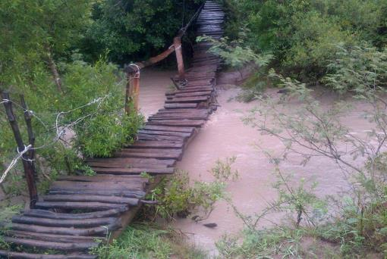
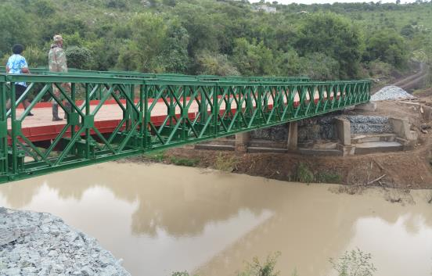
SPECIAL PROGRAMMES – GAZETTED ON 24 JULY 2020
Programmes for Immediate Job Creation: SIP 25 Welisizwe Rural Bridges Programme 1/2
The Department of Defence has committed capacity to deploy 2 160 members for the implementation of the Welisizwe Programme.
The erection of each bridge requires a team of up to 50 SANDF members.
This number is augmented by approximately 60 to 90 members from the communities through EPWP.
SANDF has capacity to implement 43 bridges concurrently.
The average duration for the implementation of each bridge from establishment to handover is about three months, thus each team is capable of rolling out four bridges per year.
In total, there is capacity to implement 172 bridges per year.
The short term requirement (by the end of the 2020/21 financial year) is to construct 14 bridges during this financial year.

Slide 5
SPECIAL PROGRAMMES – GAZETTED ON 24 JULY 2020
Programmes for Immediate Job Creation: SIP 25 Welisizwe Rural Bridges Programme 2/2
Budget Jobs (2020/21 FY) |  |  | Geographic Spread Programme Description |  | Presidential Job Creation & Protection Initiative Submission | Implementation Plan Timelines | Implementation Plan Action Items | Implementation Plan Social Facilitation / Localisation
SIP 25 Welisizwe Rural Bridges Programme | 1280 construction jobs 3840 operational jobs | R151,12 million | Eastern Cape, Free State and KwaZulu Natal | Improvement of safe river crossings to schools and other social facilities by building bridges.. These bridges erected in the rural areas provide communities with access to social infrastructure and economic opportunities. 400 bridges will be built over the MTEF period. Responsibility: DPWI, DOD | R151.12m applied for and approval awaited for 2020/21 FY Estimated for 28 September 2020 |  | The Modular Steel Bridges Technical Committee chaired by DPWI, consisting of DoT, COGTA and SANDF is evisaged to manage the process. The structure will be supported by the ISA Construction of 14 bridges by end March 2021 500 Personnel from the Artisan Programme Construction of 172 Bridges Construction of 400 Bridges within 3 Years Bridge maintenance programmes |  | As soon as the specific locations for the bridge have been determined, the stakeholder profiling will be undertaken. Identify the District and Local Champions Establishment of the Project Steering Committee as detailed Regular progress reporting to the SIP Steering Committee
0-6 MONTHS
6-12 MONTHS
+ 12 MONTHS

Slide 6
SPECIAL PROGRAMMES – GAZETTED ON 24 JULY 2020
Programmes for Immediate Job Creation: SIP 26 Rural Roads Programme
Budget Jobs (2020/21 FY) |  |  | Geographic Spread Programme Description |  | Presidential Job Creation & Protection Initiative Submission | Implementation Plan Timelines | Implementation Plan Action Items | Implementation Plan Social Facilitation / Localisation
SIP 26 Rural Roads Programme | 4000 construction jobs 80 operational jobs | R701,5 million | Eastern Cape, Free State, Limpopo, North West and KwaZulu Natal | This is a programme for the development of a structure approach towards the improvement and upgrading of rural roads in South Africa. The five most suitable roads will initially be selected for implementation. After the pilot phase, the project will be implemented on a national basis. Responsibility- NDoT, COGTA and MISA ISA is Coordinating the Project | R701.5m applied for and approval awaited for 2020/21 FY Estimated for 28 September 2020 |  | With University of Stellenbosch, develop & finalise business case and specifications per area Determination and finalisation of the roads for upgrading |  | As soon as the roads have been determined, the stakeholder profiling will be undertaken. Identify the District and Local Champions Establishment of the Project Steering Committee as detailed Regular progress reporting to the SIP Steering Committee
0-6 MONTHS
6-12 MONTHS
+ 12 MONTHS
LOCALISATION IS CRITICAL
The specifications described above were developed over a wide range of materials, climate and traffic conditions and can be applied generally. It has, however, been found that they can be fine-tuned for local conditions but this can only be done with experience in certain areas. It is more important to ensure that certain aspects such as material homogeneity, stoniness, compaction and drainage are carefully controlled and supervised, during both construction and maintenance.

Slide 7
INFRASTRUCTURE SOUTH AFRICA
Embedding the Sustainable Infrastructure Development Symposium methodology

Slide 8
Infrastructure South Africa
The Single-Entry Point for Infrastructure Investment & Implementation
The intent of the President in the 6th Administration is to centralise all infrastructure aspects under one banner and to ensure that there is consolidated capacity to drive infrastructure-led economic growth for South Africa.
Presidential Infrastructure Coordinating Commission (PICC) Council
Chaired by the President
Minister: Public Works & Infrastructure
Ms Patricia De Lille, MP
EXECUTIVE FOCAL POINT
Regulations for the Infrastructure Development Act, No 23 of 2014
Ensure the formulation of the National Infrastructure Plan
Oversight of the Strategic Infrastructure Project Pipeline and the IF in terms of the Presidential Proclamation.
Oversight and reporting of infrastructure development implementation targets – achievements, best practices, blockages, interventions, etc.
TECHNICAL FOCAL POINT
Central point of reference for strategic infrastructure planning, infrastructure and alignment.
Coordinate and align the work of the various structures responsible for both economic and social infrastructure.
Oversee the IF aimed at achieving blended financing of infrastructure.
Coordination of the monitoring and evaluation infrastructure development dashboard
Head: Infrastructure South Africa
Infrastructure Role-players
GTAC
BFI
DBSA
IFIU

Slide 9
Infrastructure South Africa
The Single-Entry Point for Infrastructure Investment & Implementation
This Infrastructure-Led Economic Growth and Recovery Plan has been developed within the context that Infrastructure South Africa or ISA will take up the responsibility of its overall co-ordination to ensure implementation. ISA has been envisaged within the context of the Infrastructure Development Act and so has
SA’s Infrastructure Investment Plan, in order to expedite delivery, job creation and to immediately kick-start our economy through infrastructure implementation and investment.
In executing SA’s Infrastructure Investment Plan, ISA will:
Work across all spheres of Government
Ensure that all projects:
  Have undertaken a comprehensive needs analysis;
  Interlinking and interdependent infrastructure networks are modelled, not individual projects;
  Infrastructure and related network resilience has been factored in;
  Infrastructure interdependencies (between assets and between networks) have been costed;
  Monitoring and identifying learnings.
Maintain good performance through planned maintenance and smarter use of assets.
Transform large-scale capital projects in terms of their planning, governance, financial management, investment, implementation and lifecycle management.
Facilitate long-term investment in infrastructure across the public and private sectors

Slide 10
Institutionalisation of Governance Models
Whole of Government-Approach and effective private sector participation
National Infrastructure Plan 2045
Reference Group Established
Comprised of Public and Private sector- infrastructure SOEs, key industry bodies such as BBC and BUSA
ESEID SOE Infrastructure Sub-Committee Established
CEOs of major Infrastructure SOEs, supported by ESEID Cluster co-chairs
Strategic Integrated Infrastructure Projects
SIP Implementation Committee
Committee in place. All nominations received. Expanded to include implementing agencies such as Coega Development Corporation, IPP Office and DBSA. All Departments critical ito Infrastructure Development Act included
Infrastructure Development Act governance structures activated
PICC Secretariat
PICC Management Committee
PICC Council
Development of robust infrastructure project pipeline
Eight Technical Working Groups established:
Social Infrastructure: GTAC, Coega Development Corporation
Municipal Infrastructure Finance: MISA, National Treasury
Agriculture & Agro-Processing: IDC, Land Bank
Human Settlements: DHS, DBSA
Digital Infrastructure: DCDT, DBSA
Transport: Transnet, Sanral
Water: DWS, DBSA
Energy: DMRE, DBSA
SIDS Steering Committee
Multilateral Development Banks, DFIs, Line Function DGs
Operationalisation of the Infrastructure Fund
Infrastructure Investment Committee
Public Sector: DPWI, NT, DTIC, DPE, ISA, MISA
Private Sector: BASA, BATSETA, ASISA, MDB Forum rep
Infrastructure Fund Strategic Advisory Committee
Public Sector: DBSA, NT, ISA
Private Sector: BASA, ASISA, BATSETA, SAICA

