Slide 1
Parliament’s Standing Committee on Appropriations
Tuesday, 20 October 2020
Dr Thulani Dlamini
CSIR CEO
CSIR Overview

Slide 2

Chairman’s overview
The CSIR is implementing a new strategy that is geared to deliver on the mandate and specifically, to support industrialisation, however the organisation operates in a resource-constrained NSI.
The decline in PG as a percentage of total income below 30% is a concern since the execution of our developmental mandate should always be adequately supported. Nonetheless, most of the income is still from the public sector.
The heavy reliance on public sector funding is a risk since there are competing priorities for the national fiscus.

Slide 3
Chairman’s overview
The CSIR has proven the importance of RD&I in tackling global threats such as pandemics through the National Ventilator Project and others.
Our impactful response to COVID-19 has been enabled by past investment in capabilities and infrastructure.
Capability development, human capital development and infrastructure investments are critical to the success of our strategy.
The CSIR needs more government investment to implement its strategy in order to respond more effectively to support various prioritised industry sectors with technology solutions.

Slide 4
Table of contents
The CSIR mandate and strategic focus
CSIR Strategy implementation plan
Funding requirements to implement the CSIR strategy
Funding landscape, trends and constraints
Research, development and innovation for impact
Conclusions

Slide 5
CSIR mandate and strategic focus

Slide 6

CSIR mandate
^{CSIR MANDATE}
“The objects of the CSIR are, through directed and particularly multi-disciplinary research and technological innovation, to foster, in the national interest and in fields which in its opinion should receive preference, industrial and scientific development, either by itself or in co-operation with principals from the private or public sectors, and thereby to contribute to the improvement of the quality of life of the people of the Republic, and to perform any other functions that may be assigned to the CSIR by or under this Act.”
(Scientific Research Council Act 46 of 1988, amended by Act 27 of 2014)

Slide 7





Vision and mission
VISION
We are accelerators of socio-economic prosperity in South Africa through leading innovation
MISSION
Collaboratively innovating and localising technologies while providing knowledge solutions for the inclusive and sustainable advancement of industry and society

Slide 8
Our values
Excellence
People-centred
Integrity
Collaboration
We excel at R&D and industrial innovation solutions that address South Africa’s challenges. We are unashamedly passionate about the impact we make and pursue excellence in every facet of CSIR life.
We care about people – our impact through innovation aims to improve lives. We respect each other’s diversity, and uphold the dignity of every person, regardless of culture or belief system. We treat our stakeholders the way we like to be treated.
We value integrity – in ourselves and in others. We are honest and fair in how we work and how we engage the world around us. We respect the trust that our colleagues and our stakeholders place in us and commit to ethical decision-making, delivery and governance.
We are keen to learn from one another and collaborate across the organisation and with external partners, to ensure our work has the best chance to innovate a better future for South Africans.
Our core values are EPIC!
The CSIR pursues Excellence, celebrates People, personifies Integrity, and welcomes Collaboration.

Slide 9





The CSIR strategic intent
Growth
Refers to inclusive and dual growth for the country and the CSIR. The CSIR will use its capabilities in e.g skilled human capital and infrastructure to assist in growing the economy; but will also grow in the same, and other competencies to become a world-class organisation.
Sustainability
Focuses on CSIR-developed technologies that lead to the advancement and sustainability of SA enterprises and the financial sustainability of the organisation in a resource-constrained environment
Impact
Focuses on the commercialisation of our technologies and innovations for industrial development, as well as technology and knowledge transfer that enable a capable state
Relevance
Addresses the CSIR’s role in leading innovation to contribute to industrial development and our ability to deliver on our mandate

Slide 10


Strategic objectives
  Conduct research, development and innovation of transformative technologies and accelerate their diffusion
  Improve the competitiveness of high-impact industries to support South Africa’s re-industrialisation, by collaboratively localising, developing and implementing technology
  Drive socioeconomic transformation through RD&I that supports the development of a capable state
  Build and transform human capital and infrastructure
  Diversify income and maintain financial sustainability and
  good governance

Slide 11
CSIR value proposition
Multidisciplinary research development and innovation capabilities
State-of-the-art research and development infrastructure
Highly skilled multidisciplinary human capital base
Solid track record in technology development, commercialisation of technologies, enterprise creation for development, new business models for the public and private sectors and scaling up of products and processes
Capability to support product, process development and service enterprises

Slide 12

Technology – Sector Clusters
Positioned to drive SA’s industrialisation
Advanced Agri & Food
Future Production
NextGen Health
Chemicals
Innovate to strengthen primary production, agro-processing and advance rural economies
Establish state-of-the-art (bio)-chemistry to drive local pharmaceutical and the broader chemical industries
Develop technologies to drive improved health outcomes and patient-centric healthcare delivery
Future Production
Future Production
Defence & Security
Manufacturing
Mining
Build resilient defence and security capabilities to strengthen national security technology capacity
Strengthen manufacturing value chain to enhance Industry Competitiveness
Support the growth and revitalisation of the mining industry
SMART Places
SMART Mobility
NextGen Enterprises & Institutions
Effect smarter resource use, sustainable economic growth and smart infrastructure and service developments
Enable South Africa to have an efficient, effective and integrated logistics sector
Support the digitalisation of government, public institutions and private sectors
The clusters are technology industry convergences that represent the CSIR’s strategic focus.
They have been selected based on national priorities, potential for socioeconomic impact and the fourth industrial revolution.

Slide 13
CSIR alignment to MTSF priorities and
STI Domains
Economic transformation and job creation
Education, skills and health
Consolidating the social wage through reliable and quality basic services
Spatial integration, human settlements and local government
Social cohesion and safe communities
A capable, ethical and developmental state
Advanced Agri & Food
Manufacturing
Mining
Chemicals
NextGen Health and Enterprises
NextGen Health and Enterprises
SMART Places
SMART Mobility
NextGen Enterprises
SMART Places
SMART Mobility
Defence & Security
NextGen Enterprises
SMART Places
SMART Mobility
A better Africa and world
ICT
The circular economy
Education of the future
Sustainable
energy
The future
of society
Health innovation
High-tech industrialisation
ICT and
smart
systems
Nutrition security
Water security
SMART
Places
Chemicals
NextGen Enterprises
NextGen Enterprises
SMART Places
NextGen Health
NextGen Enterprises
NextGen Enterprises
SMART Places
Manufacturing
Defence and Security
Advanced
Agri & Food
SMART Places
MTSF Priorities
SAForSTI Domains
CSIR Clusters

Slide 14
CSIR Strategy implementation plan

Slide 15
New strategy implementation:
Key pillars
Strategic Clusters
Capability Development
Human Capital
Development
Strategic Infrastructure
Development of capacity, competencies and capabilities aligned to stakeholder and customer value
Development of relevant skills to support industrial development
Infrastructure to strengthen scientific and industrial development and the research campus of the future, Campus Master Plan
Delivering to the CSIR Strategic objectives and are enabled by
research centres
Establishing infrastructure that is necessary to strengthen scientific excellence and industrial development
Drivers for successful Implementation:
Business development and commercialisation, technology transfer and diffusion
Governance, values, ethics, people and culture
4IR and emerging technologies
Notes:
Drivers for successful Implementation:
Funding/Investment to support strategy implementation
Governance and Business Processes
People & Innovation Culture

Slide 16
Funding / investment requirements to implement CSIR Strategy

Slide 17
Total investment requirements for
new strategy
Strategic Initiative | Total investment required over MTEF period
Strategic Clusters | R2.42 billion
Capability Development | R497 million
Human Capital Development | R215 million
Strategic Infrastructure | R1.589 billion
Total | R4.72 billion

Slide 18
Investment requirements for new strategy
Strategic Initiative | Areas of investment | Investment required over MTEF period
Advanced Agriculture and Food | RDI activities, Infrastructure, Human Capital Development and Capabilities for the support of the Agricultural and Food Industry. | R70 million
Future Production: Chemicals | Infrastructure and key RDI activities for Biochemical Conversion, CO₂ Conversion, Pharmaceutical Technologies, 2D Advanced Nanomaterials and Industrial Facilities | R250 million
NextGen Health | RDI activities, Infrastructure, Human Capital Development and Capabilities for the support of the Heath sector. | R70 million
Future Production: Mining | 4IR Technologies and Capabilities for Mining Sector Competitiveness, Mine Test and Evaluation Facilities, Capabilities and training for enhancing mine safety | R250 million
Future Production: Manufacturing | Infrastructure and RDI activities for 4IR Future Production Infrastructure, Smart/Learning Factory, Advanced Materials Engineering, Photonics and Laser Systems incl. Additive Manufacturing, Industrial Sensors | R280 million
Strategic Clusters
Delivering to the CSIR Strategic objectives and are enabled by
research centres

Slide 19
Investment requirements for new strategy
Strategic Initiative | Areas of investment | Investment required over MTEF period
Defence and Security | Aeronautics and Space, Optronics Sensor Systems, Radar and Electronic Warfare, Information and Cybersecurity, Advanced Manufacturing, Unmanned Aerial Vehicles, Integrated Security Solutions, Integrated Maritime Engineering, Rapid Operational Solutions, Test and Evaluation Capabilities and Facilities, Command and control systems, commercialisation of technologies | R350 million
NextGen Enterprises and Institutions | RDI Infrastructure & Programmes, HCD & Capability development, Technology Development & Commercialisation | R350 million
Smart Mobility | RDI infrastructure, human capital development, research programmes in Transport Systems and Operations; Transport Infrastructure and Engineering; Smart Logistics Management and Technology Development and Commercialisation | R140 million
Smart Places | RDI activities, Infrastructure, Human Capital Development and Capabilities for the support of the Environmental, Energy, Spatial Planning, Cleaner Production and Water sectors, amongst others. | R380 million
Strategic Clusters
Delivering to the CSIR Strategic objectives and are enabled by
research centres

Slide 20
Investment requirements for new strategy
Strategic Clusters
Strategic Initiative | Focus | Investment required over MTEF period
Centre for Nanostructures and Advanced Materials | Development of a vibrant nanostructures and advanced materials sector in South Africa | R45 million
The emerging technologies for 4th Industrial Revolution Centre | Addressing the opportunities presented by 4IR emerging technologies | R50 million
Cybersecurity Centre | Reduced cyber and information security threats and risks | R52 million
Water Research Centre | Technologies for decision-support and water treatment | R40 million
Centre for Robotics and Future Production | Enhance technology uptake to enable local manufacturing industry to be globally competitive | R90 million
Delivering to the CSIR Strategic objectives and are enabled by
research centres

Slide 21
Investment requirements for new strategy
Capability Development
Strategic Initiative | Intended Impact | Investment required over MTEF period
Precision Agriculture | Increase sustainability in farming | R40 million
Precision Medicine | Best approaches to prevent and treat disease | R50 million
Pharmaceuticals Platform | Localisation of APIs manufacturing | R70 million
Bio-chemical Conversion Platform | Exploitation of new value chains, and reduction of imports | R60 million
Development of capacity, competencies and capabilities aligned to stakeholder and customer value

Slide 22
Investment requirements for new strategy
Strategic Initiative | Focus and impact | Investment required over MTEF period
Young Researchers Empowerment | Young black and female researchers to grow as future pipeline of experts in areas of key strategic importance, and young industrialists. | R50 million
Graduates in Training | Holistic development of recent graduates to attain professional registration in their areas of expertise and become seasoned scientists and engineers. | R30 million
Leadership and Management Development Programme | Training of junior, middle and senior leaders in key competencies that will assist the organisation to deliver on its strategy and values. | R9 million
Accelerated Researcher Development Programme | Develop a pool of African SA chief researchers to become internationally recognised experts in their field of research. | R30 million
Youth Employment Service Initiative | Develop and impart skills, as well as create job opportunities for unemployed youth. | R5.5 million
Bursary Programmes | Targeted at undergraduate to postgraduate students to grow a pool of highly qualified individuals for our sustainability and in support of government priorities in STEM skills development. | R90 million
Human Capital
Development
Development of relevant skills to support industrial development

Slide 23
Investment requirements for new strategy
Strategic Infrastructure
Strategic Research Infrastructure | Investment required over MTEF period
Open Lab to support the local pharmaceuticals manufacturing | R80 million
Learning Factory to support manufacturing 4.0 | R30 million
Advanced Road Materials Testing Laboratories (AMTL) | R25 million
Modelling Hall to support ports and harbours | R30 million
Infrastructure to strengthen scientific and industrial development and the research campus of the future
Funding already secured from National Treasury and DSI, however an additional operational and maintenance budget will be required.

Slide 24
Investment requirements for new strategy
Strategic Infrastructure
Strategic Research Infrastructure | Investment required over MTEF period
Photonics Prototyping Facility (PPF) | R40 million
Biorefinery Industrial Development Facility | R40 million
Biomanufacturing Industrial Development Centre | R50 million
Infrastructure to strengthen scientific and industrial development and the research campus of the future
Funding already secured from DSI, however scaling is required for increased impact.

Slide 25
Investment requirements for the Campus Master Plan
Strategic Infrastructure
Priority Projects | Estimate
Shared Interdisciplinary research labs (Northern and Southern Precinct) | R529 million
Pilot and Pre-manufacturing precinct | R390 million
CSIR ICT Strategy Roadmap | R200 million
Infrastructure to strengthen scientific and industrial development and the research campus of the future

Slide 26
Investment requirements for the Campus Master Plan
Strategic Infrastructure
Priority Projects | Pre-Feasibility Estimate
Gateway to Science and Innovation Centre | R 100 million
Energy Autonomous Campus | To be informed by the funding strategy being developed
Residential Project | R 440 million (PPP funding model)
Infrastructure to strengthen scientific and industrial development and the research campus of the future
Our campus of the future will be a place where ideas become economic, social and cultural realities for the benefit of humankind.

Slide 27
Funding landscape, trends and constraints

Slide 28
Gross Domestic Expenditure on R&D as a percentage of GDP in comparison with other countries
 | 2008 | 2009 | 2010 | 2011 | 2012 | 2013 | 2014 | 2015 | 2016 | 2017
World | 1.60 | 1.65 | 1.62 | 1.64 | 1.65 | 1.67 | 1.68 | 1.69 | 1.69 | 1.72
Low-income | 0.24 | 0.26 | 0.28 | 0.29 | 0.31 | 0.33 | 0.32 | 0.33 | 0.33 | 0.29
Lower middle-income | 0.49 | 0.49 | 0.49 | 0.49 | 0.47 | 0.46 | 0.43 | 0.42 | 0.42 | 0.43
Upper middle-income | 0.98 | 1.13 | 1.15 | 1.19 | 1.27 | 1.32 | 1.37 | 1.42 | 1.46 | 1.48
High-income | 2.26 | 2.31 | 2.27 | 2.31 | 2.30 | 2.33 | 2.36 | 2.35 | 2.33 | 2.42
South Africa | 0.89 | 0.84 | 0.74 | 0.73 | 0.73 | 0.72 | 0.77 | 0.80 | 0.82 | 0.83
Source: United Nations Educational, Scientific and Cultural Organisation (Unesco) Institute for Statistics
Notes:
The CSIR operates in an underfunded National System of Innovation….

Slide 29
Details of NSI funding
Graphs/tabled/data taken from the National Advisory Council on Innovation's (NACI’s) 2020 STI Indicators Report
Notes:
The government’s investment spending on Research and Development has not impressed for several years. The target is R46.9 billion Rands to be in par with the rest of the World. The Business sector has been the biggest spender, though the business investment expenditure on R&D as a percentage of government expenditure on R&D is also declining.

Slide 30
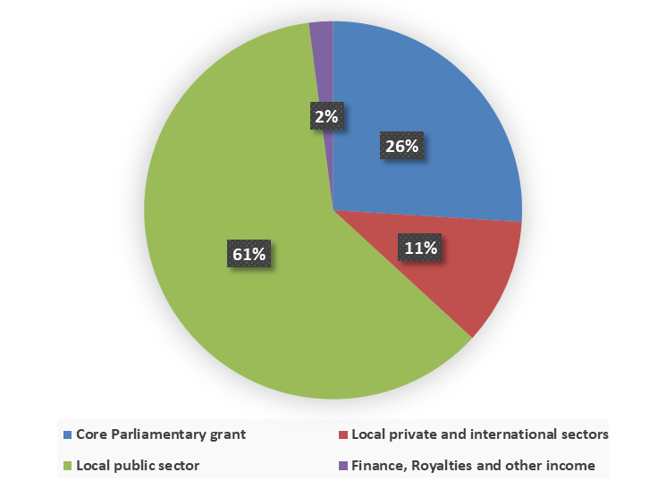
CSIR Funding model
CSIR sources of income (2020)
Parliamentary Grant
Contract R&D
  Public sector
  Private Sector
  International customers
  Royalties, licence income and other income
Largest portion is contract R&D from public sector.
The intention of the new strategy is to diversify income sources by particularly increasing income from private sector, international customers, as well as from royalties and licensing.

Slide 31
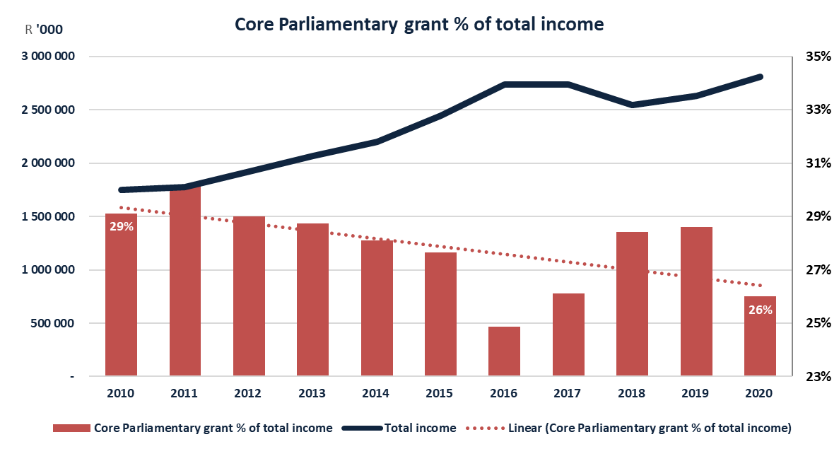
CSIR funding trends over the past 10 years

Slide 32
Impact of COVID-19 Lockdown and
PG reductions
Negatives:
Reduction in Parliamentary Grant allocation
Reduction in contract R&D income as a result of adverse economic conditions
Inability to deliver on commitments to international clients due to limited staff mobility
Reduced level of productivity – some staff not working
Inability to earn income on contracts due to delays in the procurement of goods required to support projects
Additional costs to comply with Department of Labour return-to-work regulations
Positives:
Reduction in operating costs (utilities etc.)
Rethinking ways of working impact on cost of doing business (limited travel, webinars etc.)
New opportunities in e.g. health and manufacturing, that were not
in the business plans

Slide 33
Impact of COVID-19 and PG reductions
Adjusted CSIR Income Statement 2020/21
Summary income statement (amounts excluding VAT) | Original budget R '000 000 | Adjusted budget R '000 000 | Variance to original budget R '000 000 | Variance to original budget %
Total Operating Income | 3 041 | 2 709 | -332 | -11%
Contract R&D | 2 123 | 1 878 | -245 | -12%
Parliamentary Grant allocation: | 917 | 830 | -87 | -9%
Baseline | 749 | 674 | -75 | -10%
Ring fenced allocations | 168 | 157 | -12 | -7%
Total Operating Expenses | 3 085 | 2 827 | -259 | -8%
Running | 1 174 | 1 097 | -78 | -7%
Manpower | 1 767 | 1 587 | -180 | -10%
Depreciation | 144 | 143 | -1 | -1%
Profit(loss) before investment income | -44 | -118 | -74 | -139%
Investment income | 44 | 35 | -9 | -21%
Net profit(-loss) | 0 | -83 | 83
Notes:
Reduction in running costs is directly related to the decrease in operating income Reduction in manpower costs due to delayed appointments in planned positions included in original budget Reduction in investment income due to decrease in interest rates announced by SARB

Slide 34
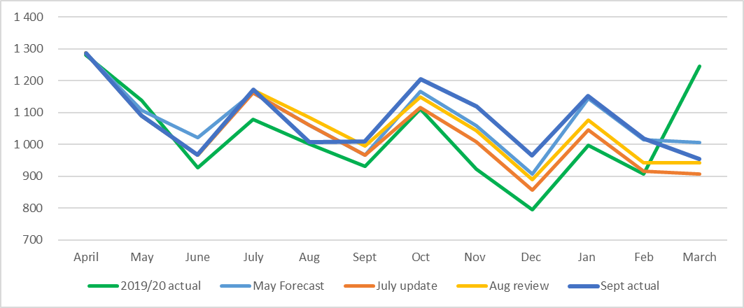
Impact of COVID-19 and PG reductions
Cash flow actual to September 2020
Comments:
Large cash inflow in March 2020 – NICIS allocation from DSI in advance
Forecast trend follows 2019/20 actual trend
Cash flow and forecast reviewed on a monthly basis

Slide 35
Impact of COVID-19 and PG reductions
Programmes that were affected by the 10% PG cuts
Strategic Clusters
Capability Development
Human Capital
Development
Strategic Infrastructure
Delivering to the CSIR Strategic objectives and are enabled by
research centres
Development of capacity, competencies and capabilities aligned to stakeholder and customer value
Development of relevant skills to support industrial development
Infrastructure to strengthen scientific and industrial development and the research campus of the future
Establishing infrastructure that is necessary to strengthen scientific excellence and industrial development
R7 million
Ring-fenced
R10.5 million
R10.4 million
R15 million
Innovation, commercialisation, technology transfer and diffusion
Support portfolios
R8 million
R29.2 million
Notes:
Drivers for successful Implementation:
Funding/Investment to support strategy implementation
Governance and Business Processes
People & Innovation Culture

Slide 36
Procurement challenges and constraints when contracting with the public sector
Section 217 of the Constitution read with section 51(1)(a)(iii) of the PFMA requires all government entities to maintain an appropriate procurement and provisioning system which is fair, equitable, transparent, competitive and cost-effective.
The CSIR, a schedule 3B entity under the PFMA subscribes to and aligns to these Constitution pillars.
The CSIR’s mandate is to “…foster, in the national interest and in fields which in its opinion should receive preference, industrial and scientific development, either by itself or in co-operation ..., and thereby to contribute to the improvement of the quality of life of the people of the Republic”.

Slide 37
Procurement challenges and constraints when contracting with the public sector
The pursuit to balance the PFMA and Constitutional requirements and the drive to achieve our mandate, objectives and Shareholders’ Compact targets, are often faced with near impossible challenges.
NT exemption requests for the CSIR and/or SOEs or government departments from following a competitive bidding processes, have only been for core mandate services.
Blanket exemptions have been requested without success.
  Several case-by-case basis exemption requests by various state-owned entities and government departments (such as Transnet, The Department of Environment, Forestry and Fisheries, various SEZs, etc) have also proven unsuccessful.
A CSIR exemption of core mandate services would be in the national interest, as per our mandate which requires that we contribute to the improvement of the quality of life of the people of the Republic. It would also result in an overall decrease of costs and increased efficiency, agility and effectiveness.
The annual impact of not being able to secure these exemptions is in excess of R450 million, even though the CSIR is now a B-BBEE Level 2 contributor.

Slide 38
Research, development and innovation for impact
Notes:
Despite all these four (4) financial challenges, CSIR has responded to the call to provide technology solutions to the Corona Virus Pandemic. CSIR supported the state by developing life-saving ventilators through the National Ventilator Project…..

Slide 39
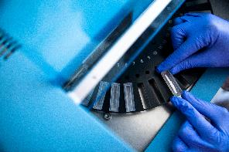
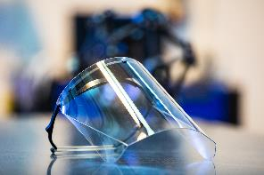
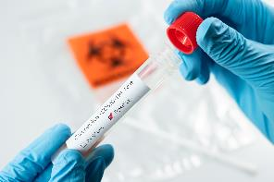
CSIR solutions and interventions in the fight
against COVID-19: Work underway or completed
A 100% local ventilator
Medical quality protective facial shields
Modelling the spread of COVID-19
Mapping vulnerable communities
Information and decision-support centre
Geo-spatial modelling to identify the level of internet connectivity to students’ locations
Mobility platform to track people movement
Taxi rank use for Gauteng response plans
Small business impact study
Impact on North West economy study
Improve broadband through use of Television White Space technology
COVID-19 sample testing
One-step PCR test kit for rapid detection
Extraction kits for naso/oropharyngeal swab
Medicinal plant products to treat COVID-19
Sanitisation of bank notes
Pulmonary delivery systems
Anti-viral face masks
Anti-viral sanitiser and lotion
Infection prevention and control programmes: infrastructure standards, surface disinfection
Environmental aspects of COVID-19 study
  Testing of drinking water
  Testing of wastewater
  Lockdown impact on air pollution study

Slide 40
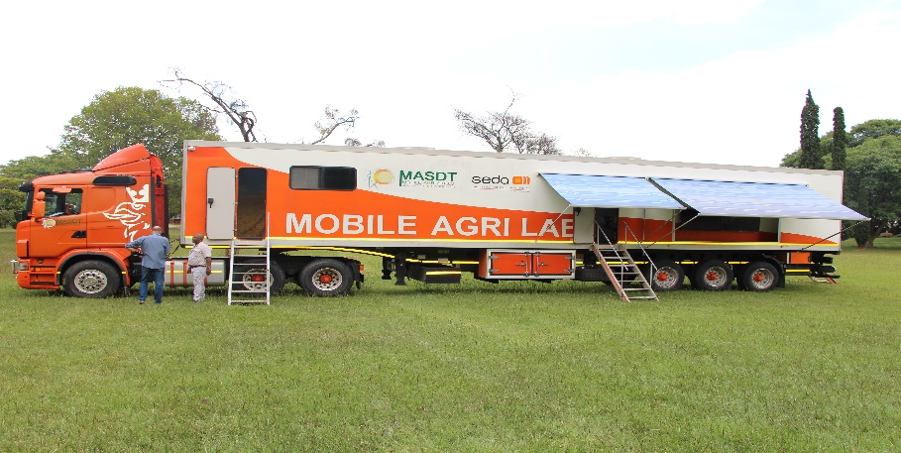

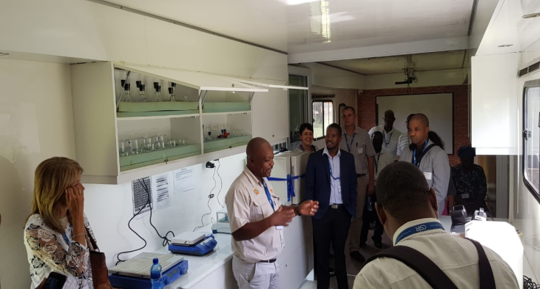
Research, development and innovation for Advanced Agriculture and Food
Removing barriers to safe food in SA through CSIR /MASDT partnership
A mobile facility that can perform testing for pathogens, pesticide residues, mycotoxins and heavy metals.
First ISO 17025 accreditation by SANAS.
The facility, owned by an SME (Mobile Agri Skills and Development and training- MASDT), will include a customised laboratory information management system with testing equipment customised for mobility that produces certified results on site.
Envisaged to support SMEs to valorise their produce for retail and export markets.
This collaborative initiative has the potential to expand across the country and the region and is supported by the SADC Regional Laboratory Association.

Slide 41
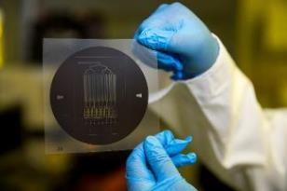
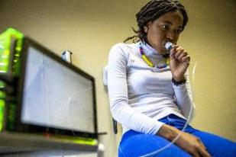
Research, development and innovation
for Chemicals
Ongoing projects
Nano-drug delivery systems: Using nano-emulsion and bio-conjugate to deliver drugs
Nano-micro-encapsulation: Nanoclays as encapsulation to protect the stability of biological active ingredients - animal feeds, food, beverage, personal care
Nano-micro-device manufacturing: Developing lab-on-chip point-of-care prototypes – Nano-based biosensors in breath analysers for non-invasive detection of illness

Slide 42
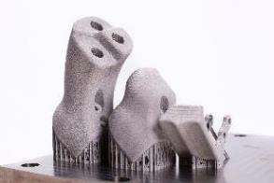
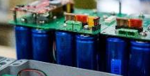
Research, development and innovation
for Manufacturing
High-speed 3D printing system for Ti metal parts
Together with Aerosud Innovation Centre, developed an advanced 3D printer for metal components
5-10x faster than best-in-class commercial systems
4.5x larger processing bed than next largest commercial machine
Compliance with aerospace manufacturing standards
New system monitors Transnet locomotives
Helps Transnet implement predictive maintenance and detect rail infrastructure defects
Collaborative approach and joint teams
Benefits: Improved safety, maintenance and availability of rail infrastructure and productivity, rapid deployment

Slide 43
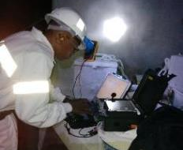
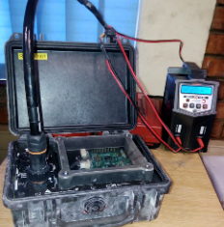
Research, development and innovation
for Mining
Uncontrolled collapse of ground is one of the leading causes of fatalities in underground mining and has significant economic impact
CSIR-developed RockPulse provides more than one min warning – device listens to the rock, extracts micro fracturing, analyses the feature series to detect early onset of large instabilities
Uses: safety, re-entry, life extension of coal mines, rock engineering investigations in gold and platinum mines
Currently being commercialised

Slide 44
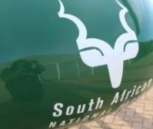
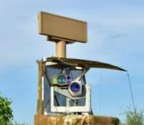
Research, development and innovation for Defence and Security
Meerkat’ Wide Area Surveillance System was designed to detect and track rhino poachers at hotspots in the Kruger National Park (KNP) - before they kill a rhino
Optimised to operate in the undulating, bush savannah environment, in any weather, day/night
It has been in continuous operational use in the KNP since early 2017 and covers >20 000ha where rhinos are most abundant
Since deployment, rhino poaching in this area was eradicated, in contrast to a poaching rate of ~1 rhino per day before Meerkat deployment
On 2 January 2020, Meerkat detected three potential poachers and an arrest was effected
Its effectiveness was confirmed with a SANParks Kudu Innovation Award in 2018

Slide 45






Research, development and innovation
for NextGen enterprises and institutions
Department of Home Affairs
National Smart ID Card
Advice on the rollout of eChannel system with banks
SA Banks
Introducing biometrics Card Verification Method in the National Payment System, in partnership with SA Banks
SASSA
Systems for biometric identification of clients for purposes of managing beneficiary database
Designing systems and processes for payment of social grants to the right people
Advice on payment system and processes in line with National Payment System and SARB requirements

Slide 46
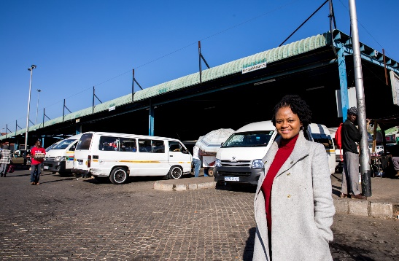
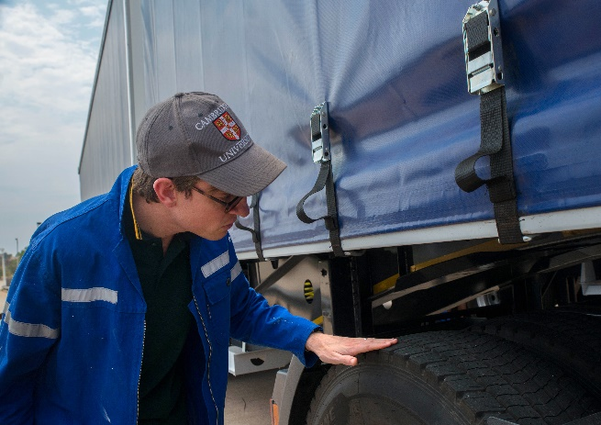
Research, development and innovation
for Smart Mobility
As part of the solution and interventions in the fight against COVID-19, the CSIR has investigated the varying utilisation of taxi ranks in Gauteng and contributed to response plans of the Gauteng Department of Roads and Transport.
The CSIR, in collaboration with the universities of the Witwatersrand and Cambridge, and tyre manufacturer Michelin, performed full-scale research trials of energy-saving green tyres on trucks.
Tests were carried out on two 56-tonne trucks and demonstrated a significant 8% to 10% reduction in fuel consumption.
This equates to an 8%-10% reduction in carbon emissions and 4% saving in operating costs.

Slide 47
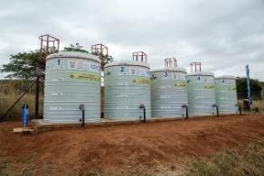

Research, development and innovation
for Smart Places
Phycoremediation technology
Algae treatment technology that reduces nutrient content and improve microbiological water quality
Value proposition: No electricity, skilled labour or chemicals needed; cost less; support green economy; use mainly existing infrastructure
Apply specific algae consortium
Implementation projects
Implemented for over five years at two rural waste stabilisation pond systems: Sekhukhune district and Mossel Bay Municipality
African Development Bank: drying algae to determine benefits (e.g. biofertiliser); implementing technology in Malawi, feasibility assessments in Botswana, Mauritius, Mozambique, Namibia

Slide 48
Conclusions

Slide 49

Conclusions - Procurement
Procurement policy reforms are needed to rectify the anomaly created by PFMA processes resulting in the CSIR having to bid for services that are core to our mandate, in the national interest.
This anomaly hampers the very financial sustainability of the organisation as it results in lost revenues in excess of R450 million per year.
Preferential procurement of core CSIR services when it comes to SOEs and government entities will improve CSIR technology and research support to the state for industrialisation and economic growth.

Slide 50
Conclusions – Parliamentary Grant
Parliamentary Grant is critical for the CSIR building new strategic capabilities to keep it competitive, and relevant in a technologically dynamic world.
The Parliamentary Grant cuts over the years hamper the ability of the CSIR to deliver on the mandate to which the organisation was created, hence these cuts are a challenge to the very existence of the organisation.

Slide 51
Conclusions – Investment Requirements
Research and development is an investment in the future and should not be seen as an expense. This is demonstrated by the work done by the CSIR in the fight against COVID-19, and through adequate and necessary investment, that we can support a capable state in dealing with other challenges we face.
Post COVID-19 economic recovery, globally and in the South African context will significantly benefit from RDI and also emerging and 4IR technologies. CSIR plays a key role in this regard, and it has demonstrated that it can accelerate innovation to drive industrialisation.
The CSIR needs R4.72 billion over the MTEF period in order to implement a strategy that would support the country’s reindustrialisation, one of the priority initiatives of the South African Economic Reconstruction and Recovery Plan.

Slide 52
Thank you
CSIR Overview

