Slide 1
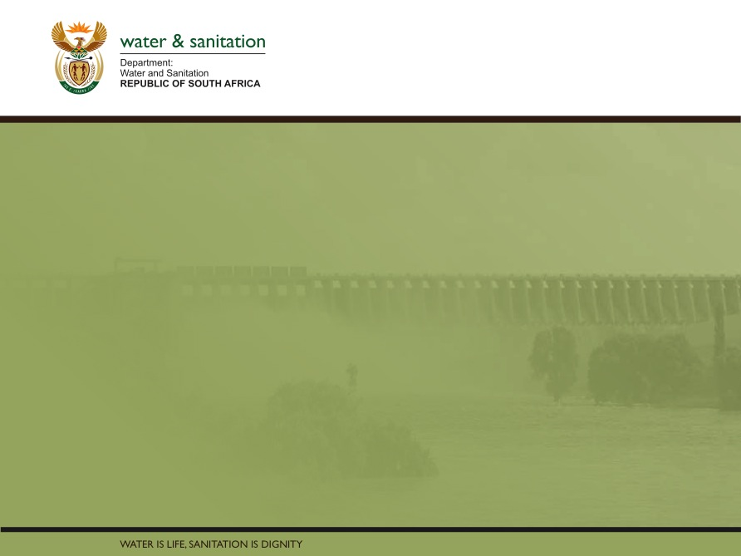
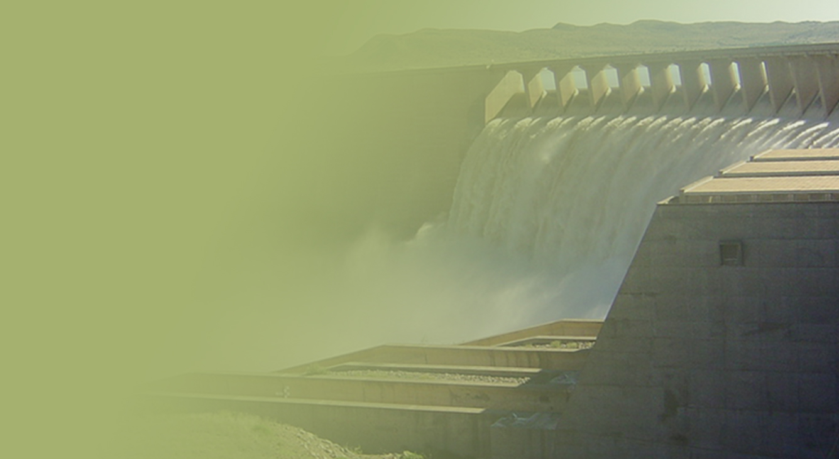
Briefing the Department of Water and Sanitation’s North West District Implementation Plan
PRESENTATION TITLE
Presented by:
Name Surname
Directorate
Date
Presented by: Mr T Balzer
Acting Director-General
16 October 2020

Slide 2
Contents
Provincial overview………………………………………………….. 4-16
Municipal Strategic Self-assessment Reports . ………... 17-20
Status of Wastewater Treatment Works…………………… 21-23
Status of Drought and interventions………………........... 24-35
Approach the District Development Model……………… 36-40
RBIG MTEF Allocations and project status………………… 41-56
WSIG MTEF Allocations and Project Status……….......... 57-61
Mining sector interventions……………………………………… 62-65
COVID19 interventions……………………………………………… 66-71

Slide 3
To brief the Portfolio Committee on the Department of Water and Sanitation’s North West District Implementation Plan for 2020/21

Slide 4
PROVINCIAL OVERVIEW

Slide 5
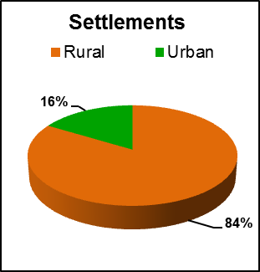
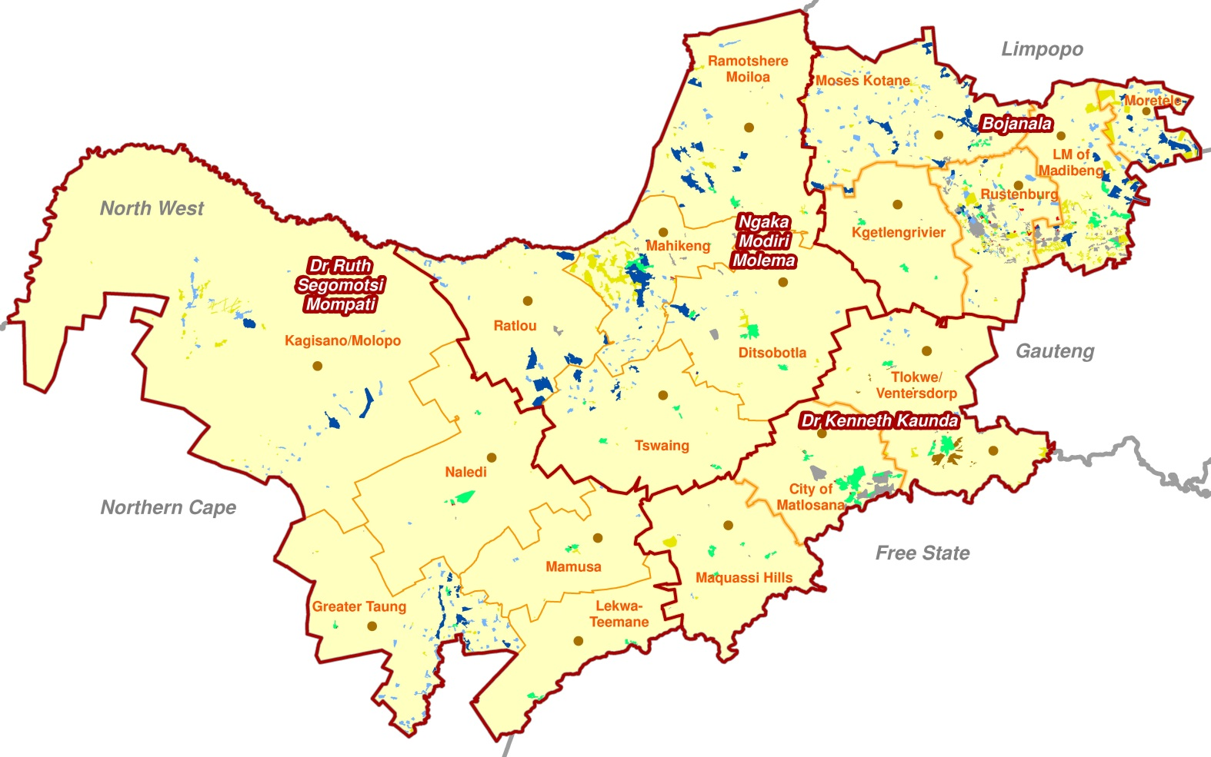
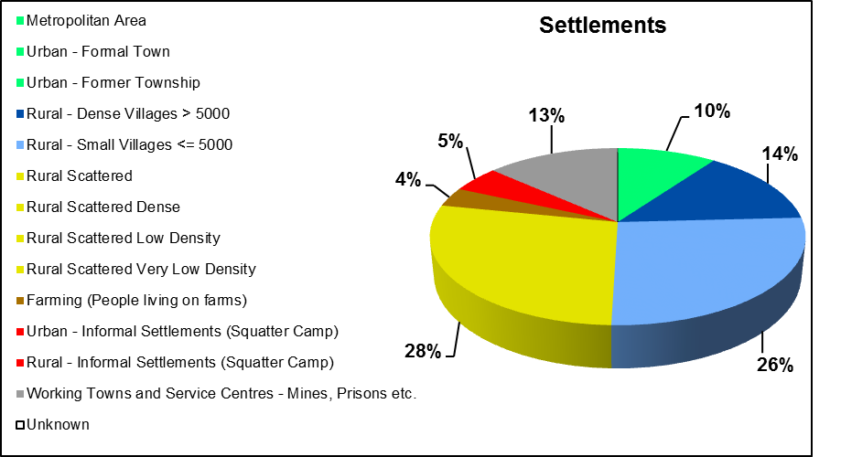
Provincial Overview
SETTLEMENT TYPES (2016)
Settlement Type
Settlements
Population
Households
Metropolitan Area
0
0
0
Urban - Formal Town
117
1 686 528
505 115
PROVINCE POPULATION DISTRIBUTION
Urban - Former Township
2
21 221
5 762
Total Population:
4 173 343
Rural - Dense Villages > 5000
169
1 300 186
371 518
Total Number of Households:
1 222 659
Rural - Small Villages <= 5000
313
481 004
134 980
Average Household Size:
3.41
Rural Scattered
314
125 169
37 589
Rural Scattered Dense
14
21 796
6 510
Rural Scattered Low Density
2
500
148
Rural Scattered Very Low Density
0
0
0
Farming (People living on farms)
42
283 618
81 613
Urban - Informal Settlements (Squatter Camp)
36
133 954
39 411
Rural - Informal Settlements (Squatter Camp)
22
32 783
12 173
Working Towns and Service Centres - Mines, Prisons etc.
160
86 584
27 840
Unknown
0
0
0

Slide 6
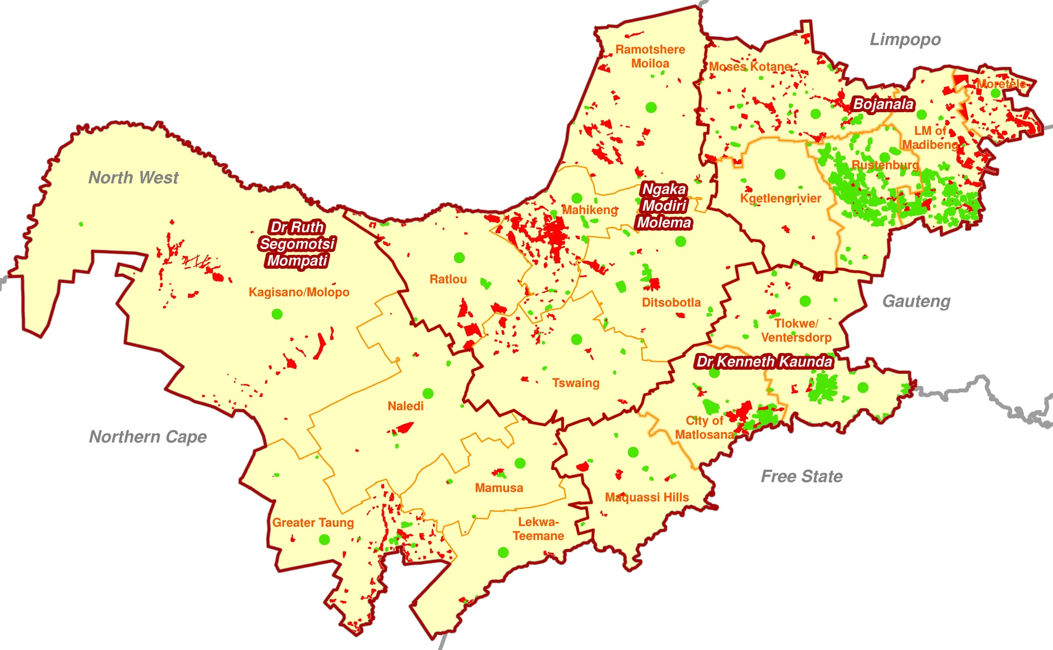
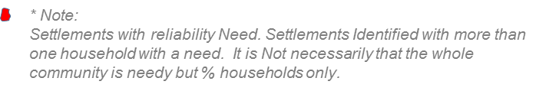
Service levels – North West
Direct Settlement Backlog Needs: Water
Total Households
1 222 659
Direct Backlog Needs
593 781
48.5%
Functionality Needs
607 629
49.7%
New Infrastructure Needs
444 642
36.3%
Resource Needs
216 168
17.6%

Slide 7
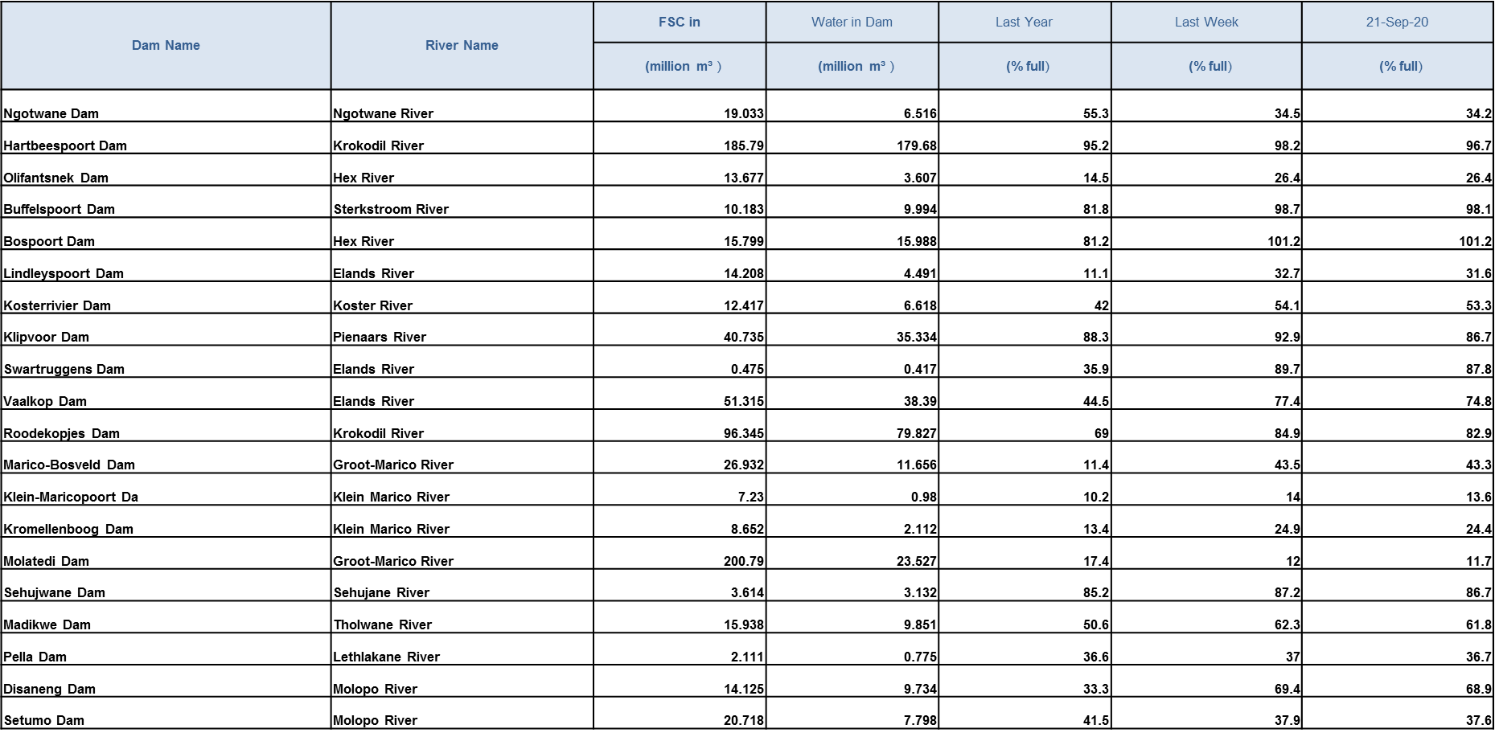
Percentage Capacity for Dams in North West – Crocodile (West)-Marico catchment

Slide 8
Dams in the Marico River Catchment
Sehujwane Dam
  In Ngaka Modiri Molema DM, Ramotshere Moiloa LM, north of the town of Zeerust
  Supplies domestic water to Motswedi, Gopane East and Borakolalo villages
  Total water requirement 0.9 million m³/annum
  Dam level at 87% on 21 September 2020
Pella Dam
  In Bojanala Platinum DM, Moses Kotane LM, north-east of the town of Groot Marico
  Supplies domestic water to Pella village
  Total water requirements 0.3 million m³/annum
  Dam level at 37% on 21 September 2020

Slide 9
Dams in the Marico River Catchment… Cont’
Molatedi Dam
  In NMM DM, Ramotshere Moiloa LM and Bojanala DM, Moses Kotane LM
  Supplies domestic water to Gaborone in Botswana
  Domestic water supplied to Kopfontein and Derdepoort border posts, Molatedi village and Madikwe Game Reserve
  Total water requirement 23.1 million m³/annum
  Firm yield of dam, following revision of hydrology in 2010, is only 16.1 million m³/annum
  Revised allocations still to be finalised
  Agreement re operation and maintenance of scheme revised in December 2014 – Sedibeng Water and Botswana Water Utilities Corporation now solely responsible for O&M
  Dam level at 12% on 21 September 2020
  Restrictions to be impemented in terms of Operating Rules as per International Agreement:
Domestic Supply 50%
Irrigation 75%
Marico-Bosveld and Kromellenboog Dams
  In Ngaka Modiri Molema DM, Ramotshere Moiloa LM, east of Zeerust, north of Groot Marico
  Supplies only irrigation water to Marico-Bosveld GWS, already restricted
  Total water requirement 18 million m³/annum
  Dam level at 43% (Marico-Bosveld), 14% (Klein Maricopoort) and 24% (Kromellenboog) on 21 September 2020

Slide 10
Dams in the Crocodile River Catchment
Koster Dam
  In Bojanala Platinum DM, Kgetlengrivier LM, north of the town of Koster
  Supplies domestic water to Koster/Reagile and irrigation water
  Total water requirement
Domestic 2.34 million m³/annum
Irrigation 2.61 million m³/annum
  Dam level at 53% on 21 September 2020
Swartruggens Dam
  In Bojanala Platinum DM, Kgetlengrivier LM, at the town of Swartruggens
  Supplies domestic water to Swartruggens/Borolelo
  Total water requirement 1.2 million m³/annum
  Dam level at 88% on 21 September 2020
Lindleyspoort Dam
  In Bojanala Platinum DM, Kgetlengrivier LM, north of the town of Swartruggens
  Supplies only irrigation water, already restricted
  Total water requirement 5.1 million m³/annum
  Dam level at 32% on 21 September 2020

Slide 11
Dams in the Crocodile River Catchment
All other dams in the Crocodile River system
  Most other dams are above 60% full.
  Hartebeespoort dam receives effluent flows from waste water treatment works in the Tshwane, Johannesburg and Ekurhuleni metropolitan areas in Gauteng
  Vaalkop Dam, the main source utilized by Magalies Water for water supply to Moses Kotane, Thabazimbi and Rustenburg areas, is maintained at a minimum level of around 45%
  Augmentation of the Vaalkop Dam occurs via the link canal from Roodekopjes Dam, with limited capacity

Slide 12
Challenges in the Crocodile(West)-Marico catchment
Water availability
  Groundwater largely utilized for water supply in rural areas
  Low dam levels in the western part of the area due to lower than normal rainfall in previous summer
  Restrictions need to be imposed and augmentation of water supply will in some instances be required by drilling boreholes
  Tankering of water may be needed to meet demands in some towns/villages or additional boreholes
  Dam levels in the eastern part are generally very high due to waste water effluent return flows from metropolitan areas
Water quality
  Quality of water is severely impacted by poor quality waste water effluent return flows from municipal waste water treatment works
  Specific areas impacted are:
Hennops River system due to waste water flows from Ekurhuleni, Johannesburg and Tshwane
Apies River due to poor management of Tshwane Rooiwal WWTWs
Magalies River - Johannesburg (Driefontein WWTWs), Mogale City (Percy Stewart and Magaliesburg WWTWs)
Jukskei River - Johannesburg Northern WWTWs
Hartbeespoort Dam and Crocodile River - Madibeng WWTWs

Slide 13
Water Resource Development Perspective
The growth in water requirements is mainly driven by urban and rural municipal demand, mining and agriculture.
Vaal and Crocodile river systems are key for further development to provide for a large portion of future growth in water requirements.
Reuse of treated effluent from metropolitan areas is a key intervention to maintain a positive balance.
Opportunity for development of local large storage dams is fully exploited.
Groundwater abstraction and eye outflows are important sources.
Once implemented, the Proposed Lesotho – Botswana Water Project, currently under pre-feasibility planning, will benefit areas such as Mahikeng and Tlokwe.
Notes:
Notes:
1. Transfer to Mahikeng from the Vaal will be an additional water requirement of 7 million m3/a on the Vaal’s balance by 2035.
2. Tlokwe LM’s water requirement already part of Vaal Balance.

Slide 14
Reconciliation Strategies for Vaal and Crocodile (West) Water Resource Systems Supplying Areas in the North West Province
Water Resource (WR) System | Description of the system and its supply area | DWS’s View of Strategic Interventions that need to be prioritized to keep the system in balance for a period of at least 25 years
Integrated Vaal River System | Consists of 14 interlinked dams including Vaal, Bloemhof, Sterkfontein, Grootdraai, Katse, and Mohale Dams Supplies water to: 60% of economy, 45% of population, Mines and industries on Eastern Mpumalanga Highveld, Bulk of Eskom’s coal fired power stations, Sasol’s coal to liquids plants, Gauteng, North West and Free State goldfields, Kimberley and Large irrigation schemes Supplies the City of Tshwane, City of Ekurhuleni and City of Johannesburg System in currently in deficit and needs urgent augmentation | Review and update the Reconciliation Strategy for the IVRS (DWS) Eradicate unlawful irrigation, notably in the upper Vaal river area (DWS & Irrigators) Implement Water Conservation/Water Demand Management with focus on loss management (15% must be saved) (City of Tshwane, City of Ekurhuleni, City of Johannesburg and other Users) Treat and use effluent (City of Tshwane, City of Ekurhuleni, City of Johannesburg and other Users), starting with desalination of acid mine water drainage (DWS) Implement the next water supply augmentation scheme (Phase 2 of the Lesotho Highlands Water Project) (DWS through TCTA)
Crocodile West River System | Consists of dams such as Hartebeespoort, Vaalkop, Klipvoor, and Roodekoppies Supplies water to areas of City of Tshwane, Madibeng, Rustenburg, Thabazimbi, Brits, Mining mainly platinum group metals and Large Irrigation The System has a growing yield due to increasing return flows from northern Gauteng. | Review and update the Reconciliation Strategy for the Crocodile West river System (DWS) Implement water conservation and water demand management (City of Tshwane and other Users) Treat and Re-use effluent (City of Tshwane and other Users) Optimize the operation of the Crocodile West Water Supply System (DWS) Transfer water from the Crocodile River to Lephalale area by Constructing the Mokolo Crocoldile (West) Water Augmentation Project (MCWAP) (DWS)

Slide 15
Lesotho-Botswana Water Transfer Project
The Governments of Botswana, Lesotho and South Africa signed a memorandum of agreement to undertake a reconnaissance study on the Lesotho to Botswana Water Transfer scheme (L-BWT) aimed at mobilizing water in Lesotho and conveying it to Botswana, supplying on the way various users in Lesotho and South Africa.
It is envisaged that eventually 200 Mm3 per annum would be conveyed through a pipeline of about 712 km from the dam in Lesotho to Botswana with additional volume to supply consumers along the route of the pipeline in Lesotho and South Africa.
Combined prefeasibility and feasibility studies for the Lesotho – Botswana Water Transfer Project have been initiated to study the new dam option, the proposed water conveyance pipeline and the option of generating hydropower along the pipeline route.
The reconnaissance study led to the selection of a technical options which includes a new dam on the Makhaleng River in Lesotho and a water conveyance pipeline to Botswana through South Africa.

Slide 16
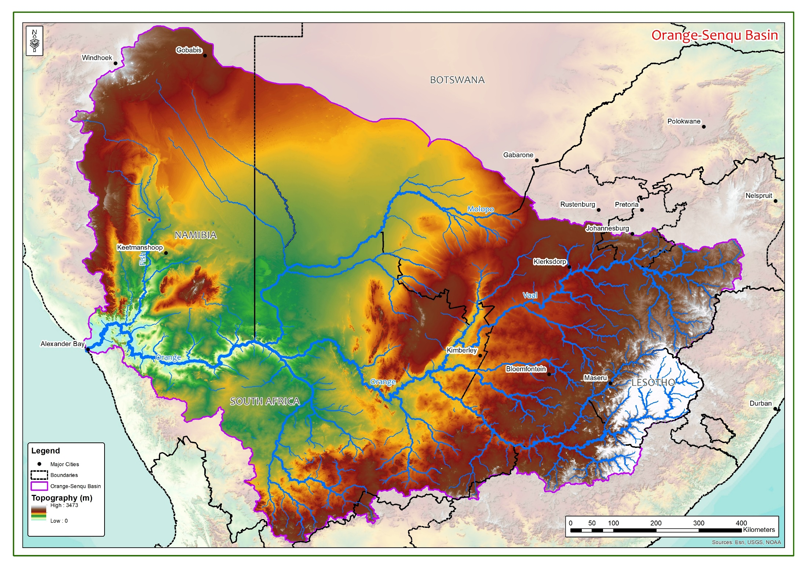
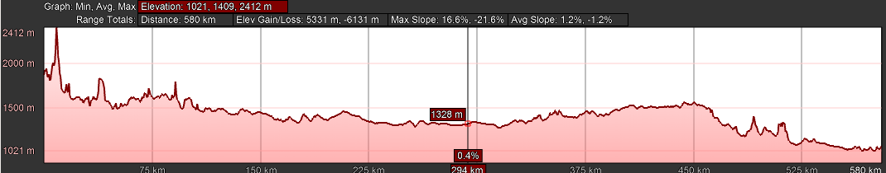
Orange River Basin
Lesotho-Botswana Water Transfer Pipeline
Distance +-600km
Height Difference - 450m

Slide 17
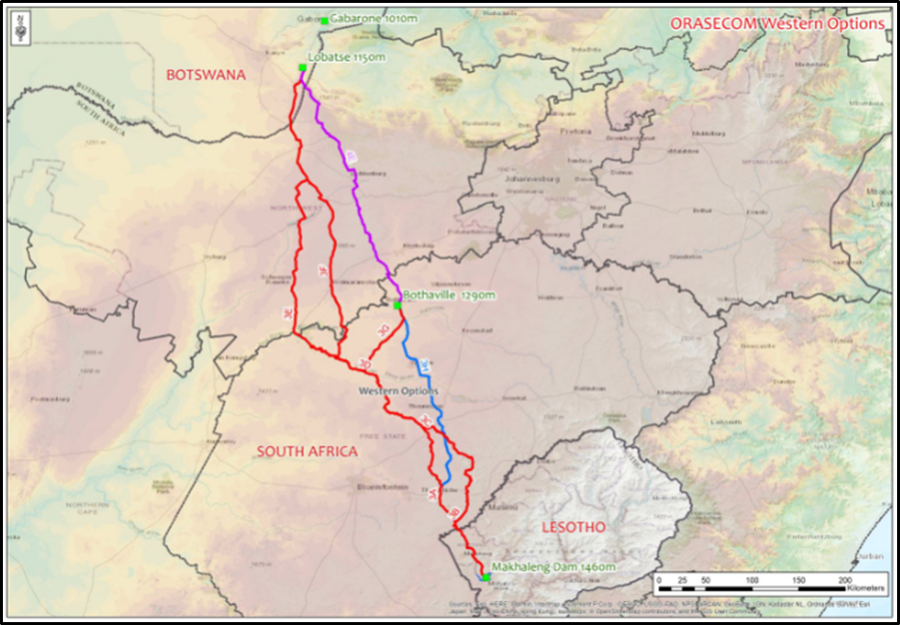
Potential routes for water
Potential routes for conveyance, three likely routing options were considered.
  The following are some of the towns that were preliminarily identified as potential recipients of a water supply from the central water conveyance route option:
  South Africa: Boikhutso, Driehoek, Maipeng, Mahikeng, Miga North, Khunotswane, Zeerust, Dinokana, and Motswedi Gopane

Slide 18
MUNICIPAL STRATEGIC SELF-ASSESSMENT REPORTS

Slide 19
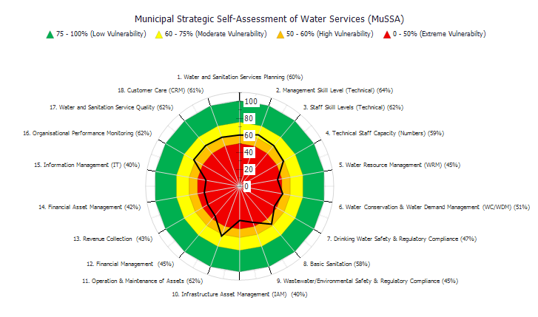

Slide 20
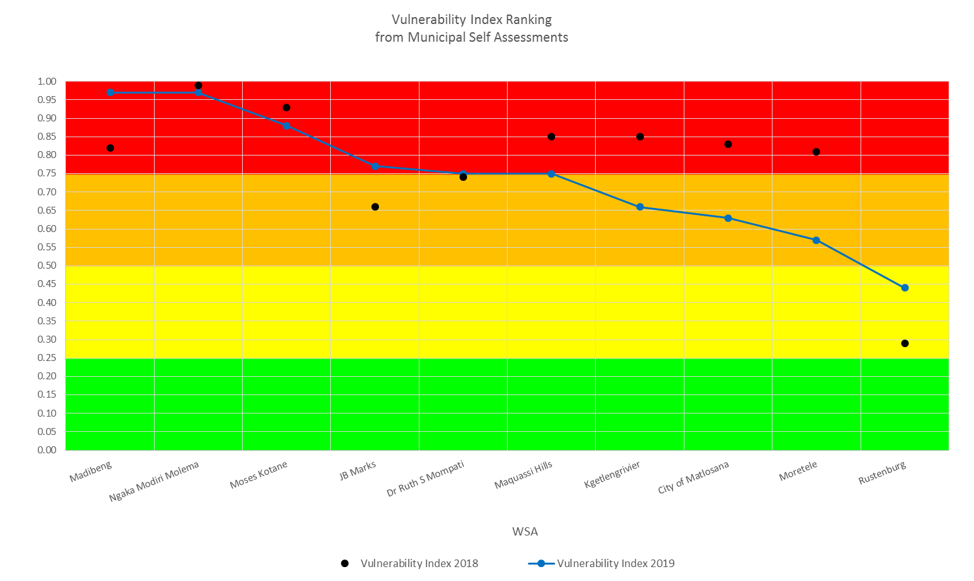
Vulnerability Index Ranking: NW (2019)

Slide 21
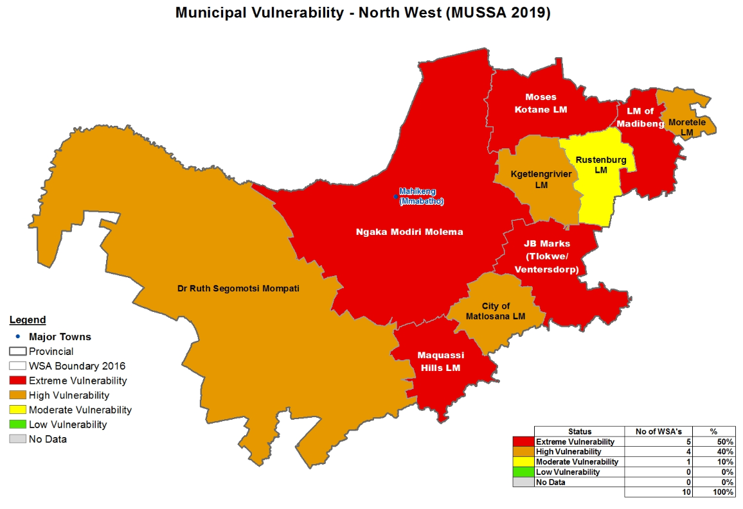
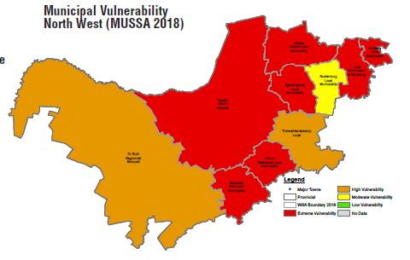
Vulnerability Index Ranking: NW

Slide 22
STATUS OF WASTE WATER TREATMENT WORKS

Slide 23
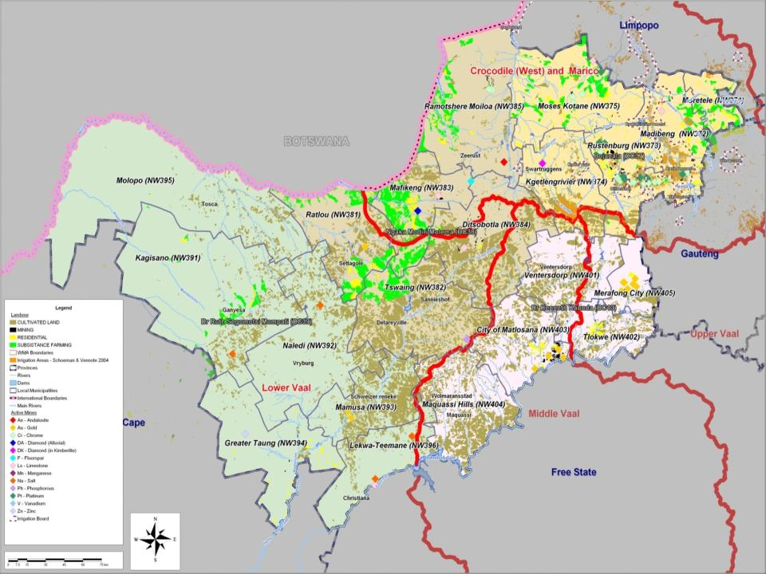

Slide 24
Enforcement on WWTW discharge and pump stations
Criminal case Section 151 (1)(2)
Execution of works Court interdict Section 53 (1)(2)
Directive Section 53(1) 19(3)
Intention to issue directive Section 53(1) 19(3)
Unauthorised, non compliant Non compliance notice Section 53(1) 19(3),
Authorised water use, Compliant to conditions of use, Green drop and Blue Drop compliant
Name of WWTW | Discharge to and impact on water resource | Remark
Klipgat | Tlolwane River | Follow up with SAPS regarding progress
Baviaanspoort | Pienaars River | Court Order to enforce compliance
Rooiwal | Apies River | Court Order to enforce compliance
Klipgat | Tlolwane River | Court Order to enforce compliance
Sunderland Ridge | Hennops River | Court Order to enforce compliance
Randfontein | Bloubank Spruit | Follow-up to monitor perfomamce after refubishment
Percy Stewart | Blougat | Follow up required to monitor Directive issued
Olifantsfontein | Kaalspruit | Follow up needed to monitor Directive and Action plan
Stiefontein | Malikudu River | Monitor O&M
Brits | Crocodile | Monitor O&M. Madibeng to attend to discharges from pump station and manholes
Licthenburg | Harts River | Applly for court Interdict- WWTWs is dysfuctional
Mafikeng | Molopo River | Improve operation and Maintenance of works
Mmabatho | Molopo River | Lack of operation and Maintenance,
Klerksdorp | Skoonspruit | Poor Operation and maintenance, Vandalism of Electrical supply
Orkney | Skoonspruit | The plant is under refurbishment. Improve O&M
Zeerust | Kareespruit River | Monitor refurbishment. O&M of existing plant. Enforce By- laws by Municipality
Temba | Apies River | Monitor operation and maintenance
Babelegi | Apies | Monitor operation and maintenance
Rietgat | Soutpan spruit | Monitor operation and maintenance
Lethabong | Hex River | Lack of operation and maintenance
Letlabile | Unknown tributary | Lack of Operation and maintenance
Sandspruit | Sandspruit River | Monitor operation and maintenance
Eagle Landing | Hartebeespoort dam | Monitor operation and maintenance
Rietfontein | Swart spruit | Monitor operation and maintenance

Slide 25
Status of Drought

Slide 26
DROUGHT - 2019/2020 GRANT ALLOCATIONS (Schedule 5B)
MUNICIPALITY | ALLOCATION 2018/19 | ACTUAL EXP. 2018/19 | ROLL OVER AMOUNT 2019/20 | NUMBER OF PROJECTS UNDER CONSTRUCTION | NUMBER OF PROJECTS COMPLETED
Rusternburg LM | 20 000 000 | 19 997 999 | 0 | 0 | 5
Kgetlengrivier LM | 44 300 000 | 20 625 146 | 23 674 854 | 5 | 0
Moses Kotane LM | 24 750 000 | 15 789 657 | 8 960 342 | 9 | 0
Kgetlengrivier LM | 25 000 000 | 1 004 344 | 23 995 655 | 1 | 0
Ngaka Modiri Molema DM | 157 674 000 | 152 302 008 | 0 | 0 | 0
Dr Ruth Segomotsi Mompati DM | 40 425 000 | 36,700 000 | 3 300 000 | 0 | 2
Madibeng LM Contractor was terminated due to non- performance and compliance with municipal SCM | 21 800 000 | 6 367 915 | 15,432,084 | 2 | 0
TOTAL | 333 949 000 | 219 757 915 | 75 362 935 | 17 | 7

Slide 27
Overall challenges and remedial actions
Operational Challenges | Proposed Solutions
Hotspot Projects in NMMDM, contractor left site due to non-payment. Late submission of variation orders Madibeng 2017/2018&2018/19 WSIG project accruals. Lack of Operations and maintenance strategy from the municipalities. Non compliant to conditional grants Late payment of service providers Implementing on tribal land ,without the tribal resolution Delays in the completion of WSIG projects. | Meeting with SW to take place on the 03 Dec 19 to finalize all accruals and unpaid invoices from hotspot project. Variation order should be prepared as early as possible to avoid standing awaiting for approvals MW to finalize all accruals for 17/18 and retention monies . Region has engage all WSA to finalize and sign off Business Plans for WSIG 2018/19 FY Kgetlengrivier and Rustenburg Municipalities not adhering to the grant conditions, on payments of service providers working on Marikana pump station. Department to work with Water Boards to engage municipalities to plan and budget for O & M. Municipalities to short circuit their procurement process through making provision for panel of contractor and professional Service Providers. Rigorous Project planning and implementation by municipalities with DWS

Slide 28
Drinking Water Hot Spots
HOTSPOT WSA/AREA | INTERVENTION REQUIRED
Madibeng LM- Mmakau, Lethlabile, Majakaneng , Jerico | Fast tracking of upgrading of the Brits WTW Appointment of the required operators
Rustenburg LM-Rustenburg & environs, Tlhabane, Paardekraal & new mining townships | Fast tracking of Pilanesberg South Bulk Water Project Speedy responses to address water quality challenges Drought funding intervention
Moses Kotane LM-Mabeskraal, Mogwase, Lerome | Fast tracking of Pilanesberg North Bulk Water Project Boreholes not yielding enough water Drought funding intervention
Ngaka Modiri Molema DM – 102 villages | Eradicate tankering in Hot Spot villages Drought Funding intevention
Dr Ruth Mompati DM | Urgent refurbishment of borehole equipment required
 | Urgent upgrading of Bloemhof WTW
 | SW assist on WS issues in Kagisano-Molopo & Mamusa LMs and Drought Interventions
Moretele LM- 58 villages (Northern & Southern cluster) | Emergency testing, drilling, equipping and connecting pipeline to the storage through Draught funding

Slide 29
Interventions in Ngaka Modiri DM: Sources of Raw Water
Water Sources | Design Capacity | Yield (previous) | Challenges | Intervention | Progress
Grootfontein (Mafikeng WTW) | 13 Boreholes | 6.2 Mℓ/day from 4 functional Boreholes | 9 are dysfunctional, Table dropped by 30m due to over abstraction within the compartment area | Geo-hydrological assessment and Rehabilitation of the boreholes | Geo-hydrological assessment was done by AGES and recommends development of new aquifer 8 boreholes currently operational 1 borehole dried up already and has been switched off for recovery. Current average yield is 9 Mℓ/day V&V assessment conducted (See Annexure B) Awaiting Term Contract for Mechanical/ Electrical and Civil Works to be able to install the electricity or lay the pipelines.
Molopo Eye (Mafikeng WTW) | 25Mℓ/day | 20Mℓ/day | Approximately shortfall of 25% | Identify other sources to augment supply | The supply from the Eye is dependent on rains and the levels of water in the relevant compartment. About 39 boreholes have been completed under drought relief programme in Mahikeng LM in order to augment supply
Setumo Dam (Mmabatho WTW) | - | 14Mℓ/day | - | Proper Management of WWTWs to improve the final effluent quality | Department Inspection shows that there is no improvement on this system.

Slide 30
Interventions in Ngaka Modiri Treatment Works
Water Sources | Design Capacity | Intervention | Progress
Mahikeng WTW | 45Mℓ/day Input: 26 Mℓ/day Output:: 23Mℓ/day | Plant fully functional but underutilised due to low raw water supply. Optimising the productivity of the plant | The raw water from Grootfontein increased from 6Mℓ/day to 9Mℓ/day after DWS CU resuscitated some boreholes. All the water meters were calibrated
Mmabatho WTW | 20 Mℓ/day Input:17 Mℓ/day Output:14Mℓ/day | Not fully functional Repair the 2 non-functional sand filters Repair activated carbon system. Current expansion of the WTW by 10Mℓ | 1sand filter completed & commissioned in September 2019 The remaining sand filter to be repaired by end Nov 2019. Activated carbon – dosing pumps and tank installed. Currently waiting for a stirrer which is being manufactured. Meantime dosing of activated carbon is done manual. Automated activated carbon device being manufactured –Jones Industrial. To be delivered by end Nov 2019. Civil - 85%, Mechanical at 54%, new Lokaleng Reservoir at 7%, Pipeline from Lokaleng Reservoir to Mafikeng is at tender stage.

Slide 31
Interventions in Ngaka Modiri : Mahikeng WwTW
Design Capacity | Challenges | Intervention | Responsibility and Timeframe | Progress
24ML/day | Completely dysfunctional No process controllers No Preventative Maintenance No Control System for plant control No chlorination being done Sludge Build ups Sedimentation tanks and reactors Three on site generators are electrical strips and have no batteries | 2 Process controllers to be hired and 1x superintendent to be shared between both Mafikeng &Mmabatho WWTW Bio-remediation currently on. Refurbishment to resume once the sludge had been dealt with | Ngaka Modiri Molema DM, End of Jul 2019 | Department conducted a follow up inspection to check if some aspects of the WWTW which were not functional have been attended to but the progress was very slow or very minimal.
3.5ML/day | 30% functionality no control and instrumentation equipment no chlorination being done no maintenance being done sludge built up in sedimentation tanks & sumps pump sets are not operational back-up generator never tested and no diesel supply | 2 Process controllers to be hired 1x superintendent to be shared between both Mafikeng &Mmabatho WWTWs | Ngaka Modiri Molema DM, end of Sep 2019 | The WWTW is still not fully functional and very little refurbishment and Operation and maintain ace that could be observed

Slide 32
Interventions in Ngaka Modiri DM
Water Source | Challenges | Intervention | Responsibility and Timeframe | Progress
Over abstraction | Declining Water levels Fractured Aquifers Oversized pumps Water Leaks/ illegal connections | Energising the new 4 boreholes to supply Rooigroond Settlement | CoGTA province | Contractor appointed on 23 Oct 19 & will be on site by end of Nov 19 Project envisaged to be completed by end January 2021. Still need to do connection to correctional services and construct pumpstation.
 |  | Upgrading of the WTW by 10Mℓ/day and Reservoir | DWS & SW End Mar 2020 | Upgrading of the WTW in progress. Contractor, DWS Construction Unit has submitted acceleration plan and new completion dates
 |  | Replacing of Meters | DWS and Sedibeng | Existing meters were fixed and new final meter installed at Mmabatho WTW. Additional meters installed at the inlet of Signal Hill Reservoirs. Actions pertaining to installation and repairs of meters completed.
 |  | Re-equipping the Boreholes to be efficiently operated Additional 3 Boreholes with smaller sized pumps. 7 boreholes equipped. | DWS & SW | A process of switching on 2 of the 37 kW pumps to allow boreholes to recover is been implemented. One (1) new 15 kW submersible pump installed in borehole no 6. New electrical panels with all relevant protection completed. Pump no 6 and 9 were equipped with new panels and protection for dry run, overload, phase failure.

Slide 33
Interventions In Bojanala DM
Affected DM/LM/ Areas | Service Delivery Challenges & affected areas | Current/Proposed Intervention/Progress | Proposed Comms & Stakeholder Intervention
Bojanala DM Moses Kotane LM | Shortage of water in the following villages: Lerome Mositwane bulk and reticulation Lerome Phase3 bulk augmentation | Reticulation completed (100%). Elevated steel tank= 90% 2,5 Ml ground reservoir = 10% | The project is ongoing, contractors on site and exemption on EIA was provided
 | Community structures | No structures established | Forums to be established in Lerome and Tlokweng villages.
 | Tlokweng bulk water supply | Installation pipeline, steel reservoir, drilling and equipping of boreholes = 15% Contractor on site, performance and workmanship good .

Slide 34
Interventions In Bojanala DM
Affected DM/LM/ Areas | Service Delivery Challenges & affected areas | Current/Proposed Intervention/Progress | Proposed Comms & Stakeholder Intervention
Kgetlengrivier LM | Shortage of water in Koster, Swarttruggens | Water leak repair at Koster Dam completed (WSIG funding). Structural repairs to the Witrand reservoir and installation of Non return valve also installed at Witrand. All projects are on going .The PSP and the contractors appointed . Assessment on Recognition of Prior Learning for Process Controllers conducted. | Challenge: The Department is struggling to get the progress reports from the Municipality for the work done . Remedial Action: The Provincial Head to engage the Municipal Manager on the reporting matter .
 | Community structures | No water and sanitation forums has been established in Kgetlengrivier LM. | Forums to be established in Borolelo and Reagile.

Slide 35
Interventions In Bojanala DM
Affected DM/LM/ Areas | Service Delivery Challenges & affected areas | Current/Proposed Intervention/Progress | Proposed Comms & Stakeholder Intervention
Madibeng LM | Shortage of water in: Letlhakaneng Madinyane Moiletswane Shakung Makgabetlwane Dipompong | New WSIG allocation to address sewer spillages and hotspot projects. The drought funding earmarked to address hotspots. Projects are being implemented and contractor appointed. Currently busy with source development which entails the testing and equipping of boreholes. | Challenge: The work has been stopped due to Contractor's poor (slow) performance on the ground Currently egaging municipality as National Treasury
 | Community structures | Forums have been established in Mmakau, Madidi and Majakaneng, Jericho and Klipgat | Forums to be established in Letlhakaneng, Shakung and Makgabetlwane villages

Slide 36
Interventions In Bojanala DM
Affected DM/LM/ Areas | Service Delivery Challenges & affected areas | Current/Proposed Intervention/Progress | Proposed Comms & Stakeholder Intervention
Dr Ruth Segomotsi Mompati DM Mamusa LM | Water shortages in Schweizer Reneke/ Ipelegeng causing sewer blockages and spillages. | Short-Medium term: Drought relief funding allocated to augment bulk water supply in the Schweizer-Reneke/ Ipelegeng and other affected areas in Mamusa LM. R27m allocated to Mamusa LM areas for drought intervention. Boreholes are being refurbished, drilled and equipped to augment the current supply. Progress for the whole of Mamusa LM drought intervention 52 Boreholes quantity tested & samples sent to laboratory for quality test. 32 Boreholes refurbished and connected to reticulation 7 x 10Kl and 1 x 5Kl Jojo tanks delivered to Communities 15 boreholes installed with new set of pumps and motors Long term: Mamusa Bulk Water Supply Augmentation: the project entails upgrading of raw water abstraction point from Vaal river, Upgrading of Boemhof Water Treatment Plant and bulk pipeline to Scheizer-Reneke, including storage reservoirs. The project is currently under construction. | The drought relief intervention project is almost completed connection currently underway All boreholes drilled and equipped . Connection of boreholes completed, water already flowing to the storages Long term intervention: The civil work= 89% . The contractor experiencing problem to lay down the labours and the site closed due to refusal to terminate employment contract.
 | Community structures |  | Forums to be established in Ipelegeng and Amalia/ Molatswaneng

Slide 37
Approach to the district development MODEL

Slide 38
District Co-ordination Model
In the President’s Budget Speech 2019, the President called for the roll-out of new Integrated District Based Approach to address service delivery challenges
Concept note on this model was circulated on the 19th August 2019
DWS evaluated the requirements and the following critical impacting zones have been identified as:
  The existing portfolios of infrastructure projects needs to be package
  A credible project pipeline must be developed
  Reporting protocols on how data is collected, consolidated, validated and verified for credibility
  Lack of M&E
  All plans must be spatially referenced and projects linked on how, why and by when

Slide 39
District Co-ordination Model (Cont…)
Consolidating a better understanding of community needs per district
Principle of long term integrated development planning
Priorities over five year term period
Build on existing good practices
Focus on all 4 District Municipalities
Produce a single integrated plan
Common appreciation and understanding of service delivery dynamics and challenges
Long term (10 year implementation plan) to be developed
All grants to be allocated to one plan
Determine infrastructure investment requirements
Ensure long-term security of water
Impacts on the one plan process figure relating to
  Demographic and District profile
  Governance and Financial
  Services Provisioning
  Infrastructure Engineering

Slide 40
Provincial Water Services Planning initiatives to address all aspects of the District Model
Project Description:
  Development of a Five Year Reliable Water & Sanitation Services Delivery Implementation Plan for each DM in the Province
Project Purpose:
  To assess the existing situation of services delivery in relation to reliability of services provision to all households in the area
  Develop a pipeline of projects for the next five years to ensure integration of implementation programmes and grant funding
Project Scope:
  The ToR of this project specifically address all the critical issues raised in the New District Model
Project Implementation Plan:
  Five Year Reliability Plan to start implementation in January 2020, project completion June 2020

Slide 41
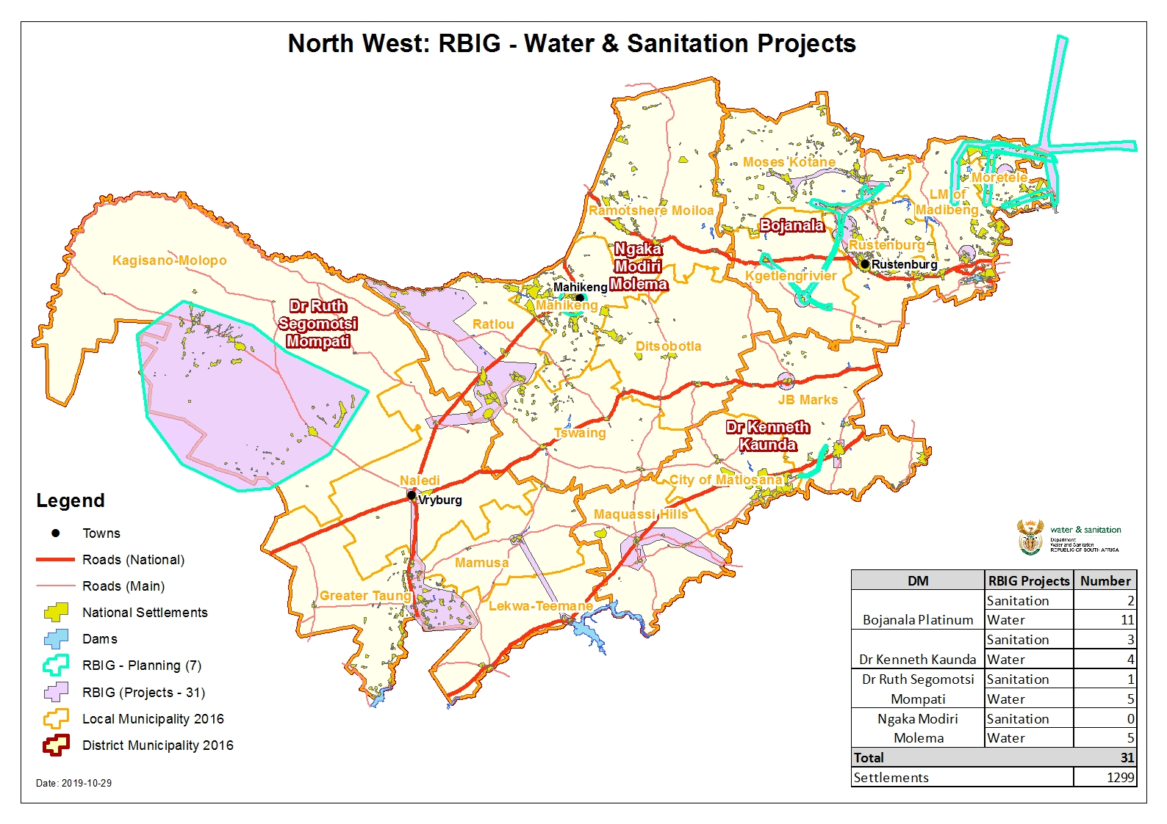

Slide 42
RBIG ALLOCATIONS AND PROJECT STATUS

Slide 43
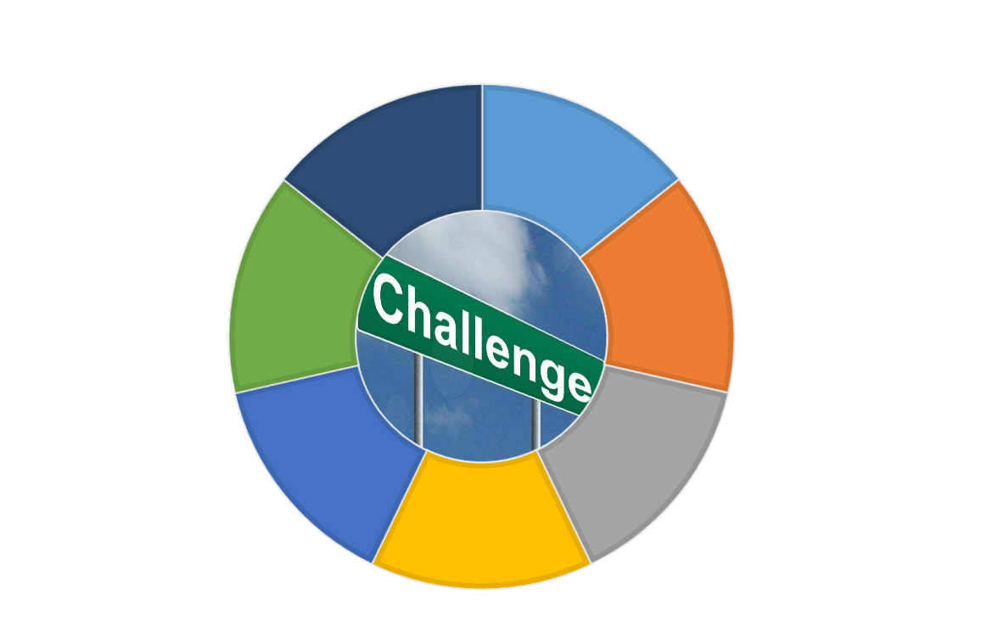
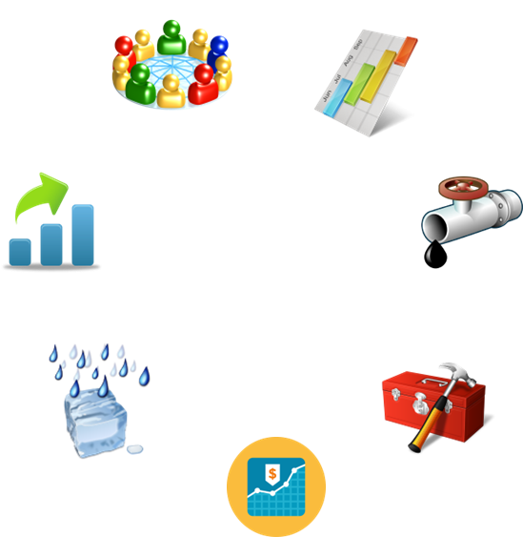
Challenges to Delivering Reliable & Safe Water Services
Water services planning & prioritization
Shifting patterns in water demand; rising energy costs
Water infrastructure
Water resources; climate change impact
Workforce &
Technical skills
Economic conditions, with water services provision

Slide 44
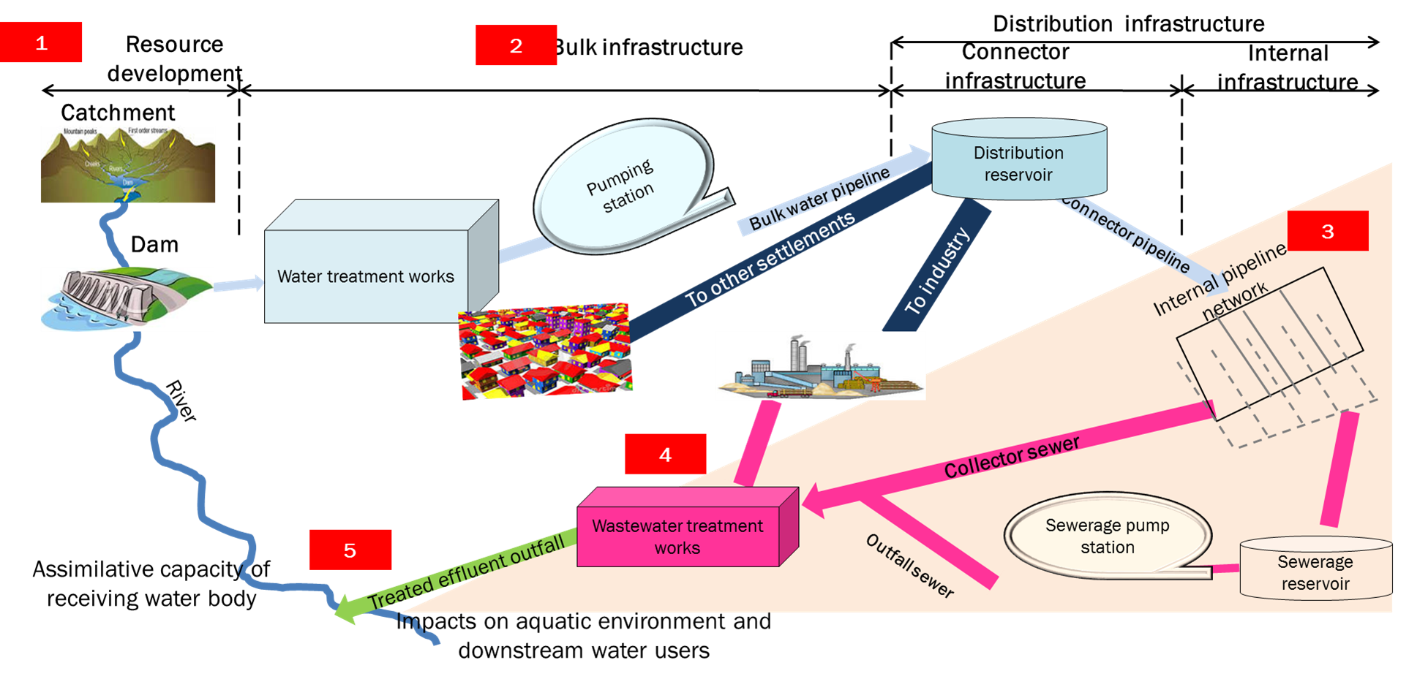
Water and sanitation supply chain

Slide 45
Summary of 2020/2021 Grant Allocations
Programme | Dora Schedule | Total per programme | Allocation | % Exp | Balance
RBIG | SCHEDULE 5B | 465,188,000 | 179,728,000 | 35% | 125,810,000
 | SCHEDULE 6B |  | 251,375,000 | 30% | 175,963,000
 | RANDWATER COV 19 |  | 34,085,000 | 100% | 0.00
WSIG | SCHEDULE 5B | 364,815,000 | 308,265,000 | 35% | 200,373,000
 | SCHEDULE 6B |  | 56,550,000 | 10% | 50,895,000
TOTAL |  | 830, 003,000 | 830, 003,000 | 42% | 553,041,000
Note: 20% of WSIG allocation under schedule 5b can augmented for tankering in the interim, the municipalities need to ensure that there are plans to provide sustainable water supply .The business plan must be submitted to the DWS for evaluation before any arrangement of tankering. Already Dr Ruth submitted for approval, which still with H/O for comments and evaluation.

Slide 46
RBIG (6B) 2019/2020 Grant Allocations
No | Project Name | 2020/21 Allocation ’000 | 2020/21 Expenditure ’000 | 2020/21 balance ’000 | Invoice at Hand
1. | Madibeng Bulk Water Supply | 120,000,000 | 16,000,000 | 104,000,000 | R 0.00
2 | Moretele South BulkWater Supply | 30,000,000 | 30,000,000 | - | -
Total |  | 150,000,000 | 46,000,000 | 104,000,000 | -
Impact Priority Projects Madibeng –The upgrade of Brits WTW covers almost 90% of the villages within Madibeng jurisdiction . The water backlog will be reduced only after the completion of the system and its associates activities . Moretele –The first phase of Kipdrift completed ,there is arrangement with MW and COT to supply the Moretele South with Temba plant. The project covers 32 villages without reliable water supply in Moretele .The pipeline and reservoirs underway .

Slide 47
RBIG (5B) 2020/2021 Grant Allocations
No | Project Name | 2020/21 Allocation | 2020/21 Expenditure | 2020/21 balance | Invoice at Hand
1 | Taung/Naledi Bloemhof Bulk Water Supply Project | 70,728 | 29,104 | 18,108 | A rollover of R27 million was requested by the DM. Still awaiting for approval from National Treasury
2. | Bloemhof Bulk Water Supply Project | 65,915
 |  |  |  | 10,996
High Impact Priority Projects Taung BWS -The project covers the entire Taung and its surrounding area .There are 52 villages to be covered under the Taung/Naledi project .The project will allow for the exclusive use of the Pudimoe water treatment plant for Pudumong and surrounding villages Bloemhof BWS – The project covers 5 area include Schweitzer Reneke and Ipelegeng. The project augment then existing supply since it already stressed due to the population growth and development.

Slide 48
RBIG (6B) Progress Report
RBIG (6B) PHYSICAL PROGRESS REPORT
No | Project Name | 2020/21 Allocation | 2020/21 Expenditure Physical Progress
1. | Madibeng Bulk Water Supply | 120,000,000 | The contractor is on site, only DWS CU working. The private contractor to return onsite after approval of the VO’s .The Abstraction pump station is 100% completed. The physical progress on upgrade of water works is 59%. Anticipate completion date Aug 2021 .
2 | Moretele South Bulk Water Supply | 30,000,000 | The work continuing very well, all land issues addressed through office of Public Protector .The independent evaluator brought in to provide a final quote of a servitude .The physical progress is 67% on the Bulk pipeline .Reservoir to be budgeted next allocation .Completion date Dec 2021
3. | Koster Waste Water Treatment Works upgrade | 3,000,000 | The project is completed ,the municipality still struggling to finalize the appointment of MW to Operate and Maintain the existing infrastructure and new WWTW .Discussion is on going ,Provincial Government support is critical at this moment .The municipality is in financial stress to afford the O&M as per MW quote
4. | Ratlou Local Municipality Bulk Water Supply | 30,000,000 | The project in Setlagole almost completed ,the section of pipeline and bulk electricity to be finalized .The project anticipate completion by December 2020 .Madibogo Pan to follow after Setlagole completion .Project progress is at 91% .
5. | Mafikeng South Bulk Water Supply | 43,000,000 | The upgrade of the water work is at 89% to completion .Delay caused by the mechanical contractor designs not approved by the engineer .The DWS CU is back on site since the level 2 lockdown .The completion date expected 01 March 2022 as there still a pipeline and reservoir to be constructed .
6. | Potchefstroom Bulk Water Supply | 20,000,375 | The project on the upgrade is progressing well, together with pump station in Ikageng.Both contractors are on site since level 3 lockdown .The anticipate completion is March 2021 provided that the LM pays the services on time .Progress to date for both phases 77%

Slide 49
RBIG (5B) Progress Report
RBIG (6B) PHYSICAL PROGRESS REPORT
NO | PROJECT NAME | 2021 ALLOCATION | FIRST TRANSFER July 2020 | COMMENTS: (Any challenges, positives etc)
1 | Taung/Naledi BWS Project | 70,728,000 | 29,104,000 | The contractor is on site at the dam, they are busy with installation of static valves and to connect to the new pipeline to WTW .There are leaks discovered on the pipeline to WTW on chambers , however the contractor is busy repairing the leaks. The connection is 99% done ,leaks repair is on going .The WTW to be in operation end of Nov 2020 .Testing will then follow .The accommodation of the DWSCU to work on the pipe configuration of payment system within the DWS,Water Trading.
2. | Bloemhof BWS Project | 65,915,000 |  | The DWSCU still struggling to complete 5% of the work ,include roof, steel roof, crawl beams ,paving,fence,new building for chlorine and air blower and new workshop. The value of the work is almost 20million.The issue of procurement within the DWSCU still a predicament .The labour issue was resolved too .The work manpower to scale down in November 2020 ,as major work coming to an end. The 5% work to be ceded to the private contractor (mechanical)already appointed . Schweizer Reneke 35 Km pipeline contractor has been appointed. Handover to be done in October 2020. One contractor is busy with 11km pipeline and anticipated completion is December 2020. The tender process for the middle section as well as the electrical and mechanical works has already commenced. The said sections will be out on tender soon.

Slide 50
WSIG (5B) Progress Report
RBIG (6B) PHYSICAL PROGRESS REPORT
Municipality | Allocation 2019/20 | Actual Exp 2019/20 | Last Transferred 2019/20 | Number of Projects Completed
Moses Kotane LM | 54,000,000 | 48,904,000 | 54,000,000 | 3
Rustenburg LM | 88,000,000 | 87.000,000 | 88,000,000 | 3
Moretele LM | 80,000,000 | 78,498,101 | 80,000,000 | 9
Dr Ruth Segomotsi Mompati | 105,000,000 | 78,000,000 | 105,000,000 | 8
Note: The projects overlap in the year 2020/21, however most of them are completed. The incomplete ones requires the rollover approval from the NT. The NT will provide a decision on the rollover applications towards the end of October 2020.

Slide 51
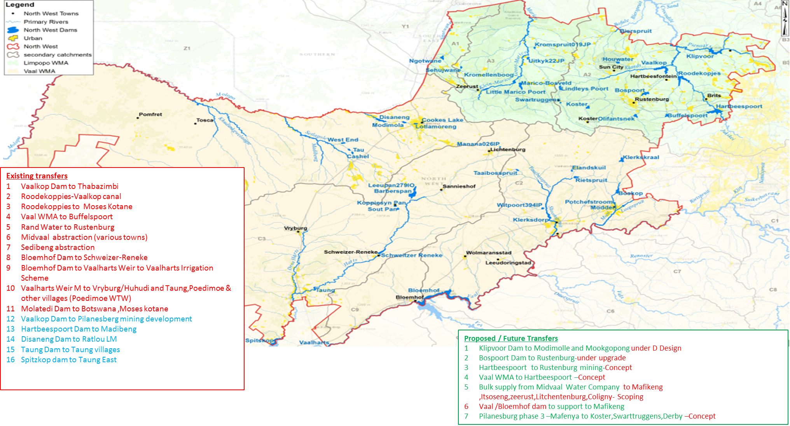

Slide 52
Planning Projects Ready for implementation
Nr | SCHEME | MUNICIPALITY | SR | TF | IRS | EIA | WL | COUNCIL RESOLUTION | APPROVE BY DWS | BUDGET 2020/2021 | BUDGET 2021/2022 | READINESS
1 | Bona-Bona BWS Project | Kagisano Molopo |  |  |  |  |  |  |  |  |  | Yes
2 | Tlapeng BWS Project | Kagisano Molopo |  |  |  |  |  |  |  |  |  | No
3 | Pilanesburg Phase 2 -Moruleng | Moses Kotane |  |  |  |  |  |  |  |  |  | Yes
4 | Madibogo Phase 2 | Ratlou |  |  |  |  |  |  |  |  |  | yes
5 | Klipvoor -Moretele North | Moretele/Waterberg |  |  |  |  |  |  |  |  |  | yes
6 | Christiana WTW upgrade | Leekwa Taemane |  |  |  |  |  |  |  |  |  | No
7 | Madikwe Upgrade of WTW | Moses Kotane |  |  |  |  |  |  |  |  |  | No
8 | Midvaal BWS Project | Ngaka Modiri M DM |  |  |  |  |  |  |  |  |  | No
SR | SCOPING REPORT
TF | TECHNICAL FEASIBILITY
WL | WATER USE LICENSE
 | YES /MILESTONES
 | NO APPROVAL

Slide 53
Planning Projects Ready for implementation
Nr | SCHEME | MUNICIPALITY | SR | TF | IRS | EIA | WL | COUNCIL RESOLUTION | APPROVE BY DWS | BUDGET 2020/2021 | BUDGET 2021/2022 | READINESS
9 | Potchefstroom WWTW upgrade | JB Marks |  |  |  |  |  |  |  |  |  | No
10 | Leeudoringstad WWTW Upgrade | Maquasihills |  |  |  |  |  |  |  |  |  | No
11 | Schoemasville WTW Upgrade | Madibeng |  |  |  |  |  |  |  |  |  | No
12 | Buisfontein BWS /Sedibeng water | Maquasihills |  |  |  |  |  |  |  |  |  | No
 | YES /MILESTONES
 | NO APPROVAL
SR | SCOPING REPORT
TF | TECHNICAL FEASIBILITY
WL | WATER USE LICENSE

Slide 54
RBIG (6B) Progress Report
RBIG (6B) PHYSICAL PROGRESS REPORT
HOTSPOT WSA/AREA | INTERVENTION REQUIRED
Madibeng LM- Mmakau, Lethlabile, Majakaneng , Jerico | Fast tracking of upgrading of Brits WTW Appointment of the required operators
Rustenburg LM-Rustenburg & environs, Tlhabane, Paardekraal & New mining townships | Fast tracking of Pilanesberg South Bulk Water Project Speedy responses to address water quality Challenges Draught Funding Intervention
Moses Kotane LM-Mabeskraal, Mogwase, Lerome | Fast tracking of Pilanesberg North Bulk Water Project Boreholes not yielding enough water Draught funding intervention
Ngaka Modiri Molema DM – 102 villages | Eradicate tankering in Hot Spot villages Draught Funding intervention
Dr Ruth Mompati DM | Urgent refurbishment of borehole equipment required
 | Urgent upgrading of Bloemhof WTW
 | SW assist on WS issues in Kagisano-Molopo & Mamusa LMs and Draught Intervention
Moretele LM- 58 villages (Northern & Southern cluster) | Emergency Testing, drilling, equipping and connecting pipeline to the storage through Draught funding

Slide 55
Drinking water hotspots
RBIG (6B) PHYSICAL PROGRESS REPORT
HOTSPOT WSA/AREA | INTERVENTION REQUIRED
Madibeng LM- Mmakau, Lethlabile, Majakaneng , Jerico | Fast tracking of upgrading of Brits WTW Appointment of the required operators
Rustenburg LM-Rustenburg & environs, Tlhabane, Paardekraal & New mining townships | Fast tracking of Pilanesberg South Bulk Water Project Speedy responses to address water quality Challenges Draught Funding Intervention
Moses Kotane LM-Mabeskraal, Mogwase, Lerome | Fast tracking of Pilanesberg North Bulk Water Project Boreholes not yielding enough water Draught funding intervention
Ngaka Modiri Molema DM – 102 villages | Eradicate tankering in Hot Spot villages Draught Funding intervention
Dr Ruth Mompati DM | Urgent refurbishment of borehole equipment required
 | Urgent upgrading of Bloemhof WTW
 | SW assist on WS issues in Kagisano-Molopo & Mamusa LMs and Draught Intervention
Moretele LM- 58 villages (Northern & Southern cluster) | Emergency Testing, drilling, equipping and connecting pipeline to the storage through Draught funding

Slide 56
Infrastructure Projects MTEF Allocations
RBIG (6B) PHYSICAL PROGRESS REPORT
Scheme | District Municipality | LM | IA | Project Cost | Project Cost DWS Commitment | Proposed Budget Allocation 2020/21 | Proposed Budget Allocation 2021/22 | Proposed Budget Allocation 2022/23
Madibeng Bulk Water Supply | Bojanala Platinum | Madibeng | Magalies Water/ DWS Construction | 405,632,000 | 405,632,000 | 120,000,000 | 144000000 | 144000000
Koster Waste Water Treatment Works upgrade | Bojanala Platinum | Kgetlengrivier | Magalies Water | 109,668,000 | 109,119,000 | 300,00,000 | - | -
Ratlou Bulk Water Supply | Ngaka Modiri Molema | Ratlou | Sedibeng Water/ DWS Construction | 271,000,000 | 271,000,000 | 30,000,000 | 30,000,050 | 30,000,000
Mafikeng South Bulk Water Supply | Ngaka Modiri Molema | Mafikeng | Sedibeng Water/ DWS Construction | 286,648,000 | 286,648,000 | 43,000,000 | 50,000,000 | 35000000

Slide 57
Infrastructure Projects MTEF Allocations
RBIG (6B) PHYSICAL PROGRESS REPORT
Scheme | District Municipality | LM | ImplementingAgent | Project Cost | Project Cost DWS Commitment | Proposed Budget Allocation 2020/21 | Proposed Budget Allocation 2021/22 | Proposed Budget Allocation 2022/23
Potchefstroom(Tlokwe) Waste Water Treatment Works upgrade (including Pipeline) | Dr Kenneth Kaunda | Tlokwe | Tlokwe | 400,000,000 | 200,000,000 | 20,375,140 | 25,000,000 | 30,000,000
Moretele North Bulk Water Supply | Bojanala platinum | Moretele | Magalies Water | 0 | 0 | 0 | 0 | 0

Slide 58
WSIG ALLOCATIONS AND PROJECT STATUS

Slide 59
Water Services Infrastructure Grant
District municipality | Local municipality | Project name | Stage | 2020/21 allocation in R’000
Bojanala | Moretele | Refurbishment of boreholes in various wards | Construction | R 2,000,000.00
 |  | Water conservation and demand management | Construction | R 17,721,176.64
 |  | Olverton, Vonteen, Swartboom, Tloonane and Utsane Water Rural Supply (WARD 2) | Procurement | R 34,071,160.33
 |  | Moretele basic Sanitation | Construction | R 29,163,231.17
 |  | Refurbishment of ward 7 package plants | Construction | R 1,332,527.64
 |  | Moretele metered yard connections in ward 21 (Kgomo Kgomo & Kontant) | Construction | R 111,904.22

Slide 60
Water Services Infrastructure Grant
District Municipality | Local Municipality | Project name | Stage | 2020/21 allocation in R’000
Bojanala | Rustenburg | Upgrading of Marikana Outfall Sewer & Pumpstation | Construction | 6,000,000.00
 |  | The Augmentation of Water Supply to Nkandla area | Procurement | 7,000,000.00
 |  | The Augmentation of Water Supply to Freedom Park | Procurement | 7,000,000.00
 |  | Rustenburg CBD AC Replacement and Aged Water Meters & Connections | Procurement | 500,000.00
 |  | Dinie Estates - Water supply -Phase 2 | Construction | 2,500,000.00
 |  | Lekgalong - Water supply Phase 5 | Construction | 2,500,000.00
 |  | Makolokwe - Water supply Phase 2 | Construction | 2,500,000.00
 |  | Erection of A 3MLSteel Tank At Tierkloof | Construction | 1,000,000.00
 |  | Upgrading opf Water Supply Infrastructure in Syferbult | Procurement | 2,700,000.00
 |  | Marikana:Maditlokwe Informal Settlement | Construction | 4,000,000.00
 |  | Provision of Temporary Water Supply in Rietvlei | Construction | 700,000.00
 |  | The augmentation of water supply to the Boschfontein | Construction | 3,400,000.00
 |  | Provision of water supply in Phoane | Construction | 1,700,000.00
 |  | Water Conservation and Demand Management (WCDM) | Procurement | 20,840,000.00

Slide 61
Water Services Infrastructure Grant
District Municipality | Local Municipality | Project name | Stage | 2020/21 allocation in R’000
Bojanala | Moretele | Pella Water Supply | Construction | 15,375,074
 |  | Tlokweng Bulk Water Augmentation - Phase I | Construction | 5,768,245
 |  | Tlokweng Water Supply - Phase II | Construction | 20,756,681
 |  | Ledig Bulk Water Supply | Construction | 4,000,00
 |  | Lerome Bulk Water Supply | Construction | 5,768,245
 |  | Bulk Water Augmentation Lerome (Mositwana Section) | Construction | 2,267,549
 |  | Letlhakane Water Supply | Design Phase | 1,120,000
 |  | Pitsedisulejang Water Supply | Design Phase | 6,244,926
 |  | Lossmytjerie Water Supply | Design Phase | 1,260,000
 |  | Letsheng Section Water Supply | Design Phase | 8,000,000
 |  | Makoshong Water Supply | Design Phase | 4,025,000
 |  | Tweelagte Water Supply | Design Phase | 4,000,000
 |  | Lerome Bulk Water | Design Phase | 12,000,000

Slide 62
Water Services Infrastructure Grant
District Municipality |  | Local Municipality | Project name | Stage | 2020/21 allocation in R’000
Dr Ruth Segomotsi Mompati | Greater Taung | Reivilo Phase 2 Water Supply | 100% Complete | 30 Aug 2020 | R 1 828
 |  | Matlhako 1& 2 Water Supply | 98% Complete | - | R 1 735
 |  | Pitsong Water Supply | 100% Complete | 30 Aug 2020 | R 1 501
 |  | Refurbushment Of Diplankeng Sanitation System | 70% Complete | - | R 3 354 59
 | Kagisano Molopo
 |  | Ditshukutshwaneng Water Supply | 100% Complete | 30 Aug 2020 | R 12 011
 |  | Louwna Water Supply | 100% Complete | 30 Aug 2020 | R 6 482
 |  | Kagiso/Kagisonyane Water Supply | 98% Complete | - | R 9 746
 |  | Piet Plessis Water Supply Phase 2 | 5% Complete | - | R 7 917
 | Mamusa | Amalia Basic Water Supply | 5% Complete | - | R 26 570

Slide 63
MINING SECTOR INTERVENTIONS

Slide 64
Mining Partnerships
LM Name | Mines | Current Projects | Budget | Progress
Madibeng LM | Lonmin (2014-2018) | Bulk water supply to Outstad, Bapong and Modderspruit | R6 058 774 | Exploration holes for yield and quality along with production boreholes in Bapong, Oustad, Modderspruit, completed. Next phase is to Equip boreholes with pumps, Install new pipelines to the reservoirs in the various areas.
 | Samancor (2015-2019) | Bokamoso (Mooinooi Ext 13) Water (construction of 2ml reservoir and bulk water line) and Sanitation (construction of Ventilated Improved Pit Latrines) Project. | R13 593 047 | Completed (December 2019)
 | Hernic (2017-2022) | Provision of water to communities of Maboloka, Oudstat, Mmakau and Koksfontein | R 2 000 000 | Borehole in Morekolodi Primary School in Mmakau equipped. Equipment including a pump, solar panels procured for the borehole in Oustad which will supply the Oustad community with water.
Total |  |  | R21,651,821.00

Slide 65
Mining Partnerships
LM Name | Mines | Current Projects | Budget | Progress
Rustenburg LM | Impala (2014-2018) | Luka/Mogono Water Infrastructure Upgrade (construction and installation of upvc pipeline with pumping station over a 06km length | R20 000 000 | Completed November 2019
 | Tharisa (2014-2018) | Maditlhokwa local community water supply project | R6 300 000 | Discussions underway between READ and Tharisa in terms of permanent water use license application recommendation letter from READ
 | Sibanye Stillwater (2016-2020) | Upgrading of Mfidikwe village water system, construction of sewage pump station & internal sewer reticulation for 411 households. | R 37 000 000 | Construction at 90%.
Total |  |  | R63 300,000.00

Slide 66
Mining Partnerships
LM Name | Mines | Current Projects | Budget | Progress
LM Name | Mines | Current Projects | Budget | Progress
Moses Kotane LM | Pilanesburg Platinum Mines (2015-2019) | Community water project | R 9 000 000 | No implementation yet. Efforts underway to secure meeting between DWS, Moses Kotane and Pilanesburg Mine to clarify the budget and scope of work since the water project concept was initiated as a joint venture between the above mentioned parties.
 | Bakubung Platinum (2014-2018) | The company contracted a PSP to deliver water collected from the municipality’s water supply point while awaiting completion of the 5ml reservoir. | R 3,600.000 | Delivery of water to communities ended in June 2019 which was part of the 2014-2018 SLP. The mine has bought three (3) water trucks for the Municipality at a cost of R3m which includes 3 years maintenance plan
Total |  |  | R12,600.000.00
Grand Total |  |  | R136,251,821.00

Slide 67
COVID19 INTERVENTIONS

Slide 68
Bojanala District Municipality
MUNICIPALITIES | ALLOCATED NO OF TANKS | DELIVERED | INSTALLATION AND COMMISSIONING | TANKS PROVIDED TO INFORMAL SETTLEMENTS | NUMBER OF WATER TANKERS ALLOCATED
Madibeng LM | 140 | 140 | 140 | 22 | 6
Rustenburg LM | 31 | 31 | 31 | 26 | 2
Moses Kotane LM | 24 | 24 | 24 | 4 | 5
Kgetleng LM | 53 | 53 | 53 | 35 | 1
Moretele LM | 34 | 34 | 34 | 2 | 4
TOTAL | 282 | 282 | 282 | 89 | 18

Slide 69
Ngaka Modiri Molema District Municipality
MUNICIPALITIES | ALLOCATED NO OF TANKS | DELIVERED | INSTALLED | TANKS PROVIDED TO INFORMAL SETTLEMENTS | NUMBER OF WATER TANKERS ALLOCATED
Ramotshere LM | 67 | 78 | 78 | 0 | 3
Ratlou LM | 42 | 42 | 42 | 0 | 2
Mafikeng LM | 64 | 64 | 64 | 0 | 4
Tswaing LM | 67 | 56 | 56 | 0 | 2
Ditsobotla LM | 38 | 38 | 38 | 0 | 2
TOTAL | 278 | 278 | 278 | 0 | 13

Slide 70
Dr Ruth Segomotsi Mompati District Municipality
MUNICIPALITIES | ALLOCATED NO OF TANKS | DELIVERED | INSTALLED | TANKS PROVIDED TO INFORMAL SETTLEMENTS | NUMBER OF WATER TANKERS ALLOCATED
Kagisano Molopo LM | 50 | 40 | 40 | 7 | 2
Naledi LM | 10 | 20 | 20 | 8 | 2
Mamusa LM | 30 | 20 | 20 | 14 | 2
Lekwa Teemane | 30 | 30 | 30 | 11 | 2
Greater Taung LM | 57 | 67 | 67 | 1 | 5
TOTAL | 177 | 177 | 177 | 41 | 13

Slide 71
Dr Kenneth Kaunda District Municipality
MUNICIPALITIES | ALLOCATED NO OF TANKS | DELIVERED | INSTALLED | TANKS PROVIDED TO INFORMAL SETTLEMENTS | NUMBER OF WATER TANKERS ALLOCATED
City of Matlosana LM | 20 | 20 | 20 | 4 | 1
Maquassi Hills LM | 18 | 18 | 18 | 7 | 1
JB Marks LM | 50 | 50 | 50 | 8 | 4
TOTAL | 88 | 88 | 88 | 19 | 6

Slide 72
Covid-19 Interventions
DWS & Rand Water finalising verification and transfer of assets (Tanks & Stands)
DWS Trucks services has been demobilised
Most tanks remains empty for longer period
DWS call centre inundated with complaints

Slide 73


THANK YOU

