Slide 1
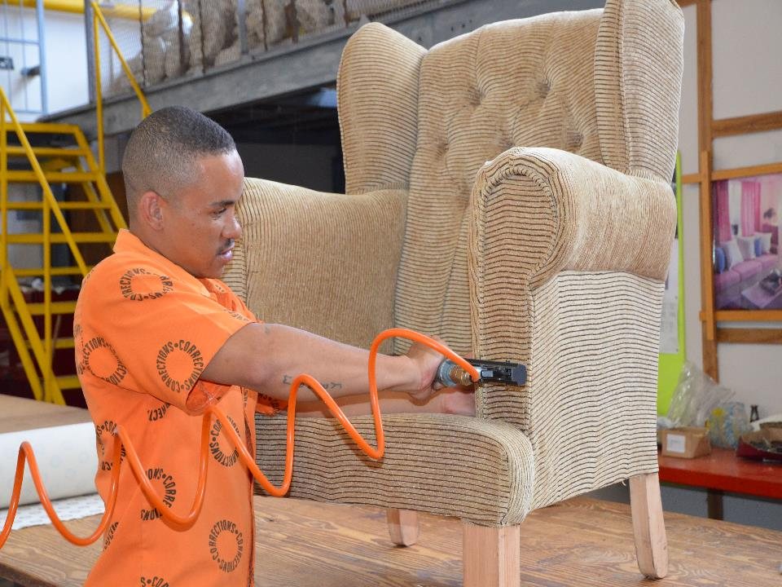
DCS QUARTER ONE
PERFORMANCE REPORT
2020/21 FINANCIAL YEAR
14 OCTOBER 2020
PRESENTATION TO THE PORTFOLIO COMMITTEE ON JUSTICE AND CORRECTIONAL SERVICES

Slide 2
Presentation outline
1
Quarterly Reporting Process
2
Overview of Quarter One Performance Report
3
Targets not achieved
4
Progress on MTSF Targets
5
Performance per Programme
6
Financial Report

Slide 3
Quarterly Reporting Process
Value Proposition Canvas
2020/21
Notes:
<a href="https://www.freepik.com/free-photos-vectors/business">Business photo created by pressfoto - www.freepik.com</a>

Slide 4

2020/21 QUARTERLY REPORTING PROCESS
The DPME has reviewed the quarterly reporting process as from 2020/21. The Department adjusted the reporting timeframes to align to the DPME guidelines.
In 2020/21 financial year, departments will no longer be reporting preliminary data at the end of quarter. The data that is reported at the end of each quarter is validated at the time of reporting.
The timing of the changes to the reporting process is not ideal as the Department becomes stretched out and stretched thin due to COVID-19.
Departments will consider strengthening its systems to ensure that within 30 days of quarter’s end information reported is validated, reliable and credible.
In the instance where the Department notes discrepancies in previous quarter’s performance reports, these discrepancies will be augmented in the Pre-Audited Annual Report.
The QPR 1 is aligned to the 2020/21 APP tabled on 08 May 2020.
The QPR 2 – QPR 4 will be aligned to the 2020/21 Revised APP tabled on 09 July 2020.

Slide 5
2020/21 Quarter One Performance Report
Value Proposition Canvas
Overview
Notes:
<a href="https://www.freepik.com/free-photos-vectors/business">Business photo created by pressfoto - www.freepik.com</a>

Slide 6
OVERALL QUARTER ONE PERFORMANCE
 | Total number of performance indicators | Total number of annual targets | Total number of quarterly targets | Achieved | Not achieved | Target measured bi-annually/ annually / per academic year
1. Administration | 11 | 14 | 8 | 4 | 4 | 6
2. Incarceration | 7 | 7 | 5 | 2 | 3 | 2
3. Rehabilitation | 8 | 11 | 9 | 5 | 4 | 2
4. Care | 5 | 5 | 5 | 4 | 1 | -
5. Social Reintegration | 7 | 7 | 4 | 2 | 2 | 3
Total | 38 | 44 | 31 | 17 | 14 | 13

Slide 7
OVERALL QUARTER ONE PERFORMANCE
Targets not achieved
Targets achieved
Targets Q1 | Achieved | Not Achieved | Measured annually
31
17
14
13

Slide 8
COMPARATIVE ANALYSIS PER PROGRAMME FOR Q1

Slide 9
COMPARATIVE ANALYSIS PER REGION FOR Q1
Region | Total number of targets Q1 | Achieved Q1 | Not Achieved Q1
LMN | 22 | 14 | 8
FS/NC | 22 | 15 | 7
KZN | 22 | 16 | 6
WC | 22 | 14 | 8
GP | 22 | 13 | 9
EC | 22 | 16 | 6

Slide 10
Targets not achieved
Value Proposition Canvas
Quarter One
Notes:
<a href="https://www.freepik.com/free-photos-vectors/business">Business photo created by pressfoto - www.freepik.com</a>

Slide 11
INDICATORS NOT ACHIEVED DURING Q1
Programme | Sub-programme | Indicator not achieved | Reasons for under-achievement | Corrective action
Administration | Management | Percentage of investigations completed for reported allegations | Due to Covid-19 lockdown levels 5 & 4 no investigation could be conducted as no travelling was permitted. | Performance will improve if the National Lockdown Regulations are eased
 | Finance | Approved Integrated finance and SCM strategy | Draft integrated finance and SCM Strategy could not be completed due to the prioritization of the Covi-19 related activities ( budget readjustment and PPE procurement ) | Identification of additional resources to assist the Department in the development of integrated finance and SCM Strategy
 | Information Technology | Percentage of Information Systems implemented as per the MISSTP | All training ceased from the 23rd of March because of the level 5 lockdown alert and there was no travelling allowed and no accommodation hotels were closed . | Sites will be reprioritized where officials are able to revel and do not require accommodation
 | JICS | Percentage of correctional facilities and PPP's facilities inspected on the conditions and treatment of inmates | National Lockdown in response to COVID -19 pandemic and the COVID-19 related restrictions placed in correctional facilities, prohibited JICS from conducting the inspections. | The inspections will be done during Q2 and Q3 of the financial year

Slide 12
INDICATORS NOT ACHIEVED DURING Q1
Programme | Sub-programme | Indicator not achieved | Reasons for under-achievement | Corrective action
Incarceration | Security Operations | Percentage of inmates who escaped from Correctional Facilities | Non adherence to policies and procedures and negligence. | Continuous monitoring of policies and procedures especially the escape prevention plan
 |  | Percentage of inmates injured as a result of reported assaults in Correctional Facilities | Non adherence to policies and procedures and idleness of inmates due to lockdown regulations during the COVID 19 period. | Continuous monitoring of Policies and procedures. Facilitate indoor activities and programmes to prevent idleness and frustrations among inmates.
 | Remand Detention | Percentage of Remand Detainees (RDs) subjected to Continuous Risk Assessment (CRA) | Target revised from 60% to 40% due to Covid-19 Pandemic Underachievement was due to the revised target. | The target of 40% will be achieved on ease of lockdown regulations
Rehabilitation | Correctional Programmes | Percentage of sentenced offenders with CSPs who completed correctional programmes | Due to COVID 19 DMA Regulations, Correctional Programmes rendered as prescribed by the CSPB for placement purposes | Performance will improve if the National Lockdown Regulations are eased.
 | Offender Development | Percentage of offenders participating in Long Occupational Skills Programmes | The targets were reviewed to zero due to the implementation of the National Lockdown Regulations Act. | Performance will improve if the National Lockdown Regulations are eased.
 |  | Percentage of offenders participating in TVET College Programmes | The targets were reviewed to zero due to the implementation of the National Lockdown Regulations Act. | Performance will improve if the National Lockdown Regulations are eased
 | Psychological , Social Work and Spiritual Care | Percentage of inmates receiving spiritual care services | 'Spiritual Workers were not allowed to render any programmes to inmates due to Covid 19 regulations | Encourage participation in spiritual care services once Lock down regulations have been relaxed

Slide 13
INDICATORS NOT ACHIEVED DURING Q1
Programme | Sub-programme | Indicator not achieved | Reasons for under-achievement | Corrective action
Care | Health and Hygiene Services | Offenders Viral load suppression rate (at 12 months) | Patients not adhering to treatment. | Strengthening continuous adherence counseling and reference to MDT for comprehensive counseling. Effective monitoring of offenders on ART
Social Reintegration | Community Reintegration | Percentage increase of victims participating in Restorative Justice Programme | Due to COVID-19 Regulations Restorative Justice programmes and Imbizos remained suspended and contact sessions with parolees/ probationers could not be conducted effectively including. | Restorative Justice processes will resume under lockdown level 2
 |  | Percentage increase of offenders, parolees and probationers participating in Restorative Justice Programme | Due to COVID-19 Regulations Restorative Justice programmes and Imbizos remained suspended and contact sessions with parolees/ probationers could not be conducted effectively | Restorative Justice processes will resume under lockdown level 2

Slide 14
Progress on MTSF Targets
Value Proposition Canvas
Quarter One
Notes:
<a href="https://www.freepik.com/free-photos-vectors/business">Business photo created by pressfoto - www.freepik.com</a>

Slide 15
MTSF INDICATORS FOR Q1
Performance Indicator | Q1 Target 2020/21 | Q1 Performance | Deviation from planned target | Reasons for over/under achievement | Corrective action
Percentage of parolees without violations per year | 97% LMN: 97% FSNC:97% KZN: 97% WC: 97% GP: 97% EC: 97% | 99.42% (46 784/47 056) LMN: (8 657/8 697) 99.54% FSNC: (4 468/4 503 )99.22% KZN: (10 587/10 667) 99.25% WC: (5 273/5 335) 98.84% GP: (9 704/9 742) 99.61% EC: (8 095/8 111) 99.76 % | 2.42% | Physical monitoring of high risk parolees was done as prescribed within the Protocols. The lockdown regulations contributed to their compliance with conditions. | n/a
Percentage of probationers without violations per year | 97% LMN: 97% FSNC:97% KZN: 97% WC: 97% GP: 97% EC: 97% | 99.37% (7 516/7 564) LMN (968/973) 99.49% FS/NC (740/748) 98.93% KZN ( 1 349/1 352) 99.78% WC (2 001/2 024) 98.86% GP (1 109/1 116) 99.37% EC (1 350/1 351) 99.93% | 2.37% | Physical monitoring of high risk probationers was done as prescribed within The Protocols and the lockdown regulations contributed to their compliance with conditions. | n/a

Slide 16
MTSF INDICATORS FOR Q1
Performance Indicator | Q1 Target 2020/21 | Q1 Performance | Deviation from planned target | Reasons for over/under achievement | Corrective action
Percentage increase of victims participating in Restorative Justice Programme | 7% LMN: 7% FSNC:7% KZN: 7% WC: 7% GP:7% EC: 7% | -84.94% (-3 948/4 594) LMN: (-300/507) -59.17% FSNC: (-1 221/1 319 )-92.57% KZN: (-703/727) -96.70% WC: (-413/416) -99.28% GP: (-885/906) -97.68% EC: (-426/719) -59.25% | -77.94% | Due to COVID-19 Regulations Restorative Justice programmes and Imbizos remained suspended and contact sessions with parolees/ probationers could not be conducted effectively | Restorative Justice processes will resume under lockdown level 2.

Slide 17
2020/21
Quarter One Performance Report
Programme One
Administration

Slide 18
PROGRAMME 1: ADMINISTRATION
MANAGEMENT
Performance Indicator | Q1 Target 2020/21 | Q1 Performance | Deviation from planned target | Reasons for over/under achievement | Corrective action
Number of ethics, fraud prevention and anti-corruption awareness workshops conducted | No target | No target | No target | No target | No target
Percentage of investigations completed for reported allegations | 10% | 2.50% | 7.50% | Due to Covid-19 lockdown levels 5 & 4 no investigation could be conducted as no travelling was permitted. | Performance will improve when the National Lockdown Regulations are eased.
Percentage of officials charged and found guilty for corrupt activities | 95% | 100% (1/1) | 5% | Due to Covid 19 lockdown no cases were finalized in April and May 2020. Only 1 case finalized after hearings commence in June. | n/a

Slide 19
PROGRAMME 1: ADMINISTRATION
HUMAN RESOURCES
Performance Indicator | Q1 Target 2020/21 | Q1 Performance | Deviation from planned target | Reasons for over/under achievement | Corrective action
Approved Integrated Human Resource Strategy | No target | No target | No target | No target | No target
Percentage of youth employed within the Department | No target | No target | No target | No target | No target
Percentage compliance to the EE plan in the filling of positions | No target | No target | No target | No target | No target

Slide 20
PROGRAMME 1: ADMINISTRATION
FINANCE
Performance Indicator | Q1 Target 2020/21 | Q1 Performance | Deviation from planned target | Reasons for over/under achievement | Corrective action
Number of audit qualifications | No target | Target measured annually | Target measured annually | Target measured annually | Target measured annually
Approved Integrated finance and SCM strategy | Draft integrated finance and SCM Strategy | Draft integrated finance and SCM Strategy could not be completed | Draft integrated finance and SCM Strategy | Draft integrated finance and SCM Strategy could not be completed due to the prioritization of the Covi-19 related activities ( budget readjustment and PPE procurement ) | Identification of additional resources to assist the Department in the development of integrated finance and SCM Strategy
Percentage of tenders above R30 million awarded to designated groups | No target | Target measured annually | Target measured annually | Target measured annually | Target measured annually

Slide 21
PROGRAMME 1: ADMINISTRATION
INFORMATION TECHNOLOGY
Performance Indicator | Q1 Target 2020/21 | Q1 Performance | Deviation from planned target | Reasons for over/under achievement | Corrective action
Approved Master Information System and Security Technology Plan (MISSTP) | Draft Master Information System and Security Technology Plan (MISSTP) | Draft MISSTP completed | none | none | n/a
Percentage of Physical Security Technology implemented as per MISSTP | 5% | 28.57% (2/7) | 23.57% | The service provider was able to prioritize the two(2) sites which are Kgosi Mampuru and Pollsmoor Management Area. | n/a

Slide 22
PROGRAMME 1: ADMINISTRATION
INFORMATION TECHNOLOGY
Performance Indicator | Q1 Target 2020/21 | Q1 Performance | Deviation from planned target | Reasons for over/under achievement | Corrective action
Percentage of sites installed with network infrastructure | 41.6% | 41.67% | none | none | n/a
Percentage of Information Systems implemented as per the MISSTP | 3% | 1.95% | 1.05% | All training ceased from 23rd of March because of the level 5 lockdown alert and there was no travelling allowed and no accommodation as hotels were closed | Sites will be reprioritized where officials are able to travel and do not require accommodation.

Slide 23
PROGRAMME 1: ADMINISTRATION
JICS
Performance Indicator | Q1 Target 2020/21 | Q1 Performance | Deviation from planned target | Reasons for over/under achievement | Corrective action
Percentage of correctional facilities and PPP's facilities inspected on the conditions and treatment of inmates | 14% | 2.88% (7/243) | 11.12% | COVID-19 related restrictions prohibited JICS from conducting the inspections on correctional facilities. | The inspections will be conducted during Q2 and Q3 of the financial year.

Slide 24
2020/21
Quarter One Performance Report
Programme Two
Incarceration

Slide 25
PROGRAMME 2: INCARCERATION
SECURITY OPERATIONS
Performance Indicator | Q1 Target 2020/21 | Q1 Performance | Deviation from planned target | Reasons for over/under achievement | Corrective action
Percentage of inmates who escaped from Correctional Facilities | 0.008% LMN: 0.008% FSNC: 0.008% KZN: 0.008% WC: 0.008% GP: 0.008% EC: 0.008% | 0.016% (23/146 130) LMN: (1/22 705) 0.004% FSNC: (9/19 765/) 0.046% KZN: (1/ 23 537/) 0.004% WC: (5/24 833) 0.020% GP: (7/35 917) 0.019% EC: (0/19 373) 0% | 0.008% | Non adherence to policies and procedures. | Continuous monitoring of the implementation of policies, procedures and the escape prevention plan

Slide 26
PROGRAMME 2: INCARCERATION
SECURITY OPERATIONS
Performance Indicator | Q1 Target 2020/21 | Q1 Performance | Deviation from planned target | Reasons for over/under achievement | Corrective action
Percentage of inmates injured as a result of reported assaults in Correctional Facilities | 1.16% LMN:1.16% FSNC:1.16 % KZN: 1.16 % WC: 1.16% GP: 1.16% EC: 1.16% | 1.20% (1 748/146 130) LMN: (190/22 705) 0.84% FSNC: (255/19 765/) 1.29% KZN: (251/ 23 537/) 1.07% WC: (336/24 833) 1.35% GP: (421/35 917) 1.17% EC: (295/19 373) 1.52% | 0.04% | Non adherence to policies and procedures. Idleness of inmates as a result of COVID 19 lockdown regulations. | Continuous monitoring of Policies and procedures. Facilitation of indoor activities and programmes to prevent idleness and frustrations among inmates.
Percentage of confirmed unnatural deaths in Correctional Facilities | No target | Target Measured Annually | Target Measured Annually | Target Measured Annually | Target Measured Annually

Slide 27
PROGRAMME 2: INCARCERATION
FACILITIES
Performance Indicator | Q1 Target 2020/21 | Q1 Performance | Deviation from planned target | Reasons for over/under achievement | Corrective action
Number of infrastructure projects completed | No target | Target Measured Annually | Target Measured Annually | Target Measured Annually | Target Measured Annually

Slide 28
PROGRAMME 2: INCARCERATION
REMAND DETENTION
Performance Indicator | Q1 Target 2020/21 | Q1 Performance | Deviation from planned target | Reasons for over/under achievement | Corrective action
Percentage of Remand Detainees (RDs) subjected to Continuous Risk Assessment (CRA) | 60% | 58.10% (91 566/157 577) | 1.90% | Target was revised from 60% to 40% due to Covid-19 lockdown regulations. | The revised target of 40% will be achieved on ease of lockdown regulations

Slide 29
PROGRAMME 2: INCARCERATION
OFFENDER MANAGEMENT
Performance Indicator | Q1 Target 2020/21 | Q1 Performance | Deviation from planned target | Reasons for over/under achievement | Corrective action
Percentage of overcrowding in correctional facilities in excess of approved bedspace capacity | 41% LMN:41% FSNC:41 % KZN: 41 % WC: 41% GP: 41% EC: 41% | 22.39% (26 995/120 567) LMN: (5 103/18 929) 26.96% FSNC: (-1 820/21 585) -8.43 % KZN: (2 259/21 278) 10.62% WC: (4 128/20 725) 19.92% GP: (10 798/25 204) 44.56 % EC: (6 527/12 846) 50.81% | 18.61% | Target achieved due to implementation of special parole dispensation in response to COVID-19 pandemic outbreak. | n/a
Percentage of offenders’ profiles approved for placement by the Correctional Supervision and Parole Boards (CSPBs) | 53% LMN: 53% FSNC: 53% KZN: 53% WC: 53% GP: 53% EC: 53% | 79.09% (8 199/10 619) LMN: (1 205/1 360) 88.60% FSNC: (1 139/2 019) 56.41 % KZN: (1 735/2 099) 82.66 % WC: (1 501/1 608) 93.35% GP: (1 745/1 876) 92.91% EC:(1 076/1 657) 64.94% | 26.09% | Effective case management processes wich result in submission of profiles reports to CSPB with relevant documents such as support, report on therapeutic and non therapeutic programmes. implementation of special parole dispensation in response to COVID-19 pandemic outbreak. | n/a

Slide 30
2020/21
Quarter One Performance Report
Programme Three
Rehabilitation

Slide 31
PROGRAMME 3: REHABILITATION
CORRECTIONAL PROGRAMMES
Performance Indicator | Q1 Target 2020/21 | Q1 Performance | Deviation from planned target | Reasons for over/under achievement | Corrective action
Percentage of sentenced offenders subjected to correctional programmes per year. | 20% LMN: 20% FSNC: 20% KZN: 20% WC: 20% GP: 20% EC: 20% | 18.85% (16 967/89 991) LMN: (2 739/15 387) 17.80% FSNC:(2 642/14 163)18.65% KZN: (2 795/15 958) 17.51% WC: (2 507/12 128) 20.67% GP: (3 731/19 568) 19.07% EC: (2 553/12 787) 19.97% | 1.15% | Facilitation of correctional programmes was negatively impacted by COVID 19 lockdown regulations. | Facilitation of correctional programmes to be conducted during Lockdown level 3,2 and 1.

Slide 32
PROGRAMME 3: REHABILITATION
OFFENDER DEVELOPMENT
Performance Indicator | Q1 Target 2020/21 | Q1 Performance | Deviation from planned target | Reasons for over/under achievement | Corrective action
Percentage of offenders participating in Long Occupational Skills Programmes | 80% LMN: 80% FSNC: 80% KZN: 80% WC: 80% GP: 80% EC: 80% | 74.15% (1 959/2 642) LMN: (208/763) 27.26% FSNC: (336/434) 77.42% KZN: (137/167) 82.04% WC: (163/163) 100 % GP: (36//36) 100% EC: (1 079/1 079) 100% | 5.85% | The targets were reviewed to zero due to the implementation of the National Lockdown Regulations Act. | Performance will improve when National Lockdown Regulations are eased.
Percentage of offenders participating in Short Occupational Skills Programmes | 80% LMN: 80% FSNC: 80% KZN: 80% WC: 80% GP: 80% EC: 80% | 99.76% (415/416) LMN: (92/92) 100 % FSNC: (189/190) 99.47% KZN: (105/105) 100% WC: (28/28) 100% GP: (0/0) 0% EC: (1/1) 100% | 19.76% | Enrolled offenders attended skills training programmes. | n/a

Slide 33
PROGRAMME 3: REHABILITATION
OFFENDER DEVELOPMENT
Performance Indicator | Q1 Target 2020/21 | Q1 Performance | Deviation from planned target | Reasons for over/under achievement | Corrective action
Percentage of offenders participating in TVET College Programmes | 80% LMN: 80% FSNC: 80% KZN: 80% WC: 80% GP: 80% EC: 80% | 31.38% (1 173/3 738) LMN: (255/873) 30.47% FSNC: (269/304) 88.49% KZN: (166/224) 74.11% WC: (0/1 890) 0% GP: (303/303) 100% EC: (180/180) 100% | 48.62% | Target was reviewed to zero due to the implementation of the National Lockdown Regulations Act. | Performance will improve when the National Lockdown Regulations are eased

Slide 34
PROGRAMME 3: REHABILITATION
OFFENDER DEVELOPMENT
Performance Indicator | Q1 Target 2020/21 | Q1 Performance | Deviation from planned target | Reasons for over/under achievement | Corrective action
Percentage of offenders participating in GET per academic year | 80% LMN: 80% FSNC: 80% KZN: 80% WC: 80% GP: 80% EC: 80% | 97.78% (29 851/30 530) LMN: (2 471/2 471) 100% FSNC: (1 763/1 816) 97.08% KZN: (1 251/1 310) 95.50% WC: (1 516/1 623) 93.41% GP: (1 653/1 661) 99.52% EC: (1 296/1 296) 100% | 17.78% | Recruitment drives were effective | n/a
Percentage of offenders participating in FET per academic year | 80% LMN: 80% FSNC: 80% KZN: 80% WC: 80% GP: 80% EC: 80% | 98.95% (3 392/3 428) LMN: (430/430) 100% FSNC: (125/129) 96.90% KZN: (164/170) 96.47% WC: (48/48) 100% GP: (129/131) 98.47% EC: (234/234) 100% | 18.95% | Recruitment drives were effective | n/a

Slide 35
PROGRAMME 3: REHABILITATION
OFFENDER DEVELOPMENT
Performance Indicator | Q1 Target 2020/21 | Q1 Performance | Deviation from planned target | Reasons for over/under achievement | Corrective action
Grade 12 pass rate obtained per academic year. | No target | Target measured per academic year | Target measured per academic year | Target measured per academic year | Target measured per academic year
Approved self-sufficiency strategy | No target | Target measured per academic year | Target measured per academic year | Target measured per academic year | Target measured per academic year

Slide 36
PROGRAMME 3: REHABILITATION
PSYCHOLOGICAL, SOCIAL WORK AND SPIRITUAL SERVICES
Performance Indicator | Q1 Target 2020/21 | Q1 Performance | Deviation from planned target | Reasons for over/under achievement | Corrective action
Percentage of incarcerated offenders, probationers and parolees who are involved in Social Work services per year | 14% LMN: 14% FSNC:14% KZN: 14% WC: 14% GP: 14% EC: 14% | 16.53% (23 967/145 018) LMN: (4 186/26 308) 15.91% FSNC: (2 927/16 964) 17.25% KZN: (5 506/28 765) 19.14% WC: (3 320/18 175) 18.27% GP: (4 479/31 671) 14.14% EC: (3 549/23 135) 15.34% | 2.53% | Risk mitigating strategy provided for limited movement of offenders thus impacting on services | n/a
Percentage of inmates receiving spiritual care services | 20% LMN: 20% FSNC:20 % KZN: 20 % WC: 20% GP: 20% EC: 20% | 6.25% (9 139/146 130) LMN: (2 006/22 705) 8.84% FSNC: (1 066/19 765/) 5.39% KZN: (2 134/ 23 537/) 9.07% WC: (1 005/24 833) 4.05% GP: (1 416/35 917) 3. 94% EC: (1 512/19 373) 7.80% | 13.75% | Spiritual Workers were not allowed to render any programmes to inmates due to Covid 19 regulations | Encourage participation in spiritual care services once Lock down regulations have been relaxed
Percentage of inmates receiving psychological care services | 5% LMN: 5% FSNC: 5 % KZN: 5 % WC: 5% GP: 5% EC: 5% | 5.12% (7 476/146 130) LMN: (953/22 705) 4 .20% FSNC: (1 072/19 765/) 5.42% KZN: (757/ 23 537/) 3.22% WC: (2 588/24 833) 10.42% GP: (1 481/35 917) 4.12% EC: (625/19 373) 3.23% | 0.12% | Target achieved due to support given by psychologists | n/a

Slide 37
2020/21
Quarter One Performance Report
Programme Four
Care

Slide 38
PROGRAMME 4: CARE
HEALTH AND HYGIENE SERVICES
Performance Indicator | Q1 Target 2020/21 | Q1 Performance | Deviation from planned target | Reasons for over/under achievement | Corrective action
Offenders Viral load suppression rate (at 12 months) | 90% LMN: 90% FSNC:90% KZN: 90% WC: 90% GP: 90% EC: 90% | 84.55% (1 872/2 214) LMN: ( 291/331) 87.92% FSNC:( 192/211) 91.00% KZN: (607/638) 95.14% WC: (382/593) 64.42% GP: ( 90/102) 88.24% EC: (310/339) 91.45% | 5.45% | Patients not adhering to treatment. | Strengthening continuous adherence counseling and reference to MDT for comprehensive counseling. Effective monitoring of offenders on ART
Offenders TB (new Pulmonary) Cure Rate | 90% LMN: 90% FSNC:90% KZN: 90% WC: 90% GP: 90% EC: 90% | 96.47% (82/85) LMN: ( 5/5) 100 % FSNC:(8/8) 100% KZN: (10/10) 100% WC: (20/22) 90.91% GP: (10/10) 100% EC: (29/30) 96.67% | 6.47% | Effective monitoring of initiated patients through Direct Observed Treatment System (DOTS) | n/a

Slide 39
PROGRAMME 4: CARE
HEALTH AND HYGIENE SERVICES
Performance Indicator | Q1 Target 2020/21 | Q1 Performance | Deviation from planned target | Reasons for over/under achievement | Corrective action
Percentage of inmates screened for diabetes | 22.50% LMN: 22.50% FSNC:22.50% KZN: 22.50% WC: 22.50% GP: 22.50% EC: 22.50% | 55.75% (15 015/26 992) LMN: ( 42 970/4 037) 73.57% FSNC:( 1 584/4 226) 37.48% KZN: (1 864/4 821) 38.67% WC: (502/2 829) 17.75% GP: ( 7 280/7 345) 99.12% EC: (2815/3 735) 21.82% | 33.25% | Inmates were offered screening during admission and PHC consultation. | n/a
Percentage of inmates screened for hypertension | 22.50% LMN: 22.50% FSNC:22.50% KZN: 22.50% WC: 22.50% GP: 22.50% EC: 22.50% | 67.60% (18 247/26 992) LMN: ( 3 152/4 037) 78.08 % FSNC: ( 2 372/4 226) 56.13% KZN: (2 768/4 821) 57.42% WC: (757/2 829) 26.76% GP: (7 716/7 345) 105.05% EC: (1 482/3 735) 39.68% | 45.10% | Inmates were offered screening during admission and PHC consultation. | n/a

Slide 40
PROGRAMME 4: CARE
NUTRITIONAL SERVICES
Performance Indicator | Q1 Target 2020/21 | Q1 Performance | Deviation from planned target | Reasons for over/under achievement | Corrective action
Percentage of therapeutic diets prescribed for inmates | 12% LMN: 12% FSNC:12% KZN: 12% WC: 12% GP: 12% EC: 12% | 6.02% (8 804/146 213) LMN: (1 597/22 075) 7.23% FSNC: (1 009/19 765) 5.10% KZN: (1 507/23 537) 6.40 % WC: (1 141/24 836) 4.59% GP: (2 249/35 917) 6.26% EC: (1 301/19 373) 6.72% | 5.98% | Review of prescribed diets scripts | n/a

Slide 41
2020/21
Quarter One Performance Report
Programme Five
Social Reintegration

Slide 42
PROGRAMME 5: SOCIAL REINTEGRATION
SUPERVISION
Performance Indicator | Q1 Target 2020/21 | Q1 Performance | Deviation from planned target | Reasons for over/under achievement | Corrective action
Percentage of parolees without violations per year | 97% LMN: 97% FSNC:97% KZN: 97% WC: 97% GP: 97% EC: 97% | 99.42% (46 784/47 056) LMN: (8 657/8 697) 99.54% FSNC: (4 468/4 503 )99.22% KZN: (10 587/10 667) 99.25% WC: (5 273/5 335) 98.84% GP: (9 704/9 742) 99.61% EC: (8 095/8 111) 99.76 % | 2.42% | Physical monitoring of high risk parolees was done as prescribed within the Protocols. The lockdown regulations contributed to their compliance with conditions. | n/a
Percentage of probationers without violations per year | 97% LMN: 97% FSNC:97% KZN: 97% WC: 97% GP: 97% EC: 97% | 99.37% (7 516/7 564) LMN (968/973) 99.49% FS/NC (740/748) 98.93% KZN ( 1 349/1 352) 99.78% WC (2 001/2 024) 98.86% GP (1 109/1 116) 99.37% EC (1 350/1 351) 99.93% | 2.37% | Physical monitoring of high risk probationers was done as prescribed within The Protocols and the lockdown regulations contributed to their compliance with conditions. | n/a
Approved Social Reintegration Framework | Target measured annually | Desktop research concluded | Target measured annually | Target measured annually | Target measured annually

Slide 43
PROGRAMME 5: SOCIAL REINTEGRATION
COMMUNITY REINTEGRATION
Performance Indicator | Q1 Target 2020/21 | Q1 Performance | Deviation from planned target | Reasons for over/under achievement | Corrective action
Percentage increase of victims participating in Restorative Justice Programme | 7% LMN: 7% FSNC:7% KZN: 7% WC: 7% GP:7% EC: 7% | -84.94% (-3 948/4 594) LMN: (-300/507) -59.17% FSNC: (-1 221/1 319 )-92.57% KZN: (-703/727) -96.70% WC: (-413/416) -99.28% GP: (-885/906) -97.68% EC: (-426/719) -59.25% | -77.94% | Due to COVID-19 Regulations Restorative Justice programmes and Imbizos remained suspended and contact sessions with parolees/ probationers could not be conducted effectively | Restorative Justice processes will resume under lockdown level 2.
Percentage increase of offenders, parolees and probationers participating in Restorative Justice Programme | 3% LMN: 3% FSNC:3% KZN: 3% WC: 3% GP: 3% EC: 3% | -80.84% (-1 287/1 592) LMN: (-189/279) -67.74% FSNC: (-122/172 ) -70.93% KZN: (-161/172) -93.60% WC: (-257/259) -99.23% GP: (-404/421) -99.96% EC: (-154/289) -53.29% | -77.84 | Due to COVID-19 Regulations Restorative Justice programmes and Imbizos remained suspended and contact sessions with parolees/ probationers could not be conducted effectively | Restorative Justice processes will resume under lockdown level 2

Slide 44
PROGRAMME 5: SOCIAL REINTEGRATION
COMMUNITY REINTEGRATION
Performance Indicator | Q1 Target 2020/21 | Q1 Performance | Deviation from planned target | Reasons for over/under achievement | Corrective action
Number of economic opportunities facilitated for offenders, parolees and probationers | No target | No target | No target | No target | No target
Number of parolees and probationers participating in community initiatives | No target | No target | No target | No target | No target

Slide 45
PERFORMANCE IMPORVEMENT PLANS Q1
The following improvement plans are in place to address areas of under-performance on the Q1 Performance Report:
Identification of additional resources to assist the Department in the development of integrated finance and SCM Strategy.
Sites for Information Systems implemented as per the MISSTP will be reprioritized where officials are able to travel and do not require accommodation
Restorative Justice processes will resume under lockdown level 2
Strengthening continuous adherence , counseling and reference to MDT for comprehensive counseling for viral load suppression
Effective monitoring of offenders on ART
Encourage participation in spiritual care services once Lock down regulations have been relaxed

Slide 46
PERFORMANCE IMPORVEMENT PLANS Q1
The following improvement plans are in place to address areas of under-performance on the Q1 Performance Report:
Overall Performance will improve when National Lockdown Regulations are eased.
Facilitation of correctional programmes to be conducted during Lockdown level 3,2 and 1.
Continuous monitoring of implementation no Security Policies and Procedures.
Facilitation of indoor activities and programmes to prevent idleness and frustrations among inmates

Slide 47
Financial Report as at 30 June 2020
Quarter One
Notes:
<a href="https://www.freepik.com/free-photos-vectors/business">Business photo created by pressfoto - www.freepik.com</a>

Slide 48
Presentation outline
A
Summary of the National State of Expenditure up to 30 June 2020
B
Summary of the National State of Expenditure per programme up to 30 June 2020
C
Summary of National State of Expenditure per economic classification up to 30 June 2020
D
Summary of Departmental Revenue up to 30 June 2020
E
COVID-19 Regional State of Expenditure per GFS up to 30 June 2020
F
Overview on cost containment measures implementation

Slide 49
A. SUMMARY OF THE NATIONAL STATE OF EXPENDITURE FOR THE YEAR TO DATE: 30 JUNE 2020

Slide 50
A. SUMMARY OF THE NATIONAL STATE OF EXPENDITURE FOR THE YEAR TO DATE: 30 JUNE 2020
OVERVIEW:
The year-to-date expenditure of the Department as at 30 June 2020 was R5,754 billion (21.47%) against the spending plan of R6,646 billion (24.80%) resulting in R892 million underspending of the projected expenditure
The spending plan included in this analysis is the original spending plan as approved at the beginning of the financial year by National Treasury
Factors that contributed to the under-/ over spending per Programme are as follows:

Slide 51
B. SUMMARY OF THE NATIONAL STATE OF EXPENDITURE PER PROGRAMME FOR THE YEAR TO DATE: 30 JUNE 2020

Slide 52
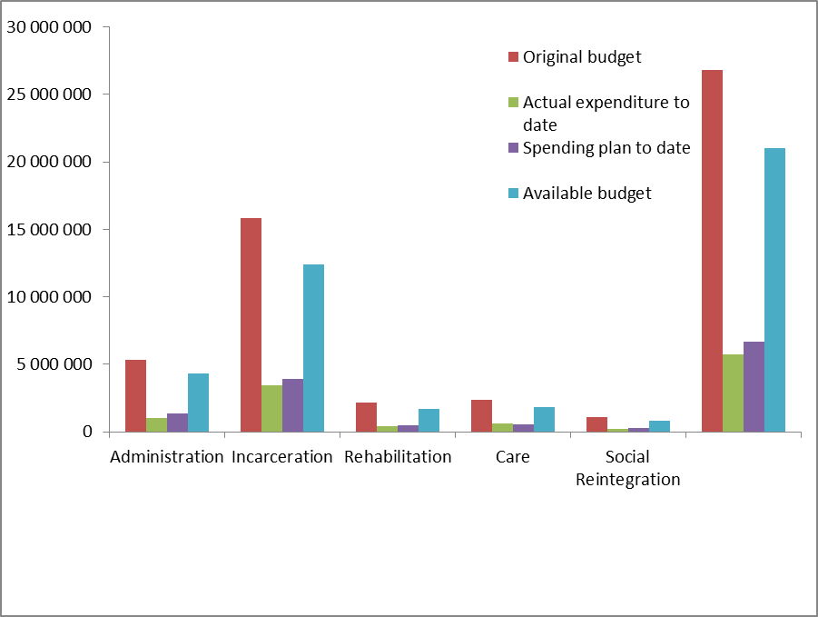
B. SUMMARY OF THE NATIONAL STATE OF EXPENDITURE PER PROGRAMME FOR THE YEAR TO DATE: 30 JUNE 2020

Slide 53
B. SUMMARY OF THE NATIONAL STATE OF EXPENDITURE PER PROGRAMME FOR THE YEAR TO DATE: 30 JUNE 2020
The actual spending of programme Administration is R1,049 billion (19.64%) against the spending plan of R1,374 billion (25.72%) resulting in R325 million underspending as a result of the following:
Compensation of Employees: The actual spending of R740 million (20.75%) against the spending plan of R816 million (22.90%) resulting in R77 million underspending due to delays of outstanding payments for 2020/21 financial year salary adjustment

Slide 54
B. SUMMARY OF THE NATIONAL STATE OF EXPENDITURE PER PROGRAMME FOR THE YEAR TO DATE: 30 JUNE 2020
Compensation of Employees (cont): The Budget Committee resolved that Branch HR must clean up PERSAL so as to ensure a credible database for reconciliation with the HRBP tool. This project of aligning PERSAL to HRBP tool was anticipated to be finalised by 30 June 2020. The report from HR is still outstanding, follow-up is being made. The permanent funded establishment as published in 2020 ENE was reported to be 5,678 against permanent PERSAL establishment of 6,806 resulting in a variance of 1,128 posts
Hereunder is the analysis of filled and vacant posts as per HRBP tool and PERSAL as at 30 June 2020
Goods and Services: The actual spending of R202 million (18.12%) against the spending plan of R429 million (38.55%) resulting in R228 million underspending was mainly on item: Fleet Services and Travel and Subsistence and due to National Lockdown as a result of COVID-19, the other contributing factor was on item: Computer Services due to delays of invoice from SITA for BAS/ PERSAL/ LOGIS systems
Interest and Rent on Land: There was an expenditure of R481 thousand incurred against a zero budget mainly due to interest paid on arrears salary in Head Office

Slide 55
B. SUMMARY OF THE NATIONAL STATE OF EXPENDITURE PER PROGRAMME FOR THE YEAR TO DATE: 30 JUNE 2020
Transfers and subsidies: The actual spending of R100,942 million (20.07%) against the spending plan of R123,836 million (24.62%) resulting in R23 million underspending as a result of invoice for April 2020 for GEMS which was paid in March 2020. The savings on GEMS will be utilised to fund the leave gratuity for early retirement without penalisation
Payments for capital assets: The actual spending of R6,246 million (3.89%) against the spending plan of R4,438 million (2.76%) resulting in R1,808 million overspending was mainly on item: Transport Equipment due to payment for vehicles of previous financial year 2019/20 paid this financial year 2020/21 amounting to R1,185 million in LMN region. Of the R1,185 million, a payment of R362 thousand was done on the 7th May 2020 and the R823 thousand was done on the 25th June 2020

Slide 56
B. SUMMARY OF THE NATIONAL STATE OF EXPENDITURE PER PROGRAMME FOR THE YEAR TO DATE: 30 JUNE 2020

Slide 57
B. SUMMARY OF THE NATIONAL STATE OF EXPENDITURE PER PROGRAMME FOR THE YEAR TO DATE: 30 JUNE 2020
Programme Incarceration: The actual spending of programme Incarceration is R3,437 billion (21.72%) against the spending plan of R3,946 billion (24.94%) resulting in R509 million underspending as a result of the following:
Compensation of Employees: The actual spending of R2,775 billion (24.03%) against the spending plan of R2,812 billion (24.35%) resulting in R37 million underspending due to funded vacant posts as well as delays of outstanding payments for 2020/21 financial year salary adjustment
The Budget Committee resolved that Branch HR must clean up PERSAL so as to ensure a credible database for reconciliation with the HRBP tool. This project of aligning PERSAL to HRBP tool was anticipated to be finalised by 30 June 2020. The permanent funded establishment as published in 2020 ENE was reported to be 26,184 against permanent PERSAL establishment of 28,462 resulting in a variance of 2,278 posts
Hereunder is the analysis of filled and vacant posts as per HRBP tool and PERSAL as at 30 June 2019:

Slide 58
B. SUMMARY OF THE NATIONAL STATE OF EXPENDITURE PER PROGRAMME FOR THE YEAR TO DATE: 30 JUNE 2020
Goods and Services: The actual spending of R590 million (16.80%) against the spending plan of R1,024 billion (29.18%) resulting in R435 million underspending due to invoice for Municipal Services amounting to R75,827 million for the month of May 2020 which was received but not yet processed for payment. The other contributing factor was on item: Agency & support/outsourced services for PPP payments as the services up to 25 March 2020 were paid during March 2020
The savings under PPP will be reprioritised to fund the estimated expenditure for COVID-19 for 2020/21 financial year for decontamination of correctional facilities
Interest and Rent on Land: There was an expenditure of R71 thousand incurred against a zero budget mainly due to interest paid on arrears salary in KZN region
Transfers and subsidies: The actual spending of R26 million (16.04%) against the spending plan of R38 million (23.22%) resulting in R12 million underspending as a result of lower than anticipated leave gratuity due for service terminations
  Payments for capital assets: The actual spending of R46 million (7.65%) against the spending plan of R72 million (12.01%) resulting in R26 million under spending was mainly on item: Buildings and Other Fixed Structures due to lockdown affecting implementation of Capital Works projects

Slide 59
B. SUMMARY OF THE NATIONAL STATE OF EXPENDITURE PER PROGRAMME FOR THE YEAR TO DATE: 30 JUNE 2020
The actual spending of programme Rehabilitation is R435 million (20.11%) against the spending plan of R489 million (22.60%) resulting in R53 million underspending as a result of the following:
Compensation of Employees: The actual spending of R367 million (22.81%) against the spending plan of R389 million (24.16%) resulting in R22 million underspending due to delays of outstanding payments for 2020/21 financial year salary adjustment

Slide 60
B. SUMMARY OF THE NATIONAL STATE OF EXPENDITURE PER PROGRAMME FOR THE YEAR TO DATE: 30 JUNE 2020
Compensation of Employees (cont): The Budget Committee resolved that Branch HR must clean up PERSAL so as to ensure a credible database for reconciliation with the HRBP tool. This project of aligning PERSAL to HRBP tool was anticipated to be finalised by 30 June 2020. The permanent funded establishment as published in 2020 ENE was reported to be 2,163 against permanent PERSAL establishment of 2,522 resulting in a variance of 359 posts
Hereunder is the analysis of filled and vacant posts as per HRBP tool and PERSAL as at 30 June 2020:

Slide 61
B. SUMMARY OF THE NATIONAL STATE OF EXPENDITURE PER PROGRAMME FOR THE YEAR TO DATE: 30 JUNE 2020
Goods and Services: The actual spending of R65 million (12.25%) against the spending plan of R97 million (18.42%) resulting in R33 million underspending on item Inventory: Farming Supplies due to less procurement of animal feed and on item Consumable Supplies for procurement of uniform and clothing for production workshop
Transfers and subsidies: The actual spending of R2,775 million against R24 thousand spending plan resulting in R2,751 million overspending as a result of payment of leave gratuity due to service terminations
Payments for capital assets: The actual spending of R919 thousand (3.25%) against the spending plan of R3 million (11.48%) resulting in R2 million underspending on Machinery and Equipment as a result of delays in payment for financial lease invoices

Slide 62
B. SUMMARY OF THE NATIONAL STATE OF EXPENDITURE PER PROGRAMME FOR THE YEAR TO DATE: 30 JUNE 2020
The actual spending of programme Care is R590 million (24.65%) against the spending plan of R575 million (24.02%) resulting in an underspending of R15 million as a result of the following:
Compensation of Employees: The actual spending of R248 million (23.78%) against the spending plan of R253 million (24.28%) resulting in R5 million underspending as a result of funded vacant post as well as delays of outstanding payments for 2020/21 financial year salary adjustment

Slide 63
B. SUMMARY OF THE NATIONAL STATE OF EXPENDITURE PER PROGRAMME FOR THE YEAR TO DATE: 30 JUNE 2020
Compensation of Employees (cont): The Budget Committee resolved that Branch HR must clean up PERSAL so as to ensure a credible database for reconciliation with the HRBP tool. ManCo will monitor progress on PERSAL clean up project. This project of aligning PERSAL to HRBP tool was anticipated to be finalised by 30 June 2020. The permanent funded establishment as published in 2019 ENE was reported to be 1,778 against permanent PERSAL establishment of 2,041 resulting in a variance of 263 posts
Hereunder is the analysis of filled and vacant posts as per HRBP tool and PERSAL as at 30 June 2020:

Slide 64
B. SUMMARY OF THE NATIONAL STATE OF EXPENDITURE PER PROGRAMME FOR THE YEAR TO DATE: 30 JUNE 2020
Goods and Services: The actual spending of R337 million (25.27%) against the spending plan of R322 million (24.14%) resulting in R15 million overspending mainly on item: Cons Supplies and Inv Medical Supplies as a result of expenditure incurred due to COVID-19 for procurement of PPEs and medical supplies for DCS members and inmates
Transfers and subsidies: The actual spending of R2,505 million and (544.57%) against the spending plan of R353 thousand (76.74%) resulting in R2,152 million overspending as a result of payment of leave gratuity due to service terminations higher than anticipated
Payments for capital assets: The actual spending of R3,317 million (17.22%) against the spending plan of R49 thousand (0.25%) resulting in R3,268 million overspending on Machinery and Equipment due to invoice of the previous financial year from the suppliers for finance lease which was paid in 2020/21 financial year

Slide 65
B. SUMMARY OF THE NATIONAL STATE OF EXPENDITURE PER PROGRAMME FOR THE YEAR TO DATE: 30 JUNE 2020
The actual spending of programme Social Reintegration is R242 million (22.50%) against the spending plan of R262 million (24.35%) resulting in R20 million under spending as a result of the following:
Compensation of Employees: The actual spending of R222 million (22.95%) against the spending plan of R237 million (24.49%) resulting in R15 million underspending was due to vacant funded posts as well as delays of outstanding payments for 2020/21 financial year salary adjustment

Slide 66
B. SUMMARY OF THE NATIONAL STATE OF EXPENDITURE PER PROGRAMME FOR THE YEAR TO DATE: 30 JUNE 2020
Compensation of Employees (cont): The Budget Committee resolved that Branch HR must clean up PERSAL so as to ensure a credible database for reconciliation with the HRBP tool. This project of aligning PERSAL to HRBP tool was anticipated to be finalised by 30 June 2020. The permanent funded establishment as published in 2020 ENE was reported to be 1,955 against permanent PERSAL establishment of 2,227 resulting in a variance of 272 posts
Hereunder is the analysis of filled and vacant posts as per HRBP tool and PERSAL as at 30 June 2020

Slide 67
B. SUMMARY OF THE NATIONAL STATE OF EXPENDITURE PER PROGRAMME FOR THE YEAR TO DATE: 30 JUNE 2020
Goods and Services: The actual spending of R19 million (17.17%) against the spending plan of R25 million (23.01%) resulting in R6 million underspending on items: Fleet Services and Travel and Subsistence due to National Lockdown as a result of COVID-19
Transfers and subsidies: The actual spending of R1,628 million (746.79%) against R112 thousand (51.38%) spending plan resulting in R1,516 million overspending as result of payment of leave gratuity due to service terminations that are higher than the anticipated
Payments for capital assets: The actual spending of R309 thousand (16.61%) against the spending plan of R410 thousand (22.04%) resulting in R101 thousand underspending on other: Machinery and Equipment due to delays in payment for financial lease invoices

Slide 68
C. SUMMARY OF THE NATIONAL STATE OF EXPENDITURE PER ECONOMIC CLASSIFICATION FOR THE YEAR TO DATE:
30 JUNE 2020

Slide 69
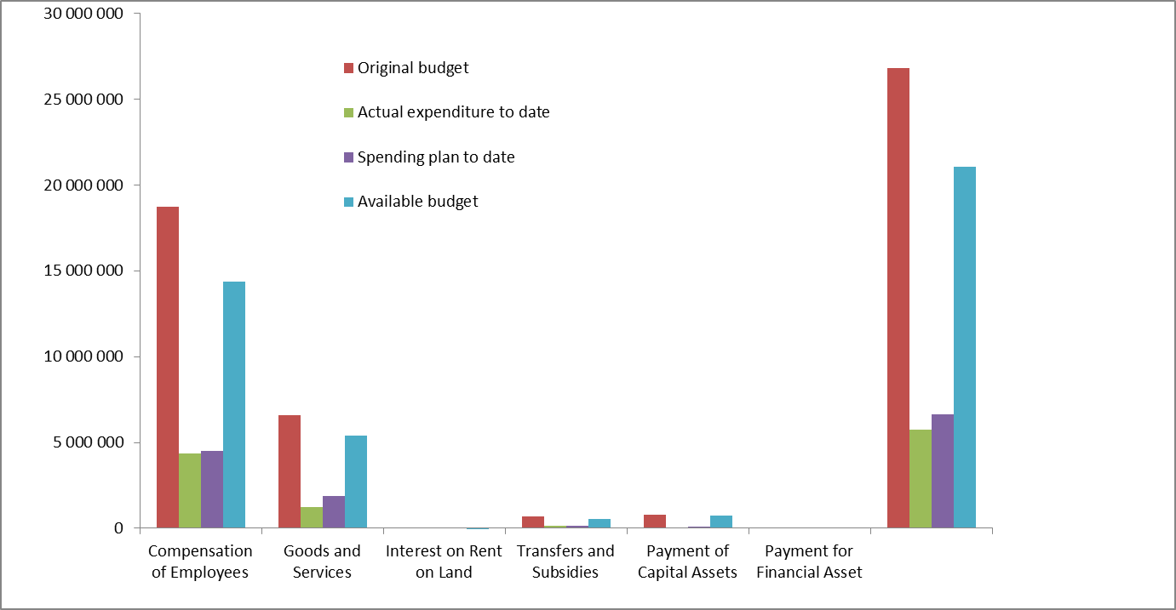
C. SUMMARY OF THE NATIONAL STATE OF EXPENDITURE PER ECONOMIC CLASSIFICATION FOR THE YEAR TO DATE:
30 JUNE 2020

Slide 70
C. SUMMARY OF THE NATIONAL STATE OF EXPENDITURE PER ECONOMIC CLASSIFICATION FOR THE YEAR TO DATE:
30 JUNE 2020
Compensation of Employees
The actual spending of R4,351 billion (23.23%) against the spending plan of R4,507 billion (24.06%) resulting in an underspending of R155 million due to delays of outstanding payments for 2020/21 financial year salary adjustment
The department enrolled 1 032 students in learnership programme in the previous financial year effective from 28 October 2019. These 1 032 learners were suppose to complete the learnership programme by end of October 2020 but due to suspension of experiential learning phase as a result of COVID-19, the completion date still needs to be reviewed
The National Commissioner approved 843 application of Early Retirement without penalisation of pension benefits in line with DPSA circular dated 25 February 2019. The estimated financial implications for 2019/20 was R 225,738 million and in March 2019 invoices of R95,993 million and R104,637 million were paid over to GEPF. In in this current financial year an estimated amount of R374,355 million will be paid over GEPF
OSD phase 2
The department has not yet finalised implementing OSD as per DBC resolution of 1 of 2016 which was signed on the 21 November 2016 for 23% in lieu of salary back pay for service termination cases. It is estimated that an amount of R81,906 million will be paid for OSD phase2

Slide 71
C. SUMMARY OF THE NATIONAL STATE OF EXPENDITURE PER ECONOMIC CLASSIFICATION FOR THE YEAR TO DATE:
30 JUNE 2020
Compensation of Employees (cont):
HRBP Tool and PERSAL
The Budget Committee resolved that Branch HR must clean up PERSAL so as to ensure a credible database for reconciliation with the HRBP tool. This project of aligning PERSAL to HRBP tool is anticipated to be finalised by 30 June 2020. The report from HR is still outstanding, follow-up is being made. The permanent funded establishment as published in 2020 ENE was reported to be 37,758 against permanent PERSAL establishment of 42,060 resulting in a variance of 4,302 posts
Hereunder is the analysis of filled and vacant posts as per HRBP tool and PERSAL as at 30 June 2020:
PERSAL reported a funded permanent establishment of 42,058 of which 37,878 are funded filled posts, 2,873 posts are filled additional to the funded establishment, mostly on entry level, resulting in a total PERSAL head count of 40,751, but leaving 4,180 vacant funded posts (9.94%)

Slide 72
C. SUMMARY OF THE NATIONAL STATE OF EXPENDITURE PER ECONOMIC CLASSIFICATION FOR THE YEAR TO DATE:
30 JUNE 2020
  Goods and Services:
  The actual spending of R1,211 billion (18.38%) against the spending plan of R1,897 billion (28.78%) resulting in an underspending of R686 million due to invoice for Municipal Services amounting to R75,827 million for the month of May 2020 which was received but not yet processed for payment. The other contributing factor was on item: Agency & support/outsourced services for PPP payments as the services up to 25 March 2020 were paid during March 2020
  The savings under PPP will be reprioritised to fund the estimated expenditure for COVID-19 for 2020/21 financial year for decontamination of correctional facilities
  Interest and Rent on Land: There was an expenditure of R552 thousand incurred against a zero budget mainly due to interest paid on arrears salary in Head Office under Programme Administration

Slide 73
C. SUMMARY OF THE NATIONAL STATE OF EXPENDITURE PER ECONOMIC CLASSIFICATION FOR THE YEAR TO DATE:
30 JUNE 2020
  Transfers and Subsidies:
  The actual spending of R133,805 million (20.10%) against the spending plan of R161,890 million (24.32%) resulting in an underspending of R28 million mainly on item: H/H: Employee Social Benefits as a result of invoice for April 2020 for GEMS which was paid in March 2020. The savings on GEMS will be utilised to fund the leave gratuity for early retirement without penalisation
  Payments for Capital Assets:
  The actual spending of R56 million (7.00%) against the spending plan of R80 million (9.90%) resulting in an underspending of R24 million mainly on item: Buildings and Other Fixed Structures was due to delays in processing invoices from DPW for Capital Works projects for June 2020. The other contributing factor is that the DCS infrastructure capital works projects approved do not align to the realistic spending plan

Slide 74
D. SUMMARY OF THE DEPARTMENTAL REVENUE FOR THE YEAR TO DATE: 30 JUNE 2020
In 2020/21 financial year, the actual revenue for 30 June 2020 is R24 million (16.35%) against the estimated revenue collection of R38 million (25.71%) resulting in under collection of R14 million mainly on Sale of goods and services other than capital assets; Fines, penalties and forfeits and Financial transactions in assets and liabilities
The department is mostly generating revenue from letting of accommodation facilities to personnel, selling of products made in correctional centres workshops and hiring out of offender labour
The offender labour also assist to supplement the budget for inmates’ gratuities

Slide 75
E. COVID-19 SUMMARY COVID-19 REGIONAL STATE OF EXPENDITURE PER ITEM LEVEL 4 FOR THE YEAR TO DATE: 30 JUNE 2020
Economic Classification:

Slide 76
E. COVID-19 SUMMARY COVID-19 REGIONAL STATE OF EXPENDITURE PER ITEM LEVEL 4 FOR THE YEAR TO DATE: 30 JUNE 2020
Economic Classification(cont):
There was an expenditure of R113,102 million mainly for provision of PPEs, leasing of quarantine/isolation sites, and medical supplies

Slide 77
E. COVID-19 SUMMARY COVID-19 REGIONAL STATE OF EXPENDITURE PER ITEM LEVEL 4 FOR THE YEAR TO DATE: 30 JUNE 2020
There was an expenditure of R56,381 million incurred mainly for provision of PPEs and leasing of quarantine/isolation sites

Slide 78
E. COVID-19 SUMMARY COVID-19 REGIONAL STATE OF EXPENDITURE PER ITEM LEVEL 4 FOR THE YEAR TO DATE: 30 JUNE 2020
There was an expenditure of R6,462 million incurred mainly for provision of PPEs and medical supplies

Slide 79
E. COVID-19 SUMMARY COVID-19 REGIONAL STATE OF EXPENDITURE PER ITEM LEVEL 4 FOR THE YEAR TO DATE: 30 JUNE 2020
There was an expenditure of R11,134 million incurred mainly for provision of PPEs and medical supplies

Slide 80
E. COVID-19 SUMMARY COVID-19 REGIONAL STATE OF EXPENDITURE PER ITEM LEVEL 4 FOR THE YEAR TO DATE: 30 JUNE 2020
There was an expenditure of R4,023 million incurred mainly for provision of PPEs and medical supplies

Slide 81
E. COVID-19 SUMMARY COVID-19 REGIONAL STATE OF EXPENDITURE PER ITEM LEVEL 4 FOR THE YEAR TO DATE: 30 JUNE 2020
There was an expenditure of R16,658 million incurred mainly for provision of PPEs and medical supplies

Slide 82
E. COVID-19 SUMMARY COVID-19 REGIONAL STATE OF EXPENDITURE PER ITEM LEVEL 4 FOR THE YEAR TO DATE: 30 JUNE 2020
There was an expenditure of R14,664 million incurred mainly for provision of PPEs and medical supplies

Slide 83
E. COVID-19 SUMMARY COVID-19 REGIONAL STATE OF EXPENDITURE PER ITEM LEVEL 4 FOR THE YEAR TO DATE: 30 JUNE 2020
There was an expenditure of R3,779 million incurred mainly for provision of PPEs

Slide 84
E. COVID-19 SUMMARY COVID-19 REGIONAL STATE OF EXPENDITURE PER ITEM LEVEL 4 FOR THE YEAR TO DATE: 30 JUNE 2020
The Department furthermore reviewed the cost containment financial circular no. 3 of 2017/18 with an Addendum no. 2 that provides sub-delegations for deviations and withdrawal of embargo on the procurement of machinery and equipment which was effective from 1 February 2019

Slide 85
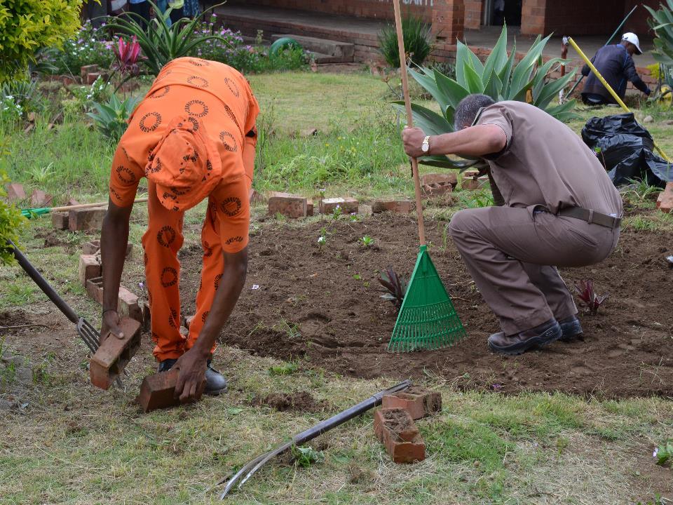
Department of Correctional Services (DCS)
Head Office: Correctional Services
124 WF Nkomo Street
WF Nkomo & Sophie De Bruyn Streets
Pretoria Central
Private Bag X136
Pretoria
0001
Website: http://www.dcs.gov.za

