Slide 1
SA POST OFFICE
Turnaround Plan and SASSA Cash Payments
Parliament Portfolio Committee on Communications
13 October 2020

Slide 2
Turnaround Plan
SASSA Grant Payments
SITA Collaboration

Slide 3
1.1 Introduction
SAPO has been severely impacted by the Covid-19 pandemic and lockdown measures – ravaged business that is dependent on physical customer presence and in-branch footprint across the economy
The return of customers to the branches has been slower than anticipated
Business operations are being normalised by clearing the accumulated backlogs
A key focus is placed on revenue retention and recovery to bring some financial stability in the short term
The high fixed costs are being addressed to lower operating costs in staff, transport, Security, Properties and Technology
The Turnaround Plan was approved on 31 July 2020
The plan responds to the business correction and recovery over the next 12 months
The Turnaround Plan will be integrated into the 2021/22FY Corporate Plan to revise the medium term outlook
The positioning of SAPO as an affordable, reliable Logistics and Delivery company of choice that will attract business from the higher Living Standards Measure (LSM)
Sustainability and relevance over the long term remains the key priority of the Turnaround Plan

Slide 4
1.2 Current environment
Lockdown regulations had a severe effect during Q1 on the SAPO trading environment, contributing to very low revenues and cash shortfalls with increased loss position.
SA Post Office’s cash flow position is severely constrained with increasing liabilities to creditors:
  Medical aid contributions,
  Pension fund contributions,
  Employee risk benefits contributions,
  SARS obligations
The above remains unpaid for the past 4 months and will remain unpaid pending financial assistance.
Non-payment of medical aid contributions could result in suspension of membership.
Non-payment of suppliers has in some cases already resulted in the interruptions of critical services and will continue to negatively impact on the ability to recover lost revenue and to move towards financial sustainability.
Payment of the monthly employee’s salaries has been prioritised over the lockdown period and still remains a priority despite the ongoing financial challenges.

Slide 5
1.2.1 Current Environment (Labour matters)
SAPO Management and the Board have been in discussions with labour on the delays in implementing the 2020/21FY substantive agreement of the multi-year collective agreement.
Although some issues have been implemented the key matter of salary increases from 1 April 2020 and outstanding medical and pension contributions that has not been paid to date.
Engagements with labour are still continuing to find workable solutions, in the interest of all parties, given the current financial challenges.
Maximum participation from both staff and management critical in revenue recovery

Slide 6
1.3 SAPO Challenges
  A sharp decline in the traditional mail volumes
  Customer seeking alternative ways of communications such as electronic mail and ecommerce
  Transport and logistics costs escalate daily within industry
  The cost of security is on the rise
  Property holding and maintenance cost escalations
  Sharp declines in revenues that are insufficient to meet operating costs
  High fixed costs in some areas of the organisation
  Customer loyalty can no longer be relied on
  The impacts of the Corona virus on operations and revenue
  The unbudgeted and high cost of Covid-19
  Very low staff morale
  Inability to honour binding agreements with staff
  Unsettled liabilities and debt are impacting business continuity
  Historic Leadership instability (currently being addressed):
    Full Board complement (only one vacancy)
    CFO appointed and CEO in final stages

Slide 7
1.4 Strategic Objectives
The following identified objectives are key to achieving the turnaround outcomes:
  Acquire funding so that all key initiatives are fully resourced.
  Reduce fixed costs comprehensively and finally.
  Eliminate organisational duplications and inefficiencies.
  Provide business opportunities to existing employees affected by cost reduction initiatives.
  Increase revenue growth and diversification by launching new products, services, and solutions through strategic partnerships.
  Improve the customer experience by responding to the real needs of customers
  Rebuild the brand to be trusted in the marketplace
  Total employee engagement at all levels

Slide 8
1.5 Transitioning the SAPO Business Model
Infrastructure Collaboration Model
  Launch an owner-managed branch model
  An owner-driver model to provide distribution services to the organisation and the market. Reduction in operating costs
2. Logistics Business Recapitalisation
  Establish strategic partnerships with willing investors to recapitalise and revive the organisation’s courier and logistics business segment.
  Consolidation of the Docex subsidiary as well as the Courier and Freight segments of the business. Scale up the Logistics business capability
3. Delivery on Demand
  Implement a delivery platform as an aggregator for owners of vehicles (Trucks, light commercial vehicles, and sedans) to undertake deliveries on demand. Greater delivery access and speed for customers
4. Digital Modernisation
  An Omni-channel (EAP) platform is currently in procurement and planned launch later this year.
  The Post Office is currently in the process to launch its e-Mall platform to the market.
  Monetise the large amounts of data that exist within the organisation, to mine existing data in compliance to privacy laws.
  Modernisation of the traditional Post Office and Relevance in the current age of technology.

Slide 9
1.5 Transitioning the SAPO Business Model
5. Cash Pay Point Model
  The social beneficiary payments at physical pay points is a significantly demanding operation.
  The SA Post Office is exploring partnering with industry experts to alleviate operational demands facing the organisation currently.
6. Government Business
  The Post Office has the largest footprint in the South Africa that provides greater access to all citizens.
  Use the Intergovernmental Relations Framework, Act (No. 13 of 2005) instead of the normal tender process. The Post Office commits to rendering an efficient service that will meet the expectations of citizens.
7. Partial exemption from PFMA prescripts
  Increasingly competitive environment requires organisational agility to ensure financial sustainability.
  Consider Revenue Share Partnerships to bring digital solutions and investments into the organisation
  Exemption from certain clauses of the Public Management Finance Act, no. 29 of 1999, to reduce the reliance on public funding by the entity

Slide 10
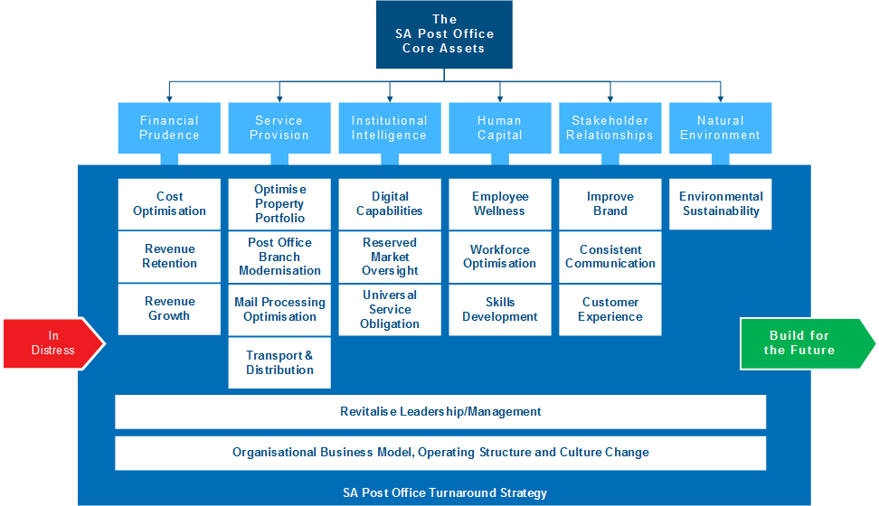
1.6 SAPO must create greater value
The prioritised initiatives will transition SAPO from distress to stability for growth

Slide 11
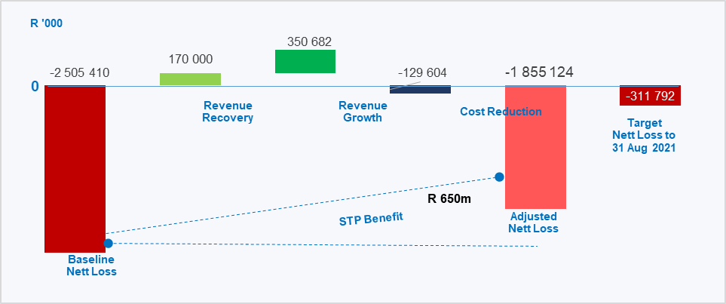
1.7 STP Financial Projection FY20/21
R650m benefit value from Turnaround initiatives for this FY to 31 March 2021
Reduction in net loss position to R312m projected to 31 August 2021

Slide 12
1.8 Baseline Revenue Recovery
Total Baseline revenues of R3.36bn forecasted for this year to March 2021
  Baseline revenues projected at R3.194bn
  Revenue recovery of R170m
    Motor Vehicle Licence – R30m
    RTIA – R50m
    Text book distribution – R20m
    Bulkmail – R50m
    Government Tenders (National & Provincial)– R20m

Slide 13
1.9 Revenue Growth - Partnerships
SAPO has embarked on revenue share partnerships which do not require the organisation to outlay upfront investment or funding.
Engagements with potential investors, those who have submitted solutions, are undergoing feasibility assessments (proof of concept).
It is anticipated that these strategic partnership engagements will strengthen and diversify revenue lines, stabilise the business and drive modernisation of the organisation.
In addition, funders are viewed as key partners to bridging finance and /or project financing and will implemented within the prescribed legislative framework.

Slide 14
1.10 Revenue Growth
Revenue growth of R351m from potential revenue share partnerships – currently in proof of concept phase
No.PO | Revenue Opportunity | Description
1 | Integrated Government Payment Platform Version 2 | Upgrade IGPS to version 2 and adopt and outsources service model for Infrastructure, Software, Support as a service.
2 | SAPO Data Centre Refresh (Towerco as a service revenue) | POC to Confirm the viability for the move of the data centre to a temporary Data centre and renovate the building and infrastructure to create an environment that can be leased to other companies to generate revenue for the Data centre services.
3 | Logistics Improvement | POC to demonstrate that the technology available can reduce cost to deliver items in the shortest possible time
4 | Insurance | Sales of insurance products to SAPO customers.
5 | Ecommerce | POC to provide an e-Commerce platform to enable SMME to trade. This will be based on a partnership model.
6 | Integration Gateway | POC to demonstrate the ability of multiple systems to interconnect with each other and offer new product and services
7 | TAX Advisory service | To review the current operational model and identify changes that can reduce the taxes paid.
8 | Money transfers | Revenue from eCommerce and money transfers
9 | Digital and static outdoor advertising solutions | Digital and static outdoor advertising solutions through buildings, billboards and other spaces
10 | Indoor advertising through HD televisions | Installation and Sales of digital space on TV
11 | SAPO - (e-Box Solution) E-mail for life | Proof of Concept (POC) and solution implementation with Road Traffic Infringement Agency (RTIA) and Gauteng Provincial Government (GPG) as test customer’s engagement in progress. Target date moved to end of July due to delays on both customers. Road Traffic Management Corporation (RTMC) is also coming on board. POC rollout focused for 1st week of August

Slide 15
1.10 Revenue Growth
No. | Revenue Opportunity | Description
12 | SAPO – Central Chronic Medicines Dispensing and Distribution (CCMDD) and National Health Insurance (NHI) | Warehouse specifications being negotiated. A bigger target of 18 million plus NHI customers is anticipated over the implementation period of this project in Q3 2020
13 | SAPO ( Bill Payment and Value Added Services (VAS) services solution | Partner ready to start with project as soon as properties and operations confirm the 9 branches. Branches not identified yet. City of Joburg (COJ) identified as a test customer for POC. POC in progress and first billing happened in week (08 – 12 June period) STBs with Wi-Fi capability are ready for testing once SAPO gives the green light. MOU and SLA was signed on 06/07/2020.
14 | SAPO -Set Top Boxes (STB) –Digital Terrestrial television (DTT) project for the unsubsidised market | STBs with Wi-Fi capability are ready for testing once SAPO gives the green light. MOU and SLA was signed on 06/07/2020.
15 | Cashless solutions and Unstructured Supplementary Service Data (USSD) | MOU and SLA was signed on 06/07/2020.
16 | DCDT – IDTV distribution | SAPO and USAASA to still finalise the outstanding SLA with the associated pricing for the rendering of the service and which will outline the accountability and responsibility of each Entity. The IDTV registration upload functionality was successfully deployed as the 1st phase into production on 31 July 2020. The initiative still in progress with 4172 registrations completed to date for qualifying matriculants.
17 | Sale of property | Karzane property sales
18 | Letting of property | Letting unutilised space
19 | Telkom recoveries (R37m rental/R18m utilities)

Slide 16
1.11 Cost Reduction
Cost Element | Benefit FY20/21 | Annual Benefit
Security & Guarding | R 17.2m
Transport Optimisation | R 17m
Staff cost optimisation | R 56.2m | R112m
Voluntary Severance Package (VSP)* | R70.1m | R 211m
Branch consolidation | R 15m | R 30m
Reduction of Property utilities by 10% | R8.4m | R16.8m
IT Network cost reduction | R10.9m | R 22m
Postbank software cost recovery | R18.2m | R18.2m
Notes *VSP Funding – R161m
Reposition grant payments in favour of payment at banks, in order to reduce dependency on cash pay points, thus reducing operating costs - including security and cash transit costs
Further key cost reduction in transport and fleet costs
Staff cost optimisation is critical to improve productivity and efficiency
Property and IT cost optimisation will realise better returns and digitisation of assets

Slide 17
1.12 Property Portfolio
SAPO have 641 company owned and 1120 leased buildings.
The value of SAPO owned properties is at R2,8bn
Key focus in the Property strategy:
  Refurbish and relocate back to our company owned buildings to save on rental cost.
  Increase rental income by renting out vacant buildings and excess space.
  Disposal of non-core properties to reduce holding and maintenance costs
  Re-development of some buildings
  Improve Building statutory Compliance.
  Rent out space for masts
  Maintenance limited to critical buildings due to funding deficit.

Slide 18
1.13 SSC Distributor Operator
Phase 0
Status quo
Phase 1
Onboarding of Courier drivers
Phase 2
Initial Ownership of Courier drivers
Phase 3
Multiple Ownership
Drivers: 455
Company Fleet: 1239
Onboarding of Regional Line haul drivers
Onboarding of local co-loading drivers
Implement 100% of Courier fleet to Driver Consortium
Implement 100% of RLH to Driver Consortium
Implement 50% of local routes to Driver Consortium

Slide 19
1.14 Programs of Work
10 Programs of Work to ensure Implementation of initiatives

Slide 20
1.15 Programs of Work
Program Name | Stage |  |  |  | Initiative | Benefits
Turnaround Funding | 1 | 2 |  |  | Improve financial sustainability Acquire R1.6bn & SASSA prefunding Evaluation and re-prioritisation of projects | Ensure business continuity and successful execution of programs
Customer experience | 1 | 2 | 3 | 4 | Focus on the customer experience and enhance marketing and Improve customer services, i.e. call centre services | Enhanced customer service standards
Cost Reduction | 1 | 2 | 3 |  | Improve financial sustainability. Prudently manage the organisation’s primary costs drivers. Reduce security costs for SASSA Dispose non-core properties Restructure/Terminate contracts (Sales, IT, SCM, Properties) | Reduced costs by R45m
Business Operations |  | 2 | 3 |  | Stabilise the organisation and improve productivity. Prioritise domestic and international parcel deliveries Increase mail automation Post Office and Mail network optimisation Rationalisation of the mail centres, depots Consolidation of infrastructure and functions | Increased service delivery standards
Revenue Generation | 1 | 2 | 3 |  | Strengthen the competitiveness of the organisation in the market Increase revenue growth and diversification by launching new products, services and solutions. | Increased revenue by R536m Revenue recovery of R170m

Slide 21
1.15 Programs of Work
Program Name | Stage |  |  |  | Initiative | Benefits
Workforce Optimisation | 1 | 2 | 3 | 4 | Organisational Change Voluntary Severance Package (Over 50) Provide business opportunities for employees Upskilling and training of employees Redeployment of staff Post-Retirement Medical Aid (PRMA) Reduction | Staff costs reduced by R211m pa.
Property Asset Optimisation |  |  | 3 | 4 | Increase rental revenue and decrease cost of non-core properties Repurpose properties to be productive assets | Increased asset utilisation, revenue growth and cost reduction
Organisational Restructuring |  | 2 | 3 | 4 | Eliminate organisational duplications and inefficiencies. Revise Business Model Rationalise support and back office services Owner Manged Branch Model Owner driver model Operator Licensing model EXCO Rationalisation | Efficient operating model
Stakeholder Engagement | 1 | 2 | 3 | 4 | Improve stakeholders relationships by the enhancing the Brand, customer services and marketing awareness | Updated & Informed Stakeholders
Transport & Distribution |  | 2 | 3 | 4 | Optimisation of fleet | Efficient Fleet &Improved service delivery

Slide 22
1.16 Critical Success Factors
The implementation of this turnaround program is underpinned by the following critical success factors:
Adequate funding to be made available to settle historical liabilities and fund the operations whilst the initiatives are being implemented.
Funding to support the revenue projects, cost optimisation and capital projects
Secure consistent and timeous prefunding and approval for the SASSA grant cash distribution
Program committees and management have the requisite delegation of authority to execute the portfolio of projects contained within the program.
Programs will be adequately resourced with the skillsets, staff and other tools deemed essential to executing the program.
The market situation will not deteriorate beyond the current economic situation.
There is sufficient stakeholder support to successful implement this turnaround program.
The statements of work submitted by divisional executives have been sufficiently assessed and planned, in conjunction divisional management teams, to produce the anticipated benefits articulated in this plan.
Procurement streamlining to provide sufficient visibility of the prioritised initiatives and mobilise a specialist procurement team to fast track the approvals of these specific initiatives, without compromising on the financial soundness of the initiative business cases.
An effective organisational change management program to mobilise employees for implementation

Slide 23
1.17 Opportunities and Challenges
Challenges
The delay in digitisation and modernisation of the post office to be relevant in the current market
The sustainability of SAPO without the strength of the Postbank assets and banking capabilities
The implementation of drastic actions to align SAPO’s cost base to its revenue
The correction of the business to reduce customer complaints especially on social media impacting the brand
Opportunities
The chance to innovate SAPO’s operating model and investing in digital solutions to match the change in market demand – Speed to implement projects
To improve performance by getting things done
A focus on the commercial principles of managing the business

Slide 24
2.1 SASSA Grant Payments - Overview
There is steady growth on the overall total for Postbank Social Disbursement Accounts (SDAs) at 1.61% for six the months to date (Mar20 – Aug20)

Slide 25
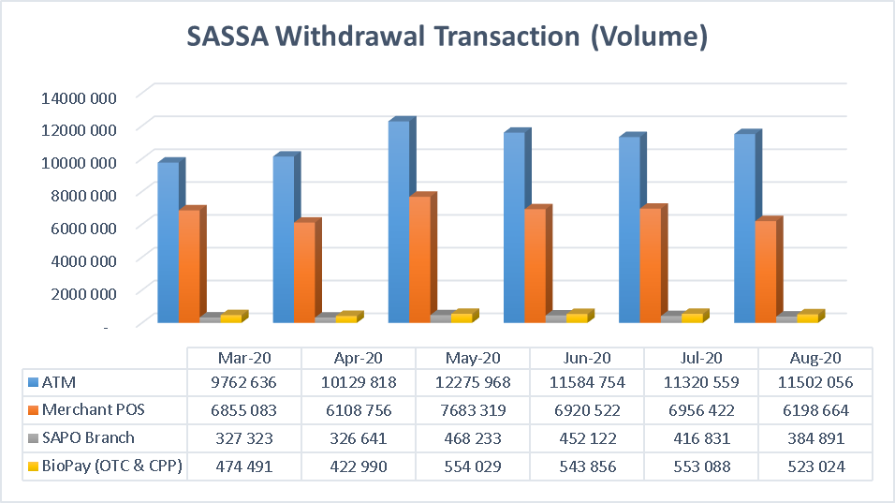
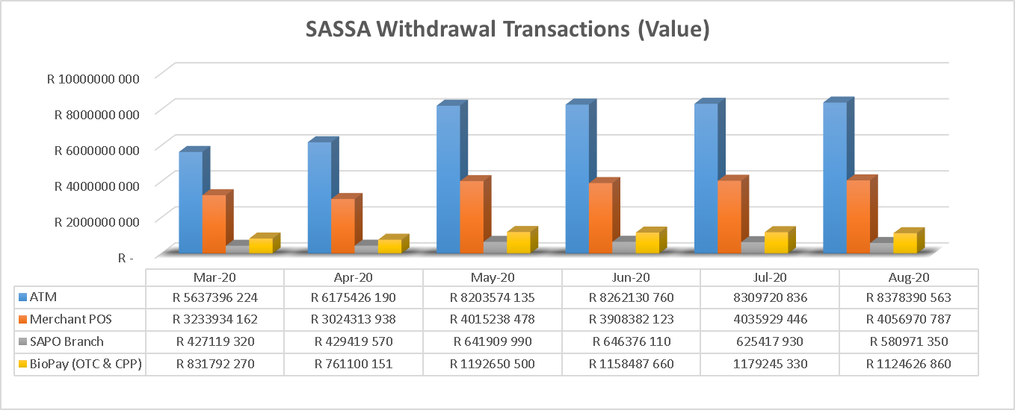
2.2 SASSA Grant Payments – Volume & Value
SASSA transaction withdrawals (Volume and Values) on SAPO platform across the different channels (for six months to date)

Slide 26
2.3 SASSA Grant Payments – Beneficiaries, CPPs & Routes
219 631 beneficiaries paid at Cash Pay Points in August 2020
1634 Cash Pay Points on 769 routes
Cash distribution costs remain very high

Slide 27


2.4 SASSA Grant Payments – SRD Grants
During July month SAPO continued paying out Covid19 SRD payments (R350).
Total of 3 284 166 beneficiary accounts were active and operational for SAPO to effect payments of grants into.
For the period 1st Aug – 14th Aug the sending of sms’s was halted by SASSA due to influx of beneficiaries at branches.
By the end of August 2020, 2 097 915 beneficiaries were paid, as compared to 1 773 102 in July; Cash values were R1 512 577 677 as compared to R766 884 142 in July 2020

Slide 28
2.5 SASSA Grant Payments – Challenges / Risks
Cash ordering and availability of cash at both Branches and Cash Pay Points - Prefunding being concluded.
Damages done to buildings that have been burgled - Properties to fast track the repairs to these buildings.
Armed Robberies at SAPO branches and CPPs –
  Armed robberies – 17 during August 2020
  Burglaries – 21 during August 2020
  CIT robberies – 2 during August 2020
  Security & Investigations has rated branches accordingly and deployed security guarding in line with that. At CPPs, Fidelity is to increase vigilance and act on intelligence information received.
Point of Sale hardware failure - Fast-track the replacement of hardware at branches - to improve services in branches.
Network connectivity – The network upgrade to all branches to be completed by mid November 2020.

Slide 29
3. SITA Collaboration
SAPO has approached SITA to leverage on their existing contracts with software companies
Pricing gains and cost reduction benefits for SAPO to utilise these transversal contracts
Other areas of collaboration being explored

Slide 30
The End
THANK YOU

