Slide 1
Budgetary Review and Recommendation Report (BRRR)
Portfolio Committee on Justice and
Correctional Services
07 October 2020

Slide 2
CONTENTS
contents
Introduction
Performance Overview 2019/20 and 2020/21 Quarter 1
Changes on the Strategic Plan and Annual Performance
Budget Expenditure
Personnel Related Matters
Infrastructure Performance
Internal Audit Findings Challenges
Corrective Measures to Turnaround the Department

Slide 3
DEPARTMENTAL PERFORMANCE: PROGRAMME 1
PERFORMANCE OVERVIEW
3

Slide 4
PERFORMANCE OVERVIEW
By the end of financial year under review, the Department achieved 57 out of 112 planned targets. This performance translated to 51% of the targets achieved.
DEPARTMENTAL PERFORMANCE: PROGRAMME 1
  The Department achieved 57 of the 112 planned targets in the Annual Performance Plan of 2019/20. The performance translated to 51% of targets being achieved.
  The progress on the implementation of the APP was monitored on a monthly and quarterly basis.
  The chart below depicts the performance of department per programme.
4

Slide 5
PERFORMANCE OVERVIEW
By the end of financial year under review, the Department achieved 57 out of 112 planned targets. This performance translated to 51% of the targets achieved.
DEPARTMENTAL PERFORMANCE: PROGRAMME 1
5

Slide 6
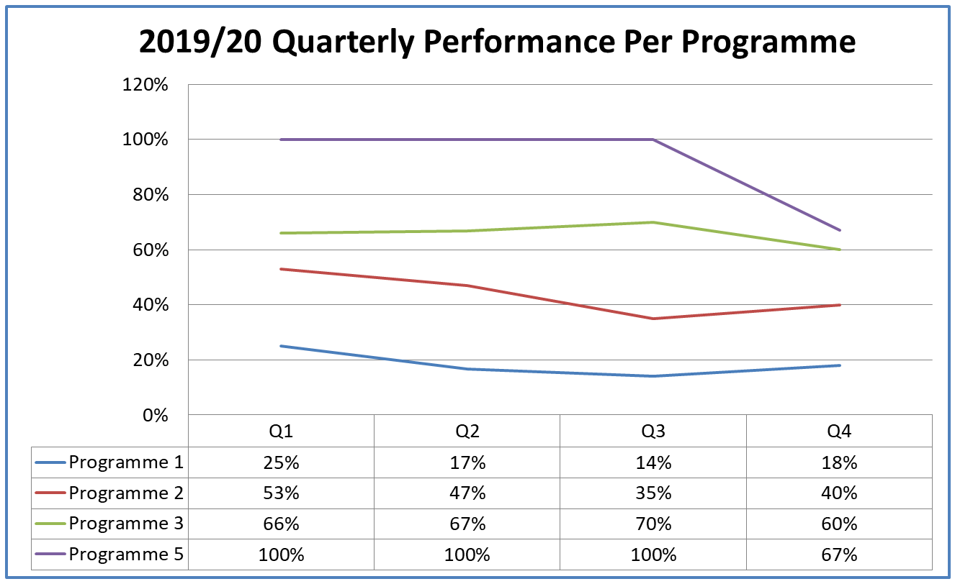
PERFORMANCE OVERVIEW
By the end of financial year under review, the Department achieved 57 out of 112 planned targets. This performance translated to 51% of the targets achieved.
DEPARTMENTAL PERFORMANCE: PROGRAMME 1
6

Slide 7
PERFORMANCE OVERVIEW
By the end of financial year under review, the Department achieved 57 out of 112 planned targets. This performance translated to 51% of the targets achieved.
DEPARTMENTAL PERFORMANCE: PROGRAMME 1
PROGRAMME 1 - 2 OUT OF 11 TARGETS ACHIEVED
Indicator description | Annual Target | Actual Output | Status
1.2 Tools to operationalise combined assurance model developed | Approved combined assurance framework | Combined assurance framework approved
2.1 Percentage of PAIA requests processed within 60 days | 96% | 96%
7

Slide 8
PERFORMANCE OVERVIEW
By the end of financial year under review, the Department achieved 57 out of 112 planned targets. This performance translated to 51% of the targets achieved.
DEPARTMENTAL PERFORMANCE: PROGRAMME 1
PROGRAMME 1 - 9 OUT OF 11 TARGETS NOT ACHIEVED
Indicator description | Annual Target | Actual Output | Status
1 Audit opinion on financial statements and predetermined objectives | Unqualified without significant findings: Vote, Guardian’s Fund, President’s Fund, predetermined objectives and TPF | Unqualified without significant findings: Guardian’s Fund, President’s Fund and TPF. Qualification: Predetermined objectives and Vote
1.1 Percentage of significant findings on key specific areas resolved | 100% | 71%
1.3 Percentage of undisputed and valid invoices paid within 30 days from date of receipt | 100% | 99%
2. Percentage compliance with PAIA by the department | 96% | 94%
2.2 Section 32 report submitted to SAHRC by target date | 31-Mar-20 | -
3 Number of priorities implemented to improve administrative capacity to deliver services | 3 | 0
3.1 Number of realigned organisational substructures | 5 Sub-Structures realigned | 2
3.2 Number of people appointed on internship and learnership programmes | 300 | 0
3.3 Repositioning Strategy on Justice College finalised by target date | Repositioning Strategy on Justice College finalised by 31 February 2020 | -
8

Slide 9
PERFORMANCE OVERVIEW
By the end of financial year under review, the Department achieved 57 out of 112 planned targets. This performance translated to 51% of the targets achieved.
DEPARTMENTAL PERFORMANCE: PROGRAMME 1
PROGRAMME 2 - 10 OUT OF 25 TARGETS ACHIEVED
Indicator description | Annual Target | Actual Output | Status
4.1 Percentage of criminal cases postponed due to unavailability of court administration staff | 0,3% | 0,2%
4.2 Percentage of child justice preliminary Inquiries finalised within 90 days after date of first appearance | 85% | 94%
5.2 Number of CCTV systems in regional courts upgraded | 12 | 28
5.3 Phase 2 of the Femicide Watch established, as required by Article 15 of the 2019 Presidential Summit Declaration against Gender-based Violence and Femicide by target date | 31-Mar-20 | Phase 2 of the Femicide Watch established
5.5 Percentage of pending sexual offences convictions approved in the ICMS NRSO by the Registrar NRSO | 100% | 100%
9

Slide 10
PERFORMANCE OVERVIEW
By the end of financial year under review, the Department achieved 57 out of 112 planned targets. This performance translated to 51% of the targets achieved.
DEPARTMENTAL PERFORMANCE: PROGRAMME 1
PROGRAMME 2 - 10 OUT OF 25 TARGETS ACHIEVED
Indicator description | Annual Target | Actual Output | Status
6 Number of children who benefitted from Family Law services | 25000 | 64032
6.1 Percentage of litigation matters finalised within 12 months from the date of opening the matter | 55% | 92%
6.2 Percentage of non-litigation matters finalised within 6 months from the date of opening the matter (mediation, conciliation and negotiations) | 60% | 92%
6.4 Percentage of maintenance matters finalised within 90 days from the date of proper service of process | 72% | 84%
8.2 Percentage of unopposed taxations processed within 14 working days from the date the matter is set down (district courts). | 98% | 98%
10

Slide 11
PERFORMANCE OVERVIEW
By the end of financial year under review, the Department achieved 57 out of 112 planned targets. This performance translated to 51% of the targets achieved.
DEPARTMENTAL PERFORMANCE: PROGRAMME 1
PROGRAMME 2 - 15 OUT OF 25 TARGETS NOT ACHIEVED
Indicator description | Annual Target | Actual Output | Status
4. Number of criminal cases on the backlog roll in lower courts | < 48 223 | 57049
4.3 Number of recorded criminal cases updated on ICMS criminal | <1800 | 6292
4.4 Number of magisterial districts and sub-districts with a supplier database of Foreign Language Interpreters | 25 | 0
5.1 Number of courts adapted in line with the Sexual Offences Court Model as required by Article 9 of the 2019 Presidential Summit Declaration against Gender-based Violence and Femicide. | 16 | 13
5.4 Percentage of Work in Progress (WIP) cases updated in the ICMS NRSO | 90% | 26%
6.3 Number of Family Advocate reports filed within 6 months from the date of opening the matter | 6500 | 4565
6.5 Number of litigation backlog matters finalised | 2000 | 599
11

Slide 12
PERFORMANCE OVERVIEW
By the end of financial year under review, the Department achieved 57 out of 112 planned targets. This performance translated to 51% of the targets achieved.
DEPARTMENTAL PERFORMANCE: PROGRAMME 1
PROGRAMME 2 - 15 OUT OF 25 TARGETS NOT ACHIEVED
Indicator description | Annual Target | Actual Output | Status
7.1 Number of new court buildings completed | 3 | 2
7.2 Number of courts where upgrading and extensions are completed | 6 | 3
8 Percentage of civil cases referred for mediated | 65% | 0%
8.1Number of courts proclaimed to provide court-annexed mediation | 34 | 0
9 Number of transformational policies developed | 3 | 0
9.1 Discussion document for the reform of the bail, arrest and expungement dispensation submitted to the Minister by 28 February 2020 | Submission of discussion document to the Minister by 28 February 2020 | -
9.2 Policy framework on community courts submitted to the Minister for approval by 28 February 2020 | Policy framework on community courts submitted to the Minister for approval by 28 February 2020 | -
9.3 Policy Framework on the choice of language in court proceedings submitted to Minister by 31/3/2020 | Policy on the choice of language in court proceedings submitted to Minister by 31 Mar-20 | -
12

Slide 13
PERFORMANCE OVERVIEW
By the end of financial year under review, the Department achieved 57 out of 112 planned targets. This performance translated to 51% of the targets achieved.
DEPARTMENTAL PERFORMANCE: PROGRAMME 1
PROGRAMME 3 - 27 OUT OF 45 TARGETS ACHIEVED
Indicator description | Annual Target | Actual Output | Status
10. Jurisdiction of Masters’ service points increased | PEAS rolled out to 10 service points MOVIT rolled out to 10 service points | PEAS rolled out to 12 service points MOVIT rolled out to 10 service points
10.4 Percentage of certificates of appointment issued in all bankruptcy matters within 10 days from receipt of all required documents | 91% | 92%
10.5 Percentage of liquidation and distribution accounts in bankruptcy matters examined within 15 days from receipt of all required documents | 93% | 96%
10.6Percentage of letters of authority issued in trusts within 14 days from receipt of all required documents | 85% | 85%
10.7 Percentage of new deceased estates registered on PEAS in the Master’s Offices | 95% | 99%
10.8 Percentage of letters of appointment issued in curatorship estates within 15 days from receipt of all required documents | 90% | 97%
10.9Percentage of Liquidation and Distribution Accounts in curatorship examined within 30 days from receipt of all required documents | 90% | 92%
13

Slide 14
PERFORMANCE OVERVIEW
By the end of financial year under review, the Department achieved 57 out of 112 planned targets. This performance translated to 51% of the targets achieved.
DEPARTMENTAL PERFORMANCE: PROGRAMME 1
PROGRAMME 3 - 27 OUT OF 45 TARGETS ACHIEVED
Indicator description | Annual Target | Actual Output | Status
11 Number of previously disadvantaged individual (PDI) advocates briefed | 1600 | 1971
12.2 Number of enrolled matters presented in High Court by State Attorney (applications and trials only) | 400 | 505
13 Percentage of legislative International Agreements scrutinised and laws certified OCSLA successfully challenged in court for constitutionality | 5% | -
13.1 Percentage of legal opinions finalised within 40 days from date of receipt of the instruction | 82% | 96%
13.2 Percentage of preliminary opinions on draft Bills and subordinate legislation completed within 40 days from date of receipt of the instruction | 82% | 91%
13.3 Percentage of suggested Bills and subordinate legislation finalised within 40 days from the date of receipt of the instruction | 82% | 94%
13.4 Percentage of international agreements and accompanying legal opinions finalised within 30 days from the date of receipt of the instruction | 85% | 88%
14

Slide 15
PERFORMANCE OVERVIEW
By the end of financial year under review, the Department achieved 57 out of 112 planned targets. This performance translated to 51% of the targets achieved.
DEPARTMENTAL PERFORMANCE: PROGRAMME 1
PROGRAMME 3 - 27 OUT OF 45 TARGETS ACHIEVED
Indicator description | Annual Target | Actual Output | Status
13.5 Percentage of draft Bills approved by Cabinet for introduction finalised within 40 days of receipt of the instruction | 82% | 100%
13.6 Percentage of translations finalised within 55 days from the date of receipt | 86% | 96%
14.2 Percentage of valid requests for extradition and mutual legal assistance in criminal matters processed and submitted to the central authority within 25 days of the date of receipt | 78% | 91%
14.3 Number of bilateral agreements on mutual legal assistance and Extradition negotiated | 2 | 7
15 Percentage of legislative instruments successfully challenged in court for constitutionality | <5% | -
15.1 Number of Bills and regulations submitted to the Minister for approval | 8 | 9
15.2 Number of research papers completed | 11 | 11
15.3 Number of court rules completed | 25 | 26
15

Slide 16
PERFORMANCE OVERVIEW
By the end of financial year under review, the Department achieved 57 out of 112 planned targets. This performance translated to 51% of the targets achieved.
DEPARTMENTAL PERFORMANCE: PROGRAMME 1
PROGRAMME 3 - 27 OUT OF 45 TARGETS ACHIEVED
Indicator description | Annual Target | Actual Output | Status
16.1 Number of awareness sessions on LGBTI rights conducted with communities and civil society organisations (including traditional and faith-based leaders) through various media platforms | 13 | 19
16.3 Number of training sessions on the Guide for Service Providers held with civil society organisations and public officials dealing with victims of hate crimes | 9 | 12
16.4 SADC Integrated information system to monitor the implementation of Trafficking in Person Act (TIP Act) implemented | Report generated on the implementation of the SADC Integrated information system | Completed the report and data collected using SADC tool
17.1 Number of sustained and visible anti-xenophobia campaigns conducted in collaboration with other departments and role-players. | 6 | 6
17.4 Policy framework for the regulation and recognition of community-based advise office sector and community based paralegals in South Africa finalised by target date | Policy framework finalised by 31 March 2020 | Policy framework finalised
16

Slide 17
PERFORMANCE OVERVIEW
By the end of financial year under review, the Department achieved 57 out of 112 planned targets. This performance translated to 51% of the targets achieved.
DEPARTMENTAL PERFORMANCE: PROGRAMME 1
PROGRAMME 3 - 18 OUT OF 45 TARGETS NOT ACHIEVED
Indicator description | Annual Target | Actual Output | Status
10.1 Percentage of letters of appointment issued in deceased estates within 15 days from receipt of all required documents | 92% | 91%
10.2 Percentage of liquidation and distribution accounts in large estates (>R250 000) examined within 15 days from receipt of all required documents | 91% | 90%
10.3 Percentage of beneficiaries in receipt of services within 40 days from receipt of all required documents (Guardian’s Fund) | 92% | 88%
10.10 Insolvency Policy submitted to the Minster for approval by target date | Insolvency Policy submitted to the Minister for approval by 30 March 2020 | -
11.1 Percentage of rand value of briefs allocated to PDIs | 83% | 82%
11.2 Percentage of number of briefs allocated to female counsel | 29% | 27%
11.3 Percentage of briefs allocated to female counsel | 41% | 39%
17

Slide 18
PERFORMANCE OVERVIEW
By the end of financial year under review, the Department achieved 57 out of 112 planned targets. This performance translated to 51% of the targets achieved.
DEPARTMENTAL PERFORMANCE: PROGRAMME 1
PROGRAMME 3 - 18 OUT OF 45 TARGETS NOT ACHIEVED
Indicator description | Annual Target | Actual Output | Status
12 Percentage reduction in legal cost paid by the state | 5% | 13% increase
12.1 Percentage reduction in capital amount claimed in medical negligence, unlawful arrest and detention claims | 97% | 65%
12.3 Percentage of litigation cases settled | 65% | 57%
14 Percentage compliance with treaties and international obligations | 85% | 63%
14.1 Number of Treaty reports tabled with DIRCO for submission to treaty bodies | 2 | 0
15.4 Project plan for repeal of apartheid era legislation approved by the Minister by target | By 31 March 2020 | -
16.2 Number of progress reports submitted to the National Task Team on the handling of reported LGBTI Hate Crime cases | 12 | 11
18

Slide 19
PERFORMANCE OVERVIEW
By the end of financial year under review, the Department achieved 57 out of 112 planned targets. This performance translated to 51% of the targets achieved.
DEPARTMENTAL PERFORMANCE: PROGRAMME 1
PROGRAMME 3 - 18 OUT OF 45 TARGETS NOT ACHIEVED
Indicator description | Annual Target | Actual Output | Status
17 Number of targets in the implementation plan of the Cabinet approved National Action Plan to combat racism, racial discrimination, Xenophobia and related intolerance implemented | 3 key initiatives implemented | 1 initiative implemented
17.2 An integrated government strategy on public education pertaining to anti-discrimination developed in line with the NAP by target date | By 31 March 2020 | -
17.3 Terms of reference for a governance structure for the implementation of the National Action Plan to Combat Racism, Racial Discrimination, Xenophobia and Related Intolerance approved by target date | By 31 March 2020 | -
18.1 Number of community projects signed off for the launch in line with the TRC recommendations | 5 | 0
19

Slide 20
PERFORMANCE OVERVIEW
By the end of financial year under review, the Department achieved 57 out of 112 planned targets. This performance translated to 51% of the targets achieved.
DEPARTMENTAL PERFORMANCE: PROGRAMME 1
PROGRAMME 5 - 2 OUT OF 3 TARGETS ACHIEVED
Indicator description | Annual Target | Actual Output | Status
22.2 Number of Integrated Justice System departmental applications that form part of the integrated Test Lab process | 9 | 9
22.3 Number of branches / sites / service centres of government departments and entities where Person Verification Services deployed | 280 | 684
20

Slide 21
PERFORMANCE OVERVIEW
By the end of financial year under review, the Department achieved 57 out of 112 planned targets. This performance translated to 51% of the targets achieved.
DEPARTMENTAL PERFORMANCE: PROGRAMME 1
PROGRAMME 5 - 1 OUT OF 3 TARGETS NOT ACHIEVED
Indicator description | Annual Target | Actual Output | Status
22.1 Number of government departments and entities exchanging information electronically | 9 | 8
21

Slide 22
By the end of financial year under review, the Department achieved 57 out of 112 planned targets. This performance translated to 51% of the targets achieved.
2020/21 QUARTER 1
DEPARTMENTAL PERFORMANCE: PROGRAMME 1
  During the quarter under review, the Department achieved 32 targets against a total of
  71 planned targets for the quarter. This performance translated to 45% of the targets
  achieved.
22

Slide 23
By the end of financial year under review, the Department achieved 57 out of 112 planned targets. This performance translated to 51% of the targets achieved.
2020/21 QUARTER 1
DEPARTMENTAL PERFORMANCE: PROGRAMME 1
PROGRAMME 1- REASON FOR UNDERPERFORMANCE
Output Indicator |  | Quarter 1 Target as per APP | Quarter 1 Actual Output | Reason for Deviation | Corrective Measures
Outcome 1: Improved governance and accountability
1.2.1 | Percentage of reported incidents of corruption resolved through the departmental Disciplinary Code and Procedure for the Public Service | 75% | 0% | Data not available | By end of August 2020, 2 active cases were recorded, however are not yet resolved.
1.3.1 | Percentage of total MMS posts occupied by Africans and women | 62% Africans | 80% Africans | Due to Covid-19 lockdown, in the first quarter, there was no recruitment process conducted. | This target was revised to 59% Africans and 46% respectively. A total of 290 officials occupied MMS posts in the Department, 232 out of 290 (80%) were African while 132 out 290 (46%) were women by end of August 2020.
 |  | 47.3% Women | 46% Women
23

Slide 24
By the end of financial year under review, the Department achieved 57 out of 112 planned targets. This performance translated to 51% of the targets achieved.
2020/21 QUARTER 1
DEPARTMENTAL PERFORMANCE: PROGRAMME 1
PROGRAMME 1 - REASON FOR UNDERPERFORMANCE
Output Indicator |  | Quarter 1 Target as per APP | Quarter 1 Actual Output | Reason for Deviation | Corrective Measures
Outcome 1: Improved governance and accountability
1.6.1 | Department’s reconfigured macro structure finalised by target date | Research | The research is not yet conducted. | There was a delay in the implementation of the project scope. | Preparation and consultation have commenced in the 1st quarter with stake holders and unions. The project to commence in the second quarter.
1.7.1 | Number of people trained in line with workplace skills plan | 1 000 | 0 | National Lockdown and restriction measures in place prohibited training | Training will commence when restriction measures are relaxed
24

Slide 25
By the end of financial year under review, the Department achieved 57 out of 112 planned targets. This performance translated to 51% of the targets achieved.
2020/21 QUARTER 1
DEPARTMENTAL PERFORMANCE: PROGRAMME 1
PROGRAMME 2 - REASON FOR UNDERPERFORMANCE
Output Indicator |  | Quarter 1 Target as per APP |  |  | Quarter 1 Actual Output | Reason for Deviation | Corrective Measures
Outcome 2: Modernised, accessible courts and people-centred services
2.2.1 | Number of Audio-Visual Remand Systems rolled out |  | 2 | 0 |  | Due to COVID-19 target was not met, however the quarterly targets were revised to be delivered in second to fourth quarter. | The terms of reference was drafted for National Steering Committee . Two planning meetings were held for National Steering Committee for the further roll out of AVR.
2.8.1 | Number of Sexual Offences Court designated in terms of section 55(A) the Criminal Law (Sexual Offences and Related Matters) Amendment Act, 2007 |  | 5 | 0 |  | The consultation with relevant stakeholders at regional level was delayed due to COVID 19 lockdown regulations. | The process for consultation with key stakeholders is underway to agree on the courts to be designated.
2.10.1 | Number of facilities with term contracts for unplanned maintenance |  | 5 | 0 |  | There were delays from SCM to invite bid specification and bid evaluation committee members for term contract | The appointment of Bid Committees members for implementation of term contract in progress. The target was revised due to COVID risk adjusted plan fourth quarter.
25

Slide 26
By the end of financial year under review, the Department achieved 57 out of 112 planned targets. This performance translated to 51% of the targets achieved.
2020/21 QUARTER 1
DEPARTMENTAL PERFORMANCE: PROGRAMME 1
PROGRAMME 2 - REASON FOR UNDERPERFORMANCE
Output Indicator |  | Quarter 1 Target as per APP | Quarter 1 Actual Output | Reason for Deviation | Corrective Measures
Outcome 2: Modernised, accessible courts and people-centred services
2.12.1 | Percentage of family litigation matters finalised within 12 months from the date of opening the matter | 82% | 0% | Data unavailable due to system challenges | Data was extracted from ICMS system for the respective sub-offices of the office of the Family Advocate to conduct verification against all the physical files to ensure accuracy and completeness. The verification project is expected to be finalised end September 2020.
2.13.1 | Percentage of family non-litigation matters finalised within 6 months from the date of opening the matter | 62% | 0%
2.14.1. | Percentage of maintenance matters finalised within 90 days from the date of proper service of process | 75% | 0% |  | The system challenges were resolved with SITA, the report was extracted. By the end August 2020, 4 173 out of 4 448 maintenance matters finalised within 90 days, this translated 94%. The target on track.
26

Slide 27
By the end of financial year under review, the Department achieved 57 out of 112 planned targets. This performance translated to 51% of the targets achieved.
2020/21 QUARTER 1
DEPARTMENTAL PERFORMANCE: PROGRAMME 1
PROGRAMME 2 – REASON FOR UNDERPERFORMANCE
Output Indicator |  | Quarter 1 Target as per APP | Quarter 1 Actual Output | Reason for Deviation | Corrective Measures
Outcome 2: Modernised, accessible courts and people-centred services
2.15.1 | Terms of Reference and Policy Framework for the review of the Criminal Procedure Act developed | Develop the Terms of Reference | - | The consultation on Terms of Reference was a lengthy process hence target was not met. | The finalisation of terms of reference will be prioritised.
2.16.1 | Terms of Reference and Policy Framework developed for the review of the Civil Justice System Developed by target date | Develop the Terms of reference | -
27

Slide 28
By the end of financial year under review, the Department achieved 57 out of 112 planned targets. This performance translated to 51% of the targets achieved.
2020/21 QUARTER 1
DEPARTMENTAL PERFORMANCE: PROGRAMME 1
PROGRAMME 2 - REASON FOR UNDERPERFORMANCE
Output Indicator |  | Quarter 1 Target as per APP | Quarter 1 Actual Output | Reason for Deviation | Corrective Measures
Outcome 7: Crime and corruption significantly reduced through effective prosecution
7.2.1 | Number of dedicated specialised Commercial Crimes Courts established in five provinces (Limpopo, North West, Eastern Cape, Mpumalanga and Free state) | Consultation with stakeholders | Consultation held with National Prosecuting Authority. Concept Note provided by NPA | Due to the Covid-19 Lockdown there were limited engagements. | A National SCCC Steering Committee and a Technical Sub-Committee was established on 24 August 2020. All regional heads and regional court presidents were asked for inputs so that the SCCC Project Framework Plan can be finalised.
28

Slide 29
By the end of financial year under review, the Department achieved 57 out of 112 planned targets. This performance translated to 51% of the targets achieved.
2020/21 QUARTER 1
DEPARTMENTAL PERFORMANCE: PROGRAMME 1
PROGRAMME 3 - REASON FOR UNDERPERFORMANCE
Output Indicator |  | Quarter 1 Target as per APP |  | Quarter 1 Actual Output | Reason for Deviation | Corrective Measures
Outcome 3: Transformed Masters Services
3.7.1 | Percentage of letters of authority issued in trusts within 14 days from receipt of all required documents |  | 75% | 68% | Due to lockdown restriction and rotation of staff | The target was revised considering the effect of lockdown restriction
3.9.1 | Percentage of liquidation and distribution accounts in curatorship estates examined within 30 days from receipt of all required documents |  | 81% | 75% | Due to lockdown restriction and rotation of staff | The target was revised considering the effect of lockdown restriction
3.10.1 | Deceased Estates Back-Office administration ICT solution implemented at Masters offices by target date |  | Analysis and design completed. | ISM and OCM in process of analysing existing back office system capabilities | Due to lockdown restriction and rotation of staff | The indicator was removed due to COVID risks adjusted plan.
29

Slide 30
2020/21 QUARTER 1
By the end of financial year under review, the Department achieved 57 out of 112 planned targets. This performance translated to 51% of the targets achieved.
DEPARTMENTAL PERFORMANCE: PROGRAMME 1
PROGRAMME 3 - REASON FOR UNDER-PERFORMANCE
Output Indicator |  | Quarter 1 Target as per APP | Quarter 1 Actual Output | Reason for Deviation | Corrective Measures
Outcome 4: Colonial/Apartheid era justice-related legislation reviewed and repealed/replace
4.1.1 | Number of Bills and Regulations submitted to the Minister for approval | 2 | - | Consultation with stakeholders extended and lockdown restriction. | Target on track. By the end of August, 5 Bills and Regulations submitted to the Minister for approval
4.4.1 | Number of research papers submitted to the South African Law Reform Commission for approval | 4 | 0 | Due to the researchers did not have the virtual meeting facilities to enable them to convene virtual meeting of advisory committees. | The facilities were only installed at the end of June and early July. The meeting with commissioners is expected to take place in September 2020 to consider the research papers for approval.
30

Slide 31
By the end of financial year under review, the Department achieved 57 out of 112 planned targets. This performance translated to 51% of the targets achieved.
2020/21 QUARTER 1
DEPARTMENTAL PERFORMANCE: PROGRAMME 1
PROGRAMME 3 - REASON FOR UNDERPERFORMANCE
Output Indicator |  | Quarter 1 Target as per APP | Quarter 1 Actual Output | Reason for Deviation | Corrective Measures
Outcome 5: Transformed State Litigation Services and the legal profession
5.3.1 | Percentage of value of briefs allocated to PDI’s counsel | 83% | 81% | Due to COVID-19 lockdown restrictions during the first quarter had a negative impact in the processing of payments. | The department continues to process the payments to ensure that target is met.
5.4.1 | Percentage of value of briefs allocated to female counsel | 29% | 22%
5.5.1 | Policy guideline on the conferral of Senior Counsel status submitted to the Minister for approval by target date | Drafting of guideline | - | Annual target
5.6.1 | State Attorney Framework contract approved by Cabinet by target date | Consultation of the draft framework | - | Annual target
31

Slide 32
By the end of financial year under review, the Department achieved 57 out of 112 planned targets. This performance translated to 51% of the targets achieved.
2020/21 QUARTER 1
DEPARTMENTAL PERFORMANCE: PROGRAMME 1
PROGRAMME 3 - REASON FOR UNDERPERFORMANCE
Output Indicator |  | Quarter 1 Target as per APP | Quarter 1 Actual Output | Reason for Deviation | Corrective Measures
Outcome 5: Transformed State Litigation Services and the legal profession
5.8.1 | Percentage of High Court matters insourced. | 10% | 0% | Due to impact of covid-19 as state attorney offices attended to urgent matters only | Progress will be continuously monitored
5.14.1 | Percentage of international agreements and accompanying legal opinions finalised within 40 days from the date of receipt of the instruction | 85% | 58% | The first stages of lockdown, affected smooth running of the office. More focus was placed on the lockdown regulations and directions which were supposed to be issued on urgent basis. | Teams have been redesigned in such way that one team is responsible for lockdown regulations and directions whilst the other team members are focusing on the core function of the office.
32

Slide 33
By the end of financial year under review, the Department achieved 57 out of 112 planned targets. This performance translated to 51% of the targets achieved.
2020/21 QUARTER 1
DEPARTMENTAL PERFORMANCE: PROGRAMME 1
PROGRAMME 3 - REASON FOR UNDERPERFORMANCE
Output Indicator |  | Quarter 1 Target as per APP | Quarter 1 Actual Output | Reason for Deviation | Corrective Measures
Outcome 6: Advancement of constitutionalism, human rights and the rule of law
6.1.1 | Number of activities in the NAP Programme of Action applicable to DoJ&CD implemented | 2 | - | The current Covid-19 pandemic impacted on the achievement of the target. All officials of the directorate were in self isolation from 15-29 June 2020. | Progress will be continuously monitored.
6.2.1 | Governance structure to lead and coordinate the implementation of NAP established | Cabinet approval of the Terms of Reference of the NAP governance structure | NAP Ministerial memo was submitted for approval of Terms of Reference for NAP Governance structure | The current Covid-19 pandemic impacted on the achievement of the target. All officials of the directorate were in self isolation from 15-29 June 2020. | The co-chairperson to be reminded to schedule a date for the IGS meeting & Secure a date with the co-chairperson of the Interim Governance Structure (IGS) for the next IGS meetings.
33

Slide 34
By the end of financial year under review, the Department achieved 57 out of 112 planned targets. This performance translated to 51% of the targets achieved.
2020/21 QUARTER 1
DEPARTMENTAL PERFORMANCE: PROGRAMME 1
PROGRAMME 3 - REASON FOR UNDERPERFORMANCE
Output Indicator |  | Quarter 1 Target as per APP | Quarter 1 Actual Output | Reason for Deviation | Corrective Measures
Outcome 6: Advancement of constitutionalism, human rights and the rule of law
6.3.1 | Number of anti-xenophobia campaigns conducted in collaboration with other departments and role-players. | 3 | 2 | The current Covid-19 pandemic impacted on the achievement of the target. All officials of the directorate were still under levels 5 | The Directorate to procure electronic devices to be used during virtual platforms for meetings and the implementation of other activities.
6.4.1 | Number of awareness sessions on vulnerable groups conducted (LGBTI rights, women, people with disabilities and children) | 3 | 0 | No awareness sessions conducted due to covid-19 restrictions. | Alternative communication such as community radio station interviews, local weekly community newspapers, social media will be utilised
34

Slide 35
By the end of financial year under review, the Department achieved 57 out of 112 planned targets. This performance translated to 51% of the targets achieved.
2020/21 QUARTER 1
DEPARTMENTAL PERFORMANCE: PROGRAMME 1
PROGRAMME 3 - REASON FOR UNDERPERFORMANCE
Output Indicator |  | Quarter 1 Target as per APP | Quarter 1 Actual Output | Reason for Deviation | Corrective Measures
Outcome 6: Advancement of constitutionalism, human rights and the rule of law
6.5.1 | Number of phases of the development of a trafficking persons intersectoral integrated data collection system developed in terms of legislation: Prevention and Combating of Trafficking in Persons Act, Act 7 of 2013 | Phase 1: establishment of an intersectoral data committee Phase 2: investigation on available data from various stakeholders: Phase 3: develop a collection tool to close gaps in available data | - | Due to lockdown Covid-19 epidemic no activities were completed in the first quarter. | Various media platforms are been considered to complete the planned activities.
35

Slide 36
By the end of financial year under review, the Department achieved 57 out of 112 planned targets. This performance translated to 51% of the targets achieved.
2020/21 QUARTER 1
PROGRAMME 3 - REASON FOR UNDERPERFORMANCE
Output Indicator |  | Quarter 1 Target as per APP | Quarter 1 Actual Output | Reason for Deviation | Corrective Measures
Outcome 6: Advancement of constitutionalism, human rights and the rule of law
6.6.1 | Number of Trafficking in Persons campaigns conducted in collaboration with other departments and role-players | 1 | 0 | Due to lockdown Covid-19 epidemic no activities were completed in the first quarter. | Various media platforms are been considered to complete the planned activities.
6.11.1 | Percentage of valid requests for extradition and mutual legal assistance processed and submitted to the Central Authority (DG) within 25 working days from receipt. | 80% | 75% | Target was not met due to lockdown restrictions. | Performance will be closely monitored
36

Slide 37
DEPARTMENTAL PERFORMANCE: PROGRAMME 1
CHANGES ON THE STRATEGIC PLAN AND ANNUAL PERFORMANCE
37

Slide 38
CHANGES ON THE PLANS
By the end of financial year under review, the Department achieved 57 out of 112 planned targets. This performance translated to 51% of the targets achieved.
DEPARTMENTAL PERFORMANCE: PROGRAMME 1
Strategic Plan
The naming of Outcome 1 “Governance and accountability” has been revised to “Improved capability and capacity for the Department and Good Governance”.
Accompanying indicators and targets for Outcome 1 were not amended.
Outcome 2 was split into two new outcomes in order to ensure that modernisation and the digitisation of justice services is a stand alone Outcome.
The split of Outcome 2 resulted in the new outcomes listed below.
    Outcome 2: Modernised and digitised justice services platforms
    Outcome 3: Increased access to justice services.
Outcome indicators and the accompanying targets for the newly developed outcome are listed on next slide.
Strategic Plan Page 28
38

Slide 39
CHANGES ON THE PLANS
By the end of financial year under review, the Department achieved 57 out of 112 planned targets. This performance translated to 51% of the targets achieved.
DEPARTMENTAL PERFORMANCE: PROGRAMME 1
Strategic Plan
The outcome indicators 2a. was changed from “Number of services provided through e-channel platforms to increase accessibility to justice services” to Number of services provided through virtual platforms to increase accessibility to justice services
The accompanying 5 year targets for the outcome indicator are as follows:
Six (6) virtual platforms :
Three (3) online applications (electronically filing of Justice services):
  Online Masters Services (Deceased Estates and Trusts) Services available on DoJ&CD;
  Online Family law services (maintenance) available on DoJ&CD internet;
  Domestic violence and harassment order applications available on DoJ&CD internet.
Three (3) Virtual services:
  Audiovisual Remand system rolled out in 60 courts;
  Audio-visual Solution (CAVS) rolled out in 50 sites; and
  Virtual Court hearings.
Strategic Plan Page 28
39

Slide 40
CHANGES ON THE PLANS
By the end of financial year under review, the Department achieved 57 out of 112 planned targets. This performance translated to 51% of the targets achieved.
DEPARTMENTAL PERFORMANCE: PROGRAMME 1
Strategic Plan
Outcome indicator “Number of Master’s services modernized” was moved to Outcome 2 which deals with the digitization
Outcome 6 Transformed State Litigation service was and legal profession was slit into two, namely:
Outcome 6 Transformed State Litigation Services
Outcome 7: Transformed Legal Profession
The accompanying indicator for the newly developed Outcome 7 as the following:
  Percentage of Senior Counsels representing blacks and female legal practitioners in line with the Policy Guideline on the conferral od Senior Counsel;
  Office of the legal Ombud established;
  Number of Regulations developed in line with the Legal Practice Act Approved by the Minister;
  The Outcome “Criminal justice system digitized and integrated was removed”. Outcome indicators that use to fall under this were moved to newly developed Outcome 2.
Strategic Plan Page 28
40

Slide 41
CHANGES ON THE PLANS
By the end of financial year under review, the Department achieved 57 out of 112 planned targets. This performance translated to 51% of the targets achieved.
DEPARTMENTAL PERFORMANCE: PROGRAMME 1
Annual Performance Plan
Indicators removed from the APP
Programme 1
2.1.1 A call centre for complaints management operation by target date
Programme 2
2.18.1 Number of magisterial districts and sub-districts with a supplier database of Foreign Language Interpreters.
Programme 3
3.4.1 Number of service points where PEAS and Masters’ Own Verification Technology (MOVIT) were rolled out (excluding 15 Masters’ offices)
Programme 5
8.1.1 Number of sites of government departments and entities where Person Verification Services are deployed
41

Slide 42
CHANGES ON THE PLANS
By the end of financial year under review, the Department achieved 57 out of 112 planned targets. This performance translated to 51% of the targets achieved.
DEPARTMENTAL PERFORMANCE: PROGRAMME 1
Annual Performance Plan
5 new indicators were introduced on the revised APP:
There is indicator introduced under Outcome 1 : “1.10 Covid-19 Risk adjusted plan implementation report’
There were 3 new indicators introduced under Outcome 2: Mordenised and digitised justice services platforms. The new indicators are listed below:
  2. 1.2 Number of sites where Cashless Court Solution (CCS) is deployed
  2.1.3 E-Submissions solution deployed by target date
  2.1.4 Number of sites where Virtual Platforms Solution (VPS) (Video Conferencing) deployed.
Only one new indicator was introduced under Outcome 3. The indicator aims to track progress relating to finalisation of backlog cases that are on the priority roll. Below is the new indicator introduced.
  2.14.1 Percentage of backlog cases on the priority roll finalised
APP on Pages 17-18 , 26 and 29
42

Slide 43
CHANGES ON THE PLANS
By the end of financial year under review, the Department achieved 57 out of 112 planned targets. This performance translated to 51% of the targets achieved.
DEPARTMENTAL PERFORMANCE: PROGRAMME 1
Annual Performance Plan
PROGRAMME 1
Outcome 1: Increased capability and capacity of the department and good governance
Indicators | Target | Revised target
1.3.1 Percentage of MMS posts occupied by Africans and women | 59% Africans 46% Women | 59% Africans 46% Women
1.4.1 Percentage of total workforce positions occupied by people with disability | 3 | 2.2
Outcome 1: Increased capability and capacity of the department and good governance
Indicators | Target | Revised target
2.1.1 Number of sites where audio visual remand system is rolled out | 10 | 18
APP on Pages 12 and 15
43

Slide 44
CHANGES ON THE PLANS
By the end of financial year under review, the Department achieved 57 out of 112 planned targets. This performance translated to 51% of the targets achieved.
DEPARTMENTAL PERFORMANCE: PROGRAMME 1
Annual Performance Plan
PROGRAMME 2: COURT SERVICES
Outcome 3: Increased access to justice services
Indicators | Target | Revised target
3.1.1 Phases of the Femicide Watch established as required by Article 15 of the Presidential summit declaration against GBVF,2019 | Phase 3 of the Femicide Watch established by 31 March 2021 (Femicide Watch report published) | Phase 3 (femicide Watch Dashboard report adopted by stakeholders by 31 March 2021
3.3.1 Percentage of criminal cases postponed due to unavailability of court administration staff | ≤ 0.3% | ≤1%
2.9 Number of new court buildings completed | 3 | 2
3.7.1 Number of facilities with term contracts for unplanned maintenance | 30 | 10
3.10.1 Percentage of family litigation matters finalised within 12 months from the date of opening the matter | 82% | 40%
3.11.1 Percentage of family non-litigation matters finalised within 6 months from the date of opening the matter | 62% | 35%
APP on Pages 23-25 and 27-29
44

Slide 45
CHANGES ON THE PLANS
By the end of financial year under review, the Department achieved 57 out of 112 planned targets. This performance translated to 51% of the targets achieved.
DEPARTMENTAL PERFORMANCE: PROGRAMME 1
Annual Performance Plan
PROGRAMME 3: MASTERS SERVICES
Outcome 3: Increased access to justice services
Indicators | Target | Revised target
3.1.1 Percentage of liquidation and distribution accounts in large estates (>250 000) examined within 15 days from receipt of all required documents | 82% | 75%
3.2.1 Percentage of letters of appointment issued in deceased estates within 15 days from receipt of all required documents | 83% | 75%
3.5.1 Percentage of certificates of appointment issued in all bankruptcy matters within 10 days from receipt of all required documents | 82% | 75%
3.6.1 Percentage of liquidation and distribution accounts in bankruptcy matters examined within 15 days from receipt of all required documents | 84% | 75%
3.7.1 Percentage of letters of authority issued in trusts within 14 days from receipt of all required documents | 75% | 70%
3.8.1 Percentage of letters of appointment issued in curatorship estates within 15 days from receipt of all required documents | 81% | 75%
3.9.1 Percentage of liquidation and distribution accounts in curatorship estates examined within 30 days from receipt of all required documents | 81% | 75%
APP on Pages 34-37
45

Slide 46
CHANGES ON THE PLANS
By the end of financial year under review, the Department achieved 57 out of 112 planned targets. This performance translated to 51% of the targets achieved.
DEPARTMENTAL PERFORMANCE: PROGRAMME 1
Annual Performance Plan
PROGRAMME 3: STATE ATTORNEY
Outcome 5: Transformed State litigation services and legal profession
Indicators | Target | Revised target
5.7.1 Percentage reduction of capital amounts claimed in medical negligence, unlawful arrest, malicious prosecution and detention claims | 75% | 60%
5.8.1 Percentage of High Court matters insourced | 10% | 3%
APP on Pages 42 and 45
46

Slide 47
CHANGES ON THE PLANS
By the end of financial year under review, the Department achieved 57 out of 112 planned targets. This performance translated to 51% of the targets achieved.
DEPARTMENTAL PERFORMANCE: PROGRAMME 1
Annual Performance Plan
PROGRAMME 3: CONSTITUTIONAL DEVELOPMENT
Outcome 6: Advanced constitutionalism, human rights and the rule of law
Indicators | Target | Revised target
6.4.1 Number of awareness sessions on vulnerable groups conducted (LGBTI rights, women, people with disabilities and children) | 12 | 6
6.6.1Number of Trafficking in Persons campaigns conducted in collaboration with other departments and role-players | 4 | 3
6.10.1 Number of country reports submitted to DIRCO for onward submission to treaty bodies | 1 | 2 (Treaty Reports (2) to be tabled in 2020. CAT & ICESCR Responses to Concluding Observation.
APP on pages 48-50- and 52-54
47

Slide 48
DEPARTMENTAL PERFORMANCE: PROGRAMME 1
BUDGET EXPENDITURE OVERVIEW
48

Slide 49
Overall Expenditure Performance
BUDGET EXPENDITURE OVERVIEW
Description | 2019/20 Expenditure R'000 | 2018/19 Expenditure R'000
Overall departmental Expenditure | 20 287 986 | 19 229 492
Overall % spent | 96% | 98%
Overall Underspending | 757 215 | 444 875
Of which
Compensation Of Employees | 293 829 | 111 788
Goods and Services | 41 980 | 163 518
Magistrates | 163 529 | 168 153
Capex | 257 877 | 1 416
49

Slide 50
Expenditure Performance Per Programme
BUDGET EXPENDITURE OVERVIEW
Expenditure Performance Per Programme
PROGRAMMES | 2019/20 EXPENDITURE R'000 | % SPENT | 2018/19 EXPENDITURE | % SPENT
Administration | 2 535 463 | 98% | 2 428 798 | 94%
Court Services | 6 428 654 | 95% | 6 320 062 | 99%
State Legal Services | 1 295 058 | 94% | 1 210 819 | 95%
National Prosecuting Authority | 4 009 197 | 97% | 3 799 395 | 100%
Auxiliary and Associated Services | 3 917 223 | 100% | 3 423 033 | 100%
Magistrates' Salaries | 2 100 166 | 93% | 2 047 385 | 92%
DEPARTMENTAL APPROPRIATION | 20 285 761 | 96% | 19 229 492 | 98%
50

Slide 51
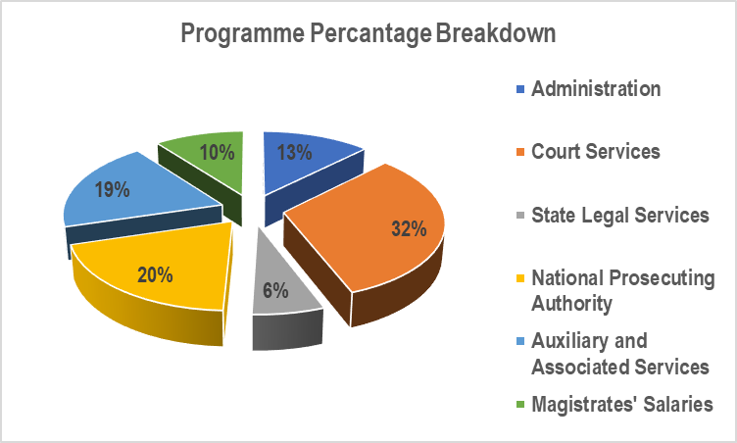
Breakdown Of Percentage spending per Programme
BUDGET EXPENDITURE OVERVIEW
51

Slide 52
Expenditure Performance per Economic Classification
BUDGET EXPENDITURE OVERVIEW
Expenditure Performance Per Economic Classification
DESCRIPTION | 2019/20 EXPENDITURE R'000 | % SPENT | 2018/19 EXPENDITURE | % SPENT
COMPENSATION OF EMPLOYEES | 11 377 251 | 96% | 10 798 813 | 98%
GOODS AND SERVICES | 5 296 331 | 99% | 4 618 793 | 97%
PAYMENTS FOR FINANCIAL ASSET | 10 769 | 100% | 22 885 | 99%
TRANSFERS & SUBSIDIES | 2 992 808 | 99% | 2 803 083 | 100%
PAYMENT FOR CAPITAL ASSET | 608 602 | 70% | 985 918 | 100%
DEPARTMENTAL APPROPRIATION | 20 285 761 | 96% | 19 229 492 | 98%
52

Slide 53
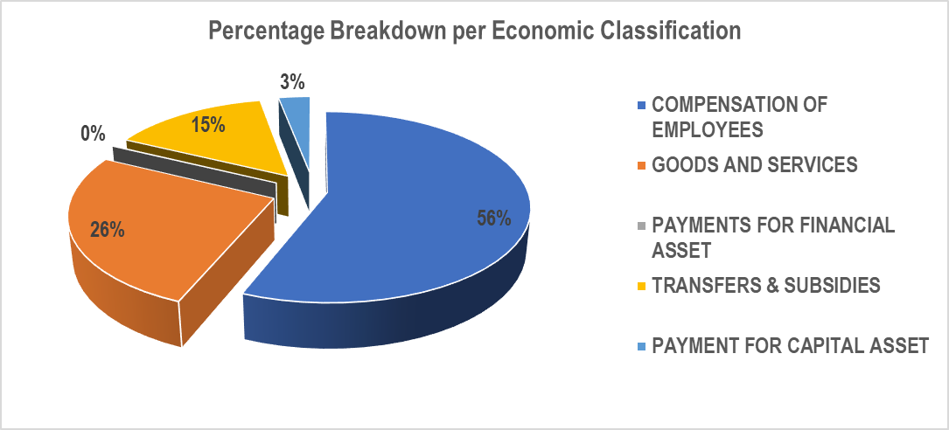
Breakdown of Percentage spending per Economic Classification
BUDGET EXPENDITURE OVERVIEW
53

Slide 54
Expenditure not directly linked to non Financial Performance
BUDGET EXPENDITURE OVERVIEW
Items | 2019/20 R’000
Accomodation Charges | 1 307 239
Security Services | 822 277
Travel and Subsistence | 378 388
Pschatric Observation | 205 715
Virtual Library | 50 727
Communication | 117 646
Legal Services | 229 203
Witness Fees | 118 435
Tranfers and Subsidies | 2 992 808
Modernisation | 518 072
Court Infrastructure | 305 357
Total | 7 045 867
Percentage of total expenditure | 33%
54

Slide 55
Linking Non Financial Performance and Financial Performance
BUDGET EXPENDITURE OVERVIEW
Programme | Indicators not Achieved | Expenditure Items
Administration | 5 | COE funded
Court Services | 15 | 12 COE funded 3 Infrastructure funded
State Legal Services | 18 | 18 COE Funded
Auxiliary and Associated Services | 1 | IJS funded
55

Slide 56
BUDGET EXPENDITURE OVERVIEW
Irregular Expenditure 2019/20
New Cases = R543,6 million
Condoned = R168 645
Removed = R54,9 million
56

Slide 57
BUDGET EXPENDITURE OVERVIEW
High Value Irregular Expenditure Cases
57

Slide 58
Budget adjustment highlights in 2019/20
BUDGET EXPENDITURE OVERVIEW
Reprioritization | Amount R’000 | Priorities | Amount R’000
Court Infrastructure | (535,900) | SIU Claims | 50,000
 |  | Investigative Directorate-NPA | 38,000
 |  | Psychatric Observations old invoices) | 102,000
 |  | Maintanance of infrastructure in courts | 70,000
 |  | Replacement of old fleet in the Regions | 35,000
 |  | Replacement of outdated computers in courts | 50,000
 |  | Historical debts write-off – State Attorney | 190,900
IJS | (208,156) | Replacement of outdated computers - NPA | 90,000
 |  | State Capture Commission | 88,000
 |  | Public Investment Corporation | 30,156
58

Slide 59
BUDGET EXPENDITURE OVERVIEW
FIRST QUARTER EXPENDITURE PERFORMANCE 2020/21
59

Slide 60
BUDGET EXPENDITURE OVERVIEW
Expenditure per Programme
PROGRAMMES | BUDGET R'000 | 2020/21 EXPENSES R'000 | % SPENT | 2019/20 FIRST QUARTER EXPENDITURE | YEAR ON YEAR % EXPENDITURE GROWTH
Administration | 2 356 456 | 169 010 | 7.2% | 462 324 | (63%)
Court Services | 7 180 283 | 1 344 266 | 18.7% | 1 469 533 | (9%)
State Legal Services | 1 431 927 | 279 797 | 19.5% | 289 772 | (3%)
National Prosecuting Authority | 4 583 924 | 1 045 081 | 22.8% | 946 274 | 10%
Auxiliary and Associated Services | 4 308 031 | 811 286 | 18.8% | 805 934 | 1%
Magistrates' Salaries | 2 550 227 | 539 654 | 21.2% | 511 452 | 6%
DEPARTMENTAL APPROPRIATION | 22 410 848 | 4 189 096 | 18.7% | 4 485 289 | (7%)
60

Slide 61
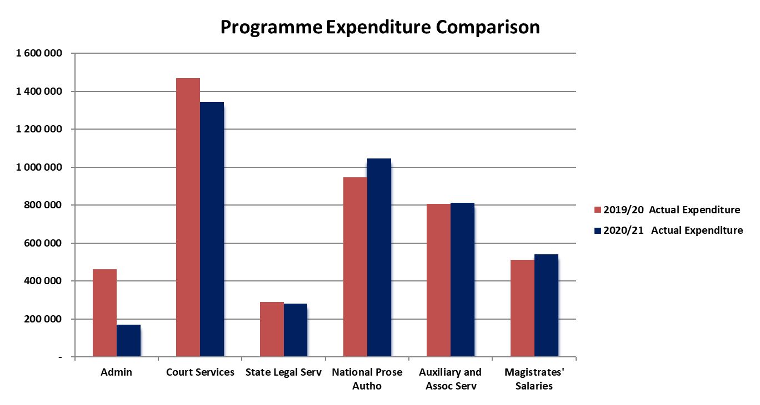
Expenditure Comparison per Programme
BUDGET EXPENDITURE OVERVIEW
61

Slide 62
BUDGET EXPENDITURE OVERVIEW
Expenditure per Economic Classification
ECONOMIC CLASSIFICATION | BUDGET R'000 | 2020/21 EXPENSES R'000 | % SPENT | 2019/20 FIRST QUARTER EXPENDITURE | YEAR ON YEAR % EXPENDITURE GROWTH
DJC&CD
COMPENSATION OF EMPLOYEES | 12 937 295 | 2 822 563 | 21.8% | 2 787 709 | 1%
GOODS AND SERVICES | 5 159 181 | 409 140 | 7.9% | 864 982 | (53%)
PAYMENTS FOR FINANCIAL ASSET | - | 294 | 0.0% | 302 | (3%)
TRANSFERS & SUBSIDIES | 3 250 214 | 780 748 | 24.0% | 723 799 | 8%
PAYMENT FOR CAPITAL ASSET | 1 064 158 | 176 351 | 16.6% | 108 497 | 63%
DJC&CD | 21 100 772 | 4 189 096 | 19.9% | 4 485 289 | (7%)
62

Slide 63
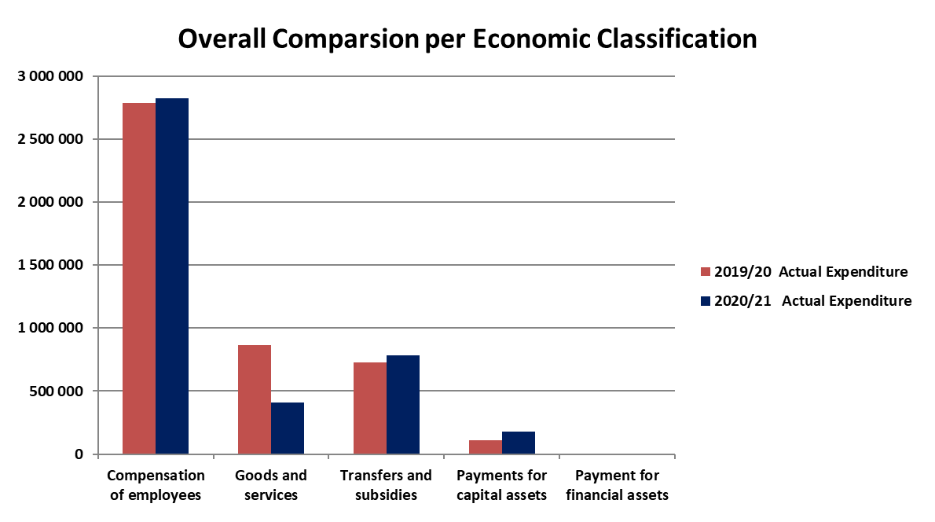
Expenditure Comparison per Economic Classification
BUDGET EXPENDITURE OVERVIEW
63

Slide 64
Spending pressures –in – year and forward looking
BUDGET EXPENDITURE OVERVIEW
Psychiatric observations
Implementation of passed legislation – Human Traffic Act, Sexual Offences Act (NRSO), Land Court Bill, etc.
Provision of security services
Review of apartheid legislation
Take-over of cleaning and garden services from DPWI
64

Slide 65
BUDGET EXPENDITURE OVERVIEW
DEPARTMENTAL PERFORMANCE: PROGRAMME 1
Challenges:
Structure and vacancies
Procurement bottlenecks
Dependence on DPWI for implementation of court infrastructure projects
Misaligned planning processes
Budget cuts
Aging workforce and limited room for skills transfer
65

Slide 66
DEPARTMENTAL PERFORMANCE: PROGRAMME 1
PERSONNEL RELATED MATTERS
OVERVIEW
66

Slide 67
3.
PERSONNEL RELATED MATTERS OVERVIEW
i
NUMBER OF INTERNS
In the past few years, the Department has been able to sustain having 300 interns in the system annually, including the 2019/20 performance year. This programme depended mainly on the discretionary grants as provided by SASSETA. As such, the Department has found itself limited in the past few years to appoint 2.5% of its total post establishment as prescribed by MPSA.
To increase the number of interns for the new performance cycles 2020/21 and 2022/23, the Department has set aside R52 million to address the gaps in the internship programme.
DEPARTMENTAL PERFORMANCE: PROGRAMME 1
67

Slide 68
3.
PERSONNEL RELATED MATTERS OVERVIEW
i
EMPLOYEE RELATIONS
The Department performs poorly in this area of work as it does not finalise matters within the prescribed timeframes. It has been found that many matters which could be finalised before grievance procedure is evoked, which could have been resolved, are not resolved at the supervisory level.
There are also matters that are delayed due to their complex nature which requires forensic investigations.
In view of the large number of outstanding matters and the dissatisfaction among staff members on the handling of these matters in the past, a Task Team has been established by the Minister to look into these matters. A preliminary report will be filed imminently.
DEPARTMENTAL PERFORMANCE: PROGRAMME 1
68

Slide 69
3.
PERSONNEL RELATED MATTERS OVERVIEW
i
ORGANISATIONAL STRUCTURE
Whilst the journey of completing the entire Departmental structure is still underway, in the 2020/21 performance cycle, the department has managed to reviewed the undermentioned sub-structures.
Branch: Financial Management;
Branch: Master of the High Court;
Chief Directorate Integrated Justice System;
Chief Directorate Justice College;
Directorate: Social-Economic Impact Assessment System;
Chief Directorate: Executive Support and Intergovernmental Relations;
Regional Office Structures: Facility Management;
Chief Directorate: Information Systems Management (ISM); and
Directorate: Employee Relations.
DEPARTMENTAL PERFORMANCE: PROGRAMME 1
69

Slide 70
3.
PERSONNEL RELATED MATTERS OVERVIEW
i
SMS VACANCY
The SMS vacancy rate is at 23%. However, it is noteworthy that the Department has managed to fill the post of Deputy Director-General: Corporate Services which has been vacant since 2017. The following recruitment processes are underway:
Shortlisting process of the position of DG which became vacant from April 2020.
Cabinet approval for the appointment of the Chief Master which remained vacant since 2016.
In the pipeline is the approval of six (6) Heads of State Attorneys in the provinces.
Shortlisting process for the three (3) Regional Court Services Heads in the provinces, are underway.
Shortlisting for the CSLA post has been completed, pre-testing has been done, awaiting assessment and interviews.
DEPARTMENTAL PERFORMANCE: PROGRAMME 1
70

Slide 71
DEPARTMENTAL PERFORMANCE: PROGRAMME 1
INFRASTRUCTURE PERFORMANCE OVERVIEW
71

Slide 72
3.
INFRASTRUCTURE PERFORMANCE OVERVIEW
i
PORTFOLIO 2019/2020
The 2019/20 capital budget allocation was originally R855 637 000 but reduced by R345 000 000 to R510 635 000. The budget was split between Department of Public Works and Infrastructure and Independent Development Trust, as the implementing agents for Infrastructure portfolio.
The DPWI requested a budget allocation of R531 349 630. The amount is made up of R397 236 639 for construction costs and R134 112 991 for Professional fees. The requested amount covers a total of five hundred and eleven Capital Projects that are at Pre-Design to Final Delivery stages. Only R241 392 605 (45%) of the budget requested was spent. The remainder of the budget R324 287 370, was set aside for the IDT programme. All the projects which were under implementation by the IDT have been completed and currently operating.
Final accounts are yet to be settled under the programme.
DEPARTMENTAL PERFORMANCE: PROGRAMME 1
72

Slide 73
3.
INFRASTRUCTURE PERFORMANCE OVERVIEW
i
CAPEX PORTFOLIO 2020/2021
2020/21 Capital Budget allocation:
The Department had a capital works budget allocation of R902 696 000.00 but was reduced to R874 435 000.00.
Following Covid-19 lockdown, the budget was further reduced to R518 995 000. The reduction was used for State Capture, DOJ Covid-19 PPE and National Treasury Covid-19 surrender.
469 projects are currently registered with DPWI for implementation. The projects are at different stages of project phases. The DPWI has requested a reduced budget allocation of R389 906 606 for projects. The amount required is for contractors at R245 350 024 and consultants fees of R144 556 582.
/
DEPARTMENTAL PERFORMANCE: PROGRAMME 1
73

Slide 74
THE IDT PROJECTS
Mpumalanga High Court
The primary access road tender was awarded and Thenjwa Engineering & Projects. Progress to date is 48%. The road bed; guardhouse and boundary wall foundations are 100% complete. Subsoil drains; storm water pipes are also completed
Extension of time was awarded for Covid-19 lockdown. Another extension of time claim was submitted and is being adjudicated
Limpopo High Court
The court building was completed in June 2015. The handing over of the completed parkade is underway.
The additional parking has been completed and interlinking of the three buildings is outstanding. IDT is conducting an assessment for the interlinking. DPWI has appointed the DBSA to take over the maintenance of the facility under the TFMS.
/
3.
INFRASTRUCTURE PERFORMANCE OVERVIEW
i
74

Slide 75
3.
INFRASTRUCTURE PERFORMANCE OVERVIEW
i
DPWI PROJECTS UNDER CONSTRUCTION:
Dimbaza Magistrate Court: Construction of a new building:
The project progress stands at 99%. There were delays due to inclement weather. The PRI telephone lines are still outstanding.
Durban (Point) Branch Court:
Building is currently 95% complete
The project will be delayed due to the outstanding CRT machine and installation additional items in line with Covid-19 Regulations.
Mamelodi Magistrate Court: Construction of a new building:
The appointment of the nominated sub-contractors for specialist works is outstanding hence the project is standing still. DPWI is working on resolving the matter.
Port Shepstone Magistrate Court: Construction of a new building:
The current overall progress is 96%.
There is no progress on site pending the outcome of litigation. DPWI has started planning for the completion of the project and appointing another contractor to complete the project.
75

Slide 76
PORTFOLIO 2019/2020
The 2019
DPWI PROJECTS UNDER CONSTRUCTION
Soshanguve Magistrate Court, refurbishments and additions:
The project was awarded in December 2019 and progress is 6%.
Vulamehlo Magistrate Court, refurbishments and additions:
The project is 92% complete.
The contractor is challenging cancellation of the contract and has issued DPWI with letter from the attorney. DPWI Legal Services is dealing with the matter.
Fraserburg Magistrate Court, refurbishments and additions:
The has reached practical completion and contractor is completing the defects/snag list.
Umbumbulu Magistrate Court, refurbishments and additions:
The original scope of the contract is complete. Contractor rectifying roof leaks.
Mthata Magistrate Court, repairs and renovations:
The project started in January 2020 and is progressing well.
3.
INFRASTRUCTURE PERFORMANCE OVERVIEW
i
76

Slide 77
3.
INFRASTRUCTURE PERFORMANCE OVERVIEW
i
BUDGET 2019/2020
Infrastructure Management | Original Allocations 000” | Revised Allocation 000”
CAPEX | 855 637 | 535 749
 |  | 64%
77

Slide 78
3.
INFRASTRUCTURE PERFORMANCE OVERVIEW
i
BUDGET 2020/2021
Infrastructure Management | Original Allocations 000” | Revised Allocation 000”
CAPEX | 902 696 | 518 995
 |  | -
78

Slide 79
PORTFOLIO 2019/2020
The 2019
/
3.
INFRASTRUCTURE PERFORMANCE OVERVIEW
i
CHALLENGES:
DPWI does not have capacity to implement the infrastructure portfolio of DoJ&CD.
For the past five years, DPWI has been underspending DoJ&CD allocated funding of CAPEX.
The town planning and procurement processes of DPWI take longer and this is what affect the delivery of projects.
The infrastructure spending of DoJ&CD improved during the time when IDT was implementing some of the key projects of DoJ&CD. However, that programme has come to an end, and has resulted in decreased spending and delivery in the past financial year.
There is lack of technical capacity within DoJ&CD, with only eight (8) technical staff responsible for overseeing more than 500 active projects across the country.
National lockdown due to Covid-19 pandemic has affected the construction industry. All construction sites were shut down and that had a negative effect on the budget, hence the under spending.
DoJ&CD Infrastructure delivery will be negatively affected by the slow delivery from DPWI. The unit is currently in the process to find another implementing agent.
The review of the facilities management structure is underway and it will improve the delivery processes of infrastructure projects in the Department
79

Slide 80
DEPARTMENTAL PERFORMANCE: PROGRAMME 1
INTERNAL AUDIT FINDINGS CHALLENGES
80

Slide 81
PORTFOLIO 2019/2020
The 2019
/
INTERNAL AUDIT FINDINGS CHALLENGES
The 2019/20 Audit Action Plan:
There were 79 findings in the Audit Action Plan.
138 interventions were planned to address the findings.
As at the 31st March 2020 (end financial year), 71% of findings (indicator 1.1) were completed.
As at 31st August 2020, 78% of the interventions were completed.
22% are interventions with future dates.
The Department has started with the process of developing the Audit Action Plan 2020/21 and is based on the management report from the Auditor-General. The 22% interventions not completed in the previous financial year will be included in this plan, and will be tracked and monitored accordingly.
81

Slide 82
DEPARTMENTAL PERFORMANCE: PROGRAMME 1
CORRECTIVE MEASURES TO TURNAROUND THE DEPARTMENT
82

Slide 83
3.
CORRECTIVE MEASURES TO TURNAROUND THE DEPARTMENT
i
DEPARTMENTAL PERFORMANCE: PROGRAMME 1
STRATEGY TO IMPROVE UNDER-PERFORMANCE
Predetermined Objectives
Management will review objectives to achieve the SMART criteria when planning. Capacity development sessions on planning and reporting on performance information in all Branches and Regions will be put in place. We will conduct training on reporting of performance information to ensure consistency on the understanding of the Technical Indicator Descriptors (TID). We will ensure compliance with the revised planning framework in preparation and tabling of the Annual Performance Plan. We will improve on record keeping measures.
83

Slide 84
3.
CORRECTIVE MEASURES TO TURNAROUND THE DEPARTMENT
i
IMPROVING PERFORMANCE:
In view of the Department being a human resource intensive organisation, its turnaround on performance is dependant on how it manages this resource.
The performance of employees must be managed through proper monitoring, supervision, resourcing and training.
Equally, there must be consequence management through timeous action to correct non-performance or poor performance through corrective measures, among others.
All of the above requires the Department's human resources component to review its processes and implement stricter measures to lead a turnaround.
There must be a shift from a performance management approach (rules-based compliance effort) to an approach that manages performance (active engagement between supervisor and employee).
84

