Slide 1

PRESENTATION TO THE PORTFOLIO COMMITTEE ON JUSTICE AND CORRECTIONAL SERVICES ON THE 2019/20 QUARTER FOUR AND 2020/21 Q1 PERFORMANCE REPORT
BY
Adv. Andy Mothibi
09 October 2020
Hotline: 0800 037 774 | Website: https://www.siu.org.za | E-mail: info@siu.org.za

Slide 2


2019/20 Q4 AND 2020/21 Q1 PERFORMANCE REPORT
1. 2019/20 Quarter 4 and Annual Performance
2. Financial Information
Presentation Overview
3. Legal Counsel
4. Governance
Compliance with laws
Internal Committee meetings
Strategic risks
Audit outcomes
5. Human Capital
6. 2020/21 Quarter 1 Performance
Hotline: 0800 037 774 | Website: https://www.siu.org.za | E-mail: info@siu.org.za

Slide 3

2019/20 Q4 AND ANNUAL PERFORMANCE

Slide 4
SUMMARY OF 2019/20 Q4 PERFORMANCE

Slide 5
SUMMARY OF 2019/20 Q4 PERFORMANCE PER BUDGET PROGRAMME

Slide 6
SUMMARY OF 2019/20 PERFORMANCE

Slide 7
SUMMARY OF 2019/20 ANNUAL PERFORMANCE PER BUDGET PROGRAMME

Slide 8
PROGRAMME 1: ADMINISTRATION
Programme Performance Indicator | Target 2019/20 | Quarter 4 Target | Quarter 4 Actuals | Year-to-Date Progress | Comment on variance | Rating
 |  |  |  |  |  | Q4 | YTD
Strategic outcome-oriented goal: To enable core services to perform optimally
Strategic objective 1: To provide compliant and sustainable financial services in accordance with service delivery standards
1.1 Percentage of valid invoices paid within 30 days or as per agreed payments terms. | 95% | 95% | 86% | 94% | Currently, there are no electronic systems and/or reports to warn employees that the 30 days target are nearing the relevant deadlines. Relevant electronic notification and reporting systems to pro-actively warn responsible employees about payment deadlines will be employed.
Strategic outcome-oriented goal: To enable core services to perform optimally
Strategic objective 2: To attract a skilled workforce that is managed within a performance driven environment
2.1 Percentage of vacancy rate maintained | 12% | 12% | 23% | 23% | The conclusion of the Agreement with recognised Union delayed than anticipated due to the complexity of issues, which affected recruitment. With the conclusion of the Agreement, focus in the 2020/21 FY will be on the acceleration of the recruitment. A monitoring mechanism to track the recruitment progress will also be developed and implemented. Recruitment has commenced and thus far appointed 8 staff members, 6 from external and 2 from internal. The process is being accelerated in order to capacitate the SIU and ensure we deliver on our mandate

Slide 9
PROGRAMME 1: ADMINISTRATION
Programme Performance Indicator | Target 2019/20 | Quarter 4 Targets | Quarter 4 Actuals | Year-to-Date Progress | Comment on variance | Rating
 |  |  |  |  |  | Q4 | YTD
Strategic outcome-oriented goal: To enable core services to perform optimally
Strategic objective 2: To attract a skilled workforce that is managed within a performance driven environment
2.2 Percentage of signed performance agreements | 80% | 80% | 0% Target not achieved. | 0% Target not achieved. However, a project plan has been was developed for the rollout of the new output based performance management system. A policy has already been developed and being socialized with staff. Management is in consultation recognised Union with a view to implement a full Performance Management system. | The progress registered with regards to the key building blocks following the concluding the agreement with recognised Union will facilitate the fast tracking of implementation in the new financial year. A commitment has been secured from the management team to accord this holistic process the necessary prioritization.

Slide 10
PROGRAMME 1: ADMINISTRATION
Programme Performance Indicator | Target 2019/20 | Quarter 4 Targets | Quarter 4 Actuals | Year-to-Date Progress | Comment on variance | Rating
 |  |  |  |  |  | Q4 | YTD
Strategic outcome-oriented goal: To enable core services to perform optimally
Strategic objective 3: To provide appropriate ICT services in accordance with set standards
3.1 Percentage implementation of 3-year ICT plan | 75% | 75% | 31% | 31% | Due to the nature of changes within the ICT environment the implementation plan in the signed ICT plan was revised which led to reprioritisation of activities in the plan. However, the revised implementation plan was not signed and therefore the initial implementation plan was used for the measurement of planned activities against those achieved.
Strategic objective 4: To collaborate with stakeholders in support of enhanced service delivery and core business objectives
4.1 Number of Stakeholder survey conducted and baseline established | 1 | 1 | 0 Target not achieved. No stakeholder survey was conducted. | No stakeholder survey was conducted | The recommendation of the survey that was conducted in the 2018/19 FY will be included into stakeholder strategy that will be developed in the fist quarter of the 2020/21 FY. This process will determine when the next survey will be conducted.

Slide 11
PROGRAMME 1: ADMINISTRATION
Programme Performance Indicator | Target 2019/20 | Quarter 4 Targets | Quarter 4 Actuals | Year-to-Date Progress | Comment on variance | Rating
 |  |  |  |  |  | Q4 | YTD
Strategic outcome-oriented goal: To enable core services to perform optimally
Strategic objective 4: To collaborate with stakeholders in support of enhanced service delivery and core business objectives
4.2 Implementation of the SIU Governance Framework | Approved SIU Governance Framework | No planned target for quarter 4. | No planned target for quarter 4. | SIU Governance Framework was approved in the second quarter. | N/A
Strategic objective 5: To provide support for strategic and organisational performance management
5.1 Number of quarterly reports produced per year | 4 | 1 | 1 performance quarterly report (Q3) was submitted to the Ministry of Justice and Correctional Services . | 4 Quarterly performance reports were submitted to the Ministry of Justice and Correctional Services | N/A

Slide 12
PROGRAMME 1: ADMINISTRATION
Programme Performance Indicator | Target 2019/20 | Quarter 4 Targets | Quarter 4 Actuals | Year-to-Date Progress | Comment on variance | Rating
 |  |  |  |  |  | Q4 | YTD
Strategic outcome-oriented goal: To enable core services to perform optimally
Strategic objective 5: To provide support for strategic and organisational performance management
5.2 Submission of 2020/24 Strategic Plan and 2020/21 Annual Performance Plan to the Minister of Justice and constitutional Development as per prescribed timeframe | 2020/24 Strategic Plan and 2020/21 APP submitted to the Justice and Correctional Services Ministry by 31 January 2020. | 2020/24 Strategic Plan and 2020/20 APP submitted to the Justice and Correctional Services Ministry by 31st January 2020. | 2020/24 Strategic Plan and 2020/21 APP submitted to the Justice and Correctional Services Ministry by 31st January 2020. | 2020/24 Strategic Plan and 2020/21 APP submitted to the Justice and Correctional Services Ministry by 31st January 2020. | N/A

Slide 13
PROGRAMME 1: ADMINISTRATION
Programme Performance Indicator | Target 2019/20 | Quarter 4 Targets | Quarter 4 Actuals | Year-to-Date Progress | Comment on variance | Rating
 |  |  |  |  |  | Q4 | YTD
Strategic outcome-oriented goal: To enable core services to perform optimally
Strategic objective 6: To protect the SIU from potential legal risks
6.1 Percentage implementation of legal compliance framework | 100% | 10% | 0% Target not achieved. | 20% -Approved Compliance Framework with Implementation Plan -Draft Compliance Policy -Compliance Risk Policy (Risk Management Framework will be employed) -Draft Legal universe document | Human Resource constraints, however resource capacitation of the unit will be prioritised in the 2020/21 financial year.
Strategic objective 7: To protect the SIU integrity from internal and external threats
7.1 Percentage submission of declaration of interests controlled for all SIU employees | 100% | 100% | 100% | 100% | N/A

Slide 14
PROGRAMME 1: ADMINISTRATION
Programme Performance Indicator | Target 2019/20 | Quarter 4 Targets | Quarter 4 Actuals | Year-to-Date Progress | Comment on variance | Rating
 |  |  |  |  |  | Q4 | YTD
Strategic outcome-oriented goal: To enable core services to perform optimally
Strategic objective 7: To protect the SIU integrity from internal and external threats
7.2 Fraud Prevention Plan Revised | Revised Fraud Prevention Plan approved by 30 Dec 2019 | No planned target for quarter 4. | No planned target for quarter 4. | Revised Fraud Prevention Plan approved by 30 Dec 2019 | N/A

Slide 15
PROGRAMME 1: ADMINISTRATION
Programme Performance Indicator | Target 2019/20 | Quarter 4 Targets | Quarter 4 Actuals | Year-to-Date Progress | Comment on variance | Rating
 |  |  |  |  |  | Q4 | YTD
Strategic outcome-oriented goal: To enable core services to perform optimally
Strategic objective 7: To protect the SIU integrity from internal and external threats
7.3 Percentage of implementation of the Integrated Security System Business Case | 40% implementation of the Integrated Security System Business Case | 15% | Target not achieved 0% The following however reflects the work that has been delivered. -Security burglar bars were installed in the Polokwane provincial office. -Security officers were deployed to the Durban provincial office. | 7% Annual target not achieved, however, the following were delivered: -A contract for the service of 3 Security guards for the Polokwane office was procured. -Security burglar bars were installed in the Polokwane provincial office. -Security officers were deployed to the Durban provincial office. | The following delays contributed to the non-achievements: -Reviewing of the implementation plan of the integrated Security System Business Case. -Appointment of the Engineer which was meant to assist with the revamping of the SIU current security system.

Slide 16
PROGRAMME 1: ADMINISTRATION
Programme Performance Indicator | Target 2019/20 | Quarter 4 Targets | Quarter 4 Actuals | Year-to-Date Progress | Comment on variance | Rating
 |  |  |  |  |  | Q4 | YTD
Strategic outcome-oriented goal: To enable core services to perform optimally
Strategic objective 8: To assess internal controls through internal audits
8.1 Percentage of approved internal audits conducted in accordance with internal audit plan | 100% | 100% | 80% (4/5) | 95% (21/22) | The outstanding audit could not be completed due the national lockdown.

Slide 17
PROGRAMME 1: ADMINISTRATION
Programme Performance Indicator | Target 2019/20 | Quarter 4 Targets | Quarter 4 Actuals | Year-to-Date Progress | Comment on variance | Rating
 |  |  |  |  |  | Q4 | YTD
Strategic outcome-oriented goal: To enable core services to perform optimally
Strategic objective 9: To enable the unit to become risk intelligent
9.1 Improvement of the SIU risk maturity level in accordance with the National Treasury ERM Maturity Rating System National Treasury ERM Maturity Rating System: Level 1: Start up Level 2: Development Level 3: Control Level 4: Information Level 5: Managed Level 6: Optimizing | Level 5 | Level 5 | Level 4.6 | Level 4.6 | Human resource constraints in both the Risk Management and SCM business units contributed to the under-achievement. However, capacitation will be prioritised in the next financial year

Slide 18
PROGRAMME 2: INVESTIGATIONS AND LEGAL COUNSEL
Programme Performance Indicator | Target 2019/20 | Quarter 4 Targets | Quarter 4 Actuals | Year-to-Date Progress | Comment on variance | Rating
 |  |  |  |  |  | Q4 | YTD
Strategic outcome-oriented goal: To achieve appropriate legal outcomes against perpetrators of maladministration and corruption
Strategic objective 1: To ensure that each case is centrally reported and monitored
1.1 Percentage of allegations centrally registered for electronic tracking | 100% | 100% | 100% | 100% | N/A
Strategic objective 2: To ensure that each allegation is assessed in accordance with standardised criteria
2.1 Percentage of centrally registered allegations that are assessed by the assessment committee | 100% | 100% | 100% | 100% | N/A

Slide 19
PROGRAMME 2: INVESTIGATIONS AND LEGAL COUNSEL
Programme Performance Indicator | Target 2019/20 | Quarter 4 Targets | Quarter 4 Actuals | Year-to-Date Progress | Comment on variance | Rating
 |  |  |  |  |  | Q4 | YTD
Strategic outcome-oriented goal: To achieve appropriate legal outcomes against perpetrators of maladministration and corruption
Strategic objective 3: To conduct forensic investigations according to predetermined standards
3.1 The number of investigations closed under a published proclamation in accordance with predetermined standards | 1300 | 400 | 658 | 2000 | The following contributed to the over-achievement of this target. -The investigation into licenses for the National Department of Transport proclamation which will resulted in a significant number of investigations being closed out. -The conflict of interest exercise conducted in the Transnet project
3.2 The number of reports submitted to the Presidency | 13 | 4 | 7 | 19 | The over-achievement is due to the finalisation and submission of final reports in respect of older proclamations that were pending for internal review processes.

Slide 20
PROGRAMME 2: INVESTIGATIONS AND LEGAL COUNSEL
Programme Performance Indicator | Target 2019/20 | Quarter 4 Targets | Quarter 4 Actuals | Year-to-Date Progress | Comment on variance | Rating
 |  |  |  |  |  | Q4 | YTD
Strategic outcome-oriented goal: To achieve appropriate legal outcomes against perpetrators of maladministration and corruption
Strategic objective 4: To initiate the implementation of legal recommendations
4.1 The number of referrals made to the Relevant Prosecuting Authority | 75 | 30 | 161 | 451 | The over-achievement resulted from fast-tracking the finalisation of referrals, and a significant number of these referrals were made from entities, against their directors and board members.
4.2 The number of referrals made for disciplinary, executive and/or administrative action | 100 | 30 | 57 | 638 | The over-achievement was due to the significant number of referrals that were made for individuals, entities and/or institutions/departments being investigated to take administrative action against a person and/or entity, such as application for National Treasury and/or CIDB to blacklist an entity for the contravention of a specific Act or regulation.

Slide 21
PROGRAMME 2: INVESTIGATIONS AND LEGAL COUNSEL
Programme Performance Indicator | Target 2019/20 | Quarter 4 Targets | Quarter 4 Actuals | Year-to-Date Progress | Comment on variance | Rating
 |  |  |  |  |  | Q4 | YTD
Strategic outcome-oriented goal: To achieve appropriate legal outcomes against perpetrators of maladministration and corruption
Strategic objective 5: To increase legal outcomes based on civil and other proceedings
5.1 The value of potential losses prevented | R30m | R10m | R0 | R400,000,000 | The SIU's ongoing investigation into Eskom resulted in the prevention of loss to the value of R400 million resulted in the over-achievement of the planned target.
5.2 The value of cash recoveries | R140m | R60m | R105,028,780 | R345,593,726 | Significant contributions that resulted in the over-achievement were made by: -The recovery of R157 million. (IDT) - The High Court ordering that a service provider repay the Department of Telecommunications an amount of R25 million. - The National Department of Transport team in the ECP worked with SAPS and the RTMC and vehicles to the value of R38 million were seized as a result of this operation. National Department of Transport investigation also secured AOD documents for R3.7m. - The Amahlathi Municipality obtained an AFU order for R92m. - Continued efforts with DPW to recover monies owed to them based on the SIU findings made during the DPW Leases investigation. Recoveries were made to the value of R6.7m

Slide 22
PROGRAMME 2: INVESTIGATIONS AND LEGAL COUNSEL
Programme Performance Indicator | Target 2019/20 | Quarter 4 Targets | Quarter 4 Actuals | Year-to-Date Progress | Comment on variance | Rating
 |  |  |  |  |  | Q4 | YTD
Strategic outcome-oriented goal: To achieve appropriate legal outcomes against perpetrators of maladministration and corruption
Strategic objective 5: To increase legal outcomes based on civil and other proceedings
5.3 The value of contract(s) and/or administrative decision(s)/action(s) set aside or deemed invalid | R800m | R300m | R3,700,000,000 | R4,330,000,000 | The over-achievement resulted in the Eskom investigation which managed to cancel a contract to the value of R3.7 billion
5.4 The value of matters in respect of which evidence was referred for the institution or defence/opposition of civil proceedings (including arbitration or counter civil proceedings) | R1.5bn | R500m | R60,736,664 | R2,165,707,065.42 | There were cases that were instituted in the Special Tribunal which contributed significantly to the over-achievement of this target.

Slide 23
PROGRAMME 3 : MARKET DATA ANALYTICS AND PREVENTION
Programme Performance Indicator | Target 2019/20 | Quarter 4 Targets | Quarter 4 Actuals | Year-to-Date Progress | Comment on variance | Rating
 |  |  |  |  |  | Q4 | YTD
Strategic outcome-oriented goal: To influence proactively the systemic and behavioural root causes of maladministration and corruption
Strategic objective 1: To direct internal and influence external strategic decision making processes through data analysis
1.1 Number of internal trend analysis reports issued | 2 | 1 | 1 | 2 | N/A
1.2 Number of external risk assessment and trend analysis reports issued | 2 | 1 | 1 | 2 | N/A
Strategic objective 2: To assist State institutions with the prevention of the reoccurrence of reported cases
2.1 Number of systemic improvement plans developed in conjunction with targeted State institutions | 1 | 1 | 1 improvement plan developed with DPW (Prestige unit) | 1 improvement plan developed with DPW (Prestige unit) | N/A

Slide 24
PROGRAMME 3 : MARKET DATA ANALYTICS AND PREVENTION
Programme Performance Indicator | Target 2019/20 | Quarter 4 Targets | Quarter 4 Actuals | Year-to-Date Progress | Comment on variance | Rating
 |  |  |  |  |  | Q4 | YTD
Strategic outcome-oriented goal: To influence proactively the systemic and behavioural root causes of maladministration and corruption
Strategic objective 3: To increase public awareness about targeted anti-corruption behaviour
3.1. Number of targeted awareness campaigns conducted. | 1 | 1 | 3 awareness campaigns conducted with NDPW, IH Harris Primary School and EC DoT | 3 awareness campaigns conducted with NDPW, IH Harris Primary School and EC DoT | The awareness session with IH Harris was the one that was planned for the 2019/20 FY. The two additional awareness campaigns due to the following: The awareness campaign with NDPW was postponed from the 2018/19 FY to the 209/20 FY. The session with the Eastern Cape dept. of Transport was a request from the department itself to the SIU.
3.2 Number of public perception surveys conducted | 1 | 1 | 1 public perception survey conducted | 1 public perception survey conducted | N/A N/A

Slide 25
FINANCIAL INFORMATION

Slide 26
Financial Results: Quarter Ending 31 March 2020
Note: The Financial Results submitted for the 4th Quarter ending 31 March 2020 had a surplus of R 186 million and was based on Unaudited Financial Information. The Final Results herein are based on Audited Financial Statements as signed off on the 30th September 2020

Slide 27
Financial Results: Quarter Ending 31 March 2020
Explanation of Material Differences between budget and actual amounts:
Income:
CARA Funds: In terms of section 68 of the Prevention of Organised Crime Act, 1998 ( Act No 121 of 1998), Cabinet approved the recommendations of the Criminal Asset Recovery Committee( CARC), to allocate R16 million to the SIU , to support Corruption fighting and other forms of Economic Crimes as part of the Anti Corruption Task Force ( ACTT) and activities relating to the SIU Special Tribunal. An amount of R 5.8 million was already expenses on these costs and recognised as income. The amount was not budgeted for as it was only approved in December 2019.
Interest Received: The positive balance is due to higher than expected average bank balances.
Expenses:
3. Salaries: The SIU underwent an Organisational Review Process, whereby a new Organisational Structure was developed. The SIU intends to capacitate the new structure over the MTEF period, which will result in expenses being in line with the budgeted expenses. The recruitment process was started in earnest but could not be finalized in the 2019/20 financial year.
4. Travel and Operational Costs: The underspending relates to the recruitment process. These costs were not incurred as anticipated during the year under review. The recruitment process is still ongoing.
5. Administration Costs: The debt impairment projection is based on the evaluation of each state institution’s circumstances, including the historic payments, any application for exemptions made to National Treasury not to pay SIU in terms of the SIU Act, payments received after 31 March 2020 and is consistent wit previous financial years. A major portion of the debts impaired during 2018/19 financial year ( R100 million) were recovered as a result of the SIU’s on-going efforts to recover debts. Several engagements with Senior Management of these institutions, Portfolio Committees and National Treasury have contributed towards this achievement.

Slide 28
Financial Results: 1st Quarter Ending 30June 2020
Notes:
Income: The under-recovery in income is mainly due to the recovery of fees for services rendered to State Institutions, which is used to determine project income. Due to the National lock-down, most projects were put on hold because the SIU was not regarded as an essential service
Expenses: The under-spending in total expenditure is due to the National lock-Down. Most of the projects/ programmes anticipated to begin in April had to be put on hold. This included the recruitment process and travel related to investigations.

Slide 29
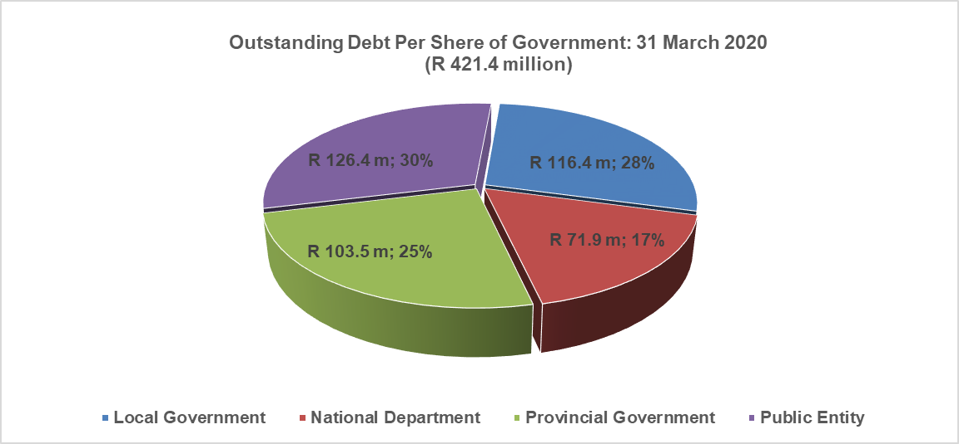
Debtors Book: Period Ending 31 March 2020
Note: The Difference between the Aged Debtors Books and the Total Outstanding is due to R 3.3 million provide for at year end for revenue due to the SIU but not invoiced yet

Slide 30
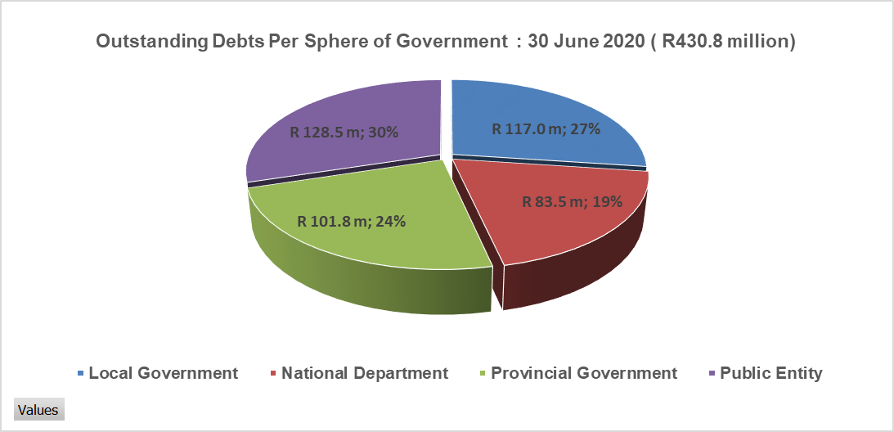
Debtors Book :1st Quarter Ending 30 June 2020

Slide 31
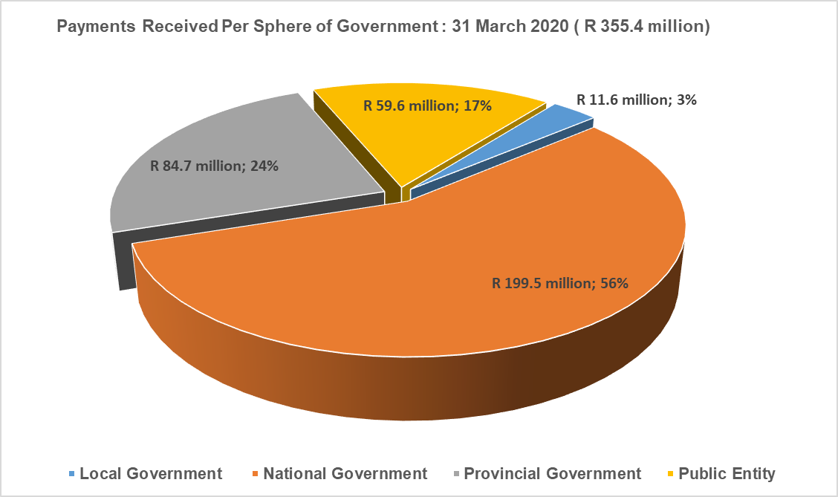
Payments Received : Period Ending 31 March 2020

Slide 32
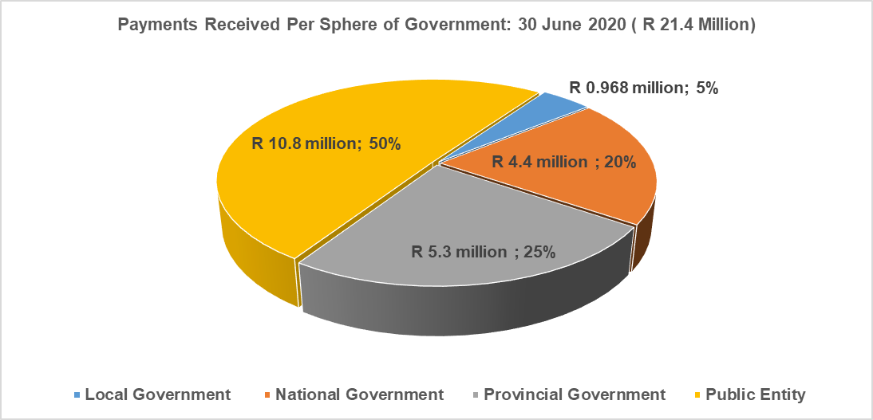
Payments Received : Period Ending 30 June 2020

Slide 33
SIU FUNDING MODEL
The SIU has highlighted the shortcomings in the current funding model to the DoJ and to National Treasury in the last few years.
A detailed engagement was held with National Treasury (NT) on 5 October 2020, and the CFO of the DoJ.
The next steps would be to consider alternative options that will ensure the medium to longer term sustainability of the SIU.
It is work in progress and the Committee will be updated in due course.

Slide 34
LEGAL

Slide 35
LEGAL COUNSEL
Courts | Number of cases | Value of contracts | Matters to be heard / Judgements reserves | Dates of hearing and/or Trial dates | Number of restraints
Special Tribunal | 35 | R5.8bn | 6 | GP 12/2020: 8 October 2020, GP 07/ 2020: 20-21 Nov 2020 NW 01/2020: 13 Oct 2020, NW02/2020: 13 Oct 2020, GP 10/2020: 19 Oct 2020, GP 03/2020: 3 Nov 2020 | 4
High Court | 50 | R9.943bn | 2 | 6-16 Oct 2020 19 Oct 2020, 22 October 2020. 16-17 Nov 2020 | -

Slide 36
GOVERNANCE

Slide 37
COMPLIANCE WITH LAWS AND REGULATIONS
Established a Compliance Function: Drafted Compliance Framework, Regulatory universe, Compliance Risk Management Plan, Compliance Monitoring Plan, Training Plan, and obtained authority to recruit compliance officer.
The compliance function advised and furnished opinions to SIU business units on the nature and extent of relevant legislative provisions.
Adherence of applicable legislation by SIU business Units were ensured and monitored through policy, practice and assurances by governance structures.

Slide 38
GOVERNANCE COMMITTEE MEETINGS
Executive Committee (EXCO)
The EXCO of SIU continued to meet on monthly scheduled EXCO meetings as per SIU governance calendar through out the year 2019/20
Risk Management Committee (RISKCO)
The Risk Committee comprises SIU internal members and one external member which is the independent Chairperson of the Risk Committee. The Committee meetings were convened twice in the calendar year as per the Terms of Reference which requires the committee to meet for the minimum of two times year.
Audit Committee
The Audit committee continued to play a critical role of oversight on SIU financial controls and monitoring of the audit plan with 4 independent members.
Human Resources Management Committee
The HR committee is an independent committee that advices the HoU and Executive management of HR related issues and its chaired by an independent chairperson.
ICT Committee
In strengthening the SIU governance the ICT committee has been established to advice on the ICT governance and is also chaired by an independent chairperson.
No | Committee Name | Nr. Of Meetings Held during Period under Review for 2019/20 | Nr. Of Meetings Held during Period under Review for 2020/21
1 | Audit Committee | 5 | 2
2 | Risk Management Committee | 2 | 1
3 | Human Resource Management Committee | 2 | 1
4 | ICT Committee (New) | 1 | 1

Slide 39
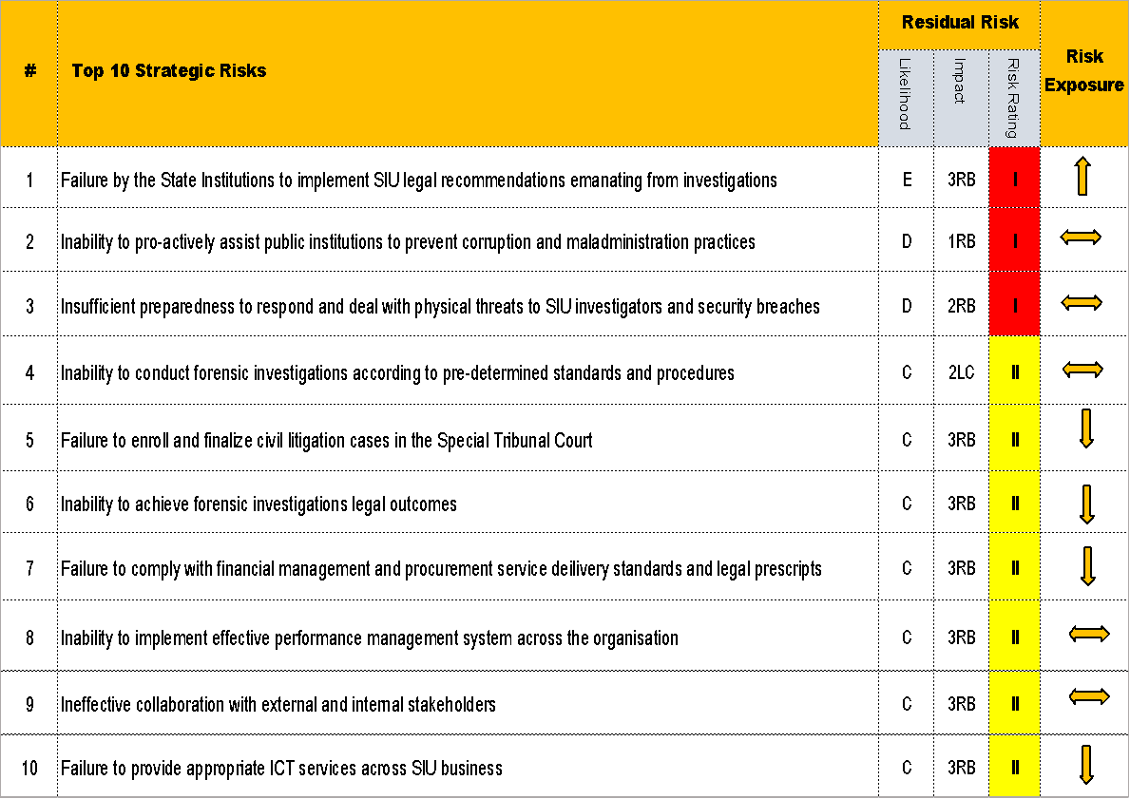



STRATEGIC RISK REGISTER 2019/20/21
In the current year 2020/21 the strategic risks has been reviewed in line with our strategic plan and APP for 2020/21
One of the emerging risk in the current year is the limited resources which was the root cause of the in the previous financial year on risk number 4 in the previous slide. But with the number of proclamations approved and the ones that are on the pipeline this became an independent risk on its own.

Slide 40
SIU 2019 AUDIT OUTCOMES
The SIU pride itself and strive to continue ensuring sound financial management ,good governance, internal control and risk management. This continues to be affirmed by the audit outcomes from the office of the Auditor General.
The role and effectiveness of Internal Audit , Risk Management, oversight committees and management as a whole is notable and demonstrated in the results of audit outcomes, a notable significant reduction in number of audit findings raised year on year and continuous resolution and monitoring of resolution of previous audit findings.

Slide 41
SIU 2019 AUDIT OUTCOMES
SIU 2019 achieved the Clean audit outcome in 2019/20 financial for the fourth consecutive year, a “clean audit” outcome, as a result of :
The Annual Financial Statements being free from any material misstatements;
No material findings on the usefulness and reliability of the reported performance information;
No material findings on compliance with key legislation;

Slide 42
SIU 2019 AUDIT OUTCOMES
The Annual Financial Statements being free from any material misstatements;
No material findings on the usefulness and reliability of the reported performance information;
No material findings on compliance with key legislation;
No material deficiencies in internal controls.
SIU 2019 achieved the Clean audit outcome in 2019/20 financial year yet again, as a result of :

Slide 43
SIU AUDIT OUTCOMES OVER 5 YEAR PERIOD
No | 2015/16 | 2016/17 | 2017/18 | 2018/19 | 2019/20
1. AUDIT OPINONS OVER 5 YEARS
1 | Unqualified Audit opinion | Clean audit | Clean Audit | Clean audit | Clean Audit

Slide 44
HUMAN CAPITAL

Slide 45
HEADCOUNT REPORT
The SIU’s own attractiveness as an employer of choice is paramount to our ability to attract and retain key talent. The demand for capacity in SIU is driven mainly by the rising number of approved proclamations.
The current internal and external supply of the critical skills may not meet the current and future demand due to markets demands for similar skills. It is the SIU’s intention to build an internal talent pipeline.
The SIU has made a reasonable transformation progress in terms of its top management level and it is our commitment to advance EE agenda. As at the end of September 2020, our staff complement totaled 540, of which 497 (92%) are permanent, 20 (3.7%) are fixed term, and Interns are 23 (4.3%) , as compared to 516 in 2019/20.
Hotline: 0800 037 774 | Website: https://www.siu.org.za | E-mail: info@siu.org.za

Slide 46
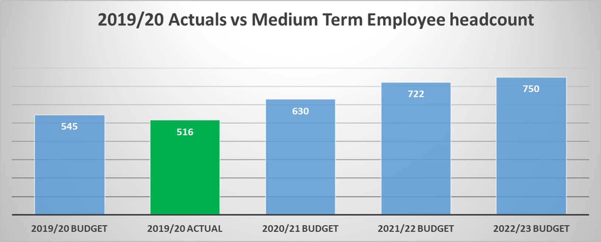
PROJECTED GROWTH: Medium term employee headcount
.
36% growth projection by 2022
14% Vacancy rate 2020/21
Hotline: 0800 037 774 | Website: https://www.siu.org.za | E-mail: info@siu.org.za

Slide 47
CAPACITATING THE SIU
The target at the beginning of the financial year the target is to employ 22 external appointees to achieve a 14% vacancy rate. The actual vacancy rate as at end June 2020 of Q1 was 18.6% and currently at 17.8% against a 14% 2020/21 vacancy rate or plan.
Perm (Int , ext & PwD) | 147
Contract vacancies | 21
8 positions targeted for PwD were advertised at DoL (ESSA),
5 unskilled, 2 semi-skilled and 1 skilled.
Hotline: 0800 037 774 | Website: https://www.siu.org.za | E-mail: info@siu.org.za

Slide 48
RECRUITMENT STATUS
On hold | 21
To be advertised | 10
Active (Contract & Perm) | 158
Hotline: 0800 037 774 | Website: https://www.siu.org.za | E-mail: info@siu.org.za

Slide 49
EMPLOYMENT STATUS – EE Report
Six (6) Appointments were made by Quarter 2:
Two (2) internal incumbents were promoted from senior management level to top management level; 1 African Female and Indian Male.
Three (3) external candidates at middle - management level (Professionally Qualified) , 2 African females and 1 males.
Three (3) external candidates appointed at Skilled Technical level, 2 African Females and 1 African Male.
 | Male |  |  |  | Female
Occupational Level | African | Coloured | Indian | White | African | Coloured | Indian | White | TOTAL
1 - Top Management | 6 | 1 | 2 | 1 | 4 | 0 | 0 | 0 | 14
2 - Senior Management | 9 | 1 | 0 | 9 | 3 | 0 | 2 | 4 | 28
3 - Professionally Qualified | 43 | 13 | 15 | 33 | 18 | 2 | 4 | 20 | 148
4 - Skilled Technical | 98 | 8 | 8 | 8 | 98 | 7 | 17 | 31 | 275
5 - Semi-skilled | 7 | 0 | 0 | 0 | 30 | 1 | 2 | 4 | 44
6 - Unskilled | 0 | 0 | 0 | 0 | 8 | 0 | 0 | 0 | 8
GRAND TOTAL | 164 | 23 | 25 | 51 | 161 | 10 | 25 | 59 | 518
Hotline: 0800 037 774 | Website: https://www.siu.org.za | E-mail: info@siu.org.za

Slide 50
ADDITIONAL SKILLS REQUIRED
21 x Middle and senior levels of the following roles are required and advertised:
Hotline: 0800 037 774 | Website: https://www.siu.org.za | E-mail: info@siu.org.za

Slide 51
2020/21
QUARTER 1 PERFORMANCE REPORT

Slide 52
SUMMARY OF 2020/21 Q1 PERFORMANCE

Slide 53
SUMMARY OF 2020/21 Q1 PERFORMANCE PER BUDGET PROGRAMME

Slide 54
Summary of factors contributing to the under-achievement and way forward
National lockdown due to Covid-19
All these have had an impact on SIU Operations in particularly planned Quarter 1 targets.
Way Forward
The lockdown specifically for the first two months (April and May) of the first quarter significantly affected the operations teams from having access to State institutions.
State Institutions were not in a position to process SIU payments during Lockdown.
The closure of the SIU offices also affected and delayed our work.
With the easing of the lockdown, the Q1 under-achievement will be rectified and achievement will be fast –tracked from the second quarter onwards.
Application of technology in order to conduct investigations. (e.g TEAMS) will allow for business continuity for disruptions that may emanate due to covid-19 (e.g. temporary closure offices for disinfection)
Increase productivity and capacity to minimise the negative impact – We have since seen improvement.

Slide 55
PROGRAMME 1: ADMINISTRATION
Programme Performance Indicator | Annual Target 2020/21 | Quarter 1 Target | Achievement | Deviation | Corrective Action | Rating
Outcome 1: A compliant, high-performance SIU that is well-capacitated to rid society of corruption, maladministration and fraud in State institutions
Output: Good governance and controls environment for positive audit outcomes
1.1 Maintain an unqualified overall AG audit outcome on previous year's performance | Unqualified audit | No planned target | No planned target
Output: Risk management measures to improve high levels of risk maturity
1.2 Maintain SIU's risk maturity level 5 in accordance with the following National Treasury ERM Maturity rating system: Level 1: Start up Level 2: Development Level 3: Control Level 4: Information Level 5: Managed Level 6: Optimizing | Level 5 | Approved risk management plan | Risk Management Committee approved the Risk Management plan on the on the 04 May 2020 as per the target. | The risk committee recommended approval of the risk management plan subject to the inclusion of previously non-achieved actions plans as well as non-achieved policies. | The risk committee recommendations will be incorporated into the risk management plan.

Slide 56
PROGRAMME 1: ADMINISTRATION
Programme Performance Indicator | Annual Target 2020/21 | Quarter 1 Target | Achievement | Deviation | Corrective Action | Rating
Outcome 1: A compliant, high-performance SIU that is well-capacitated to rid society of corruption, maladministration and fraud in State institutions
Output: Prescribed SIU annual plans to provide strategic support and ensure compliance
1.3 Submission of 2020/21 APP to Minister of Justice & Correctional Services as per prescribed timeframe | 2021/22 APP submitted to Minister of Justice & Correctional Services no later than 31 January 2021 | No planned target | No planned target

Slide 57
PROGRAMME 1: ADMINISTRATION
Programme Performance Indicator | Annual Target 2020/21 | Quarter 1 Target | Achievement | Deviation | Corrective Action | Rating
Outcome 1: A compliant, high-performance SIU that is well-capacitated to rid society of corruption, maladministration and fraud in State institutions
Output: Prescribed SIU annual plans to provide strategic support and ensure compliance
Output: Filled vacancies of funded key SIU positions
1.4 Percentage of vacancies in funded posts | 14% | 18% | 18.6% | The national lockdown had an negative impact which resulted in delays in the recruitment processes. | Recruitment will be fast-tracked in the next quarters.
Output: Standard performance management system in place
1.5 Percentage implementation of performance management system | 100% | Roll out of training on performance management system Executives Performance Agreements signed | Target not achieved | Due to closure of offices following the lockdown, there was insufficient time to proceed and complete the planned deliverables within the first quarter. | The follow-up training module will be rolled out regarding the detailed performance agreements in quarter 2.

Slide 58
PROGRAMME 1: ADMINISTRATION
Programme Performance Indicator | Annual Target 2020/21 | Quarter 1 Target | Achievement |  | Deviation |  | Corrective Action | Rating
Outcome 1: A compliant, high-performance SIU that is well-capacitated to rid society of corruption, maladministration and fraud in State institutions
Output: SIU stakeholders managed through outcomes of biennial stakeholder perception surveys
1.6 Percentage Implementation of the 2018/19 stakeholder survey recommendations | 60% implementation of approved intervention plan-based recommendations from findings | 10% | Target not achieved | Planned engagements with respective business units to discuss the recommendations and finalise implementation plans could not take place has taken places due to closure of offices as a result of COVID-19 |  | A report with the survey recommendations and the implementation plan will be discussed and finalised with the respective heads of business units

Slide 59
PROGRAMME 1: ADMINISTRATION
Programme Performance Indicator | Annual Target 2020/21 | Quarter 1 Target | Achievement | Deviation | Corrective Action | Rating
Outcome 1: A compliant, high-performance SIU that is well-capacitated to rid society of corruption, maladministration and fraud in State institutions
Output: Develop and deploy a plan to leverage technology to create a globally competitive high-performance organisation
1.7 Percentage implementation of an approved ICT Plan | 80% | 75% | Target not achieved. However, the incomplete deliverables from the previous financial were executed as follows. 1. WAN Deployment to all regional offices completed. 2. Enhancements to PIMS and PTMS- The 2 Developers have been appointed but due to delays caused by COVID lockdown, enhancement work is not yet completed. 3. DR site installation completed, but due to delays caused by COVID lockdown, testing could not be completed, testing is in progress.

Slide 60
PROGRAMME 2: INVESTIGATIONS AND LEGAL COUNSEL
Programme Performance Indicator | Annual Target 2020/21 | Quarter 1 Target | Achievement | Deviation | Corrective Action | Rating
Outcome 2: State assets and cash resources are protected from maladministration, fraud and corruption for the realisation of full value-for-money for State programmes
Output: Civil and other legal proceedings to recover cash assets and set aside contracts and administrative actions that are deemed to be invalid
2.1 Rand value of potential cash and/or assets to be recovered | R148m | R37m | R637,087.75 | The national lockdown had a significant impact on the work of the SIU. The operations teams had no access to the state institutions/entities, which resulted in planned target not being achieved. | Following the easing of the lockdown, the Operations teams have since been able to able to resume work and liaise with state respective institutions/entities.
2.2 Rand value of actual cash and/or assets recovered | R60m | R5m | R1,428,136.85 | The national lockdown had a significant impact on the work of the SIU. The operations teams had no access to the state institutions/entities, which resulted in planned target not being achieved. | Following the easing of the lockdown, the Operations teams have since been able to resume work and liaise with state respective institutions/entities.
2.3 Rand value of contact(s) and/or administrative decision(s)/action(s) set aside or deemed invalid | R900m | R225m | 0 | The national lockdown had a significant impact on the work of the SIU. In addition, the courts had prioritised matters that were not heard which has affected the outcome of civil matters that have been instituted | Following the easing of the lockdown, the Operations teams have since been able able to resume work and liaise with state respective institutions/entities. The courts are also fully operational.

Slide 61
PROGRAMME 2: INVESTIGATIONS AND LEGAL COUNSEL
Programme Performance Indicator | Annual Target 2020/21 | Quarter 1 Target | Achievement | Deviation | Corrective Action | Rating
Outcome 2: State assets and cash resources are protected from maladministration, fraud and corruption for the realisation of full value-for-money for State programmes
Output: Civil and other legal proceedings to recover cash assets and set aside contracts and administrative actions that are deemed to be invalid
2.4 Rand value of potential loss prevented | R300m | R60m | 0 | The national lockdown had a significant impact on the work of the SIU. The teams had no access to the state institutions/entities and this led to the non-achievement of the target. | With the lockdown the SIU is now able to resume work and liaise with state institutions/entities
Outcome 3: Confidence in the governance systems, structures and policies of the State is restored and maintained
Output: Legal proceedings and other due processes to conclude investigations, refer investigations for necessary action and submit mandatory status reports to the President
3.1 Number of referrals made for disciplinary action against officials | 150 | 38 | 9 | The national lockdown had a significant impact on the work of the SIU. The operations teams had no access to the state institutions/entities, which resulted in planned target not being achieved. The investigations teams were only able to finalise referrals and deliver documents to the state institutions/entities from 1 June 2020 | The non-achievement will potentially be corrected in quarter 2, following a currently pending matter that has a number of referrals being finalised.

Slide 62
PROGRAMME 2: INVESTIGATIONS AND LEGAL COUNSEL
Programme Performance Indicator | Annual Target 2020/21 | Quarter 1 Target | Achievement | Deviation | Corrective Action | Rating
Outcome 3: Confidence in the governance systems, structures and policies of the State is restored and maintained
Output: Legal proceedings and other due processes to conclude investigations, refer investigations for necessary action and submit mandatory status reports to the President
3.2 Number of referrals made for executive and/or administrative action | 100 | 25 | 40,931 | The National Department of Transport investigation hassled to a recommendation that 40,896 licences be cancelled as the licence holders were deceased | N/A
3.3 Number of referrals made to the relevant Prosecuting Authority | 200 | 100 | 96 | The national lockdown had a significant impact on the work of the SIU and the operations teams had no access to the state institutions/entities, which resulted in planned target not being achieved. | There are a number of referrals being finalised and the under-achievements should be addressed in the next quarters.
3.4 Number of investigations closed under a published proclamation | 1400 | 400 | 291 | The national lockdown had a significant impact on the work of the SIU which resulted in planned target not being achieved. | With the easing of the lockdown, the investigations teams continues to finalise matters and the under-achievement should potentially be addressed in the next quarters.

Slide 63
PROGRAMME 2: INVESTIGATIONS AND LEGAL COUNSEL
Programme Performance Indicator | Annual Target 2020/21 | Quarter 1 Target | Achievement | Deviation | Corrective Action | Rating
Outcome 3: Confidence in the governance systems, structures and policies of the State is restored and maintained
Output: Legal proceedings and other due processes to conclude investigations, refer investigations for necessary action and submit mandatory status reports to the President
3.5 Rand value of matters in respect of which evidence was referred for the institution or defence/opposition of civil proceedings | R1.6bn | R400m | 0 | The national lockdown had a significant impact on the work of the SIU to an extent that no civil matters were instituted in the Special Tribunal or other courts. This resulted in planned target not being achieved. | The easing of the lockdown will allow for civil matters being able to be instituted in the Special Tribunal and other courts
3.6 Number of cases issued in the Special Tribunal | 20 | 3 | 1 | Due to the national lockdown, the special tribunal court was closed, this led to the non-achievement of the planned target. | The easing of the lockdown will allow for civil matters being able to be instituted in the Special Tribunal.
3.7 Number of reports submitted to the Presidency | 15 | 6 | 0 | The national lockdown had a significant impact on the work of the SIU and no final reports were submitted to the Presidency | There are a number of reports that are being finalised and that should be submitted to the Presidency in the next quarter. The underachievement will be corrected in the following quarter.

Slide 64
PROGRAMME 3 : MARKET DATA ANALYTICS AND PREVENTION
Programme Performance Indicator | Annual Target 2020/21 | Quarter 1 Target | Achievement | Deviation | Corrective Action | Rating
Outcome 4: Corruption, maladministration and fraud deterred through proactive preventative mechanisms and effective enforcement of consequence management measures
Output: Awareness campaigns targeted at specific audiences
4.1 Number of targeted awareness campaigns conducted | 1 | State institutions identified and engaged for buy-in | Local Government has been identified for conducting anti-corruption campaign
Output: Insights on corruption and maladministration generated from surveys
4.2 Number of annual trend reports generated | 1 | Data collection methodology approved | Data collection methodology was approved.
Output: Data from concluded matters to develop improvement plans (for clients)
4.3 Number of systemic improvement plans developed in conjunction with targeted state institutions or sectors | 1 | Identify state institution | PSETA has been engaged
Output: Recorded allegations received electronically in a central location to facilitate ease of tracking
4.4 Percentage allegations centrally recorded for electronic tracking | 100% | 100% | 100%

Slide 65
PROGRAMME 3 : MARKET DATA ANALYTICS AND PREVENTION
Programme Performance Indicator | Annual Target 2020/21 | Quarter 1 Target | Achievement | Deviation | Corrective Action | Rating
Outcome 4: Corruption, maladministration and fraud deterred through proactive preventative mechanisms and effective enforcement of consequence management measures
Output: Develop and implement a comprehensive strategy on data analytics
4.5 Establishment and development of Data analytics capability | Programme design developed | Benchmarking exercise including RFI commenced | Benchmarking exercise including RFI commenced
Output: Access for the Assessment Committee to duly undertake assessment of all centrally registered allegations
4.6 Percentage of centrally registered allegations assessed by the Assessment Committee | 100% | 100% | 100%

Slide 66

THANK YOU
Hotline: 0800 037 774
Website: https://www.siu.org.za
E-mail: info@siu.org.za
Follow Us
@RSASIU
Hotline: 0800 037 774 | Website: https://www.siu.org.za | E-mail: info@siu.org.za

