Slide 1
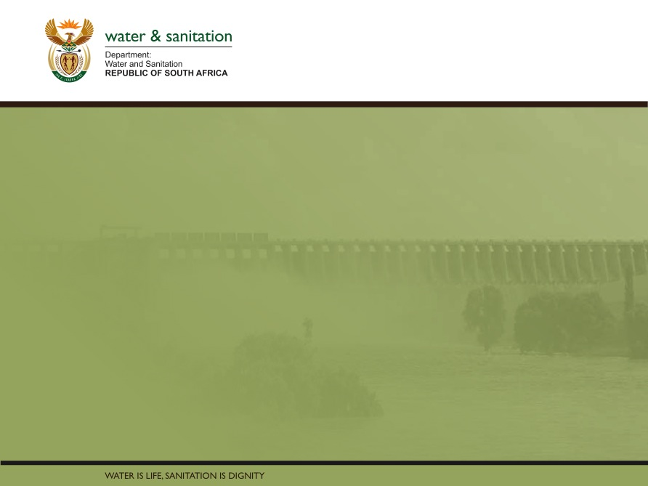
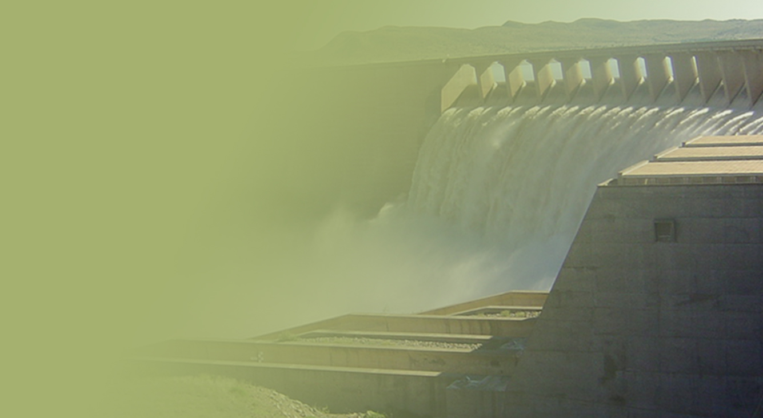
Briefing the Department of Water and Sanitation’s Mpumalanga Provincial Implementation Plan
PRESENTATION TITLE
Presented by:
Name Surname
Directorate
Date
Presented by:
Mr. T Balzer
Acting Director-General
09 October 2020

Slide 2
Contents
Purpose………...…………………..…………………...…………………...….……..3
Mpumalanga Situational analysis…..……………………………………………4-19
Water Service Development Plan ..……………………………………………20-28
Drought status in the province………………………………………………….29-35
COVID-19 interventions…………………………………………………………36-40
District Development Model ..…………………………..………………………41-44
Water and sanitation projects at planning stage……………………….……..45-50
Allocations for regional bulk and water services infrastructure grants…..…51-60

Slide 3
Purpose
To brief the Portfolio Committee on the Department of Water and Sanitation’s Mpumalanga Implementation plan for 2020/21

Slide 4
Mpumalanga situational analysis

Slide 5
Provincial overview
  Mpumalanga province encompasses an area of 79 490 km²
    The province is bordered by two African countries with are Mozambique and a Kingdom of eSwatini.
    All rivers are part of the internationally shared basins:
      Komati- Usuthu basin shared with Mozambique & a Kingdom of eSwatini.
      Vaal basin shared with Lesotho, Namibia & Botswana.
      Olifants-Limpopo basins shared with Zimbabwe, Mozambique & Botswana.
    The province has:
      three (3) District Municipalities (Gert Sibande, Ehlanzeni and Nkangala); and
      17 Local Municipalities (LMs). All 17 LMs have been given status of being Water Service Authorities (WSAs).
    The estimated population in the province was at 4 300 000 (Stats SA: 2016)
    The estimated number of households was at 1 238 861 (Stats SA 2016)

Slide 6
MPUMALANGA
CHARACTERISTICS OF WATER RESOURCE INFRASTRUCTURE
There are 26 main Dams in the Province with a Storage Volume of just under 2.6 Billion m³.
Groundwater use is limited in comparison to surface water
The province’s developed water resources are linked to those of other Provinces through transfer schemes
Transfer schemes comprise Vaal, Olifants, and Usuthu linkages
Other schemes to optimise the system are contemplated as Eskom needs and users in the Olifants Catchment change

Slide 7
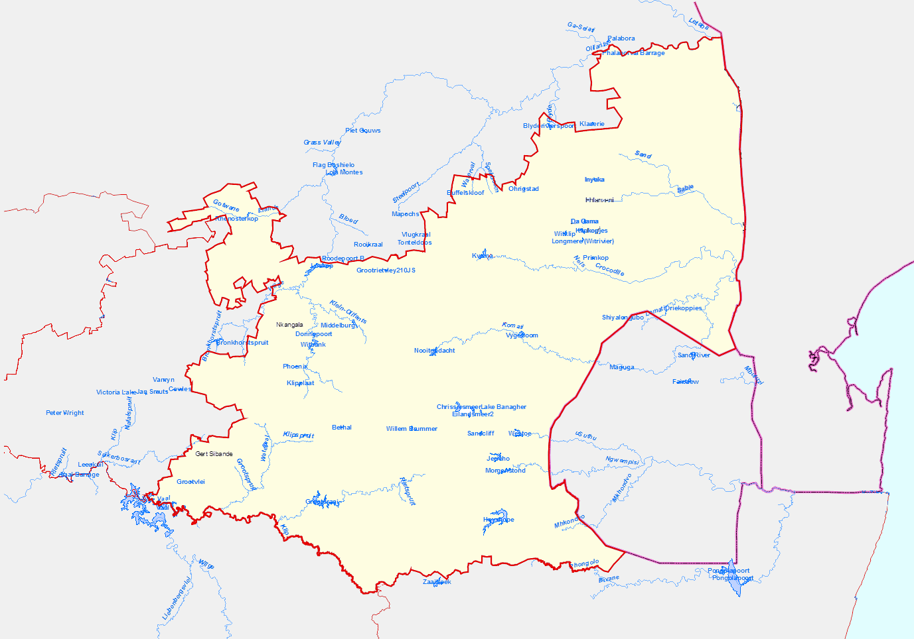
Mpumalanga large dams
Limpopo
Blyderivierpoort
:Water transfers
:Dams
Klasierie
Ohrigstad
Injaka
Mkhombo dam
Da Gama
Witkip
Klipkopie
North West
Longmere
Rust de Winter
Kwena
Mozambique
Loskop
Primkop
Middelburg
Driekoppies
Witbank
Vygeboom
Gauteng
Nooitgedacht
Trichardsfontein
Westoe
Jericho
Swaziland
Grootdraai
Morgenstond
Vaal
Heyshope
Free State
Zaaihoek
KwaZulu Natal

Slide 8
MPUMALANGA PROVINCE
DRIVERS OF WATER DEMAND
Drivers of growth in water demand
  A number of growing towns like Nelspruit, White River, Middelburg, Witbank, and many other small towns and villages
  A large rural population, in which some settlements are transitioning to urban due to natural clustering;
  Mining and power generation on the Highveld
  Irrigated agriculture (Sugarcane and Banana farms in the Lowveld)
  Afforestation on the escarpment
  International demands - The province shares water resources with neighbouring states of Mozambique and Eswatini
The water situation is challenged due to increasing demands and competing requirements.

Slide 9
MPUMALANGA: CURRENT WATER RESOURCE SYSTEMS BALANCE SITUATION
Water supply system | Major water users | System water balance | Major dams in the system | Future water sources
Upper Usuthu | Chief Albeit Luthuli LM; Eskom; irrigation; Gauteng; Mkhondo | Stressed | Heyshope, Morgenstoond, Westoe, Jericho | Groundwater
Upper Olifants | Eskom, Irrigation | Stressed (water quality issues) | Witbank, Loskop | Treatment of mine affected water
Upper Vaal | Standerton, Eskom, Sasol, Secunda | Balanced | Grootdraai
Upper Inkomati | Chief Albert Luthuli LM, Mining, Irrigation, Eskom | Balanced | Lomati dam, Boesmanspruit, Nooightgerdact; Vygeboom
Lower Inkomati | Nkomazi LM, international, irrigation | Stressed | Driekoppies dam and various smaller dams | Groundwater
Crocodile | Mbombela LM, irrigation | Stressed | Kwena and various farm dams | Crocodile East Water Project (proposed dam development)
Sabie | Bushbuckridge | balanced | Inyaka, Mwarite (and various small dams | Groundwater

Slide 10
INTERVENTIONS FOR MPUMALANGA PROVINCE
Water Conservation and Demand Management (WC/WDM)
Removal of Invasive Alien Plants (IAPs)
Reallocation of water across and within water use sectors
Optimise system operations
Inter-catchment transfers
Groundwater development
Development of Water Resource Infrastructure
  Surface developments
  Groundwater options
  Other options (e.g. Reuse of Effluent)

Slide 11
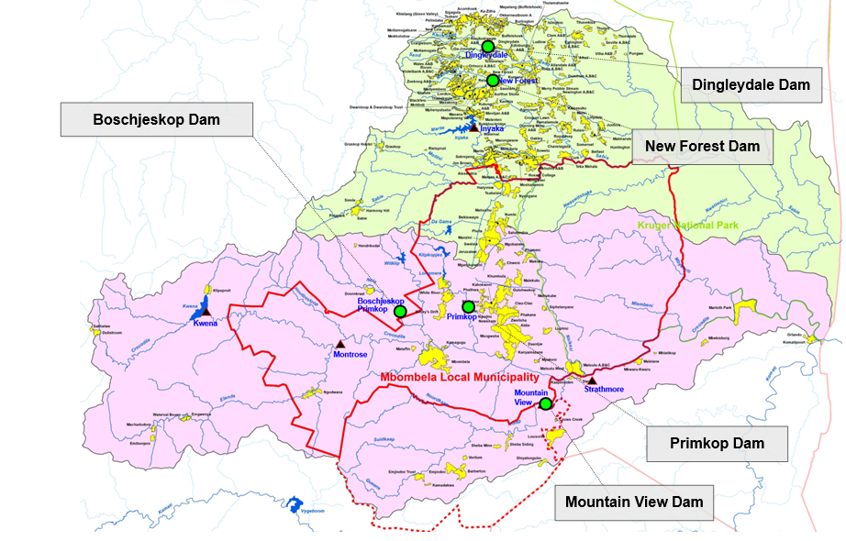
LOCATIONS OF POTENTIAL DAMS

Slide 12
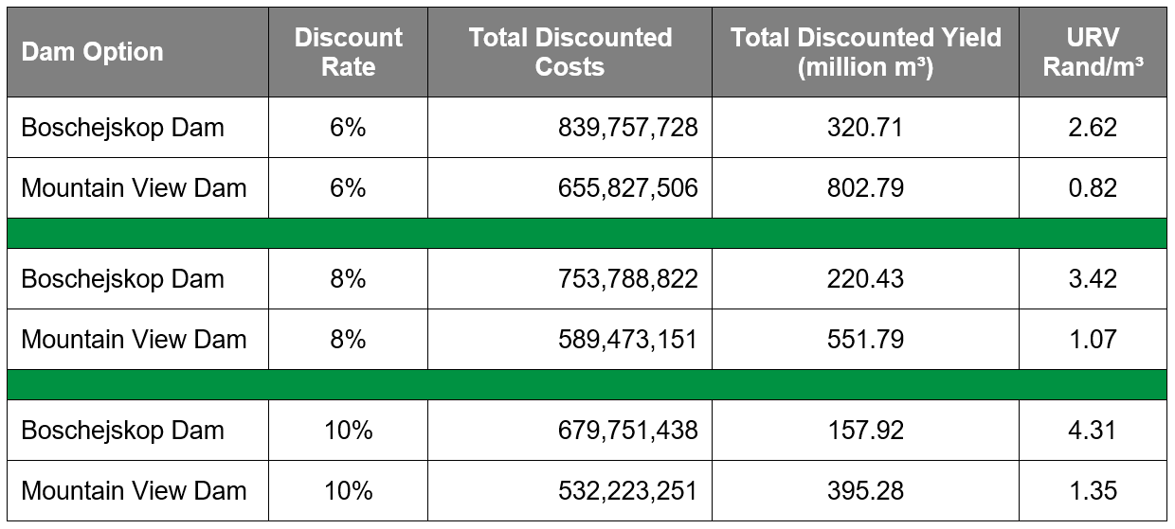
Selected Interventions: Regional Schemes (Dams)
Unit Reference Values (for a 45 year period from completion of construction)
Crocodile River Catchment
Mountain View Dam URV’S significantly lower than Boschejskop Dam.
Yield of Mountain View Dam (78.1 million m³/a) is more than double that of the Boschejskop Dam (32.1 million m³/a).
URV’s do not include energy (pumping) costs.

Slide 13
Water Services Provincial Perspective
Name of Municipality | Total number of HH 2016 | Households with Access to water | Households with Access to water as a % | Households below basic level of service / backlogs | Households below basic level of service / backlogs as %
EHLANZENI DISTRICT | 483 903 | 409 112 | 84.5% | 74 791 | 15.5%
NKANGALA DISTRICT | 421 143 | 390 292 | 92.7% | 30 851 | 7.3%
GERT SIBANDE DISTRICT | 333 815 | 305 282 | 91.5% | 28 533 | 8.5%
Grand Total PROVINCIAL | 1 238 861 | 1 104 686 | 89.2% | 134 175 | 10.8%

Slide 14
Sanitation Provincial Perspective
Name of Municipality | Total number of HH 2016 | SANITATION
 |  | Households with Access to Flush/Chemical toilets | Households with Access to sanitation as a % | Households with Access to VIP toilets | Households with Access to VIP as % | Households below basic level of service / backlogs | Households below basic level of service / backlogs as %
EHLANZENI DISTRICT | 483 903 | 139 885 | 28.9% | 321 834 | 66.5% | 22 184 | 4.1%
NKANGALA DISTRICT | 421 143 | 233 899 | 55.5% | 180 173 | 42.8% | 7 071 | 1.7%
GERT SIBANDE DISTRICT | 333 815 | 268 491 | 76.2% | 57 859 | 17.3% | 10 253 | 3.1%
Grand Total PROVINCIAL | 1 238 861 | 642 275 | 51.8% | 559 866 | 45.2% | 39 508 | 3.0%

Slide 15
Household Water Services Indicators Per Municipality
Province/District/Local Municipality | Main source of water for drinking |  | Sanitation Facility
 | Access to Piped Water | Other Sources | Flush/ Chemical Toilet | Other | None
Mpumalanga | 1 090 892 | 147 969 | 607 082 | 593606 | 38 174
Gert Sibande DM | 305 282 | 28 533 | 234 267 | 90 787 | 8 760
Albert Luthuli | 43 656 | 9 824 | 12 559 | 39 120 | 1 801
Msukaligwa | 46 846 | 4 243 | 38 895 | 10 899 | 1 295
Mkhondo | 38 789 | 6 805 | 21 312 | 22 318 | 1 965
Pixley Ka Seme | 20 334 | 2 212 | 15 102 | 6 485 | 958
Lekwa | 34 987 | 2 347 | 32 318 | 3 902 | 1 114
Dipaleseng | 13 479 | 1 397 | 10 996 | 2 980 | 901
Govan Mbeki | 107 191 | 1 704 | 103 086 | 5 082 | 726
Nkangala DM | 379 870 | 41 274 | 233 783 | 180 173 | 7 187
Victor Khanye | 21 093 | 3 177 | 20 897 | 3 055 | 318
Emalahleni | 136 628 | 13 792 | 108 868 | 39 366 | 2 186
Steve Tshwete | 82 631 | 4 082 | 71 000 | 14 671 | 1 042
Emakhazeni | 12 947 | 1 686 | 12 060 | 1 817 | 756
Thembisile Hani | 77 972 | 4 768 | 9 329 | 71 294 | 2 117
Dr JS Moroka | 48 599 | 13 769 | 11 629 | 49 970 | 768
Ehlanzeni DM | 405 740 | 78 162 | 139 031 | 322 645 | 22 226
Thaba Chweu | 32 940 | 4 082 | 26 690 | 10 006 | 326
Mbombela | 140 782 | 41 012 | 58 923 | 115 792 | 7 079
Umjindi | 21 141 | 2561 | 15 236 | 7 284 | 1 182
Nkomazi | 88 675 | 15 290 | 13 068 | 84 436 | 6 461
Bushbuckridge | 122 202 | 15 217 | 25 114 | 105 126 | 7 178

Slide 16
Status: wastewater and water treatment works
Mpumalanga Province consists of seventy seven (77) Municipal owned Wastewater Treatment Works (WWTWs) within their jurisdiction respectively.
The Province is further serviced by fourteen (14) Wastewater Treatment Works owned by the Department of Public Works.
They are ninety one (91) Municipal owned Water Treatment Works monitored by DWS.
The Department conducts inspections on quarterly basis at Wastewater and Water Treatment Works (WWTWs) to ascertain compliance with the provision of the National Water Act, Act 36 of 1998; Water Services Act, Act 108 of 1997.

Slide 17
Municipal wastewater treatment works
Mpumalanga
77 municipal WWTWs
Gert Sibande DM (29)
1. Dipaleseng LM: 4 WWTWs
2. Govan Mbeki LM: 6 WWTWs
3. Lekwa LM: 1 WWTWs & 1 Ponds system
4. Msukaligwa LM: 3 WWTWs & 3. Ponds systems
5. Mkhondo LM: 2 WWTWs
6. Chief Albert Luthuli: 1 WWTWs & 4 Ponds systems
7. Dr Pixley Ka Isaka Seme: 5 WWTWs
Nkangala DM (24)
1. Thembisile Hani LM: 1 WWTWs & 3 Ponds systems
2. Dr JS Moroka LM: 1 WWTWs & 1 ponds system
3. Victor Khanye LM: 2 WWTWs
4. Emalahleni WWTWs: 8 WWTWs
5. Steve Tshwete LM: 4 WWTWs
6. Emakhazeni LM: 4 WWTWs
Ehlanzeni DM (24)
1. Bushbuckridge LM: 6 WWTWs & 1 Ponds system
2. Thaba Chweu LM: 4 WWTWs
3. City of Mbombela: 7 and 1 Pond system WWTWs
4. Nkomazi LM: 1 WWTWs and 4 Ponds Systems

Slide 18
Non-compliant wastewater treatment works
Mpumalanga
34 municipal WWTWs
Gert Sibande DM (12)
1. Dipaleseng LM: 3 WWTWs
2. Govan Mbeki LM: 3 WWTWs
3. Lekwa LM: 1 WWTWs
4. Msukaligwa LM: 2 WWTWs
5. Dr Pixley Ka Isaka Seme: 3 WWTWs
Nkangala DM (10)
1. Thembisile Hani LM: 1 WWTW & 1 Pond system
2. Victor Khanye LM: 2 WWTWs
4. Emalahleni WWTWs: 3 WWTWs
5. Emakhazeni LM: 3 WWTWs
Ehlanzeni DM (10)
1. Bushbuckridge LM: 3 WWTWs
2. Thaba Chweu LM: 3 WWTWs
3. Nkomazi LM: 1 WWTW and 1 Pond System

Slide 19
Common reasons for non-complaint WWTWs in municipalities
The WWTWs is being upgraded
Raw sewage is discharged into the river without being treated . Is being upgraded – RBIG.
The WWTWs is not operational
Raw sewage is overflowing into the environment
The Activated Sludge is not operating effectively
Return Activated Sludge pumps are not operational
Sludge drying beds are not maintained
The pump stations and manholes are overflowing into the water resource
Effluent discharged into the water resource does not meet the general standards limit
Maintenance of the treatment process unit is not prioritized
Overflow of pump stations
Septic tankers dispose raw sewage into the emergency ponds
The manholes are overflowing into the water resource

Slide 20
Water services development plan

Slide 21
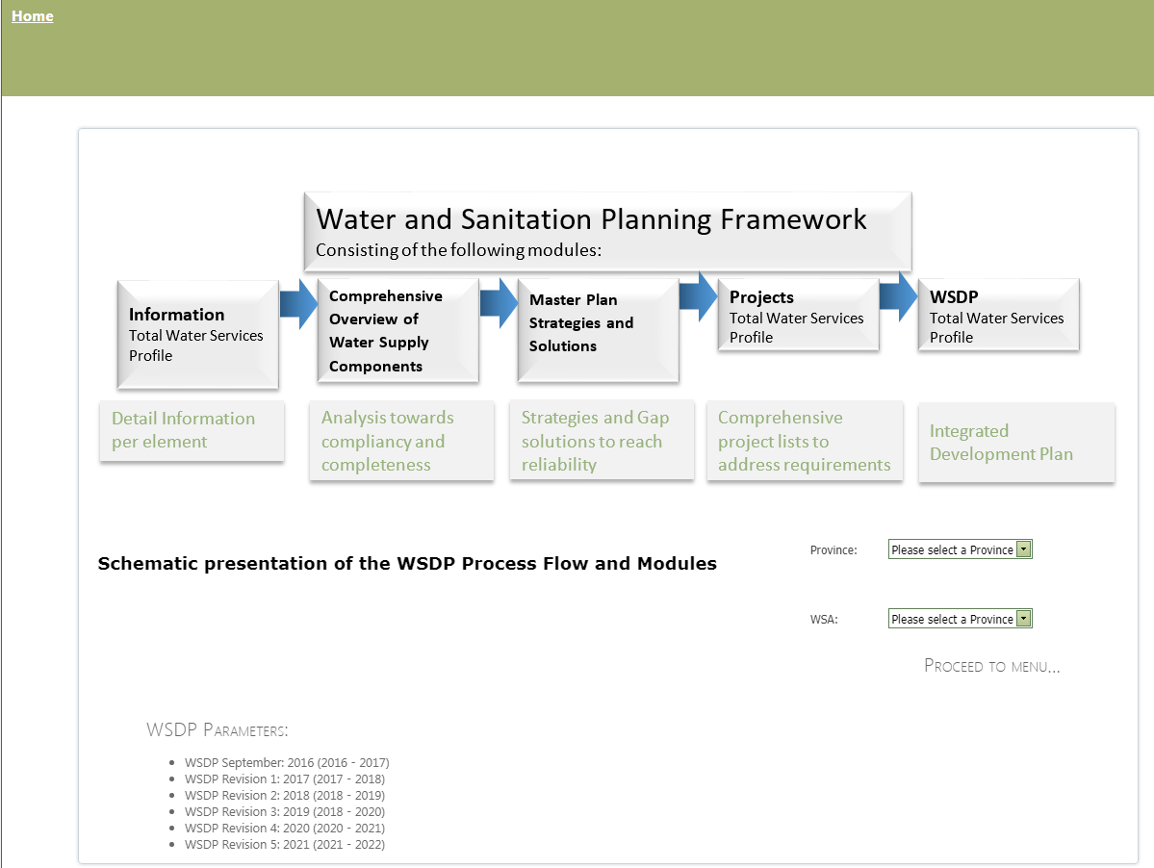
Water and sanitation planning framework

Slide 22
Water services development planning
Water Services Development Planning (WSDP) is a process to enhance the understanding of the Water and Sanitation Business.
The WSDP system ensures that planning happens through a structured approach based on factual information and knowledge system that integrates all aspects related to Water and Sanitation Services provision
DWS has developed an online web-enabled system that allows for easy access, map and data viewing of demographic, service level conditions and all other infrastructure related knowledge.
The WSDP website is part of a national integrated system covering all WSA in South Africa and can be access at all times to ensure on-going knowledge transfer to all levels of society
A WSDP document is produced as an outflow result of the interactive planning activities captured in the comprehensive database structure embedded as part of the online system.
The WSDP System allows for easy updating by the WSA through access security allocations guided by the log- in registration process.

Slide 23
WSDP assessment for 2016-2021 cycle
Water Services Authority | WSDP Assessment for Cycle 2016 – 2021 | Score | Comment
Bushbuckridge | Silver | 64% | WSA to update WSDP in 2020/21
Nkomazi | Purple | 30% | WSA to update WSDP in 2020/21
City of Mbombela | Purple | 0% | WSA to update WSDP in 2020/21
Thaba Chweu | Purple | 0% | WSA to update WSDP in 2020/21
Emakhazeni | Purple | 0% | WSA to update WSDP in 2020/21
Steve Tshwete | Red | 35% | WSA to update WSDP in 2020/21
Emalahleni | Purple | 0% | WSA to update WSDP in 2020/21
Victor Khanye | Purple | 0% | WSA to update WSDP in 2020/21
Thembisile Hani | Purple | 0% | WSA to update WSDP in 2020/21
Dr JS Moroka | Purple | 0% | WSA to update WSDP in 2020/21
Dipaleseng | Red | 43% | WSA to update WSDP in 2020/21
Lekwa | Purple | 0% | WSA to update WSDP in 2020/21
Govan Mbeki | Purple | 0% | WSA to update WSDP in 2020/21
Msukaligwa | Purple | 0% | WSA to update WSDP in 2020/21
Chief Alert Luthuli | Purple | 0% | WSA to update WSDP in 2020/21
Dr Pixley Ka Isaka Seme | Purple | 0% | WSA to update WSDP in 2020/21
Mkhondo | Purple | 0% | WSA to update WSDP in 2020/21

Slide 24
Municipal priority action plan (MPAP)
Resolving vulnerabilities to enable meeting of national Medium Term Strategic Framework (MTSF) target of 90% Reliable Water Services is crucial
Achieved via a facilitated “priority action planning process” – called a Municipal Priority Action Plan
The plan is arrived at via an “organisational consensus” exercise involving all key municipal stakeholders

Slide 25
MPAP rollout in MP
Will be completed for the 27 priority DMs and 57 IMTT priority municipalities
Priority DM WSAs in MP
IMTT priority municipalities
Ehlanzeni DM
Thaba Chweu
Nkomazi
Bushbuckridge
City of Mbombela
Msukaligwa
Lekwa
Govan Mbeki
Emalahleni
Steve Tshwete
Thembisile Hani
Thaba Chweu
City of Mbombela

Slide 26

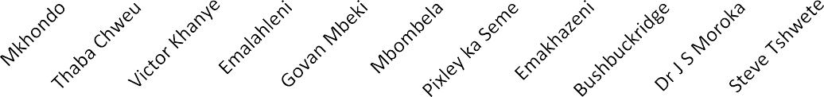
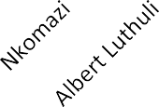
MuSSA vulnerability index ranking
1.00
0.95
0.90
0.85
0.80
0.75
0.70
0.65
0.60
0.55
0.50
0.45
0.40
0.35
0.30
0.25
0.20
0.15
0.10
0.05
0.00
Vulnerability Index
2018
1 - 0.75
ExtremeVulnerability
WSAs

Slide 27
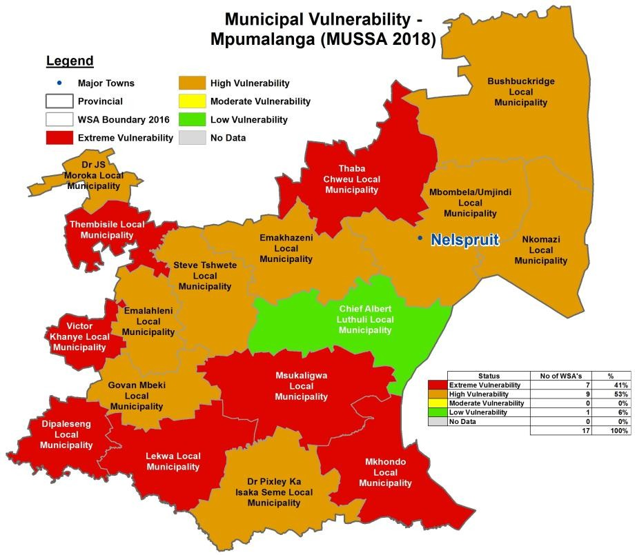
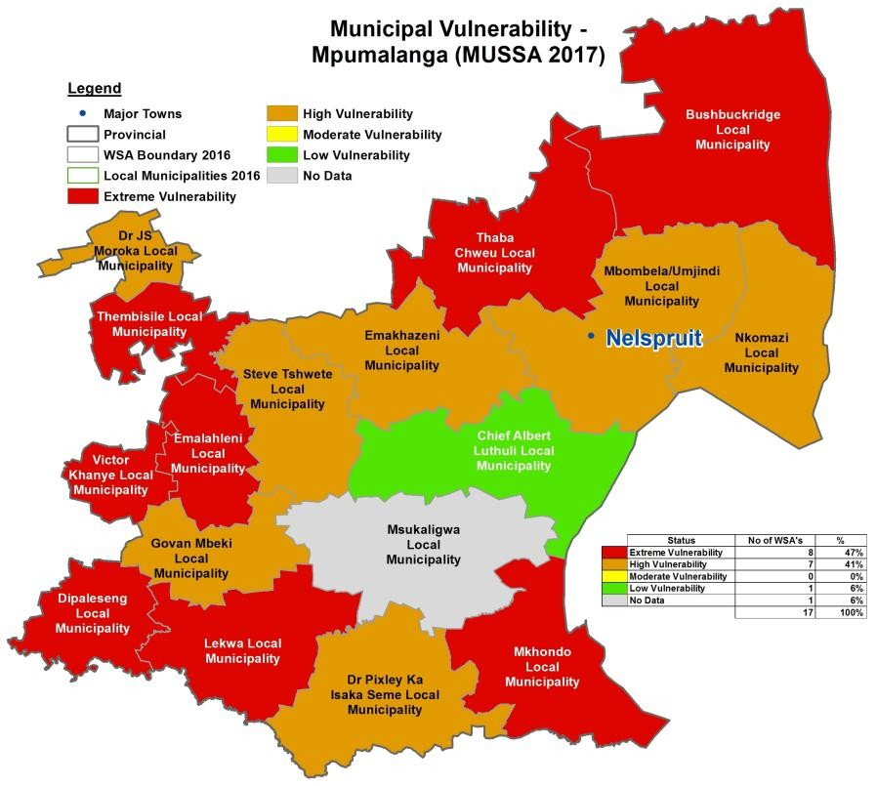
Vulnerability index ranking
Notes:
All WSAs in MP participated in the MuSSA process
Overall vulnerability improved marginally in 2018/19 as compared to 2017/18
8 WSAs improving, 5 WSAs deteriorating and 4 WSAs remained the same

Slide 28


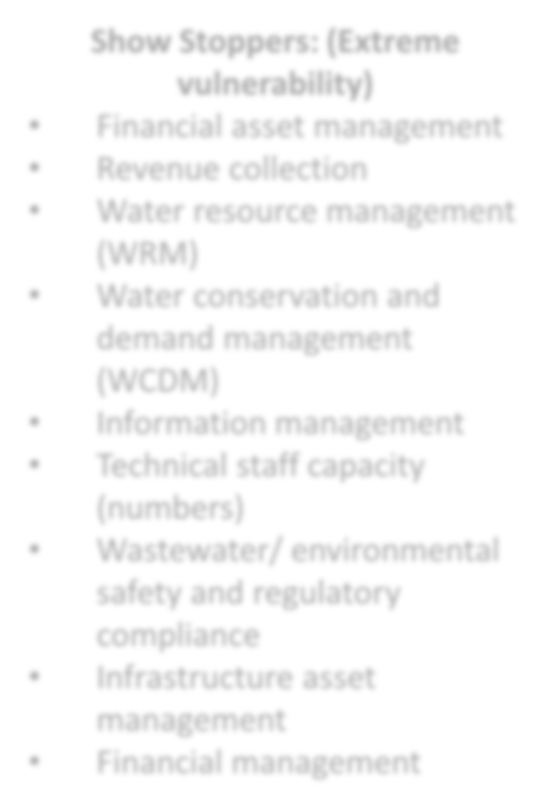
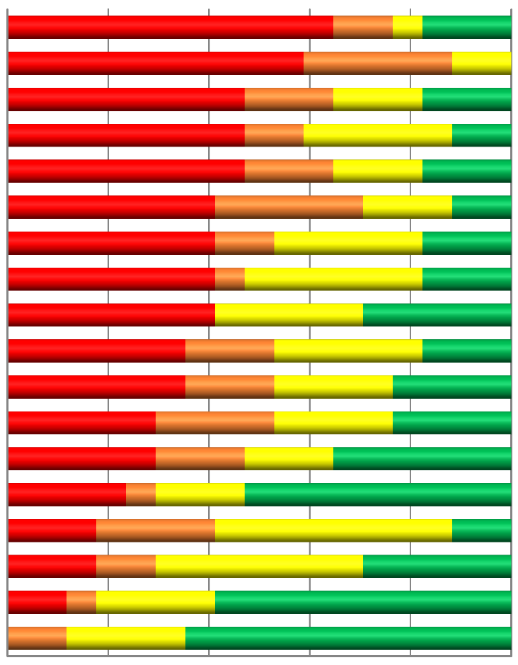

Vulnerability hotspots
MPUMALANGA
Show Stoppers: (Extreme vulnerability)
Financial asset management
Revenue collection
Water resource management (WRM)
Water conservation and demand management (WCDM)
Information management
Technical staff capacity (numbers)
Wastewater/ environmental safety and regulatory compliance
Infrastructure asset management
Financial management
Revenue Collection
Financial Asset Management
Information Management
Water Resource Management (WRM)
Water Conservation & Demand Management (WCDM)
  Wastewater/ Environmental Safety & Regulatory…
12. Financial Management
18. Customer Care (CRM)
3. Staff Skill Levels (Technical)
  Infrastructure Asset Management (IAM)
8. Basic Sanitation
4. Technical Staff Capacity (Numbers)
Drinking Water Safety & Regulatory Compliance
2. Management Skill Level (Technical)
Operation & Maintenance (O&M) of Assets
17. Water Service Quality
  Water Services Planning
16. Organisational Performance Monitoring
This identifies the vulnerabilities- What is DWS doing to support the Municipalities in addressing these vulnerabilities?
0%
20%
40% 60%
Cumulative Percentage of WSAs
ExtremeVulnerability Moderate Vulnerability No data
High Vulnerability Low Vulnerability
80%
100%

Slide 29
Drought status of the province

Slide 30
Areas experiencing drought (based on SPI and dam level values) | City of Mbombela Local Municipality, Thembisile Hani Local Municipality, Dr JS Moroka, Bushbuckridge
Areas where drought disasters have been declared, dates of declarations | National State of Disaster: March 2018. Provincial Disaster: Nov 2016
Relevance of real time monitoring coverage and challenges experienced (Gaps in Network, Funds etc.) | 99% coverage, insufficient funds if instruments fail/break.
Dams where restrictions have been published (number and detail) | June 2020: Crocodile System (Kwena dam) 20% restriction on domestic, 60% restriction on irrigation. June 2020: Sabie system 40% irrigation restriction; 10% restriction on domestic supply. June 2020: Lower Komati (Driekoppies dam) 20% irrigation June 2020: Kaap River (Lomati Dam) 10 % domestic April 2016: Mkhombo Dam 20 % domestic 40% irrigation
Dams in extreme to exceptional drought category (<40% level) | Ohrigstad Dam: 9%, Mkhombo Dam 1.9%, Klipkopje dam 22%
DMs, LMs, towns, settlements impacted: number of households and population | Dr JS Moroka (249 705 people) and Thembisile Hani LM (310 458 people). Bushbuckridge LM (549 676 people) City of Mbombela (689 206 people)
DWS funding request: Number of District, Local Municipalities and metros | Gazetted Allocations: 2018/19: Dr JS Moroka: R18 million. Thembisile Hani R14 million. Emakhazeni LM: 18million. Steve Tshwete LM: 6.8 million. TOTAL allocation for Mpumalanga- R56.8 million.

Slide 31
Overview of Thembisile Hani LM intervention
Project name | Scope of work | Budget allocation
Drilling, refurbishment, equipping and electrification of boreholes in Mathyzensloop, Sheldon and Boekenhouthoek | Refurbishment of 2 x Boekenhouthoek boreholes, Refurbishment of 1 x Matheyzensloop boreholes and Drilling of 1 x Sheldon Borehole and Refurbishment of 2 x hand pump boreholes | R 2 104 051,50
Drilling, refurbishment, equipping and electrification of boreholes iKwaggafontein and Verena | Refurbishment of 1 borehole and 1X drilled at Kwaggafontein A (W28)x(Refurbishment of 2 boreholes installed with hand pumps and 1X drilled at Kwaggafontein A (W 29), (Refurbishment of 1 borehole installed with hand pump) 1X drillled at Kwaggafontein C, Refurbishment of (1x borehole and 2X drilled at Kwaggafontein D (1x hand pump ) (1x Electrification)and 1X drilled at Verena | R 4 519 974,38
Drilling, refurbishment ,equipping and electrification of boreholes in Bundu, Rietfontein and Machipe | Refurbishment of 4 x Bundu boreholes ( 3 electrification& 1 hand pump) ,Refurbishment of 3X Machipe (3 electrification) and Refurbishment of 2X Rietfontein( 1 hand pump & 1 electrification) | R 4 509 370,80
Drilling, refurbishment, equipping and electrification of boreholes in Tweefonein DK Blesbok Farm,Loopspruit Farms and Hartesbeespruit, Seringkop and Kwaggafontein D. | Refurbishment of borehole with Hand pump at Tweefontein DK x1, Loopspruit x1 and Kwaggafontein D x1. Refurbishment of borehole with Electrical driven pump at Tweefontein C x1, Seringkop x1 and Bleskop x1. Refurbishment of borehole with Windmill at Hartebeespruit x1. | R 2 866 603,32
Total cost estimate |  | R 14 000 000,00

Slide 32
Overview of Dr J S Moroka LM intervention
Project name | Scope of work | Budget allocation
Drilling, equipping and Rehabilitation of existing boreholes in various villages. (Greenside, Katjibane and Seabe) | Drilling, Equipping and Rehabilitation of existing boreholes in various villages. (Greenside, Katjibane and Seabe) | R 3 000 000,00
Drilling, equipping and Rehabilitation of existing boreholes in various villages. (Loading,Semahlase, Ramantsho and Sehokho) | Drilling, Equipping and Rehabilitation of existing boreholes in various villages. (Loading,Semahlase, Ramantsho and Sehokho) | R 3 000 000,00
Drilling, Equipping and Rehabilitation of existing boreholes in various villages. (Kgaphamadi, Ga-Mmakola,Madubaduba, Molapo'a Mogale, Dithabaneng, DMA and Maphotla | Drilling, Equipping and Rehabilitation of existing boreholes in various villages. (Kgaphamadi, Ga-Mmakola,Madubaduba, Molapo'a Mogale, Dithabaneng, DMA and Maphotla) | R 10 000 000,00
Equipping and Rehabilitation of existing boreholes in various villages. (Pankop/ Masobe, Phake, Metimadima and Matshiding) | Equipping and Rehabilitation of existing boreholes in various villages. (Pankop/ Masobe, Phake, Metimadima and Matshiding) | R 2 000 000,00
Total cost estimate |  | R18 000 000,00

Slide 33
Overview of Emakhazeni LM intervention
Project name | Scope of work | Budget allocation
Water Supply in rural areas Ward 1 and 4 | 1. 3 new of Boreholes to be drilled tested for yield and equipped with wind mill pumps. 2. 3 x boreholes and 3 x wind mills to be refurbished 3. 1x30KL elevated steel tank will be installed in Paardeplaats were the water collection depot will be located, 4. 4x5000L elevated yard tanks will be installed in the farms in Ward 1 and Ward 4 respectively. 5. Pipes to be installed in Paardeplaats consist of 50mm dia and 25mm dia HDPE(PN16), pipe length are 125m and 480mrespectively.6. The pipe diameters to be utilized are 25mm and 50 mm with total pipe length of 1555m in all farms. | R4 500 000,00
Water Supply in rural areas Ward 2 | Portable water supply to 26 communities in rural areas. Systems to include borehole abstraction, storage and distribution with yard connections. 1.New boreholes to be drilled -1 2.Boreholes that have to be refurbished - 2 3. Number of Windmills that need to be refurbished - 3 4.Tanks: 2500L - 4, 5000L - 13, 10 000L - 3 5. Pipe Reticulation - 3km of 50 diameter Class 12 HDPE pipe | R5 700 000,00
Water Supply in rural areas ward 5 and 6 | Developing of 1 x new Borehole with a pump that is powered by a windmill Construction of 1 x new elevated steel tank with a capacity of 30kl (4.5m high Construction of 50mm diameter HDPE pipeline to the dwelling (Estimated total length is 500m) Construction of 15 x new 5000l Jojo tanks elevated by 1.5m | R3 200 000,00
Water Supply in rural areas Ward 8 | Drilling and equipping of four new boreholes Supply and Install 2X40KL @ 5m stand Abeco or Similar Steel Tanks Supply and Install of a Climax Windmills or similar to pump 20000 litres of water per day for a maximum head of 150m Supply and Install a 50 mm HDPE of 2000 metres pumping line from the boreholes to the Water Tanker Supply and Install a 40 mm HDPE of 1500 metres water reticulation pipe from the Water Tanker to the households and addition of the stand connection. Refurbishing of 7 existing boreholes within the farm areas of ward 8 Supply and install 8x5000l plastic water tanks , JoJo or similar to farms that has existing water infrastructure | R4 600 000,00
Total cost estimate |  | R18 000 000,00

Slide 34
Overview of Steve Tshwete LM intervention
Project name | Scope of work | Budget allocation
Drought Relief Funding (Site, Drill and Equip Boreholes and Erect Related Water Infrastructure For The Hendrina Water Schemes) | In principle the scope of works entails of the siting & establishment of six (6) boreholes, and electrical supply to the boreholes; installation of fence, installation of 5X10kl jojo tanks with stands, construction of connection network and installation of package plant | R6 800 000.00
Total cost estimate |  | R6 800 000.00

Slide 35
Progress on drought intervention
Dr J S Moroka : 11 boreholes have been refurbished, while 15 new boreholes have been drilled, giving a total of 26 boreholes and two package plants.
Refurbishment of Mthombo Emergency Pipeline to supply water to Weltevreden Water Treatment Plant (Dr JS Moroka LM). An amount of R38m allocated from the Municipal Infrastructure Grant. Contractor has been appointed by Dr JS Moroka. Site establishment scheduled for 6 October 2020.
Thembisile Hani : 27 boreholes have been refurbished, while 07 new boreholes have been drilled, giving a total of 34 boreholes.
Emakhazeni : 08 borehole have been refurbished and 10 new boreholes have been drilled, giving the total of 18 boreholes.
Steve Tshwete : 06 new boreholes have been drilled.

Slide 36
Covid-19 interventions

Slide 37
Ehlanzeni DM
Local Municipality | Project | Cost (R)
Nkomazi | Refurb Of Various Boreholes In Nkomazi | 16 375 574
Bushbuckridge | Total Nkomazi | 16 375 574
 | Refurbishment Of Sanitation Infrastructure In Bushbuckridge Local Municipality | 4 258 624
 | Refurbishment Of Boreholes | 11 521 522
 | Installation Of New Boreholes | 18 391 371
 | Total Bushbuckridge | 34 171 518
Thaba Chweu | Refurbishment Of Boreholes In Mashishing | 10 000 000
City Of Mbombela | Verulam Sewer House Connection | 16 227 868
 | Refurbishment Of Kanyamazane WTW | 23 091 422
 | Drilling, Equip and Energize New Boreholes In Barberton Town | 4 800 000
 | Refurbishment Of Barberton WWTW | 16 349 329
 | Total City of Mbombela | 60 468 619
Total Ehlanzeni DM |  | 121 015 713

Slide 38
Nkangala DM
Local municipality | Project name | Cost (R)
Dr Js Moroka | Refurbishment And Upgrading Of B/W Pipeline From Mthombo To Supplement Weltevreden WTW | 40 511 045
 | Replacement Of Bulkline And Installation Of Pump In Makopanong | 8 500 000
 | Replacement Of Bulkline And Installation Of Pump In Siyabuswa D (Mogononong) | 8 500 000
 | Installation Of Borehole In Moletji | 398 816
 | Installation Of Borehole In Waterval | 379 500
 | Installation Boreholes With The Storage Tanks And Electricity Connections In Dr Js Moroka Local Municipality In Mjakaneng Village | 882 021
 | Water Provision In Moripe Gardens | 846 601,34
 | Water Provision In Maphotla Gardens | 687 211
 | Installation Boreholes With The Storage Tanks And Electricity Connections In Dr Js Moroka Local Municipality In Nokaneng Village | 882 021
 | Installation Boreholes With The Storage Tanks And Electricity Connections In Dr Js Moroka Local Municipality In Phake Village | 882 021
 | Installation Boreholes With The Storage Tanks And Electricity Connections In Dr Js Moroka Local Municipality In Madubaduba Village | 882 021
 | Water Provision In Pankop | 882 021
 | Water Provision In Toitskraal | 444 331
 | Water Provision In Kuduspoort | 444 331
 | Water Provision In Maganagobuswa | 882 021
 | Water Provision In Semohlase Village | 563 873
 | Construction Of Sewer Reticulation In Ga-Phahla | 21 152 065
 | Total Dr Js Moroka Tr's | 87 719 903
Steve Tshwete | Site, Drill, Equip Boreholes And Install Water Storage Tanks At Various Farms /Rural Areas | 7 244 997
 | New Storage Pullenshope | 12 788 820
 | Construction Of Low Flush Toilets In Farms | 8 616 720
 | Total Steve Tshwete | 28 650 537
Thembisile Hani | Kameelpoortnek/Suncity A, B, C & D, Kwaggafontein A, D & E, Mahlabathini, Lithuli, Kwamhlanga A, B, C, And Various Farms | 47 235 041
 | Upgrading Of Water Infrastructure In Sheldon | 58 305 000
 | Kwamhlanga WWTW : Refurbishment & Upgrading Of Eastern And Western WWTW of KwaMhlanga | 21 815 452
 | Total Thembisile Hani | 127 355 494
Totals |  | 222 320 395

Slide 39
Gert Sibande DM
Local Municipality | Project Name | Cost (R)
Govan Mbeki | Installation Of 31 Boreholes In Gmm Game Farms | 16 491 264
Mkhondo | Installation Of New Boreholes In Mkhondo | 9 167 378
Msukaligwa | Refurbishment Of Northern Wtw's Sludge Pump Station And Booster Pump Station | 1 985 709
 | Refurbishment Of Davel WWTW's | 12 323 123
 | Upgrading Of Kwazanele WWTW's | 121 074 000
 | Electro-Mechanical Upgrade To Extension 32,33 & 34pumpstations In Ermelo | 9 813 039
 | Drilling Of Warburton Boreholes | 5 608 113
 | Upgrading Of Breyton WTW's | 398 451 033
 | Total Msukaligwa | 549 255 017
Chief Albert Luthuli | Upgrading And Refurbishment Of Carolina WTW Phase 4 | 13 698 255
 | Proposed Water Infrastructure For Nhlazatshe 7 | 15 812 483
 | Proposed Water Infrastructure For Nhlazatshe 6 | 21 336 028
 | Bulk And Network Sewer At Emanzana Phase 2 | 43 736 851
 | Manzana Water Scheme | 26 881 838
 | Ekulindeni Water Reticulation | 17 764 806
 | Total Chief Albert Luthuli | 139 230 262
Dr Pixley Ka Isaka Seme | Refurbishment And Upgrading Of Perdekop Wwtw's | 74 557 554
 | Refurbishment And Upgrading Of Wakkerstroom | 49 557 553
 | Refurbishment Of Volkrudt Sewer Pumpstations | 6 169 497
 | Refurbishment And Upgrading Of Amersfoort WWTW's | 12 255 209
 | Total Dr Pixley Ka Isaka Seme | 142 539 813
Lekwa | Lekwa Boreholes | 18 367 000
 | Rural Sanitation | 30 210 592
 | Lekwa Sewer Pumpstations | 39 009 878
 | Total Lekwa | 87 587 470
Totals Gert Sibande District |  | 714 143 922
Total Covid 19 MIG Reprioritised Funds For Mpumalanga Province |  | 1 023 308 511

Slide 40
Water tanks distribution
District municipality | Storage tanks allocations | Local municipality | Tanks distributed
Nkangala DM | 188 | Dr JS Moroka | 64
 |  | Thembisile Hani | 50
 |  | Emalahleni | 25
 |  | Steve Tshwete | 15
 |  | Victor Khanye | 14
 |  | Emakhazeni | 20
Gert Sibande DM | 262 | Pixley ka Seme | 50
 |  | Msukaligwa | 40
 |  | Mkhondo | 50
 |  | Govan Mbeki | 40
 |  | Lekwa | 25
 |  | Dipaleseng | 15
Ehlanzeni DM | 150 | City of Mbombela | 30
 |  | Bushbuckridge | 45
 |  | Thaba Chweu | 40
 |  | Nkomazi | 35
Total number of tanks |  |  | 600

Slide 41
District development model

Slide 42
Institutionalisation: set-up at district levels
There are 3 districts in Mpumalanga Province, namely Gert Sibande, Nkangala and Ehlanzeni District Municipalities.
Each district shall have a District Hub supported by District based Task Teams that are representative of all sectors in the Province.
The district Hubs shall be coordinated centrally through the Provincial Project Management Unit
DWS works in partnership with COGTA and District Municipalities in implementation of Infrastructure Projects
DWS is part of the Provincial Project Management Unit (PPMU)
Provincial One Plan
District Based One Plan
District Based One Plan
District Based One Plan

Slide 43
District coordination task teams and hubs
All National Departments with/ without Regional Offices within the Province
All Provincial Sector Departments and their Entities
Provincial SALGA and SETA’s
All local municipalities within the District Area
Representation of Traditional Leaders and Community Based Organisations
Eskom, Rand Water, DBSA, MISA, NDA, NYDA, Private sector Rep’s
Representation of all three spheres of Government within a District area.
All development partners within a District area shall form part of the Teams and Hubs.
The MMF’s and EMF existing structures to be extended for the purposes of coordinating all other stakeholders

Slide 44
District Development Model
The District Coordinating Model shall help to address amongst others:
  Challenges of misalignment of plans in the IDP and Sector Plans
  Address the impact of Government Investment.
  Address capacity gaps to accelerate delivery
  Enable all spheres to focus on One Plan at District Levels.
  Financial resources appropriated correctly for each financial year outputs.
  Derive a clear medium term to long-term planning vision.
Provincial COGTA to re-organize itself to fit-in to drive accelerated planning and implementation support through mobilized expertise.
The COGTA Mpumalanga has partnered with the DBSA to set-up a PMU at a Provincial level that shall support all District municipalities in rolling out the “Khawuleza Model”
The Implementation Plan is currently rolling and the District profiles have been undertaken by COGTA
DWS works in partnership with COGTA and District Municipalities in implementation of Infrastructure Projects

Slide 45
water and sanitation projects at planning stage

Slide 46
City of Mbombela LM
Project name | Project scope | Project status | Townships | Population | No. of households
Nsikazi North Bulk Water Supply RBIG | Phase 2: construction of 23 km pipeline form Nyongane to Nsikazi Villages | Planning/ Feasibility scheduled for 2020/21 financial year. | Bekiswayo | 409 | 82
 |  |  | Chochocho | 2165 | 433
 |  |  | Ga-Tshwene | 976 | 195
 |  |  | Jerusalem | 1610 | 322
 |  |  | Khumbula | 2499 | 500
 |  |  | Mahushu | 4668 | 934
 |  |  | Makoko | 944 | 189
 |  |  | Malekutu | 2311 | 462
 |  |  | Manzini | 2832 | 566
 |  |  | Mgandusweni | 4710 | 942
 |  |  | Mjejane | 289 | 58
 |  |  | Mountain View | 1744 | 349
 |  |  | Mzadza | 2626 | 525
 |  |  | New Tshabalala | 3306 | 661
 |  |  | Ngcobaneni | 998 | 200
 |  |  | Numbi B | 1985 | 397
 |  |  | Nyongane | 1682 | 336
 |  |  | Phameni | 622 | 124
 |  |  | Phola | 3090 | 618
 |  |  | Salubindza | 2747 | 549
 |  |  | Sand river | 1671 | 334
 |  |  | Swalala | 3590 | 718
 |  |  | Tshabalala | 2190 | 438
TOTAL |  |  |  | 49 664 | 9993

Slide 47
Emalahleni LM
Project name | Project scope | Project status | Townships | Population | No. of households
Emalahleni Bulk Water Supply | Upgrade Emalahleni WTW From 75 ML/D To 100ml/D | Feasibility investigation planned for 2020/21 | Kwa Guqa | 129 401 | 25 880
 |  |  | Clewer | 13 046 | 2 609
 |  |  | Pine Ridge Industrial | 18 871 | 3 774
 |  |  | Klarinet | 36 694 | 7 339
 |  |  | Jackaroo | 12 699 | 2 540
 |  |  | Blanchville
 |  |  | Del Judor | 20 348 | 4 070
 |  |  | Lynville | 36 383 | 7 277
 |  |  | Thushanang
 |  |  | CBD | 50 451 | 10 090
 |  |  | Tasbet / Duvha | 39 322 | 7 864
 |  |  | Phola / Ogies | 12 917 | 2 583
Total |  |  |  | 370 132 | 74 026

Slide 48
Thembisile Hani LM
Project name | Project scope | Project status | Townships | Population | No. of households
Loskop Bulk Water Scheme | The implementation of water supply augmentation to meet the medium-to long term bulk water needs of Thembisile Hani Local Municipality. The scheme entails construction of abstraction point at Loskop dam, 20Ml/d treatment module, 50km bulk pipeline, 4 pumpstrat ions and storage reservoir. | Feasibility and IRS to be completed in 2020/21 | Kwagafontein Cluster Tweefontein”k” Vlaklaagte 1 Kwaggafontein “a” Kwaggafontein “b” Kwaggafontein “c” Kwaggafontein “d” Kwaggafontein “e” Boekenhouthoek Bundu Mathysenzloop | 89 402 | 19 867
 |  |  | Langkloof Cluster | 3 016 | 670
 |  |  | Matshipe Cluster | 2 316 | 514
 |  |  | Thembalethu Cluster Thembalethu Tweefontein E Tweefontein F Tweefontein G Tweefontein H Tweefontein J Verena A&B Verena C Verena D Wolvenkop Buhlebesizwe Buhlebuzile | 81 700 | 18 155
Total |  |  |  | 176 434 | 39 206

Slide 49
Dr J S Moroka LM
Project name | Project scope | Project status | Townships | Population | No. of households
Western Highveld/ Rus De Winter Bulk Water Scheme | Abstract bulk raw water from the Rust De Winter Dam, 10Ml/d Water Treatment Works (WTW), bulk pipeline and reservoir for the Western Highveld Mathanjana Area. | Implementation Readiness Study to be done in 2020/21 | Masobe, Mammetlake, Phake, Seabe, Rankaile Loding, Ramantsho, Mmaduma, Marapyane | 71 203 | 19 332
Total |  |  |  | 71 203 | 19 332

Slide 50
Msukaligwa LM
Project name | Project scope | Project status | Townships | Population
Msukaligwa Bulk Water Project | Ermelo/ Wesselton water supply upgrade | Feasibility to be done in 2020/21 | Ermelo/ Wesselton | 161 160
Total |  |  |  | 161 160

Slide 51
Allocations for Regional bulk and water services infrastructure grants

Slide 52
Executive Summary on Project Implementation Plan 2020/2021
(Grant allocation and Expenditure as at 05 October 2020)
PROGRAMME | DORA SCHEDULE | ALLOCATION R’000 | SPENT/ TRANSFERREND BY 05/10/2020 R’000 | % EXPENDITURE | BALANCE R’000
RBIG | SCHEDULE 5B | R 478 407 | R 89 500 | 19 | R 388 907
 | SCHEDULE 6B | R 275 366 | R 78 509 | 29 | R 196 857
WSIG | SCHEDULE 5B | R 402 375 | R91 875 | 22 | R 310 500
 | SCHEDULE 6B | R 50 650 | R 26 498 | 53 | R 24 152
TOTAL |  | 1 206 798 | 286 382 | 24 | R 920 416

Slide 53
2020/21 QUARTER 2 PERFORMANCE TARGETS
PPI & ANNUAL TARGET | TARGET ON THE 2ND QUARTER | ACHIEVED | COMMENTS
PPI No 3.7.1.2: 6 Number of large Regional Bulk Infrastructure Project phases under construction | 5 projects under schedule 5B (DORA) Empuluzi / Methula Phase 3B of 8 Empuluzi / Methula 4B of 8 Empuluzi / Methula Phase 8 of 8 Balfour / Siyathemba RBWS Phase 2 of Phase 6 Balfour / Siyathemba RBWS Phase 3 of 6 | All 5 projects under construction (100%) | N/A
PPI No 3.7.1.2: 4 Number of large Regional Bulk Infrastructure Project phases under construction | 4 projects under schedule 6B (DORA) Driekoppies Phase 1A of 5 Driekoppies Phase 1C of 5 Driekoppies Phase 2A of 5 Driekoppies Phase 3B of 5 | All 4 projects under construction (100%) | N/A
PPI No 3.7.2.2: 1 Number of large Regional Bulk Infrastructure Project phases completed | 1 project under schedule 5B (DORA) 1 Empuluzi/Methula RBWS Phase 8 of 8 | 100% Achievement | N/A

Slide 54
2020/21 QUARTER 2 PERFORMANCE TARGETS
PPI & ANNUAL TARGET | TARGET ON THE 2ND QUARTER | ACHIEVED | COMMENTS
PPI No 3.7.1.3: 8 Number of small regional bulk infrastructure project phases under construction | 6 under schedule 5B Bushbuckridge Water Services Phase 2 (Maviljan WWTW’s) Amsterdam/ Sheepmoor Phase 3 of 4 Balfour WWTW’s Phase 2 of 3 Balfour WWTW’s Phase 3 of 3 Eerstehoek Phase 1 of 4 RBWS Eerstehoek Phase 2of 4 RBWS | All 6 projects (100% achievement) | N/A
PPI No 3.7.1.3: 6 Number of small regional bulk infrastructure project phases under construction | 6projects under schedule 6B Sibange Phase 1of 5 Sibange Phase 2 of 5 Sibange Phase 3 of 5 Sibange Phase 4 of 5 Sibange Phase 5 of 5 Lekwa COVID-19 Project *Projects highlighted in red are those not achieved* | 4 projects Achieved (under achieved: 67%) | Sibange Phase 2of 5 : contractor terminated due to poor performance and project at re-tendering stage -Lekwa COVID-19 awaiting appointment of Implementing Agent

Slide 55
2020/21 QUARTER 2 PERFORMANCE TARGETS
PPI & ANNUAL TARGET | TARGET ON THE 2ND QUARTER | ACHIEVED | COMMENTS
PPI No.3.8.1: 26 Number of small WSIG projects under construction | 7 under schedule 5B Chief Albert (1) Govan Mbeki (2) Mkhondo (2) Msukaligwa (1) ThabaChweu (1) Thembisile (2) | 14 Achieved (over-achied 200%) Chief Albert (1) Govan Mbeki (1) Mkhondo (2) Msukaligwa (2) Nkomazi (1) ThabaChweu (2) Emakhazeni (2) Thembisile (3) | Due to COVID-19 water projects had to be fast tracked to respond to pandemic
PPI No.3.8.1: 1 Number of small WSIG projects under construction | 1 under schedule 6B Refurbishment of Rooikopen Sewer network | 1 Achieved (100%) | N/A
PPI No.3.8.2: 11 Number of small WSIG projects completed | 2 under schedule 5B Msukaligwa (1) | 2 Achieved (over-achieved 200%) Msukaligwa (2) | Projects fast tracked to respond to COVID-19

Slide 56
PROJECT DETAILS
RBIG SCHEDULE 6B - UP TO DATE
PROJECT NAME | 2020/21 ALLOCATION R’000 | 2020/21 PROJECT COMMITMENT R’000 | 2020/21 EXPENDITURE R’000 | INV AT HAND | 2020/21 BALANCE (EXP & INVOICE AT HAND) | PROJECTED EXP AT 31 MARCH 2021 | SURPLUS/(DEFICIT) | PROJECT STATUS
Balf/Siyat/Greyl/Willem/Nthor Bulk Water Supply | R 66 807 | R 185,199 | R 12,327 | R0,00 | R 54,480 | R 85 000 | (R 18 193) | 2 Phases under implementation in various stages
Thembisile Water Scheme (Loskop) | R 22 498 | R 45,615 | R 3,700 | R0,00 | R 18 798 | R 22 498 | - | Awaiting Approval of IRS by Planning to advertise for construction
Western Highveld (Rust de Winter) Bulk Water Scheme | R 1 000 | R0,00 | R0,00 | R0,00 | R 1 000 | R 1 000 | - | Submission for appointment of IA in progress
Northern Nzikazi Bulk Water Supply | R 1 000 | R0,00 | R0,00 | R0,00 | R 1 000 | R 1 000 | - | Submission for appointment of IA in progress
Driekoppies Upgrading | R 54 960 | R 199,404 | R 21,745 | R 0,00 | R33,215 | R 90 000 | (R 35 040) | 5 Phases under implementation in various stages
Sibange Bulk Water Supply | R 50 000 | R 126,544 | R 12,675 | R 0 | R 37,325 | R 60 000 | (R 10 000) | 4 Phases under construction in various stages
Lekwa Waster Services | R 2 000 | R 0,00 | R 0,00 | R 0,00 | R 2 000 | R 2 000 | - | Submission for appointment of IA in progress
Lekwa Outfall Sewer (Sakhile ext 8) | R 29 040 | R 0,00 | R 0,00 | R 0,00 | R 29,040 | R 29 040 | - | Submission for appointment of IA in progress
Lekwa Water Supply | R 20 000 | R 0,00 | R 0,00 | R 0,00 | R 20,000 | R 20 00 |  | Submission for appointment of IA in progress
RS144-MPUMALANGA RAND WATR COV19 | R 28 061 | R 0,00 | R 28,061 | R 0,00 | R 0,00 | R 28 061 | R 0,00 | Tankering by Rand Water
TOTALS | R 275 366 | R 556,762 | R78,509 (29%) | R 0 | R 196,857 | R 318 599 | R 63 233

Slide 57
PROJECT DETAILS
RBIG SCHEDULE 6B - UP TO DATE
MUNICIPALITY | PROJECT NAME | 2020/21 ALLOCATION R’000 | 2020/21 TRANSFERRED R’000 | FUNDS WITHHELD | PROJECTED TRANSFERS BY 31 MARCH 2021 | PROJECT STATUS
CHIEF ALBERT LUTHULI | Empuluzi BWS | R 139 568 | R 30 000 | R0,00 | R 139 568 | 2 PHASES UNDER CONSTRUCTION AT VARIOUS STAGES AND 1 PROJECT AT PRACTICAL COMPLETION
 | Eesterhoek/Ekulindeni | R 80 000 | R 10 000 | R0,00 | R 80 000 | 2 PHASES UNDER CONSTRUCTION, BOTH JUST ESTABLISHED SITE
MKHONDO | Amsterdam and Sheepmoor Bulk Water Scheme | R 20 000 | R 3 000 | R0,00 | R 20 000 | 1 PHASE UNDER CONSTRUCTION AND OTHER PHASE AT DESIGN STAGE
MSUKALIGWA | Msukaligwa Regional Water Supply Scheme | R 75 000 | R 10 000 | R0,00 | R 75 000 | 1 PHASE AT TENDER STAGE
DIPALISENG | Balfour WWTW | R 45 000 | 13 500 | R0,00 | R 45 000 | 2 PHASES UNDER CONSTRUCTION
BUSHBUCKRIDGE | Bushbuckridge | R 23 000 | 23 000 | R0,00 | R 23 000 | PROJECT PHASE UNDER CONSTRUCTION
GOVAN MBEKI | Embalenhle Bulk Sewer | R 60 000 | R 0,00 | R0,00 | R 60 000 | COVID 19 PROJECT AWAITING TRANSFER OF FUNDS
STEVE TSHWETE | Steve Tshwete Water Services | R 35 839 | R0,00 | R0,00 | R 35 839 | COVID 19 PROJECT AWAITING TRANSFER OF FUNDS
TOTALS |  | R 478 407 | R89 500 | R0,00 | 478 407 | Amended payment schedule including Covid 19 projects not yet approved by National Treasury and thus no progress to projects as funds have been transferred

Slide 58
PROJECT DETAILS
WSIG SCHEDULE 6B - UP TO DATE
PROJECT NAME | 2020/21 ALLOCATION R’000 | 2020/21 PROJECT COMMITMENT R’000 | 2020/21 EXPENDITURE R’000 | INV AT HAND | 2020/21 BALANCE (EXP & INVOICE AT HAND) | PROJECTED EXP AT 31 MARCH 2021 | SURPLUS/(DEFICIT) | PROJECT STATUS
ROOIKOPEN SEWER UPGRADE | R 50 650 | R 105 146 | R 26 499 | R0 ,00 | R 24 151 | R 70 650 | (R 20 000) | Phase under implementation AT 30% progress

Slide 59
WSIG (5B) 2020/2021 GRANT ALLOCATIONS
MUNICIPALITY | 2020/21 ALLOCATION | FIRST TRANSFER 000’ | STATUS
Chief Albert Luthuli | R 26 375 | R 6 375 | Design / Tender
Msukaligwa | R 20 000 | R 10 000 | Design / Tender
Mkhondo | R 26 000 | R 16 000 | Under construction
Dr Pixley ka Isaka Seme | R 30 000 | R 5 000 | Planning
Govan Mbeki | R 30 000 | R 5 000 | Tender
Emalahleni | R 30 000 | R 0,00 | BP
Steve Tshwete | R 25 000 | R 8 000 | Design/ Tender
Emakhazeni | R 30 000 | R 4 000 | Design / Tender
Thembisile Hani | R 50 000 | R 10 000 | Under Construction
Thaba Chweu | R 15 000 | R 4 500 | Under Construction
Nkomazi | R 40 000 | R 13 000 | Under Construction
Bushbuckridge | R 80 000 | R 10 000 | Under Construction
Total | R402 375 | R 91 875

Slide 60
Decent sanitation infrastructure: projects for 2018/19 and 2019/20 FY
2018/19 PROJECT IMPLEMENTATION | BUDGET ALLOCATED | EXPENDITURE | NUMBER OF UNITS INSTALLED
Constructed 1200 convertible sanitation units in various wards (Midland regions) for 2018/19 FY | R12 000 000 | R12 000 000 | 1496
Construction of 320 VIP Toilets in Mangweni and Steenbok Villages for 2018/19 FY | R4 900 000 | R4 900 000 | 320
Provision of alternative and maintaining existing sanitation in Lusushwane Scheme for 2855 households for 2018/19 FY | R2 600 000 | R2 600 000 | 2855

Slide 61
Decent sanitation infrastructure: projects for 2018/19 and 2019/20 FY
2019/20 PROJECT IMPLEMENTATION | BUDGET ALLOCATED | EXPENDITURE TO DATE | NO OF UNITS INSTALLED
Constructed 1500 VIP convertible sanitation units in various wards Bushbuckridge Local Municipality (Northern region) for 2019/20 FY | R15 000 000 | R11 119 441 | Project in progress 1024

Slide 62
Thank you

