Slide 1
NCOP: Select Committee on Transport
SANRAL Update
October 2020

Slide 2

CONTENTS
Horizon 2030 Strategy Update
Financial Performance
Covid1-19 Update
Support Function Update

Slide 3
Horizon 2030 Strategy
Update

Slide 4
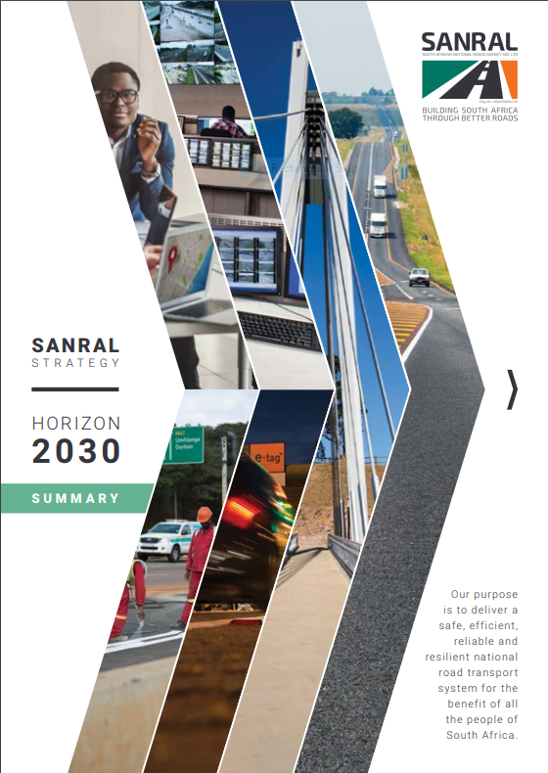
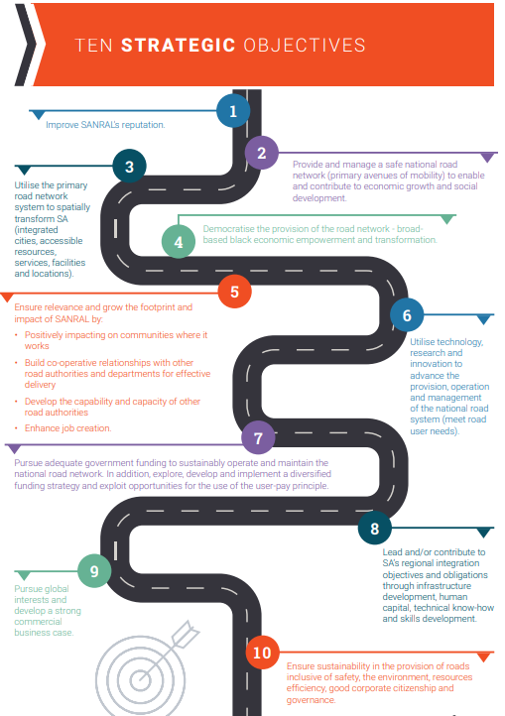

Slide 5
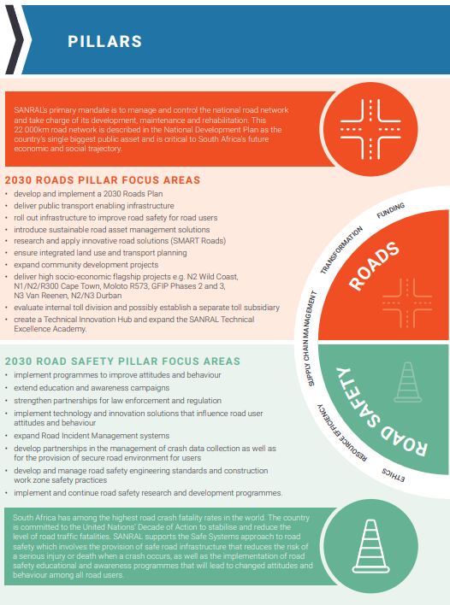
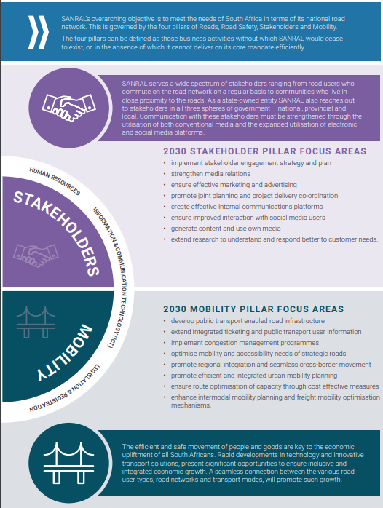

Slide 6
ROADS PILLAR: FOCUS AREAS
develop and implement a 2030 Roads Plan
  Final draft to be submitted to SANRAL Board for wider consultation approval this financial year
deliver public transport enabling infrastructure
  Updated Public Transport Infrastructure guidelines approved for implementation
roll out infrastructure to improve road safety for road users
  Road safety addressed as part of each SANRAL CAPEX projects, various pedestrian walkway and bridge projects been implemented. Research, innovation and partnerships being pursued to improve road safety performance.
introduce sustainable road asset management solutions
  SANRAL Asset Management System to undergo ISO 55000 accreditation in 2021
research and apply innovative road solutions (SMART Roads)
  SANRAL has appointed 16 research panels looking at various identified research priorities
ensure integrated land use and transport planning
  SANRAL is following SPLUMA requirement on all SANRAL projects to ensure integration. New Development Planning and Land Use Management Unit proposed for establishment at SANRAL.
expand community development projects
  New approved Community Development Strategy now being implemented to benefit communities, create jobs and train SMMEs.
deliver high socio-economic flagship projects e.g.
  N2 Wild Coast – Msikaba Bridge project underway, N2 Mtentu Bridge project retendered, New road section design projects underway with construction project tenders planned for over the next 6 months
  N1/N2/R300 Cape Town – Tenders issued for consulting engineering design services. Funding is a serious constraint.
  Moloto R573 – Gauteng portion transferred on 5th June 2020 to SANRAL, designs being completed. Phase 1 project completed in Mpumalanga. Limpopo project affected by contractor business rescue. Phase 2 projects tendered early in 2020.
  GFIP Phases 2 and 3 – No progress. Future projects dependent on outcome with current GFIP e-toll matter.
  N3 Van Reenen – Part of the new SIP projects as Gazetted by the Minister of Public Works.
  N2/N3 Durban - Project underway. 8 Construction tender packages underway. 6 more project packages to be tendered over next 6 months.
evaluate internal toll division and possibly establish a separate toll subsidiary
  Focus currently on the establishment of a central Toll Division within SANRAL. Awaiting approval processes. Toll subsidiary to be investigated over the medium term.
create a Technical Innovation Hub and expand the SANRAL Technical Excellence Academy.
  The Innovation Hun is operational in Cape Town office. The Excellence Academy has been refocused with a new 5-year plan.

Slide 7
ROAD SAFETY PILLAR: FOCUS AREAS
implement programmes to improve attitudes and behavior
  Extensive road safety programme rolled out at schools
extend education and awareness campaigns
  Marketing and communications campaigns rolled out focusing on Responsible driving, responsible walking, and driver behavior.
strengthen partnerships for law enforcement and regulation
  Ongoing engagements with RTMC and CBRTA to strengthen partnerships. Co-olocation with RTMC at COC in Midrand,and new MOU with CBRTA.
implement technology and innovation solutions that influence road user attitudes and behavior
  SANRAL has appointed 16 research panels to conduct research in various identified research priority areas
expand Road Incident Management systems
  New tenders issued to enable expansion to whole SANRAL road network
develop partnerships in the management of crash data collection as well as for the provision of secure road environment for users
  Being pursued through partnership with RTMC
develop and manage road safety engineering standards and construction work zone safety practices
  Research panel work to deliver material for improved standards and practices
implement and continue road safety research and development programmes
  Work pursued through the established research panels.

Slide 8
STAKEHOLDER PILLAR: FOCUS AREAS
implement stakeholder engagement strategy and plan
  Approved stakeholder engagement strategy being implemented. SANRAL 14-point plan used as basis for project level stakeholder relations management. Strategic partner for stakeholder engagement and social facilitation appointed.
strengthen media relations
  Structured media relations targeting improved media perceptions, own media and digital media.
ensure effective marketing and advertising
  Project level campaigns being implemented e.g. Moloto road, N2/N2 KZN and N2 Wild Coast.
promote joint planning and project delivery co-ordination
  SANRAL is directly involved in planning processes led by the Infrastructure Investment Office in the Presidency.
create effective internal communications platforms
  Instruments in place to ensure effective communication with employees, including on covid-19 related matters
ensure improved interaction with social media users
  Capacity established within SANRAL to effectively engage on social media. Tender for a new social media partner underway.
generate content and use own media
  Various own media platforms established and being used for periodic(e.g By the Way and Hello Series) and project level content (e.g. N2 Wild Coast project publications)
extend research to understand and respond better to customer needs.
  Work pursued through the established research panels

Slide 9
MOBILITY PILLAR: FOCUS AREAS
develop public transport enabled road infrastructure
  Updated Public Transport Infrastructure guidelines approved for implementation
extend integrated ticketing and public transport user information
  Successful pilot project complete in Gauteng, MOU signed with key stakeholders for implementation
implement congestion management programmes
  Implementation is part of SANRAL’s Intelligent Transport Solution
optimise mobility and accessibility needs of strategic roads
  Various corridor development plans developed. Strong focus on development planning support, access control and statutory control compliance.
promote regional integration and seamless cross-border movement
  SANRAL actively participating in cross border initiatives such as the Border Management Agency BMA working groups, Border facility improvements, and road infrastructure development initiatives
promote efficient and integrated urban mobility planning
  SANRAL is working with municipalities to ensure compliance with SPLUMA requirements and to promote integrated planning.
ensure route optimisation of capacity through cost effective measures
  The SANRAL Asset Management System enables the analysis of route capacity requirements and evaluate viable response options.
enhance intermodal mobility planning and freight mobility optimisation mechanisms.
  SANRAL has appointed 16 research panels looking at various identified research priorities, some of which focusing on intermodal and freight mobility

Slide 10
SA ROAD NETWORK - 2020
Authority | Paved | Gravel | Total
SANRAL | 22 253 | 0 | 22 253
Provinces - 9 | 46 509 | 226 273 | 272 882
Metros - 8 | 51 682 | 14 461 | 66 143
Municipalities | 37 680 | 219 223 | 256 903
Total | 158 124 | 459 957 | 618 081
Un-Proclaimed (Estimate) |  | 131 919 | 131 919
Estimated Total | 158 124 | 591 876 | 750 000
Un-Proclaimed Roads = Public roads not formally gazetted by any Authority
Although SANRAL network only represents 3.6% of the 618,081 km proclaimed network, it carries 34.5 % of the annual vehicle kilometres driven in South Africa.
Currently more than 70% of the long distance road freight in South Africa is transported on the SANRAL road network.

Slide 11
SANRAL NETWORK CONDITION - 2020
Type | Year | V-Good | Good | Fair | Poor | V-Poor
Length (km) | 2020 | 3,217 | 9,821 | 7,793 | 1358 | 61
% | 2020 | 14.5% | 44.1% | 35.0% | 6.1% | 0.3%
Currently 1420 km or 6.4% of SANRAL roads are in poor to very poor surface condition, which are well within the international norm of 10% for well-maintained network.
This is largely due to the preventative maintenance first strategy followed by SANRAL

Slide 12

SANRAL FUNDING TREND
SANRAL FUNDING TREND – NEGATIVELY IMPACTED BY:
e-Tolls future still not resolved – results in low payment compliance – negatively impacting SANRAL ability to finance toll portfolio in short term.
Toll portfolio short term funding shortfall addressed by transfers from Non-Toll – This reduced budget for new projects (R5.75bn in 2018/19, R2,5bn in 2019/20 and R2.53 billion transferred so far in 2020/21).
Impact of COVID-19 and lockdown regulations on future funding availability – Non Toll allocation reduced by R1.1 billion, Toll CAPEX funding not secured yet.

Slide 13
SANRAL Project Pipeline – 2020/21 to 2022/23
Project Type | Non-Toll |  | Toll |  | Total
 | Design | Construction | Design | Construction | Design | Construction
Routine Maintenance | 146 | 116 | 47 | 67 | 193 | 183
Periodic Maintenance | 141 | 45 | 25 | 4 | 166 | 49
Special Maintenance | 70 | 26 | 12 | 1 | 82 | 27
Community Projects | 78 | 17 | 8 | 0 | 86 | 17
Strengthening | 20 | 16 | 7 | 0 | 27 | 16
Improvements | 119 | 32 | 8 | 2 | 127 | 34
New Facilities | 118 | 38 | 32 | 14 | 150 | 52
Totals | 692 | 290 | 139 | 88 | 831 | 378
 | 982 |  | 227 |  | 1209
SANRAL Tender Sequence (Attempting to limit to 20 per month)
Operational Tenders - RRM / Toll / etc – Operational contracts coming to end
Periodic Maintenance – Limited Regulatory Approvals/Commercial Material Sources
Strengthening/Improvement/New - Projects with all regulatory approvals in place
On average 125 new maintenance/construction contractor only tenders per year.
e-toll decision imperative for certainty of project delivery

Slide 14
Annual Financial Statements 2019/20

Slide 15
Statement of Financial Position
R’billion |  | 2019/20 | 2018/19
Assets
 | Non-current Assets | 441.147 | 402.887
 | Current Assets | 20.913 | 9.999
 | Non-current assets held for sale | 0.022 | 0.034
Total Assets |  | 462.082 | 412.921
R’billion |  | 2019/20 | 2018/19
Equity |  | 331.496 | 293.811
Liabilities |  | 130.586 | 119.110
 | Non-current liabilities | 105.801 | 100.800
 | Current Liabilities | 24..784 | 18.310
Total Equity and Liabilities |  | 462.082 | 412.921

Slide 16
Statement of Profit and Loss
R’billion |  | 2019/20 | 2018/19
 | Revenue | 13.590 | 16.661
 | Other income and other gains | 1.353 | 1.084
 | Operating expenses | (11.074) | (11.825)
Operating (loss)/Profit |  | 3.869 | 5.920
 | Investment income | 1.478 | 0.741
 | Fair value adj for investment property | 0.014 | (0.003)
 | Finance Cost | (4.098) | (4.237)
Profit (Loss) for the year |  | 1.263 | 2.421
 | Revaluations | 36.422 | 23.732
Total comprehensive income for the year |  | 37.685 | 26.153

Slide 17
Statement of Cash flows
R’billion |  | 2019/20 | 2018/19
Cash generated from operations |  | 14.844 | 7.016
 | Interest income | 1.232 | 0.741
 | Finance cost paid | (3.786) | (3.871)
Net cash from operating Activities |  | 12.291 | 3.886
Net cash from investing activities |  | (7.755) | (5.566)
Net cash from financing activities |  | 3.258 | 2.772
Total Cash and Cash Equivalents |  | 16.534 | 8.740

Slide 18
Audit Report 2019/20
Unqualified Opinion
Key Audit Matter | Outcome
Revaluation of road network and road structures | AGSA was satisfied that the revaluation of road network and road structures is appropriate, reasonable, is fairly valued and appropriately disclosed in the annual financial statements.
Expected credit losses on e-toll trade and other receivables | AGSA was satisfied that the expected credit losses on e-toll and other receivables were reasonable, in line with their expectations and appropriately disclosed in the annual financial statements in accordance with IFRS.
E-toll revenue | AGSA was satisfied that e-toll revenue was recognised and accounted for in line with the requirements of IFRS 15 and appropriately disclosed in the annual financial statements.

Slide 19
Emphasis of Matter
Description | Reference
Material Impairments – trade and other receivables expected credit losses (impairment) of R10.177 billion were recognized. R9.831 billion of this impairment relates to the impairment of e-toll receivables. | Note 11
Irregular expenditure Irregular expenditure of R342 million was incurred in the current year, due to non-compliance with prescribed procurement prescripts. R227m (66%) relates to irregular contracts identified in the current year, of which R174 million which relate to one contract that was paid without following proper approvals from National Treasury. | Note 43

Slide 20
Irregular Expenditure

Slide 21
Covid-19 and Support Functions Update

Slide 22



Covid-19 IMPACT High-level Overview
How COVID-19 affected SANRAL operations and 2020 plans
Financial year end and audit process disruptions
Supply chain disruptions and slow implementation of the procurement plan
Limited impact on corporate operations – operationally geared to work remotely
Slow budget expenditure due to suspension of construction activities and project delays.
Drastic reduction of traffic on toll roads leading to significant toll revenue losses
Supply challenges - Limited suppliers with shortage of stock, resulting in long lead times for delivery
Procured temperature screening equipment for all offices
Adequate levels of sanitizers masks and gloves secured ahead of 4 May re-opening.
New and updated SOPs published for gradual ramp-back of business operations from 4 May 2020
Procurement of PPE's and disinfectants/sanitizers
Shortfall of R2.53 billion (incl VAT) on toll portfolio for GFIP. Approved by NT.
R3.5bn HWAY20 maturity successfully closed. Further maturities in October and March requiring a further R3.2bn.
SANRAL is pursuing a R7bn NDB Loan and a R7bn MIGA loan guarantee. Half of the loan guaranteed by MIGA can be used for refinancing, with the remainder earmarked for capital projects. No decision yet.
Debt Exposure
Force Majeure claims from construction projects, toll operators and other outsourced operations.
Under spending on projects – R670 million per month
Lost toll revenue (reduced traffic) – R640 million to date
Contingency allocation made for Covid-19 related expenses and claims
Risk Exposure
Agile procurement processes now required
Prioritisation of construction projects to drive economic recovery
Internal reallocation of budget to address areas with revenue shortfall
Scenario led operational plans for remainder of 2020/21 FY – incremental lockdown level relaxation (risk adjusted).
Interventions

Slide 23
Covid-19 RESPONSE PLANNING
9 MONTH COVID-19 HORIZON
MAY | JUN | JUL | AUG | SEPT | OCT | NOV | DEC | JAN | FEB | MAR | APRIL
LEVEL 4: 3rd Capacity
LEVEL 3: 50% Capacity
LEVEL 2: 75% Capacity
LEVEL 1: 100% Capacity
TODAY
STATUS
Majority Work from Home (WFH)
Constructions Sites – 50% Capacity
50% Work from Home (WFH)
Constructions Sites – 100% Capacity
50% Work from Home (WFH)
Constructions Sites – 100% Capacity
100% Staff Capacity from Offices
Constructions Sites – 100% Capacity
Scenarios
Implementing 90 day plan
Category 2: 2nd 3 months
Review and update operations plan
changes and impact to planning
What has changed (what must we do differently – if any)
How does the current level impact our operation or resumption to operations
Category 3: 3rd 3 months
Review and update operations plan
changes and impact to planning
What has changed (what must we do differently – if any)
How does the current level impact our operation or resumption to operations
Return to normal / new normal operations
Reversal of Levels 4 to 5 etc.
This will result in triggering the Level 5, 4, 3, 2 scenario
Notes:
*Milestone shapes are manipulated with greater ease when slide Zoom is set to 200-400%

Slide 24
RISK Management
How COVID-19 affected SANRAL operations and 2020 plans
Risk Exposure
Procurement of PPE's and disinfectants/sanitizers
Supply Chain Management
Managing supply chain environment by; Extending tender validity periods. Procurement of PPE during lockdown. Remote SCM processes. Agile adjudication. Introduction of updated and responsive SOPs for Covid-19 SCM conditions
Human Capital & Buildings
Deployment of Sanitizers and PPE Development of responsive SOPs for WFH, RTO, Employee health and safety, etc. Communication updates to keep staff informed of COVID-19 developments and interventions Appointment of essential services personnel and for emergency responses when required. Implementation of access control, screening of staff and guests, and cleaning of offices Maintaining staff morale, productivity and performance
Projects and Construction
Managing the impact of the suspension of construction activities. Claims from contractors Employment of site staff and viability of service providers Security of construction sites and related equipment. Safety of motorists. Efficient Tunnel operations Project backlog and budget underspending
Finance
Allocate 10% of the unspent budget to the cost centre for Covid-19 claims and expenses. Provision for unforeseen staff expenses during shutdown (special leave and on call). Delays with AFS, Audit, Payroll, Processing vendor payments etc. Under funding and debt exposure
Business Continuity
Ensure resilience and cyber risk mitigation of the IT infrastructure and systems. Securing newly implemented or scaled remote working practices to ensure the continuity of critical functions. Assessment and implementation of controls to mitigate against new risks created by the new working environment Potential for fraud and misconduct
Toll Operations
Oversight of toll operations as essential services during lockdown. Efficiency of toll operation with scaled down staff during lockdown. Safeguarding of motorists and toll collectors Operation of the Huguenot Tunnel Claims for revenue loss and operational disruptions The supply chain disruptions Non-achievement of performance goals

Slide 25

ICT2023 strategy: Status overview
Background:
Project management function includes initiating, planning, executing, controlling, and closing strategic and non strategic business requirements with the goal to achieve specific goals and meet specific success criteria deliver targeted programs. The primary challenge of the project management function is to achieve all of the project goals within the given constraints and budget. The project office is tasked with the implementation of the ICT2023 strategy delivery.
Strategic Projects
Strategic Projects
Project events:
Ongoing - Implementing CIS standards, Updating and refreshing relevant policies
Data Leak Protection (DLP) – implementation underway
SAP Digital Transformation
Project events:
Refer SAP S/4 Project Dashboard
Internal PMO resourcing underway
Enhance Information Security
Drive innovation and compliance
Project events:
Mature governance environment
Improvements with 2018/19 audits
SAP Digital transformation a key enabler
Project events:
Conduct a SWOT on the existing HR policy
Update HR policy as an ongoing activity
Benchmark high-performing companies HR policy environment and framework
Create a Paperless environment
Ensure end-user satisfaction
Project events:
RFT for new Helpdesk system to be finalized by end of August 2020
Increase Bandwidth capacity
Project Events:
WAN tender – Approved and advertised 31 July 2020
Consolidate and integrate ICT systems
Project events:
Not started
Toll System Standardisation
Project Events:
Tender document development underway in conjunction with internal team
Develop data-driven organisation
Project events:
Not started
25

Slide 26
HR2022 strategy: Status overview
Background:
The ICT function includes initiating, planning, executing, controlling, and closing strategic and nonstrategic business requirements with the goal to achieve specific goals and meet specific success criteria deliver targeted programs. The primary challenge of the project management function is to achieve all of the project goals within the given constraints and budget. The project office is tasked with the implementation of the ICT2023 strategy delivery.
Strategic Objectives
Strategic Objectives
Revise the human resource strategy
Targets:
Strategy 2030 which encompasses the HR vision is completed
Ensure effective recruitment by implement the employment equity plan
Targets:
Filled vacancies and bridge skills gap
Implemented the employment equity (EE) plan.
Revise SANRAL’s human resources policy
Targets:
Conduct a SWOT on the existing HR policy
Update HR policy as an ongoing activity
Benchmark high-performing companies HR policy environment and framework
Targets:
HR Policy review & submission to EXCO for approval.
Clearly define the SANRAL Performance Management Framework.
Conduct performance management training at all regions.
Design uniform performance management templates and ensure utilisation
Drive a high impact performance team culture
Review SANRAL’s operating model and organizational structure
Targets:
Revised the operating structure
Revised structure communicated with stakeholders
Updated and developed role definitions in accordance with the Patterson JE
Targets
Trained key staff nationally
Trained executives on leadership
Improved leadership and management skills through the application of “Time to Think.” methodologies to ignite the human mind.
Drive succession planning by using talent management methods
Targets:
Review SANRAL’s existing succession plan
Build a culture of succession
Draft a new succession plan and management Framework
Ensure ongoing leadership development
26

Slide 27
HR2022 strategy Management Status overview
Background:
Horizon 2030 identified four corporate pillars: Roads, road safety, stakeholders and mobility. It further set out several enablers, the first of which is human resources. Other enablers are: information and communication technology (ICT), legislation and regulation, ethics, resource efficiency, supply chain management (SCM), transformation, and funding. The Human Resources function has a role to play in relation to all corporate business pillars and impacts on several enablers, notably transformation and ethics. Horizon 2030 refers to five key focus areas for the Human Resources function:
Reviewing HR strategy, policies and organisational structure.
Strengthening leadership development.
Effective recruitment through the employment equity plan and skills development.
Driving a high-impact performance culture in the organisation.
Ensuing succession planning through talent management interventions.
Strategic Objectives
Strategic Objectives
Revise the human resource strategy
Targets:
Strategy 2030 which encompasses the HR vision is completed
Ensure effective recruitment by implement the employment equity plan
Targets:
Filled vacancies and bridge skills gap
Implemented the employment equity (EE) plan.
Revise SANRAL’s human resources policy
Targets:
Conduct a SWOT on the existing HR policy
Update HR policy as an ongoing activity
Benchmark high-performing companies HR policy environment and framework
Targets:
HR Policy review & submission to EXCO for approval.
Clearly define the SANRAL Performance Management Framework.
Conduct performance management training at all regions.
Design uniform performance management templates and ensure utilisation
Drive a high impact performance team culture
Review SANRAL’s operating model and organizational structure
Targets:
Revised the operating structure
Revised structure communicated with stakeholders
Updated and developed role definitions in accordance with the Patterson JE
Drive succession planning by using talent management methods
Targets:
Review SANRAL’s existing succession plan
Build a culture of succession
Draft a new succession plan and management Framework
Targets
Trained key staff nationally
Trained executives on leadership
Improved leadership and management skills through the application of “Time to Think.” methodologies to ignite the human mind.
Ensure ongoing leadership development
Targets
Review existing SANRAL skills and develop a skills plan
Develop 3-year Employment Equity Plans to direct internal transformation
Key Focus Area: Implement a skills development plan
27

Slide 28
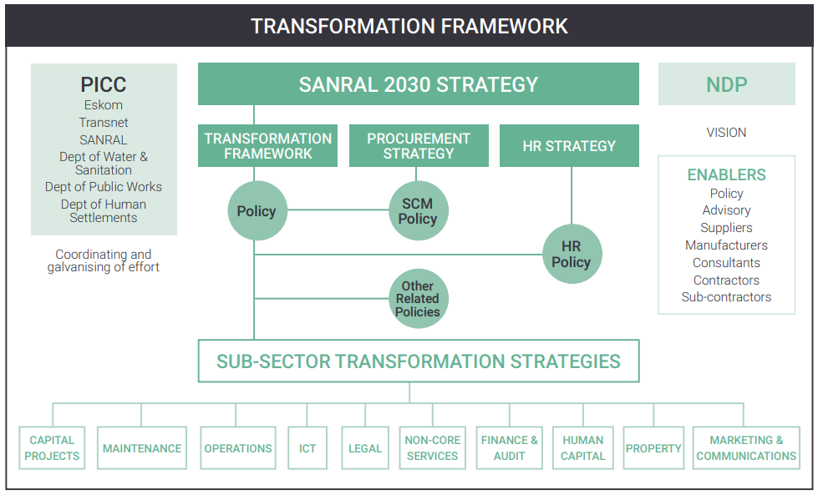

Slide 29
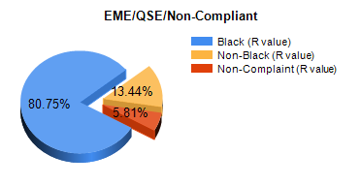
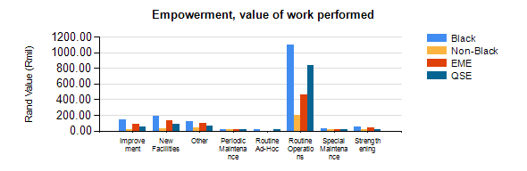
Transformation Progress and statistics

Slide 30
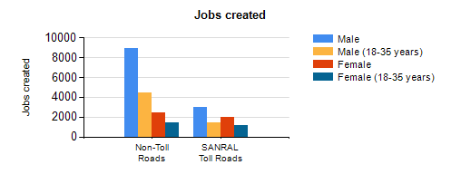
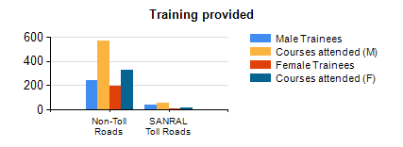
Transformation Progress and statistics

Slide 31
End

