Slide 1
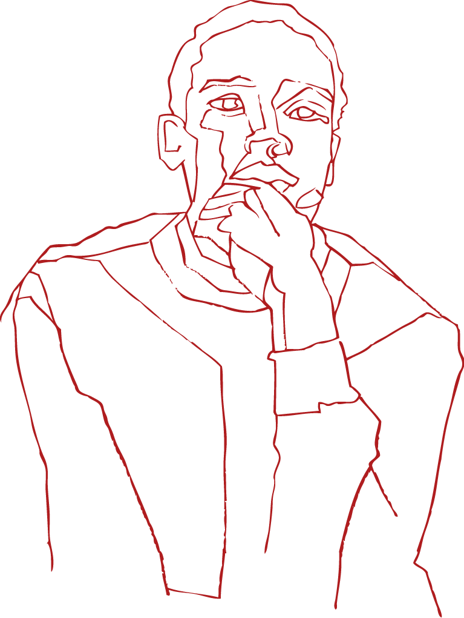
SPOTLIGHT
ON DROPOUT
06/10/2020

Slide 2
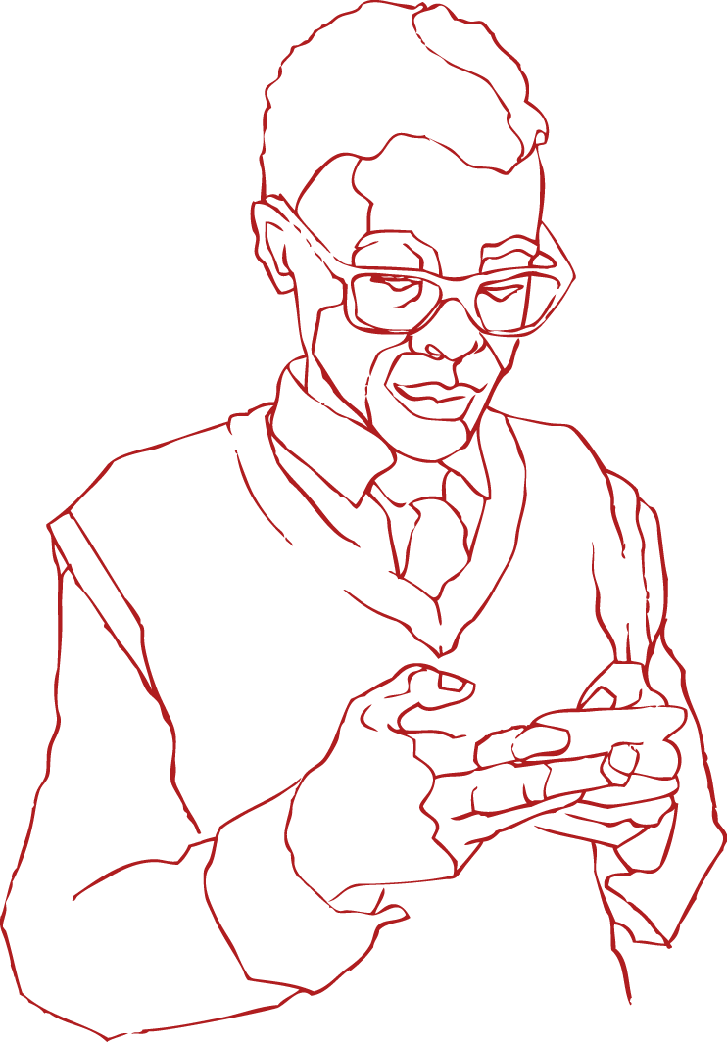
AGENDA
PURPOSE OF THE MEETING:
Share key research findings
Outline strategic options to reduce dropout, and potentially assist with improving other educational outcomes (such as improving teaching and learning, reduce repetition rates, improve school throughput)
Provide clear implementation steps based on three years of iterative learning
Build a lasting relationship and learning partnership for future collaboration in this area
PRESENTERS:
MERLE MANSFIELD, Zero Dropout Campaign Programme Director
ANGE BIDEN, Policy Consultant

Slide 3
ABOUT THE ZERO
DROPOUT CAMPAIGN
A national campaign working towards halving the rate of school dropout by 2030
OUR PRIORITIES
Increase national awareness about the problem of school dropout and spur action towards addressing it
Demonstrate what it takes to help children make it through school
Mobilise a network of schools committed to work together to reduce dropout
HOW?
We have collaborated with non-profit organisations (NPOs) to test models of intervention
Psychosocial support and data monitoring are central to these interventions

Slide 4
WHAT DOES DISENGAGEMENT LOOK LIKE?
Notes:
Disengagement is a term now being used globally to describe how learners are gradually affected by a process, and an interaction of factors, and lose the ability to focus in school
There are a number of factors. Most focus on the ‘push-out’ factors, such as poor attainment, failure and repetition, and poor teaching
There are a range of other factors – the ‘pull-out’ factors, which are generally within the family and community. These are issues such as the effects of poverty, inequality, and poor levels of child support
It is thought that it is mainly learning related issues that drive dropout
Our finding is that the problem is far more complex, and sits within the DISENGAGEMENT area, which is affected by more than just what is taking place, or not taking place at the school;

Slide 5
Notes:
Disengagement is a term now being used globally to describe how learners are gradually affected by a process, and an interaction of factors, and lose the ability to focus in school
There are a number of factors. Most focus on the ‘push-out’ factors, such as poor attainment, failure and repetition, and poor teaching
There are a range of other factors – the ‘pull-out’ factors, which are generally within the family and community. These are issues such as the effects of poverty, inequality, and poor levels of child support
It is thought that it is mainly learning related issues that drive dropout
Our finding is that the problem is far more complex, and sits within the DISENGAGEMENT area, which is affected by more than just what is taking place, or not taking place at the school;

Slide 6
PUSH OUT
Notes:
Disengagement is a term now being used globally to describe how learners are gradually affected by a process, and an interaction of factors, and lose the ability to focus in school
There are a number of factors. Most focus on the ‘push-out’ factors, such as poor attainment, failure and repetition, and poor teaching
There are a range of other factors – the ‘pull-out’ factors, which are generally within the family and community. These are issues such as the effects of poverty, inequality, and poor levels of child support
It is thought that it is mainly learning related issues that drive dropout
Our finding is that the problem is far more complex, and sits within the DISENGAGEMENT area, which is affected by more than just what is taking place, or not taking place at the school;

Slide 7
POOR TEACHING AND LEARNING
PUSH OUT
Notes:
Disengagement is a term now being used globally to describe how learners are gradually affected by a process, and an interaction of factors, and lose the ability to focus in school
There are a number of factors. Most focus on the ‘push-out’ factors, such as poor attainment, failure and repetition, and poor teaching
There are a range of other factors – the ‘pull-out’ factors, which are generally within the family and community. These are issues such as the effects of poverty, inequality, and poor levels of child support
It is thought that it is mainly learning related issues that drive dropout
Our finding is that the problem is far more complex, and sits within the DISENGAGEMENT area, which is affected by more than just what is taking place, or not taking place at the school;

Slide 8
POOR TEACHING AND LEARNING
PUSH OUT
POOR LEARNER OUTCOMES
(Failure & Repetition, Learners Over Age)
Notes:
Disengagement is a term now being used globally to describe how learners are gradually affected by a process, and an interaction of factors, and lose the ability to focus in school
There are a number of factors. Most focus on the ‘push-out’ factors, such as poor attainment, failure and repetition, and poor teaching
There are a range of other factors – the ‘pull-out’ factors, which are generally within the family and community. These are issues such as the effects of poverty, inequality, and poor levels of child support
It is thought that it is mainly learning related issues that drive dropout
Our finding is that the problem is far more complex, and sits within the DISENGAGEMENT area, which is affected by more than just what is taking place, or not taking place at the school;

Slide 9
POOR TEACHING AND LEARNING
PUSH OUT
POOR LEARNER OUTCOMES
(Failure & Repetition, Learners Over Age)
DISENGAGEMENT
Notes:
Disengagement is a term now being used globally to describe how learners are gradually affected by a process, and an interaction of factors, and lose the ability to focus in school
There are a number of factors. Most focus on the ‘push-out’ factors, such as poor attainment, failure and repetition, and poor teaching
There are a range of other factors – the ‘pull-out’ factors, which are generally within the family and community. These are issues such as the effects of poverty, inequality, and poor levels of child support
It is thought that it is mainly learning related issues that drive dropout
Our finding is that the problem is far more complex, and sits within the DISENGAGEMENT area, which is affected by more than just what is taking place, or not taking place at the school;

Slide 10
POOR TEACHING AND LEARNING
PULL OUT
PUSH OUT
POOR LEARNER OUTCOMES
(Failure & Repetition, Learners Over Age)
DISENGAGEMENT
Notes:
Disengagement is a term now being used globally to describe how learners are gradually affected by a process, and an interaction of factors, and lose the ability to focus in school
There are a number of factors. Most focus on the ‘push-out’ factors, such as poor attainment, failure and repetition, and poor teaching
There are a range of other factors – the ‘pull-out’ factors, which are generally within the family and community. These are issues such as the effects of poverty, inequality, and poor levels of child support
It is thought that it is mainly learning related issues that drive dropout
Our finding is that the problem is far more complex, and sits within the DISENGAGEMENT area, which is affected by more than just what is taking place, or not taking place at the school;

Slide 11
COMMUNITY FACTORS
POOR TEACHING AND LEARNING
PULL OUT
PUSH OUT
POOR LEARNER OUTCOMES
(Failure & Repetition, Learners Over Age)
DISENGAGEMENT
Notes:
Disengagement is a term now being used globally to describe how learners are gradually affected by a process, and an interaction of factors, and lose the ability to focus in school
There are a number of factors. Most focus on the ‘push-out’ factors, such as poor attainment, failure and repetition, and poor teaching
There are a range of other factors – the ‘pull-out’ factors, which are generally within the family and community. These are issues such as the effects of poverty, inequality, and poor levels of child support
It is thought that it is mainly learning related issues that drive dropout
Our finding is that the problem is far more complex, and sits within the DISENGAGEMENT area, which is affected by more than just what is taking place, or not taking place at the school;

Slide 12
COMMUNITY FACTORS
POOR TEACHING AND LEARNING
FAMILY
FACTORS
PULL OUT
PUSH OUT
POOR LEARNER OUTCOMES
(Failure & Repetition, Learners Over Age)
DISENGAGEMENT
Notes:
Disengagement is a term now being used globally to describe how learners are gradually affected by a process, and an interaction of factors, and lose the ability to focus in school
There are a number of factors. Most focus on the ‘push-out’ factors, such as poor attainment, failure and repetition, and poor teaching
There are a range of other factors – the ‘pull-out’ factors, which are generally within the family and community. These are issues such as the effects of poverty, inequality, and poor levels of child support
It is thought that it is mainly learning related issues that drive dropout
Our finding is that the problem is far more complex, and sits within the DISENGAGEMENT area, which is affected by more than just what is taking place, or not taking place at the school;

Slide 13
COMMUNITY FACTORS
POOR TEACHING AND LEARNING
FAMILY
FACTORS
PULL OUT
PUSH OUT
POOR LEARNER OUTCOMES
(Failure & Repetition, Learners Over Age)
DISENGAGEMENT
DISENGAGEMENT
Notes:
Disengagement is a term now being used globally to describe how learners are gradually affected by a process, and an interaction of factors, and lose the ability to focus in school
There are a number of factors. Most focus on the ‘push-out’ factors, such as poor attainment, failure and repetition, and poor teaching
There are a range of other factors – the ‘pull-out’ factors, which are generally within the family and community. These are issues such as the effects of poverty, inequality, and poor levels of child support
It is thought that it is mainly learning related issues that drive dropout
Our finding is that the problem is far more complex, and sits within the DISENGAGEMENT area, which is affected by more than just what is taking place, or not taking place at the school;

Slide 14
COMMUNITY FACTORS
POOR TEACHING AND LEARNING
FAMILY
FACTORS
PULL OUT
PUSH OUT
POOR LEARNER OUTCOMES
(Failure & Repetition, Learners Over Age)
DISENGAGEMENT
DISENGAGEMENT
LEARNER
DROPOUT
Notes:
Disengagement is a term now being used globally to describe how learners are gradually affected by a process, and an interaction of factors, and lose the ability to focus in school
There are a number of factors. Most focus on the ‘push-out’ factors, such as poor attainment, failure and repetition, and poor teaching
There are a range of other factors – the ‘pull-out’ factors, which are generally within the family and community. These are issues such as the effects of poverty, inequality, and poor levels of child support
It is thought that it is mainly learning related issues that drive dropout
Our finding is that the problem is far more complex, and sits within the DISENGAGEMENT area, which is affected by more than just what is taking place, or not taking place at the school;

Slide 15
COMMUNITY FACTORS
POOR TEACHING AND LEARNING
FAMILY
FACTORS
PULL OUT
PUSH OUT
POOR LEARNER OUTCOMES
(Failure & Repetition, Learners Over Age)
DISENGAGEMENT
DISENGAGEMENT
LEARNER
DROPOUT
Notes:
Disengagement is a term now being used globally to describe how learners are gradually affected by a process, and an interaction of factors, and lose the ability to focus in school
There are a number of factors. Most focus on the ‘push-out’ factors, such as poor attainment, failure and repetition, and poor teaching
There are a range of other factors – the ‘pull-out’ factors, which are generally within the family and community. These are issues such as the effects of poverty, inequality, and poor levels of child support
It is thought that it is mainly learning related issues that drive dropout
Our finding is that the problem is far more complex, and sits within the DISENGAGEMENT area, which is affected by more than just what is taking place, or not taking place at the school;

Slide 16
COMMUNITY FACTORS
POOR TEACHING AND LEARNING
FAMILY
FACTORS
PULL OUT
PUSH OUT
POOR LEARNER OUTCOMES
(Failure & Repetition, Learners Over Age)
LEARNER
DROPOUT
DISENGAGEMENT
DISENGAGEMENT
Notes:
Disengagement is a term now being used globally to describe how learners are gradually affected by a process, and an interaction of factors, and lose the ability to focus in school
There are a number of factors. Most focus on the ‘push-out’ factors, such as poor attainment, failure and repetition, and poor teaching
There are a range of other factors – the ‘pull-out’ factors, which are generally within the family and community. These are issues such as the effects of poverty, inequality, and poor levels of child support
It is thought that it is mainly learning related issues that drive dropout
Our finding is that the problem is far more complex, and sits within the DISENGAGEMENT area, which is affected by more than just what is taking place, or not taking place at the school;

Slide 17
AMY-LEE’S* STORY
Amy-Lee is from Lotus River; she is 21 years old and tells us that she dropped out of school in Grade 10 due to a combination of peer pressure and socio-economic circumstances.
“My friends really put lots of pressure on me. I’d call them in the morning and say I was going to school and they’d say I was boring. Come on, come on…and then I’d join the click,” she says.
She wants to work towards getting her Senior Certificate by attending a night school, but Amy-Lee lives in a dangerous area and would need to find a safe way to commute to class.
“I have so many regrets now. I know that if I’d stayed in school I’d be so far by now. Some of those friends are back at school now and I’m still at home. Some are pregnant. Some are just at home working on their mother’s nerves,” Amy-Lee laughs.
*Not her real name

Slide 18
Solving the dropout crisis
lies in providing ongoing psychosocial support, with targeted support
by monitoring and tracking
learner level data.
Notes:
If we begin, with the same causal loop of teaching and learning, but begin with interventions which focus on morals, psychosocial support and ensuring engagement can happen…
Then, we begin to see how this becomes a positive reinforcing circle with positive outcomes.
If we plug interventions to improve teaching and learning into this positive reinforcing loop, then they can get tractions, and learner outcomes will improve. You cannot teach, and improve learning outcomes of disengaged learners
Through this, we can begin to prevent dropout.

Slide 19
Notes:
If we begin, with the same causal loop of teaching and learning, but begin with interventions which focus on morals, psychosocial support and ensuring engagement can happen…
Then, we begin to see how this becomes a positive reinforcing circle with positive outcomes.
If we plug interventions to improve teaching and learning into this positive reinforcing loop, then they can get tractions, and learner outcomes will improve. You cannot teach, and improve learning outcomes of disengaged learners
Through this, we can begin to prevent dropout.

Slide 20
TEACHING AND LEARNING
DISENGAGEMENT
LEARNER OUTCOMES
Notes:
If we begin, with the same causal loop of teaching and learning, but begin with interventions which focus on morals, psychosocial support and ensuring engagement can happen…
Then, we begin to see how this becomes a positive reinforcing circle with positive outcomes.
If we plug interventions to improve teaching and learning into this positive reinforcing loop, then they can get tractions, and learner outcomes will improve. You cannot teach, and improve learning outcomes of disengaged learners
Through this, we can begin to prevent dropout.

Slide 21
LEARNER OUTCOMES
DISENGAGEMENT
TEACHING AND LEARNING
Notes:
If we begin, with the same causal loop of teaching and learning, but begin with interventions which focus on morals, psychosocial support and ensuring engagement can happen…
Then, we begin to see how this becomes a positive reinforcing circle with positive outcomes.
If we plug interventions to improve teaching and learning into this positive reinforcing loop, then they can get tractions, and learner outcomes will improve. You cannot teach, and improve learning outcomes of disengaged learners
Through this, we can begin to prevent dropout.

Slide 22
Psychosocial support interventions
LEARNER OUTCOMES
ENGAGEMENT
TEACHING AND LEARNING
Notes:
If we begin, with the same causal loop of teaching and learning, but begin with interventions which focus on morals, psychosocial support and ensuring engagement can happen…
Then, we begin to see how this becomes a positive reinforcing circle with positive outcomes.
If we plug interventions to improve teaching and learning into this positive reinforcing loop, then they can get tractions, and learner outcomes will improve. You cannot teach, and improve learning outcomes of disengaged learners
Through this, we can begin to prevent dropout.

Slide 23
Psychosocial support interventions
LEARNER OUTCOMES
ENGAGEMENT
TEACHING AND LEARNING
Teaching and learning intervention
Notes:
If we begin, with the same causal loop of teaching and learning, but begin with interventions which focus on morals, psychosocial support and ensuring engagement can happen…
Then, we begin to see how this becomes a positive reinforcing circle with positive outcomes.
If we plug interventions to improve teaching and learning into this positive reinforcing loop, then they can get tractions, and learner outcomes will improve. You cannot teach, and improve learning outcomes of disengaged learners
Through this, we can begin to prevent dropout.

Slide 24
NOLUTHANDO’S* STORY
Noluthando left school in 2018 due to a combination of peer pressure and a range of complex push-out and pull-out factors in her life. While at home, she became a mother at the age of 15.
Luckily, Noluthando was able to turn her situation around. With the help of a supportive mentor, she resumed her schooling with the goal of building a better life for her daughter.
“After I had my daughter, the Check & Connect mentor helped me get back to school. She would call me almost every day and encourage me to come back to school. She would tell me to come back, change how I behave and focus on my studies so I can be somebody in the future,” she says.
*Not her real name

Slide 25
PRESENTATION
OVERVIEW
A national campaign working towards halving the rate of school dropout by 2030
SOUTH AFRICA’S DROPOUT CRISIS
Pervasive and normalised
Perceptions about dropout
The Covid-19 moment
BUILDING A RESILIENT EDUCATION SYSTEM
Learner-level data tracking
Efficient referral systems
CASE STUDIES
RECOMMENDATIONS
Make Dropout reduction a KPI
Improve data and monitoring
Provide psychosocial support

Slide 26
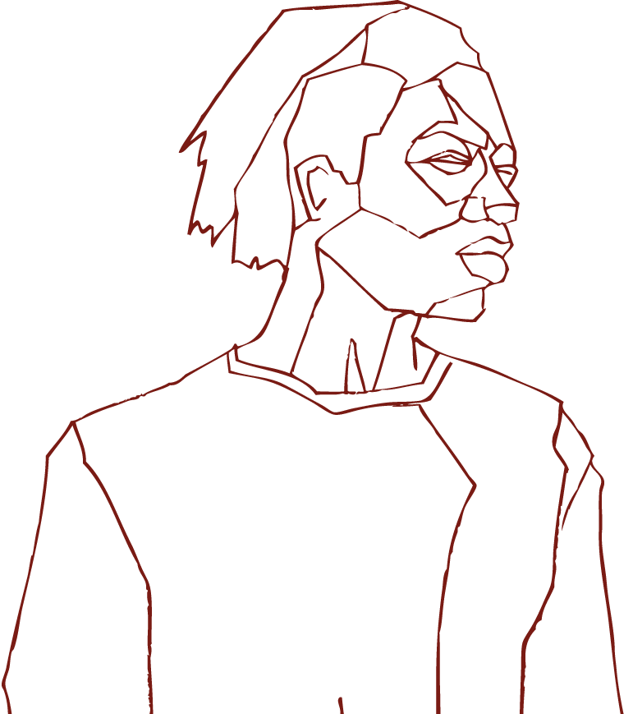
SOUTH AFRICA’S
DROPOUT CRISIS

Slide 27
40%
Around 40% of learners who start school in Grade 1 will exit the schooling system before completing Grade 12.

Slide 28
SOUTH AFRICA’S
DROPOUT CRISIS
Pervasive and normalised
Education sector receives the lion’s share of the government budget (even though funding per learner has been declining)
Despite this investment, around 40% of learners who start school won’t finish
This has largely been a hidden crisis
No proper data tracking and monitoring to accurately reflect extent of the problem
Despite the knock-on effect of dropout on unemployment and social spending, there is no national task team or coordinated effort to tackle the problem
!
!
DARK GREY
R69 G69 B67
HEX# 454543
!
!
!

Slide 29
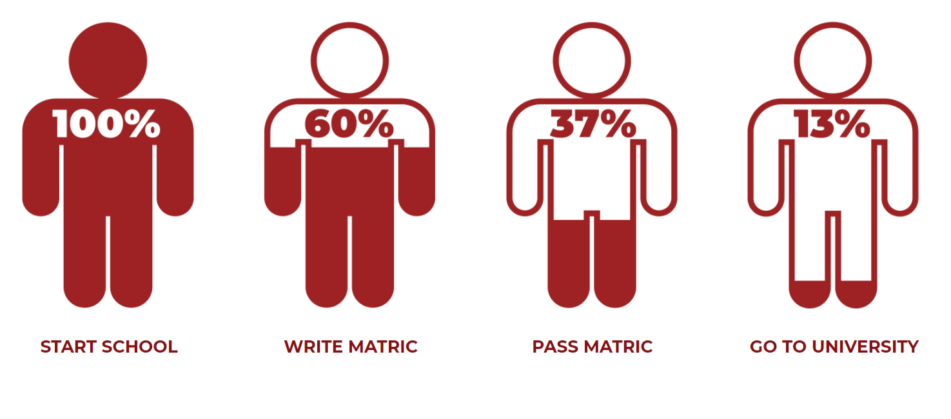
THE TRUE MATRIC PASS RATE
OF THE 2008 COHORT
The percentage of Grade 1 learners who made it to Grade 12 and beyond

Slide 30
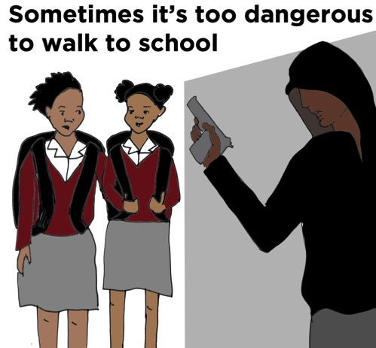
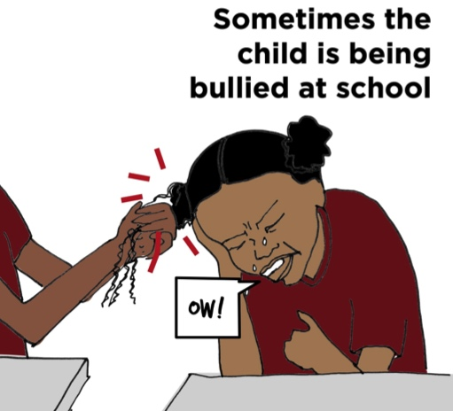
SOUTH AFRICA’S
DROPOUT CRISIS
Perceptions about dropout
Contrary to popular belief, learners don’t leave school because they are lazy or irresponsible
Dropout is rarely a single event; it’s a cumulative process of disengagement that occurs over time
Disruptions in the home, school and community push and pull the child away from school

Slide 31
BUT…
We can catch learners
BEFORE they drop out with:
Early warning systems
Proper data tracking and monitoring
Psychosocial support

Slide 32
SOUTH AFRICA’S
DROPOUT CRISIS
The Covid-19 moment
The Covid-19 pandemic (health, economic & social impact) amplifies disruptions that cause dropout
NIDS/CRAM survey shows:
Economic impact: 3 million people lost their jobs by April (18% decline compared to February)
Increased hunger: 1 in 2 households (47% of respondents) ran out of money to buy food in April
Health access: 1 in 4 people were unable to access medicine and contraceptives in the 14 days prior to the survey
The pandemic has brought dropout into sharp focus
The Covid-19 school closures, coupled with the economic shocks of lockdown, are expected to worsen dropout

Slide 33
“Being at home during Covid-19 has been difficult. We were sent work — we picked it up and then dropped it off when we were finished. But it is difficult to adjust without a teacher. Being able to see them and interact with the teachers online would have made the time easier, I think.”
Cassidy, 15, Ottery, Western Cape

Slide 34
“I was trying to adapt. I was trying to cover the time we lost. But since we are closing now I’m not sure whether I will be able to get back on track again”
Khanya, 18, Umbumbulu in Kwa-Zulu Natal

Slide 35
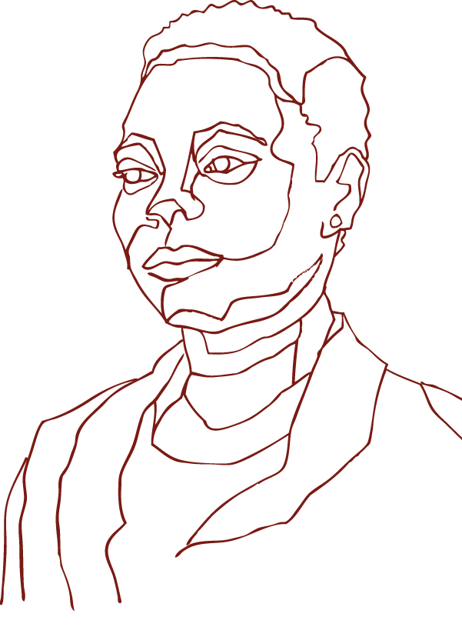
BUILDING A RESILIENT
EDUCATION SYSTEM

Slide 36
BUILDING A RESILIENT
EDUCATION SYSTEM
Learner-level data tracking
Research shows that one of the best ways to prevent dropout is through effective monitoring systems
These systems must track learner progress to alert education officials when learners are at risk
What should we be tracking?
ABC’s*…
Academic results
Behaviour problems
Chronic Absenteeism
* Findings based on international best practice and research on learner disengagement and dropout. (UNESCO Monitoring Education Participation Series)

Slide 38
BUILDING A RESILIENT
EDUCATION SYSTEM
Efficient referral systems
Through a referral system, at-risk learners are identified early and given necessary support:
Mentoring
Counselling
Home visits
Research shows that learners who stay in and do well at school, despite challenging circumstances, often succeed because they have stable, positive emotional relationships with at least one parent or key person
EVERY CHILD NEEDS A CHAMPION!
Referral system would be further strengthened through inter-sectoral collaboration (Health, SocDev & Education)

Slide 39
CASE
STUDIES

Slide 40
CASE
STUDIES
Overview of our implementing partners
An initiative that mobilises the community of Swellendam to tackle school dropout as a collective
Using Early Warning Systems to support and respond to young people at risk of dropping out
Creating opportunities for psychosocial support and academic catch-up in schools
Using Child and Youth Care Workers (CYCWs) at schools to provide lower-cost psychosocial support

Slide 41
CASE
STUDIES
Overview of our implementing partners
DARK GREY
R69 G69 B67
HEX# 454543

Slide 42
CASE
STUDIES
EWS risk assessment and SHARED model
Holistic community intervention
HOW?
By rallying community members and school leadership around the issue of dropout
EWS risk assessment
HOW?
Six schools able to track and reflect absenteeism from 2018 - 2019
Track learner-level data with the EWS tool
Two schools monitor all their intermediate phase learners, while others monitor the entire school cohort
With EWS, able to monitor the number of learners who drop out per grade, each quarter, in each school
Notes:
CAP uses the SHARED framework as a guide, as community intervention plan. The acronym defines: Supporting the whole child through SBST; Hard Data gathering on attendance & academic; Accountability of school structures (teachers, SMT’s, etc.); Relationship building through value-based activities and leadership mentoring; Enrichment Mindset through supporting basic literacy & numeracy & sensory development beyond curriculum and Defined & deliberate education for the community through a network approach. (discussed in more detail below)

Slide 43
CASE
STUDIES
Check & Connect
Leveraging EWS and mentorship programme
HOW?
Identify at-risk learners in grades 6 - 9
Connect these learners with mentors
Six schools connected to the Data Driven Districts Dashboard
Principals trained to use the system to track school data
Notes:
As represented by Figure 1: Gr 8 Learner Dropout, all three of the high schools show a decrease in dropout in grade 8 from 2016 – 2018, with the least dropout recorded in Wongalethu in 2018. Both Mzamowhethu and Mzokhanyo show a decreasing dropout rate to below 10%.

Slide 44
CASE
STUDIES
Check & Connect
Notes:
As represented by Figure 1: Gr 8 Learner Dropout, all three of the high schools show a decrease in dropout in grade 8 from 2016 – 2018, with the least dropout recorded in Wongalethu in 2018. Both Mzamowhethu and Mzokhanyo show a decreasing dropout rate to below 10%.

Slide 45
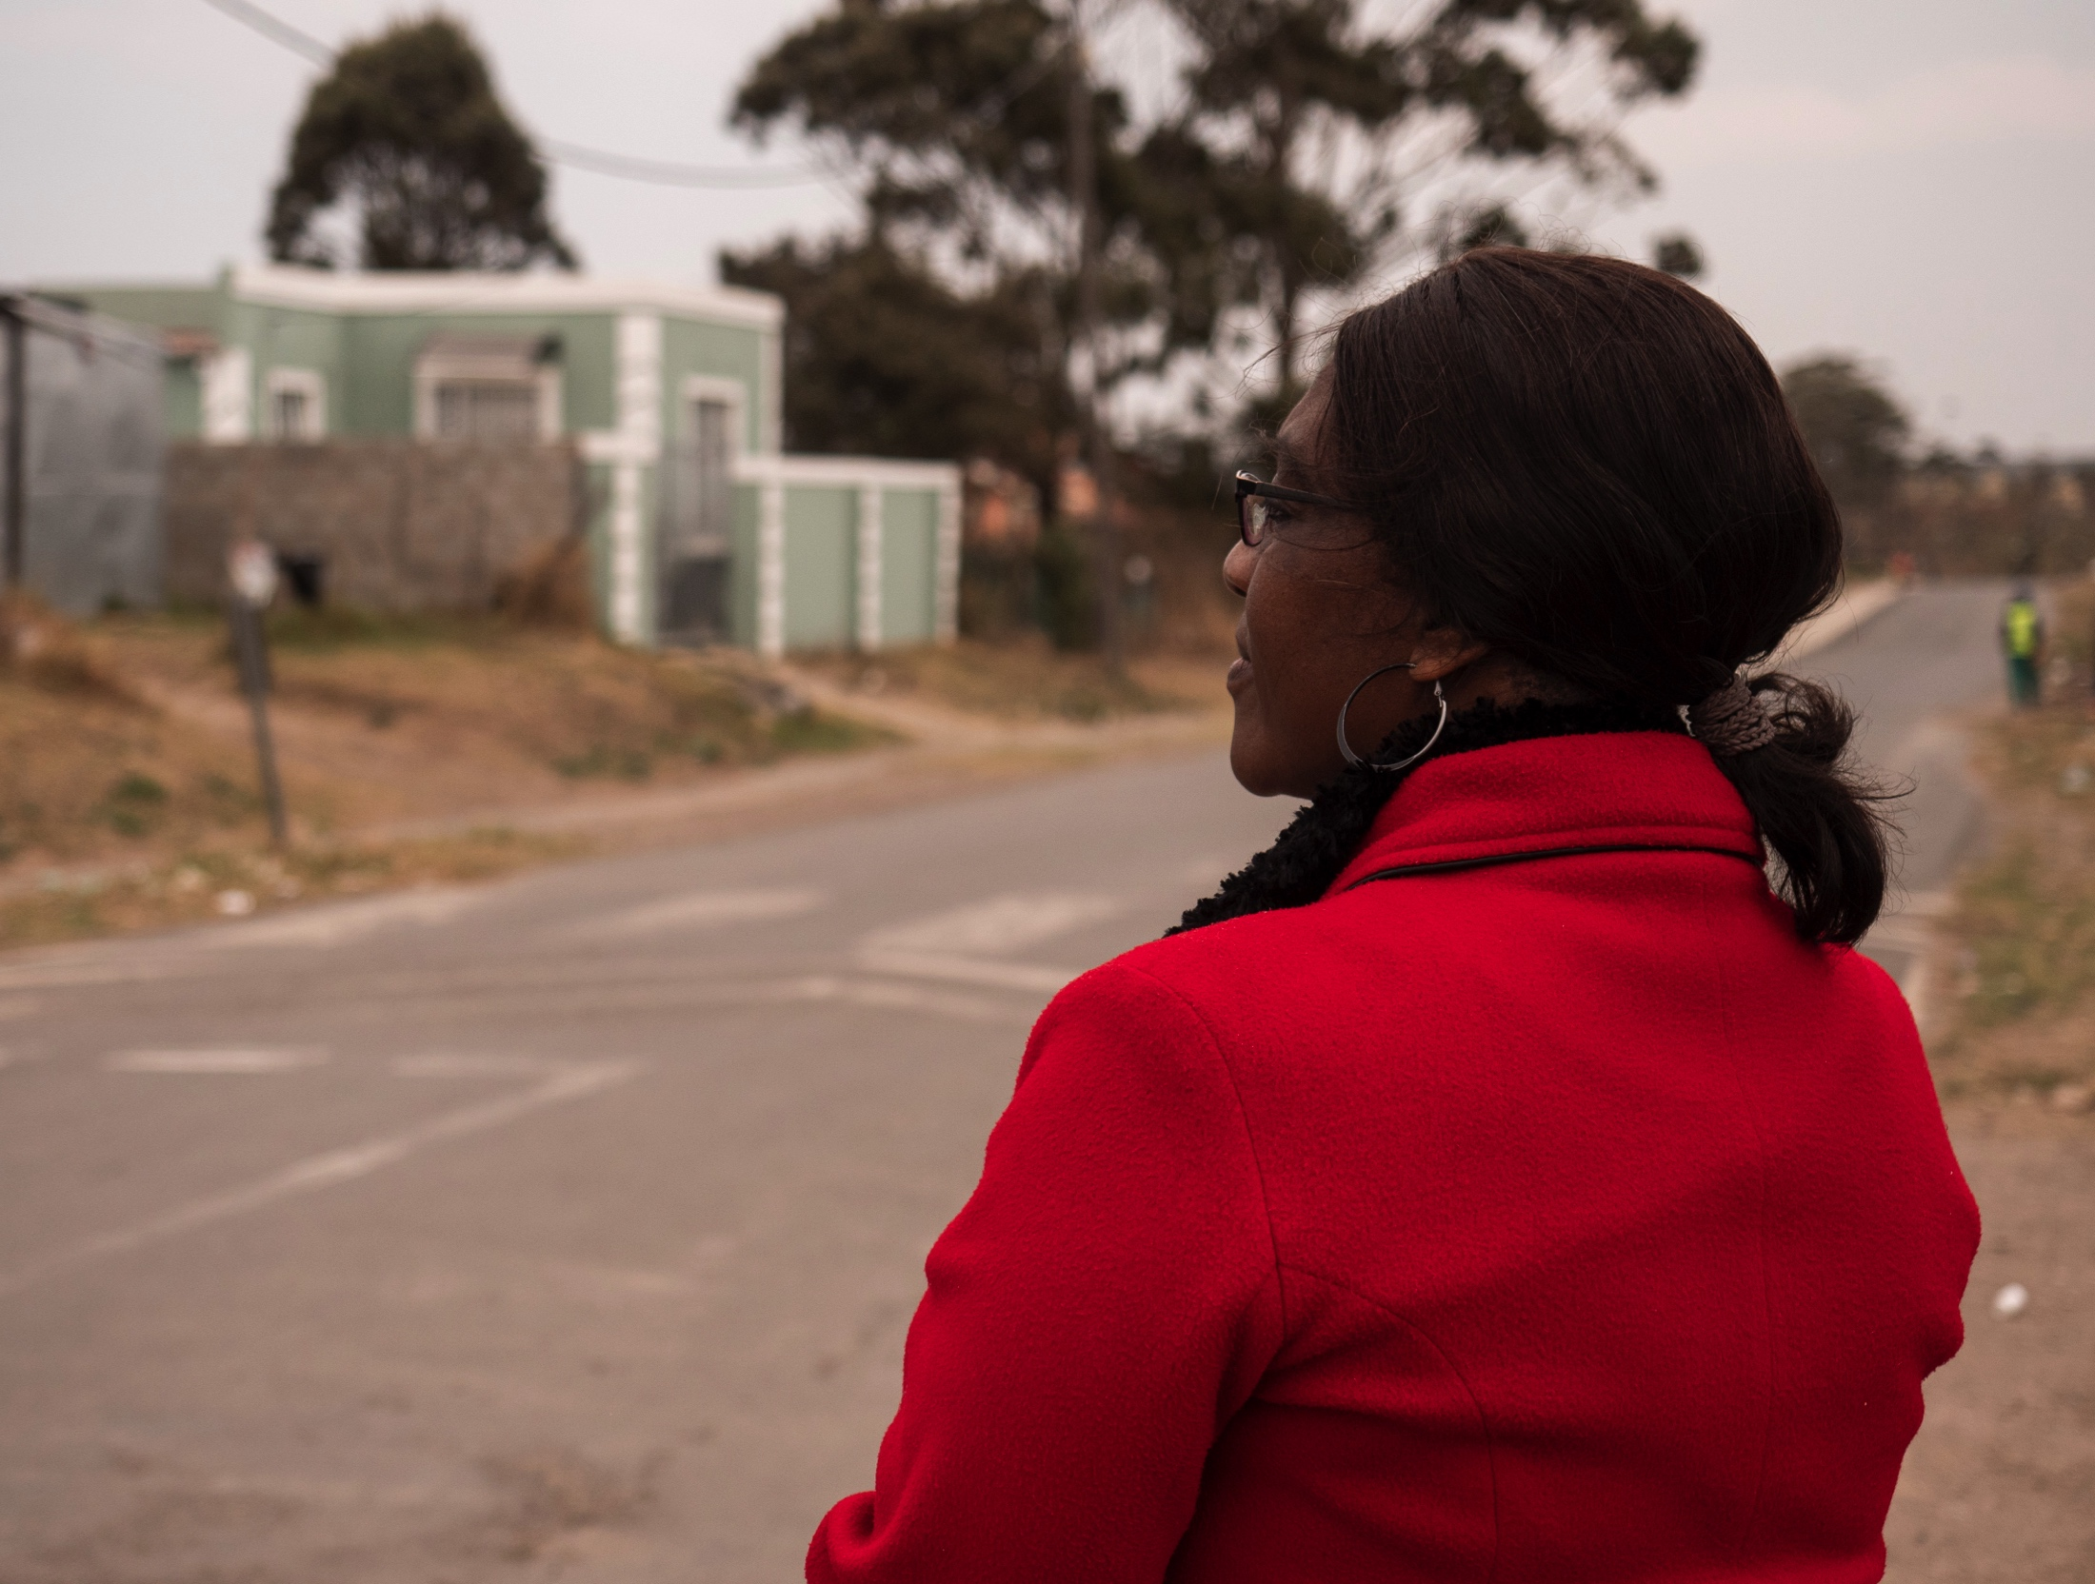
“The check and connect mentorship programme helps because some of them come from parents who are demotivated. When the social worker is helping them you at least see the child is motivated. If I’m having a problem, I’ll ask the social worker to help. She knows how to talk to them.”
Xoliswa Adonis, Grade 7 teacher, Duncan Village

Slide 46
CASE
STUDIES
Absenteeism tracking and Khula Sayso
Instil a culture of learning
HOW?
Promote school attendance and value of education
Tracking absenteeism
HOW?
Mentor schools to track learner attendance accurately and in real-time
Quality data management protocols
Notes:
Figure 1: Chronic Learner Absenteeism: 2018, 2019
Although the data is not able to relay any clear trends yet, the fact that this data is now available is a step in the right direction. Prior to this data being available, teachers would identify learners at risk and refer them to Khula. However, many learners would fall through the cracks. This approach strengthens Khula’s ability to monitor learner referrals from schools in an objective manner.
Khula also has an advanced case tracking system - from internal referrals to case closure, and well-developed wellness assessments, which form a critical part of M&E for psychosocial support programmes for children

Slide 47
CASE
STUDIES
Absenteeism tracking and Khula Sayso
Notes:
Figure 1: Chronic Learner Absenteeism: 2018, 2019
Although the data is not able to relay any clear trends yet, the fact that this data is now available is a step in the right direction. Prior to this data being available, teachers would identify learners at risk and refer them to Khula. However, many learners would fall through the cracks. This approach strengthens Khula’s ability to monitor learner referrals from schools in an objective manner.
Khula also has an advanced case tracking system - from internal referrals to case closure, and well-developed wellness assessments, which form a critical part of M&E for psychosocial support programmes for children

Slide 48
CASE
STUDIES
Isibindi Ezikoleni model
Training and capacitating schools
HOW?
Prevent dropout by providing a school-based child and youth care service
CYCWs work with Learner Support Agents (LSAs) employed by DBE to support school spaces
Tiered approach of intervention
Early intervention
Full intervention
Whole school prevention
Seven schools using the Data Driven Districts Dashboard
Worked with New Leaders Foundation to train principals and school staff on capturing data, however, school capacity for data management is low
DARK GREY
R69 G69 B67
HEX# 454543

Slide 49
“They create a space for us to be able to talk about things, even if they are topics that are sensitive or we feel uncomfortable talking about…they allow us the space that we can actually share and talk to them.”
Ntandokazi, 16, Ntshiyabantu village in Kwa-Zulu Natal

Slide 50
RECOMMENDATIONS

Slide 51
#1.
MAKE DROPOUT REDUCTION
A KPI

Slide 52
RECOMMENDATION #1
MAKE DROPOUT REDUCTION A KPI
What is the status quo?
What is the status quo?
DBE’s revised five-year strategic plan 2015/16 – 2019/20 mentions dropout, with an emphasis on keeping learners engaged up to grade 9
No target identified for learner dropout
Positions dropout as a concern for learners with special needs
DARK GREY
R69 G69 B67
HEX# 454543

Slide 53
RECOMMENDATION #1
MAKE DROPOUT REDUCTION A KPI
The shift we want to see
The shift we want to see…
Make dropout a KPI and set reduction targets
Dropout prevention strategies are an explicit goal, with feedback required on the development of systems to manage and measure this
Strong focus on boosting learner engagement
An understanding that dropout prevention is a mechanism to improve education outcomes, and a range of other KPIs
Regular discussions about the ‘Care and Support in Schools’ function at national and provincial levels
DARK GREY
R69 G69 B67
HEX# 454543

Slide 54
#2.
IMPROVE DATA AND MONITORING

Slide 55
RECOMMENDATION #2
IMPROVE DATA AND MONITORING
What is the status quo?
What is the status quo?
Some data monitoring taking place with SA-SAMS
Some analysis and SMT feedback and development with DDD
Insufficient psychosocial interventions
DARK GREY
R69 G69 B67
HEX# 454543

Slide 56
RECOMMENDATION #2
IMPROVE DATA AND MONITORING
The shift we want to see
The shift we want to see…
Expedite the SA-SAMS re-write, universalise and link to LURITS
An individual learner tracking identifier is key to developing data systems for dropout
Mandate the use of the individual learner tracking number (ID Number)
Ensure all required indicators are understood, universally defined, properly used and captured on SA-SAMS

Slide 57
RECOMMENDATION #2
IMPROVE DATA AND MONITORING
The shift we want to see
The shift we want to see…
Facilitate implementation of improved data practices
Institutionalise data collection at schools
Awareness on the importance/value of data for schools
Infrastructure and human resources needed to fulfil the data management process
Establish a Learnership on how to use data to design cross-cutting, school-level interventions

Slide 58
RECOMMENDATION #2
IMPROVE DATA AND MONITORING
The shift we want to see
The shift we want to see…
Build an early warning system
With a functional EMIS and right indicators at learner level, design a tool to assess risk based on ABCs
Create system of alerts for educators
Create space/time in schools to track ABC indicators, identify learners and develop interventions
Assess interventions over time

Slide 59
#3.
PROVIDE PSYCHO-SOCIAL SUPPPORT

Slide 60
RECOMMENDATION #3
PROVIDE PSYCHOSOCIAL SUPPORT
What is the status quo?
What is the status quo?
Although there are a range of policies and processes — including White Paper 6, the Psychosocial Support Strategy (PSS) and others — there are no explicit plans for systematically ensuring the right support services are available in all schools
Chief Directorate for “Care and Support in Schools”
DARK GREY
R69 G69 B67
HEX# 454543

Slide 61
RECOMMENDATION #3
PROVIDE PSYCHOSOCIAL SUPPORT
The shift we want to see
The shift we want to see…
A national Psychosocial Support Strategy linked to the EWS
Risk informed (data) strategy for national delivery
Risk informed distribution of services
Develop an effective inter-sectoral referral strategy
System located within DBE and provinces
Universal coverage and reach
Strong existing institutional framework
Real impact for learning outcomes
DARK GREY
R69 G69 B67
HEX# 454543

Slide 62
THANK YOU.

