Slide 1
Department of Defence: Draft 2019/20 Annual Report Analysis
6 October 2020
Dr Wilhelm Janse van Rensburg
Researcher: JSC on Defence & PC on Defence & Military Veterans

Slide 2
Disclaimer
This analysis is based on the draft Annual Report from the Department of Defence (DOD). As such, information is yet to be audited and finalised and may change upon the submission of the finalised Annual Report. Furthermore, the analysis will not refer to the input of the Auditor General since this audit opinion has not been finalised.
Potential BRRR discussion points for the PCDMV will be raised.

Slide 3
DOD support to MTSF outcomes
Outcome 3: Border management & internal stability
15 Landward units deployed for border safeguarding.
Assistance with water pollution in the Vaal River and selected municipalities.
Assistance with wildfires.
Supporting Operation Phakisa and the Oceans Economy.
Search and rescue operations.
Support to the Department of Health through requested interventions.
Outcome 11: Political cohesion in Southern Africa
SANDF deployed peacekeeping forces in the SADC region (The DRC and Mozambican channel).
10 Defence Attaches deployed to the SADC region.

Slide 4
Minister of Defence Priorities
2014-2019
Defence Strategic Direction
Strategic Resourcing Direction
Organisational Renewal
Human Resources Renewal
Capability Sustainment Direction
Ordered Defence Commitments Direction
2020-2025
Strategic Direction. “Arrest the Decline”.
Strategic Resourcing. Revenue generation to supplement defence fiscal allocation.
Human Resources. Maintaining the SANDF Establishment Force Levels.
Organisational Renewal. Ensuring appropriate organisational structure.
Capability Sustainment. Maintenance of defence capabilities.
Ordered Defence Commitments. Increased contribution by Defence to the National Developmental Agenda.

Slide 5
Programme Performance
Financial performance per programme:
Breakdown per economic classification not provided
Classified targets:
Percentage available of medical stock (since 2016).
Reimbursements to the DOD for SANDF deployments to the UN (since 2016).

Slide 6
Programme 1: Administration
Expenditure: R5,993 billion
Expenditure per subprogramme:
Legal Services underspent by R1.423 million.
Defence Foreign Relations underspent by R4.452 million
Performance:
The Administration programme set 82 targets for 2019/20. Of these, a total of 36 are not reported on in the draft Annual Report. Of the remaining 46 targets, two are considered classified, 28 were achieved and 16 not achieved.

Slide 7
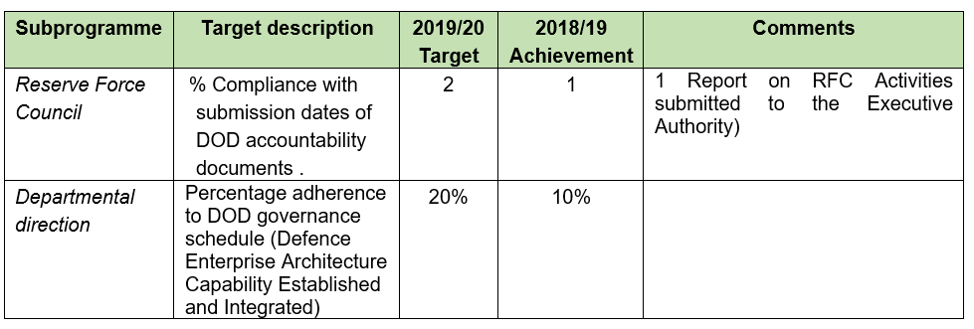
Programme 1: Administration (continued)

Slide 8
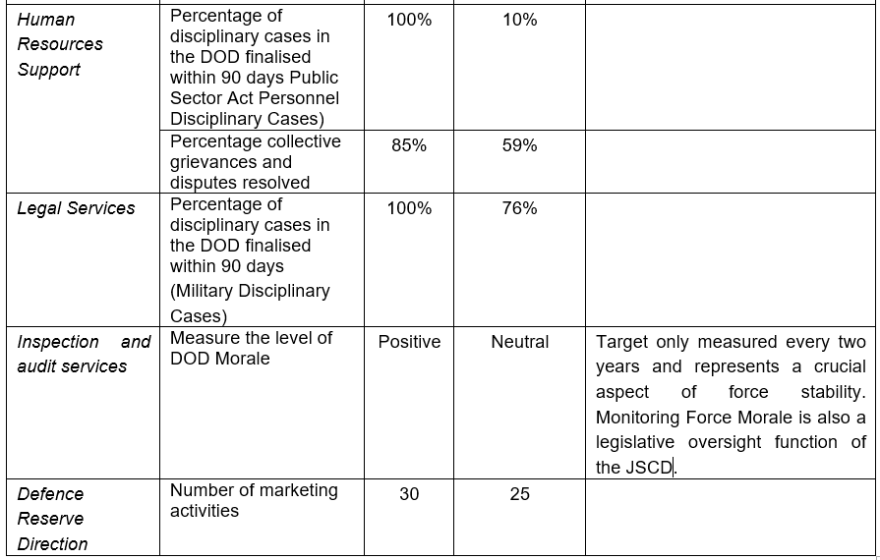
Programme 1: Administration (continued)

Slide 9
Programme 2: Force employment
Expenditure: R3,492 billion
Five achieved targets:
100% compliance with number of ordered commitments (external operations).
15 sub-units deployed for border safeguarding.
100% compliance with number of ordered commitments (internal operations).
100% compliance with SADC Standby Force.
Completion of 1 interdepartmental, interagency and multinational military exercise.

Slide 10
Programme 3: Landward defence
Expenditure: R16,764 billion
Performance:
Training targets as well as force training exercises achieved.
Selected performance highlights:
Humanitarian Aid and Disaster Relief.
Sewage clean-up operation in Mahikeng.
Support to Emfuleni Municipality (Vaal River).
National Rural Youth Service Corps training.

Slide 11
Programme 4: Air Defence
Expenditure: R6,701 billion
Flying hour performance:
Total target: 17 200* flying hours planned with 16 232 achieved. This consists of the following breakdown:
12 749.5 hours for force preparation
2 576 hours for force employment
907.1 VVIP hours
*Note: Target reduced from 25 000 in previous years.

Slide 12
Programme 5: Maritime Defence
Expenditure: R4,709 billion
Sea hours target: 10 000
Sea hour achievement: 6 612.55
Force Employment: 2 745.85 hours
Force Preparation: 3 866.70 hours
Reasons for low performance: Refits and maintenance and repair. This led to operational defects and the non-availability of platforms to conduct all scheduled Force Preparation and Force Employment activities.
*Note: Target reduced from 25 000 in previous years.

Slide 13
Programme 6: Military Health Support
Expenditure: R5,363 billion
Performance targets:
Healthcare activities: 2 089 102 healthcare activities in 2019/20, falling short of the target of 2 140 550 .
Training target: 640 trained vs target of 648.

Slide 14
Programme 7: Defence Intelligence
Expenditure: R1,002 billion
Performance targets:
Vetting decisions: 7 167 vetting decisions, falling short of the target of 7500.
Defence Intelligence Products: 968 products produced against a target of 448.
Follow-up on strategies required:
Cyber Warfare Strategy. (No finalisation since 2015/16)
Sensor Strategy. (Draft sensor strategy was completed in 2016/17)

Slide 15
Programme 8: General support
Expenditure: R6,858 billion
All reported targets achieved, including:
Procurement requests fully completed within 90 days (99%)
Utilisation of endowment property in the DOD (93%)
Modernised, sustainable DOD ICT Integrated Prime Systems Capabilities (112%)
Deliberate crime prevention operations (174)
Criminal cases investigated (backlog) (56%)
Criminal cases investigated (in-year) (47%)

Slide 16
Organisational Structure
Key issues:
Personnel spending: R31.947 billion (63%).
Reductions in navy personnel from 7 076 (2017) to 6 647 (2019/20).
Performance agreements not signed by 13 Senior Managers.
Sick leave cost: R400.189 million; Average number of sick-days increased from 7 to 8.
Suspension with pay: 56 people are suspended for an average of 251 (R14,116 million)

Slide 17
Financial overview
Revenue generation
Reimbursement from UN: Claim not submitted due to MOU being ‘under consideration’.
No sale of capital assets – auctioneer yet to be appointed.
Irregular expenditure
R2,609 billion: Compensation of Employees.
R143 million for unfairly awarded verification contract.
R28 million for ICT contract (not through SITA).
Fruitless and wasteful expenditure
R20 million – non utilisation of leased property.

Slide 18
Conclusion
What can drive the preliminary BRRR discussion?
The upcoming Lekgotla between the Defence Committees and the DOD on its Force Structure will provide a platform to address many of the concerns emerging from the 2019/20 Annual Report.
Urgency in implementation is required, which required parliamentary oversight.
Balanced discussions with all roleplayers around funding for capability requirements on the one hand and internal DOD interventions to save costs and streamline the Force on the other.

Slide 19
Defence Sector overview
Thank you
Dr Wilhelm Janse van Rensburg
Researcher: JSC on Defence
Email: wjansevanrensburg@parliament.gov.za
Tel: 021 403 8276

