Slide 1
LAND INVASION STRATEGIES TO PROTECT DOHS LAND
Presented by: Ms. J Samson
Date: 16 September 2020

Slide 2
Impact on Land Invasions
Causes of Land Invasions
Types of Land Invasions
Statistics (Cape Metro)
Frequency of Invasions
Mandates
Risks and Challenges
Strategies to protect public land
Protection of public infrastructure and housing projects
Impact caused on number of Housing opportunities and infrastructure projects due to land invasions
Action Plan

Slide 3
Impact of Land Invasions

Slide 4
Increased Urbanisation - Impact of Land Invasions
2018 Population
4 322 031
Households living in informal dwellings
± 230 000
No. of Households
±1.35 million
Average Household Size 3.2
Cape Town experienced rapid urbanisation between 1996 and 2016
Population increase of 56%
94% increase in number of households
65% of all informal dwellings are located within informal settlements, & the balance located in backyards

Slide 5
Underlying Causes of Land Invasions

Slide 6
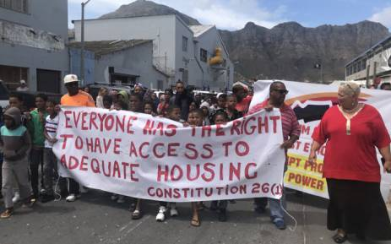
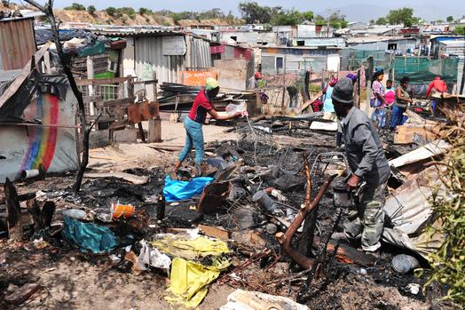
Underlying Causes of Land Invasions
Huge housing demand (backlog) and overcrowded households.
Insufficient delivery of housing stock.
Invasion seems the only alternative.

Slide 7
Types of Land Invasions

Slide 8
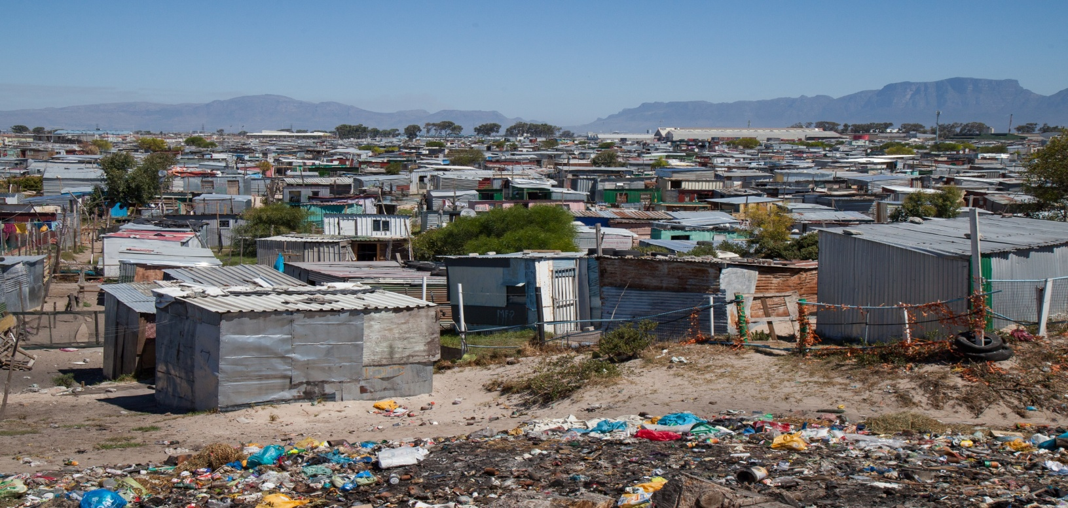
Types of Land Invasions
Homogenous growth of existing informal settlements that span into other properties.
New settlements or targeted land invasion.
Land invasion is not needs driven, but opportunistic in nature.

Slide 9
Statistics (Cape Metro)

Slide 10
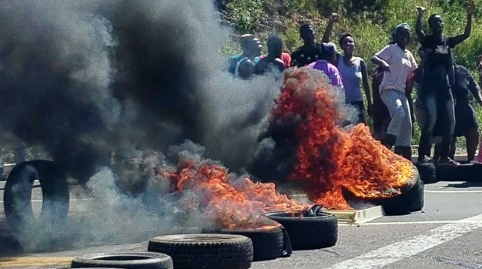
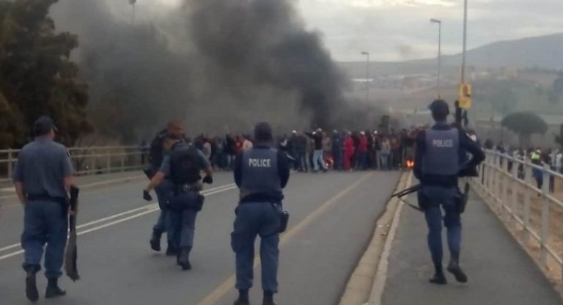
Statistics: 11 July – 12 August (Cape Metro)
56,716 x Structures Demolished
77 x Land Invasions
22,840 x Plots Cleared
97 x Protest Actions
57 x Arrests
43 x Injuries (I.O.D)
14 x Official Vehicles Damaged
8 x Private Vehicles Damaged
12 x Relocation
9 x Court Orders
6,664 x Rubber Rounds

Slide 11
Frequency of Invasions

Slide 12
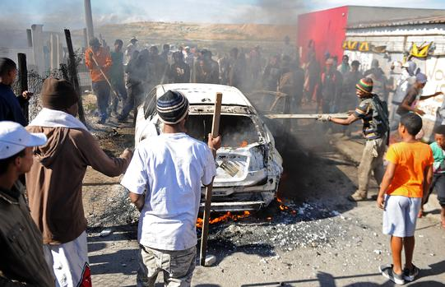
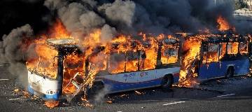
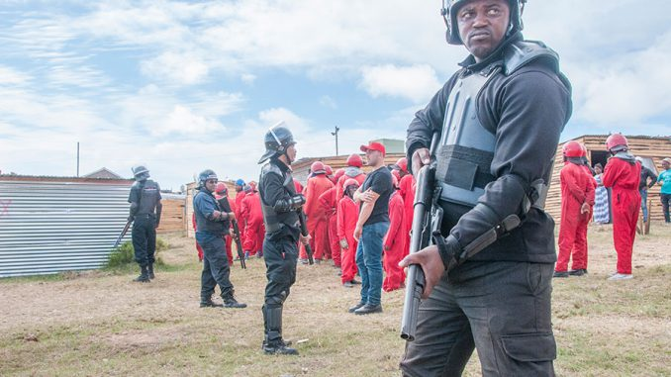
Frequency of Current Invasions
These are Abnormal Circumstances
Large Scale Criminality, Violence and an Attempt to Destabilize Government
A normal response and normal resource requirements will not suffice

Slide 13
Mandates

Slide 14
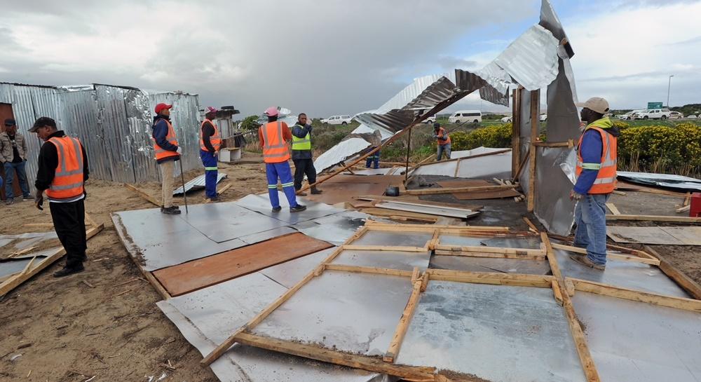
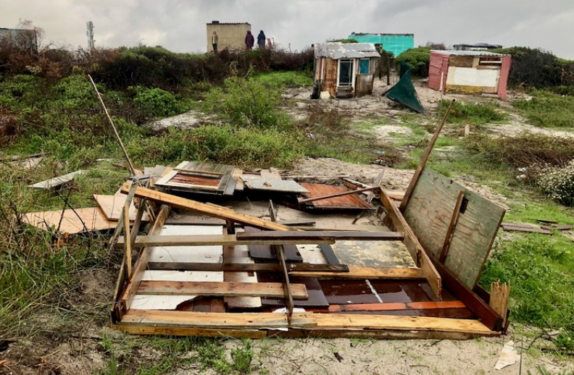
Provincial Mandate
The DHS can only actively respond to land invasion on properties it owns.
It can assist (in a limited capacity and at their expense) and advise Municipalities and other entities which procedures to follow.
DHS constrained by other Departments and State Entities piggy-backing on DHS expertise.

Slide 15
National Mandate: SAPS
The SAPS policing objectives, in accordance with the provisions of Section 205 of the Constitution are to:
Prevent, combat and investigate crime;
Maintain public order;
Protect and secure the inhabitants of the Republic and their property;
Uphold and enforce the law.
However: The Province can be prevented from deploying its service provider to protect its own land/ property by SAPS.
GOVERNMENT’S HANDS ARE TIED

Slide 16
Risks and Challenges

Slide 17
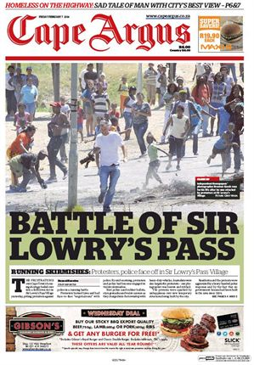
Risks and Challenges
Relationship between City Law Enforcement and SAPS.
Violence, possible loss of life.
Loss of developable land.
Increase in informal settlements and subsequent basic services delivery.
Loss in time, money and manpower.
Negative impact on surrounding and communities.
Negative media attention.
Low morale of the public at large losing confidence in government.

Slide 18
Strategies to protect public land

Slide 19
The Department is in daily consultation with the City of Cape Town in an anti-land invasion war-room.
The latest intelligence on possible land invasion threats and tactical responses are discussed.
The information is then shared among all interested role-players.
The Department has an internal unit of property inspectors, who monitors the vacant properties daily and subsequently thwart off imminent threats immediately.
The Service Provider appointed, has extensive experience in land invasions, and is used where masses are moving onto Human Settlement land.

Slide 20
Strategies implemented for the protection of public land from illegal land occupation (cont…)
High Probability lists were compiled to prioritise properties proven to be more prone to land invasions:
Reasons could be location and awareness of ownership; and
Information being circulated that the land is earmarked for development.
The list was extracted from the portfolio of properties under the management of the Department of Human Settlements.
The Settlement Control Unit has a list of all properties at hand for quick verification.
5

Slide 21
Interventions Implemented
Very little invasions happened on DHS land over the past few weeks.
This can be ascribed to active monitoring teams being put in place.
Two DoHS staff teams respond immediately to threats received via intelligence reports and the Anti-land Invasion Hotline (CoCT).
Improved SOP within DoHS to respond appropriately to requests for deployment of a service provider.
A Provincial JOC established to improve communication among Provincial Land Owner Departments to, in order to co-ordinate responses.
Improved collaboration with CoCT through the Anti-Land Invasion Unit, Metro Police and SIU - War Room that meets daily to share information and assistance between CoCT & WCG.

Slide 22
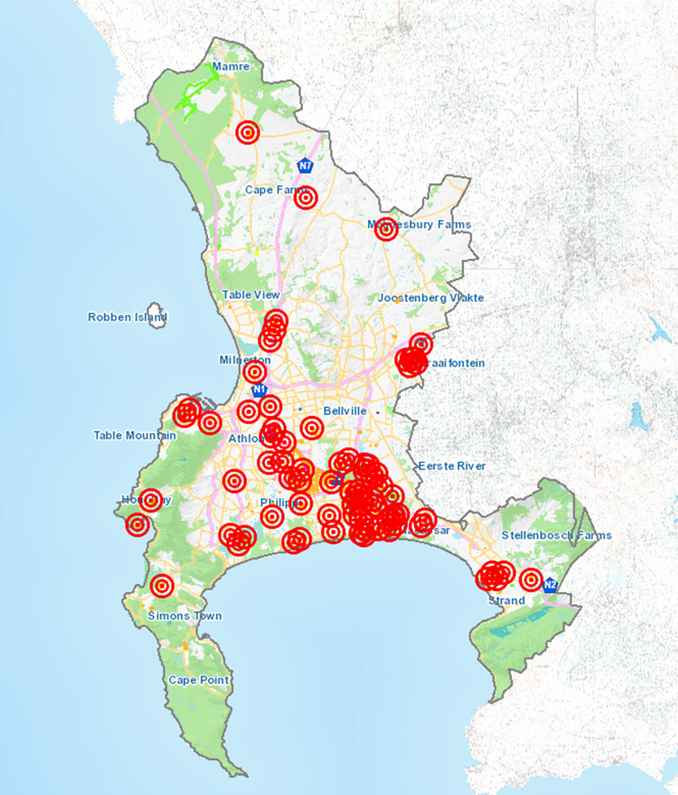
Metro Hot Spots

Slide 23
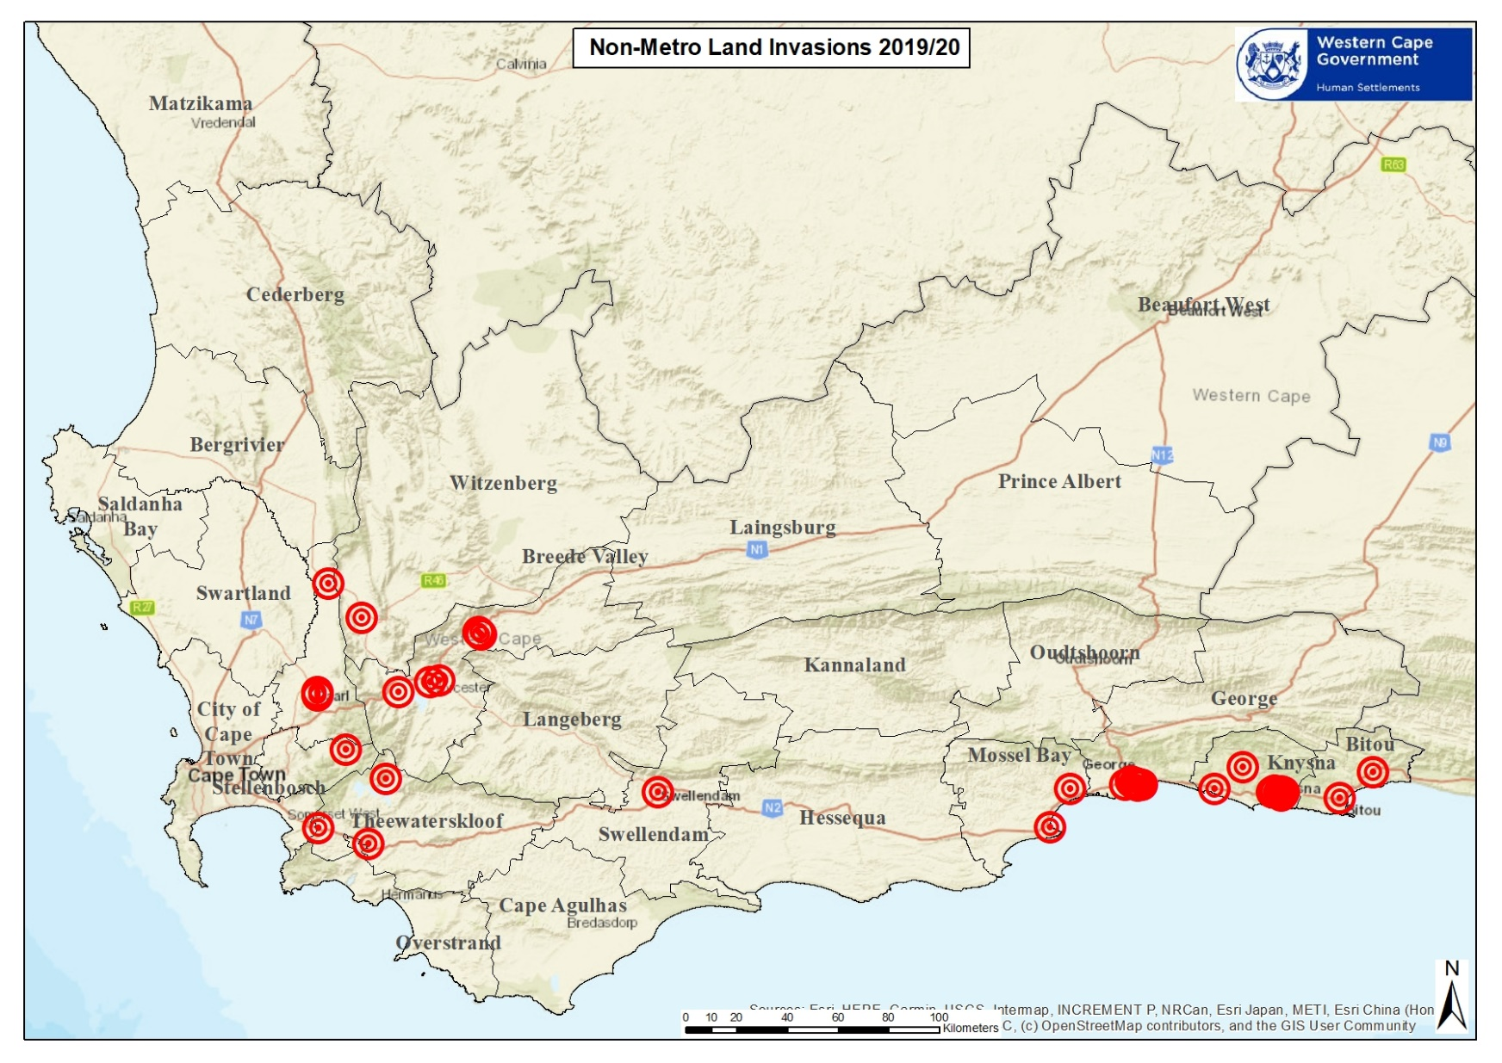
Non-Metro Hot Spots

Slide 24
Non-Metro hotspots
Municipality | Area under threat
Drakenstein Municipality | Unathi, Mbekweni, Gouda, Next to Thusong Centre Mbekweni
Knysna Municipality | Sedgefield Dunes, Sedgefield; Rheenendal, Karata, Rhobololo,Concordia, White Location, Bloemfontein, Happy Valley, Ethembeni, Hornlee, Oupad, Damsebos, Hlalani and Nekkies.
Breede Valley Municipality | De Doorns ( Stofland), De Doorns ( Hassie Square), Rawsonville ( Spokiedorp & Hammat Petersen), Worcester Zwelethemba ( North Mandela) and Worcester Roodewal (7de laan)
Mossel Bay Municipality | Grootbrak, Thusong Centre, New Rest
Theewaterskloof municipality | Grabouw Sianyanzela and villiesdrop protea heights block d, and again botrivier, New France
Bitou Municipality | Qolweni,kurland
Witzenberg Municipality | Pine Valley, Wolseley
George Municipality | Thembalethu, Rosedale, Pacaltsdorp
Swellendam Municipality | Railton Informal Settlement
Stellenbosch Municipality | Langrug
Swartland Municipality | Silvertown
Saldana Municipality | Laingville 309 Housing Project, Paternoster Housing project, George Kerridge
Bergrivier Municipality | Veldrif , Noordhoek Housing Project
Cederberg Municipality | Old Cape Road reserve, Clanwilliam, Riverview, Clanwilliam
Matsikama Municipality | Vredendal Ph5 Housing Project, Lutsville Housing project, Lutsville West, Lutsville, Vredendal, Klawer, Doringbaai

Slide 25
Protection of public infrastructure and housing projects

Slide 26
Systems implemented to ensure that public infrastructure and housing projects are protected from illegal occupation and vandalism
A Standard Operating Procedure was implemented to allow Project Managers to secure the release of a tactical team to secure public infrastructure and projects.
Contractors on site have their own security, but if the need arises, the project manager will be supported with tactical assistance.
Property inspectorate secures vacant units by placing a security guard in the unit.
The rental unit is then prepared for the next waiting list applicant.

Slide 27
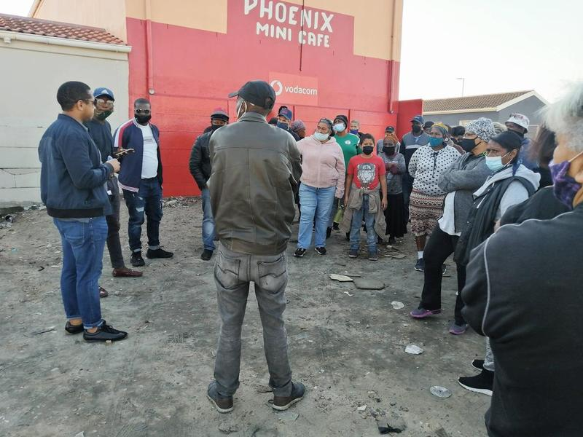
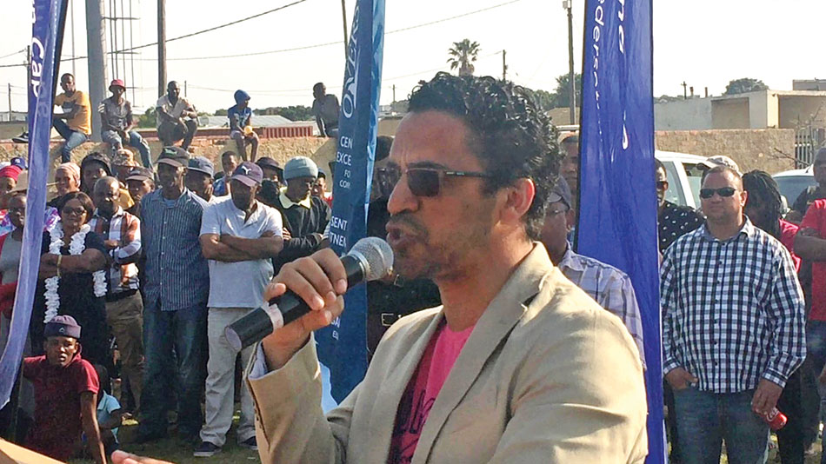
Proactive Prevention Response
Frame the media and community narrative.
Isolate the “ring leaders” of these invasions – legal consequences.
Develop a procedure to responding to land invasions.
Request active policing by the SAPS in the prevention of land invasions.
Increase monitoring of unoccupied land and shack farming.
Involvement of community, neighborhood watches, NGOs, etc.

Slide 28
Impact caused on number of housing opportunities and infrastructure projects due to land invasions

Slide 29
Impact caused on number of Housing opportunities and infrastructure projects due to land invasions
Estimated direct / indirect cost already spent in excess of R187m
R107m Service Provider (past 15 months); and
R80m fixing vandalised units & extension of time claims.
Excludes legal costs (not yet determined).
Est. Short Term Expenditure
(end August 2020)
Budget estimate of
R20 – R50 million
Est. Medium Term Expenditure
Budget estimate of
R100m-200m
Est. Long Term (3 yr) Expenditure
Budget estimate of
R500 million

Slide 30
Action Plan

Slide 31
Action Plan
Database compilation of properties.
Appointment of new service provider - DHS land Refresh MOU with City and develop MOU with other Municipalities.
Development of SOP, which includes basic assessment of risk per Municipality, evaluation of potential responses and identification of hot spots.
Development of a Stakeholder Management Plan.
Identify a Coordinator to liaise with operation partners - SAPS, Mun, Contractor Community mobilization – Minister Fritz & Bredell (empower neighborhood watches, community development workers, NGOs, etc.).

Slide 32
Additional Initiatives: Work In Progress
Department of Community Safety to engage SAPS to have a WCG presence at their JOC.
Share best practices within Metro with Municipalities via an Agency Agreement developed through SALGA (especially around Legal Expertise).
Enhance existing procedures within WCG as well with external entities.
Investigate the possibility of a central appointment of a panel of service providers for all Departments to access.
Risk assessment template to be dispensed to each Municipality to determine susceptibility to potential invasions.

Slide 34
Jacqui Samson
Head: Human Settlements
+27 (0)21 483 2869
Jacqueline.Samson@westerncape.gov.za
4th Floor, 27 Wale Street, Cape Town

