Slide 1

COOPERATION/ RELATIONSHIP WITH THE SOUTH AFRICAN POLICE SERVICES WESTERN CAPE
04 September 2020

Slide 2
City Enforcement Mandate
The City of Cape Town has a threefold mandate of:
Traffic policing
By-law enforcement
Crime prevention

Slide 3
Role of the South African Police Service in terms of SAPS National Instruction 7 of 2017 regarding land invasions.

Slide 4
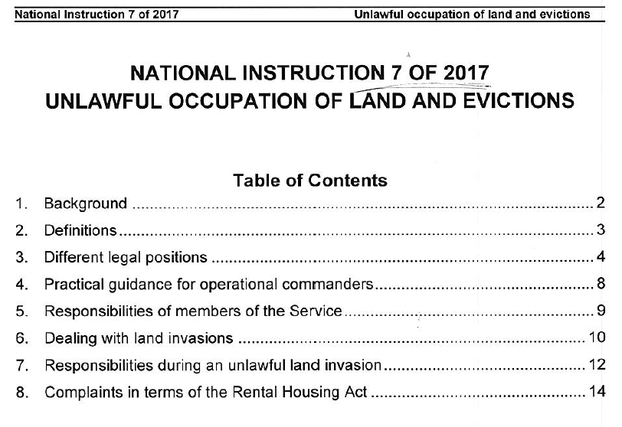
Roles and Responsibilities of SAPS in terms of Land Invasions

Slide 5
Roles and Responsibilities of SAPS in terms of Land Invasions: National Instruction 7 of 2017
Feedback
The City of Cape Town is currently struggling with the various SAPS Stations in terms of the reporting of tress pass cases. Most of these cases get closed of undetected without using the following documentation:
Witness statements
CCTV Footage, Video Footage, EPIC Footage or any social media info or footage for downloading at SAPS.
Determination of damage and cost to infrastructure
Court Orders served on the particular sites
Integrated Operational Plans
Utilization of the informer system

Slide 6
Roles and Responsibilities of SAPS in terms of Land Invasions: National Instruction 7 of 2017
Feedback
The City of Cape Town operational components in terms of Metro Police, Traffic and Law Enforcement is currently part of a daily operational planning meeting with SAPS at 16:00 at the SAPS Command Centre. Station Commanders are responsible to put the operational plan in place regarding the required land invasion operation and the City Policing Services are in support of the operations.
Public Order Police will be activated by the Station Commander for assistance in terms of a high risk area operation or assistance in terms of an aftermath regarding the operation

Slide 7
Roles and Responsibilities of SAPS in terms of Land Invasions: National Instruction 7 of 2017
Feedback
The SAPS is responsible for the investigation of all criminal cases reported as part of land invasions, should it be tress pass, public violence, malicious damage to property, arson, murders, attempted murders, extortion or any cases reported in terms of the Amendment Act regarding essential infrastructure.
The City approached the Provincial Commissioner to have a watching brief agreement in place in terms of cases reported by the City. We are waiting for a response. The City provided SAPS with all information and footage for further investigation

Slide 8
Focus on Investigations should be extended to the following.
Follow the money …. Shack-lords / land mafia / “estate agents” selling the land
Source and financing of building of material I.e. from wholesale supplier to local distributor
Delivery vehicles to site / “Investor-vehicles” – ownership and relationship to land invasion
Public violence & damage to property – Identification and criminal charges
SAPS role in terms of National Instruction 7 of 2017 in terms of the investigation of any criminal cases.
The City is also in the process of requesting the NPA to look at all dockets relating to land invasions, by setting up a meeting with the NPA.
SAPS & POPS - availability and resources
  Protection to land owner: National, Provincial, Private land National Parastatals
  Acting on Court Orders / Interdicts through a coordinated approach
  Response to contravention of court orders
  Opening of Trespass cases – SAPS to investigate
  The execution of arrest of perpetrators of crimes linked to land invasions

Slide 9
Land Invasions
Relationship and co-operation between City of Cape Town Policing Components and the South African Police Service

Slide 10
Relationship and co-operation between City of Cape Town Policing Components and the South African Police Service
Overall the City of Cape Town, Safety and Security Directorate in terms of Metro Police, Traffic and Law Enforcement have a good operational relationship with the South African Police Services in the Western Cape. Three major incidents impact on the relationship with SAPS. The three incidents can be described as follows:
- COVID-19 Strandfontein Homeless Site
- Refugee Situation in terms of Green Market Square and the two current sites
- Khayelitsha Land Invasion Incident that led to the banning of Law Enforcement from the Prov Joints and the Prov JOC.

Slide 11
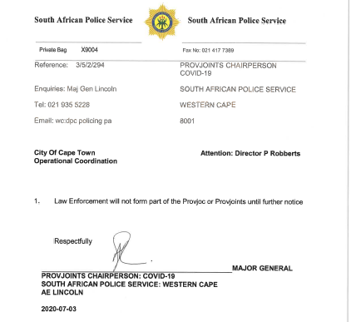
Operational Coordination between the South African Police and City of Cape Town, Metro Police and Law Enforcement: Law Enforcement Incident

Slide 12
Break down in relationship between the South African Police and City of Cape Town, Metro Police, Traffic and Law Enforcement: Law Enforcement Incident
Banning of Law Enforcement from the Provincial Joints and Prov JOC by Major General Lincoln on the 3rd July 2020
Lack of support to City of Cape Town Safety and Security Services with land invasion operations during banning of Law Enforcement.
Several request to chairperson of Provincial JOC for urgent intervention.
Withdrawal of City Services from the Prov JOC meetings and the Provincial Joint Operational Centre due to no feedback from SAPS
Request for intervention by the COVID-19 Cabinet.
Request for intervention by the MEC for Community Safety.
Letter to the Provincial Commissioner dated 13th July 2020
Meeting between City, DOC’s and the South African Police Services
Meeting between Acting ED le Roux and the Provincial Commissioner
Reactivation of Joint and Integrated operations, operational meetings and operational coordination in first week in August 2020.

Slide 13
Operational Coordination between the South African Police and City of Cape Town, Metro Police, Traffic and Law Enforcement
Responsibility of SAPS in terms of National Instruction 7 of 2017 is currently the guiding document on which the City base their operational approach in terms of addressing all threats of land invasions.
Availability of SAPS to form part of operations. National Instruction 7 of 2017 was only implemented in terms of the Station Commissioner’s involvement as from the middle of August2020. POP’s availability always questionable due to other threats like protest actions, marches, taxi violence and serious major incidents.
Land invasion operational planning meetings daily with SAPS. City identified land invasions per area. Communicate identified station and applicable erf number with Prov SAPS. Prov SAPS instruct Station Commanders to attend planning meetings. Daily at 16:00 at SAPS Command Centre. Operation get executed next day.
Weekly operational coordination meeting between SAPS Public Order Policing, Metro Police, Traffic and Law Enforcement happens on a Thursday to sort out any operational issues.
COVID-19 PROV JOC: Integrated meetings are attended between SAPS and all external role players on a Tuesday and a Thursday weekly.

Slide 14
Operational Coordination between the South African Police and City of Cape Town, Metro Police, Traffic and Law Enforcement
Core Command Group meetings with SAPS: Integrated operational meetings between SAPS, Metro Police, Law Enforcement, Traffic, Provincial Traffic and SANDF in terms of joint operations. Meetings take place on a Monday and a Friday.
Cape Town Safety and Security Directorate is represented by Dir Robberts, Director for Operational Coordination and Chief le Roux Chief of Metro Police at the Provincial Joints.
The City don’t get invited to the Provincial Crime Combatting Forum meeting PCCF. It is exclusively a SAPS operational meeting. Some of the Cluster Crime Combating Chairpersons do invite the representatives from Metro Police, Traffic and Law Enforcement to the Cluster CCCF meetings or some station commanders to the SCCF meetings.
Integrated Provincial Joint Operational 24hour Centre. Prov JOC

Slide 15
Law Enforcement Powers

Slide 16
Powers of Law Enforcement Officers
Whilst Law Enforcement Officers do not have all the powers of the South African Police – and their efficacy in reducing crime should be the object of contention, Law Enforcement Officers may amongst others, implement the powers conferred upon a Peace Officer in terms of, section 40(1), (Peace Officer may arrest without a warrant),
(a) who commits or attempts to commit any offence in his presence
(b), whom he reasonably suspects of having committed an offence referred to in Schedule 1, other than the offence of escaping from lawful custody
(c), who has escaped or who attempts to escape from lawful custody
(d), who has in his possession any implement of housebreaking or car- breaking as contemplated in section 82 of the General Law Third Amendment Act, 1993, and who is unable to account for such possession to the satisfaction of the peace officer

Slide 17
Powers of Law Enforcement Officers
(e), who is found in possession of anything which the peace officer reasonably suspects to be stolen property or property dishonestly obtained, and whom the peace officer reasonably suspects of having committed an offence with respect to such thing
(f), who is found at any place by night in circumstances which afford reasonable grounds for believing that such person has committed or is about to commit an offence
(h) who is reasonably suspected of committing or of having committed an offence under any law governing the making, supply, possession or conveyance of intoxicating liquor or of dependence-producing drugs or the possession or disposal of arms or ammunition and
(j) who wilfully obstructs him in the execution of his duty;
and Section 41(a) Demand name and address, of the Criminal Procedure Act.

Slide 18
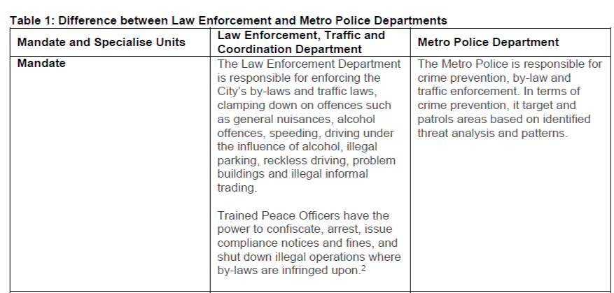
City enforcement mandate/powers
In addition to the above, staff have additional responsibilities and duties assigned to them in terms of their approved job descriptions. One example of this is the protection of municipal staff and land, property and infrastructure.

Slide 19
Oversight and Investigation measures by the City of Cape Town
The City of Cape Town Metro Police , Traffic and Law Enforcement are exposed to the following oversight and investigation measures
Safety and Security internal investigations (SSIU)
Safety and Security portfolio committee
Civilian Oversight Committee
Provincial Police Ombudsman
Provincial Portfolio Committee for Community Safety
Office of Provincial MEC for Community Safety
City has requested to be subject to IPID oversight for years and would welcome the amendment of the legislation by National Government to include oversight over Municipal Peace Officers.

Slide 20
Oversight and Investigation measures by the City of Cape Town
Continue:
  Disciplinary matters involving municipal Pace Officers (Law Enforcement) therefore functions in the same manner as that of Metro Police except for reporting the matters to IPID.
  This is also the case for hundreds of policing services across SA in municipalities with municipal peace officers and traffic officers
The reason disciplinary matters fall outside of the scope of IPID is due to the fact that national government has not yet amended the IPID Act to include municipal peace officers.
The City would welcome the inclusion of the municipal peace officers and has called for their inclusion previously.

Slide 21
Cape Town Metropolitan Police Service

Slide 22
Metro Police Service: Chief Response
Metro police are established in terms of the SAPS act and there is uniform legislation countrywide on Metro Police.
The MPS Chief should indicate how alleged police brutality is viewed by internal disciplinary regulations. The Chief should indicate whether all cases under the investigative mandate of the IPID are reported and what disciplinary sanctions were handed down during the past financial year.
  All relevant cases are reported to IPID, inclusive of all shooting incidents involving the Metropolitan Police Department’s members.
  IPID determines the course of action to be taken once the investigation is completed.
The MPS Chief should indicate whether it has an effective Internal Affairs unit to deal with issues relating to breaches of respective Codes of Conduct. Are these units working with the IPID?
  The CTMPD Internal Affairs Section was established in 2005 and is functional since.
  The Section Reports monthly to IPID and refers all related matters timeously.

Slide 23
Metro Police Service: Chief Response
The Metro Police Chief should indicate whether training (provided by SAPS) on crowd management has improved and whether it takes the recommendations of the Farlam Commission’s Panel of Experts into account?
  SAPS afforded CTMPD Crowd Management training as per recommended standards. The provisions of the Farlam Commission Panel of Experts is taken into account.
  Fall under command and control of SAPS as determined by National Instruction 04/2014. A letter from the Mayor was send to the National Commissioner requesting additional training of Metro Police , Traffic and Law Enforcement in terms of Crowd Management. Waiting for an outcome from the National Commissioner
Has any specialised equipment, in terms of crowd management, been procured by MPS? If so, the MPS Chief should indicate what type of equipment was procured.
  The following specialized equipment was procured for the CTMPD:
    Armadillo protective wear, inclusive of helmets
    Specialised vehicles, viz. Water Canon and Nyala

Slide 24
Metro Police Service: Chief Response
The Metro Police Chief should provide examples of current crime prevention programmes or operations in its respective metropolitan areas as well as successes and challenges faced.
The Metro Police, Traffic and Law Enforcement forms part of Joint and Integrated Operations with the South African Police in the Metropole on a daily base.
Integrated deployment in terms of Hotspot approach regarding COVID-19 Disaster Management Act.
Integrated deployment in terms of Joint Operations coordinated by the Core Command Group meetings on a Monday and Friday.
Integrated deployment in terms of the Marches, Protest Actions and Major Events
Integrated deployment in terms of Crime Prevention Operations requested by the Prov JOC
Integrated deployment in terms of Crime Prevention Operations requested by the Prov Joints.
Integrated deployment in terms of Crime Prevention Operations requested by the SAPS Cluster Commanders
Integrated deployment in terms of Crime Prevention Operations requested by the SAPS Station Commanders.

Slide 25
Metro Police Service: Chief Response
The Metro Police Chief should provide examples of current crime prevention programmes or operations in its respective metropolitan areas as well as successes and challenges faced.
Expansive CCTV network which expands every year and which increasingly covers crime hotspots [list numbers of cameras]
The City and Provincial governments have invested very substantial amounts of budget in the Neighbourhood Safety Teams that make up the Provincial Safety Plan (also referred to as the Law Enforcement Advancement Programme or LEAP) to
The City has developed partnerships with:
  About 50 City Improvement Districts which reduces crime and grime
  Over 50 000 active neighbourhood watch members combatting crime across the City
  Over 400 Law Enforcement Auxiliary Volunteer Officers (reservists)

Slide 26
Metro Police Service: Chief Response
The City engages in a wide range of social crime prevention initiatives, including among others:
  45 000 EPWP jobs
  Metro Police Youth Cadets
  Drug Treatment Matrix Clinics
  Mayor’s Urban Regeneration Programme intervention to improve infrastructure, economic development and job creation in crime hotspots to reduce poverty and crime
  GBV and domestic violence awareness and counselling sessions
  Men and Masculinity programme to combat gender based violence
  Women For Change programme to prioritise job creation for residents in social housing including a wide range of social development interventions
  City undertakes Strengthening Families programme to support youth and risk and ensure their reintegration with their families
  Safer schools program (a partnership with Province)

Slide 27
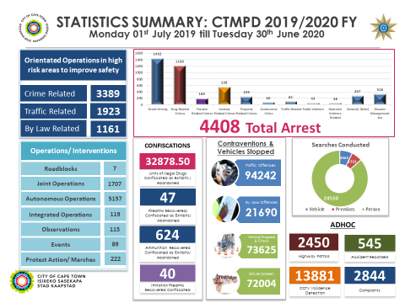
Metro Police Service: Chief Response
The Metro Police Chief should provide examples of current crime prevention programmes or operations in its respective metropolitan areas as well as successes and challenges faced.

Slide 28
Metro Police Service: Chief Response
In terms of the Domestic Violence Act (DVA), the MPS has various responsibilities. The MPS Chief should indicate whether it complies with these responsibilities.
For instance, do MPS members have access to a comprehensive list of suitable shelters and where medical attention can be obtained for those victims in need thereof?
  Yes. Contact Lists and places of safety available at respective deployment offices and as part of the Standby System enforced by Safety and Security
  MPS members have access to a comprehensive list of suitable shelters and where medical attention can be obtained for those victims in need thereof and the City maintains a strong relationship with such shelters, e.g. Saartjie Baartman which we supported with additional resource and food relief during the lockdown period

Slide 29
Metro Police Service: Chief Response
In terms of the Domestic Violence Act (DVA), the MPS has various responsibilities. The MPS Chief should indicate whether it complies with these responsibilities.
Are members serving interim or final protection orders if so ordered by the court?
  This is a SAPS Competency; however, CTMPD enforces such interim/final protection order.
The Committee should consider the oversight architecture relating to the DVA, as the Civilian Secretariat for Police Service (CSPS) monitors and evaluates the compliance to the DVA by SAPS members – who is overseeing MPSs adherence to the DVA?
  Respective Areas with oversight from DOCS
Disciplinary action against a member of the MPS failing to adhere to the DVA must be taken by the Executive Head of the MPS – is this happening?
  Yes, when the need arises

Slide 30
Metro Police Service: Chief Response
Specialised SAPS Anti-Gang Units have been established in the Western Cape, Eastern Cape and Gauteng to curb escalating gang violence. The Cape Town Metro Police has established a Gang Task Team to address gang violence. Will the other affected MPS also establish specialised anti-gang units? Cooperation between Metro Police and SAPS is essential in this regard, as the fragmentation of state resources can jeopardize an effective response to the scourge of gang violence. The mandate of Metro Police is crime prevention. As such, the Cape Town Metro Police must indicate what it is doing to proactively address gang violence as part of its crime prevention mandate.
  Information driven proactive and reactive operations
  Uses technology such as, but not limited to,
    CCTV footage,
    EPIC and
    C3 information, to embark of predictive policing strategies.

Slide 31
Metro Police Service: Chief Response
Continue:
The Cape Town Metro Police has established a Gang and Drug Task Team to address gang violence.
Cooperation between Metro Police and SAPS in this regard, as the fragmentation of state resources can jeopardise an effective response to the scourge of gang violence. The Provincial Joints Priority Committee on Gang Violence seized to exist.
The mandate of Metro Police is crime prevention. The Cape Town Metro is proactively addressing gang violence and drugs/ drug trafficking as part of its crime prevention mandate through the following interventions:
  GDTT
  Reward Informer management
  K9 sniffer dogs
  SU/NST/LEAP
  SSIU undertaking watching briefs on cases
  SIMS gathering operational information to ensure more effective action by GDTT
  Gunfire detection system (tender currently being renewed)
  City of Cape Town Reward System

Slide 32
Metro Police Service: Chief Response
The MPS Chief should explain their crime prevention responsibilities in terms of the Drug and Drug Trafficking Act, 1992 (Act 140 of 1991).
  CTMPD Gang Drug and Task Teams as well as the Operational Areas liaises with the respective SAPS stations and embark on joint and integrated operations. Reports of successes and achievements are shared with the SAPS Command Center POCC
The MPS Chief should indicate whether it is part of the current review of the National Drug Master Plan as a key stakeholder in crime prevention countrywide.
  The Department of Community Safety was responsible to establish a Provincial Joints Priority Committee to deal with the roll out of the rewiev of the drug master plan. It never happened.
Has any progress been made towards the development of a National Metro Police qualification?
  This is a RTMC competency to which an accredited training institution must conform to.
Can the section 334(1) of the Criminal Procedure Act, 1977 be revisited in terms of the appointment of peace officers and the conditions thereto?
  Alderman JP Smith to respond
  See the information note of Col Cloete in terms of the SAHRC case

Slide 33
Metro Police Service: Chief Response
Can the City specify the training period for the Law Enforcement Officers and what the training curriculum consists of?
  The training period is six months
  The curriculum consists of:
    Peace Officer and Traffic Warden course US 377224
    Tactical Survival techniques US 120477
    Basic Handgun Training US 117705, 123512 and 123515
    Basic Shotgun Training US 119652 and 123514
    Pepper Spray Training
    Radio Procedures Training
    Docket and Statement Writing
    Vehicle Impoundments
    By-law Training
    Powers and Duties
    NRTA 93/96 Definitions
    Apply knowledge of NRTA pertaining to Law Enforcement Officer, Road Users and Vehicles
    Control Traffic
    Demonstrate knowledge of the Land Transport Legal Framework
    Examine Vehicle Fitness at the Roadside
Is there a difference between the law enforcement officers and traffic police enforcement of bylaws?
  No. Both are appointed as Peace officers under Section 334(1) in the criminal procedure act and therefore can enforce accordingly.

