Slide 1
SALGA SUPPORT TO MSUNDUZI
LOCAL MUNICIPALITY
Engagement with the Portfolio Committee of COGTA, September 2020

Slide 2
Introduction
01
Support to Msunduzi
02
Risks & Proposals
03

Slide 3
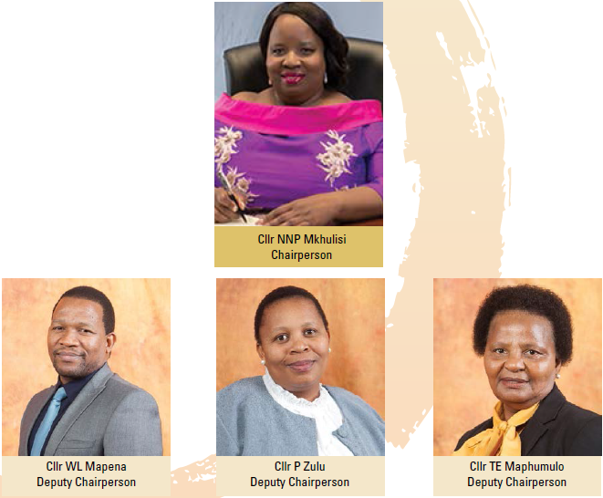
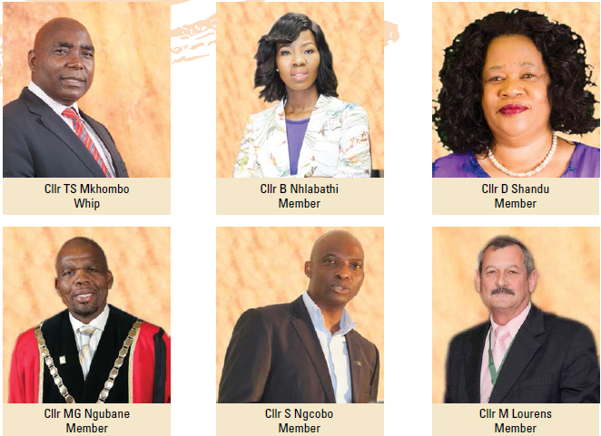
Notes:
As a member-focused organisation, SALGA prides itself for putting its members first.

Slide 4
SALT
SUPPORT
S
A
ADVISE
LOBBY
L
T
TRAIN

Slide 5
01
02
Establish Technical Committees to provide Hands-on Support
Monitor state of municipalities per cluster and Advise
03
04
Via IGR, Lobby on behalf of Municipalities
Develop an annual prospectus & Train Cllrs and officials

Slide 6
Supported all 54 municipalities last year in all areas of the business
All units host at least one conference and numerous symposiums
SUPPORT
Annual Support Plan & Technical Committees in all clusters
ADVISE
Cutting-edge conferences & symposiums
Monthly SALGA KZN Circular is a standing item on all council meetings and it updates members on positions & progress made.
Trained over 3000 Cllrs & Officials across all units
LOBBY
Annual Lobbying Strategy
TRAIN
Capacity Building Prospectus

Slide 7
S
Each portfolio has set up a Technical Committee made up of municipal experts. These experts have are deployed by SALGA KZN to solve practical problems in line with Support Plan
Direct support provided by SALGA staff,
A
SALGA KZN advises members via a Monthly SALGA Circular that is a standing item on all council meetings the municipalities to be support and the nature of the support, as well as quarterly Municipal Briefs, issue specific Booklets, Memos, and biannual newsletter.
SALGA KZN advises members using forum meetings, symposiums and conferences.
L
SALGA KZN Lobbying Strategy lists the positions adopted at PMA, PEC and other structures which SALGA lobbies and updates quarterly.
T
SALGA KZN Support Plan lists the municipalities to be support and the nature of the support
The SALGA KZN Capacity Building prospectus is updated annually and lists all training opportunities offered by the province.

Slide 8
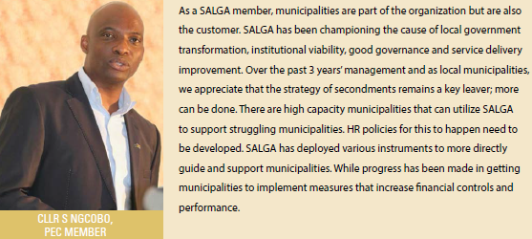

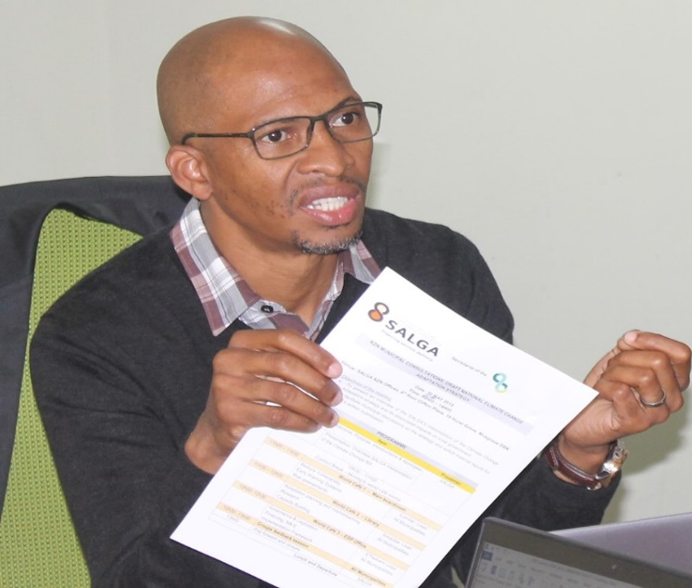
Technical support

Slide 9
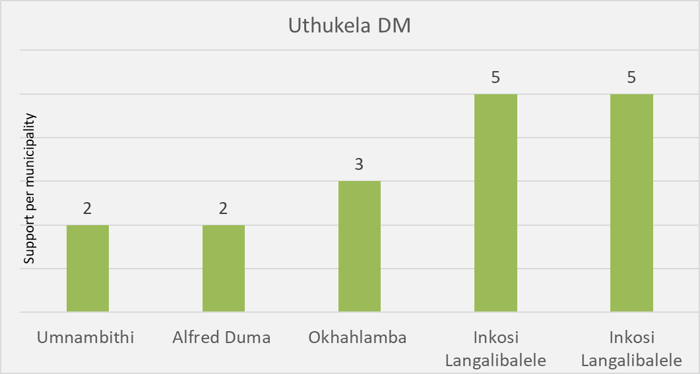
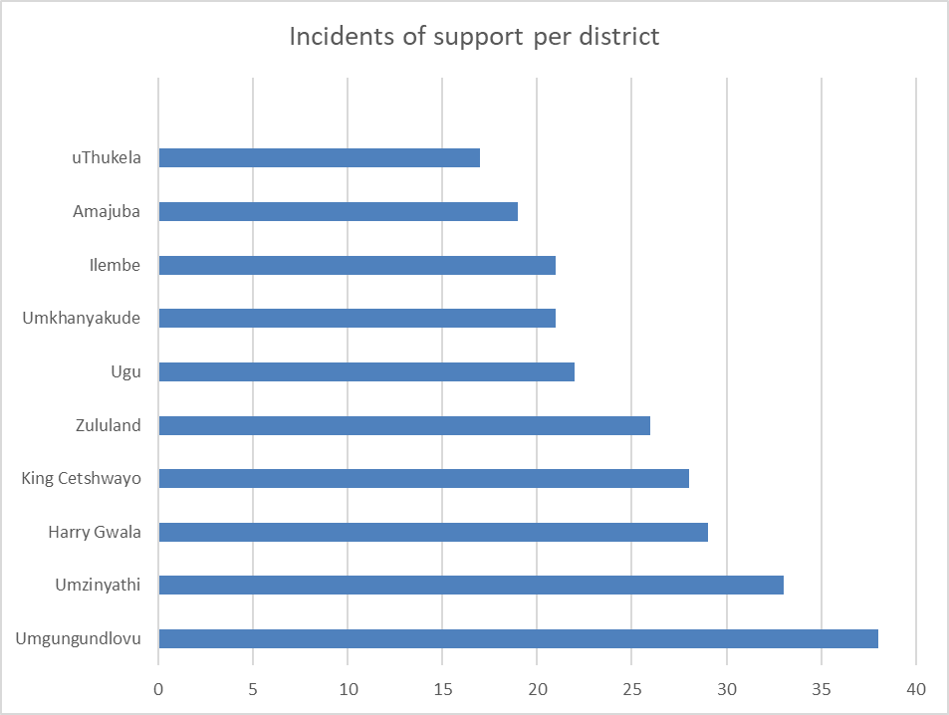
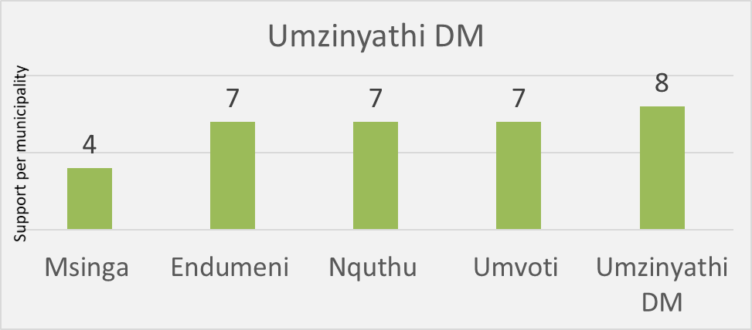
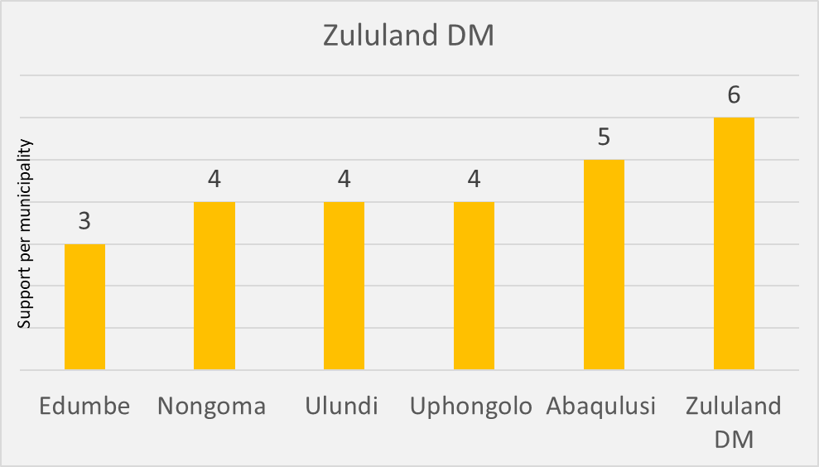
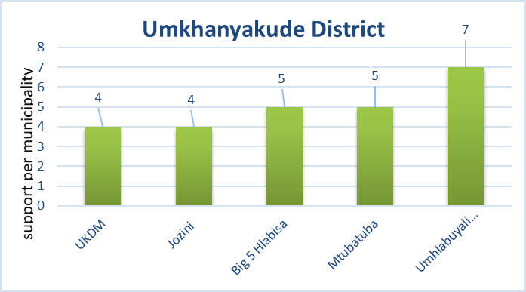
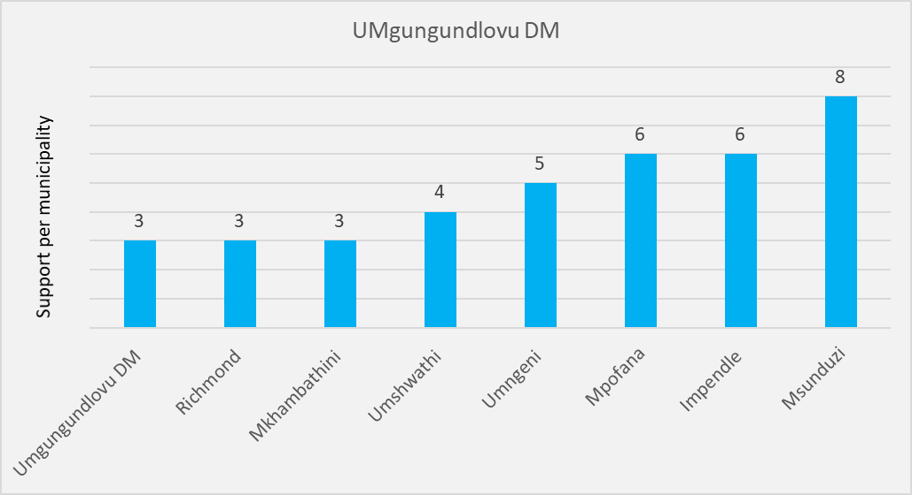
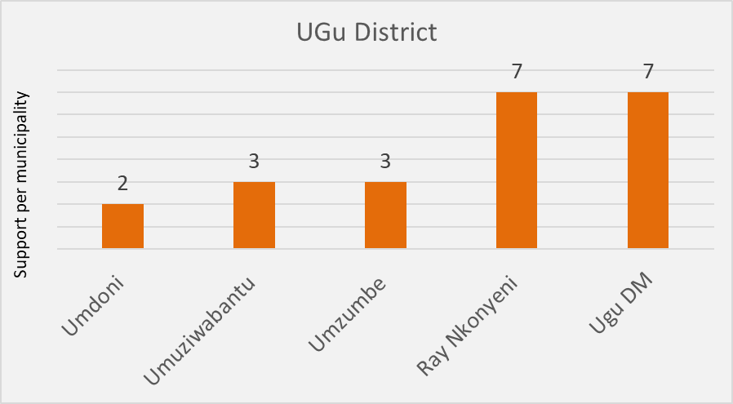
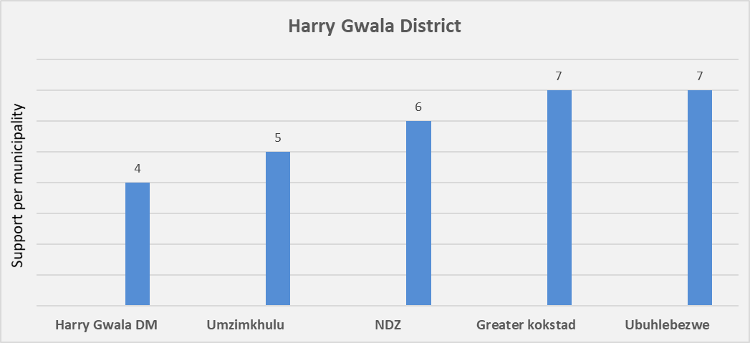
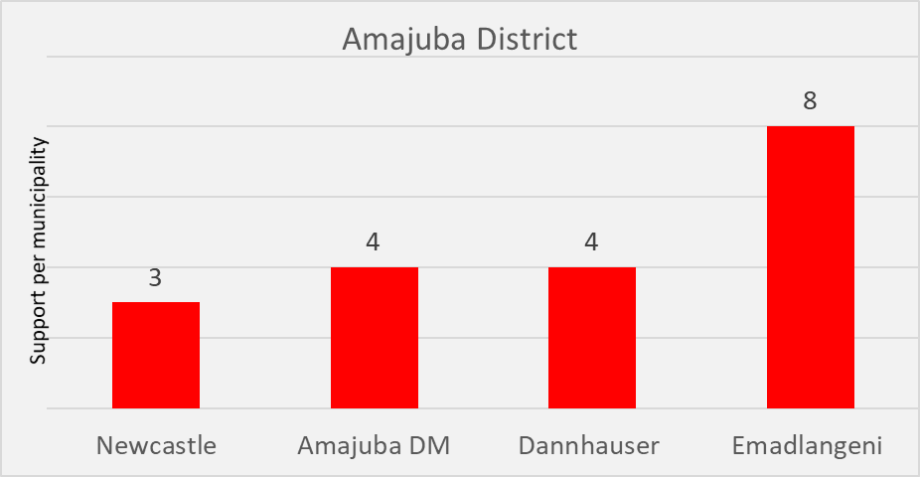
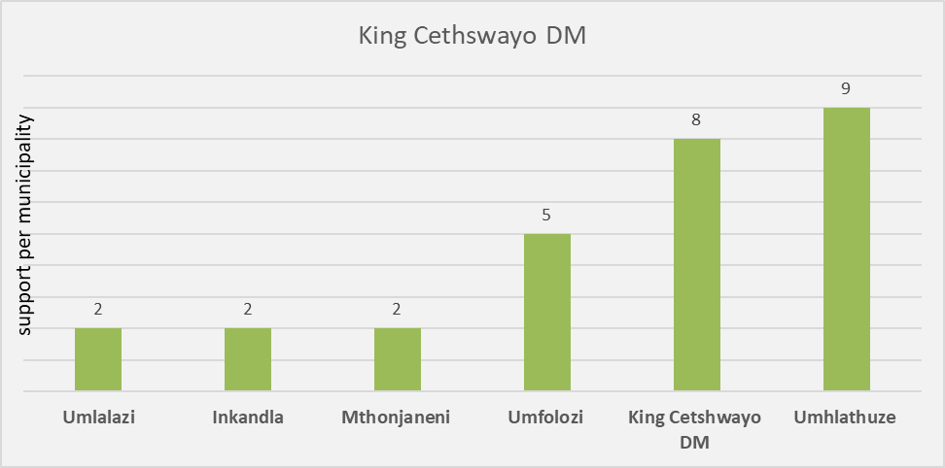
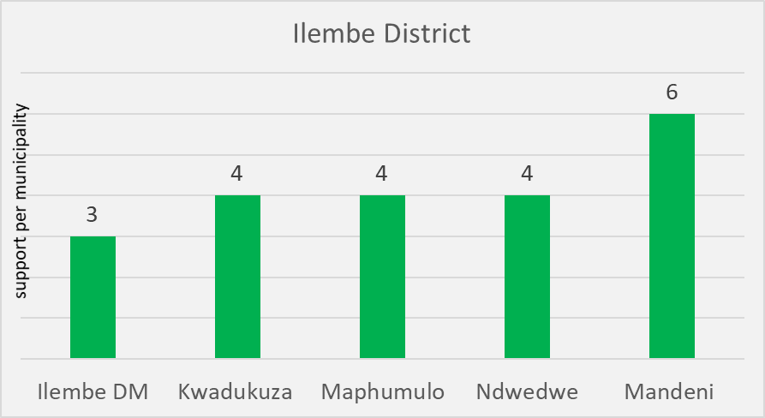

Slide 10
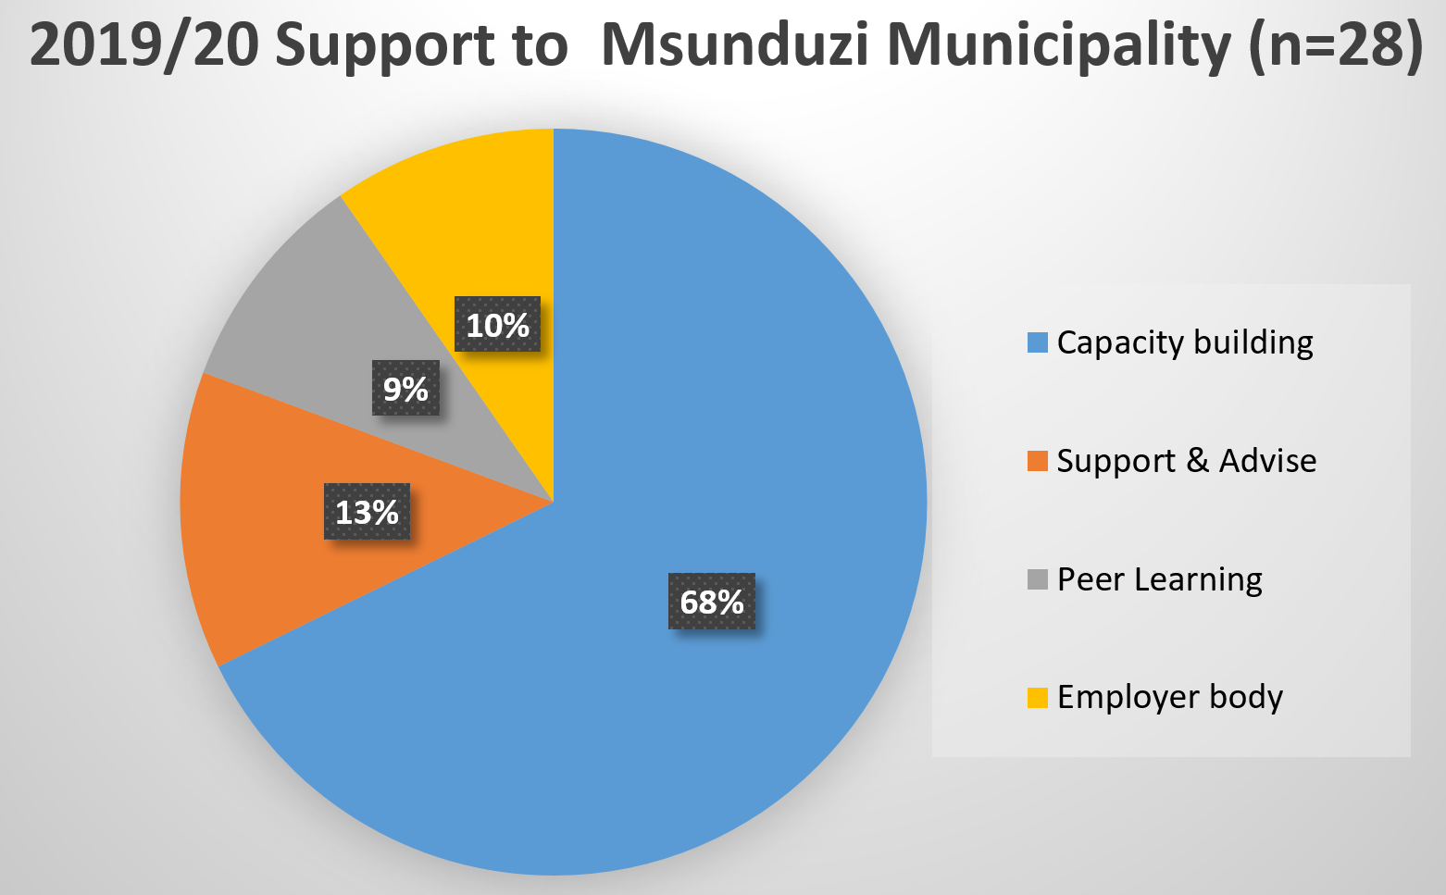

Slide 11
Representation (Technical Support)

Slide 12
Training

Slide 13
Lack of skills in HR & LR can lead to disputes if employees are not capacitated.
TRAINED officials on Chairing & Prosecuting Disciplinary Hearings, Interpretation & Application of Collective Agreements, Powers & Function of the Local Labour Forum, Strike Management Training, Performance Management Training
Negative audit outcomes on HR & PMS/non implementation of IDP
SUPPORTED municipalities with representation in arbitrations & conciliations
LOBBIED on behalf of member in SALGBC bargaining structures
Lack of improvement in service delivery and Equitable implementation of salary increases & salary scales and exemption applications.
SUPPORTED the ongoing cascading of Performance Management to levels below Section 54 (a) and 56 Managers.
SUPPORT municipalities with HR value chain to improve the HR maturity outcomes.
SUPPORTED implementation of the salary and wage increases & exemption applications
TRAINED MPAC members to undertake their roles and responsibilities
SUPPORTED the implementation of job evaluation
Accredited PMS Training
Peer Learning on HR Best Practices
Public-Private Partnerships (PPP) Capacity Training
Revenue Management, Credit Control and Debt Collection Training
Cost reflective tariff base standards benchmark training

Slide 14
SALGA SUPPORT PROGRAMME
2017/18 Financial Year
No | Support Programs | Description and Impact
1 | Job Evaluation Training | Standardization of the remuneration framework
2 | LLF; Service Charter & Collective Agreement Training | To capacitate members of the LLF (management and councillors) to ensure the effective functioning of the LLF to address matters of mutual interest. Create awareness in terms of service charter to allow the LLF to further engage and enhance service delivery. To capacitate councillors and officials on the provisions of the main collective agreement to try and avoid interpretation disputes
3 | Representation at Arbitration and Conciliations | Representation at the Bargaining Council.

Slide 15
SALGA SUPPORT PROGRAMME
2017/18 Financial Year
No | Support Programs | Description and Envisage Impact
4 | ICIP Portfolio Based Induction For MPAC | MPAC members and officials equipped to undertake their roles and responsibilities to ensure effective MPAC committees .
5 | Arbitration & Conciliation Training | To capacitate officials, and or senior managers on how to effectively prepare and present a case at the bargaining council.
6 | Induction Training on the Roles and Responsibilities Training of Councillors, Political Structures | To capacitate political office bearers and senior officials on the roles and responsibilities of political office bearers, councillors generally, municipal managers and chief finance officers

Slide 16
SALGA SUPPORT PROGRAMME
2018/19 Financial Year
No | Support Programs | Description and Envisage Impact
1 | Interpretation & Application of Collective Agreements: DC Training | Capacity building on the Disciplinary Collective Agreement to prevent interpretation disputes and ensure proper implementation
2 | Post Profiling Support | To assist the municipality improve its HR maturity rating in terms of the elements of the HR Value Chain through Peer Learning on the sharing of best practices.
3 | Interpretation & Application of Collective Agreements: Conditions of Service Collective Agreement | Training on the provisions of the Conditions of Service Collective Agreement to try and prevent interpretation disputes on the agreement and ensure proper implementation and application of the agreement

Slide 17
SALGA SUPPORT PROGRAMME
2018/19 Financial Year
No | Support Programs | Description and Envisage Impact
4 | Senior Managers Induction Programme | To capacitate senior managers on their roles and responsibilities, including the various pieces of legislation to enable them to effectively carry out their responsibilities
5 | Representation at Arbitration and Conciliations | Representation at the Bargaining Council.
6 | Job Evaluation Training | The workshop provided an understanding of the purpose of job evaluation, comprehensive guidelines in the use and application of system, practical experience in the evaluation of actual jobs and an opportunity to analyse results and discuss problems.

Slide 18
SALGA SUPPORT PROGRAMME
2019/20 Financial Year
No | Support Programs | Description and Envisage Impact
1 | LLF; Collective Agreements; DC; Conditions of Service Training | To capacitate members of the LLF (management and councillors) to ensure the effective functioning of the LLF to address matters of mutual interest. Create awareness in terms of service charter to allow the LLF to further engage and enhance service delivery. To capacitate councillors and officials on the provisions of the main collective agreement to try and avoid interpretation disputes
2 | Interpretation & Application of Collective Agreements: Conditions of Service Collective Agreement | Training on the provisions of the Conditions of Service Collective Agreement to try and prevent interpretation disputes on the agreement and ensure proper implementation and application of the agreement
3 | Arbitration & Conditions Training | To capacitate officials, and or senior managers on how to effectively prepare and present a case at the bargaining council.

Slide 19
SALGA SUPPORT PROGRAMME
2019/20 Financial Year
No | Support Programs | Description and Envisage Impact
4 | Chairing & Prosecuting Disciplinary Hearings | To capacitate officials, and or senior managers on specific skills to act as a Presiding Officer or Employer representative in line with the provisions of the Disciplinary Collective Agreement. The course assists delegates to prepare for disciplinary hearings in the gathering of evidence and the taking of statements but most importantly assists in presenting a case and to cross examine and re-examine witnesses.
5 | Councillor Workshop on the Powers and Functions of the LLF and DC Agreement | To capacitate councillors on the powers and functions of the LLF, to enable an understanding of what matters are permissable at the level of the LLF and training on the provisions of the Disciplinary Collective Agreement to prevent interpretation disputes and ensure proper implementation and application of the collective agreements by municipalities.

Slide 20
SALGA SUPPORT PROGRAMME
2019/20 Financial Year
No | Support Programs | Description and Envisage Impact
6 | Representation at Arbitration and Conciliations | Representation at the Bargaining Council.
7 | Implementation of Job Evaluation | Standardization of the remuneration framework
8 | Msunduzi Intervention Steercom Meeting | Advise on Human Resources and Labour Relations matters
9 | Case Law Journal and Practical Guideline to the implementation of collective agreements, labour legislation and policies | Key Learnings on recent court outcomes and awards/rulings. The journal will assist municipalities with representation at the arbitrations and conciliations. The Practical Guideline will clarify questions that municipalities generally raise with SALGA and assist with induction of employees.

Slide 21
SALGA SUPPORT PROGRAMME
2019/20 Financial Year
No | Support Programs | Description and Envisage Impact
10 | Peer Learning on HR Best Practices | The Peer Learning programme is aimed at assisting municipalities towards improving their value chain elements as contained in the HR maturity model and to facilitate assistance between municipalities with regards to best practices by SALGA through the HR assessment tool
11 | Accredited PMS Training | This is an accredited skills programme pitched at NQF levels 4-6 with a blended learning approach of contact and electronic learning. PMS/ HR Practitioners capacitated on the PMS framework, legislation, reporting, monitoring and evaluation,etc.

Slide 22
SALGA SUPPORT PROGRAMME
2017/18 Financial Year
Support Programs | Description and Envisage Impact
Public-Private Partnerships (PPP) Capacity Training | To capacitate municipal official on PPP concept as an option to procure and manage infrastructure; to scope the term for the purpose of the PPP Guide, and to explain its main characteristics to improve service delivery
Revenue Management, Credit Control and Debt Collection Training | To capacitate municipal official on how to best manage revenue your own revenue before enhancement to maximise cash collection

Slide 23
SALGA SUPPORT PROGRAMME
2018/19 Fiancial Year
Support Programs | Description and Envisage Impact
Cost reflective tariff base standards benchmark training | To equip municipality with sound understanding of all the costs of providing services and a “realistic” estimate of revenue that it is likely to receive from any solid waste charges in order to close the gap between citizens’ expectations and the reality in terms of what they in fact can deliver.
Alternative ICT revenue streams for municipalities | Municipality to understand various availble revenue streams and start tapping on those sources of revenue

Slide 24
SALGA SUPPORT PROGRAMME
2019/20 Financial Year
Support Programs | Description and Envisage Impact
GRAP & Audit Readiness Training | To equip municipality on the understanding of GRAP application and interpretation to prepare a good quality AFS

Slide 25

Poor labour Relations
Inefficient apartheid spatial design
Lack of skills
Crime / Corruption
Financial constraints & mismanagement
Poor planning & lack of IGR
Sector-Specific Challenges

Slide 26
Prolonged suspensions eroded labour Relations
Vacancies in key positions
Lack of skills frontline skills
Poor compliance with governance framework
Costs increasing faster than revenue
Poor customer relations & perception poor billing
Msunduzi-Specific Challenges

Slide 27
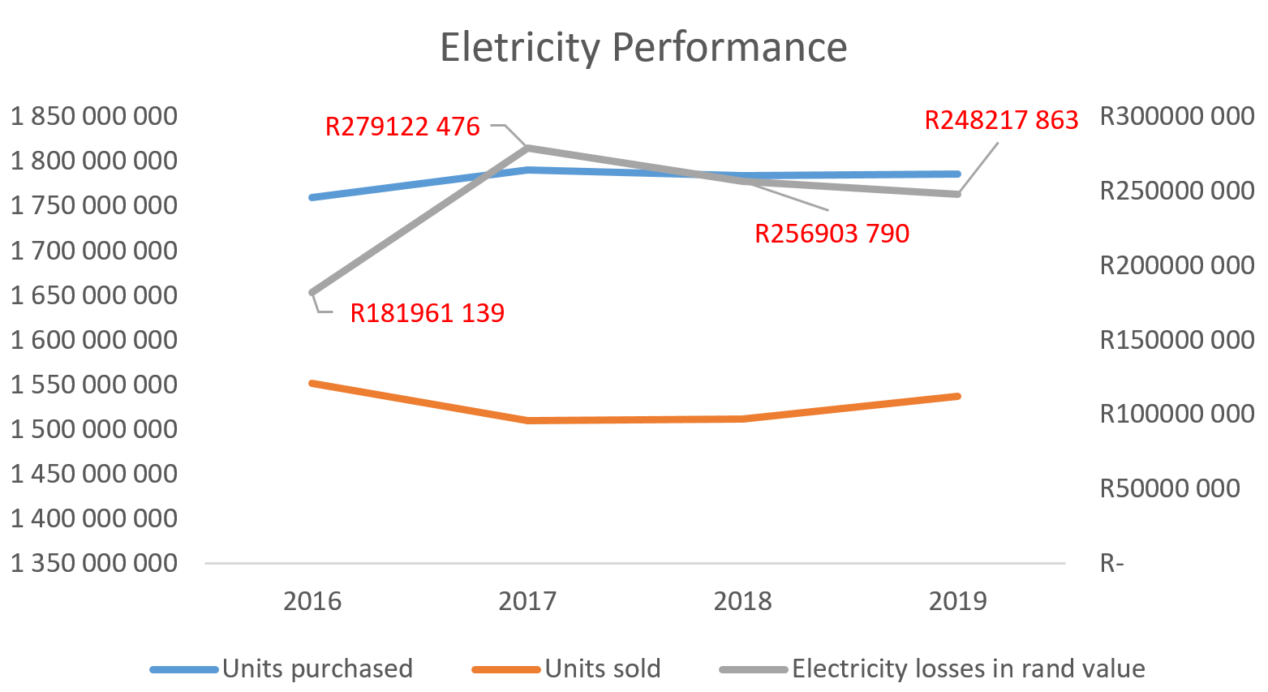
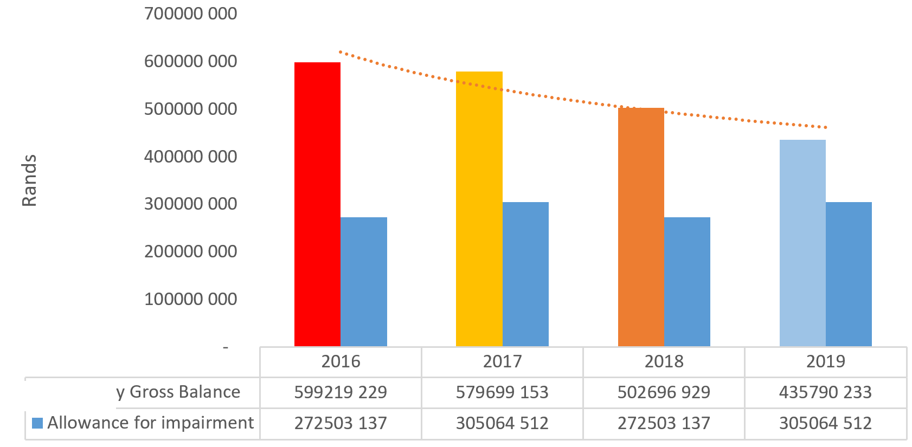
The electricity business is deteriorating and will likely render the municipality unable to meet its obligations in the near future. Unless tariffs are set at asset replacement levels and losses are brought back to sustainable levels.

Slide 28
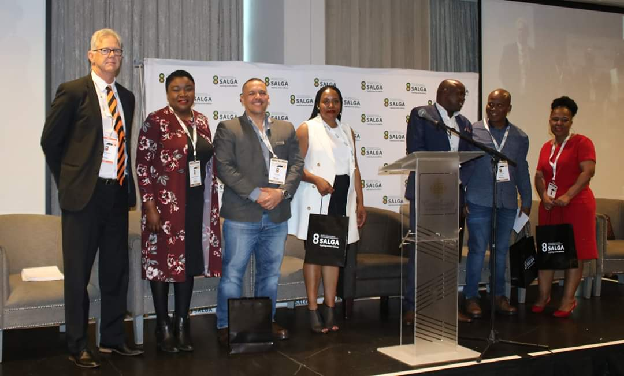
HR & Labour Relations
The prolonged tug-of-war between unions and the municipality is a result of prolonged suspensions and dysfunctional LLFs. Councillors (Portfolio Committee) must be at the centre of correcting this so that it does not take on a political narrative.
Notes:
SALGA is an Employer body for local government and in 2019 it is noteworthy that

Slide 29
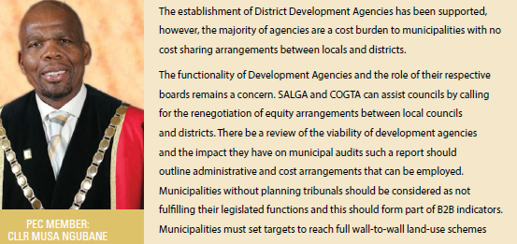
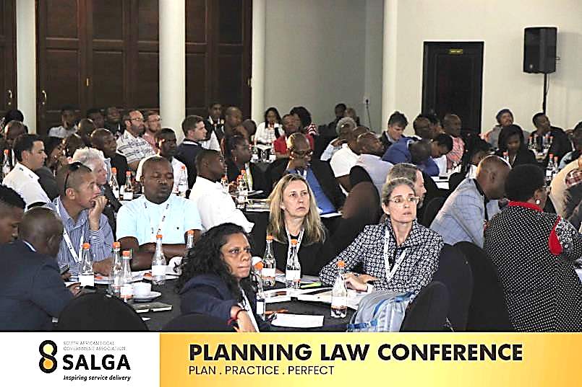
Economic Development & Planning
The municipality has excellent economic recovery initiatives that, if supported, can make the city a driver of economic growth. But this is all subject to the development and implementation of comprehensive spatial planning, the eradication of land invasions and the ability to forge partnerships for external financial support.

Slide 30
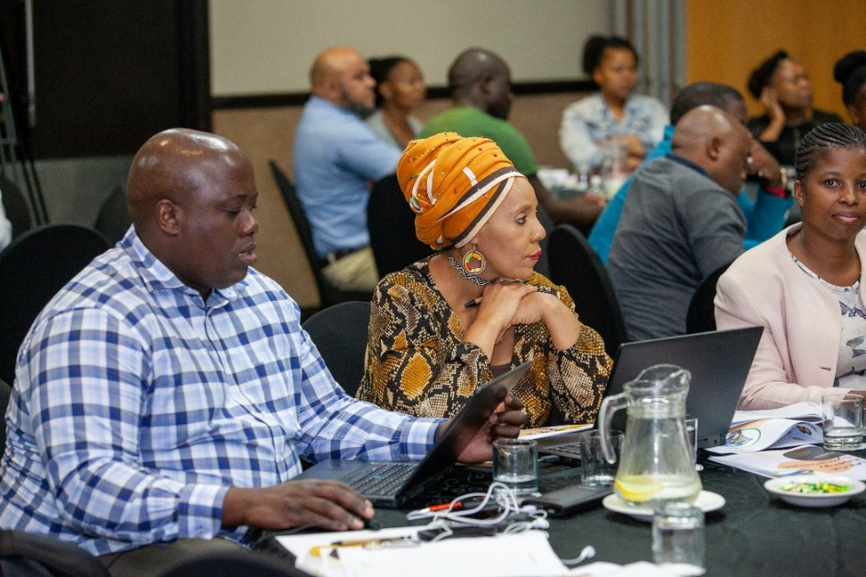
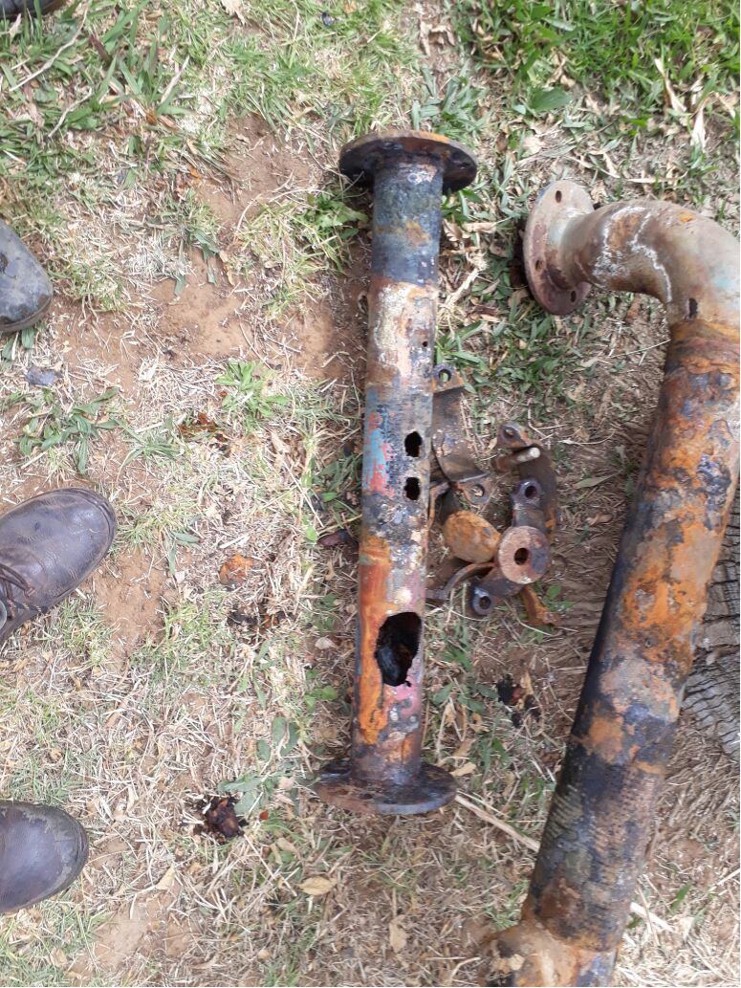
Infrastructure services
Cable theft, illegal connections, aged transformers, & old or insufficient water pipes. These are the challenges that this municipality faces but has failed to address within it financial resources. Typical of most s139 municipalities, there is little evidence that councillors are given a central role in changing culture of consumers

Slide 31
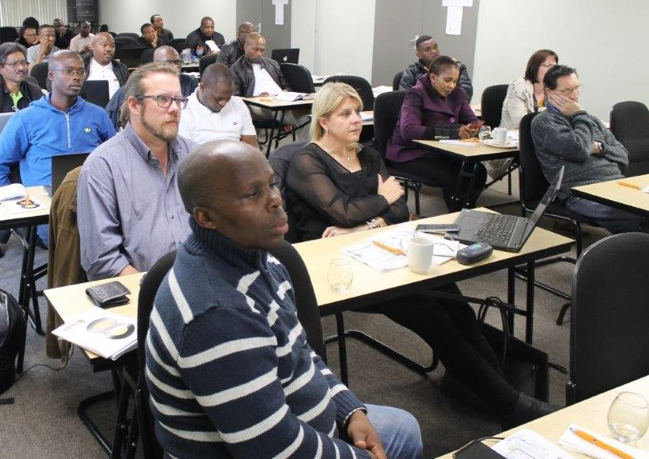
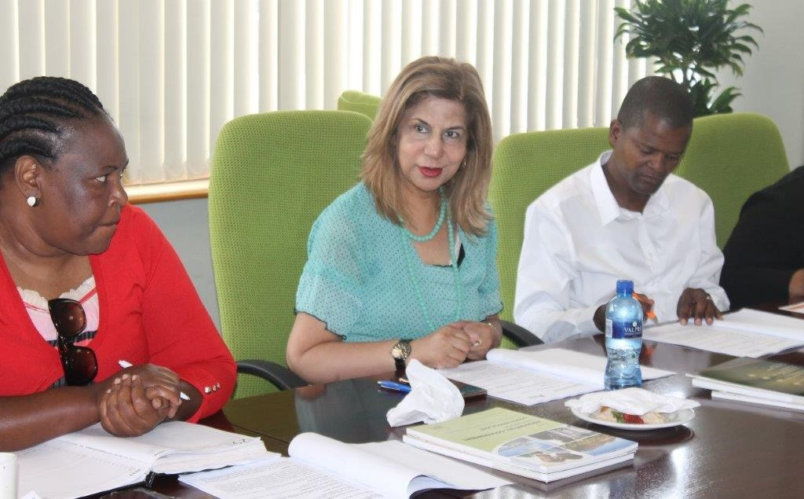
Municipal Finance
Unless the situation improves, one can foresee the municipality having difficulty servicing its utility debts. An aggressive debt collection programme the MM implemented is supported but may be short-lived. Some debt is simply not collectable. External support to urgently fix billing challenges cannot be stressed enough.

Slide 32
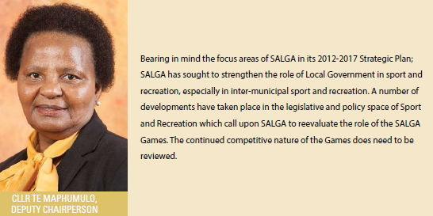
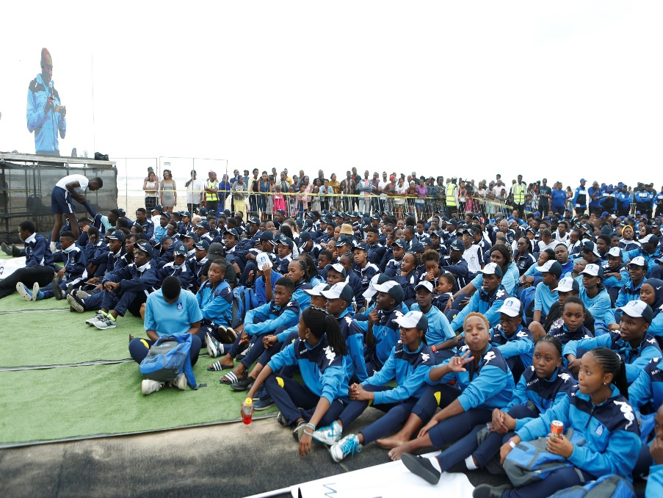
Inclusive communities
There is a history of social ills in this area and urban sprawl only worsens this. With better social relief a number of households can live a decent live but it is not possible if rates and taxes keep increasing. As many employers have closed shops in the inner-city there is increasing building invasion and drug abuse by young people.

Slide 33
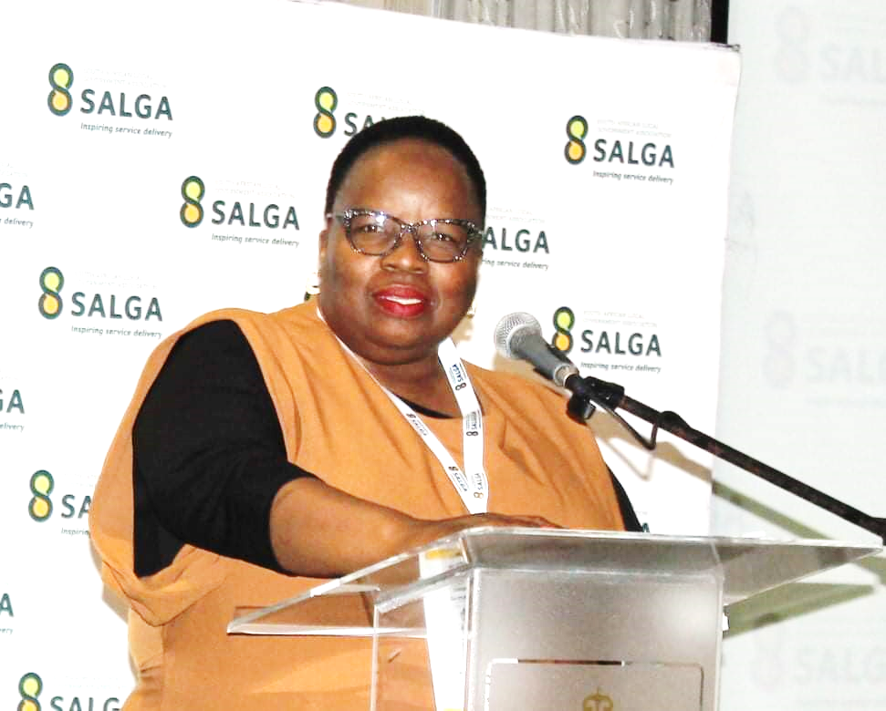

Governance & intergovernmental relations
The longer the municipality stays under section 139 the less likely that normal collaboration between citizens, councillors and the administration will be restored prior to the elections. It is important to remember and treat why the municipality was put under administration.

