Slide 1



PORTFOLIO COMMITTEE ON COOPERATIVE GOVERNANCE AND TRADITIONAL AFFAIRS
2 September 2020
GROWING KWAZULU-NATAL TOGETHER

Slide 2

OPENING REMARKS
GROWING KWAZULU-NATAL TOGETHER
Chairperson of the Portfolio Committee on Co-operative Governance and Traditional Affairs Honourable A. F. Muthambi;
Honourable Members;
Ladies and Gentlemen;

Slide 3
OPENING REMARKS
GROWING KWAZULU-NATAL TOGETHER
We are honoured to have been invited by the Portfolio Committee on Cooperative Governance and Traditional Affairs to brief Honourable Members on the Covid-19 Response Plan for KwaZulu-Natal.
We have honoured this invitation in recognition of the Constitutional mandate of the Portfolio Committee which is to oversee the Department of Cooperative Governance, the leading department in our national response to the Covid-19 pandemic.

Slide 4
OPENING REMARKS
GROWING KWAZULU-NATAL TOGETHER
In line with the invitation we have structured our presentation according to the following broad areas:
  Programme of the KZN Provincial Command Council
  Department of Cooperative Governance and Traditional Affairs
  Department Human Settlements

Slide 5
OPENING REMARKS
GROWING KWAZULU-NATAL TOGETHER
  Department of Education
  Department of Health – In particular here details will be provided of the Provincial Health Plan to Covid-19 including the health promotion, prevention, containment and treatment and Quarantine facilities and use of the
  Department of Public Works facilities for activation and isolation.

Slide 6


KZN PROVINCIAL COMMAND COUNCIL

Slide 7
BACKGROUND
GROWING KWAZULU-NATAL TOGETHER
The Corona Virus Infectious Disease (Covid-19) which has to date reached pandemic proportions was first diagnosed in KwaZulu-Natal on the 5th Match 2020.
It was declared as a pandemic on the 12 March 2020 by the WHO.
This triggered a health emergency in the country as efforts to contain the spread and educate people about the virus ensued.

Slide 8
BACKGROUND
GROWING KWAZULU-NATAL TOGETHER
The first case was an imported case (Patient Zero, who had travelled via Italy)
Since then cases started to increase rapidly every day and local to local transmission begun.
The KwaZulu-Natal Preparedness and Response Plan was immediately activated to contain, manage and mitigate the pandemic

Slide 9
BACKGROUND
GROWING KWAZULU-NATAL TOGETHER
Following the Declaration of the Disaster by the President of the Republic, His Excellency Cyril Ramaphosa.
1. A Multi-Sectoral Coordination structure was established at Provincial and Local level to oversee the province’s Covid-19 response and mitigation plan.
-Provincial Command Council
-District Command Councils

Slide 10
BACKGROUND
GROWING KWAZULU-NATAL TOGETHER
The Provincial Command Council tasks included among others:
Ensuring that the Health care system is geared to respond comprehensively to the COVID-19 pandemic, minimise the risk to health care workers and maximise good patient outcomes.
Capacitate emergency medical services to respond to reported cases;

Slide 11
BACKGROUND
GROWING KWAZULU-NATAL TOGETHER
Establish and maintain screening capacity;
Continuously inform the public of the public Health risks of the Covid-19 and measures in place (through risk communication and community engagement)
The Provincial Command Council adopted a continuous, consistent, communication approach and used it to heighten awareness and minimise panic in society

Slide 12
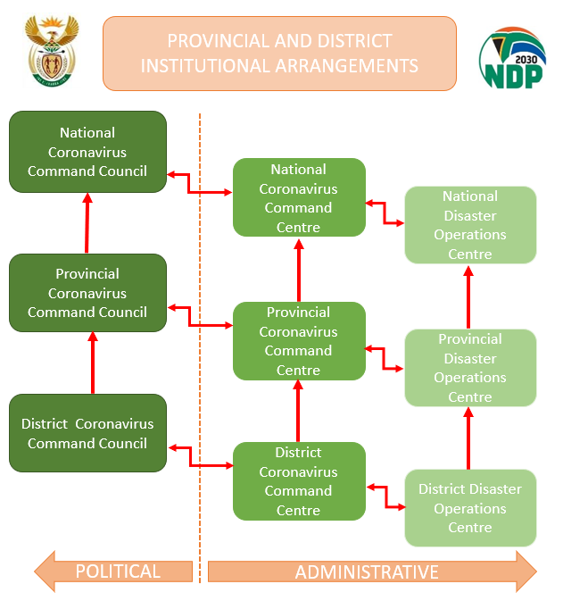
GROWING KWAZULU-NATAL TOGETHER
GROWING KWAZULU-NATAL TOGETHER
COMMAND COUNCIL INSTITUTIONAL ARRANGEMENTS
12

Slide 13
GROWING KWAZULU-NATAL TOGETHER
COORDINATING STRUCTURES
INTERVENTION | ACTIVITIES | PERSON RESPONSIBLE | PROGRESS
Political Command Team | Meets on Fridays at 12pm | Premier and Chairs | In place and fully functional
Technical Command Team – chaired by Director General | Co-ordinate all HOD’s Meets on Thursday and adhocly via Microsoft teams when required | Chaired by DG | In place and fully functional
Prov JOC – Disaster Management Team ( co chaired – DOH and COGTA | Meets Tues and Thurs at 11 am Ethekwini Disaster centre | DOH/COGTA | In place and fully functional. Has sector representation and feeds into the technical command team and ProvJoints
PROVJOINTS | Meets daily at SAPS Headquarters at 8am | JCPS Cluster | In place and fully functional with representation from OTP, Health, DEDTEA, DSD, CS, COGTA
13

Slide 14
GROWING KWAZULU-NATAL TOGETHER
COORDINATING STRUCTURES
INTERVENTION | ACTIVITIES | RESPONSIBLE PERSON | PROGRESS
District Command Councils – Coordinating structures at District level | All MEC Champions and Mayors Functional structures at district level up to ward level | Respond in line with the District Development Model/ OSS Champions | Command Centres set up in all districts Scheduled meetings: Umkhanyakude: Thursdays (Pol&Tech) UGu: Wednesdays Harry Gwala: Fridays Mzinyathi : Thursdays Zululand: Thursdays Ilembe Tuesdays (Technical) Thursdays (Political) Amajuba: Mondays and Thursdays UThukela:Thursdays UMgungundlovu:Thursdays eThekiwni: Tuesdays(Technical) Thursdays(Political) King Cetshwayo
14

Slide 15
KZN COVID-19 SITUATIONAL REPORT
31 AUGUST 2020

Slide 16
BACKGROUND
GROWING KWAZULU-NATAL TOGETHER
As at 31 August 2020 the Province of KwaZulu-Natal had 627 041 confirmed cases.
New Cases = 1985
Deaths = 14 149
Full Recoveries = 540 923
Unallocated = 50

Slide 17
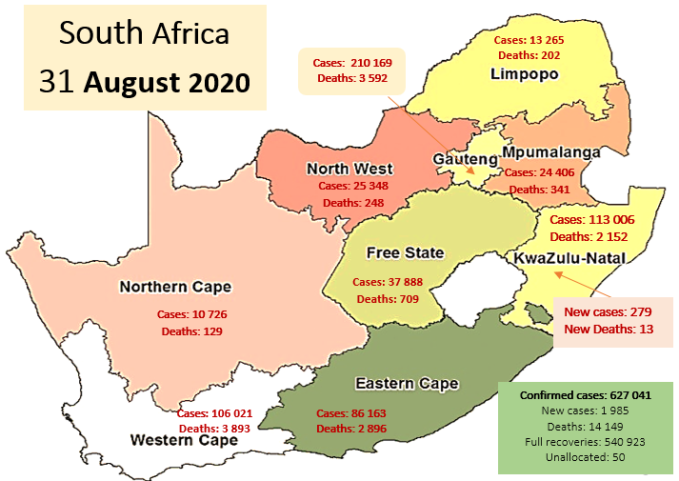
GROWING KWAZULU-NATAL TOGETHER
BACKGROUND
On 31 August 2020, KwaZulu-Natal Province recorded 279 new cases
KwaZulu-Natal Province continue to be the second highest in number of laboratory-confirmed cases countrywide.
The province have recorded 13 new COVID-19 related death.
KwaZulu-Natal Province contributes 15% (n=2 152) of the deaths countrywide.

Slide 18
The median number of cases reported in the province since the beginning of August was 805 cases/daily (range 261-2 893). Of the 279 new cases recorded on 31 August 2020, eThekwini District recorded 41% followed by King Cetshwayo (17%) (Table 1).
The number of new cases dropped below 300 on the 25 and 31 August 2020 (Figure 5).
GROWING KWAZULU-NATAL TOGETHER
DISTRIBUTION OF CASES BY REPORTING DATE AND DISTRICT

Slide 19
GROWING KWAZULU-NATAL TOGETHER
DISTRIBUTION OF CASES AND DEATHS BY DISTRICT, KWAZULU-NATAL, 5 MAR-31 AUG 2020
District | New cases | %. New cases | Total cases | %.Total | Total deaths | %. Total deaths | Case Fatality rate (%)
EThekwini | 113 | 40.5 | 53 400 | 47.3 | 1 060 | 49.3 | 2.0
ILembe | 42 | 15.1 | 5 984 | 5.3 | 57 | 2.6 | 1.0
UMgungundlovu | 20 | 7.2 | 15 665 | 13.9 | 335 | 15.6 | 2.1
UThukela | 4 | 1.4 | 4 841 | 4.3 | 112 | 5.2 | 2.3
King Cetshwayo | 47 | 16.8 | 9 453 | 8.4 | 193 | 9.0 | 2.0
UGu | 11 | 3.9 | 4 697 | 4.2 | 88 | 4.1 | 1.9
Amajuba | 13 | 4.7 | 6 514 | 5.8 | 108 | 5.0 | 1.7
UMkhanyakude | 9 | 3.2 | 2 353 | 2.1 | 49 | 2.3 | 2.1
Harry Gwala | 5 | 1.8 | 2 289 | 2.0 | 50 | 2.3 | 2.2
Zululand | 5 | 1.8 | 4 606 | 4.1 | 50 | 2.3 | 1.1
UMzinyathi | 3 | 1.1 | 2 454 | 2.2 | 50 | 2.3 | 2.0
Unallocated | 7 | 2.5 | 750 | 0.7 | 0 | 0.0 | 0.0
Total | 279 | 100.0 | 113 006 | 100.0 | 2 152 | 100.0 | 1.9
*NB: Due to transfer in and out of patients, some patients demise in the districts they were transferred to, contributing to change in number of deaths by district after reallocation.

Slide 20
GROWING KWAZULU-NATAL TOGETHER
INCIDENCE RISK BY DISTRICT (PER 100 000 POPULATION)
The overall incidence risk for the province was 93 cases per 100 000 population (calculated using active cases). The incidence risk has been declining since the beginning of August. King Cetshwayo District continue to be the district with the highest infection rate (305 cases per 100 000) followed by Harry Gwala (169 cases/100 000) and UMgungundlovu Districts (137 cases/100 000). Only four districts has an incidence risk of <100 cases per 100 000 population. Table 2: Incidence risk by district, KwaZulu-Natal, 5 Mar-31 Aug 2020 (n=113 006)
District | Total cases | Cumulative incidence risk/ 100 000 | Mid-2019*(n) | Active cases | Incidence risk/ 100 000
EThekwini | 53 400 | 1 373 | 3 890 001 | 2 414 | 62
ILembe | 5 984 | 893 | 669 748 | 232 | 35
UMgungundlovu | 15 665 | 1 398 | 1 120 208 | 1 341 | 120
UThukela | 4 841 | 688 | 703 839 | 92 | 13
King Cetshwayo | 9 453 | 986 | 958 905 | 2 925 | 305
UGu | 4 697 | 585 | 802 228 | 711 | 89
Amajuba | 6 514 | 1 170 | 556 971 | 565 | 101
UMkhanyakude | 2 353 | 351 | 670 206 | 44 | 7
Harry Gwala | 2 289 | 455 | 502 792 | 688 | 137
Zululand | 4 606 | 537 | 857 877 | 134 | 16
UMzinyathi | 2 454 | 441 | 556 312 | 574 | 103
Unallocated | 750 | N/A | N/A | 750 | N/A
Total | 113 006 | 1 001 | 11 289 086 | 10 470 | 93
*Active cases=Total cases-(recoveries + deaths)

Slide 21
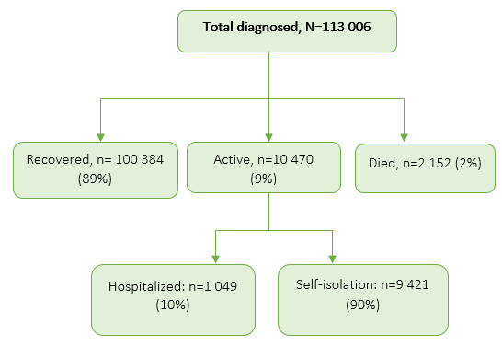
GROWING KWAZULU-NATAL TOGETHER
SUMMARY OF LABORATORY CONFIRMED CASES
Summary of laboratory-confirmed cases, KwaZulu-Natal, 5 Mar-31 August 2020 (n=113 006)
The number of new cases dropped below 300 on the 25 and 31 August 2020

Slide 22
GROWING KWAZULU-NATAL TOGETHER
DISTRIBUTION OF PATIENTS BY AGE AND SEX
Female cases continue to dominate with approximately 60% of the confirmed cases (Figure 5b). Among the new cases received on 31 August 2020, female cases dominated (56%)
Sex distribution of COVID-19 cases, KwaZulu-Natal, 5 Mar-31 Aug 2020
The number of cases decrease with increase in age in both male and female cases. Majority of cases are between the ages of 30-39 years (Figure 6). The median age remains 38 years (range 0-98 years).

Slide 23
GROWING KWAZULU-NATAL TOGETHER
OVERALL NUMBER OF SAMPLES TESTED AND DETECTION RATE BY PROVINCE, SOUTH AFRICA, 31 AUGUST 2020
Province | Total tests |  |  |  | New tests
 | No. tests | Percentage tested | No. positive | Percentage test positive | No. new tests | Percentage tested | No. positive | Percentage test positive
Eastern cape | 407 170 | 11% | 85 716 | 21.1% | 1 431 | 7% | 178 | 12.4%
Free state | 233 065 | 6% | 39 476 | 16.9% | 1 977 | 9% | 436 | 22.1%
Gauteng | 1 217 344 | 33% | 209 451 | 17.2% | 6 275 | 29% | 548 | 8.7%
KwaZulu-Natal | 638 480 | 17% | 107 893 | 16.9% | 3 732 | 17% | 460 | 12.3%
Limpopo | 82 465 | 2% | 10 688 | 13.0% | 830 | 4% | 129 | 15.5%
Mpumalanga | 138 767 | 4% | 28 354 | 20.4% | 1 352 | 6% | 210 | 15.5%
North west | 95 688 | 3% | 21 219 | 22.2% | 802 | 4% | 133 | 16.6%
Northern cape | 51 307 | 1% | 8 971 | 17.5% | 1 455 | 7% | 300 | 20.6%
Western cape | 569 395 | 15% | 111 287 | 19.5% | 3 263 | 15% | 243 | 7.4%
Unknown | 241 191 | 7% | 38 441 | 15.9% | 785 | 4% | 109 | 13.9%
Total | 3 674 872 | 100% | 661 496 | 18.0% | 21 902 | 100% | 2 746 | 12.5%

Slide 24
GROWING KWAZULU-NATAL TOGETHER
HOSPITAL ADMISSIONS/ISOLATIONS
On 31 Aug 2020, the province had 1 049 patients admitted in both private (n=719, 69%) and public (n=330, 31%) hospitals.
Of those admitted, 236 patients (22%) required intensive care services. Private hospitals had more patients in ICU (87%, n=206) than public facilities (13%, n=30).
Among those who required intensive care, 50% (n=119) were ventilated. Other patients, 9% (n=94) were admitted in high care units in both private (89%, n=84) and public (11%, n=10) facilities (Table 4 & 6).

Slide 25
GROWING KWAZULU-NATAL TOGETHER
Admissions in public facilities, KwaZulu-Natal, 31 Aug 2020 (n=330)
DISTRICT | Total admissions |  | ICU patients |  |  | High care
 | Total patients | Oxygenated | Total patients | Ventilated | Oxygenated | Total Patients | Oxygenated
EThekwini | 144 | 80 | 16 | 12 | 4 | 6 | 0
UMgungundlovu | 38 | 14 | 8 | 3 | 6 | 0 | 0
UMzinyathi | 6 | 0 | 0 | 0 | 0 | 0 | 0
UGu | 23 | 9 | 1 | 1 | 0 | 0 | 0
Amajuba | 27 | 10 | 0 | 0 | 0 | 4 | 0
UThukela | 4 | 0 | 0 | 0 | 0 | 0 | 0
King Cetshwayo | 38 | 10 | 4 | 1 | 0 | 0 | 0
Zululand | 8 | 2 | 0 | 0 | 0 | 0 | 0
ILembe | 28 | 14 | 1 | 0 | 0 | 0 | 0
Harry Gwala | 4 | 1 | 0 | 0 | 0 | 0 | 0
UMkhanyakude | 10 | 0 | 0 | 0 | 0 | 0 | 0
Total | 330 | 140 | 30 | 17 | 10 | 10 | 0

Slide 26
GROWING KWAZULU-NATAL TOGETHER
Number of patients admitted in ICU by facility, KwaZulu-Natal, 31 August 2020
Inkosi Albert Luthuli (IALCH) had majority (33%) of patients admitted in intensive care units, followed by Edendale Hospital (20%).
Hospital | ICU patients | %. ICU | Ventilated patients | %. Ventilated
Edendale | 6 | 20.0 | 2.0 | 33.3
Greys | 2 | 6.7 | 1.0 | 50.0
Ngwelezana | 4 | 13.3 | 1.0 | 25.0
Inkosi Albert Luthuli | 10 | 33.3 | 9.0 | 90.0
King Edward | 3 | 10.0 | 2.0 | 66.7
RK Khan | 3 | 10.0 | 1.0 | 33.3
Madadeni | 0 | 0.0 | 0.0 | 0.0
GJGM | 1 | 3.3 | 0.0 | 0.0
PSH | 1 | 3.3 | 1 | 100.0
Total | 30 | 100.0 | 17 | 56.7

Slide 27
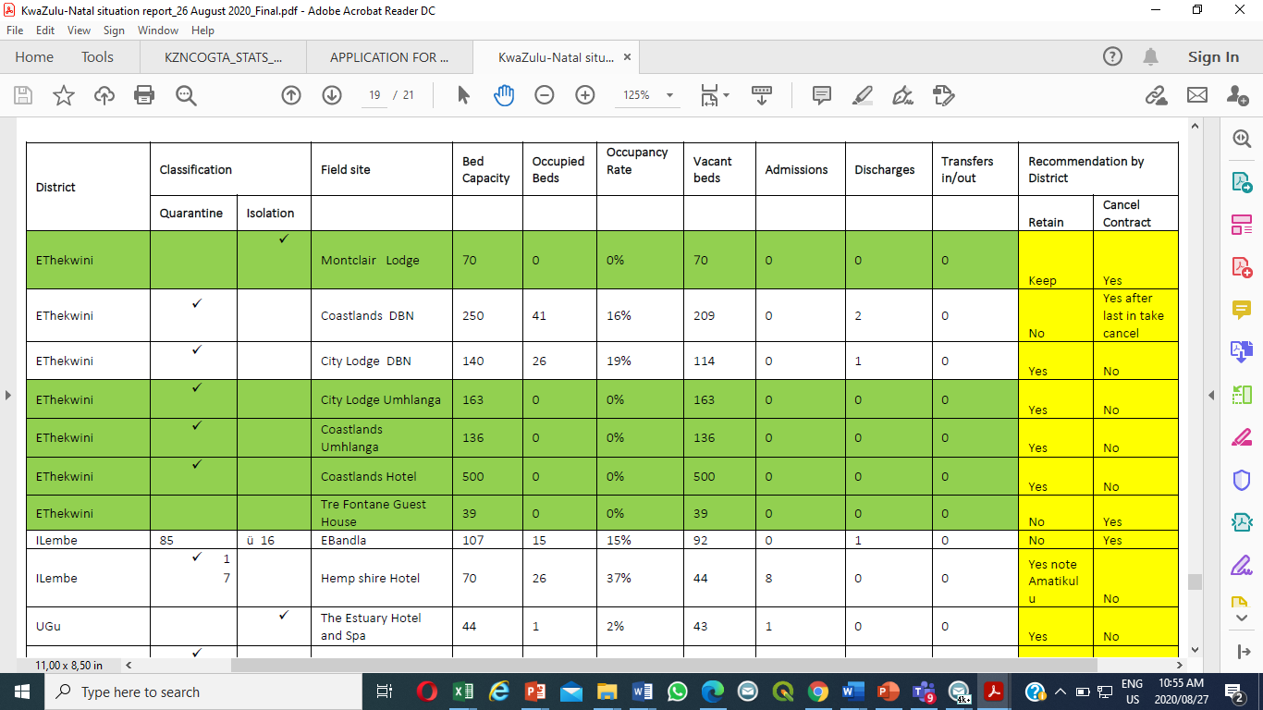
GROWING KWAZULU-NATAL TOGETHER
COVID-19 FIELD HOSPITALS, QUARANTINE AND ISOLATION SITES

Slide 28
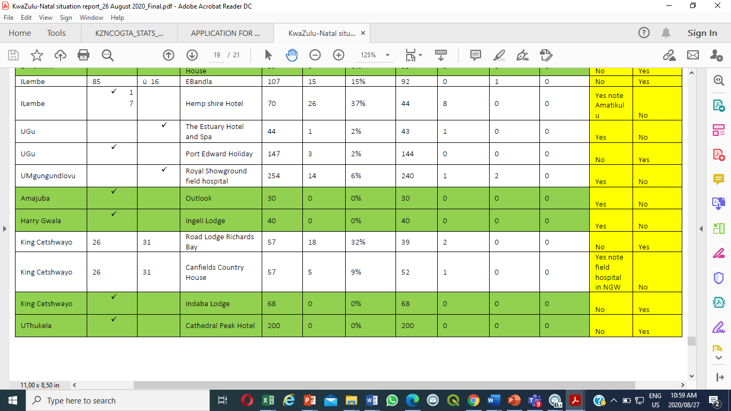
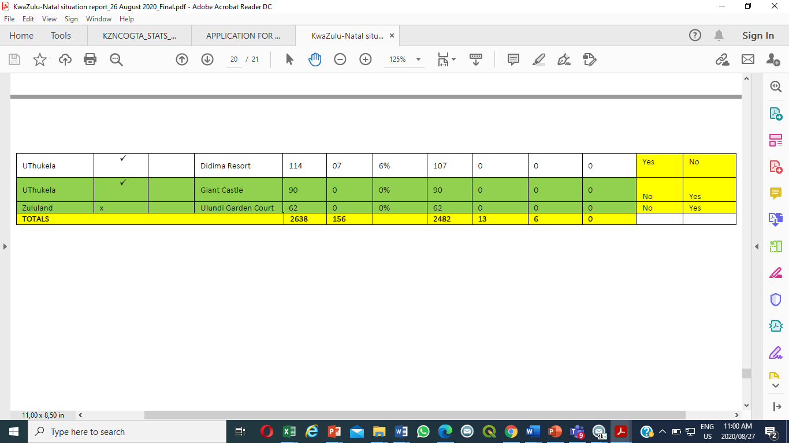
GROWING KWAZULU-NATAL TOGETHER
COVID-19 FIELD HOSPITALS, QUARANTINE AND ISOLATION SITES

Slide 29
COVID-19 EXPENDITURE

Slide 30
GROWING KWAZULU-NATAL TOGETHER
COVID -19 EXPENDITURE
By the 27th of July, KwaZulu-Natal had spent an amount to the tune of(R2 929 033 565) on the Covid-19 related expenditure.
Of this, the provincial departments spent a combined R1 999 810 799,
Municipalities spent R925 271 000, and
Public entities spent R4 001 766.
Of the R2.9 billion spent so far, a total of R 1 139 923 090.99 (representing 57% of the total spend) was spent on infrastructure programmes.

Slide 31
GROWING KWAZULU-NATAL TOGETHER
COVID -19 EXPENDITURE
These are projects that relate to upgrades and alterations to health facilities and to the establishment of quarantine facilities.
Many of these are infrastructural projects in schools, in our hospitals and in our communities. Many of these projects will benefit our communities long after the Covid-19 pandemic has passed.

Slide 32
GROWING KWAZULU-NATAL TOGETHER
COVID-19 EXPENDITURE
Of the R2.9 billion spent so far, a total of R 1 139 923 090.99 (representing 57% of the total spend) was spent on infrastructure programmes. These are projects that relate to upgrades and alterations to health facilities and to the establishment of quarantine facilities.

Slide 33
GROWING KWAZULU-NATAL TOGETHER
COVID-19 EXPENDITURE
Many of these are infrastructural projects in schools, in our hospitals and in our communities. Many of these projects will benefit our communities long after the Covid-19 pandemic has passed.
The full report on the KZN Covid-19 expenditure has been made public and is accessible.

Slide 34
GROWING KWAZULU-NATAL TOGETHER
SUMMARY EXPENDITURE OVERVIEW
PUPLIC ENTITIES
R4 001 766
MUNICPALITIES
R925 271 000
DEPARTMENTS
R1 999 465 704
Total R 2 928 738 470
COVID-19 EXPENDITURE
34

Slide 35
GROWING KWAZULU-NATAL TOGETHER
EXPENDITURE PER PROVINCIAL DEPARTMENT
Provincial Departments | Amount
Agriculture and Rural Development | 19 319 447.35
Arts and Culture | 1 135 806.00
Community Safety and Liaison | 775 277.57
Co-operative Governance and Traditional Affairs | 1 431 529.11
Economic Development, Tourism and Environmental Affairs | 7 416 575.10
Education | 487 447 612.63
Health | 1 415 362 034.56
Human Settlements | 1 807 007.58
Office of the Premier | 1 896 220.46
Provincial Treasury | 898 692.38
Public Works | 1 970 574.67
Social Development | 54 241 700.92
Sport and Recreation | 660 060.22
Transport | 5 103 165.45
Total | 1 999 465 704,00
35

Slide 36
GROWING KWAZULU-NATAL TOGETHER
EXPENDITURE PER ENTITY
Entity | Total Value
Trade and Investment KwaZulu-Natal (TIKZN) | R 1,208,765.00
KwaZulu-Natal Liquor Authority | R 920,595.68
KwaZulu-Natal Gaming and Betting Board | R 622,970.60
KwaZulu-Natal Sharks Board Maritime Centre of Excellence | R 402,515.00
KwaZulu-Natal Film Commission | R 279,948.37
Tourism KwaZulu-Natal | R 159,090.40
Moses Kotane Institute | R 139,541.00
Ithala Development Finance Corporation Limited | R 94,888.99
Dube TradePort Corporation (DTPC) | R 87,269.36
Agribusiness Development Agency (ADA) | R 86,192.45
Grand Total | R 4,001,776.85
36

Slide 37
GROWING KWAZULU-NATAL TOGETHER
TOP 10 CONTRIBUTORS TO COVID-19 EXPENDITURE
Table 1: Top 10 municipal contributors to the COVID-19 expenditure in KZN
In total, the 10 municipalities account for the bulk of the COVID-19 expenditure reported in the province which totals R816,6 million and constitutes 88 percent of the total expenditure reported.
37

Slide 38
DEPARTMENT OF COOPERATIVE GOVERNANCE AND TRADITIONAL AFFAIRS

Slide 39
GROWING KWAZULU-NATAL TOGETHER
COGTA COVID 19 INTERVENTIONS
The Province of KZN formulated a very comprehension response plan to Covid 19. All Department’s mandates find expression in the plans and for Cogta , it resulted in the following interventions that are within the Departments Mandate.
COVID 19 STRUCTURES ALIGNED TO DDM
  All District Covid 19 structures are meeting weekly and ministers are now participating in the weekly meetings
  Clusters have been established to support the Command Council and these are operating effectively to deal with response plans ( economic , infrastructure and employment issues, social issues, governance and finance issues as well as justice and safety issues)
CIRCULARS TO MUNICIPALITIES
  Several circular have been issued by the COGTA IGR unit to ensure regulations are communicated with municipalities to enable these organs of state to adhere to regularity compliance when establishing the required relief interventions such as homeless shelters.

Slide 40
GROWING KWAZULU-NATAL TOGETHER
COGTA COVID 19 INTERVENTIONS
COMMUNICATION & BUSINESS CONTINUTIY
  To ensure business continuity, virtual platforms have been utilised to convene the Provincial meetings of the Department with the Municipalities such as MuniMec.
  Over and above that communication channels utilising social media platforms such as WHATSAPP were developed to ensure instant communication with Mayors and Municipal Managers in the Province.
POST LOCKDOWN RECOVERY PLANS
  KZN COGTA has developed a Post Lockdown Recovery Plan for the Department in line with its mandate to support local government, guided by the National and Provincial imperatives (legislation, policy guidelines and the ministerial regulations). The Post Lockdown plan was adopted by the Provincial Cabinet on 20 May 2020.
  Furthermore, KZN COGTA engaged all 54 municipalities as a sector to develop their own individual Plans and these have been submitted to COGTA

Slide 41
GROWING KWAZULU-NATAL TOGETHER
COGTA COVID 19 INTERVENTIONS
WATER SUPPLY INTERVENTIONS
  Static Tanks – Installation
  Static Tanks – Distribution
  Water Tankers
  Boreholes programme water : schools re-opening readiness (All targets met)
MIG REPRIORITISATION
  Approvals were sought and obtained to amend the MIG business plans to focus on Covid 19 relief projects, the grants are being monitored by KZN COGTA in 11 municipalities both Local and District.
PROVINCIAL WATER MASTER PLAN

Slide 42
GROWING KWAZULU-NATAL TOGETHER
COGTA COVID 19 INTERVENTIONS
Approved Grant Transfers R84 Million for short to Medium term water projects
  Umzinyathi DM R2 800 00.00
  Uthukela DM R7 000 000.00
  Amajuba DM R1 100 000.00
  Umhlathuze Water R 29 000 000.00
  Ugu DM R 2 700 000.00
  Ugu DM R 14 000 000.00
  Ugu DM R 1 385 000.00
  Uthukela DM R 8 000 000.00
  Amajuba DM R 1 210 000.00
  Harry Gwala R 15 000 000.00
  Newcastle R20 000 000.00
  Zululand R 1 900 000.00
Traditional Affairs: The Department procured and distributed approximately 350ml x 840 sanitizers, 1lt x 20 sanitizers and 300 Face masks for Traditional Councils.
Cemeteries: Circular 4 of 2020, by KZN COGTA: COVID 19: Identifying number of burial spaces, Creation of a platform for stakeholders in handling of deceased persons.
SANITISATION AND WASTE MANAGEMENT
Waste - cleaning, waste picking, clearing illegal dumping sites
De-sludging / emptying of VIP latrines, septic tanks and conservancy tanks by vacuum sewerage tanker – “honeysucker” and Clearing of sewer blockages and sewer spills
Sanitization – disinfection of public areas

Slide 43
LOCAL GOVERNMENT ECONOMIC RECOVERY APPROACH

Slide 44
GROWING KWAZULU-NATAL TOGETHER
COVID 19 RESPONSE INTERVENTIONS:
RECOVERY PLANS – LG AND ECONOMIC SECTOR RECOVERY
The KZN Economic Recovery Plan is structured into twelve streams (Clothing & Textile, Informal Economy; Health & Innovation; 4IR, ICT & Innovation; Tourism; Trade and Investment; Infrastructure Development; Agriculture and Agro-processing; Creative Economy; informal economy, Red Tape and delays in regulatory environment.
Recovery plan for each sector have been developed outlining proposed short, medium and long term strategies to sustain the sector under the new norm that has been triggered by the pandemic
Cross cutting and key areas of consideration are the following:
  The need to do things differently – 4IR -Smart cities, efficient energy, efficient water, ICT and innovation in all sectors.
  Consideration of opportunities presented by new economies
  Transformation of academics to develop relevant skills which will supply critical sectors and have a potential to support economic growth – Manufacturing, Agriculture, Retail, ect
  Effectiveness of the One Stop Shop in unlocking development in the Province (SCM, Act 70/70, Water Use License, Development Approvals, Roads Access Approvals)
  The issue of dying industrial hubs (Isithebe, Ezakheni, Mooi River, etc), historical KZN Beef Hubs (hides for leather products, link to automotive hubs)
  Broadband roll-out as a socio-economic stimulator – e.g the tower at Caluza in Edendale which is estimated to benefit more than 5000 households within 50km radius
  Unlocking high impact development eg Carto ridge Interchange as new nodal development
28

Slide 45
COVID 19 RESPONSE INTERVENTIONS FOR INFORMAL ECONOMY
GROWING KWAZULU-NATAL TOGETHER
COVID 19 RESPONSE INTERVENTIONS FOR INFORMAL ECONOMY
As means to institutionalise the way of Municipalities provide support to Informal Economy, circulars were sent to all Municipalities on the following:
  Regular sanitization of the Informal Trading spaces;
  Assessment of Current Trading Space and identifying additional space to accommodate overflow post Covid 19 as most people would revert to informal trading due to job losses;
  Mapping of existing space and potential new spaces and develop sharing times of available trading spaces if required;
  Encouraging pop-up markets and regulated streets times in towns and identifying criteria and promotion of economic activities in townships and rural areas;
  Identify space for mini factories to support cluster industrial hubs; and
  Auditing the current Infrastructure to support economic development i.e. access to water and sanitation

Slide 46
GROWING KWAZULU-NATAL TOGETHER
BUSINESS CONTINUITY MANAGEMENT
The Department has established a Business Continuity Management (BCM) Committee for COVID-19.
The BCM Committee meets daily to monitor the COVID-19 related incidents occurrence and implement measures to combat the spread of virus as well as ensure business continuity in terms of provision of tools of trade, decontamination of facilities, reporting of cases in the department and municipalities.
The BCM also advises the accounting Officer on any potential risks due to the pandemic

Slide 47
GROWING KWAZULU-NATAL TOGETHER
ROLE OF TRADITIONAL LEADERS
During the Lockdown Alert levels 5-2, the Department allocated permits to all EXCOs of the Local House of Traditional Leaders to ensure that AmaKhosi are still able to carry out mandatory work relative to curbing Covid-19 spread.
The Provincial House of Traditional Leaders took a decision to suspend cultural initiation to eliminate and reduce the infection rate.
The Department of Health working with COGTA continues to train traditional leaders to mainstream awareness and education on COVID 19.
Traditional Councils (TCs) through izinduna are assisting in terms of prohibiting community members to have gatherings (cultural events/activities, imicimbi, sport tournaments etc) during the lockdown.

Slide 48
GROWING KWAZULU-NATAL TOGETHER
EFFECTS OF BUDGET CUTS ON PROJECTS INCLUDING SERVICE DELIVERY PROJECTS
The budget cuts have affected the following high impact service delivery projects:
The infrastructure projects of R20.636m affected by budget cuts are as follows:
Electrification project (Abaqulusi Ward 2, Jozini Ward 4) – R14.376m. This has affected the installation of 419 connections.
Electrification project (Endumeni Fankomo Elect project) – R1.6m. This has affected the installation of 39 connections.
Water Treatment Works (Ezakheni WTW) – R4.3m. The last Ladysmith unrest re service deliver led to the damaging of the current fencing. This national key point in this district will not be secured if this project does not continue.
The job creation and poverty eradication projects affected by the budget cuts as follows:
Amakhosi Rural Economic Projects ( Transfer of ADA) –R13m, for the construction of green house tunnels under KwaXolo TA (UGU District) and the construction of additional hydroponic tunnels and open field irrigation under Gumede TA (ILembe district)
In Service training of Interns in municipalities as well as the procurement of tools of trade for municipal interns already deployed to municipalities
Other critical projects:
Rapid Response to Disaster – R11.595m – which is inclusive of lightning conductors and emergency relief stock.

Slide 49
DEPARTMENT OF HUMAN SETTLEMENT

Slide 50
GROWING KWAZULU-NATAL TOGETHER
KZN DHS Plan Covid -19 Response Plan
The COVID-19 pandemic interventions from the Department of Human Settlements are informed by the following:
  Over-crowding (informal settlements)
  High risk areas or settlements where the virus is likely to rapidly spread
  Areas with limited or no access to clean water
Programme launched at Inyoni Informal Settlement in ILembe District , Mandeni LM , ward 16 on 21 April 2020.

Slide 51
GROWING KWAZULU-NATAL TOGETHER
KZN DHS Plan Covid -19 Response Plan
  The Department rolled out:
  Community-wide sanitisation programme
  Community mobilisation and education campaigns
2. Water and Sanitation
Community-wide sanitisation programme to be implemented
Community mobilisation and community education
Ensure that there is sufficient water in all areas
More areas of intervention going foward:
  Identify public land and land preparation

Slide 52
DEPARTMENT OF EDUCATION

Slide 53
GROWING KWAZULU-NATAL TOGETHER
FUNCTIONALITY OF SCHOOLS SINCE THE RETURN OF LEARNERS
After the closure of schools as part of flattening the pandemic curve, GRADE 12 and Grade 5 returned on 8 June 2020. However due to the increase in the infection rates, National Coronavirus Command Council closed schools again on 27 July 2020
On 3 August 2020 Grade 12 learners returned followed by GRADE 7 on 11 August 2020
On 24 August 2020 GRADES R, GRADE 1, GRADE 2, GRADE 3, GRADE 4, GRADE 6, GRADE 9, GRADE 10 and GRADE 11. Grades 5 and 8 returned to school on 31 August 2020
With the return of leaners and teachers to school the Department ensured that the system was prepared with all the following:
Safety guidelines were prepared and distributed to districts to be distributed to schools
Safety committees were established and trained at schools, circuit, district and head office level

Slide 54
GROWING KWAZULU-NATAL TOGETHER
FUNCTIONALITY OF SCHOOLS SINCE THE RETURN OF LEARNERS
PPEs provided in each school which included cloth face masks, face shields, hand sanitizers, disinfectants, thermometers, liquid soap, gloves to ensure the safety of teachers, learners and non-teaching staff
As part of the non-negotiables for the re-opening of schools the Department ensured that all schools were provided with cleaners, all schools were deep cleaned, and the grass was cut
The Department appointed 6320 screeners at each schools to ensure that the proper screening protocol is adhered to prior to the entry into school premises
A total of 467 schools were vandalised in the province in the various districts through forced entry into classrooms and offices - 401 (88%) schools have been repaired to date with 66 which are currently being repaired

Slide 55
GROWING KWAZULU-NATAL TOGETHER
FUNCTIONALITY OF SCHOOLS SINCE THE RETURN OF LEARNERS
As hygiene is of the number one requirement to avoid the spread of the virus, it was important to ensure that the Department provided water tanks, water stations and water to schools with no water –
  the Department therefore signed SLAs with municipalities and Randwater to supply water
  The Department provide 3480 water tanks to schools
To ensure that sanitisation at school premises was addressed schools with a lack of or poor sanitisation were supplied with chemical toilets – a total of 1060 Chemical Toilets were provided
2 352 374 learners are being provided with a hot meal during schooling hours to ensure that leaners are healthy

Slide 56
GROWING KWAZULU-NATAL TOGETHER
FUNCTIONALITY OF SCHOOLS SINCE THE RETURN OF LEARNERS
  Social distancing regulations indicate that classroom capacity should be 15 – 20 learners per classroom, however there is a shortage of classrooms and mobile classrooms to provide a temporary solution the Department is considering DESK SHIELDS

Slide 57
GROWING KWAZULU-NATAL TOGETHER
PARTNERSHIPS
KZN Department of Health – in terms of Health and Safety guidelines, screening guidelines, training of screeners and employees, priority testing for learners and teachers, and regulations for desk shields
Local and Regional Radio Stations – to broadcast lessons to learners during lockdown and to learners who are exempted
KZN Department of Public Works – provision of screeners at schools

Slide 58
GROWING KWAZULU-NATAL TOGETHER
PARTNERSHIPS
Bidvest – assisted the Department to clean and sanitize schools prior to the return of learners
KZN COGTA, District Municipalities and Randwater –for the provision of water to schools with no water
The use of the VODACOM School is being finalised for all grades who are exempted to do e-learning
The Department is planning to partner with local universities to broadcast lessons and distribute them to exempted learners

Slide 59
GROWING KWAZULU-NATAL TOGETHER
SERVICE DELIVERY LIMITATIONS
Budget Constraints –
  COVID-19 was not a projected intervention by the Department and therefore the Department’s normal programme budgeting has been affected which is compromising service delivery
  There is a current shortfall of R1.192 billion to cover cost for the COVID-19 expenditure

Slide 60
GROWING KWAZULU-NATAL TOGETHER
SERVICE DELIVERY LIMITATIONS
As a result of the large number of teachers applying for concessions due to comorbidities there is insufficient specialised teachers
Even though there are partnerships in place with municipalities to provide water, the provision of water still remains a challenge
Even though the Department has provide chemical toilets to 1060 schools poor or lack of sanitation remains a huge challenge in the province
Insufficient mobile classrooms to accommodate social distancing regulations due to budget constraints however the Department has provided Desk shields which will provide a temporary solution
A total of 467 schools were vandalised in the province in the various districts through forced entry into classrooms and offices

Slide 61
GROWING KWAZULU-NATAL TOGETHER
SERVICE DELIVERY LIMITATIONS
139 schools have been disrupted since 8 June 2020 in Zululand, Umzinyathi, Amajuba, King Cetshwayo, Pinetown, Harry Gwala and Uthukela. These disruptions were caused by public protests and fears regarding COVID-19
Insufficient Learner Transport

Slide 62
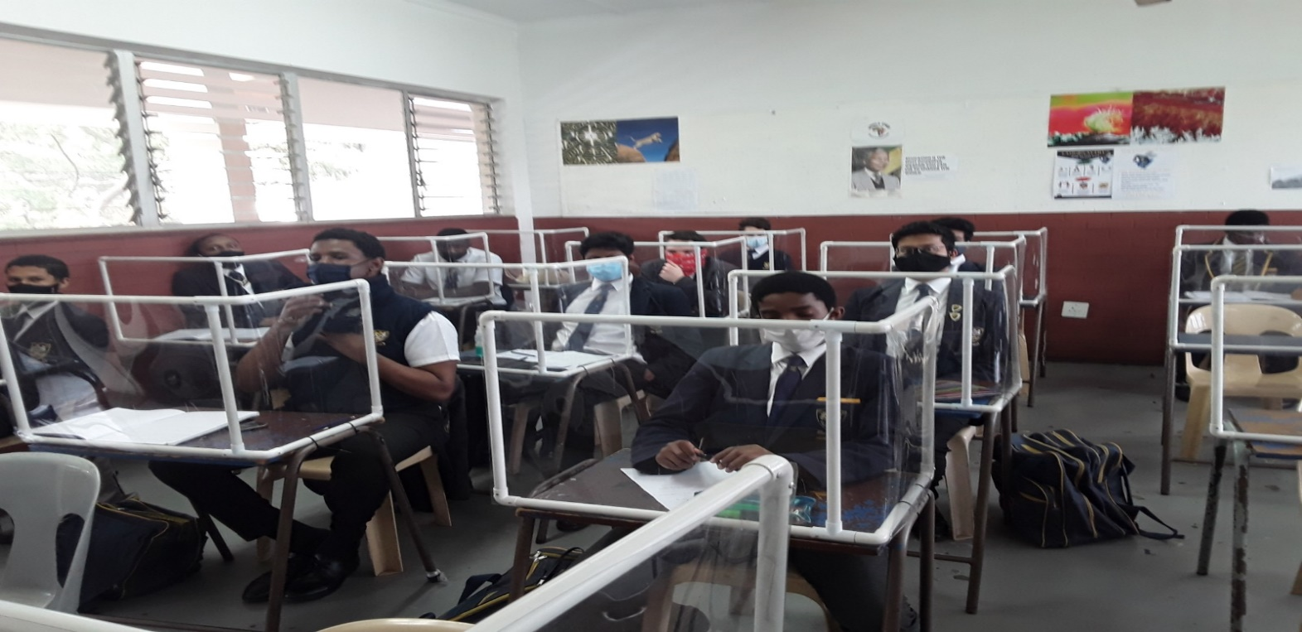
GROWING KWAZULU-NATAL TOGETHER
SOCIAL DISTANCING-SCREENS ARE USED

Slide 63
DEPARTMENT OF HEALTH

Slide 64
GROWING KWAZULU-NATAL TOGETHER
RESPONSE PLAN AND INSTITUTIONAL ARRANGEMENTS
The current response plan assumes that human-to-human transmission takes place, and that it may be amplified in specific settings, including healthcare facilities, in families and communities who had direct contact with the affected individuals. The response strategy emphasizes education and awareness first as part of health promotion, creating enabling environments for people and communities to adopt COVID-19 infection preventive behaviours, as well as the rapid identification and close monitoring of contacts of affected persons.
(1) Institutional Arrangements - The following structures guide the response to the epidemic
      The Provincial command centre chaired by the Premier meet weekly.
      Social Cluster engages weekly with all departments to improve the integration between the departments and strengthen the response to COVID-19
      Provincial Joint Operations Committee (JOC) meet twice a week is chaired by COGTA and HEALTH
      KZN DOH Provincial War Room meets daily to focus on the DOH interventions
      JOC meetings are held at municipal level
64

Slide 65
GROWING KWAZULU-NATAL TOGETHER
RESPONSE TEAMS AND STRATEGY
(2) Activation of outbreak response teams
Out-break teams are available at all levels from the provincial, district and at institutional level.
Teams include representation from Communicable Diseases Coordinators, Emergency Care Managers, Infection Prevention and Control Practitioners (IPCP), Environmental Health Practitioners, National Health Laboratory Service – Microbiologists, Infectious Diseases Clinicians and Port Health.
The district and institutional Communicable Diseases Control Managers together with Infection Prevention and Control Practitioners function as Outbreak Champions to create awareness; conduct training and coordinate activities at institutional level.
Teams are activated in the event of cluster outbreaks
(3) Health Promotion and Prevention
A health promotion strategy has been developed, in collaboration with UKZN, focussing on
    Unpacking behaviour and mobilising personal & social change
    A community-engaged communication strategy that aligns with the health promotion plan to seed behaviour change
    Engagement with OSS structures to entrench the strategy at community levels
65

Slide 66
GROWING KWAZULU-NATAL TOGETHER
PREVENTATIVE AND AWARENESS MEASURES
Preventive and awareness measures include
    Distribution of the National 2019 Novel Coronavirus Guidelines and SOPs;
    Mainstreaming of public awareness and training of all community based structures such as Community Development Workers (CDWs); Community Care Givers (CCGs), Government Field Workers;
    Ensuring appropriate communication to the public, travellers and healthcare workers/practitioners with emphasis on the basics on infection prevention and control, cough hygiene and hand washing; and
    Provision of sanitization and hygiene materials in all public places, government facilities and other amenities with support from social partners
    Social Distancing in waiting areas as well public areas
    Review of patient visiting hours to limit contact and exposure of both patients and visitors
    Implementing Quarantine measures
    Encouraging Self-Isolation measures
66

Slide 67
GROWING KWAZULU-NATAL TOGETHER
RISK COMMUNICATION
Risk Communication
    Risk communication aims at creating public awareness regarding the disease, precautionary measures and on what to do.
    The department has identified a core team of Senior Managers who will support the MEC and Head of Health considering the large number of key stakeholders that need to be engaged. Stakeholder engagement programme is coordinated in the office of the MEC.
    To date House of Traditional Leaders, KZN Council of Churches, Interfaith Leaders, Municipalities, Provincial departments, Women in Business, Ports, Airports and border control have been reached.
    Social Media, Newsprint, Billboards, Virtual meetings / seminars are used to strengthen health promotion and prevention.
    24 hour call centre [033 846 6000]in place to address both public concerns and queries about COVID-19 disease, and provide clinical support to health care workers, especially regarding treatment, management and other areas of concern
67

Slide 68
GROWING KWAZULU-NATAL TOGETHER
CASE MANAGEMENT
  (4) Case Management
      Critical Care Plans have been developed per hospital to reflect on bed, critical care equipment and staff.
      Standard operating procedures and guidelines developed for the management of high patients (to children, mental health care, maternal health, HIV/AIDS, TB). Developed in collaboration with UKZN.
      Fever clinics established throughout the province, to assist with effective screening and triaging of all patients arriving at health care facilities.
      Asymptomatic COVID 19 cases are being managed in community settings – home, designated facilities such as hotels, lodges and B&Bs.
      EMS transports patients between the different levels of care
      Guidelines have been developed and implemented for mortal remains
      The National Health Laboratory Health Services (NHLS) continues to provide specimen testing and collaborates with the private sector. In the event of backlogs, the workload is distribute to other provinces.
      Patients on the Chronic Medication Distribution Programme have their scripts extended to limit movement to pick up points.
68

Slide 69
GROWING KWAZULU-NATAL TOGETHER
HEALTH FACILITIES AND RESOURCE ENHANCEMENT
  (5) Health Facilities Preparedness
      Hospitals with low occupancy rates have been reconfigured to cater for COVID-19 patients – this included structural changes.
      Guidelines are in place for protecting all hospitals against COVID-19 contamination through stringent Infection Control and Prevention Guidelines (National Dept. of Health, 2020) to sustain current hospital services for non COVID-19 patients requiring hospital care
      Temporary field hospitals have been constructed to accommodate the projected influx of COVID-19 patients
      Various hospitality entities have been engaged to provide beds for quarantine / isolation patients
  (6) Resource enhancement
      Provincial Disaster Conditional Grant allocation for six months to fund the response to COVID-19
      Prioritisation of filling of posts
      NDOH increase of staff and professional nurses in Districts
      Investment in IT for a contact tracing APP (NDOH)
69

Slide 70
GROWING KWAZULU-NATAL TOGETHER
OCCUPATIONAL HEALTH AND SAFETY
  (7) Occupational Health and Safety
Various measures have been put in place to promote a safe environment for staff – these include
    Personal protection equipment ( Full Face Visor/ goggles, Fluid Resistant Isolation Gowns) for the full range of staff
    Psychosocial Support for Staff – district-based implementation plans in place
    Ongoing training of staff (in collaboration with UKZN) for infection prevention and control. Target group includes all DOH disciplines, private sector health staff, South African Military Health Services (SAMHS) and Disaster Management Forums from all health districts.
    Treatment and care of Workers - HR guidelines for management of exposed and infected HCWs is developed. This document provides guidance on the prevention of Covid-19 spread in the workplace and the measures to be taken when dealing with employees who are infected with Covid-19 in the workplace. Roles and responsibilities of supervisor and employees are specified. Guidance has been given to other sector departments
70

Slide 71
GROWING KWAZULU-NATAL TOGETHER
PROFILE OF QUARANTINE FACILITIES
DOH engages and consults with the Department of Public Works on activation of quarantine and isolation facilities especially for infected people and contacts from hotspot areas. The table below provides a status of the quarantine facilities in the province.
District | External Field sites | Beds Occupied (25 Aug 2020)
EThekwini | Montclair Lodge | 0
EThekwini | Coastlands DBN | 47
EThekwini | City Lodge DBN | 27
EThekwini | City Lodge Umhlanga | 0
EThekwini | Coastlands Umhlanga | 0
EThekwini | Coastlands Hotel | 0
EThekwini | Tre Fontane Guest House | 0
ILembe | EBandla | 16
ILembe | Hemp shire Hotel | 11
UGu | The Estuary Hotel and Spa | 0
UGu | Port Edward Holiday | 5
UMgungundlovu | Royal Showground | 21
Amajuba | Outlook | 0
Harry Gwala | Ingeli Lodge | 0
King Cetshwayo | Road Lodge Richards Bay | 18
King Cetshwayo | Canefields Country House | 6
King Cetshwayo | Indaba Lodge | 0
UThukela | Cathedral Peak Hotel | 0
Uthukela | Didima Resort | 47
Uthukela | Giant Castle | 0
Zululand | Ulundi Garden Court | 0
TOTALS |  | 198
71

Slide 72
GROWING KWAZULU-NATAL TOGETHER
ACHIEVEMENTS
  The lockdown measures assisted in the preparation of :
      1st wave of pandemic was managed with fewer severe cases and fatalities
      Quick turnaround for SCM
      Setup of field hospitals
      Sourcing nationally of WHO experts
      Support from academia and social partners
      Strong Provincial Command Centre provide oversight and direction
      Integrated approach to the pandemic (all sectors)
      Elimination of laboratory backlog
      Practical interventions (health promotions strategy , risk communication strategy , training of staff)
      Targeted testing strategy
      Mobilised teams for increased community screening
      ICT Innovations for contact tracing (with support from social partners and NDOH
72

Slide 73
GROWING KWAZULU-NATAL TOGETHER
RISK | MITIGATION
2ND wave of Pandemic - Community spread of disease | Community awareness – strengthen health promotion Increase contract tracing and community screening
Inadequate accommodation for patients at healthcare facilities | Identification of additional beds outside the public sector for isolation, quarantine, high care and ICU. Infrastructure enhancement to identified sites Implement plan to manage influx of patients to health facilities
Affected / Infected Health Care Workers | Implement HR guidelines for management of exposed and infected HCWs Increase pool of resources of health care workers Adequate PPE for Healthcare workers Fast-track testing and lab-results for HCWs
73

Slide 74
GROWING KWAZULU-NATAL TOGETHER
CONCLUSION
The Province is seeing a remarkable decrease in the number of COVID-19 cases since the beginning of August.
KZN has also observed a decline in the number of hospital admissions at both public and private hospitals.
This is an indication that the Province reached its peak, and the trend is going down.
It is important that the prevention measures be strengthened to avoid second wave
Health Promotion, contact tracing, surveillance, case management: quarantine
of contacts and isolation of confirmed cases and protection of vulnerable groups
are key strategies in preventing second wave.
74

Slide 75
GROWING KWAZULU-NATAL TOGETHER
CONCLUSION
The Province is seeing a remarkable decrease in the number of COVID-19 cases since the beginning of August.
KZN has also observed a decline in the number of hospital admissions at both public and private hospitals.
This is an indication that the Province reached its peak, and the trend is going down.
It is important that the prevention measures be strengthened to avoid second wave
Health Promotion, contact tracing, surveillance, case management: quarantine
of contacts and isolation of confirmed cases and protection of vulnerable groups
are key strategies in preventing second wave.
75

Slide 76
GROWING KWAZULU-NATAL TOGETHER
KZN STILL ON FULL ALERT
The decrease in the number of daily confirmed cases do not imply that the virus has abated. We remain vigilant as KwaZulu-Natal.
The sale of alcohol remains a major threat to our health care facilities since alcohol contributes to the high number of emergency cases at health facilities.
The increased movement of people and more opportunities for interaction increases the risk of spreading COVID-19 from person to person.
76

Slide 77
THANK YOU

