Slide 1
SANPARKS 1st QUARTER REPORT – 2020/21 Presentation to the Portfolio Committee on Forestry Fisheries and Environment Presented by Mr. Fundisile Mketeni 26 August 2020
SOUTH AFRICAN NATIONAL PARKS

Slide 2
Presentation outline
Vision and Mission
Performance against Outputs and Targets
Financial Performance

Slide 3
CHALLENGES WHICH CONTINUE TO IMPACT ON IMPLEMENTATION OF PLANNED ACTIVITIES
Due to the necessary closure of tourism facilities, tourism income and activities were affected
A large number of employees cannot perform their normal work duties due to connectivity issues in rural areas;
Due to the necessary compliance work to be done to implement all regulations and guidelines ( i.e. covid-committees, development of new SOPs, procurement of PPE, etc.) ‘normal’ work was affected. Both human and financial resources are directed at the COVID- 19 related work .
3

Slide 4
SANParks vision & mission
VISION
A world class system of sustainable national parks reconnecting and inspiring society
1
MISSION
Develop, protect, expand, manage and promote a system of sustainable national parks that represents biodiversity and heritage assets, through innovation and best practice for the just and equitable benefit of current and future generations.
2

Slide 5
SANPARKS ANNUAL PROGRESS AGAINST THE Q 1 TARGETS SET FOR 2020/21
OUTCOME GOAL 1: SUSTAINABLE BIODIVERSITY AND CULTURAL HERITAGE ACROSS LAND AND SEA DELIVERS BENEFITS FOR THE PEOPLE OF SA AND THE WORLD , NOW AND IN THE FUTURE
SUB OUTCOME: PROTECTED AREAS EXPANSION ALIGNED WITH NNPAES AND SANPARKS LAND INCLUSION PLAN
PERFORMANCE INDICATOR | ACTIONS / INTERVENTIONS
 | Q 1 TARGET | Programme 1st Quarter Progress and Analysis | Revised Target or Comments on ongoing challenges
Number of hectares added to national parks | Implementation Plan for 2020/21 developed | Achieved Implementation Plan for 2020/21 developed | 4 000 ha
SUB OUTCOME: EFFECTIVE AND EFFICIENT MANAGEMENT OF NATIONAL PARKS
Percentage of METT corrective Actions implemented | Individual park specific corrective action based on METT assessment identified | Achieved Corrective actions identified for all parks, including marine protected areas. | Revised target: 45% progress against identified METT corrective actions implemented Parks scored below ≥ 67% reassessed
= On target
= work in progress
= Off target
= No
milestone

Slide 6
SANPARKS ANNUAL PROGRESS AGAINST THE Q 1 TARGETS SET FOR 2020/21
OUTCOME GOAL 1: SUSTAINABLE BIODIVERSITY AND CULTURAL HERITAGE ACROSS LAND AND SEA DELIVERS BENEFITS FOR THE PEOPLE OF SA AND THE WORLD , NOW AND IN THE FUTURE
SUB OUTCOME: DEGRADED ECOSYSTEMS REHABILITATED
PERFORMANCE INDICATOR | ACTIONS / INTERVENTIONS
 | Q 1 TARGET | Programme 1st Quarter Progress and Analysis | Revised Target or Comments on ongoing challenges
Number of degraded ha of land rehabilitated | 3 800 ha | Not achieved : 13 initial ha cleared. No in field work done due to lock down in level 5 and 4 | Revised Target: 5 000 initial ha
 | 3, 259 ha | Not achieved : 17 follow up ha cleared. No in field work done due to lock down in level 5 and 4. | Revised Target : 20 000 ha
Number of m ³ of degraded wetlands under rehabilitation | 1,575 m ³ | Not achieved: 0 m³ cleared . No in field work done due to lock down in level 5 and 4 | Revised Target: 3,000 m³
= On target
= work in progress
= Off target
= No
milestone

Slide 7
SANPARKS ANNUAL PROGRESS AGAINST THE Q 1 TARGETS SET FOR 2020/21
OUTCOME GOAL 1: SUSTAINABLE BIODIVERSITY AND CULTURAL HERITAGE ACROSS LAND AND SEA DELIVERS BENEFITS FOR THE PEOPLE OF SA AND THE WORLD , NOW AND IN THE FUTURE
SUB OUTCOME: CLIMATE CHANGE VULNERABILITY REDUCED AND CLIMATE RESILEINCE IMPROVED
PERFORMANCE INDICATOR | ACTIONS / INTERVENTIONS
 | Q 1 TARGET | Programme 1st Quarter Progress and Analysis | Revised Target or Comments on ongoing challenges
Number of climate change response interventions implemented | Climate change vulnerability assessments initiated for 2 parks Climate Change Response action Plan initiated | Work in progress Climate change vulnerability assessments initiated for two parks. Climate change response action plan initiated | Revised Target: Climate change preparedness strategy Draft one completed Climate change vulnerability assessments completed for five parks
SUB OUTCOME: A FRAMEWORK TOWARDS IMPROVED MANAGEMENT OF AQUATIC SYSTEMS DEVELOPED
Number of estuarine and marine management plans developed | Commence consultation process on one draft estuarine and marine management plan | Work in progress : Consultation has commenced on the draft estuarine and marine management plan. | Revised target: Guideline document for development of Estuarine and MPA management plans in line with stakeholder and legislative requirements
= On target
= work in progress
= Off target
= No
milestone

Slide 8
SANPARKS ANNUAL PROGRESS AGAINST THE Q 1 TARGETS SET FOR 2020/21
OUTCOME GOAL 1: SUSTAINABLE BIODIVERSITY AND CULTURAL HERITAGE ACROSS LAND AND SEA DELIVERSBENEFITS FOR THE PEOPLE OF SA AND THE WORLD , NOW AND IN THE FUTURE
SUB OUTCOME: A FRAMEWORK TOWARDS IMPROVED MANAGEMENT OF CULTURAL HERITAGE DEVELOPED
PERFORMANCE INDICATOR | ACTIONS / INTERVENTIONS
 | Q1 TARGET | Programme 1st Quarter Progress and Analysis | Revised Target or Comments on ongoing challenges
Number of cultural heritage assessments conducted | Heritage resources identified, confirmed and data base updated for 3 parks | Not achieved Confirmation of heritage assets could not be done as field work was not possible due to lockdown. Instead virtual meetings were held and plans made for field work in Q2 | Cultural heritage resource assessments conducted in 3 national parks
SUSTAINABLE POPULATIONS OF SPECIES OF SPECIAL CONCERN MONITORED AND MAINTAINED
Percentage annual increase in rhino populations | Surveys planned | Achieved Surveys were planned | Decline in rhino populations in KNP halted Rhino populations in other parks increasing at 4%
= On target
= work in progress
= Off target
= No
milestone

Slide 9
SANPARKS ANNUAL PROGRESS AGAINST THE Q 1 TARGETS SET FOR 2020/21
OUTCOME GOAL 1: SUSTAINABLE BIODIVERSITY AND CULTURAL HERITAGE ACROSS LAND AND SEA DELIVERSBENEFITS FOR THE PEOPLE OF SA AND THE WORLD , NOW AND IN THE FUTURE
SUB OUTCOME: WILDLIFE CRIME IN NATIONAL PARKS REDUCED
PERFORMANCE INDICATOR | ACTIONS / INTERVENTIONS
 | Q1 TARGET | Programme 1st Quarter Progress and Analysis | Revised Target or Comments on ongoing challenges
Number of rhinos poached in KNP and 6 parks reduced | ≤ 60 rhinos poached in KNP ≤ 1 rhino poached in other parks | Achieved 28 rhinos poached None in Parks | Rhinos poached in KNP less than ≤ 250 animals Less than ≤ 5 animals poached in 6 parks
Number of elephants poached reduced | ≤ 10 elephants poached | Achieved 2 elephants poached in KNP, 0 in parks | Less than 40 animals poached
= On target
= work in progress
= Off target
= No
milestone

Slide 10
SANPARKS ANNUAL PROGRESS AGAINST THE Q 1 TARGETS SET FOR 2020/21
OUTCOME GOAL 2: IMPROVED DIVERSE RESPONSIBLE TOURISM
SUB OUTCOME: IMPROVED TOURISM PERFORMANCE
PERFORMANCE INDICATOR | ACTIONS / INTERVENTIONS
 | Q1 TARGET | Programme 1st Quarter Progress and Analysis | Revised Target or Comments on ongoing challenges
Percentage Improvement in CSI rating | 0.2% increase | Not achieved 0% . No visitors to parks due to lockdown. It is still unknown when the tourism facilities will be opened. | 1.0 % point improvement in CSI on baseline in March 2020
Percentage increase in numbers of visitors to national parks year on year | 0.2% increase | Not achieved 21, 716 Self drive clients | Revised Target: 68,3% decline from 6 326 448 to 2 000 000
= On target
= work in progress
= Off target
= No
milestone

Slide 11
SANPARKS ANNUAL PROGRESS AGAINST THE Q 1 TARGETS SET FOR 2020/21
OUTCOME GOAL 2: IMPROVED DIVERSE RESPONSIBLE TOURISM
SUB OUTCOME: IMPROVED TOURISM PERFORMANCE
PERFORMANCE INDICATOR | ACTIONS / INTERVENTIONS
 | Q 1 TARGET | Programme 1st Quarter Progress and Analysis | Revised Target or Comments on ongoing challenges
Percentage increase on accommodation occupancy | 0.0% increase | Achieved No accommodation due to the lock down period | Revised Target: 5% Point decline from 2019/2020 actual performance (From 59,0 To 54,0% For Period 1 December To 31 March year-on-Year)
Total number of new and diverse tourism products implemented | No target | None targeted for this Q | Revised Target: 4
SUB OUTCOME: IMPROVED RESPONSIBLE TOURISM
Responsible tourism measures determined | Identify measures for responsible tourism scorecard | Work in progress Consultation on the measures in in progress | Measures, baselines and targets for responsible tourism determined
= On target
= work in progress
= Off target
= No
milestone

Slide 12
SANPARKS ANNUAL PROGRESS AGAINST THE Q 1 TARGETS SET FOR 2020/21
OUTCOME GOAL 3: SUSTAINABLE SOCIO ECONOMIC DEVELOPMENT PROGRAMME THAT ENSURES DELIVERY OF BENEFITS TO THE LAND CLAIMANTS , HISTORICALLY DISADVANTAGED COMMUNITIES AND THE PEOPLE OF SA
SUB OUTCOME: TRANFORMATION OF WILDLIFE ECONOMY THROUGH INCREASED PDI PARTICIPATIONS
PERFORMANCE INDICATOR | ACTIONS / INTERVENTIONS
 | Q 1 TARGET | Programme 1st Quarter Progress and Analysis | Revised Target or Comments on ongoing challenges
Number of animals delivered to communities and individual emerging game farmers | Applications for game loans and donations approved by EXCO HIE≥VEMENTS &TIONS | None | Revised Target: ≥ 500 animals delivered
Number of Full Time Equivalent (FTE) job opportunities created through EPWP | EPWP FTE ≥ 775 Other jobs: ≥ 100 | Work in progress 684 FTEs 0 Other jobs EPWP was required to be paid during lockdown levels 5 and 4 | Revised Target: EPWP FTE = ≥ 3,542 Other Jobs: ≥ 200
= On target
= work in progress
= Off target
= No
milestone

Slide 13
SANPARKS ANNUAL PROGRESS AGAINST THE Q 1 TARGETS SET FOR 2020/21
OUTCOME GOAL 3: SUSTAINABLE SOCIO ECONOMIC DEVELOPMENT PROGRAMME THAT ENSURES DELIVERY OF BENEFITS TO THE LAND CLAIMANTS , HISTORICALLY DISADVANTAGED COMMUNITIES AND THE PEOPLE OF SA
SUB OUTCOME: TRANFORMATION OF WILDLIFE ECONOMY THROUGH INCREASED PDI PARTICIPATIONS
PERFORMANCE INDICATOR | ACTIONS / INTERVENTIONS
 | Q1 TARGET | Programme 1st Quarter Progress and Analysis | Revised Target or Comments on ongoing challenges
Number of jobs created for youth, women and people with disabilities through EPWP | Youth: ≥ 4 400 Women: ≥ 3 600 PwD : ≥ 168 | Not achieved Youth: ≥ 1 303 Women: ≥ 948 PwD : ≥ 39 NRMP projects not captured on WIMMS – data capturers not at office due to lockdown. | Revised Target: Youth EPWP: ≥ 3,285 Women EPWP: ≥ 2,777 People with Disabilities EPWP: ≥ 80
SUB OUTCOME: IMPROVED ACCESS AND SUSTAINABLE USE OF NATURAL RESOURCES BY LOCAL COMMUNITIES
Baseline of communities accessing natural resources determined | Community needs of natural resource use assessed | Not achieved Online survey questionnaire draft completed and due for dry run with selected Officers | Baseline determined
= On target
= work in progress
= Off target
= No
milestone

Slide 14
SANPARKS ANNUAL PROGRESS AGAINST THE Q 1 TARGETS SET FOR 2020/21
OUTCOME GOAL 3: SUSTAINABLE SOCIO ECONOMIC DEVELOPMENT PROGRAMME THAT ENSURES DELIVERY OF BENEFITS TO THE LAND CLAIMANTS , HISTORICALLY DISADVANTAGED COMMUNITIES AND THE PEOPLE OF SA
SUB OUTCOME: IMPROVED PARTICIPATION OF PDIs IN SANPARKS BUSINESS
PERFORMANCE INDICATOR | ACTIONS / INTERVENTIONS
 | Q 1 TARGET | Programme 1st Quarter Progress and Analysis | Revised Target or Comments on ongoing challenges
Number of SMMEs contracted for provision of services and goods | ≥ 400 SMMEs contracted through the EPWP Other SMMEs contracted ≥ 5 | Not achieved 279 SMMEs contracted in EPWP SMME’s being paid during lockdown level 5 and 4 | Revised Target: ≥ 316 SMMEs contracted: EPWP
Percentage of expenditure on affirmative procurement | 15% | Achieved 74.06% | BBBEE spent : 65%
 | 5% | Achieved 76.35% | 30% outsourced opportunities to EMEs and QSEs by main contractors
= On target
= work in progress
= Off target
= No
milestone

Slide 15
SANPARKS ANNUAL PROGRESS AGAINST THE Q 1 TARGETS SET FOR 2020/21
OUTCOME GOAL 3: SUSTAINABLE SOCIO ECONOMIC DEVELOPMENT PROGRAMME THAT ENSURES DELIVERY OF BENEFITS TO THE LAND CLAIMANTS , HISTORICALLY DISADVANTAGED COMMUNITIES AND THE PEOPLE OF SA
SUB OUTCOME: IMPROVED EDUCATION AND SKILLS
PERFORMANCE INDICATOR | ACTIONS / INTERVENTIONS
 | Q 1 TARGET | Programme 1st Quarter Progress and Analysis | Revised Target or Comments on ongoing challenges
Number of beneficiaries from target groups trained | Beneficiaries training needs assessed | Not achieved Collaborative engagement for funding and subject matter specialist in process with 2 potential partners. | ≥ 450
Number of programmes aimed at upskilling Youth | Youth training needs assessed | Achieved | 1
Number of schools accessing the national parks for educational purposes | ≥ 50 | Not achieved None –due to schools being closed during lockdown level 5 and 4 | Revised Target: ≥ 50
= On target
= work in progress
= Off target
= No
milestone

Slide 16
SANPARKS ANNUAL PROGRESS AGAINST THE Q 1 TARGETS SET FOR 2020/21
OUTCOME GOAL 3: SUSTAINABLE SOCIO ECONOMIC DEVELOPMENT PROGRAMME THAT ENSURES DELIVERY OF BENEFITS TO THE LAND CLAIMANTS , HISTORICALLY DISADVANTAGED COMMUNITIES AND THE PEOPLE OF SA
SUB OUTCOME: SUSTAINED CORPORATE SOCIAL INVESTMENT TOWARDS COMMUNITY DEVELOPMENT
PERFORMANCE INDICATOR | ACTIONS / INTERVENTIONS
 | Q 1 TARGET | Programme 1st Quarter Progress and Analysis | Revised Target or Comments on ongoing challenges
Number of Individuals/ Communities where Social legacy projects have been completed | Tender process initiated | Work in progress 8550 vulnerable families supplied with food parcels around all 19 parks and 80 water tanks installed around KNP. | Revised Target: 30 The Social legacy focus, output indicator and annual target were revised for the 2020/21 year due to SANParks need to respond to the challenges experienced by the local community as a result of the Covid 19 pandemic.

Slide 17
SANPARKS ANNUAL PROGRESS AGAINST THE Q 1 TARGETS SET FOR 2020/21
OUTCOME GOAL 3: SUSTAINABLE SOCIO ECONOMIC DEVELOPMENT PROGRAMME THAT ENSURES DELIVERY OF BENEFITS TO THE LAND CLAIMANTS , HISTORICALLY DISADVANTAGED COMMUNITIES AND THE PEOPLE OF SA
SUB OUTCOME: IMPROVED PARTICIPATION OF LAND CLAIMANTS IN SANPARKS BUSINESS
PERFORMANCE INDICATOR | ACTIONS / INTERVENTIONS
 | Q 1 TARGET | Programme 1st Quarter Progress and Analysis | Revised Target or Comments on ongoing challenges
Claimant Beneficiation scheme developed an implemented as per land claims identified | Negotiations of draft beneficiation scheme and valuation report with all relevant stakeholders completed Negotiations on the beneficiation package for Colchester Land claimants Feasibility studies on proposed projects and bankable business plans developed | Work in progress The independent facilitator has been appointed by the Commission. Feasibility study has been developed | Revised Target: KNP Land Claims beneficiation scheme developed Qwaqwa Land claim beneficiation package developed
= On target
= work in progress
= Off target
= No
milestone

Slide 18
SANPARKS ANNUAL PROGRESS AGAINST THE Q 1 TARGETS SET FOR 2020/21
OUTCOME GOAL 4: SUSTAINABLE AND TRANSFORMED ORGANISATION THROUGH REVENUE , PEOPLE, SYSTEMS AND BUSINESS PROCESSES
SUB OUTCOME: FINANCIALLY SUSTAINABLE ORGANISATION
PERFORMANCE INDICATOR | ACTIONS / INTERVENTIONS
 | Q1 TARGET | Programme 1st Quarter Progress and Analysis | Revised Target or Comments on ongoing challenges
Revenue raised through Resource Mobilisation | R 10 million | Achieved R 10 338 million | Revised Target: R 65 million
Revenue raised through Tourism Performance | R 459 million | Not achieved R 3, 732, 880 All Tourism facilities closed for lockdown. Only self drives opened recently | Revised target: R 189 million
= On target
= work in progress
= Off target
= No
milestone

Slide 19
SANPARKS ANNUAL PROGRESS AGAINST THE Q 1 TARGETS SET FOR 2020/21
OUTCOME GOAL 4: SUSTAINABLE AND TRANSFORMED ORGANISATION THROUGH REVENUE , PEOPLE, SYSTEMS AND BUSINESS PROCESSES
SUB OUTCOME: FINANCIALLY SUSTAINABLE ORGANISATION
PERFORMANCE INDICATOR | ACTIONS / INTERVENTIONS
 | Q 1 TARGET | Programme 1st Quarter Progress and Analysis | Revised Target or Comments on ongoing challenges
Revenue raised through Wildlife Sales | R 3 million | Not achieved No wildlife sales due to lockdown restrictions under Level 4 and 5 | Revised Target: R 4 million
Income to Cost Ratio | 1:1 | Not achieved 0.35: 1 Due to lockdown, much less revenue generated ( accommodation still closed and self drives only opened recently) | Revised Target: 0,64 : 1
= On target
= work in progress
= Off target
= No
milestone

Slide 20
SANPARKS ANNUAL PROGRESS AGAINST THE Q 1 TARGETS SET FOR 2020/21
OUTCOME GOAL 4: SUSTAINABLE AND TRANSFORMED ORGANISATION THROUGH REVENUE , PEOPLE, SYSTEMS AND BUSINESS PROCESSES
SUB OUTCOME: TRANSFORMED AND CAPABLE HUMAN CAPITAL
PERFORMANCE INDICATOR | ACTIONS / INTERVENTIONS
 | Q 1 TARGET | Programme 1st Quarter Progress and Analysis | Revised Target or Comments on ongoing challenges
Percentage of women in management positions | 39.9% | 39.6% - Achieved | 41%
Percentage of People with Disabilities increased | 1.8% | 1.1 % - Not achieved | 2%
Black as a percentage as management increased | 62.5% | 61.5% - Achieved | 64%
= On target
= work in progress
= Off target
= No
milestone

Slide 21
SANPARKS ANNUAL PROGRESS AGAINST THE Q 1 TARGETS SET FOR 2020/21
OUTCOME GOAL 4: SUSTAINABLE AND TRANSFORMED ORGANISATION THROUGH REVENUE , PEOPLE, SYSTEMS AND BUSINESS PROCESSES
SUB OUTCOME: TRANSFORMED AND CAPABLE HUMAN CAPITAL
PERFORMANCE INDICATOR | ACTIONS / INTERVENTIONS
 | Q 1 TARGET | Programme 1st Quarter Progress and Analysis | Revised Target or Comments on ongoing challenges
Percentage of payroll spent on skills development programmes increased | 20% of 2.3% | Work in progress R885,119.50 (7%) has been spent on Skills Development Programme Due to lockdown, no training ( apart from virtual) is taking place. | Revised target: 1%
Number of Impact Assessments conducted on Strategic Group Training interventions | Research on strategic group training intervention identified | Not achieved No work done due to Covid 19 pandemic impact. Also motivated for it to be removed from the APP | Impact Assessment Tool Developed
= On target
= work in progress
= Off target
= No
milestone

Slide 22
SANPARKS ANNUAL PROGRESS AGAINST THE Q 1 TARGETS SET FOR 2020/21
OUTCOME GOAL 4: SUSTAINABLE AND TRANSFORMED ORGANISATION THROUGH REVENUE , PEOPLE, SYSTEMS AND BUSINESS PROCESSES
SUB OUTCOME: ORGANISATIONAL ETHICAL CULTURE MATURITY IMPROVED
PERFORMANCE INDICATOR | ACTIONS / INTERVENTIONS
 | Q 1 TARGET | Programme 1st Quarter Progress and Analysis | Revised Target or Comments on ongoing challenges
Percentage Ethics Strategy and policy approved and implemented | Ethics Strategy and Policy drafted Ethics Strategy implemented : 50% | Work in progress Ethics Strategy and Policy drafted Ethics strategy implemented at 29% | Ethics Strategy and Policy Approved by the Board 95% implementation
= On target
= work in progress
= Off target
= No
milestone

Slide 23
SANPARKS ANNUAL PROGRESS AGAINST THE Q 1 TARGETS SET FOR 2020/21
OUTCOME GOAL 4: SUSTAINABLE AND TRANSFORMED ORGANISATION THROUGH REVENUE , PEOPLE, SYSTEMS AND BUSINESS PROCESSES
SUB OUTCOME: EFFICIENT, INNOVATIVE AND BUSINESS PROCESSES SUPPORTIVE OF SANPARKS CORE BUSINESS
PERFORMANCE INDICATOR | ACTIONS / INTERVENTIONS
 | Q 1 TARGET | Programme 1st Quarter Progress and Analysis | Revised Target or Comments on ongoing challenges
Specifications for Integrated Information Decision support tool developed | Workshops on Integrated Information Decisions Tool conducted with 2 divisions | Not achieved PowerBI License procured No Workshop s conducted due to the Covid-19 Lockdown | Specifications for Integrated Information Decision support tool developed
 | Status Quo analysis conducted | Not achieved Status Quo analysis not conducted due to Covid-19 lockdown | Organisational Standard on turn around times for critical business processes developed
= On target
= work in progress
= Off target
= No
milestone

Slide 24
SANPARKS ANNUAL PROGRESS AGAINST THE Q 1 TARGETS SET FOR 2020/21
OUTCOME GOAL 4: SUSTAINABLE AND TRANSFORMED ORGANISATION THROUGH REVENUE , PEOPLE, SYSTEMS AND BUSINESS PROCESSES
SUB OUTCOME: SOUND CORPORATE GOVERNANCE
PERFORMANCE INDICATOR | ACTIONS / INTERVENTIONS
 | Q1 TARGET | Programme 1st Quarter Progress and Analysis | Revised Target or Comments on ongoing challenges
Percentage Execution of the Internal Audit Plan | 20% | Not achieved There was no service provider appointed Due to the Covid -19 lockdown, no travel could take place. | 80%
Percentage of corrective actions implemented | 10% | Achieved 20 % | 50% corrective actions implemented Self Assessments conducted
= On target
= work in progress
= Off target
= No
milestone

Slide 25
SANPARKS ANNUAL PROGRESS AGAINST THE Q 1 TARGETS SET FOR 2020/21
OUTCOME GOAL 4: SUSTAINABLE AND TRANSFORMED ORGANISATION THROUGH REVENUE , PEOPLE, SYSTEMS AND BUSINESS PROCESSES
SUB OUTCOME: SOUND CORPORATE GOVERNANCE
PERFORMANCE INDICATOR | ACTIONS / INTERVENTIONS
 | Q 1 TARGET | Programme 1st Quarter Progress and Analysis | Revised Target or Comments on ongoing challenges
Level of ERM maturity improved | ERM maturity plan developed | Achieved ERM maturity improvement plan developed ERM maturity improvement plan implemented 30% | ERM maturity improvement plan developed and implemented
Percentage Implementation of ERM | 50 % implementation of the ERM Annual plan | Achieved ERM plan monitored and implemented 30% | Monitor and review implementation of ERM
= On target
= work in progress
= Off target
= No
milestone

Slide 26
SANPARKS ANNUAL PROGRESS AGAINST THE Q 1 TARGETS SET FOR 2020/21
OUTCOME GOAL 4: SUSTAINABLE AND TRANSFORMED ORGANISATION THROUGH REVENUE , PEOPLE, SYSTEMS AND BUSINESS PROCESSES
SUB OUTCOME: EFFECTIVE STAKEHOLDER AND PARTNERSHIP MANAGEMENT
PERFORMANCE INDICATOR | ACTIONS / INTERVENTIONS
 | Q 1 TARGET | Programme 1st Quarter Progress and Analysis | Revised Target or Comments on ongoing challenges
Stakeholder and partnership management strategy developed and approved | Key stakeholders and partners mapped | Work in progress | Stakeholder and partnership management strategy developed and approved
 | Status quo analysis conducted | Work in progress | Assessment Tool for stakeholders and partners developed
Number of SANParks Week free visitors to national parks | No target | No target | Revised Target: 15 000
= On target
= work in progress
= Off target
= No
milestone

Slide 27
SANPARKS ANNUAL PROGRESS AGAINST THE Q 1 TARGETS SET FOR 2020/21
OUTCOME GOAL 4: SUSTAINABLE AND TRANSFORMED ORGANISATION THROUGH REVENUE , PEOPLE, SYSTEMS AND BUSINESS PROCESSES
SUB OUTCOME: APPROPRAITE AND WELL MAINTAINE INFRASTRUCTURE
PERFORMANCE INDICATOR | ACTIONS / INTERVENTIONS
 | Q 1 TARGET | Programme 1st Quarter Progress and Analysis | Revised Target or Comments on ongoing challenges
Draft 5 year investment Plan developed | Approval of TOR of Investment Committee | Achieved TOR of Investment Committee approved | Establishment of infrastructure investment committee
Maintenance and recapitalisation plan towards improvement and infrastructure condition developed | Condition assessment of infrastructure plan approved | Not achieved Condition of infrastructure plan not approved | Revised target: Condition assessment of Infrastructure 60%
= On target
= work in progress
= Off target
= No
milestone

Slide 28
QUARTER 1 : OVERALL SANParks SUMMARY OF PERFORMANCE
OUTCOME GOALS | % On target | % Work in progress | % Off Target | % No Milestone
OUTCOME GOAL 1: SUSTAINABLE BIODIVERSITY AND CULTURAL HERITAGE ACROSS LAND AND SEA DELIVERS BENEFITS FOR THE PEOPLE OF SA AND THE WORLD , NOW AND IN THE FUTURE | 45,4 % (5/11) | 18, 2 % ( 2/11) | 36, 4% (4/11) | 0% (0)
OUTCOME GOAL 2: IMPROVED DIVERSE RESPONSIBLE TOURISM | 25% (1/4) | 25% (1/4) | 50% (2/4 ) | (1/5)
OUTCOME GOAL 3: SUSTAINABLE SOCIO ECONOMIC DEVELOPMENT PROGRAMME THAT ENSURES DELIVERY OF BENEFITS TO THE LAND CLAIMANTS , HISTORICALLY DISADVANTAGED COMMUNITIES AND THE PEOPLE OF SA | 25 % (3/12) | 25 % (3/12) | 50% (6/12) | 0% (0)
OUTCOME GOAL 4: SUSTAINABLE AND TRANSFORMED ORGANISATION THROUGH REVENUE , PEOPLE, SYSTEMS AND BUSINESS PROCESSES | 35 % (7/ 20) | 20% (4/20) | 45% (9/20) | (1/21 )
TOTAL | 34% (16/47) | 21 % (10/47) | 45% ( 21/47) | 2/49

Slide 29
OVERALL SUMMARY OF FIRST QUARTER PERFORMANCE FOR SANParks
% On target | % Work in progress | % Off Target | % No milestone
34% (16/47) | 21 % (10/47) | 45% ( 21/47) | (2/49)
29

Slide 30
Financial performance as at the end of the 1st Quarter

Slide 32
TOTAL REVENUE & EPENDITURE
Total revenue, for the year to date, amounts to R137, 531m (R523, 950m), and is R38, 343m less than the expected budget of R175, 873m. The negative variance is mainly as a result of the EPWP allocation which has been budgeted for but not yet received, and the infrastructure grant which has not materialised. The concession fees are also a contributing factor to the negative variance. If EPWP is excluded, a positive variance of R7, 234m, is achieved. Actual and budgeted income excluding EPWP amount to R137, 563m and R130, 330m, respectively. The positive variance excluding EPWP of R7, 234m relates to more income generated than anticipated.
Total expenditure to date reflects a R118, 149m favourable variance when compared to the budget, as a result of the cost curtailment measures introduced due to the lockdown and Covid-19 effects. For the period under review, the expenditure budget variance is -24%.

Slide 33
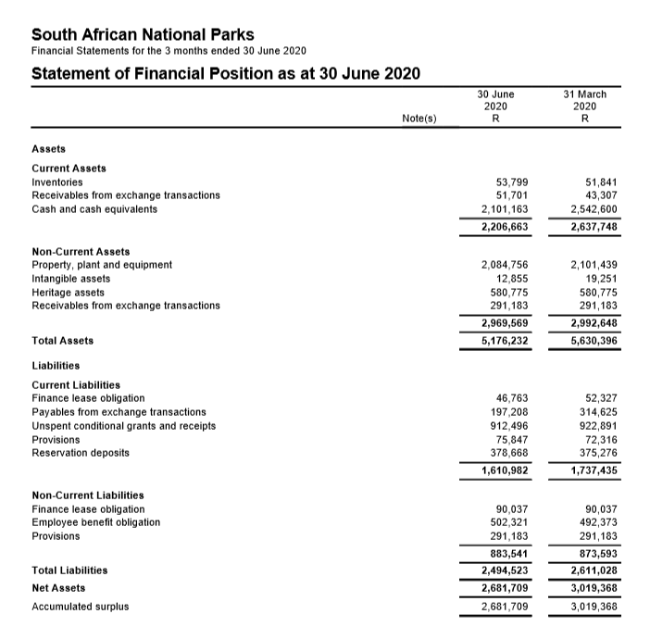
Financial Performance – March 2019

Slide 34
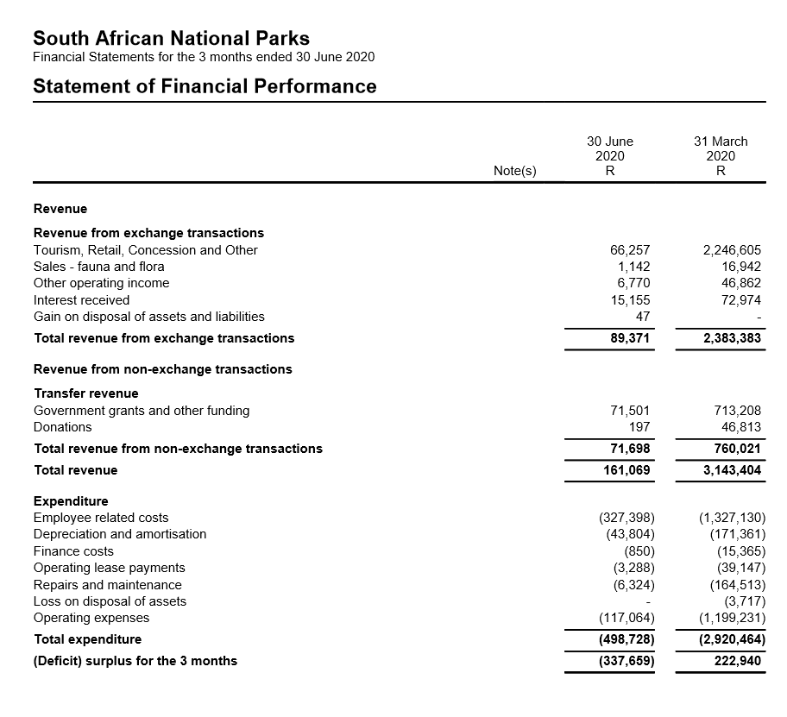
Financial Performance – March 2019

Slide 35
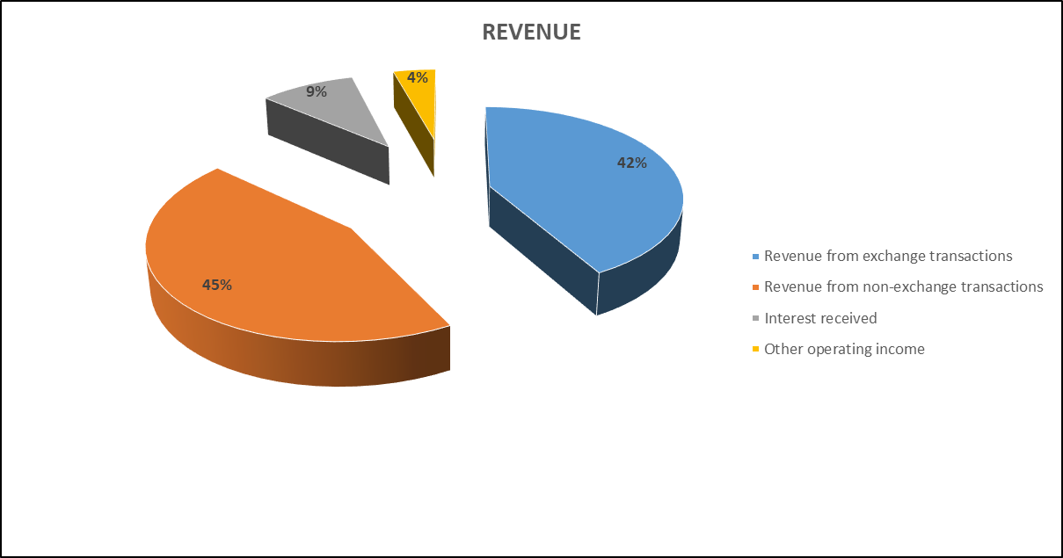
Financial Performance – March 2019

Slide 36
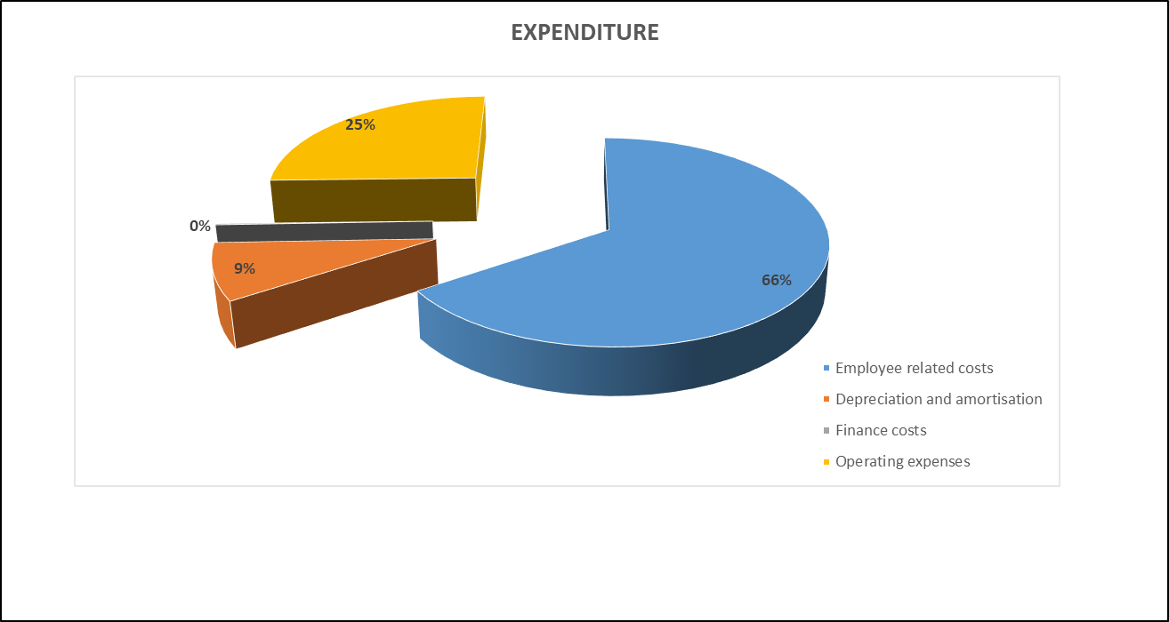
Financial Performance – March 2019

Slide 37
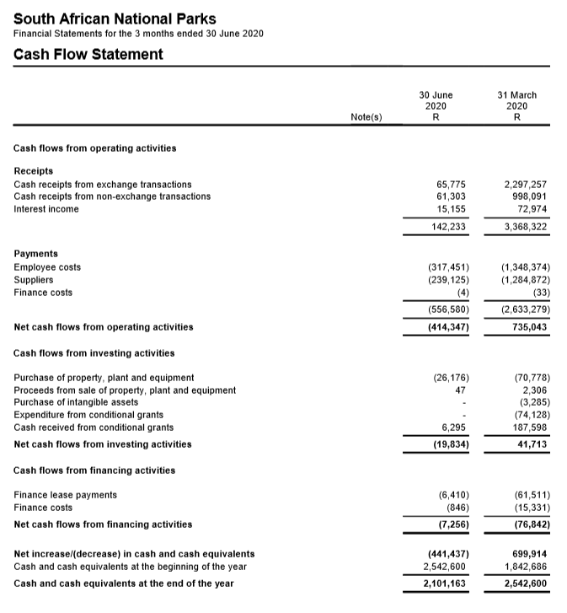
Financial Performance – March 2019

Slide 38
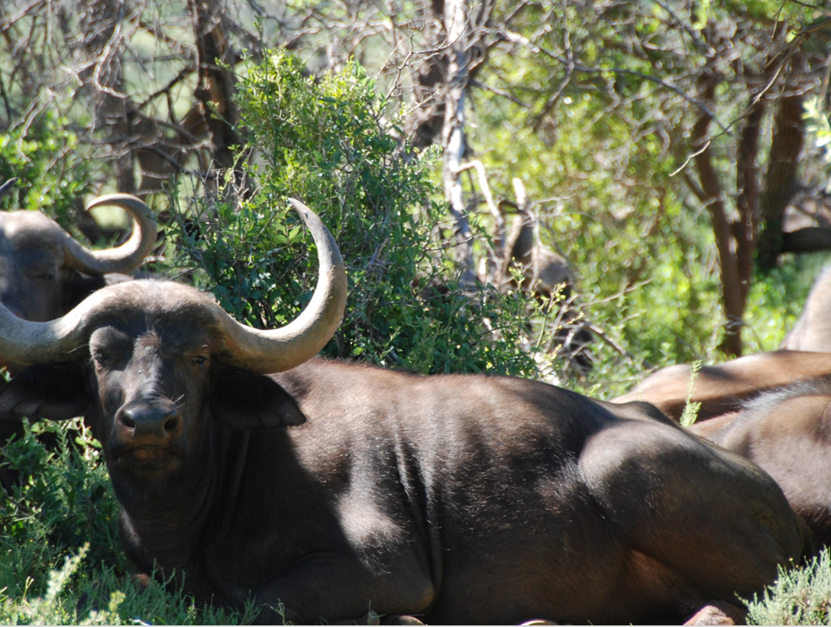
Thank you
THANK YOU

