Slide 1
Access to diversified media for alla
State of Community Broadcasting
02 September 2020

Slide 2
AGENDA
Table of Contents
1
2
3
ITEM 01
ITEM 02
ITEM 03
Strategic Overview
The Funding Model
Funding Process
4
5
6
7
ITEM 04
ITEM 05
ITEM 06
ITEM 07
Media Landscape
COVID-19 Emergency Relief.
Sector Challenges
Way Forward

Slide 3
Strategic Overview
Constitutional Mandate
Bill of Rights
Section 16:
Everyone has a right Freedom of Expression
Section 32: Everyone as a Right to Access to Information
Section 15 (1)
“Everyone has the right to freedom of conscience, religion, thought, belief and opinion

Slide 4
National Development Plan
Alignment to Vision 2030
Priority 6
Priority 1
Priority 5
Building a Capable, Ethical and Developmental State
Economic Transformation and Job Creation
Social Cohesion and Safe communities
MDDA Goal:
Capable, effective and efficient organisation in support of the delivery of the mandate
MDDA Goal: Capacitated, digital responsive community- based media in SA.
MDDA Goal:
Media diversity promoted through the growth and sustainability of community-based media in SA.

Slide 5
MDDA Mandate
In terms of Section 3 of the MDDA Act, 2002
Encourage the channeling of resources to the community media sectors
Raise public awareness with regard to media
development &
diversity
issues
Encourage ownership of, and access to, media by HDGs as well as by historically diminished indigenous
language and cultural groups
Support initiatives which promote literacy and a culture of reading
Encourage research regarding media development & diversity
Liaise with other statutory
bodies such as
ICASA and
USAASA
Encourage the development of human resources and training, and capacity building, within the media industry,
especially
amongst

Slide 6
Vision, Mission & Values
Vision
An accessible, transformed
and diversified media
Vision
Mission
To support the development of a vibrant, innovative, sustainable and people-centred community media sector through resourcing, knowledge-based research and capacity building, in order to give a voice to historically disadvantaged communities.
Values
Mission
Values
Accountability, Inclusivity, Integrity, Ubuntu, Professionalism.

Slide 7
Strategic Objectives
2020/2025 Medium Term Strategic Framework
Objective 1
Objective 2
Objective 3
Facilitate ownership, control and access to information and content production of community broadcasting by historically advantaged communities.
To facilitate ownership, control and access to information and content production of community and small commercial publications by historically Advantaged communities.
To monitor and
evaluate input, output
and compliance to MDDA grant-in-aid contracts to measure the effectiveness and efficiency of the MDDA support
Objective 4
Objective 5
To position the MDDA as an authoritative leader and voice on community and commercial media by proactive advocacy and lobbying interventions and established stakeholder relationships
To expand our footprint as the MDDA by creating a positive image in pursuance of the MDDA’s mandate to grow the community and small commercial media.

Slide 8
MDDA’s Funding Model
2020/21 – 2024/25 MTSF Budget
Planned
Projected
Projected
Description ( R 000)
2020/21
(R 000)
2021/22
(R 000)
2022/23
(R 000)
2023/24
(R 000)
2024/25
(R 000)
2022/23
Revenue
94 840
97 080
98 077
98 107
98 673
Broadcast Funders
55 995
56 136
56 280
56 426
56 576
Grants Income
33 427
35 223
36 528
37 992
39 515
Other Income: Interest
5 418
5 721
6 628
3 688
2 582
-
Source
Broadcasters
Government Grant
Interest
Total
Sources of Funding
55 994 790
33 427 000
Amount
5 418 000
94 840 000
Sources of Funding
Broadcast
50 395 311
-
-
50 395 311
Research
-
3 789 740
-
3 789 740
3 268 527
2 360 124
Print and Digital
-
5 628 651
35 026 088
Administration
5 599 479
26 368 734
3 057 876

Slide 9
Current Broadcast Funders
USAF Levies
Funder | Amount – R’000 000
Capricorn Fm | 129 103,18
Classic FM | 16 336,74
Heart 104.9 fm | 208 240,04
Igagasi 99.5 fm | 269 386,62
Multichoice Africa (Pty) | 40 000 000,00
Radio Algoa (BRFM) | 207 539,40
Y FM Radio Station | 115 333,94
E TV (Pty) Ltd | 2 944 701,25
SABC | 8 942 536,27
East Coast Radio | 550 169,00
Kaya FM | 298 132,52
Vuma FM | 36 599,15
Rise FM | 17 614,14
CAPE TALK | 102 947,93
KFM / Crescent Consortium | 460 659,26
Radio 702 PRIMEDIA Broadcasting | 459 225,07
Radio Jacaranda | 588 621,00
Highveld Stereo (Africa on Air) 947 | 897 548,60
R55 994 790

Slide 10
Who do we support?
Under the MDDA Act
1. Community media
Geographically founded community or
any group of persons or sector of the public having a specific ascertainable common interest.
2. Small Commercial Media
Independent media enterprises or initiatives
Run for personal gain as micro, very small or small business as classified in the National Small Business Act, 1996.
NPO, NGO, CBO, Section 21 non- profit
3. Research and Capacity Building
Through procurement processes
Informed by Skills Audit
4. Digital, New and Online Media
Non-profit organisations
Online publications

Slide 11
Why do we support community media
Why Community Media
Social Dialogue
Public Participation &
Active Citizens
,.
Social
Cohesion
Transformation of the media
Dissemination of information
Voice for
the voiceless
Nation Building

Slide 12
The Funding Scheme
Support in terms of the MDDA Act
1. Direct Funding (Grants)
6. Media Research
2. Indirect support
5. Emergency Funding
3. Training and Capacity Building
4. Project Evaluation

Slide 13
Items Funded for the Broadcast Sector
The Basket
Content Production
Training and Capacity Building
Stipends
Salaries
Telecommunications
Local travel
Sales & Marketing
Finance
Grantee Orientation
Management
Administration
Capital Expenditure
Bank charges
Audit Fees
Rentals
Maintenance
Insurance
Stationery
Broadcast Studios
Computers
Laptops
OBE Devices
Generators
Printers
Transmission or Signal Distribution
Self provision Transmitters
Relief for Sentech Fees

Slide 14
Items Funded for Publishers
The Basket
Capital Expenditure
1
2
Printing and Distribution
Computers
Laptops
Printers
Cameras
Furniture
Website Design
Cash Grants and negotiated discounts with commercial print companies.
Operational Costs
4
3
Content Production
Stationery
Bank Charges
Audit Fees
Salaries, stipends, transportation

Slide 15
Signal Distribution Funding
Calls for Applications in March 2020
Funding for 22 approved projects
R6,6 million for newly approved projects.
Debt settlement & 12 months transmission fees
Connection Fees
About R2m for 4 projects funded previously but still off air.
Call for Applications
R11,8 approved 16 qualifying projects for debt settlement

Slide 16
Compliance is Key
The Life Cycle
Application Criteria
Contracting
Requisite documentation
Agreement on how to use the funds.
Compliance with grant-in aid agreement
Projects Approval
Disbursement
Governance
Only the Board selects and approves projects, in terms of the MDDA Act.
In tranches.
And only if compliant with prior reporting.
Deviations
Reporting
To be approved prior to implementation.
On use of funds.
Poor reporting or non-reporting leads to non disbursement of next tranches.

Slide 17
Improved Funding Process
MDDA Implemented a new funding process in 2019
Daily Applications
Annual Call for Applications
+10 Policies as application
requirement
Eliminated policies as a criteria to apply. Part of project development.
No Grant
Funding Policy
THEN
NOW
2019 Board approved
1st Grant Funding policy
Huge Backlog from 2010 worth over R850 million
No applications are held over. No backlog.
Blanket bailout approach to signal distribution
Calls for Signal Distribution
with a selection criteria

Slide 18
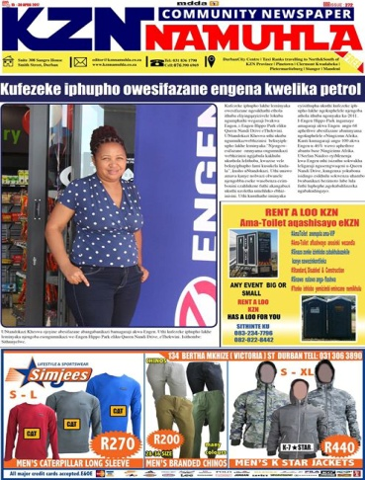
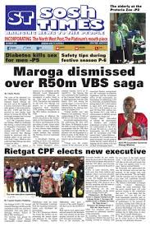
The Landscape Community Media

Slide 19
Media Landscape
MDDA Funded its first project in January 2004
2004 January – MDDA funds 1st project
MDDA Act promulgated
1994
2003
2020
2002
2004
Limited to Vyre Weekblad & Bush Radio funded by International Donors
Media industry highly monopolised,
- Limited or no diversity of news or opinion
- Voice of black people in media suppressed.
2003 - MDDA starts operating
MDDA Regulations Published
244 licensed community radio stations. 8m listeners.
5 Community Television.
Over 200 publishers.
Three tier system of private, public and community broadcast media in place

Slide 20
Licensed Community Radio Stations
Per Province, Per District Municipality
V
9
Gauteng
61
C
13
Limpopo
33
M
3
Free State
14
W
4
North West
18
S
4
Northern Cape
10
E
8
BP
5
T
24
Mpumalanga
21
NMM
6
J
21
N
8
Dr RSM
2
WR
4
E
7
JTG
1
Dr KK
5
S
5
GS
5
FD
1
A
2
Umk
2
ZF M
1
FB
3
L
3
TM
4
Z
4
Uth
2
Umz
1
KC
3
M
6
Umg
2
I
2
KwaZulu-Natal
32
HG
2
E
10
N
3
PKS
2
AN
2
Ugu 2
JQ
3
CH
1
OR
4
WC
3
A
1
SB
5
BC
5
Eastern Cape
25
Western Cape
30
CW
6
CT
12
GR
5
NMB
5
6
O
2

Slide 21
Licensed Community Radio Stations
Per Province, Per District Municipality

Slide 22
Licensed Community Radio Stations
Per Province, Per District Municipality

Slide 23
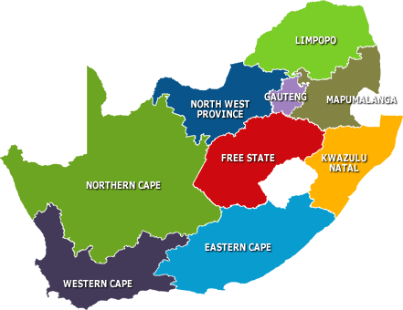
MDDA Community Broadcast Footprint
By Province
33
157 Licensed Radio Stations Funded
12 lost licenses
145 Licensed & Funded
5 Licensed Televisions
5 Funded by MDDA
1 Lost License
28
16
14
61
18
25
21
Province | Total Stations
E/Cape | TBN
Free State | 0 - Initiative
Gauteng | Soweto & Tshwane
KZN | 1KZN
Limpopo | Not licensed
Mpuma | 0
N/Cape | 0
N/ West | Not issued
W/Cape | Cape TV
Total | 5
14
22
10
6
6
32
5
16
30
13
25

Slide 24
5 Years Funding Period (2015 – 2019) Per Sector

Slide 25
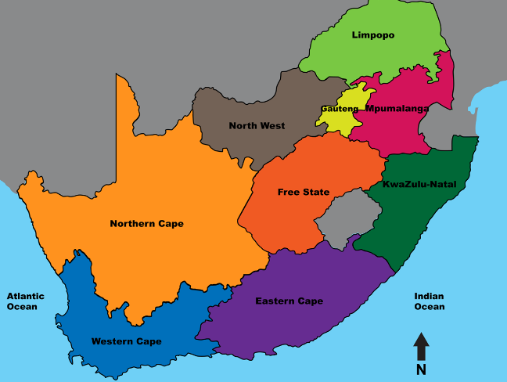
Provincial Spread for 2019/20 Broadcast & Print Targets
22 community radio stations approved on 28 March 2020 across provinces. 10 community and small commercial print media on 28 March 2020 per province.
3
4
1
0
0
0
0
0
5
2
2
0
0
2

Slide 26
Community Print Today
No. of Publications
Circulation
Readership
Publishing Languages
Total Funded
- 180
- 87 weekly
38 fortnightly
55 monthlies
7 million per month
+20 million per month
97 publish in indigenous languages or combination of indigenous and English/Afrikaans
33 community print
45 small commercial print

Slide 27
Community & Small Commercial Print MDDA footprint
Funding and non financial support to 33 Community Print Projects owned and managed by NGOs (Government supported). And to 45 Small Commercial Media Print Projects owned and managed by HDIs.
3
6
9
8
2
3
1
0
2
0
7
5
5
3
3
8
7
6

Slide 28
Capacity Building and Research Support
Sustainability of the Sector
Total number of community media practitioners trained to-date
3 405
Number of Interventions
98
Females Trained
1 478
Males Trained
2 027
R
Types of Training Interventions
Financial management Skills
Mentorship and Coaching
Grantee Orientation
Marketing and Sales
Election Reporting
Digital Literacy

Slide 29
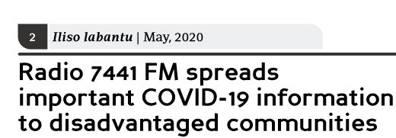
MDDA COVID-19 Emergency Relief Fund

Slide 30
MDDA’s Response to COVID-19
Launched R20 million Emergency Relief Fund on 30 March 2020
First Phase Emergency Relief
Phase II Emergency Relief
@ R45 000.00 packages (print and broadcast)
For content generation
Telecommunications,
Fuel & PPEs
Printing & Distribution.
R50 000 & R20 000 packages
Rentals/Bond repayments
Salaries/Stipends
Hygiene Essentials
Telecommunications
Content generation & Dissemination
R10 million
From Broadcast Budget
September 2020
Phase III Emergency Relief
R10 million
115 Broadcasters
116 Publishers
To be approved by Board.
About R80 000 per project
Announced in Q3
Content Production for Broadcasters only
R10 million
Under Disbursement
30 March 2020
25 May 2020
Selection Criteria
Not limited to MDDA beneficiaries
Inability to generate income due to COVID-19
Requisite documents requested & Reporting before next tranche.

Slide 31
COVID-19 1st Phase Provincial Spread
130 Broadcasters applied, 115 radio stations and 1 TV.
141 Community & small commercial print applied; 116 Approved within set criteria.
16
15
13
22
13
44
5
10
6
14
6
5
19
4
13
12
9
5

Slide 32
Supporting Government’s Message
On the Prevention of COVID-19
Appeals for Donation
Cascading Govt Messages
MDDA Emergency Funding is not sufficient for vital content generation as the coronavirus stays with us longer.
Distributed Government messages to MDDA & ICASA broadcast databases.
Key Messages
Facebook & Google
Key messages to community and small commercial print and digital media
Could not assist, however, initiated discussions for future engagements.
Engaging community radio stations
Standard Bank & National Treasury
Minister in The Presidency interviewed on various community radio stations on the pandemic.
Approached for funding. Could not assist.
Communications Task Team
MDDA member of the NCC Comms Task Team

Slide 33
Sector Challenges
Sustainability in Spotlight
High Operating Costs
Poor Content
Signal Distribution costs
High printing & Distribution costs
Maintenance costs
SAMRO/SAMPRA fees
Rentals and office accommodation, etc.
Standardized content generation funding
Seda SLA
Unreliable Audience
research
Requisite Skills
Training and capacity development interventions informed by Skills Audit.
Met with Broadcast Research Council for possible partnership
Poor governance & compliance
Training, mentorship and coaching interventions.
Sector Engagements.
Advertising
Unregulated & poor coordination of government advertising
Technological Changes
& Innovation
Regulation and Policy

Slide 34
Lobbying & Partnerships
Looking for more projects support
A
Major Print Sector
Broadcast Funders
Draft SLAs with major print on:
Printing Discounts
Access to Paper
Training interventions
Distribution
Preferential Printing
Monthly Acc Reconciliations
Digitalisation
3-year contract with Multichoice R40 million p.a.
Meeting other commercial broadcast who are not directing USAF levy to MDDA.
B
D
Others
Met KAS German media programme regarding partnering on research
National Lotteries
Africa Media Fund
Google
Facebook
Open Foundation Society
SLA with Seda on training & development
C
Telecommunications
Met with MTN & Vodacom Receptive to partner MDDA on digital media pilot study.
Finalise partnerships

Slide 35
Way Forward
Action Plans
Building a Sustainability Model for the Sector
Audience Measurement
Exploring Expanding TV footprint
Consultative Conference held
Draft ToRs for sustainability research.
Research to inform Sustainability Model
In discussions with Broadcast Research Council (BRC) on
improved audience measurement
In discussions with ICASA on community television
20 Year MDDA Review
Review impact of Mandate &
Achievements
Strengths/Weaknesses.
Launch Sustainability Model for the Sector
Competition Commission Fund
Sector Digital Presence
Agreed on implementation terms.
In consultation with learning institutions on bursaries uptake.
Agreement on % to fund existing advertising/media agencies for sustainability purposes.
Setting selection criteria for start ups & sustainability funding.
Met with Industry Experts
Finalise discussions with Telcos on Zero rating projects websites, URLs, APPs, etc
Fund more digital projects
Consulting ICASA on Digital Sound Broadcasting legislative framework
Digital Strategy Research & Skills Audit commenced.

