Slide 1
Presentation on behalf of Independent Producers Organisation (IPO) to: PARLIAMENTARY PORTFOLIO COMMITTEE ON COMMUNICATIONS Joint meeting with the Select Committee on Public Enterprises and Communication Rehad Desai and Nimrod Geva Wednesday, 2 September 2020

Slide 2
The Independent Producers Organisation
IPO is a representative, national organisation of independent South African film, television and video producers,
Represents, protects and promotes interests and needs of producers.
IPO currently represents the interests of over seventy percent of working producers in South Africa.
IPO strives towards creating an empowered, transformed and representative film and television industry
We are committed to the advancement of a sustainable and conducive environment for producers, creating opportunities for the full value chain of workers across the sector
We aim to maximize the film and tv industry’s potential to contribute to the country’s economy, and preserving & promoting South Africa’s national identity and stories.

Slide 3
SABC Turnaround strategy
The overall turnaround strategy for the broadcaster is
Credible
Comprehensive
Most importantly, finally being executed
As independent producers who create the majority of the SABC’s programming we would like to focus on the content aspect of the strategy and what is needed to make it happen.
We support the SABC in plans to increase its spend on content to:
Entertain, educate and inform audiences
Drive advertising revenue
Meet mandate goals

Slide 4
Turnaround strategy
We welcome plans to boost content spend, benchmark costs for production to market rates and reward artists for their efforts more fairly.
But it in order to do this, SABC must address the elephant in the room…
… an out of control wage bill
e-tv 11 % of total expenses
M-Net 12% of total expenses
SABC 37% of total expenses
And SABC spends only 22 % on content – this ratio should be reversed.

Slide 5
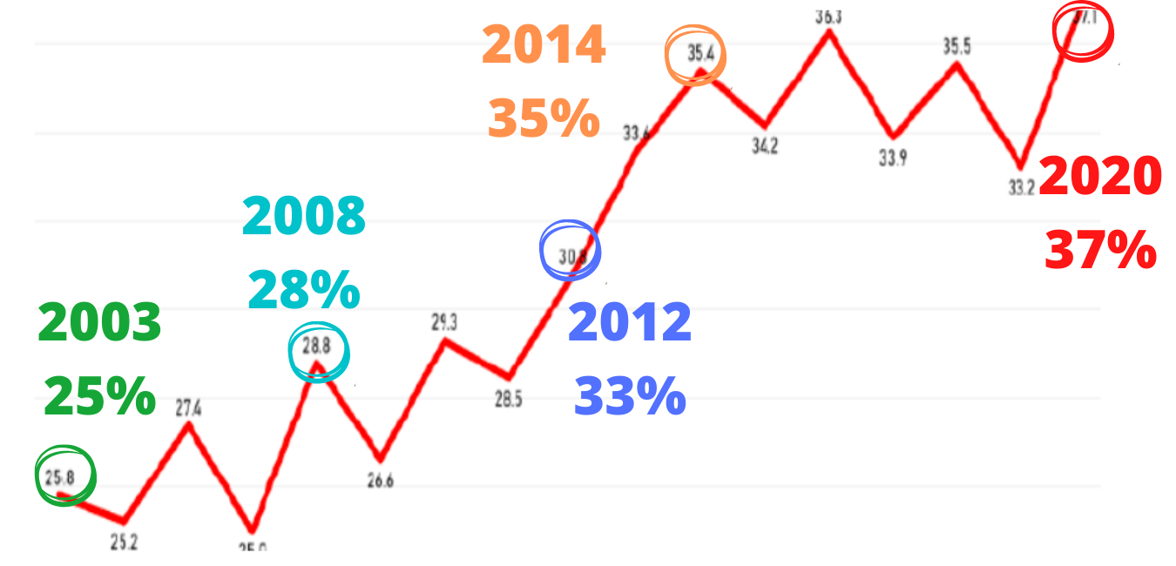
Permanent Employee Compensation
as Percentage of OPEX

Slide 6
Solving the wage bill crisis
This wage bill is clearly out of control, unsustainable and unnecessary given the competition’s cost structures.
The turnaround plan makes every effort to find other ways to raise revenue and cut costs.
But with the pressures of
planned losses of R1.5bn in 2020/2021;
advertising collapsing due to COVID cutbacks on spend;
-- it is very clear that SABC has run out of options.
Retrenchments should be a ‘last resort’, say opponents of the S189 process. It is clear that we have long ago reached the point where this is no longer avoidable.

Slide 7
Solving the wage bill crisis
When we talk about ‘saving jobs’ by stopping S189 process, we are really only talking about saving jobs at the SABC. We are forgetting that thousands of jobs have already been lost in the private sector due to SABC crisis – those job losses are “invisible”:
-- e.g. actors, writers, directors, production managers, gaffers etc.
There has already been a bloodbath of jobs lost primarily by those who actually create and produce the content that keeps the SABC alive.
Those who are genuinely worried about all jobs need to fight to reverse this.
By increasing the % spend on local content to be more conducive of a public broadcaster, the SABC will enable the industry to grow which will have a net positive effect on jobs for the country.

Slide 8
Solving the wage bill crisis
Will the bloated middle-management of the SABC also be trimmed?
Or will it again be the independent production sector that must bear the full brunt of the SABC’s financial woes?
We believe that it is critical that content is prioritised to boost revenue, audiences and meet mandate.
If we are concerned for jobs, we must push for investment in content which also helps the SABC become financially viable.
If content budgets keep getting slashed the SABC faces a dangerous downward spiral.

Slide 9
The Downward Spiral of Content Budget Cuts
Smaller Audiences
Lower Advertising Revenue
Cost cutting
Under-investment in content

Slide 10
Content and Public Mandate
Aside from revenue, cutting content budgets also reduce SABC’s ability to meet mandate goals
Consequences:
This is of even more concern during the COVID crisis.
Less Public Service Content on health e.g. importance of vaccinations for children even during COVID, debates and documentaries etc.
Less investment in Education content– particularly important at a time of school closures and need to catch-up missed lessons.
Less fresh content also means fewer people glued to their screens and more people going out and not social distancing.
It has also pushed artists to the breaking point.

Slide 11
Change in Salaries vs Content Prices 2006-2019 – Artists getting exploited
Salaries
Content

Slide 12
SABC’s Independence is Under Attack, Again.
We have seen why the turnaround plan is necessary. The SABC Board and Executive must be allowed to complete the execution of the turnaround strategy for the sustainability of the SABC and the industry.
The SABC’s independence in operational and other matters must be safeguarded. We urge that oversight by Parliament supports the SABC’s critical turnaround plans.
Calls for the dissolution of the Board from certain quarters are irresponsible and add to undue political pressure on the Board. The public needs a stable board after years of chaos.
It is clear that they are motivated by a desire to stop the Board’s process to comply with Treasury conditions regarding the wage bill and the urgent need to stabilise the broadcaster financially, which will save jobs for all in the medium term.

Slide 13
SABC Request for COVID-related assistance
It is well-known that the COVID crisis has hit broadcasters who are dependent on advertising around the world very badly.
According to the SABC, the anticipated adverse impact of COVID-19 on revenue is currently estimated at approximately R1.5bn for this fiscal.
We support further relief to the broadcaster to allow it to survive and prevent further cuts to content budgets and consequent job losses throughout the content creation value chain.

Slide 14
We thank you for the opportunity to make this input.
Rehad Desai: rehad@icon.co.za
Nimrod Geva: nimrod@ipo.org.za
www.ipo.org.za

