Slide 1
PRESENTATION ON THE PROGRESS OF AUDIT IMPLEMENTATION ACTION PLAN
02 SEPTEMBER 2020

Slide 2
PURPOSE
The purpose of the presentation is:
To provide the Portfolio Committee with progress made to resolve the audit findings for 2017/2018 and 2018/2019 financial years

Slide 3
BREAKDOWN AND PROGRESS OF FINDINGS 2017/2018
Business Unit | Total Findings | No. of Findings Unresolved | No. of Findings Resolved
Supply Chain Management | 4 | 0 | 4
Monitoring & Evaluation | 1 | 0 | 1
Information Systems | 4 | 3 | 1
Internal Control | 2 | 0 | 2
Finance | 1 | 0 | 1
Internal Audit | 1 | 0 | 1
TOTAL | 13 | 3 | 10

Slide 4
BREAKDOWN AND PROGRESS OF FINDINGS 2018/2019
Business Unit | Total Findings | No. of Findings Unresolved | No. of Findings Resolved
Supply Chain Management | 11 | 1 | 10
HRM | 2 | 0 | 2
Information Systems (3 findings grouped together) | 1 | 1 | 0
Internal Control | 3 | 1 | 2
Finance | 3 | 3 | 0
Internal Audit | 1 | 1 | 0
Other (Policies and Sassa) | 3 | 2 | 1
TOTAL | 24 | 9 | 15

Slide 5
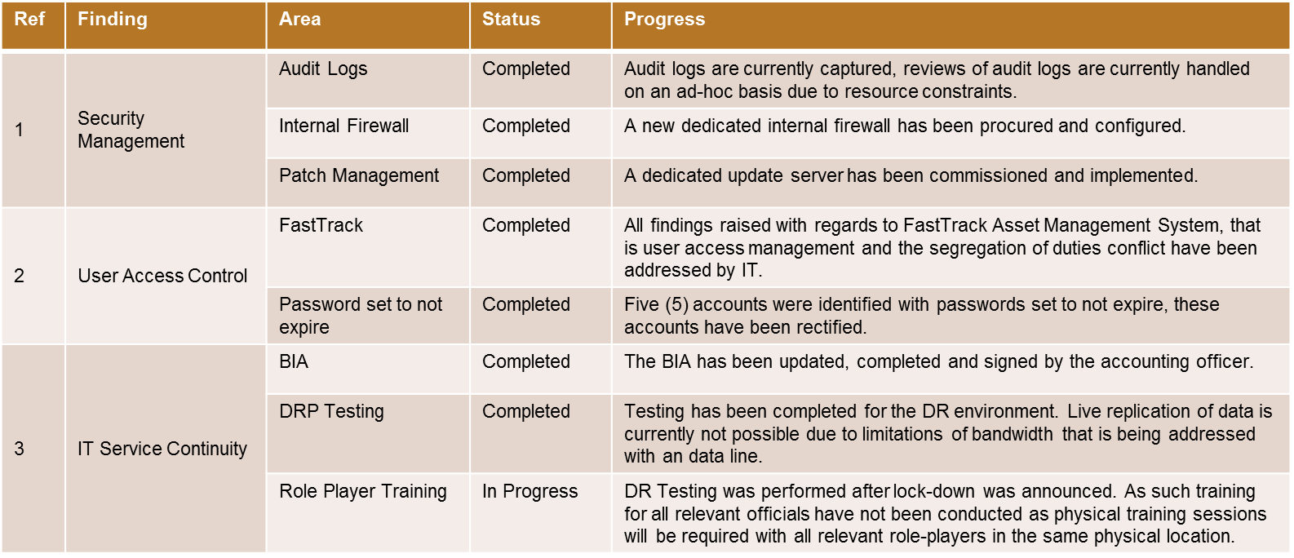
SUMMARY OF PROGRESS ON FINDINGS FOR 2017/2018 FINANCIAL YEAR
Progress on audit findings for 2017/2018 financial year for IT:

Slide 6
SUMMARY OF PROGRESS ON FINDINGS FOR 2018/2019 FINANCIAL YEAR
DIRECTORATE | FINDING | CURRENT STATUS
SCM | Payments made to supplier’s / service providers after 30 days | A centralised e-mail address for the receiving of invoices in the department has been implemented. Invoice tracking system developed and implemented. System to be tested.
Internal Control | Policies not reviewed | 2 Policies are approved. Remaining 16 policies are currently being reviewed. 4 policies are ready to be tabled at MANCO for approval.
Internal Audit | Non-compliance in terms of assurance reviews/assessments conducted once every five years not completed | DSD is in a process of procuring an automated audit software. As an immediate interim intervention, a contract appointment was made until the end of November 2020 whilst a process to fill the post permanent is being addressed.

Slide 7
SUMMARY OF PROGRESS ON FINDINGS FOR 2018/2019 FINANCIAL YEAR
DIRECTORATE | FINDING | CURRENT STATUS
Finance | Minor/Major assets, a number of issues and misstatements relating to the disclosure of minor/major assets in the asset register and the financial statements | The Asset Register was updated by removing all duplications and indicating the assets which were disposed in the previous year. DSD is in the process of doing asset verification and has not yet finalised it.
 | Pre-payments and advances: Unauthorised expenditure included in SOCPEN Advances. An amount of R26 354 000.00 is presented and disclosed as SOCPEN Advances in the AFS | A letter was written to National Treasury in October 2019 requesting guidance on how this matter needs to be dealt with. While the Department is waiting for feedback from National Treasury, a follow-up meeting is being arranged.
Information Systems | Findings as per prior year | Progress already provided as per 2017/2018 financial year

Slide 8
RECOMMENDATION
It is recommended that members of the Portfolio Committee kindly take note of the progress made with regards to the Audit Implementation Action Plan.

