Slide 1
2020/21
DEPARTMENT OF DEFENCE
Q1 Performance Report
Presentation to the PCD&MV of 02 September 2020

Slide 2
Aim
Information brief to the
Portfolio Committee on Defence and Military Veterans
on the DOD Q1 Performance Report
for FY2020/21

Slide 3
Presentation Structure
Legislative Requirements
DOD QPR Instruction for FY2020/21
Amended Reporting Requirements
Additional COVID-19 Reporting Requirements
Background
DOD Result-Based Model

Slide 4
Presentation Structure
DOD Q1 Performance Report
Analysis of DOD Output Indicators
Q1 Strategic Overview
DOD Selected Performance Indicators
Q1 Performance Status
Q1 Financial Performance Information
DOD COVID-19 Response Expenditure
Report on Irregular Expenditure
BRRR Feedback

Slide 5
Legislative Requirements
In terms of Section 38(1)(a)(i) and (ii) of the PFMA, 1999 as amended, the “Accounting Officer for a department must ensure that the department has and maintains effective, efficient and transparent systems of financial and risk management and internal control; and a system of internal audit under the control and direction of an audit committee”.
The Treasury Regulations, section 5.3.1 states that, the Accounting Officer of an institution must establish procedures for quarterly reporting to the Executive Authority to facilitate effective performance monitoring, evaluation and corrective action.

Slide 6
Legislative Requirements
The Revised NT Framework for Strategic Plans and Annual Performance Plans, states that QPRs “give information about progress on implementing an institution’s APP on a quarterly basis, with particular reference to performance against outputs”
The DOD Quarterly Performance Report Instruction No 0014/2020 gave effect to the legislative framework applicable on QPRs, and provided DOD unique guidelines for the compilation of respective QPRs.

Slide 7
Amended Legislative Requirements
The DPME 2020/21 Guidelines for National Quarterly Reports states that:
“Reporting on both financial and non-financial performance is important in measuring the performance of government institutions. Non-financial information is essential for assessing progress towards predetermined service delivery performance targets”.
“Performance information allows for a results-based management approach, where results or performance can be regularly measured in order to recognise success and failure, and to adjust strategy accordingly”.

Slide 8
Amended Reporting Requirements
As from FY2020/21, departments must populate validated outputs at the end of each quarter. Departments are encouraged to develop internal mechanisms to ensure that by end of 30 days after the quarter the performance information reported is validated, reliable and credible.
Note. Q1 reporting was done against the DOD APP for 2020 tabled on 12 March 2020. Reporting against the remainder of FY2020/21 quarters will be done against the Adjusted DOD APP for 2020, tabled on 20 July 2020.

Slide 9
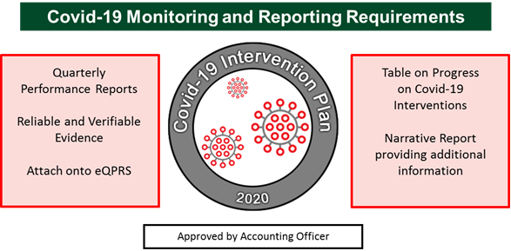
Additional COVID-19 Reporting Requirements
As from FY2020/21, departments must monitor both financial and non-financial performance in relation to COVID-19 interventions. QPRs will be utilised to monitor and track implementation of COVID-19 interventions, in addition to continuous service delivery programmes.

Slide 10
Background
The DOD institutionalised the Result-Based Management Framework as prescribed in the Revised Framework with effect from FY2020/21 as a tool to ensure that the Department fulfils its Constitutional mandate as expressed in terms of the intended impact, outcomes and outputs.

Slide 11
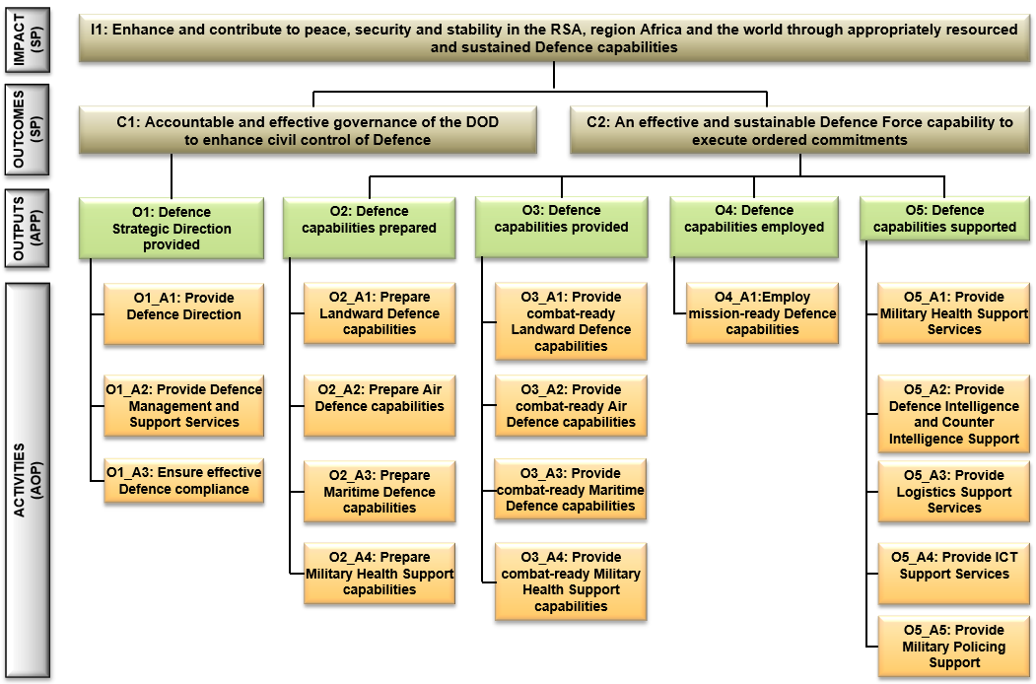
DOD Result-Based Model

Slide 12
DOD Q1 Performance
Report

Slide 13
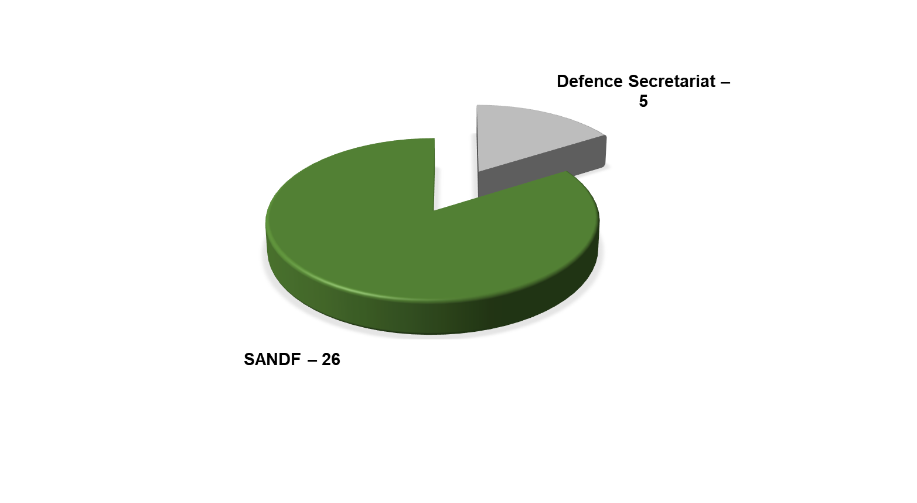
Analysis of DOD Output Indicators
DOD Output Indicators (31) per Entity: FY2020/21
Excluding SANDF Classified Indicators

Slide 14
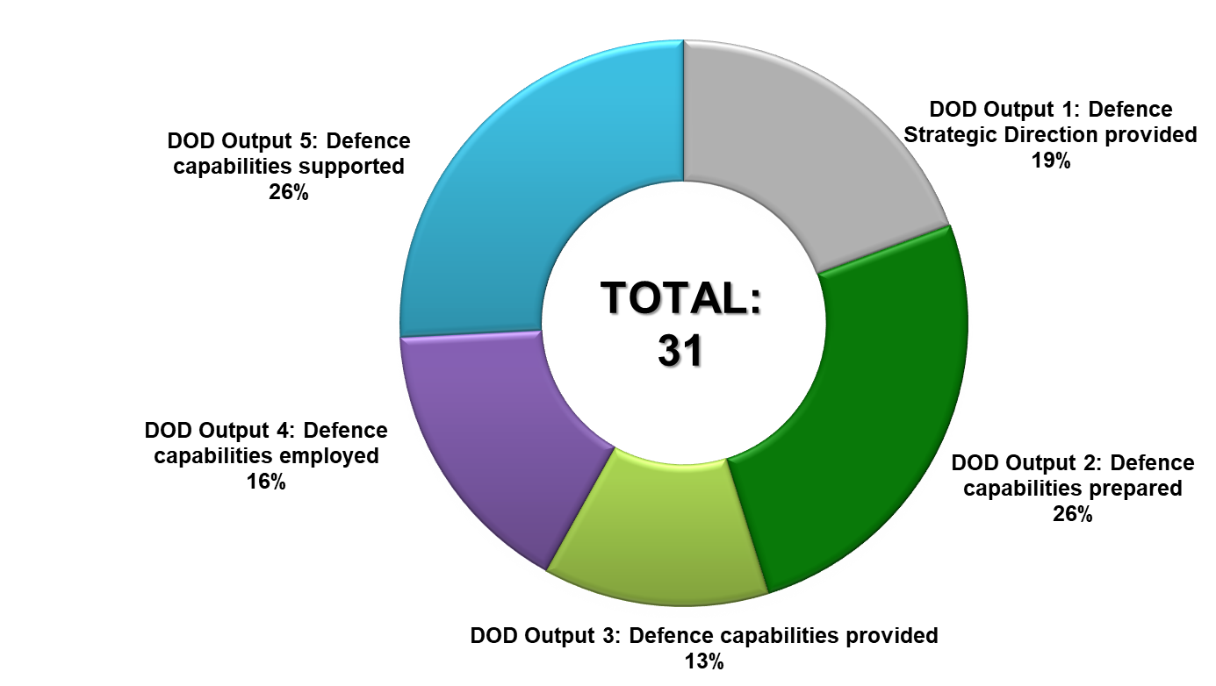
Analysis of DOD Output Indicators
DOD Output Indicators (31) per Output: FY2020/21 (Q1)

Slide 15
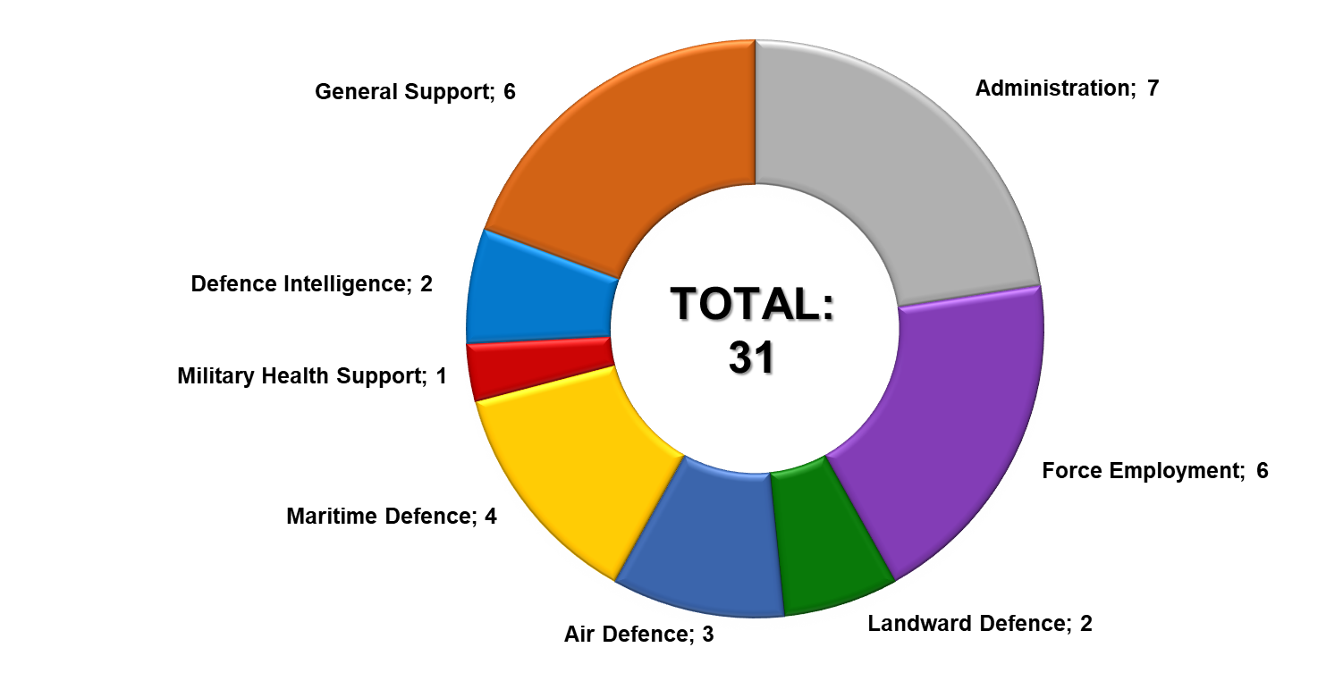
Analysis of DOD Output Indicators
DOD Output Indicators (31) per Programme: FY2020/21 (Q1)
Excluding SANDF Classified Indicators

Slide 16
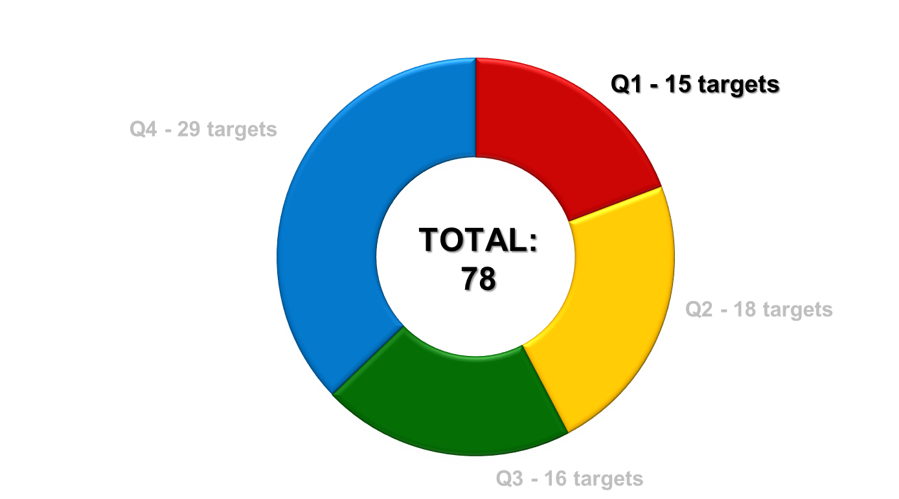
Analysis of Def Sec Output Indicators
DOD Targets per Quarter: FY2020/21 (Q1)

Slide 17
Analysis of DOD Targets per Programme
Programme | Q1 | Q2 | Q3 | Q4 | Total
Administration | 3 | 3 | 3 | 7 | 16
Force Employment | 4 | 4 | 4 | 6 | 18
Landward Defence | 1 | 2 | 2 | 2 | 7
Air Defence | 1 | 2 | 1 | 2 | 6
Maritime Defence | 1 | 2 | 1 | 3 | 7
Military Health Support | 1 | 1 | 1 | 1 | 4
Defence Intelligence | 2 | 2 | 2 | 2 | 8
General Support | 2 | 2 | 2 | 6 | 12
Total | 15 | 18 | 16 | 29 | 78

Slide 18
Q1 Strategic Overview

Slide 19
Corporate Governance and Accountability
During the period under review, the Secretary for Defence provided strategic direction to the DOD through various governance activities and interventions.
These included timely decision-making on strategic and defence diplomacy matters, effective management and processing of official departmental documents, chairing of various DOD management bodies, as well as the attendance of Director-Generals’ meetings, Cabinet Lekgotlas and Government Clusters.

Slide 20
Corporate Governance and Accountability
The declaration of a ‘National State of Disaster’ in terms of the Disaster Management Act, 2002, required government to provide an integrated and coordinated disaster management mechanism that would focus on managing and mitigating the impact of the COVID-19 Coronavirus pandemic.
To this end, the President appointed the JCPS Cluster Co-Chairpersons to coordinate, facilitate and integrate the ‘all of government approach’ to the efforts of the key work groups that would be established to focus on COVID-19.
In addition, the President instructed that the National Joint Operational and Intelligence Structure would serve as the custodian of all reports during this crisis.

Slide 21
Corporate Governance and Accountability
These work groups were made up of communication experts, educators, actuaries, scientists, health specialists, engineers, disaster management centre representatives, legal advisors, the top-level leadership of the country’s intelligence, security and law-enforcement agencies as well as teams from the departments that constitute the economic and social clusters of the FOSAD.
The Secretary for Defence was responsible to Co-Chair the JCPS Cluster of Government at DG level.

Slide 22
Corporate Governance and Accountability
To this extend, the Secretary for Defence led and coordinated activities in the following key areas during Q1:
Establishment of COVID-19 pandemic work teams.
Provision of strategic direction and guidance to the appointed work streams.
Formulation of a Socio-Economic Recovery Plan for the country, post COVID-19 national lockdown.
Developing and consolidating a Draft Framework on the Risk Adjusted Strategy.
Ensuring the alignment of government-wide security priorities and programmes that were submitted to Cabinet.

Slide 23
Corporate Human Resource Status
The DOD requires an average HR strength of 77 000. In order to assure a more sustainable defence capability, an average HR strength of 75 000 will be maintained during FY2020/21, supplemented by planned Reserve Force mandays of 2 695 963.
This will result in a projected shortfall of Rb3,017 on the CoE budget for FY2020/21.
The DOD’s actual strength as at 30 June 2020 was 73 595, which was below the planned average strength of 75 227 for June 2020.

Slide 24
Corporate Human Resource Status
The NT letter: “Request to Increase the Compensation of Employees’ Budget Limit of the DOD by Rb2,625 in FY2019/20” dated 17 March 2020, indicated that the request from the DOD to increase the FY2019/20 CoE ceiling was not supported.
The DOD received an additional allocation via the 2020 Special Adjustment Budget of Rm763,4, in support of its COVID-19 response. This allocation is specifically and exclusively appropriated and is aligned to the expenditure in terms of allowances paid and projected payments.
It is projected that the funded HR strength will continue to decrease due to higher than anticipated attrition within the Department.

Slide 25
Command of Forces
MTSF 2019 – 2024 Priorities
During the quarter under review, the SANDF supported the following MTSF Priorities:
Priority 6: “Social Cohesion and Safer Communities”
(Support to the People)
Priority 7: “A Better Africa and a Better World”
(Regional Security)

Slide 26
Command of Forces
In terms of Support to the People, the SANDF deployed 15 sub-units to execute Op CORONA (Border Safeguarding) in Limpopo, Mpumalanga, KwaZulu-Natal, Free State, Eastern Cape, Northern Cape and North-West Provinces.
Efforts to contribute towards Op PHAKISA objectives continued through the conduct of two Op CORONA coastal patrols during Q1.

Slide 27
Op CORONA Operational Successes
Operational Successes | Q1 | Q2 | Q3 | Q4 | YTD
Weapons Recovered | 8 |  |  |  | 8
Illegal Foreigners Apprehended | 1 115 |  |  |  | 1 115
Criminals Arrested | 172 |  |  |  | 172
Stolen Vehicles Recovered | 32 |  |  |  | 32
Dagga Confiscated | 3 852 kg |  |  |  | 3 852 kg
Live-stock Recovered | 338 |  |  |  | 338
Contraband Goods Confiscated | Rm23,12 |  |  |  | Rm23,12
Precious Metals Confiscated | - |  |  |  | -

Slide 28
Command of Forces
In support to Government Departments (Op PROSPER), the SANDF operational concept for Safety and Security Support is to employ multi-rolled military capabilities on request and according to the prescripts of the Defence Act 42 of 2002. The SANDF was not requested to provide assistance during Q1.
In terms of Disaster Aid and Relief (Op CHARIOT), the SANDF was not requested to provide assistance during Q1.

Slide 29
Command of Forces
In terms of search and rescue (Op ARABELLA), the SANDF provided assistance in the:
The CASEVAC of a passenger who suffered a heart attack aboard the Queen Mary 2, 216nm South West of the Coast of Durban. An Oryx helicopter from 15 Squadron successfully retrieved the patient in challenging conditions and delivered him safely to hospital for urgent treatment on 02 April 2020.
On 06 May 2020, an Oryx helicopter from 15 Squadron conducted a CASEVAC 7nm offshore of Park Rynie in the KwaZulu-Natal South Coast. A sailor on board a bulk motor carrier fell ill and had to be evacuated to a hospital facility in Durban.
The SANDF supported to the national effort to mitigate the spread of COVID-19 (Op NOTLELA) from 24 March 2020 to date.

Slide 30
Command of Forces
In terms of Regional Security the SANDF continued to provide Force Structure Elements to the United Nations PSO in the DRC (Op MISTRAL). These included:
SANDF Specialist Contingent in Kinshasa
Force Intervention Battalion Group in Sake Base
Composite Helicopter Unit in Goma
Due to the need to harness the limited number of operationally available SA Navy platforms for deployment in Op NOTLELA, it was decided that there will be no Op COPPER long range deployment in the Mozambique Channel during Q1.

Slide 31
DOD Selected
(included in the ENE) Performance Indicators

Slide 32
Selected Performance Indicator Summary
The following 10 selected performance indicators are published in the 2020 Estimates of National Expenditure for Vote 23.
Performance Indicator | Target | Q1 | Q2 | Q3 | Q4 | YTD
Total number of Defence Attaché offices | 44 | 44 | - | - | - | 100%
Number of Military Skills Development Members in the System | 3 604 | 3 576 | - | - | - | 99%
Number of Reserve Force mandays | 2 695 963 | 867 690 | - | - | - | 32%
Percentage compliance with the Southern African Development Community Standby Force | 100% | 100% | - | - | - | 100%
Percentage compliance with number of external operations | 100% | 100% | - | - | - | 100%

Slide 33
Selected Performance Indicator Summary
Performance Indicator | Target | Q1 | Q2 | Q3 | Q4 | YTD
Percentage compliance with number of internal operations | 100% | 100% | - | - | - | 100%
Number of planned joint, interdepartmental, interagency and multinational military exercises | 5 | - | - | - | - | 0%
Number of landward sub-units deployed on border safeguarding per year | 15 | 15 | - | - | - | 100%
Number of hours flown per year | 17 100 | 3 380.10 | - | - | - | 19.8%
Number of hours at sea per year | 10 000 | 3 290.61 | - | - | - | 33%

Slide 34
DOD Number of Hours Flown per Year
Flying Hours Year-On-Year Analysis
Flying Hour Type | FY2018/19 |  | FY2019/20 |  | FY2020/21
 | Target | Actual | Target | Pre-audited | Planned | YTD
Force Employment | 4 000 | 2 441.60 (61%) | 4 000 | 2 576.00 (64%) | 4 000 | 969.10 (24%)
VVIP | 1 000 | 545.70 (54.6%) | 1 000 | 907.10 (91%) | 1 000 | 76.80 (7.7%)
Force Preparation | 20 000 | 14 882.90 (74.4%) | 12 200 | 12 749.50 (105%) | 12 100 | 2 334.20 (19.3%)
TOTAL | 25 000 | 17 870.20 (71.5%) | 17 200 | 16 232.60 (94.4%) | 17 100 | 3 380.10 (19.8%)

Slide 35
DOD Number of Hours at Sea per Year
Sea Hours Year-On-Year Analysis
Sea Hour Type | FY2018/19 |  | FY2019/20 |  | FY2020/21
 | Target | Actual | Target | Pre-audited | Planned | YTD
Force Employment | 12 000 | 4 545.00 (37.9%) | 10 000 | 2 745.85 (27%) | 7 800 | 2 826.88 (36%)
Force Preparation |  | 3 159.13 (26.3%) |  | 3 866.70 (39%) | 2 200 | 463.73 (21%)
TOTAL | 12 000 | 7 704.13 (64.2%) | 10 000 | 6 612.55 (66%) | 10 000 | 3 290.61

Slide 36
Q1 Performance Status

Slide 37
Q1 Performance against DOD Outputs

Slide 38
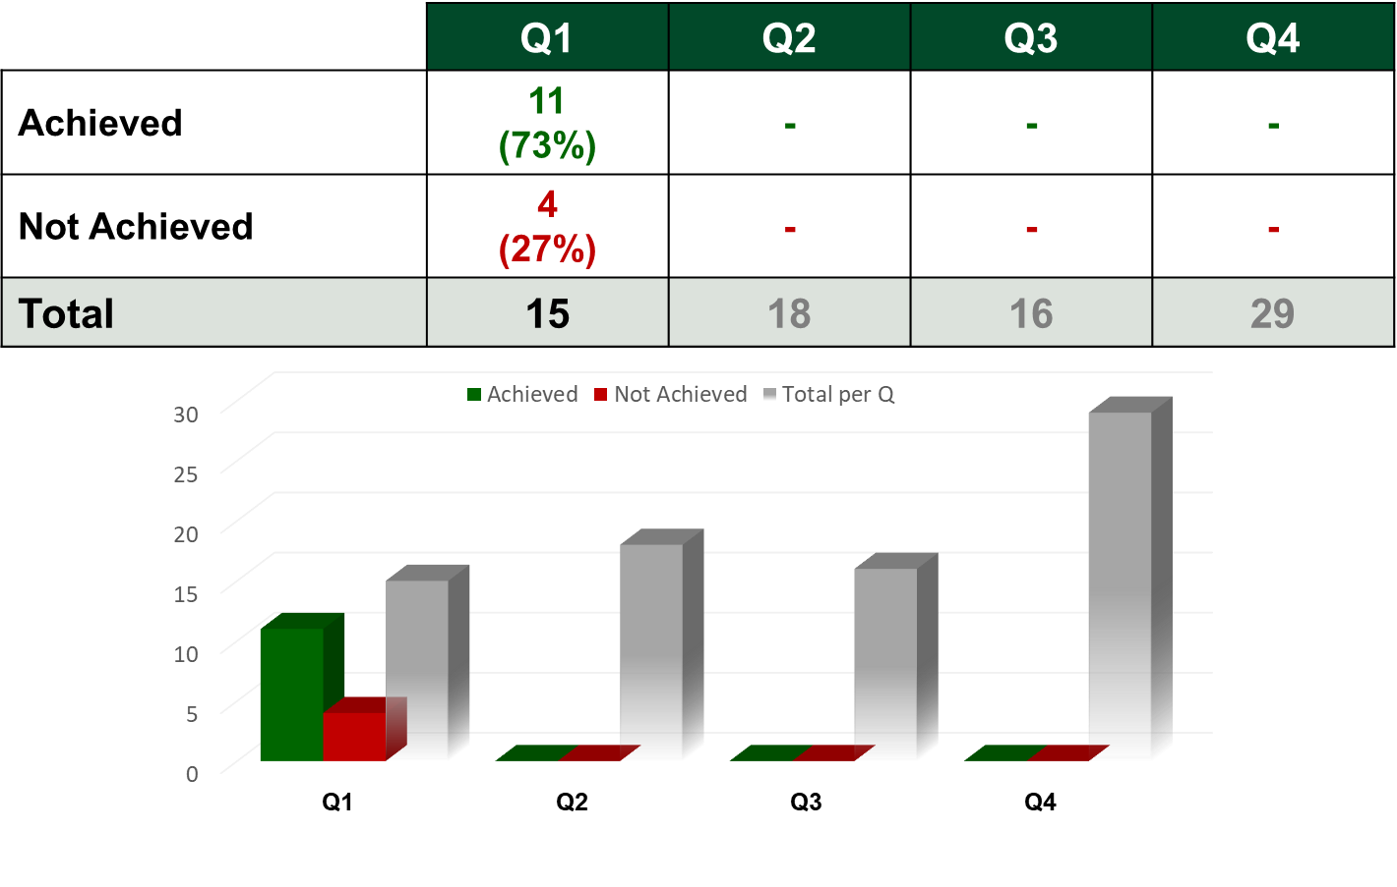
Q1 Performance Status on Targets per Quarter
38

Slide 39
Q1 Financial Performance Information

Slide 40
Summary of State of Expenditure: 30 June 2020
DOD Planned Expenditure: 21.6%
 | R’000
Budget Allocation | 55 318 621
Less: Expenditure | 12 181 540
Total Amount Available | 43 137 081
% Expenditure (Paid) | 22.0%
40

Slide 41
Summary of State of Expenditure: 30 June 2020
Programme | 2020/21 ENE | Adjust-ments | Available Funds | Approved Drawing | Approved Drawing | Actual Expenditure | Actual Expenditure | Variance | Variance
 | R'000 | R'000 | R'000 | R'000 | % | R'000 | % | R'000 | %
a | b | c | d | e | f=(e/d) | g | h=(g/d) | i=(e-g) | j=(i/e)
Administration | 5 731 874 | -163 500 | 5 568 374 | 1 169 755 | 21,0% | 1 215 295 | 21,8% | -45 540 | -3,9%
Force Employment | 3 671 088 | 763 424 | 4 434 512 | 805 854 | 18,2% | 853 958 | 19,3% | -48 104 | -6,0%
Landward Defence | 17 421 897 | 0 | 17 421 897 | 4 202 924 | 24,1% | 4 275 512 | 24,5% | -72 588 | -1,7%
Air Defence | 7 405 301 | 239 000 | 7 644 301 | 1 608 653 | 21,0% | 1 422 972 | 18,6% | 185 681 | 11,5%
Maritime Defence | 4 915 613 | 0 | 4 915 613 | 1 173 701 | 23,9% | 1 065 023 | 21,7% | 108 678 | 9,3%
Military Health Support | 5 655 997 | 660 000 | 6 315 997 | 1 286 732 | 20,4% | 1 290 486 | 20,4% | -3 754 | -0,3%
Defence Intelligence | 1 187 534 | 0 | 1 187 534 | 297 947 | 25,1% | 298 279 | 25,1% | -332 | -0,1%
General Support | 6 449 317 | 1 381 076 | 7 830 393 | 1 409 229 | 18,0% | 1 760 015 | 22,5% | -350 786 | -24,9%
Total | 52 438 621 | 2 880 000 | 55 318 621 | 11 954 795 | 21,6% | 12 181 540 | 22,0% | -226 745 | -1,9%
41

Slide 42
Comments on of State of Expenditure per
Programme: 30 June 2020
Contributing factors to negative or positive balances of more than 8% of actual drawings per Programme are as follows:
Air Defence. Under expenditure of R185.681 million was mainly due to:
COVID-19. The closure of local and international businesses following the collective global responses to contain the spread of the COVID-19 virus had a negative impact on the ability of the South African Air Force to financially perform as planned.
Defence Industry Performance. The closure of Denel largely due to persistent, but necessary, lockdown regulations had negatively impacted on deliverables directly related to planned cash flow.
Prolonged Procurement Processes. Prolonged procurement processes regarding the upkeep of aircraft systems had an effect on cash flow performance during the first quarter. The SAAFs cash flow performance will improve as the financial year progress.

Slide 43
Comments on of State of Expenditure per
Programme: 30 June 2020
Contributing factors to negative or positive balances of more than 8% of actual drawings per Programme are as follows:
Maritime Defence. Under expenditure of R108.678 million was mainly due to the unprecedented COVID-19 lockdown and procurement challenges experienced as follows :
Human Resources and Training. The restrictions posed on travelling impacted on the movement of personnel i.e. courses, training, staff visits and meetings. This mainly affected subsistence and travelling expenditure.
Maintenance and Repair of Ships.
The lockdown and procurement challenges had an impact on the process of placing System Support and technical upkeep contracts. ARMSCOR and DOD procurement experienced no bids or bidders not meeting the required criteria.
Available contractors shifted the delivery target to the right, negatively affected spares availability, required for the M&R of Ships. The latter had an direct impact on the availability and readiness of Navy Platforms.

Slide 44
Comments on of State of Expenditure per
Programme: 30 June 2020
Contributing factors to negative or positive balances of more than 8% of actual drawings per Programme are as follows:
General Support. Over expenditure of R350.786 million was mainly due to the centralised procurement of all PPEs, equipment and the establishment of quarantine / isolation facilities etc. required by the DOD to support efforts to contain the COVID-19 virus. RM344,007 was paid in this regard at the end of Q1.

Slide 45
Summary of State of Expenditure per
Economic Classification: 30 June 2020
Economic Classification | 2020/21 ENE | Adjust-ments | Available Funds | Approved Drawing | Approved Drawing | Actual Expenditure | Actual Expenditure | Variance | Variance
 | R'000 | R'000 | R'000 | R'000 | % | R'000 | % | R'000 | %
a | b | c | d | e | f=(e/d) | g | h=(g/d) | i=(e-g) | j=(i/e)
Compensation of Employees | 31 177 687 | 763 424 | 31 941 111 | 7 900 429 | 24,7% | 8 059 732 | 25,2% | -159 303 | -2,0%
Goods and Services | 13 396 238 | 1 146 390 | 14 542 628 | 2 370 020 | 16,3% | 2 298 128 | 15,8% | 71 892 | 3,0%
Transfers and Subsidies | 7 091 013 | -117 000 | 6 974 013 | 1 614 520 | 23,2% | 1 600 598 | 23,0% | 13 922 | 0,9%
Payments for Capital Assets | 773 683 | 1 087 186 | 1 860 869 | 69 826 | 3,8% | 223 052 | 12,0% | -153 226 | -219,4%
Payments for Financial Assets | 0 | 0 | 0 | 0 | 0,0% | 30 | 100,0% | -30 | 100,0%
Total Expenditure | 52 438 621 | 2 880 000 | 55 318 621 | 11 954 795 | 21,6% | 12 181 540 | 22,0% | -226 745 | -1,9%

Slide 46
Comments on of State of Expenditure per
Economic Classification: 30 June 2020
Contributing factors to negative or positive balances of more than 8% of actual drawings per economic classification are as follows:
Payments for Capital Assets. The over expenditure of R153.226 million was as a result of payment of invoices received from the National Department of Public Works and Infrastructure for work completed on immovable properties in accordance with the User Asset Management Plan as well as the payment of Microsoft Software Licenses.
Payments for Financial Assets. The over expenditure of R0.030 million was mainly due to the write-off transactions for thefts and other losses. It should be noted that the Department does not make provision during the budget allocation for unforeseen expenditure such as foreign exchange losses, thefts and other losses, etc. Funds are reserved to clear these transactions at financial year-end.

Slide 47
DOD COVID-19 Response Expenditure per Programme: 30 June 2020
Programme | April 2020 | May 2020 | June 2020 | Cumulative
 | R'000 | R'000 | R'000 | R'000
Administration | 13 | 71 | 239 | 323
Force Employment | 33 544 | 76 062 | 159 748 | 269 354
Landward Defence | 53 | 9 770 | 18 593 | 28 416
Air Defence | 112 | 4 327 | 40 290 | 44 729
Maritime Defence | 158 | 3 179 | 2 951 | 6 288
Military Health Support | 4 669 | 16 547 | 7 540 | 28 756
Defence Intelligence | - | - | - | -
General Support | 48 145 | 123 871 | 171 991 | 344 007
Total | 86 694 | 233 827 | 401 352 | 721 873

Slide 48
DOD COVID-19 Response Expenditure per Economic Classification: 30 June 2020
Economic Classification | April 2020 | May 2020 | June 2020 | Cumulative
 | R'000 | R'000 | R'000 | R'000
Current Payments | 86 694 | 232 528 | 390 072 | 709 294
Compensation of Employees | 33 501 | 68 703 | 141 417 | 243 621
Goods and Services | 53 193 | 163 825 | 248 655 | 465 673
Minor Assets | 2 | 4 631 | 4 220 | 8 853
Contractors | - | - | 38 849 | 38 849
Fleet Services | 5 | 5 311 | 42 | 5 358
Inventory: Clothing material and accessories | 3 188 | 4 396 | 15 061 | 22 645
Inventory: Food and food supplies | 4 | 6 817 | 17 376 | 24 197
Inventory: Fuel, oil and gas | - | 4 930 | 6 659 | 11 589
Inventory: Materials and supplies | - | 4 219 | 23 | 4 242
Inventory: Medical supplies | 33 833 | 108 596 | 159 257 | 301 686
Inventory: Medicine | - | 168 | 2 346 | 2 514
Consumable Supplies | 48 | 420 | 869 | 1 337
Consumables: Stationery, office supplies | 32 | 68 | 36 | 136
Property Payments | - | 198 | 1 239 | 1 437
Travel and Subsistence | - | 24 071 | 2 678 | 26 749
Operating Payments | 16 081 | - | - | 16 081
Transfers and Subsidies | - | - | 3 000 | 3 000
Payments for Capital Assets | - | 1 299 | 8 280 | 9 579
Total | 86 694 | 233 827 | 401 352 | 721 873

Slide 49
Irregular Expenditure (IE)
IE for Q1 as at 30 June 2020 amounted to Rm51,2; comprising of the following categories:
Description | Amount (R)
Contract awarded in 2017/18 through unfair bidding process for asset management contract | 39 461 209
Extension of a contract with more than 15% without NT approval for Quantity Survey fees for the refurbishment of 1 Mil hospital | 6 861 655
Contracts awarded in 2018/19 through Incorrect bid evaluation process for the acquisition of spare parts for the shipyards | 3 233 116
Procurement processes not followed for the construction and building of a diving swimming pool for training for the SA Navy | 1 468 564
Points awarded for functionality were incorrectly calculated for a 3-year garden services for the Castle of Good Hope | 181 500

Slide 50
BRRR Feedback

Slide 51
BRRR Status
S/N | BRRR Activity | Status
1 | Status of the Special Defence Account CoE Underfunding Status of Projects BIRO, HOTEL and HOEFYSTER | Status quo remains regarding underfunding.
2 | Status of Irregular Expenditure and Fruitless and Wasteful Expenditure | Refer to the Presentation regarding FY2020/21 Q1 status.
3 | Internal Audit Division’s capacity | 49 out of 69 post were filled as on 30 Jun 2020.
4 | Tangible Assets | Status quo remains, AGSA audit in process for FY2019/20.

Slide 52
BRRR Status
S/N | BRRR Activity | Status
5 | Reimbursements | Due to COVID-19, no reimbursement statements received from the UN for Q1.
6 | Maritime Combat Expenditure Air Defence Combat Expenditure | GDA - R180 855 684 SDA - R195 098 245 GDA - R56 512 651 SDA - R10 837 607 (detailed flying hours and hours at sea provided earlier)
7 | SA Navy frigates and submarines midlife upgrades | Status quo remains; no funds are available for midlife upgrades.
8 | Modern Military Force | Status quo remains; no funds are available to enter into new contracts to modernise current equipment.

Slide 53
Thank you…

