Slide 1
STATE OF KANNALAND LOCAL MUNICIPALITY PRESENTATION TO THE COGTA PORTFOLIO COMMITTEE
Time: 09H00
Date: 01 September 2020
Presenter: Ms A Bruwer
Virtual Meeting

Slide 2
PRESENTATION OUTLINE / TABLE OF CONTENTS
Purpose of the presentation
Problem Statement/Introduction
Socio-economic Status
Education
Governance & Municipal Capacity
Financial Management
Auditor-General perspective
Financial Recovery Plan
Service Delivery Status
Key Challenges
COGTA Support to Kannaland
Factors hampering service delivery
General Remarks
Strengths and Opportunities
Conclusion
Recommendations

Slide 3
PURPOSE OF THE PRESENTATION
The purpose of the presentation is to:
Provide an overview of the state of Kannaland Local Municipality (LM)
Indicate the support provided by COGTA to Kannaland LM.
Identify strengths and opportunities

Slide 4
PROBLEM STATEMENT / INTRODUCTION
Kannaland LM has been under intervention in terms of section 139(5) of the Constitution since December 2016 and is the only municipality in the Western Cape that is currently under intervention.
When the municipality was placed under intervention in 2016, the main challenges were identified as:
Financial Health in terms of National Treasury ratios for the previous 2 years which indicated that the municipality was in financial distress.
Auditor General has found financial non-sustainability in its findings
The Directorate for Priority Crime Investigation (Hawks) is conducting an investigation into alleged fraud at the municipality. The investigation is ongoing and was still in progress in February 2020.
The provincial government has put plans in place to assist the municipality in managing its affairs.
Although there has been some significant improvement of governance and financial management, the Municipality still faces significant challenges such as financial viability, human resources management and service delivery.
Notes:
Since 2016, Kannaland Municipality has improved drastically through the following:
The Council leadership, which resulted in the removing of certain officials who were later investigated for many acts of corruption.
There was a general improvement of governance and financial management, as well as the implementation of projects and addressing issues, e.g. the payment of debt to ESKOM.

Slide 6
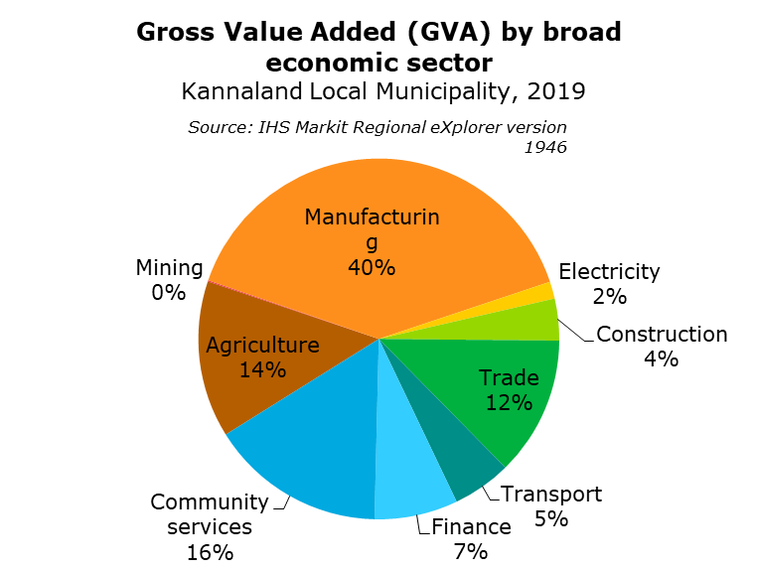
SOCIO-ECONOMIC STATUS
Poverty:
14 100 (55.20% )people out of the total population of 25 574 living in poverty, using the upper poverty line definition.
Economic active population:
9 830 in 2019, which is 38.43% of its total population.
Largest number of jobs in 2019
Trade sector - 2 020 employed people (20.5% of total employment).
The finance sector - 1 960 (19.9%)
Economic drivers
Manufacturing (40%)
Community Services (16%)
Agriculture (14%)
Per capita income:
R 51,700 ( lower than Western Cape (R 82,400) and of the Garden Route District Municipality (R 78,100) and of South Africa
(R 60,800).

Slide 7
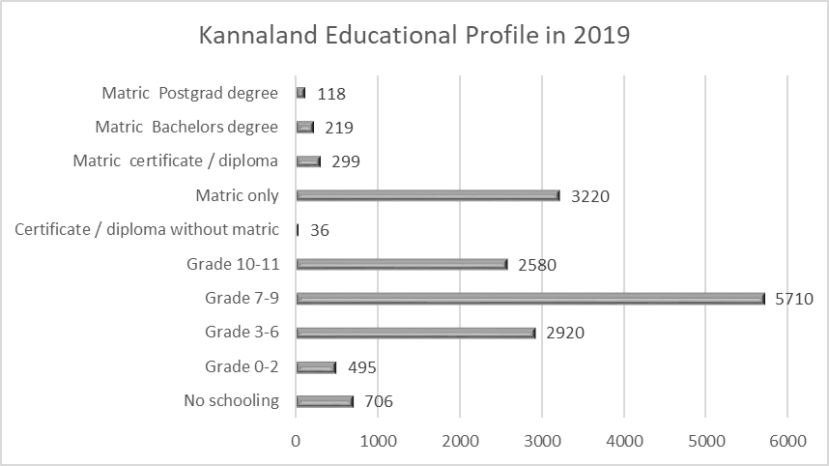
EDUCATION
Although the number of people without any schooling decreased from 2009 to 2019, the majority of people living in Kannaland still had less than a grade 9 educational level.
The number of people within the 'matric only' category, increased from 2,710 to 3,220. However, the number of people with 'matric and a certificate/diploma' decreased with an average annual rate of -2.69%, with the number of people with a 'matric and a Bachelor's' degree decreasing with an average annual rate of -1.59%.

Slide 8
GOVERNANCE
Kannaland is a category B Municipality with a mayoral executive system combined with a ward participatory system as provided for in the Western Cape Determination of Types of Municipalities Act, 2000.
Following election of 3 August 2016 , the DA and ANC councillors formed a coalition to govern without ICOSA, but DA national leadership said that the coalition had not been authorized.
In March 2017 the ANC recalled its councillors to put an end to the coalition. However the mayor has not been recalled despite the national ANC structures stating that this would happen. A motion of no confidence in the mayor and speaker of the municipality was put forward in August 2017. The motion failed with the DA and ANC in the municipality against the motion, leaving the ANC mayor Magdalene Barry in power. The Democratic Alliance spokesperson on local government stated that the party would side with the ANC in order to keep the Independent Civic Organisation away from the public purse. This follows forensic evidence detailing financial misconduct that amounted to more than R14 million under Jeffrey Donson's tenure.

Slide 9
GOVERNANCE & MUNICIPAL CAPACITY
The instability has not allowed for a culture of good governance to be developed, which contributed to action plans not being developed, implemented or monitored to address all the prior year audit findings and previously reported internal control deficiencies.
Since 2016, Council repaired oversight roles, and improved communication to the public, e.g. through implementation of MPAC, and replaced management positions with good officials, nurturing good relationships and appointed a mentor and an administrator.
Appointment of new MM, CFO and Technical Director took very long – but the structure was changed for the better. Certain contract positions were terminated and Director: Technical Services was added – who was appointed only in Feb 2019. A competent electrical services manager was also appointed. Most of the vacant positions are still vacant, e.g. in technical services and on all middle management levels.
The supply chain manager is still in acting position – it can indirectly contribute to current delivery challenges.
The vacancy rate of the municipality was 33.37% for the 2018/19 financial year.
All staff in the finance section have not achieved their prescribed minimum competency levels, due to a lack of funding and planning and, consequently, do not have the requisite skills and experience to ensure compliance with the financial reporting requirements of the Standards of GRAP.

Slide 10
FINANCIAL MANAGEMENT
Kannaland has adopted an unfunded budget in 2019/20 and the adjusted budget for the 2018/19 financial year was also unfunded.
For the 2020/21 period, the municipality is planning to spend R68 986 110 on capital projects.
Kannaland budgeted for an operational deficit of R6 122 644, further budget cuts still need to be implemented and funding sources be implemented.
The total expected Operational Revenue is R161 332 850 and Operational Expenditure is R167 455 494.
Contributed assets funded by conditional national grants in the budget to the amount of R63 321 350 and R5 664 760 funded by own funds.

Slide 11
FINANCIAL MANAGEMENT
Key interventions (municipality)
The municipality adopted a hands-on cash management approach through a planned cash flow management committee. The municipality's updated cash management policy has been in effect since 1 July 2019.
No external loans will be sourced to fund capital projects. The capital acquisitions for 2020/2021 will be limited to the availability of cash funds and secured grant funding.
The municipality has implemented a process to ensure that all available national and provincial government grants are accessed in order to service part of our capital programme.
The municipality is currently undertaking an internal land audit with the aim to identify properties which could be alienated. The process, however, is at the stage that any financial inflows will only be accounted for in the next adjustments budget. These funds will be utilized to build the CRR.

Slide 12
AUDITOR GENERAL PERSPECTIVE
AG highlighted that in Kannaland LM there is a lack of oversight due to instability in the political and administrative positions. Key positions such as those of the Chief Financial Officer and the supply chain management manager have not been filled permanently, with different employees acting in these positions.
The municipality indicated in the 2018/19 annual report that the absence of a chief financial officer position, coupled with an unstable financial accounting system and ineffective human resource management practices, have contributed to the poor implementation of internal controls over accurate and complete financial information. As a result, basic daily and monthly controls were not embedded in the Municipality’s processes to ensure proper record keeping, timely, accurate and complete processing of transactions, reconciliation of transactions and regular monitoring of compliance with relevant legislation.
2018-19 | 2017-18 | 2016-17 | 2015-16 | 2014-15
Audit not finalised at legislated date | Unqualified with findings | Qualified | Disclaimer | Unqualified with findings

Slide 13
FINANCIAL RECOVERY PLAN
The Kannaland Municipality is facing significant fiscal and service delivery difficulties, which undermine the effective and efficient performance of its functions and mandate. More importantly these difficulties are becoming increasingly severe and unless focussed action is undertaken to address the underlying causes, Kannaland Municipality will find it increasingly difficult to perform its mandate.
Key components identified as priority are:
Review the current budgeting strategy and process as well as expenditure and management systems to ensure efficient and effective service delivery in line with Kannaland Municipality priorities.
Review revenue management systems to maximise revenue generation possibilities and improve revenue performance.
Review cash and debt management strategies and practices.
Review internal controls and delegations regarding financial management.
Implementing asset management through an integrated infrastructure and asset management plan.
Review governance practices in the Supply Chain Management practices and implement proper controls and risk management practices. Conduct organisational redesign, compile all job descriptions, and have job evaluations done and appropriate capacitation of BTO with skilled personnel. Review IT infrastructure and implement Accounting, Budget, and Reporting Reforms (mSCOA etc.). Review all short term and long-term liabilities as well as contingent liabilities and schedule the repayment of debt.
Notes:
A budget task team was established for the preparation of the 2020/21 budget. The budget task team was confronted with numerous challenges during the budget process. The following matters will probably impact on the final annual budget:
The continued negative effect of the economic downturn, more so now that our national economic health is in a volatile state.
The increasing service delivery shortcomings and the inability of the municipality to properly fund service delivery requirements.
The inability of the municipality to establish a capital replacement reserve to provide financial leverage for non-cash items in the budget.
Insufficient funding for the rehabilitation and/or replacement of components that have reached the end of their design life.
inadequate maintenance budgets, which could be attributed to the municipality’s limited income base.
Inadequate interdepartmental cooperation with the preparation and implementation of the budget.
Failure to implement strategic plans developed for the improvement of the financial health of the municipality.
Kannaland's outstanding creditor book due to previous financial challenges which the current budget must provide for.
Nersa’s directive that bulk purchases will once again increase above the inflation rate for municipalities.
The national disaster due the COVID 19 Pandemic.

Slide 14
SERVICE DELIVERY STATUS
Service delivery is still at basic level mainly due to lack of funding, however risk is lower due to:
Appointment of engineer and reinstating focus on most urgent issues, e.g. water & sanitation
Revenue enhancement programme’s implementation commenced, with some improvements, e.g. related to replacement of water meters and cleaning up of customer data – ongoing.
Plant and equipment still needs major repairs and maintenance (R&M) – however, some was improved by various projects, especially those related to drought. Current focus on water and sanitation result in allocating MIG and WSIG for R&M and upgrading of water and sanitation treatment works and networks, instead of sport facilities and roads.
Some waste management plant and other vehicles were procured as essential tools, however still lack maintenance and some cannot be used, e.g. a bulldozer standing most of the time.
Service delivery is limited and barely maintained sustainably – it cannot support the huge growth potential in the area.
There’s not adequate capital and operational funding. Large amounts of funding is required for capital projects just to increase the service level to the required nominal level, e.g. large upgrading is required especially on water and sanitation in all areas.

Slide 15
KEY CHALLENGES
The Municipality’s low revenue and the increased inability to collect revenue keeps revitalisation and development at a very slow pace.
Lack of funding for key infrastructure developments, and demand on own municipal funding contributions is a major blockage of projects e.g. RBIG funds were approved and all requirements were done, but there is a lack of own funds for:
New Swartberg Dam for Ladismith (including options to Repairs / Replace existing)
Upgrading of the Ladismith waste water treatment works (WWTW)
External factors such as the drought caused a huge and remaining impact on the local economy, agriculture and other local economic activities, and lowers the income to all and the municipality.
Although key top management positions were filled, some middle management positions are still vacant, which cause blockages in the work flow and implementation.
There is political interferences on many levels, which causes tension, sustainability risks and risk in tenure of senior officials, especially if delegations are not managed strongly.
As a small municipality, the regulation 32 supply chain deviations was used extensively but phased out – this and other very strict financial accounting controls cause a major delay and challenge to some infrastructure development and other service deliveries.

Slide 16
COGTA SUPPORT TO KANNALAND
MISA was supporting the Municipality for many years – however, the support prior to August 2016 was constrained by the lack of a technical director and other personnel, lack of office space, equipment, funding and support to allow for proper technical service delivery and infrastructure development. The MISA support was compromised to a certain extent and could improve dramatically after 2016, e.g. through local assistance during the drought, and cooperating with the interventions of the WC DLG.
Since 2016, the following was done and funded by MISA:
a revenue enhancement programme, roads master plan, funding applications for many capital projects, as well as oversight, M&E and support on many operational service delivery aspects, e.g. related to management of bulk water supply implementation of MIG projects.
MISA supported the municipality by providing technical and management capacity.
3. Focus on water and sanitation services improved:
Planning and budgeting for infrastructure development starting with the highest priorities
Operations of treatment plants and sustainable electricity supply, including maintenance planning and oversight of capital improvement programmes, e.g. INEP
Support the current lowering of unaccounted-for water

Slide 17
MUNICIPAL INFRASTRUCTURE GRANT (MIG) SUPPORT
2019/20 Allocation |  | 2019/20 Expenditure |  | 2020/21 Allocation
Capital Allocation | Project Management Unit (PMU) | Capital Expenditure | PMU Expenditure | Capital Allocation | Project Management Unit (PMU)
9,757,000 | 514,000 | 3,645,000 | 431,000 | 9,721,000 | 512,000
The municipality utilizes the 5% provision for PMU personnel, which is also supported technically by MISA, which has deployed a Chief Engineer, Professional Engineer, young graduate (Civil Engineer), and an Electrical Engineer.
The Provincial Department of Local Government (DLG) support consists of a Chief Engineer and a Project Manager to oversee all the roles and responsibilities of the Province as outlined on the MIG Framework.
DCOG support consists of a Director, Deputy Director and Assistant Director to oversee financial compliance in terms of the Division of Revenue Act and compliance in terms of the MIG framework and policy.

Slide 18
FACTORS HAMPERING SERVICE DELIVERY
Challenges do exist regarding the capacity of bulk infrastructure services with specific reference to wastewater treatment works, water storage and water works. This has delayed the delivery of human settlements over the past few years which has resulted in the significant increase in the housing waiting list. The beneficiary list is in process to be updated according the correct requirements
Inability to spend grant funding leading to limited access to reliable infrastructure: In 2018/19, the municipality underspent its conditional grants by R14,2 million, as disclosed in note 22.6 to the financial statements (2017-18: R12,9 million). The annual report 2018/19 provides the following reasons for the under-expenditure:
i. External factors (Poor contractor performance )
ii. Internal factors (Slow SCM procurement processes; delays in payment of service providers; unavailability of counter funding )
Lack of planning leading to the late appointment of contractors which affects commitment levels over the MTEF: Although the municipality has a 3-year capital plan, the status of commitment levels (registered projects against total allocation) is still a challenge, with 100% commitment for the 2020/21 allocation, 65% for 2021/22 and 0% for 2022/23.
Significant improvements were realized in 2019/20 as a result of combined support from DLG, MISA and DCOG though expenditure was affected by construction delays due to Covid-19 regulations and processing of claims for work done was affected by positive cases within the municipality’s Finance unit. The municipality will apply for a roll-over of the unspent funds for 2019/20.

Slide 19
GENERAL REMARKS
The general management style and sense of urgency to address issues, can be improved to strengthen the implementation of change and sustainable improvements on all levels.
The level of political interference in service delivery and municipal management lowered since 2016, however it is entrenched throughout in many levels and may cause frustration and despondency amongst the officials at certain times – strong leadership and management abilities and direction is required. The current improvements should be continued and supported.
Funding for certain projects should be made available especially because huge amount of planning was already done for all service sectors but cannot be implemented. For example, if the bulk water supply in the area can be taken to the required level – agriculture and related beneficiation, as well as tourism industries may enable a huge growth in employment, e.g. perhaps up to 40% - which would have a positive effect on the contribution of municipal revenue for all services.
There’s an opportunity to take over the electricity supply from ESKOM in the rural towns, such as Zoar, which will enable the municipality to build better customer relations and improve revenue in the rural areas.
The improvements (although some were slow) since 2016, should be acknowledged and their continuation should be supported, especially through financial and management support.

Slide 20
STRENGTHS & OPPORTUNITIES
Kannaland Municipality is renowned for its cheese factories and the production of world famous dairy and wine products – and there is potential to allow large expansions of this industry.
There’s also a large potential to improve or re-instate the agriculture in the area to a previous higher level to supply jobs, especially in Zoar.
Unfortunately the municipal capacity to supply additional water and sanitation bulk services to the areas, is so low that the industries are looking elsewhere for expansion and development and agriculture is competing for the same water as the municipality.
The natural beauty of the area can ensure a steady income especially through tourism – however, the municipality could not do much to develop tourism due to lack of funding.
The Municipality has currently a stable political leadership which is recognised and supported by the public.

Slide 21
CONCLUSION
Kannaland is impacted by two things:
A. Years of weak administration
B. Low potential for development and a weakening economic base resulting from the drought and Covid-19 impact on tourism
Kannaland’s local economy is built on the opportunities created by tourists visiting the area. It is essential that the tourism industry be further developed and investment into this industry be promoted to ensure continuous growth. The Covid-19 Pandemic has had a severe impact on the region in this regard.
The Western Cape Provincial Government has identified agri-processing as a key growth sector, most likely to deliver economic growth and jobs. The agri-processing sector is however highly dependent on agricultural produce which was severely impacted by the drought over the past few years.
Water security drives agricultural performance which provides the sustainability base of the area. The municipality’s infrastructure focus on water, therefore, makes sense. Regarding agriculture, a move towards high-income long-term crops such as tree nuts could be considered.
The development strategy should be to promote spatial justice and resilience by optimising under-utilised assets and where appropriate, identifying viable development catalysts for disadvantaged small settlements.
The municipality’s attempts to attract investment, should be supported, provided good governance principles are applied. (e.g. Solar farm PPP,

Slide 22
RECOMMENDATIONS
That COGTA continues to provide support through MISA and MIG;
That implementation of the financial recovery plan continues; and
That the municipality be supported by the provincial and national government to attract investment and stabilise the tourism agricultural and agri-processing sectors which largely impacts the municipalities economic viability and long-tern financial sustainability.

