Slide 1
Kannaland: State of the Municipality
Presentation to the Portfolio Committee on Co-operative Governance & Traditional Affairs
Inspiring Innovative Competence
ings

Slide 2
Presentation Overview
Introduction
Implementation of the Post Audit Action Plan
State of Finance
Institutional capacity
Internal Audit
Financial Recovery Plan
Inspiring Innovative Competence
ings

Slide 3
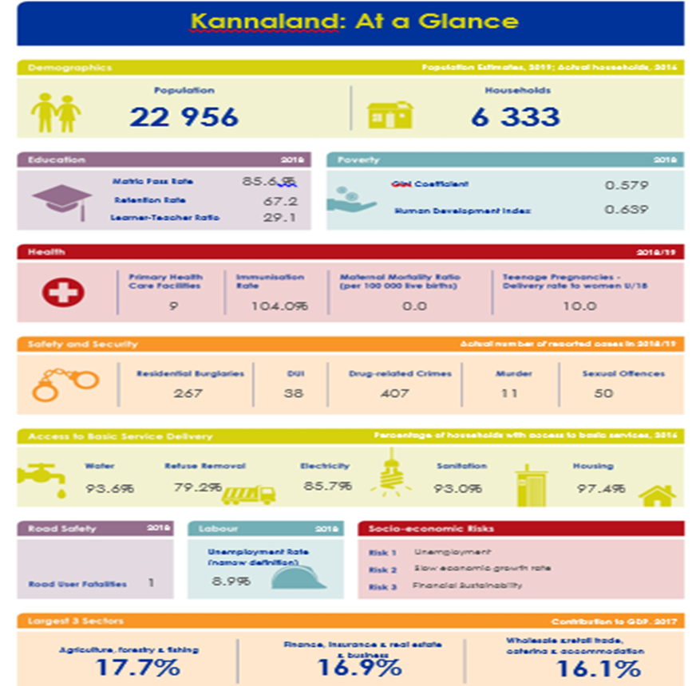
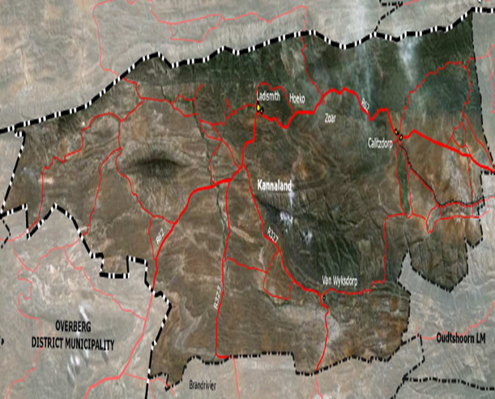
Introduction: Kannaland at a glance
Consist of four wards, namely:
Ladismith, Nissenville, Zoar and Calitzdorp
ings

Slide 4
Introduction: Economic realities
The value of the Kannaland economy was R1.2 billion (current value) in 2017.
In 2018 economic growth rate has slumped to 1.1 per cent (in real terms) from 3.1 per cent in 2017.
In terms of employment, there were 10 023 jobs in Kannaland in 2017.
The municipal area’s economy is primarily driven by the agriculture, which accounts for 17.7 per cent of total GDPR.
The Covid-19 pandemic, resulted in a further decline in the employment rate of Kannaland.
Inspiring Innovative Competence
ings

Slide 5
Outline of the Municipal Audit Outcome for the period 2018, 2019 and 2020 (Implementation of the Post Audit Action Plan)
Audit outcomes for the past three years have improved;
2016/17 – Qualified with findings.
Municipality resolved to apply for Section 139 of the MFMA 2 December 2018.
2017/18 – Unqualified with findings.
2018/19 – Unqualified Audit with findings.
As at 25 August 2020, 50 out of 76 audit findings were resolved.
Some of these findings will be resolved with the compilation of the 2019/20 Annual Financial Statements.
An audit action plan to resolve the outstanding findings is attached as a separate annexure.
2019/20 – To be audited in November 2020 due to the deadline extension.
Inspiring Innovative Competence
ings

Slide 6
State of Finances: Breakdown of Covid-19 expenditure
Covid-19 Funding & Expenditure | ZAR
Grant funding | Amount
Western Cape Government (Food relief) | 450 000.00
National Government (Disaster relief) | 298 000.00
Total Grant funding | 748 000.00
Expenditure | Amount
Personal protective clothing | 258 651.54
Food relief | 450 000.00
PPE & related | 808 441.49
Total expenditure | 1 517 093.02
Shortfall | -769 093.02
Inspiring Innovative Competence
ings

Slide 7
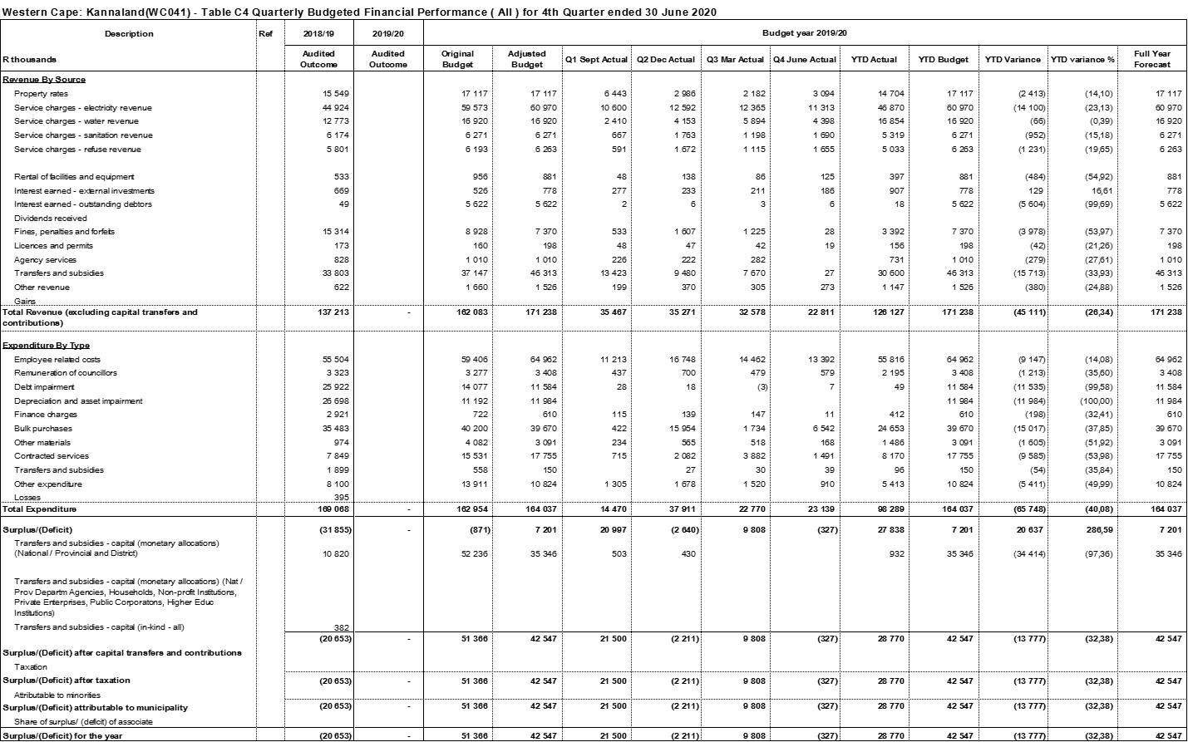
State of Finances: Operational performance

Slide 8
State of Finances: Operational performance
Revenue
We have experienced a significant revenue loss under the national lockdown.
The previous slide demonstrates a ±29.90% revenue decrease of between the third and forth quarter.
Debt Collection for the period was 76.36%.
There was also a further increase on Outstanding Debtors due to non-payment by consumers during this period.
The municipality expects an increase on the Debt Impairment due to job losses experienced due to the pandemic.
Expenditure
The pandemic resulted to a significant decrease in expenditure particularly the contracted services.
This has negatively affected the delivery of services.
The municipality reprioritised these savings into COVID-19 related expenses such as Personal Protective Clothing (PPE).
Inspiring Innovative Competence
ings

Slide 9
State of Finances: Breakdown of unauthorised, irregular, fruitless and wasteful expenditure
Unauthorised, irregular, fruitless and wasteful expenditure | 2019 ZAR | 2018 ZAR
Unauthorised expenditure | 4 123 020 | 91 726 429
Irregular expenditure | 12 447 097 | 130 053 803
Fruitless & wasteful expenditure | 1 570 519 | 5 846 348
Inspiring Innovative Competence
ings

Slide 10
State of Finances: Consequence management
Unauthorized Expenditure – Occurred due to incorrect budgeting which resulted on overspending.
Remedial Action
Effective monitoring of budget spending has resulted into the significant decrease from R91.7 million to just R4 million. Measures are being implemented to ensure that there is no unauthorized expenditure.
Irregular Expenditure – Occurred due to a lack of proper controls which will ensure that every expense is compliant with the Municipal Finance Management Act and Regulations.
Remedial Action
Appointment of skilled personnel, financial control and processes to ensure that all financial transactions are in line with the relevant act and regulations.
Fruitless & Wasteful Expenditure – Occurred due to our financial constraints. This amount is as a result of penalties/interest charged to us by our creditors as we could not meet our financial obligations.
Remedial Action
Preparation of payment plan (30 Sept 2020) and negotiating it with our creditors.
Where corrupt activities have been suspected, we have reported those cases to the law enforcement agencies and their investigations are underway.
Inspiring Innovative Competence
ings

Slide 11
Institutional capacity
The posts of Municipal Manager, Chief Financial Officer and Director: Technical Services are filled.
Inspiring Innovative Competence
ings

Slide 12
Internal Audit
Concluded shared services MOA with Garden Route DM for ICT, Internal Audit and Risk Management services;
Risk based IA plan developed; and
Internal controls are being restored.
Inspiring Innovative Competence
ings

Slide 13
Financial Recovery Plan
The Municipality voluntarily requested to be placed under Administration, and the Provincial Executive resolved accordingly,
A Final Recovery Plan was developed as part of a Section 154 Support Package. – to introduce a holistic support strategy to Kannaland
The FRP allowed access to support from National and Provincial Departments and other stakeholders forming part of the support package
To support the implementation of the FRP, a dedicated Administrator was appointed, for this exclusive purpose. – Council remains functional.
The Administrator functions independently, but also takes responsibility for the Financial Governance, as part of the Comprehensive Support Package
Inspiring Innovative Competence
ings

Slide 14
FRP: Status quo/ Reality check
Project progress with FRP stands at 97%;
This progress are not necessary equal in terms of the institutional maturity and financial sustainability of the municipality;
The FRP also does not in every respect comply with section 142 of the MFMA and must be statutorily aligned to set firm financial targets and enhance the financial recovery process (this is currently in progress);
Definite and measurable targets must be set to positively affect the organisational capacity and institutional knowledge;
Although projects are result orientated, results are not necessarily immediate; and
Projects are defined under 7 key performance areas for project and performance management purposes.
Inspiring Innovative Competence
ings

Slide 15
FRP: Key performance areas
The seven key performance areas identified are the following:
Institutional Stability
Good Governance
Financial Sustainability
Basic Service Delivery & Infrastructure
Economic Development
Planning
Risk Management and Internal Audit
Inspiring Innovative Competence
ings

Slide 16
FRP: KPA 1: Institutional Stability
Organisational review
Organisational structure reviewed and adopted
Organisational placement is in progress\
Critical posts identified
Job descriptions redrafted
Human Resources
Review contract appointment and terminations
HR policies reviewed and redrafted
Leave audit
Outstanding disciplinary matters have been finalized and ddiscipline is applied throughout the organisation
Appointment of acting and permanent senior managers have been concluded
Inspiring Innovative Competence
ings

Slide 17
FRP: KPA 1: Institutional Stability
Culture of meetings reintroduced
Senior Management meetings held
LLF meetings held
Workplace stabilised between employer and employee
Political stability between councillors
Corporate identity and new logo adopted and established
Inspiring Innovative Competence
ings

Slide 18
FRP: KPA 2: Good governance
Second unqualified audit opinion
Development and review of plans & policies
Storm Water and roads Master Plans
Electricity Master Plans
Infrastructure Growth Plans
Repair and maintenance Framework
Human Settlements Plan
Updated Municipal Code comprising of all its By-Laws
Water and Sanitation By-law (Review, amendment and cost in terms of publication)
Informal Trading By-law (Review and amendment of By-law)
Pounds By-law (Development of By-law)
Review of Delegations
Training for Councilors on Code of Conduct and MPAC
Inspiring Innovative Competence
ings

Slide 19
FRP: KPA 2: Good governance
Public Participation
Development and monitoring of Citizen/ Client Service Charters
Ward Committee Functionality: Training, Know Your Ward Committee Campaigns
Development and review of Ward Committee Operational Plans
Development and review of Public Participation and Ward Committee Policies
Design a new municipal corporate Identity
Inspiring Innovative Competence
ings

Slide 20
FRP: KPA 3: Financial sustainability
mSCOA implementation are on track
Financial Management and Accounting training are on track
Cost containment and revenue enhancement measures are being implemented
Reconciliation of bulk and reticulation of trading services are now being done
Creditors Payment Settlement Plan will be reviewed as soon as the creditors list as a sub part of the AFS has been finalised.
A general Valuation will be launched on 25 November 2020.
Inspiring Innovative Competence
ings

Slide 21
FRP: KPA 4: Basic service delivery & Infrastructure
Water security for Kannaland.
A newly designed Water Tariff Structure as well as unique Drought Tariff structure, specific for each town, introduced for 2020/21 year.
Progress made to provide Ladismith (High Risk) with water security in terms of the following additional interventions:
5 New exploration boreholes drilled by 30 June 2020
Borehole T1 equipped and connected into the water supply network
Planning completed for deep borehole drilling into TMG aquiver
Obtained summary report from Geo-Hydrologist to guide a clear way forward for further drilling and doing the WULA for the whole wellfield
Replaced existing borehole water meters with non-intrusive meters for more accurate recording
Filter drain under river bed partly opened and quotation obtained to rehabilitate further
Inspiring Innovative Competence
ings

Slide 22
FRP: KPA 4: Basic service delivery & Infrastructure
Water Conservation and Demand Management:
Replaced the faulty bulk water meter measuring all bulk water into Ladismith town with a new bulk meter and a logger in June 2020 and started recording hourly water into the network.
Planned the installation of zonal meters and loggers to detect any water leakages
A recent water balancing report shows great improvement in UAW within acceptable industry norms
Waste disposal
Refuse is removed on a daily basis as per Municipal Schedule
Landfill site is maintained on a daily basis and refuse is covered.
Inspiring Innovative Competence
ings

Slide 23
FRP: KPA 5: Economic development
Established a Forum with the Agricultural and Business sector to improve basic service delivery;
Liaising with Tourism sector regarding the Kannaland brand marketing and assistance to tourism organisations; and
Planning an economic indaba.
Inspiring Innovative Competence
ings

Slide 24
FRP: KPA 6: Planning
Spatial Development Framework in process of completion.
Inspiring Innovative Competence
ings

Slide 25
FRP: KPA 7: Internal Audit & Risk Management
Concluded shared services MOA with Garden Route DM for ICT, Internal Audit and Risk Management services;
Risk based IA plan developed; and
Internal controls are being restored.
Inspiring Innovative Competence
ings

Slide 26
FRP: The way forward
Good governance and institutional capacity are improving drastically due to fundamental principles of these KPA’s being put in place.
Financial reporting and accountability have improved, and the Municipality is making steady progress in implementing mSCOA and institutionalising basic measures influencing future financial sustainability.
Service delivery and accountability therefore is improving constantly; and
The Municipality has attained political and administrative stability through these actions of the FRP that creates a platform for a stable future.
The FRP is in a process of revision and will be amended into a practical tool through which financial improvement will be measurable and tracked and institutional capacity will be developed through mentored engagements.
Inspiring Innovative Competence
ings

Slide 27
Thank you & Questions
Inspiring Innovative Competence
ings

