Slide 1
OH&S at Tygerberg Hospital during the
COVID pandemic

Slide 2
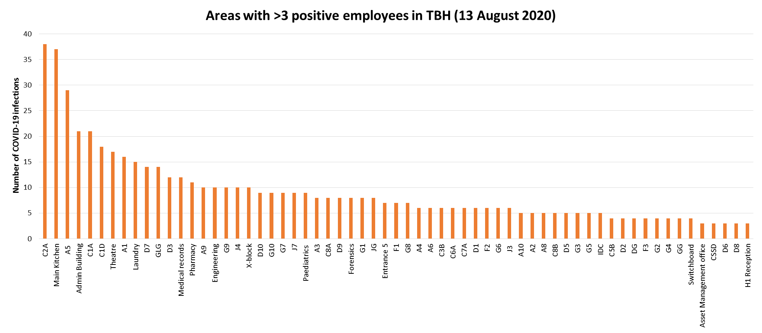
Most affected areas

Slide 3
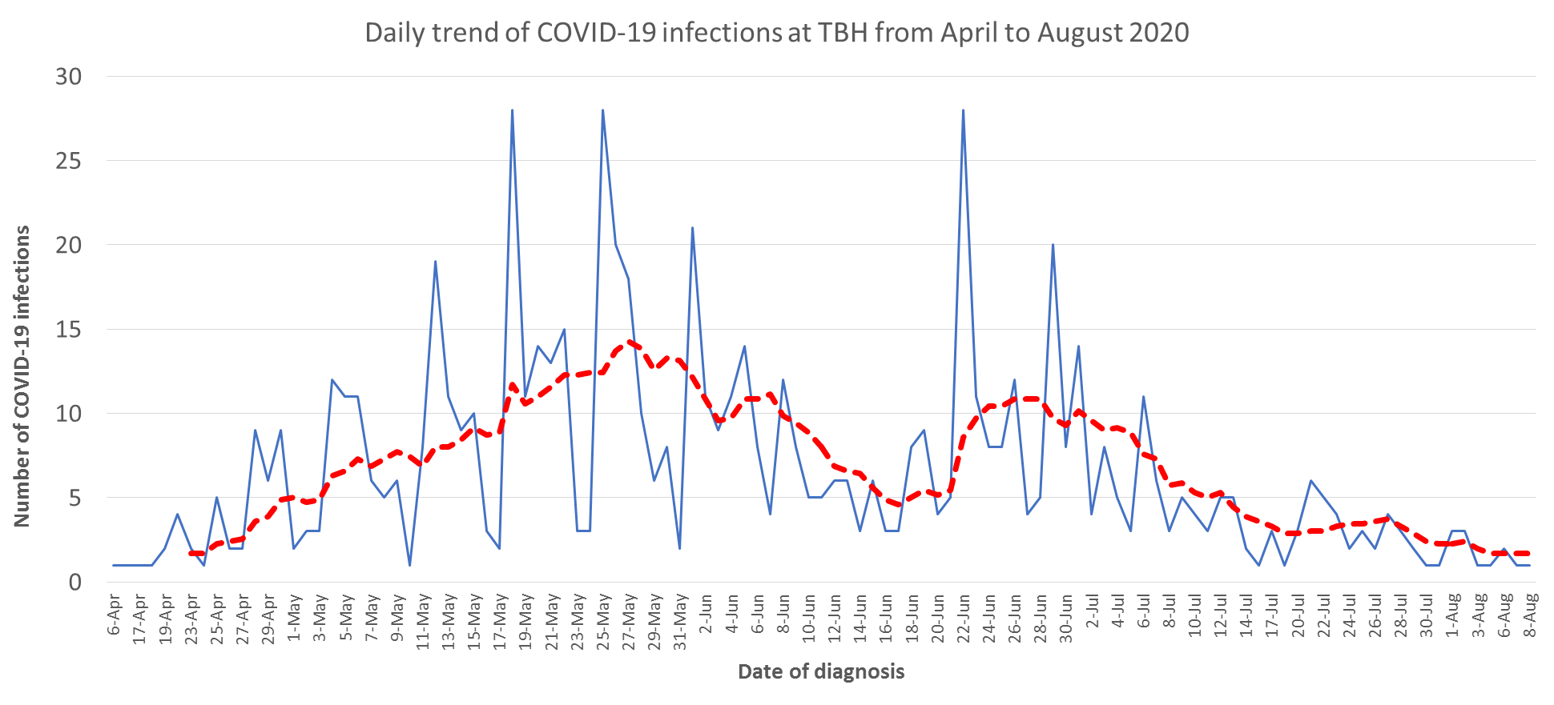
Daily trends COVID-19 infections at TBH (13 August 2020; n=743)

Slide 4
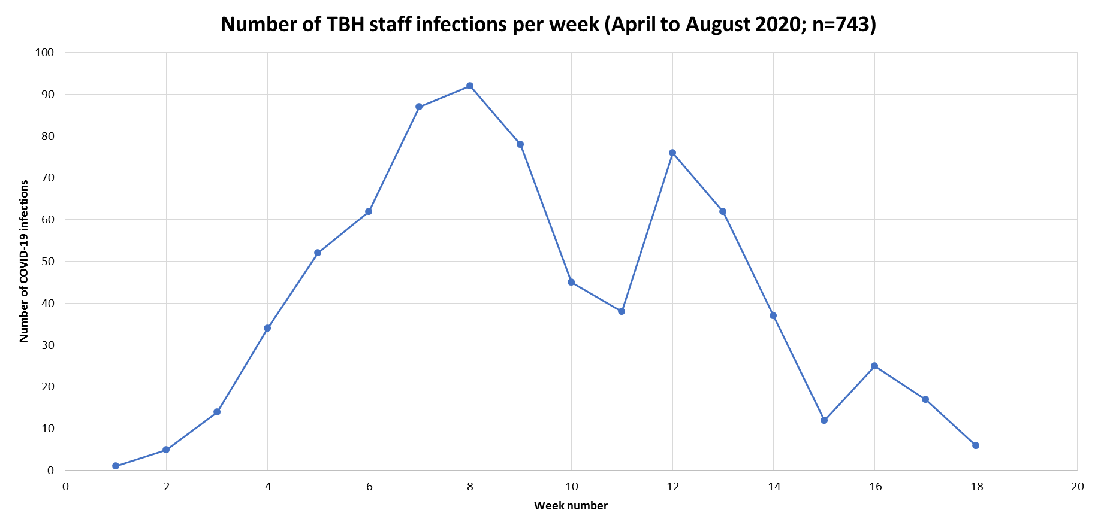

Slide 5
COVID-19 OHS & IPC policy & strategy for the hospital

Slide 6
Structure/ steps
Risk assessments
  Personal
  Workplace areas
Risk mitigation
Medical surveillance
Case management
  Exposure
  Symptomatic (unknown)
  Confirmed disease

Slide 7
Assessing Staff Exposure Risk and Staff Illness Risk (vulnerability)
Assess individual vulnerability (based on risk of serious disease/ death)
Assess working environment (likelihood of contact with COVID individuals)

Slide 8
OHS assessments done (17 Aug 2020)
Note: Assessments performed by all line managers – some cases referred to occupational health for ratification/ adjudication

Slide 9
Structure/ steps
Risk assessments
  Personal
  Workplace areas
Risk mitigation
Medical surveillance
Case management
  Exposure
  Symptomatic (unknown)
  Confirmed disease

Slide 10
Workplace assessments
Rapid (desk-top) assessment
  Performed by team of experts in view of the novelty of the risk (new virus)
Area risk assessments
  Following a Dept of Employment & Labour inspection

Slide 11
Rapid desk-top risk assessment

Slide 13
Workplace area assessments
Review all tasks performed
Assess risk of exposure associated with the tasks
Determine control measures required
Example: UIPC

Slide 15
Structure/ steps
Risk assessments
  Personal
  Workplace areas
Risk mitigation
Medical surveillance
Case management
  Exposure
  Symptomatic (unknown)
  Confirmed disease

Slide 16
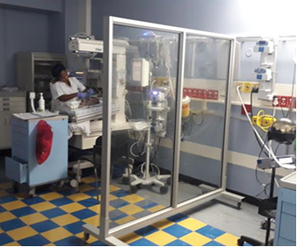
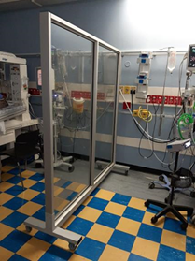
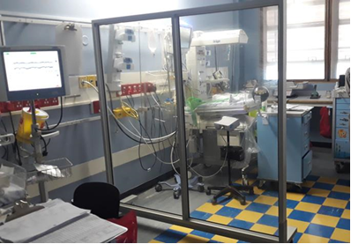

Engineering controls

Slide 17
Personal Protective Equipment

Slide 18
Structure/ steps
Risk assessments
  Personal
  Workplace areas
Risk mitigation
Medical surveillance
Case management
  Exposure
  Symptomatic (unknown)
  Confirmed disease

Slide 19
Buddy-screening system

Slide 20
Structure/ steps
Risk assessments
  Personal
  Workplace areas
Risk mitigation
Medical surveillance
Case management
  Exposure
  Symptomatic (unknown)
  Confirmed disease

Slide 21
Dealing with symptomatic staff, staff exposure and exposure risk evaluation

Slide 23
Completion of COIDA documentation (17 Aug 2020)
684 of 803 positive employees (85.2%)
(100% of those who have returned to work)
Still need to be completed for those who are currently booked off sick
Still require documentation for some who passed away (engaging with family members)

Slide 24
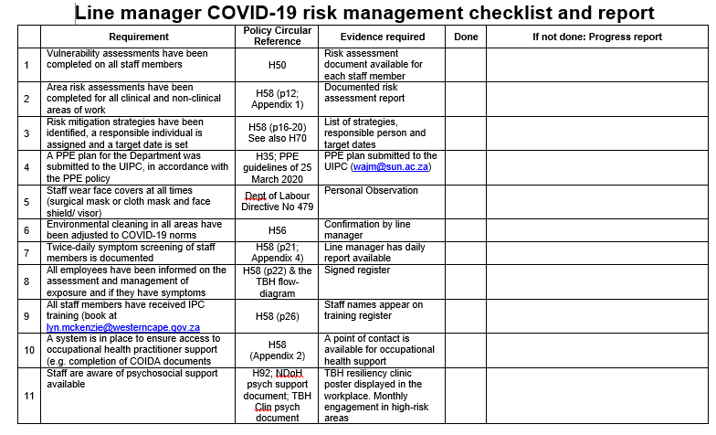
Bringing it all together:

