Slide 1
SOUTH AFRICAN WEATHER SERVICE
2020/21
FIRST QUARTER PERFORMANCE REPORT
“South African Weather-related Solutions for everyone, everyday”
Mr Mnikeli Ndabambi
Acting Chief Executive Officer

Slide 2
OVERALL SUMMARY OF FIRST QUARTER PERFORMANCE
Programmes | Number of targets | Achieved (100%) | Partially Achieved (50-99%) | Not Achieved (0-49%)
Programme 1: Weather and Climate Services | 4 | 4 | - | -
Programme 2: Research and Innovation | 3 | 3 | - | -
Programme 3: Infrastructure and Information Systems | 7 | 5 | 2 | -
Programme 4: Administration (Incl. Corporate and Regulatory Services) | 5 | 3 | - | 1
Total | 19 | 15 | 3 | 1
Percentage |  | 78.95% | 15.79% | 5.26%

Slide 3
OVERALL SUMMARY OF FIRST QUARTER PERFORMANCE
% On target | % Work in progress | % Off target | % No milestone
79% (15/19) | 16% (3/19) | 5% (1/19) | 13,6% (3/22)
NB: % On Target + % Work in Progress + % Off Target = 100%
% No Milestone excluded as no progress is measured against no milestone targets.

Slide 4
PROGRAMME 1:
WEATHER AND CLIMATE SERVICES

Slide 5
PROGRAMME 1: WEATHER AND CLIMATE SERVICES
Outcome: Lives and property protected against meteorological-related risks
Output : Meteorological related solutions provided to meet user needs
2020/21 Annual Target | 1st Quarter Target 2020/21 | Programme Annual Progress and Analysis | Revised Target or Comments on ongoing challenges
98% FPZA41 availability | 98% FPZA41 availability | Achieved 99% FPZA41 available | N/A
98% Aerodrome warnings accuracy | 98% Aerodrome warnings accuracy | Achieved 99% Aerodrome warnings accuracy | N/A
90% TAF accuracy | 90% TAF accuracy | Achieved 95% TAF accuracy | N/A
95% SOLAS availability | 95% SOLAS availability | Achieved 97% SOLAS availability | N/A
= On target
= work in progress
= Off target
= No milestone

Slide 6
OVERALL SUMMARY OF PROGRAMME 1 PERFORMANCE
% On target | % Work in progress | % Off target | % No milestone
100% (4/4) | 0% (0/4) | 0% (0/4) | 0% (0/4)

Slide 7
PROGRAMME 2:
RESEARCH AND INNOVATION

Slide 8
PROGRAMME 2: RESEARCH AND INNOVATION
Outcome: Lives and property protected against meteorological-related risks
Output: Enhanced meteorological related body of knowledge
2020/21 Annual Target | 1st Quarter Target 2020/21 | Programme Annual Progress and Analysis | Revised Target or Comments on ongoing challenges
47 Research outputs | 7 Research outputs | Achieved 11 Research outputs (9 x Journal Articles, 2 x Conference papers) | 30 Research outputs
1 new climate solution | Needs Analysis completed | Achieved Needs Analysis completed Proposed solution is: Regional Weather and Climate of South Africa: Gauteng | N/A
6 Solutions developed | Needs Analysis completed | Achieved Needs Analysis completed | N/A
= On target
= work in progress
= Off target
= No milestone

Slide 9
OVERALL SUMMARY OF PROGRAMME 2 PERFORMANCE
% On target | % Work in progress | % Off target | % No milestone
100% (3/3) | 0% (0/3) | 0% (0/3) | 0% (0/3)

Slide 10
PROGRAMME 3:
INFRASTRUCTURE AND INFORMATION SYSTEMS

Slide 11
PROGRAMME 3: INFRASTRUCTURE AND INFORMATION SYSTEMS
Outcome: Lives and property protected against meteorological-related risks
Output: Optimal core technological capability
2020/21 Annual Target | 1st Quarter Target 2020/21 | Programme Annual Progress and Analysis | Revised Target or Comments on ongoing challenges
85% AWS and ARS availability | 85% AWS and ARS availability | Achieved 85% AWS and ARS availability | N/A
90% GAW infrastructure availability | 90% GAW infrastructure availability | Partially Achieved 76% GAW infrastructure availability (68.4% + 80.5%) ÷ 2 = 74.45% Challenges: National Lockdown due to COVID-19 impacted on access to laboratory infrastructure. Corrective measures: Procurement of required gasses for measurements, Backup power acquisition and GAW Business Case implementation | 85% GAW infrastructure availability
85% Radar infrastructure availability | 85% Radar infrastructure availability | Achieved 85% Radar infrastructure availability | N/A
= On target
= work in progress
= Off target
= No milestone

Slide 12
PROGRAMME 3: INFRASTRUCTURE AND INFORMATION SYSTEMS
Outcome: Lives and property protected against meteorological-related risks
Output: Optimal core technological capability
2020/21 Annual Target | 1st Quarter Target 2020/21 | Programme Annual Progress and Analysis | Revised Target or Comments on ongoing challenges
90% LDN infrastructure availability | 90% LDN infrastructure availability | Achieved 93% LDN infrastructure availability | N/A
95% SAAQIS availability | 95% SAAQIS availability | Achieved 99% SAAQIS availability | N/A
85% priority areas air quality stations available on SAAQIS meeting minimum data requirements | 85% priority areas air quality stations available on SAAQIS meeting minimum data requirements | Partially achieved 56% Priority Areas Air Quality meeting minimum data requirements Challenges: Faulty instruments, intermittent power failures and vandalism. Corrective measures: Network recapitalization process ongoing. New PM instruments delivered and installed in the HPA. Installation for the VPA will take place during August 2020. | 75% priority areas air quality stations available on SAAQIS meeting minimum data requirements
82% climate data available on National Climate Database meeting minimum data requirements (AWS & ARS | 82% climate data available on National Climate Database meeting minimum data requirements (AWS & ARS | Achieved 94% climate data available on National Climate Database meeting minimum data requirements | N/A
= On target
= work in progress
= Off target
= No milestone

Slide 13
OVERALL SUMMARY OF PROGRAMME 3 PERFORMANCE
% On target | % Work in progress | % Off target | % No milestone
71% (5/7) | 29% (2/7) | 0% (0/7) | 0% (0/7)
NB: % On Target + % Work in Progress + % Off Target = 100%
% No Milestone excluded as no progress is measured against no milestone targets.

Slide 14
PROGRAMME 4:
ADMINISTRATION (INCLUDING CORPORATE AND REGULATORY SERVICES)

Slide 15
PROGRAMME 4: ADMINISTRATION (INCLUDING CORPORATE AND REGULATORY SERVICES)
Outcome: Organisational Sustainability
Output: Internal excellence achieved within the organisation
2020/21 Annual Target | 1st Quarter Target 2020/21 | Programme Annual Progress and Analysis | Revised Target or Comments on ongoing challenges
1.5 liquidity ratio | 1.5 liquidity ratio | Not Achieved 0.49 current ratio for liquidity Challenges: Target not met due to declining debtors’ book as a result of increased provision for doubtful debts and lower revenue sales Corrective measures: 2020/21 Target revision for current ratio for liquidity in response to challenges brought by COVID-19. | 0.6 liquidity ratio
65% local expenditure on affirmative procurement | 65% local expenditure on affirmative procurement | Achieved 93% local expenditure on affirmative procurement | N/A
BBBEE Level 7 achieved | N/A | No milestone | Level 6 BBBEE
R39.18 mil commercial revenue (unregulated) | R6 mil Commercial Revenue | Partially achieved R4.84 mil Commercial Revenue Challenges: Commercial Partners’ revenue below budget, and other sales of products and services negatively impacted by COVID-19. Corrective measures: 2020/21 Target revision for Non-Regulated Commercial Revenue in response to challenges brought by COVID-19. | R19.1 mil commercial revenue (unregulated)
= On target
= work in progress
= Off target
= No milestone

Slide 16
PROGRAMME 4: ADMINISTRATION (INCLUDING CORPORATE AND REGULATORY SERVICES)
Outcome: Organisational Sustainability
Output: Internal excellence achieved within the organisation
2020/21 Annual Target | 1st Quarter Target 2020/21 | Programme Annual Progress and Analysis | Revised Target or Comments on ongoing challenges
Unqualified audit opinion achieved | N/A | No milestones | N/A
≤8% attrition rate | ≤8% attrition rate | Achieved 1% attrition rate required | N/A
95% WSP targets met | Develop WSP and submit to TETA | Achieved The Workplace Skills Plan and Annual Training Report (ATR) finalized and submitted to TETA . | 75% WSP targets met
85% stakeholder perception rating | N/A | No milestone | Removed annual target from 2020/21 APP
= On target
= work in progress
= Off target
= No milestone

Slide 17
OVERALL SUMMARY OF PROGRAMME 4 PERFORMANCE
% On target | % Work in progress | % Off target | % No milestone
60% (3/5) | 20% (1/5) | 20% (1/5) | 0% (3/8)
NB: % On Target + % Work in Progress + % Off Target = 100%
% No Milestone excluded as no progress is measured against no milestone targets.

Slide 18
QUARTER 1 FINANCIAL REPORT

Slide 19
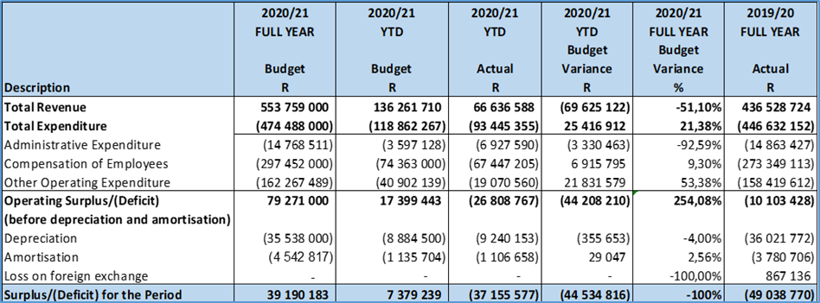
FINANCIAL REPORT
SUMMARY OF THE STATEMENT OF FINANCIAL PERFORMANCE

Slide 20
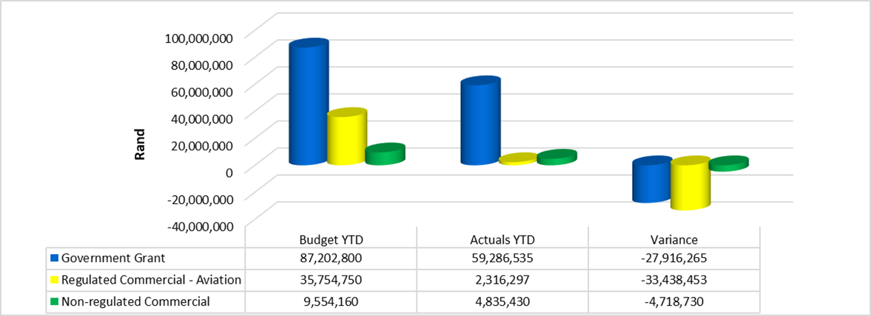
SUMMARY OF REVENUE

Slide 21
SUMMARY OF REVENUE
The Total Actual Revenue for the period ending 30 June 2020 was R66,64m against the budget of R136,26m resulting in a negative variance of R69,63m for the period.
The Government Grant comprises of:
R47,34m Operational Grant; and
R 4,70m South African Air Quality Information System (SAAQIS) Grant
Capital Expenditure Grants of R7,24m was recognized in the Statement of Financial Performance as conditions were fulfilled. The Capital Expenditure Grant relates to requisitions issued towards the end of the 2019/20 Financial Year.
The Total Commercial Revenue which is made up of Aviation (Regulated) Revenue and Non-Regulated Revenue is as follows;
Regulated Commercial - Aviation Revenue for the First Quarter of the Financial Year is 94% below the budget of R35,75m by R33,43m (Actual: R2,3m). This was mainly due to the lockdown in the aviation industry caused by the COVID-19; and
Non-regulated Commercial Revenue for the First quarter amounts to R4,8m, which is 49% below the budget of R9,5m.

Slide 22
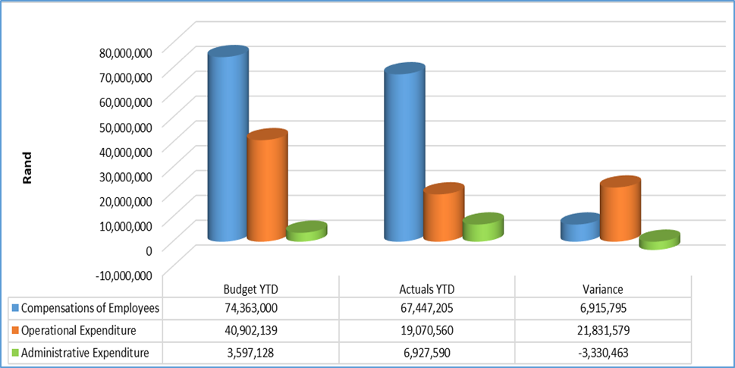
SUMMARY OF EXPENDITURE

Slide 23
SUMMARY OF EXPENDITURE
The Total year to date (excluding Depreciation and Amortization) amounts to R93,45m which is 21.38% below the budget of R118,86m.
The Administrative Expenditure for the First Quarter of the Financial Year amounts to R6,93m which is above the budget of R3,6m by 92.59% with major over-spending attributed to the following;
Bad debts provision of R5,2m due to long outstanding debtors. The majority of this provision emanates from clients within the aviation sector.
The over-expenditure of R100k on Internal Auditing is a timing difference between the budget allocation and the work performed by Internal Audit during the First Quarter of the current financial year.
The Compensation of Employees is below the budget of R74,36m by 9.3% (Actual: R67,45m). There are a number of vacant positions especially at Senior Management Level including that of the Chief Executive Officer, Chief Financial Officer which are yet to be filled.
The Operating Expenditure is 53.38% (R21,83m) below budget of R40,9m (Actual: R19,07m). The only area of concern on over-spending under Operating Expenses is Communication Costs which exceeded the budget by R553k due to Data Costs which increased significantly between April and May 2020 as a result of more employees working from home.

Slide 24
End Thank you!

