Slide 1
SANPARKS 4TH QUARTER REPORT Presentation to the Portfolio Committee on Forestry Fisheries and Environment Presented by Mr. Fundisile Mketeni 26 August 2020
SOUTH AFRICAN NATIONAL PARKS

Slide 2
Presentation outline
Vision and Mission
Performance against Strategic Objectives
Financial Performance

Slide 3
SANParks vision & mission
VISION
A world class system of sustainable national parks reconnecting and inspiring society
1
MISSION
Develop, protect, expand, manage and promote a system of sustainable national parks that represents biodiversity and heritage assets, through innovation and best practice for the just and equitable benefit of current and future generations.
2

Slide 4
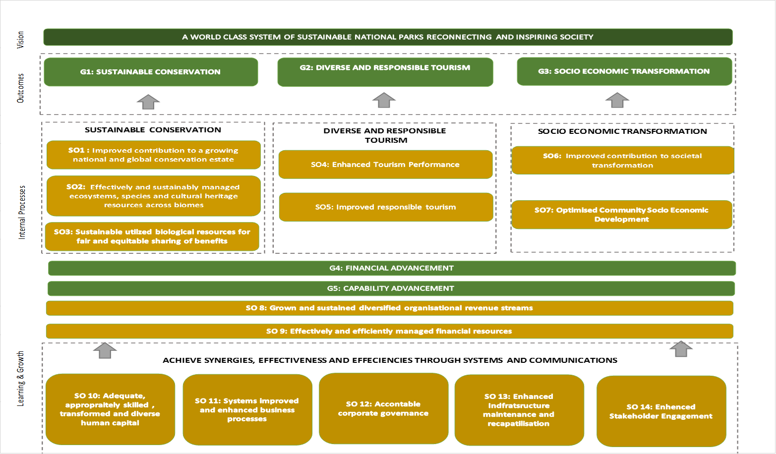
SANPARKS STRATEGIC MAP

Slide 5
GOAL1: SUSTAINABLE CONSERVATION
STRATEGIC OBJECTIVE 1: IMPROVED CONTRIBUTION TO A GROWING NATIONAL AND GLOBAL CONSERVATION ESTATE
Performance indicator | Annual target 2019/20 | Programme Annual Progress and Analysis
Total area acquired for inclusion in the National Parks in accordance with the Land Inclusion plan in support of national and global expansion targets | ≥ 136 300 ha | 138 344ha of land included into national parks
% Implementation of planned activities undertaken for the three new Marine Protected Areas (MPAs) managed by SANParks | 95% implementation of planned activities undertaken for the three new MPAs managed by SANParks | 95% implementation of planned activities undertaken for the three new MPAs managed by SANParks Three new Marine Protected Areas (MPA’s), namely, Addo Elephant National Park MPA, Namaqua National Park MPA and Robben Island MPA, were declared during the financial year, adding 229 519 ha to the conservation estate.
SANParks contribution to TFCAs assessed | Draft consolidated report on the assessment of SANParks contribution to TFCA compiled | The draft consolidated report on reviewed TFCA agreements was completed.
= On target
= work in progress
= Off target
= No
milestone

Slide 6
GOAL1: SUSTAINABLE CONSERVATION
STRATEGIC OBJECTIVE 2: EFFECTIVELY AND SUSTAINABILITY MANAGED ECOSYTEMS, SPECIES AND CULTURAL HERITAGE RESOURCES ACROSS BIOMES
Performance indicator | Annual target 2019/20 | Programme Annual Progress and Analysis
Tracking park management effectiveness through the number of national parks achieving a METT score of ≥ 67% and progress against identified corrective actions | % progress against identified corrective actions 80% of park achieving a METT score of > 67% | A total of 19 parks completed an online METT assessment - 3 assessments were done during quarter 4 of 2019/20. 18 of the 19 parks achieved a score of 71%, i.e. 94.7% of parks scored ≥ 67%
Percentage reduction of fossil fuel generated energy consumption in Parks and Kruger | Readiness audit for 4 identified parks Prepare baseline determination for 4 parks 2% reduction for 3 parks | Readiness audit was initiated in the following 4 parks: Namaqua, Table Mountain, Camdeboo and Knysna NP’s. Progress against baseline determination was achieved for the following Parks: Agulhas, Bontebok, West Coast and Karoo NP’s. Baseline consumption was completed for the above Parks. Parks identified for consumption Measurements: Augrabies, Kgalagadi, Mokala NP, Addo Elephant, Mountain Zebra, Golden Gate, Mapungubwe & Marakele The average usage recorded over a seven to eight- month period shows a reduction of 10% from the baseline. (Averaged across these eight parks)
= On target
= work in progress
= Off target
= No
milestone

Slide 7
GOAL1: SUSTAINABLE CONSERVATION
STRATEGIC OBJECTIVE 2: EFFECTIVELY AND SUSTAINABILITY MANAGED ECOSYTEMS, SPECIES AND CULTURAL HERITAGE RESOURCES ACROSS BIOMES
Performance indicator | Annual target 2019/20 | Programme Annual Progress and Analysis
Percentage reduction of fossil fuel generated energy consumption in Parks and Kruger | 2% reduction of fossil fuel consumption year on year for KNP. | There was a 2.14% reduction of fossil fuel year on year
Percentage reduction of water consumption in Parks and Kruger | Identify four parks for readiness audit. Progress against Baseline determination for four parks. 2% reduction for 3 parks | Readiness audit was initiated for: Tankwa, West Coast, Mokala & Knysna NP’s. Progress against Baseline Determination was not measured. The average decrease was recorded for Agulhas -24%, Wilderness -7% and Bontebok -41%.This provides an average decrease in water consumption across these three parks -24%. Challenges: Baseline determination was not concluded as the water meters were not installed. Corrective Actions MyCity electronic meter devices and water meters for Glen Reenen and Golden Gate Hotel have been installed during April 2020. Procurement of other meter readings is underway.
= On target
= work in progress
= Off target
= No
milestone

Slide 8
GOAL1: SUSTAINABLE CONSERVATION
STRATEGIC OBJECTIVE 2: EFFECTIVELY AND SUSTAINABILITY MANAGED ECOSYTEMS, SPECIES AND CULTURAL HERITAGE RESOURCES ACROSS BIOMES
Performance indicator | Annual target 2019/20 | Programme Annual Progress and Analysis
Percentage reduction of water consumption in Parks and Kruger | 2% reduction of water consumption year on year for KNP. | There was a 0.1%. reduction of water consumption year on year for Kruger Challenges: A high number of pipe bursts on the main water supply line at Pretoriuskop. Lack in adequate awareness amongst our guests and staff. Corrective actions The water tariffs must be reviewed. The irrigation hours need to be reduced. The provision of raw water for irrigation purposes in camps and ranger post must be implemented to phase out irrigating with fresh water. Old reticulation infrastructure in camps require replacement
= On target
= work in progress
= Off target
= No
milestone

Slide 9
GOAL1: SUSTAINABLE CONSERVATION
STRATEGIC OBJECTIVE 2: EFFECTIVELY AND SUSTAINABILITY MANAGED ECOSYTEMS, SPECIES AND CULTURAL HERITAGE RESOURCES ACROSS BIOMES
Performance indicator | Annual target 2019/20 | Programme Annual Progress and Analysis
Total hectares of land rehabilitated/ restored | 26 424ha | 31,875 ha of land was rehabilitated The absorption of the Working for the Coast teams in Working for Ecosystems until such time that the programme became active enabled more initial land rehabilitation. More initial clearing was done in KNP to address new populations of Parthenium after the high rainfall events towards the end of the year (11,000ha)
Total hectares of land rehabilitated/ restored | Follow- up : 186 969 ha | 197,655 ha of follow-up land was rehabilitated. In the Cape, GRNP and Frontier Regions planned work areas were affected by fire and unexpected high regrowth resulted in changes made from initial to follow-up clearing linked to address the regrowth after the fire. In order to close out the landowner agreements, the focus in the Integrated Zones of SANParks moved to follow-up rehabilitation. Some alien invasive vegetation clearing and land rehabilitation was done at a lower cost, by using the quotation system, allowing more hectares to be worked.
= On target
= work in progress
= Off target
= No
milestone

Slide 10
GOAL1: SUSTAINABLE CONSERVATION
STRATEGIC OBJECTIVE 2: EFFECTIVELY AND SUSTAINABILITY MANAGED ECOSYTEMS, SPECIES AND CULTURAL HERITAGE RESOURCES ACROSS BIOMES
Performance indicator | Annual target 2019/20 | Programme Annual Progress and Analysis
Total hectares of land rehabilitated/ restored | 6,015m³ | The overall cubic meter target was exceeded at 6,850m³ , caused by changing from harder to softer engineering options particularly in Kruger.
Percentage implementation of the Annual Rhinoceros Plan | 95% implementation of the Annual Rhinoceros plan | 88% (22/25) of planned activities were completed. Challenges Completion of the socio-ecological research study was delayed and the Kruger Rhino Strategy was not completed Corrective Actions Activities will be prioritized for implementation in the new financial year
= On target
= work in progress
= Off target
= No
milestone

Slide 11
GOAL1: SUSTAINABLE CONSERVATION
STRATEGIC OBJECTIVE 2: EFFECTIVELY AND SUSTAINABILITY MANAGED ECOSYTEMS, SPECIES AND CULTURAL HERITAGE RESOURCES ACROSS BIOMES
Performance indicator | Annual target 2019/20 | Programme Annual Progress and Analysis
Number of rhino fatalities due to poaching in KNP & 6 rhino parks | ≤ 500 | 303 rhinos were poached This is a significant reduction of 21.6% and 197 animals under the established target of 500 set for the fiscal year. This can be contributed to: The Rangers persistent commitment, successes, ever evolving tactics and resilience to overcome daunting odds; High value “key knock on” lower level arrests, including internal collaborators in all departments; The ECI commitment to arresting “high value” higher level syndicate targets outside the KNP; The evolution and effectiveness of K9 involvement, particularly the emerging successes of free running hounds applied in operations Challenges Relatively little known / or understanding of forces at play which may be impacting the national / international syndicates in terms of supply and demand;
= On target
= work in progress
= Off target
= No
milestone

Slide 12
GOAL1: SUSTAINABLE CONSERVATION
STRATEGIC OBJECTIVE 2: EFFECTIVELY AND SUSTAINABILITY MANAGED ECOSYTEMS, SPECIES AND CULTURAL HERITAGE RESOURCES ACROSS BIOMES
Performance indicator | Annual target 2019/20 | Programme Annual Progress and Analysis
Percentage implementation of the Annual Elephant Plan | 95% implementation of Annual Elephant Plan | 80.7% (21/26) activities scheduled for the year was implemented Challenges: The construction of the enclosures to protect sensitive riparian vegetation in Mapungubwe could not be completed due to lack of funding. Although a proposal to define the social expectations of stakeholders concerning elephants in the Garden Route was completed and registered, ethics requirements from the Nelson Mandela University imposed constraints on completion of the activity. Corrective Actions Mapungubwe National Park Management is applying for new funds from the EPWP programme. The Garden Route Science Node will complete the social survey as soon as approval of ethics are obtained.
= On target
= work in progress
= Off target
= No
milestone

Slide 13
GOAL1: SUSTAINABLE CONSERVATION
STRATEGIC OBJECTIVE 2: EFFECTIVELY AND SUSTAINABILITY MANAGED ECOSYTEMS, SPECIES AND CULTURAL HERITAGE RESOURCES ACROSS BIOMES
Performance indicator | Annual target 2019/20 | Programme Annual Progress and Analysis
% implementation of Cultural Heritage Plan | Cult. strategy developed 95 % activities implemented of the annual cultural heritage plan | The cultural strategy was developed 100% (25/25) planned annual activities were implemented
Improved Climate Change preparedness | Draft Climate change preparedness plan developed | The draft climate change preparedness plan was completed
% implementation of the Air wing Strategy | 90%implementation of the Airwing Strategy implemented | Only 35 % (7/20) air wing strategy was implemented Challenges: HCM processes and delays compounded by housing and budgetary constraints. Procurement and Supply Chain actions. Corrective Measures Appointment of replacement Rotor-wing pilot to fill vacancy Appoint suitable service providers on contract terms. Improved maintenance planning and forecasting Liaison with National Treasury to align procurement with the realities of unscheduled aircraft maintenance and high value assets
= On target
= work in progress
= Off target
= No
milestone

Slide 14
GOAL1: SUSTAINABLE CONSERVATION
STRATEGIC OBJECTIVE 2: EFFECTIVELY AND SUSTAINABILITY MANAGED ECOSYTEMS, SPECIES AND CULTURAL HERITAGE RESOURCES ACROSS BIOMES
Performance indicator | Annual target 2019/20 | Programme Annual Progress and Analysis
% implementation of activities in the annual research plan informed by the research strategy | Research strategy finalised and research plan developed | The research strategy was finalised and approved by EXCO and a research plan was developed.
STRATEGIC OBJECTIVE 3: SUSTAINABLY UTILIZED RESOURCES FOR FAIR AND EQUITABLE SHARING OF BENEFITS
% Implementation of the SANParks Wildlife Economy and Sustainable Use Programme | 95 % implementation of the Wildlife Economy and Sustainable Use Programme | 89% (17/19) activities were implemented. Challenges: Extensive consultation with the increased number of applications, delayed the determination of capturing costs and delivery of the animals delayed the submission to EXCO. Corrective measures: The project completed in Q 1 of the new financial year.
= On target
= work in progress
= Off target
= No
milestone

Slide 15
GOAL 2: DIVERSE AND RESPONSIBLE TOURISM
STRATEGIC OBJECTIVE 4: IMPROVED TOURISM PERFORMANCE
Performance indicator | Annual target 2019/20 | Programme Annual Progress and Analysis
Percentage growth in Tourism revenue year on year | 5.5% increase year on year | For the period under review total revenue from Tourism increased by 6.5% to R1.885-billion, from R1.769-billion achieved in the previous year. Challenges: Domestic economic and market conditions remain subdued with general declines evident in visitation and stayover in national parks. As a result of the COVID-19 global pandemic, SA was placed in lockdown with effect midnight 26-27 March 2020. In preparation national parks were vacated from 25 March 2020. Corrective actions Resumption of business as soon as possible and continued emphasis on marketing and promoting national parks to domestic and international markets, through innovative initiatives such as stokvel marketing, social media drives targeting non-traditional markets, etc.
= On target
= work in progress
= Off target
= No
milestone

Slide 16
GOAL 2: DIVERSE AND RESPONSIBLE TOURISM
STRATEGIC OBJECTIVE 4: IMPROVED TOURISM PERFORMANCE
Performance indicator | Annual target 2019/20 | Programme Annual Progress and Analysis
Total number of visitors to National Parks | 7 000 000 | A total of 6,326,448 people visited the National Parks Challenges: Domestic economic and market conditions remain subdued with general declines evident in visitation and stayover in national parks. As a result of the COVID-19 global pandemic, SA was placed in lockdown with effect midnight 26-27 March 2020. In preparation national parks were vacated from 25 March 2020. Corrective actions: Resumption of business as soon as possible and continued emphasis on marketing and promoting national parks to domestic and international markets, through innovative initiatives such as stokvel marketing, social media drives targeting non-traditional markets, etc.
= On target
= work in progress
= Off target
= No
milestone

Slide 17
GOAL 2: DIVERSE AND RESPONSIBLE TOURISM
STRATEGIC OBJECTIVE 4: IMPROVED TOURISM PERFORMANCE
Performance indicator | Annual target 2019/20 | Programme Annual Progress and Analysis
Accommodation occupancy | 73% | Accommodation Unit Occupancy 69.4% ( 3.6% points below target ) Challenges: Domestic economic and market conditions remain subdued with general declines evident in visitation and stayover in national parks. As a result of the COVID-19 global pandemic, SA was placed in lockdown with effect midnight 26-27 March 2020. In preparation national parks were vacated from 25 March 2020. Corrective Actions: Resumption of business as soon as possible and continued emphasis on marketing and promoting national parks to domestic and international markets, through innovative initiatives such as stokvel marketing, social media drives targeting non- traditional markets, etc.
Number of New and Diverse Revenue Generating Products Implemented | 14 | 14 new products were implemented
= On target
= work in progress
= Off target
= No
milestone

Slide 18
GOAL 2: DIVERSE AND RESPONSIBLE TOURISM
STRATEGIC OBJECTIVE 4: IMPROVED TOURISM PERFORMANCE
Performance indicator | Annual target 2019/20 | Programme Annual Progress and Analysis
Develop and implement Hospitality Improvement Plan | Hospitality Improvement plan – 2 interventions | Hospitality Improvement Plan developed: Two Interventions implemented: Grading Plan for 2020 was completed Appointment of a Service Provider for Hospitality Training
Total number of Visitor Management and Interpretation Plans reviewed and submitted | 3 visitor management plans and 3 interpretation plans | Three (3) Visitor Management Plans and Two Interpretation Plans reviewed and submitted
Customer satisfaction index | 82% | 80.4% Reservations 86.7%, Gate Access 86.4%, Overall Experience 84.3%, Activities 81.7%, Nature Experience 81.0%, Reception 80.5%, Dining 73.3%, Shopping 72.1% and Accommodation 71.8%.
= On target
= work in progress
= Off target
= No
milestone

Slide 19
GOAL 2: DIVERSE AND RESPONSIBLE TOURISM
STRATEGIC OBJECTIVE 5: IMPROVED RESPONSIBLE TOURISM
Performance indicator | Annual target 2019/20 | Programme Annual Progress and Analysis
Develop a Responsible Tourism Assessment Plan | Responsible Tourism Assessment Tool developed | The Responsible Tourism Assessment Tool was developed
= On target
= work in progress
= Off target
= No
milestone

Slide 20
GOAL 3: SOCIO ECONOMIC TRANSFORMATION
STRATEGIC OBJECTIVE 6: IMPROVED CONTRIBUTION TO SOCIETAL TRANSFORMATION
Performance indicator | Annual target 2019/20 | Programme Annual Progress and Analysis
Integrated Transformation Strategy developed and implemented | Draft Integrated Transformation Strategy Developed | The draft Integrated Transformation Strategy (ITS) was developed and signed off by the COO
% of a portfolio of opportunities for SMMEs Developed and Implemented | Portfolio of SMMEs developed and approved | A portfolio of SMMEs opportunities was developed and submitted to EXCO during November 2019 EXCO meeting. However EXCO referred the document to Product Prioritisation Committee for further work.
= On target
= work in progress
= Off target
= No
milestone

Slide 21
GOAL 3: SOCIO ECONOMIC TRANSFORMATION
STRATEGIC OBJECTIVE 6: IMPROVED CONTRIBUTION TO SOCIETAL TRANSFORMATION
Performance indicator | Annual target 2019/20 | Programme Annual Progress and Analysis
Number of Social Legacy projects implemented | 3 Social legacy projects implemented | Only one of three (1/3) social legacy project was completed and the two others are at different stages of completion. Provision of phase 2 of Makushu Primary School Ablution Facilities have been completed. Contractors are on site for construction of two science laboratories viz; Jacob Mdluli and the Bunny Khosa Science Laboratories. Challenges: The contracts were not awarded in time, due to internal capacity constraints Corrective measures: These will be completed in Q 2 of the new financial year
= On target
= work in progress
= Off target
= No
milestone

Slide 22
GOAL 3: SOCIO ECONOMIC TRANSFORMATION
STRATEGIC OBJECTIVE 6: IMPROVED CONTRIBUTION TO SOCIETAL TRANSFORMATION
Performance indicator | Annual target 2019/20 | Programme Annual Progress and Analysis
% Claimant beneficiation scheme developed and implemented as per land claims identified | Land Clams Beneficiation Scheme/s developed (Colchester land claim -Addo NP) 80 % of activities implemented as per plan | The land claims beneficiation package for Colchester Land Claimants was approved by EXCO and the Board for negotiation, facilitated by the Land Claims Commission in line with the prescripts of the Restitution of Land Rights Act of 1994. Challenges: Claimants Dispute over the Equitable Redress and Rights provided in the Settlement Award 79 % 19/ 24 outputs in the KNP Implementation Plan were implemented. PMU activities were put on halt until an independent facilitator has been appointed to further develop the beneficiation scheme. Corrective Measures: Facilitate the appointment of the in depended facilitator in Q1 of 2020/21 Financial year.
= On target
= work in progress
= Off target
= No
milestone

Slide 23
GOAL 3: SOCIO ECONOMIC TRANSFORMATION
STRATEGIC OBJECTIVE 6: IMPROVED CONTRIBUTION TO SOCIETAL TRANSFORMATION
Performance indicator | Annual target 2019/20 | Programme Annual Progress and Analysis
Number of Environmental Education programmes developed and implemented | 3 Environmental Education Programmes developed and implemented | 3 EE Programmes document were developed but not yet approved Climate Change Response Programme Higher Education Conservation Awareness & Education Support Programme & SANParks National Science Engagement Programme Challenges The EE plans are largely informed and dependent on the finalization of the Socio Economic Transformation Strategy , which is still being finalized. Corrective Actions SET Strategy to be completed in Q 2 of new financial year
Determination of baseline for Rand value of goods and services procured from local communities by SANParks | Baseline on % Rand value spent on local SMMEs determined | A baseline on percentage spent on local EME’s and QSE’s determined. R44, 162,208.22 has been spent on EME’s and QSE’s this year.
= On target
= work in progress
= Off target
= No
milestone

Slide 24
GOAL 3: SOCIO ECONOMIC TRANSFORMATION
S O 6: IMPROVED CONTRIBUTION TO SOCIETAL TRANSFORMATION
Performance indicator | Annual target 2019/20 | Programme Annual Progress and Analysis
Relevant skills training programme in support of community development programmes developed | Skills audit report approved | The skills audit report was approved
Total number of Free Access Entrants ( SANParks week) | 75 000 | There were 113 032 free access entrants during SANParks week (Q2) The target was exceeded as the SANParks week free access entry was extended to the weekend and this was not the case in previous years
= On target
= work in progress
= Off target
= No
milestone

Slide 25
GOAL 3: SOCIO ECONOMIC TRANSFORMATION
S O 7: OPTOMISED COMMUNITY SOCIO ECONOMIC DEVELOPMENT
Performance indicator | Annual target 2019/20 | Programme Annual Progress and Analysis
Total Number of Full-time Equivalent (FTE’s) Jobs Created through EPWP | 5451 | 5,406 FTE’s jobs were created This can be ascribed to the later start of projects in the Working for the Coast programmes – EPWP participants started working in December 2019, as opposed to a revised start date of September 2019. The turnover in the Tourism Monitors programme and slow appointment of Environmental Monitors in the Inland Coordination programme also impacted on the person days, and FTE’s achieved.
Rand Value Spent on SMMEs through EPWP | R208, 462 million | R 208 840 million were spent on SMMEs through the EPWP programme SANParks was requested to continue implementation of the Eco-Furniture Programme and new projects funded by the National Department of Tourism. Additional SMME’s were appointed in the new projects. The recording of long-term contracts in the WIMS database adds to the figure, while teams are still in field. WIMS database management cannot change this, and in future Excel spreadsheet record will be in place
= On target
= work in progress
= Off target
= No
milestone

Slide 26
GOAL 3: SOCIO ECONOMIC TRANSFORMATION
S O 7: OPTOMISED COMMUNITY SOCIO ECONOMIC DEVELOPMENT
Performance indicator | Annual target 2019/20 | Programme Annual Progress and Analysis
Total Number of SMMEs / Enterprises Supported through EPWP | 417 | 651 SMMEs WERE supported through the EPWP This over achievement is due to: New approved projects from NDT, i.e. Addo Main Rest Camp Extension and Dinosaur Interpretive Centre project in Golden Gate which added 10 SMME’s Continued implementation of the Eco-Furniture Programme with 83 SMME has not included in the target Employment of additional teams in NRMP and Wetlands as part of remedial action to make up for time lost due to late start and impacts of SMME’s not being compliant in Health & Safety, i.e. letter of Good Standing from the Compensation Commissioner.
= On target
= work in progress
= Off target
= No
milestone

Slide 27
GOAL 4: FINANCIAL ADVANCEMENT
S O 8: GROWN AND SUSTAINED DIVERSIFIED ORGANISATIONAL REVENUE STREAMS
Performance indicator | Annual target 2019/20 | Programme Annual Progress and Analysis
% Own Revenue Generated | 72% | 76% own revenue was generated. More revenue generated from conservation fees
Fundraising Revenue raised | R 60.4 million | R 113,035,724.77 was raised which includes: Cash, Grant and Websites Donation R 102,701,308 In Kind donations: R 5,399,620.20 Strategic partners donations: R 4,934,796.92
STRATEGIC OBJECTIVE 9: EFFECTIVELY AND EFFICIENTLY MANAGED FINANCIAL RESOURCES
% Finance Strategy developed and implemented | Finance Strategy approved by the Board | Finance Strategy was presented to the Board, which requested further work to be done
= On target
= work in progress
= Off target
= No
milestone

Slide 28
GOAL 4: FINANCIAL ADVANCEMENT
STRATEGIC OBJECTIVE 9: EFFECTIVELY AND EFFICIENTLY MANAGED FINANCIAL RESOURCES
Performance indicator | Annual target 2019/20 | Programme Annual Progress and Analysis
% Expenditure Budget Variance | ≤ 0% | - 7 % The R 221, 846 million favourable variance is due to the following: Timing difference in maintenance expenditure, operating costs and special project expenses. Maintenance costs to date are R53 188 million below budget. The underspending is due to the budget funded from the infrastructure grant being provided for but the expenses have not been incurred. Operating costs are below the budget mainly as a result of savings in insurance costs, marketing costs, and data communication costs.
Cost to Income Ratio | 01:01 | 01.08:1 Income to cost is within the 01:01 threshold, as operational revenue is 8% above the operational expenditure incurred to date. Total revenue, for the year to date, amounts to R3, 1143, 404 b, and is R222, 936m more than the total operating costs to date.
= On target
= work in progress
= Off target
= No
milestone

Slide 29
GOAL 5: CAPABILITY ADVANCEMENT
STRATEGIC OBJECTIVE 10: ADEQUATE, APPROPRIATELY SKILLED, TRANSFORMED AND DIVERSE HUMAN CAPITAL
Performance indicator | Annual target 2019/20 | Programme Annual Progress and Analysis
% of Employees from Designated EE Groups ( Black Management) BM=Total number of Black as % of management (grade D and upper) | 62% | 60.9% Improve efforts to retain staff and recruit in accordance with the target.
% of Employees from Designated EE Groups (Woman Management) (b) WM= Total number of Woman as % of total management (grade D and upper) | 43% | 39.6% Corrective Measures HCM will continue to advise Line Managers to increase efforts on recruitment of black female Managers in the new financial year Maximise retention of female Managers Recruitment of female Managers to be part of recruitment plan Recommend that recruitment of female be part of Line Managers’ KPAs
= On target
= work in progress
= Off target
= No
milestone

Slide 30
GOAL 5: CAPABILITY ADVANCEMENT
STRATEGIC OBJECTIVE 10: ADEQUATE, APPROPRIATELY SKILLED, TRANSFORMED AND DIVERSE HUMAN CAPITAL
Performance indicator | Annual target 2019/20 | Programme Annual Progress and Analysis
% of Employees from Designated EE Groups (People living with Disability) PwD= Total number of people living with disabilities as % of total staff complement. | 2% | 1.7 % Challenges: The target was not met due to the new requirement for submission of medical certificates confirming disability, which started in Q2. Corrective Actions Roll out information sessions to obtain certification. Implementation of EE Plan
% of Employees from Designated EE Groups (Male to Female ratio) M:F= Total male to female ratio | 1:08 | 1:0.7 Implementation of the EE and targeted recruitment plans with stronger focus on females. Recommend that recruitment of female be part of Line Managers’ KPAs.
= On target
= work in progress
= Off target
= No
milestone

Slide 31
GOAL 5: CAPABILITY ADVANCEMENT
STRATEGIC OBJECTIVE 10: ADEQUATE, APPROPRIATELY SKILLED, TRANSFORMED AND DIVERSE HUMAN CAPITAL
Performance indicator | Annual target 2019/20 | Programme Annual Progress and Analysis
% closing of critical competency skills gap | Skills gap report developed | The skills gap report was not developed Challenges & Corrective Actions Appointment of the service provider has not yet been finalised due to the inconsistency of the pricing schedule submitted by bidders. This process will recommence in the new financial year
% of payroll spent on the skills development programme | 2% (R18,8m) of the baseline total payroll | Only 1,2% of payroll ( R 14,394.826) was spent on the skills programme. Challenges Due to COVID-19, tertiary institutions are not taking payments although bursary allocations approved. Purchase orders also made to services provides. Corrective Actions: Complete payment process in Q1 of 2020/2021 L&D to design generic TOR for training. Resume training in Q1 for compliance training.
= On target
= work in progress
= Off target
= No
milestone

Slide 32
GOAL 5: CAPABILITY ADVANCEMENT
STRATEGIC OBJECTIVE 10: ADEQUATE, APPROPRIATELY SKILLED, TRANSFORMED AND DIVERSE HUMAN CAPITAL
Performance indicator | Annual target 2019/20 | Programme Annual Progress and Analysis
Number of initiatives for employee relations implemented (Labour, Cohesion, Wellness) | 40 Management & Labour Engagement, 40 rights and responsibilities sessions and 20 wellness campaigns | 40 Management & Labour Engagement, 40 rights and responsibilities sessions and 20 wellness campaigns were implemented .
= On target
= work in progress
= Off target
= No
milestone

Slide 33
GOAL 5: CAPABILITY ADVANCEMENT
STRATEGIC OBJECTIVE 11: SYSTEMS IMPROVED AND ENHANCED BUSINESS PROCESSES
Performance indicator | Annual target 2019/20 | Programme Annual Progress and Analysis
Number of projects implemented from the ICT strategy | 4 ICT projects implemented form the ICT strategy | This target was achieved with 5 ITC projects implemented from the ITC strategy. These are: Implementation of new BPM System: Appworks Implementation of Redundant Firewall Implementation of FortiWeb Web Application Firewall (WAF) to Teraco Move tape backup to Azure cloud backup’s Supply and implement IT infrastructure at Skukuza Safari Lodge and Nombolo Mdhluli Conference Centre :
Number of business processes mapped and automated | Mapped: 4 Automated: 4 | 4 processes mapped and automated Facilities Helpdesk ( mapped & Automated) IT User Access ( mapped &Automated) HCM Query Management (Mapped & automated ) Capex Mapped APP Automated
= On target
= work in progress
= Off target
= No
milestone

Slide 34
GOAL 5: CAPABILITY ADVANCEMENT
STRATEGIC OBJECTIVE 12: ACCOUNTABLE CORPORATE GOVERNANCE
Performance indicator | Annual target 2019/20 | Programme Annual Progress and Analysis
% Compliance with Governance requirements | 100% | 100% compliance with governance requirements Q1,2 & 3 performance report submitted Q 1,2 & 3 ENE report submitted Final draft of APP and Strategic Plan submitted to DFFE
Unqualified audit opinion | Unqualified audit report with no matters | 2018/19 resulted in an unqualified audit report, with matters Quarter 1,2 & 3 report verified by performance team and internal audit . Corrective measures: Implementation of the audit plan to address corrective actions
= On target
= work in progress
= Off target
= No
milestone

Slide 35
GOAL 5: CAPABILITY ADVANCEMENT
STRATEGIC OBJECTIVE 12: ACCOUNTABLE CORPORATE GOVERNANCE
Performance indicator | Annual target 2019/20 | Programme Annual Progress and Analysis
% implementation of Enterprise Risk Management Strategy | 100% | 100% ( 16/16 ) activities of the Enterprise Risk Management Strategy was implemented.
Development and implementation of the Ethics Strategy | Ethics strategy developed | The Ethics strategy was developed
STRATEGIC OBJECTIVE 13: ENHANCED INFRASTRUTURE MAINTENANCE AND RECAPITILISATION
Develop and implement national priority maintenance and recapitalisation management system | Service Provider for the development of an Infrastructure Maintenance and Capitalisation Management System appointed | The Service Provider was not appointed Challenges: The award of the tender could not be finalised by the end of March 2020, due to the unavailability of Bid Adjudication Committee members. Corrective measures: The Bid Adjudication Committee will commence in the first quarter of the new financial year
= On target
= work in progress
= Off target
= No
milestone

Slide 36
GOAL 5: CAPABILITY ADVANCEMENT
STRATEGIC OBJECTIVE 14: ENHANCED STAKEHOLDER ENGAGEMENT
Performance indicator | Annual target 2019/20 | Programme Annual Progress and Analysis
Media reputation rating | ≥ 95% | 97%
Number of awareness campaigns conducted. | 12 awareness campaigns conducted | 14 awareness campaigns conducted. This target is slightly overachieved due to ad hoc awareness campaigns.
% of Stakeholder management plan developed and implemented | Stakeholder Plan approved by EXCO | The stakeholder Management Plan was not finalised. Challenges: The Stakeholder Management Plan was not finalised due to delays in finalisation of the Stakeholder Analysis and Ranking project. In addition, human resource challenges added to delays in finalisation of the plan. Corrective measures: The stakeholder management plan will be finalised in the new financial year. SANParks will further consult with an external expert to assist in finalising the plan.
= On target
= work in progress
= Off target
= No
milestone

Slide 38
Financial performance

Slide 40
TOTAL REVENUE & EPENDITURE
Total revenue, for the year to date, amounts to R2, 642, 890b (R2, 631, 477b), and is R358, 800m less than the expected budget of R3, 001, 690b. The negative variance is mainly as a result of all SANParks income streams performing below budget, as a result of the effects of the Covid-19 Pandemic, and special projects income which has not yet materialised. If EPWP is excluded, the negative variance between actual and budgeted revenue decreases to R143, 351m. Actual and budgeted income excluding EPWP decreases to R2, 358, 514b and R2, 644, 572b, respectively. The negative variance excluding EPWP of R286, 058m relates to the infrastructure grant which has not yet been realised as income, and under achievement on the rest of the income components except for conservation fees.
Total expenditure to date reflects a R296, 951m favourable variance when compared to the budget, as a result of a timing difference in maintenance expenditure, operating costs and special project expenses.

Slide 41
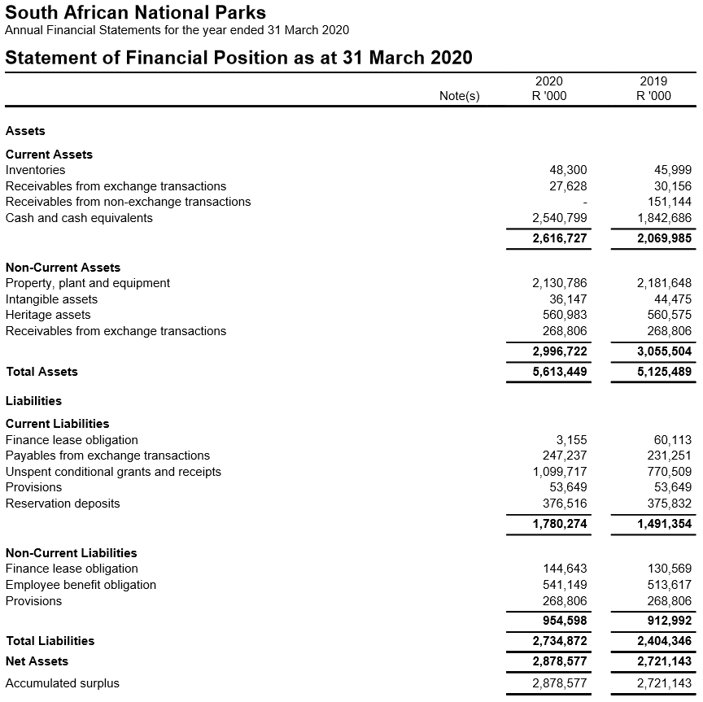
Financial Performance – March 2019

Slide 42
Financial Performance – March 2019

Slide 43
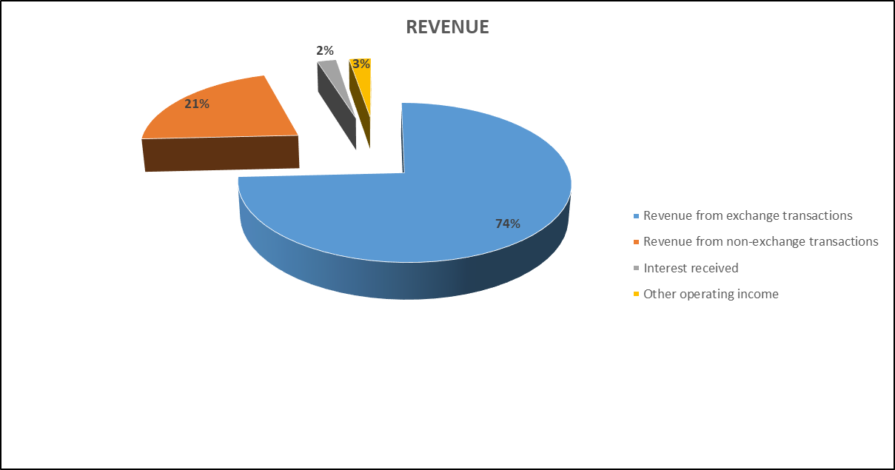
Financial Performance – March 2019

Slide 44
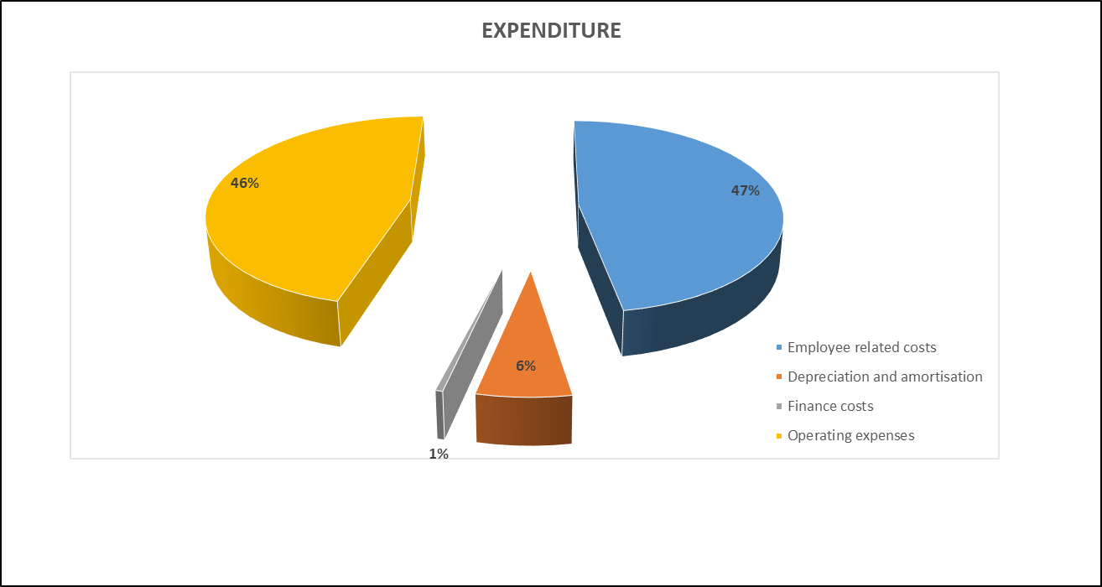
Financial Performance – March 2019

Slide 45
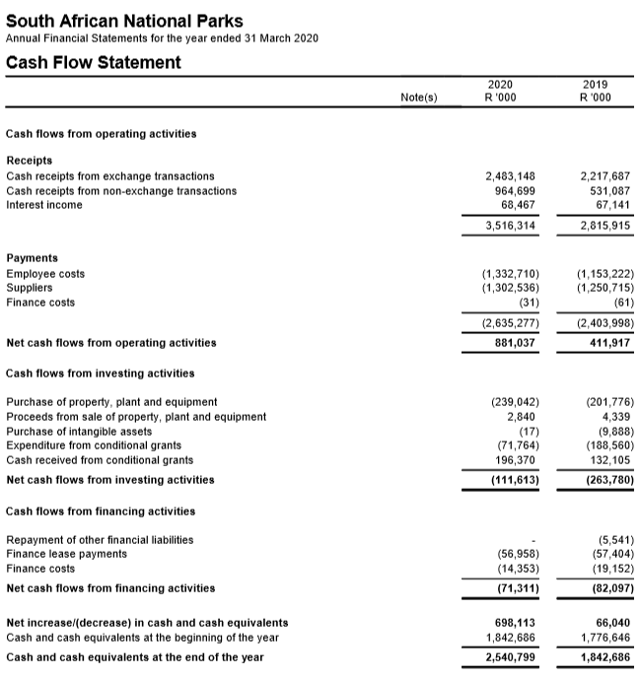
Financial Performance – March 2019

Slide 46
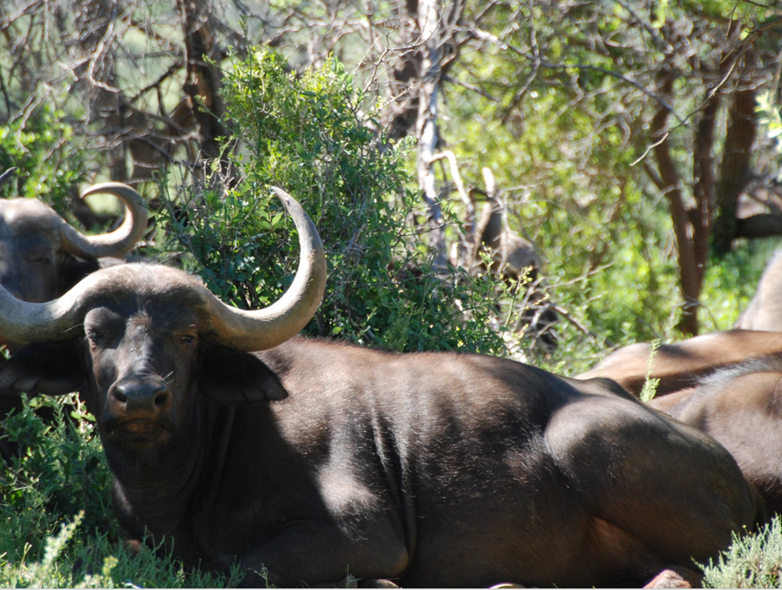
Thank you
THANK YOU

