Slide 1
PORFOLIO COMMITTEE ON COOPERATIVE GOVERNANCE AND TRADITIONAL AFFAIRS STATUS OF SECTION 139 MUNICIPALITIES 25 August 2020

Slide 2
LAYOUT OF PRESENTATION
Mangaung Metropolitan Municipality
Mafube Local Municipality
Metsimaholo Local Municipality
Maluti a Phofung Local Municipality

Slide 3
MANGAUNG METROPOLITAN MUNICIPALITY

Slide 4
BACKGROUND
The financial crisis that developed in the Mangaung Metropolitan Municipality led the Free State Provincial Executive Council (Exco) to invoke Section 139(5)(a) and (c) of the Constitution of the Republic of South Africa, 1996 (Act No. 108 of 1996), as amended, and placed the Municipality under intervention.
An Intervention Team comprising of individuals from national and provincial government departments, as well as from the private sector, was assembled to implement the mandatory Financial Recovery Plan.
The Intervention Team initially comprised of the following persons:
Adv. MM Mofokeng Lead Provincial EXCO Representative
Mr TL Mkaza Assistant Prov. EXCO Representative
Mr E Mohlahlo Acting HOD: Public Works (FS Prov Govt)
Ms L Mokheseng Manager: COGTA (FS Prov Govt)
Ms M Sesing Accountant General, FS Prov Treasury

Slide 5
BACKGROUND (CONT.)
The Team took a decision to allocate the members specific areas of focus right at the beginning, as follows:
Adv. MM Mofokeng Service Delivery
Mr TL Mkaza Governance & Administration
Ms L Mokheseng Governance & Administration
Mr E Mohlahlo Finance
Ms M Sesing Finance
Initially the team comprised of five (5) members as stated in 2.3 above, however over the last five (5) months only three (3) of the members remained with Adv. Mofokeng and Mr Mkaza physically managing the programme. Ms L Mokheseng assisted the two representatives intermittently during that period.
It is worth noting that the Provincial EXCO representative and his assistant also focused on the financial matters of the Municipality given that the two colleagues allocated finance were not available.

Slide 6
Back ground (cont.)
The Intervention Team submits monthly reports to the Provincial EXCO on activities taking place in the Municipality and progress attained on the execution of the mandatory Financial Recovery Plan. These reports are also submitted to the War Room meetings comprising of delegations from National Treasury, Free State Provincial Treasury, Mangaung Metropolitan Municipality and the Intervention Team.
The Provincial EXCO approved Terms of Reference for the Intervention Team on 16 March 2020. These Terms of Reference were submitted to the Executive Mayor of Mangaung Metropolitan Municipality on 13 May 2020 by the MEC: Finance.
The Administration in the Municipality reluctantly co-operated with the Intervention Team intermittently raising the issue that the Terms of Reference were not finalised; therefore, the Intervention Team could not actually start with its work.
The delay in the finalisation of the Terms of Reference created unnecessary tensions between the Intervention Team and the City Manager, who later addressed a letter to all Heads of Directorates instructing them not to carry out instructions from the Intervention Team as it did not have legal powers to do so.

Slide 7
Back ground (cont.)
The Free State Provincial HOD: COGTA submitted the Terms of Reference to the State Attorney for a legal opinion. The opinion once received was tabled before the War Room. It indicated that the Provincial EXCO was within its rights to invoke section 139(5)(a) and (c) and further that interventions are not intrusive but intended to support and assist municipalities in turning around.
It is worth noting that the Municipal Council on considering a report on the Terms of Reference resolved that whilst it notes these they should be subjected to further legal interpretation and opinion.
The uncertainty created by the doubt cast on the legality of the intervention, its powers and authority, has made it difficult for the Intervention Team to enforce some of the critical decisions that could be impactful.

Slide 8
INTERVENTION APPROACH
The Intervention Team commenced by conducting a diagnostic analysis of the nature of the challenges facing the Municipality so as to structure their strategies and action plan.
Subsequent thereto the Team embarked on several actions in pursuit of the primary objective of the intervention which is financial rescue, stabilization and sustainability of the Municipality.
The Intervention Team and National Treasury finalised the Financial Recovery Plan reflecting specific targets which must be achieved by the Municipality during May 2020.
Progress attained on each of the set targets is submitted in a report to the War Room where it is discussed by all the parties.
Progress reporting is on the following:
Financial
Service Delivery
Governance

Slide 9
PROGRESS REPORT
The Intervention Team submitted reports initially on a format that did not cover all targets and areas. The Intervention Team and National Treasury develop a template for reporting which would assist in measuring progress and identifying areas of deficiencies and those that needed special attention.
Performance on the three broad areas of financial recovery, service delivery improvement and governance will be presented in this report in the afore-mentioned template.
The information provided hereunder is for the month of July as it reflects the current state in which the Municipality is in.
This state is a cumulative net results of work performed over a period of six months within the constraints alluded to above.

Slide 10
PROGRESS REPORT
Financial Recovery
Capital budget procurement plan
 | Problem statement | Capital budget procurement plan not in place
1 | Recommendations | Properly determine the fundamental reason for this failure Make key interventions to address the reasons Ensure the development of a capital budget procurement plan for 2020/21
2 | Steps taken | 2020-21 Procurement Plan was compiled Only “implementation ready” projects are included in the 2021 budget
3 | Progress made | Regular meetings of the Bid Committees 2020-21 Procurement Plan aligned to the approved budget Bids Progress Reports shared with all Heads of Departments
4 | Other noteworthy developments | Review of SCM Policy for the 2020/21 FY adopted by Council Bid Committees reviewed

Slide 11
PROGRESS REPORT
Financial Recovery (cont.)
Cash Management
 | Problem statement | Cash management is poor and cash balances are too low
1 | Recommendations | Properly determine the fundamental reason for this failure Make key interventions to address the reasons Establish Cashflow Management Committee with clear Terms of Reference (TOR) to ensure strict control over payments and management of bank balances
2 | Steps taken | Enhancement of Daily Cash Flow Management Model Alignment of procurement of goods and services with available cash flows All commitments reviewed and approved by EXCO Representative Cash flow projections for the 1st quarter of 2020/21 compiled
3 | Progress made | Reduction of long outstanding creditors from R642,8 million in June 2020 to R 577 million in July 2020. Operational costs financed from own revenue (No encroachment in Unspent conditional grants)
4 | Other noteworthy developments | Impact of non-implementation of debt collection and credit control measures on available cash flow (Lockdown regulations) DBSA and payment was processed on 09 July 2020 (Standard Bank loan paid in June 2020)

Slide 12
PROGRESS REPORT
Financial Recovery (cont.)
Irregular, Unuathorised, Fruitless and Wasteful Expenditure
 | Problem statement | Irregular, unauthorised, fruitless and wasteful expenditure is too high
1 | Recommendations | Properly determine the fundamental reason for these failures Implement measures to prevent and address these failures Identify, investigate, take action and report on all cases as per legislation
2 | Steps taken | Prior years irregular, fruitless and wasteful expenditure identified by Finance Directorate and report submitted to the Office of the City Manager for further handling Debt impairment sufficiently budgeted in the 2020/21 to prevent over-expenditure
3 | Progress made | Finance Directorate identified irregular, unauthorised, fruitless and wasteful expenditure during the 2018/19 audit process and submitted to the accounting officer for further handling.
4 | Other noteworthy developments

Slide 13
PROGRESS REPORT
Financial Recovery (cont.)
Irregular, Unuathorised, Fruitless and Wasteful Expenditure
 | Problem statement | Irregular, unauthorised, fruitless and wasteful expenditure is too high
1 | Recommendations | Properly determine the fundamental reason for these failures Implement measures to prevent and address these failures Identify, investigate, take action and report on all cases as per legislation
2 | Steps taken | Prior years irregular, fruitless and wasteful expenditure identified by Finance Directorate and report submitted to the Office of the City Manager for further handling Debt impairment sufficiently budgeted in the 2020/21 to prevent over-expenditure
3 | Progress made | Finance Directorate identified irregular, unauthorised, fruitless and wasteful expenditure during the 2018/19 audit process and submitted to the accounting officer for further handling.
4 | Other noteworthy developments

Slide 14
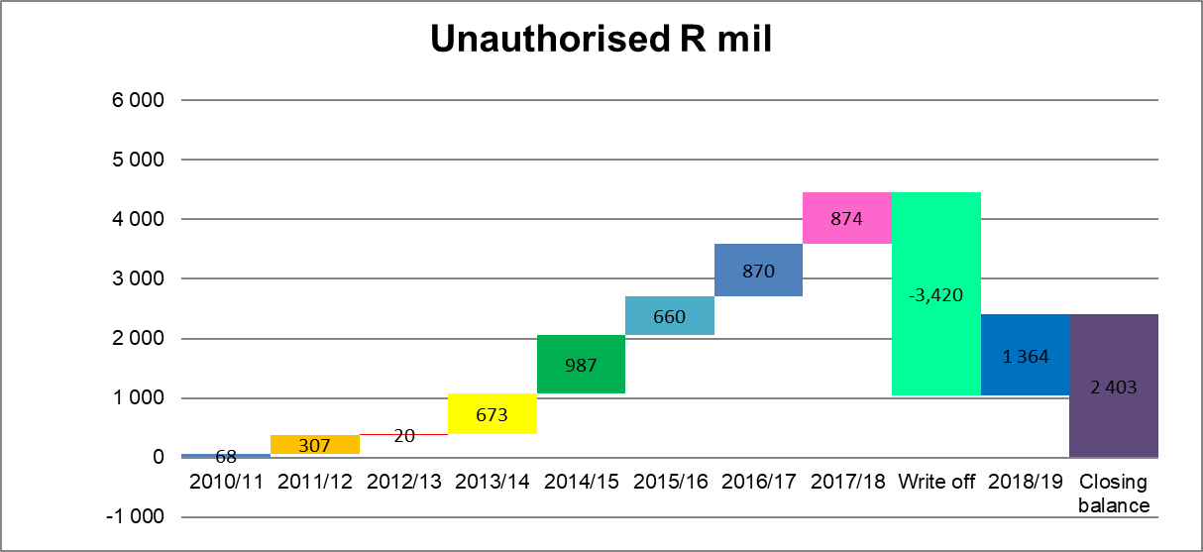
PROGRESS REPORT
Financial Recovery (cont.)
Unuathorised Expenditure

Slide 15
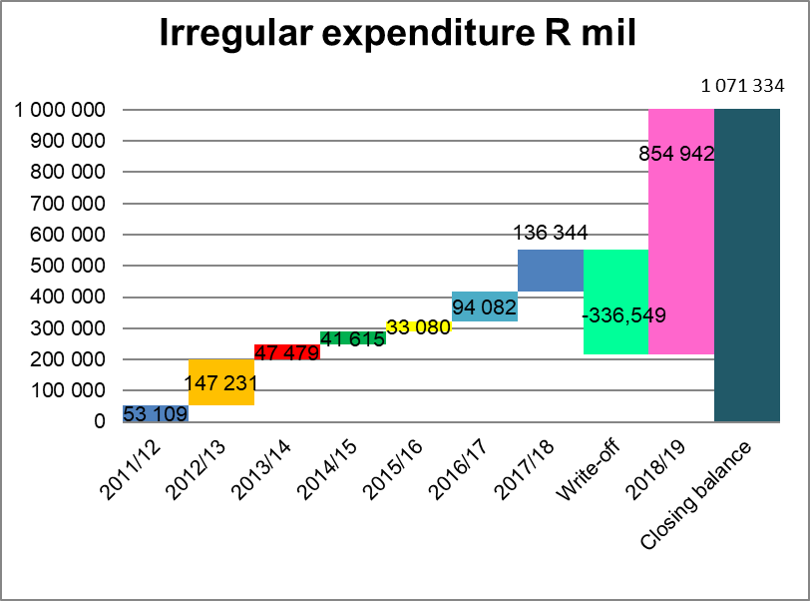
PROGRESS REPORT
Financial Recovery (cont.)
Irregular Expenditure

Slide 16
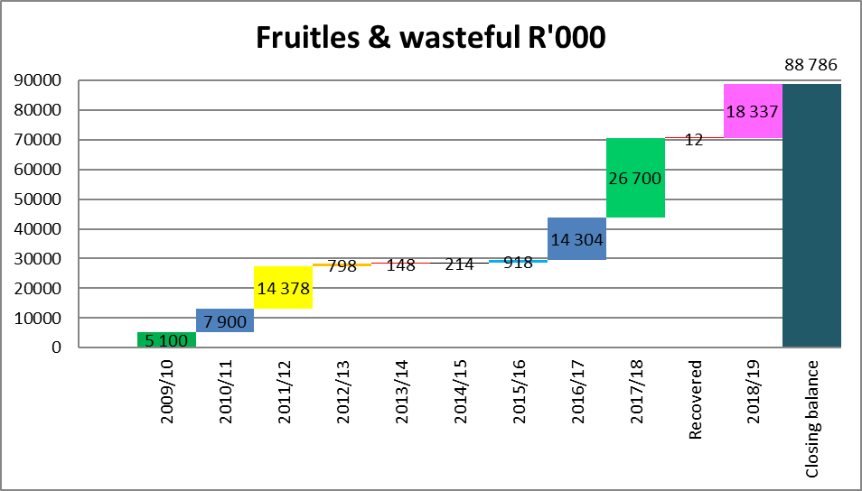
PROGRESS REPORT
Financial Recovery (cont.)
Fruitless and Wasteful Expenditure

Slide 17
PROGRESS REPORT
Financial Recovery (cont.)
Review outsourcing contracts with a view to reducing and improving effectivess
 | Problem statement | Some outsourced contracts duplicate functions of internal components
1 | Recommendations | Assess and identify all contracts that duplicate internal functions of the Municipality and terminate due to financial constraints. Properly determine the fundamental reason for these failures Implement measures to prevent and address these failures
2 | Steps taken | A register of contracts availed to Intervention Team Supply Chain Management tasked to assess all new requisitions from individual departments and propose cost effective ways of providing services
3 | Progress made | None
4 | Other noteworthy developments | None

Slide 18
PROGRESS REPORT
Financial Recovery (cont.)
Financial targets

Slide 19
PROGRESS REPORT
Financial Recovery (cont.)
Financial targets (cont.)

Slide 20
PROGRESS REPORT
Financial Recovery (cont.)
Financial targets (cont.)

Slide 21
PROGRESS REPORT
Financial Recovery (cont.)
Financial targets (cont.)

Slide 22
PROGRESS REPORT
SERVICE DELIVERY
Solid Waste Management (July 2020)
Domestic Waste Collection

Slide 23
PROGRESS REPORT
SERVICE DELIVERY (cont.)
Solid Waste Management (July 2020)
Domestic Waste Collection

Slide 24
PROGRESS REPORT
SERVICE DELIVERY (cont.)
Solid Waste Management (July 2020)
Domestic Waste Collection

Slide 25
PROGRESS REPORT
SERVICE DELIVERY (cont.)
Removal of illegal waste dumps and cleaning of open spaces
Residents going through open spaces and public amenities tend to litter. For this reason, the Municipality is expected to remove that waste. Over the period under review the Municipality was able to manage public cleansing as follows:
30 illegal heaps were removed across all areas in the city in the April/May months;
The central trading areas were cleansed beyond the normal, with the removal of illegal advertising also being removed;
All illegal trading items and stalls were also removed in the central areas.
In the month of June, the city could only remove 2 illegal heaps as machinery required maintenance. The Directorate only got a single tipper and TLB towards the end of the month. However, the litter pickers continued with their work of removing light waste in open spaces using plastic bags and rakes.

Slide 26
PROGRESS REPORT
SERVICE DELIVERY (cont.)
Landfill sites
Waste that is removed throughout the area is disposed at the landfill sites one in the North and the other in the South of the city. The operations at these sites is regulated and requires special machinery. The Municipality at this moment is facing a huge challenge in that it lacks the necessary machinery. The machinery currently used is outdated and breaks frequently. The Municipality runs into incessant problems in that it lacks funding to repair these. The results thereof have been backlogs in managing these landfill sites correctly according to legislation.
Amidst these challenges the following actions have been taken:
The programme towards the regularization of landfill sites has been initiated.
Cleansing outside and inside the landfill sites is done.
New cells are currently being created in the North landfill site.
Unknown persons have settled at the landfill sites thus creating problems for the management of these sites. Though they have been advised not to settle at these sites they have simply ignored those warnings. The COVID -19 Regulations stipulate that all people should be indoors. All homeless people are provided shelters. This Municipality is no exception to the rule, therefore the person living on the landfill sites had to be removed to safe places.
The Law Enforcement Agencies conducted an operation of removing these people from the sites. It is disheartening to report that they have returned to the sites.
A multi-disciplinary team is being currently assembled by the Mangaung Metro Corona Virus Command Centre to address this challenge.
It is crucial to note that collection of refuse in both residential areas and the CBD changes constantly given the availability of compaction trucks and enough workers. Should either of the two components be affected it impacts on the extent to which the service is rendered.
At the moment the Municipality is investigating other mechanisms that could be used to address some of the underlying problems such as lack of resources and staff shortage.

Slide 27
PROGRESS REPORT
SERVICE DELIVERY (cont.)
Challenges in Solid Waste Management
The city is anticipating the following processes in July – September which can help alleviate the situation.
Filling of critical posts, in particular appointment of general workers. The Directorate requires about 122 to normalize overtime to 40 hours at Domestic Waste in particular.
Advertising of request for proposal document on the collection of waste with the whole intention of getting innovative ideas on the whole waste management hierarchy.
The Directorate has engaged the Department of Environmental Affairs on assistance in three areas, viz:
Cleansing of Open Spaces,
Rehabilitation of Landfill sites and
Repairs to buy back centres and transfer station.

Slide 28
PROGRESS REPORT
SERVICE DELIVERY (cont.)
Engineering Services
Visible water losses and Water provision in Informal settlement
Overall water losses

Slide 29
PROGRESS REPORT
SERVICE DELIVERY (cont.)
Engineering Services
Visible sewer spillages and VIP Vacuuming Programme
Road maintenance

Slide 30
PROGRESS REPORT
GOVERNANCE
Political – Administrative Interface
Council Governance & Oversight

Slide 31
PROGRESS REPORT
GOVERNANCE
System of Delegation
Executive Management Team meetings

Slide 32
PROGRESS REPORT
GOVERNANCE
Audit Committee
Audit Outcomes
Risk Management

Slide 33
PROGRESS REPORT
GOVERNANCE
ICT Governance Framework
Labour relations
Procurement

Slide 34
PROGRESS REPORT
GOVERNANCE
Litigation
Disciplinary Board

Slide 35
PROGRESS REPORT
GOVERNANCE
Legal
Contract Management

Slide 36
PROGRESS REPORT
STRATEGIC ASSESSMENT AND CORRECTIVE ACTIONS AS REQUIRED
The emergence of COVID -19 has significantly affected the Intervention Programme. As reflected in this report and the previous ones since March 2020, it impacted amongst others, as follows:
Decline in revenue;
Reduced ability to enforce credit control;
Steady increase in number COVID -19 infected employees;
Increasing fear and panic amongst employees;
Lockdown regulation – employees working from home and/or not allowed to report physically for duty;
Reduced productivity.
The cumulative net result of the above has been gradual stagnation in operations within the Municipality. This therefore calls to question the initial targets that were set at the beginning of the intervention whether it would be possible to meet those as planned.
It is also worth mentioning that since March the demand for services has increased in real terms whilst the ability of the Municipality to provide these has been steadily declining due to, amongst others, the situation adverted to above.

Slide 37
PROGRESS REPORT
STRATEGIC ASSESSMENT AND CORRECTIVE ACTIONS AS REQUIRED (cont.)
The Intervention Team therefore proposes the following actions as urgent and should be implemented accordingly:
Strategic Planning Session of Mayoral Committee and EMT (NB: Budget has been approved and operations for the year must start in earnest, preceded by a Strategic Planning Session);
Organisational Restructuring;
Assessment and Training of SCM Staff and senior officials;
Implementation of Consequence Management;
ICT Upgrade and budget provision;
Training on Disciplinary and Grievance Procedures
Enforcement of Austerity measures
Development of the Revenue Enhancement Strategy
Improvement on collection of revenue
Improvement of Contract Management
Training of Councillors on key responsibilities
In conclusion it must be indicated that in earlier reports it was reported that the Intervention Team established three Task Teams. The primary objective of the Task Teams was to ensure that certain specific activities are undertaken and monitored by the Champions. The Task Teams have not functioned optimally due to the disruption caused by COVID-19.
The Teams should be reactivated and report accordingly to the Intervention Team on the Action Plans.
The Intervention Team requires full support from National and Provincial Treasuries, National and Provincial COGTA in the implementation of the Financial Recovery Plan. As alluded to above the Intervention Team has for all intends and purposes been operating with two members, hence the request for assistance. The Team has not been adequately resourced to enable it to perform its work optimally.

Slide 38
SUPPORT NEEDED
The Team request that it be assisted by ensuring that its recommendations are acted upon. For instance, in the May report it was mentioned that the Municipality requires extensive financial assistance to conduct amongst others:
Forensic investigations,
Due diligence on Water and energy provision;
Capacity building for inter alia SCM and senior officials
Waste Management;
Revenue Enhancement Strategy
Initially at the inception of the intervention programme there were various individuals who were meant to support the Team. As indicated above this has not happened. It will be appreciated if the persons who have since left the team be replaced by other persons adequately skilled on the other areas such as financial management. The individuals to be replaced are Mr Mohlahlo and Me Sesing.

Slide 39
MAFUBE LOCAL MUNICIPALITY

Slide 40
Performance for the 2017/18 financial year (AG finding 2017/18)
Audit outcomes

Slide 41
BASIC FOR DISCLAIMER OF OPINION

Slide 42
ANALYSIS OF 2017/18 AUDIT OUTCOME
The Audit Report for 2017/2018 AFS was received on the 9th of January 2020;
14 qualification paragraphs that recurred from the previous Audit primarily due to poor accounting records / insufficient supporting documentation;
The Audit report highlight the remuneration of the former MM to be above the upper limits for section 55 and 56 managers. There is overpayment of R2.9 million
Municipal current assets exceed its liabilities by R414 million;
Annual Performance Report was disclaimed

Slide 43
POST –AUDIT ACTION PLAN FOR 2017/18 FINANCIAL YEAR
The said Audit Action Plan for 2017/2018 has been developed with the technical assistance of Messrs PKF;
Little progress registered with the implementation of Audit Action Plan due to workers strike and subsequently compounded by the break-out of COVID 19 Pandemic
Interventions to improved the audit outcome for 2018/2019 FY:
Appointment of consultants for compilation of AFS (PKF Auditors to deal with two set of the AFS viz 2018/2019 & 2019/2020 );
Compilation of Audit Action plan to address prior year audit findings;
Establishment of Clean Audit Steering Committee and
Redesign and implementation of internal controls.

Slide 44
POST –AUDIT ACTION PLAN FOR 2017/18 FINANCIAL YEAR
The said Audit Action Plan for 2017/2018 has been developed with the technical assistance of Messrs PKF;
Little progress registered with the implementation of Audit Action Plan due to workers strike and subsequently compounded by the break-out of COVID 19 Pandemic
Interventions to improved the audit outcome for 2018/2019 FY:
Appointment of consultants for compilation of AFS (PKF Auditors to deal with two set of the AFS viz 2018/2019 & 2019/2020 );
Compilation of Audit Action plan to address prior year audit findings;
Establishment of Clean Audit Steering Committee and
Redesign and implementation of internal controls.

Slide 45
COVID-19 EXPENDITURE ON NATIONAL DISASTER RELIEF GRANT
How much funding was allocated to the Municipality in relation to the R151 million for the year ended 30 June 2020? | How much funding was received by the Municipality in relation to the R151 million for the year ended 30 June 2020? | Comments to indicate on what the funding was spent ( COVID PPEs – cloth masks, sanitizers, protective clothing for employees and safety boots, gloves, sanitizing dispensing stands
R 447 000,00 | R 447 000,00 | R 447 000,00

Slide 46
BILLING VS COLLECTION
The collection trend for the second semester of 2019/20 financial year is as follows. On average the collection rate is 17.4%

Slide 47
FACTORS FOR UNDER-COLLECTION
The total number of water meters is 20193 of which 4360 are in the conditions that are not acceptable as some:
Are invisible due to vapour and no readings can be taken;
Cannot be accessed due to being covered by soil and some situated deep under-ground which makes it risky and difficult for meter readers to access;
Are damaged while others are not moving at all;
Are leaking, caused by old infrastructure pipes;
In some areas, there are households without water meters.
Poor collection and court judgements
The Municipality is Grant dependent with over 80% of its total revenue being Grants. The recent judgement against our bank accounts by creditors like SARS, Pension schemes and others will have a huge impact on the operations of the Municipality as this would mean lesser available financial resources as would have expected to meet all the needs of the community.

Slide 48
FACTORS FOR UNDER-COLLECTION
The total number of water meters is 20193 of which 4360 are in the conditions that are not acceptable as some:
Are invisible due to vapour and no readings can be taken;
Cannot be accessed due to being covered by soil and some situated deep under-ground which makes it risky and difficult for meter readers to access;
Are damaged while others are not moving at all;
Are leaking, caused by old infrastructure pipes;
In some areas, there are households without water meters.
Poor collection and court judgements
The Municipality is Grant dependent with over 80% of its total revenue being Grants. The recent judgement against our bank accounts by creditors like SARS, Pension schemes and others will have a huge impact on the operations of the Municipality as this would mean lesser available financial resources as would have expected to meet all the needs of the community.

Slide 49
DEBTORS PERFORMANCE
The total debtors as at 31 May 2020 amounts to R626 626 591 after a monthly average payment of R1 793 884 received towards debtors, of which amounts to 19% of total billing.

Slide 50
CREDITORS MANAGEMENT
Creditors as at 31 May 2020 amounts to R544 854 932 , more of the creditors have been carried over from the previous financial years and as a result, creates big cash flow constraints for the Municipality in the current year;

Slide 51
CREDITORS MANAGEMENT (cont.)
Settlement of creditors in accordance with section 65 (2) of the MFMA
In our attempt to pay our creditors within 30 days, we have managed to make payment arrangements in terms of outstanding debt with the following suppliers:
SALGA;
ESKOM (FBE);
Sibusisiwe (Settled);
Basia Environmental;
Beyond 2014;
Neelo Africa (Settled);
BCX
Negotiations are still on going between the Municipality and Rural maintenance.
All current 3th party payments are paid on time and are currently up to date to the except PAYE, SARS and Pension Funds

Slide 52
INTERVENTIONS IMPLEMENTED
Enlisted SITA for commercial printing of municipal accounts to deal with backlog of 10 months of printing and issuing accounts;
Municipality is implementing and replacing 1458 conventional water meters with pre-paid water meters targeting industrial, business and domestic customers in the four towns. Anticipate the project to be concluded by the 30th of November 2020;
Working with COGTA with resources provided through the Municipal Systems Improvement Grant (MSIG) to conduct data cleansing exercise and review the Revenue Enhancement Strategy of the Municipality

Slide 53
UNAUTHORIDSED EXPENDITURE

Slide 54
Irregular EXPENDITURE

Slide 55
Fruitless & wasteful EXPENDITURE

Slide 56
PROGRESS ON INVESTIGATION OF UIF
The section 32 committee/MPAC has been established in March 2015 to assist the Municipality with the investigation of any unauthorized, irregular, fruitless and wasteful expenditure incurred by the Municipality;
The investigation that was conducted by the Municipal MPAC was rejected by AGSA due to methodology that was used for these investigations. Therefore, municipal MPAC has to re-perform the investigations and the process is on going;
Provincial COGTA has conducted a forensic investigation of UIF on the behalf of the Municipality and the said report will be instructive in taking appropriate consequence management

Slide 57
CONSEQUENCE MANAGEMENT
Auditor General mentioned in his report that there were no consequence management initiatives by the Municipality, and that consequence management must be implemented as a matter of urgency;
Management of Mafube Local Municipal take the recommendation of Auditor General seriously, and to prove this, the following are some of the cases against some of the municipal employees:
MISCONDUCT CASE
Fabricate medical certificate
FINANCIAL MISCONDUCT CASE
Unbanked deposit
Unauthorised, Irregular, Fruitless and Wasteful Expenditure

Slide 58
INSTITUTIONAL CAPACITY
Vacancy status of top management – Municipal Manager post is vacant and other senior management positions have been filled and their contracts are active until 2022.
Management is in the process of finalising the Organogram with the assistance of SALGA.
Minimum competency:
Senior Management – 4 Completed;
Middle Management – 8 Completed, 3 not yet completed
Other Staff – 11 Completed

Slide 59
AUDIT COMMITTEE AND INTERNAL AUDIT
Audit committee has been established, however it did not convene the minimum recommended number of meetings during the year;
Municipality has an internal audit unit which is not fully functional, however, as part of strengthening governance issues, Municipality will be appointing Manager: Internal Audit and at least two (2) internal auditors to add to the current team;
The internal audit team play a pivotal role in ensuring that laws and regulations are followed. Municipality developed an audit action plan, and IA is monitoring this audit action plan;

Slide 60
INTERNAL AUDIT unit
Challenges, Root cause and Associated Risk | Possible Solutions / Actions
Manager Internal Post is vacant Shortage of staff in the Unit Non-implementation of recommendations of Audit Action Plan Risk Management Unit also require staffing | Manager Internal Auditor post will be advertised; Internal and / or normal appointments of Internal Auditors should be made by end September 2020; Administrators to support in the review of the Action Plan

Slide 61
MUNICIPAL PUBLIC ACCOUNTS COMMITTEE
Have been established
A schedule of meetings have been developed and approved by Council

Slide 62
Service delivery – water services
The Municipality succeeded in expending 100% of received capital grants for 2019/2020 FY;
The Municipality provides water services to 20 744 households and has a backlog of 176 households at Frankfort.
The Municipality has installed 15 jojo tanks that are periodically filled by 5 water trucks (DWS intervention) as follows:
Ntswanatsatsi – 5*10KL tanks
Qalabotjha – 1* 10KL tank
Namahadi – 8*10KL and 1* 5KL tank
The construction of Qalabotjha/Villiers 6.5 megalitres water reservoir is 98% complete with an investment of R27.7 million from MIG is 98% complete and will be commissioned from the 4th of September 2020;

Slide 63
Service delivery – water services (cont.)

Slide 64
Service delivery – Sanitation services
The Municipality provides basic sanitation services to 18 193 households with backlogs of 2 627 households as follows:
In Namahadi – 2121
In Qalabotjha – 202
In Mafahlaneng – 304

Slide 65
Service delivery – Sanitation services (cont.)

Slide 66
Service delivery – electricity services
The Municipality provides basic sanitation services to 18 193 households with backlogs of 2 627 households as follows:
In Namahadi – 2121
In Qalabotjha – 202
In Mafahlaneng – 304

Slide 67
Service delivery – electricity services (cont.)

Slide 68
Service delivery – CHALLENGES
Insufficient water supply in high-lying sections of Mamello and Phomolong that will be alleviated by construction of a dedicated pipeline to provide water services to these communities;
Leveraging resources for the replacement of cement asbestos pipe that are prone to bursting and constitute a significant proportion of water network in the Municipality;
Conducting of prompt maintenance of our water and waste water service delivery infrastructure and eradication of the mentioned basic sanitation backlog;
Sourcing of resources for the refurbishment of Waste Water Treatment Works and avoid the discharging of raw sewer into the Vaal River System;
Leveraging additional resources for addressing roads and storm-water backlogs standing at 224.54km and will need a capital outlay of R225 million to eradicate. This backlog represents 68.59% of the total road network of 327.32 km that criss-crosses the municipal area;

Slide 69
Service delivery – CHALLENGES (CONT.)
Inadequate municipal fleet, that encumbers the Municipality in providing prompt and reliable municipal services such as refuse removal and maintenance of the bulk water, sanitation and roads and storm-water infrastructure;
Restoration of waste removal services on a Weekly basis in all the towns and periodic removal of illegal dumping sites;
Non-maintenance of parks and open areas, non-pruning of trees in busy streets and this affects flow of traffic;
Digging of graves, non maintenance of public amenities; and
Non-complying landfill sites.

Slide 70
METSIMAHOLO LOCAL MUNICIPALITY

Slide 71
BACKGROUND
On the 11th of February 2020, the Free State Provincial Executive Council resolved to intervene in the affairs of the Metsimaholo Local Municipality (MLM), thus placed it under administration.
The decision was informed by challenges and failures of the Municipality and its governance structures to meet regulatory and constitutional obligations of the Municipality.
On the 20th of February 2020, Member of Executive Committee (MEC) of Cooperative Governance and Traditional Affairs (COGTA), Mr S.T. Nxangisa announced in Council that Metsimaholo Local Municipality (MLM) is forthwith placed under provincial administration under Section 139 (1) (b) of the Constitution of the Republic of South Africa.

Slide 72
BACKGROUND (CONT.)
An Administration Team comprising of the following members were seconded:
Tebogo Manele Administrator
Motsumi Mathe Acting Municipal Manager
Bennet Molotsi Acting Director Corporate Services (deceased)
Palesa Qulunga Financial Advisor
In March /April two more members of the Team were seconded:
Luvkuyo Ntoyi Acting Director Technical Services
Keneiwe Lepesa Acting CFO

Slide 73
KEY DELIVERABLES OF THE ADMINISTRATION TEAM (TERMS OF REFERENCE)
The Administration Team was mandated to intervene and address the following matters:
Council’s failure to appoint Senior Managers (Section 56)
Suspended Municipal Manager (Mr. Molala)
Instability in the Municipality and revived Service Delivery
Finance Management and Supply Chain Management
2018/19 Audit Outcomes

Slide 74
Progress report
Council’s failure to appoint Senior Managers (Section 56)
In July 2020, the Administrator recommended appointment of Acting Senior Managers:
Dr Gino Alberts (Social Services)
Ms Keneuwe Lepesa (CFO)
Mr. Theko Mojela (LED & Tourism)
Mr. Luvuyo Ntoyi (Technical Services)
Mr. Ephriam Sediane (Corporate Services)
The names of will be tabled before the MAYCO, to be tabled in the next Council sitting.

Slide 75
Progress report (cont.)
Council’s failure to appoint Senior Managers (Section 56) (cont.)
A report before the Mayoral Committee recommended that in August 2020 a process to fill these vacancies of Senior Managers to commence and be finalised in the next 3 months.
Advertisements be released in August 2020;
Panel to be constituted within August 2020;
Shortlisting and Interviews be conducted during October 2020;
Notices, if any, be service in November 2020;
Assumption of duty be on 01 December 2020 (before the beginning of half yearly period (2021).

Slide 76
Progress report (cont.)
Suspended Municipal Manager (Mr. Molala):
The Municipality’s legal representatives are engaging with Mr. Molala’s lawyers with the intention to resolve the matter. The Municipality believes it has a strong case against Mr. Molala in line with outcomes of Forensic Investigations by Edge Froensic & Risk Consultants.
Council has to take a stand on the matter, and resolve on supporting the current appeal against Mr. Molala, and or subject him to disciplinary process.
A Disciplinary Tribunal has been established to deal with Senior Managers cases.
Administrator is liaising with both legal teams to speed up resolution.

Slide 77
Progress report (cont.)
Instability in the Municipality and revived Service Delivery:
Administration team, led by the Acting Municipal Manager, at Administration Level has stabalised the Municipality.
All functions of the Municipality are operational, as most employees perform assigned responsibilities and duties.
Local Labour Forum is revived and fully attended by Employer Component (Councillors and Administration) and Labour (SAMWU and IMATU).
All Basic Service Delivery objectives are implemented: Refuse removal, Water and Sanitation, and Cleaning, are excellent. But closing of potholes and fixing and maintaining street lights need more effort and focus.

Slide 78
Progress report (cont.)
Finance Management and Supply Chain Management:
Finances are managed very well, as controls and procedures are being followed.
Collection rate dropped from average of 83% to about 74% in the last 6 months of the 2019/20 financial year. May be due to COVID-19.
Salary bill is currently at about 27% and set to increase to about 33.8% after filling of current vacancies, plus Senior Managers.
The Municipality meets all its key commitments to Eskom, Randwater, Sasol, Salaries, Third parties and Insurances.
Supervision of Overtime is still a challenge, currently sitting at 13,8% of the salary bill. Measures have been put in place to monitor each overtime requested for approval.

Slide 79
Progress report (cont.)
Finance Management and Supply Chain Management (cont.):
Supply Chain processes were decentralised, hence lack of control and proper management. Now centralised.
Ms Palesa Qulunga (Finance Advisor) works closely with Ms Luyanda Radebe (Acting SCM Manager) to implement controls and new systems to improve SCM operations.
All Purchase Requests are being initiated by end user department are now strictly signed by SCM Manager, Budget Officer, Acting Director and finally Acting Municipal Manager.
All invoices are not accompanied signed by end user department and submitted with signed reports.
Bid Committees are established and operate optimally.

Slide 80
Progress report (cont.)
2018/19 Audit Outcomes:
Auditor General qualified the Municipality and the following key findings were noted:
Suspended Municipal Manager (Mr. Molala)
Matters are put in place in order to resolve this issue.
Oranjeville Sports Complex Project
The forensic investigation was concluded and report submitted to Acting Manager (25 May 2020). Summary report with recommendations submitted to the Executive Mayor and Administrator, to be tabled before next Council.

Slide 81
Progress report (cont.)
2018/19 Audit Outcomes (cont.):
Oranjeville Sports Complex Project
Recommendations cover:
Irregular, fruitless and wasteful expenditure incurred in the Oranjeville Sports Complex be recovered from identified officials, contractor and architects.
Disciplinary case be initiated against the Accounting Officer and officials for their acts of misconduct.
Criminal case be opened against relevant officials, contractor and architects.
Service providers verified to have irregular benefitted from this project be blacklisted.

Slide 82
MALUTI A PHOFUNG
LOCAL MUNICIPALITY

Slide 83
GOVERNANCE MATTERS
Financial failure is determined within the context of the following factors, either singly or in combination;
(a) the Municipality has failed to make payments as and when due;
(b) the Municipality has defaulted on financial obligations for financial reasons;
(c) the actual current expenditure of the Municipality has exceeded the sum of its actual current revenue plus available surpluses for at least two consecutive financial years;
(d) the Municipality had an operating deficit in excess of five per cent of revenue in the most recent financial year for which financial information is available;

Slide 84
GOVERNANCE MATTERS
(e) the Municipality is more than 60 days late in submitting its Annual Financial Statements to the Auditor-General in accordance with section 126;
(f) the Auditor-General has withheld an opinion or issued a disclaimer due to inadequacies in the Financial Statements or records of the Municipality, or has issued and opinion which identifies a serious financial problem in the Municipality;
(g) any of the above conditions exists in a Municipal Entity under the Municipality’s sole control, or in a Municipal Entity for whose debts the Municipality may be responsible, and the Municipality failed to intervene effectively; or
(h) any other material condition exists which indicates that the Municipality, or a Municipal Entity under the Municipality’s sole control, is likely to be unable for financial reasons to meet its obligations.

Slide 85
MUNICIPAL VACANCIES AND RECRUITMENT
The Municipal Manager and CFO were appointed from the 1st of April 2020.
Municipal Manager – Mr Tseko Mothamaha
Chief Financial Officer – Ms Jerminah Baleni-Mazinyo

Slide 86
FINANCIAL MANAGEMENT AND ACCOUNTABILITY
Financial Management
The overall financial position of the Maluti a Phofung Local Municipality is a major source of concern given its inability to pay and meet financial obligations timely as contemplated in the Municipal Finance Management Act, 2003.
The Department of Cooperative Governance & Traditional Affairs & the Provincial Treasury has invested over recent years, as illustrated below, in various initiatives to improve and turn around the Municipality’s difficulties through providing support to management and building, expanding and supplementing capacity.

Slide 87
FINANCIAL MANAGEMENT AND ACCOUNTABILITY
Financial Management
Municipality | Support rendered by COGTA & PT | Timeframe | Amount
Maluti a Phofung | Municipal Audit Turn-around | March 2015 to 30 December 2016 | R 10,033,817.00
 | Management Support Program | 01 July 2015 to 30 June 2016 | R 3,000,000.00
Total |  |  | R 13,033,817.00
An urgent intervention by the Provincial Executive is necessary in terms of section 139 (1) (b) of the Constitution of the Republic of South Africa, 1996 (Act No. 108 of 1996), as amended, to assume responsibility for the relevant obligations in the Municipality to the extent necessary to maintain essential national standards, restore finances to a sound footing and meet established minimum standards for the rendering of services

Slide 88
FINANCIAL MANAGEMENT AND ACCOUNTABILITY
Maluti a Phofung Local Municipality constantly failed to decisively deal with and resolve the following issues:
Financial Management, Administration and Accountability
The financial management and administration of the Municipality is not of a desired standard. The Council had received a number of consecutive Disclaimer Audit opinions until the intervention by Provincial Treasury & CoGTA in the 2015/16 financial year, as pointed out below;
Local Municipality: | Audit Opinion 2011/2012: | Audit Opinion 2012/2013: | Audit Opinion 2013/2014: | Audit Opinion 2014/2015: | Audit Opinion 2015/2016:
Maluti a Phofung | Disclaimer | Disclaimer | Disclaimer | Disclaimer | Qualified

Slide 89
FINANCIAL MANAGEMENT AND ACCOUNTABILITY
2016/2017
The Maluti a Phofung Local Municipality failed to compile and submit its 2016/2017 Annual Financial Statements, Fixed Asset Register, Audit Work File, Pre-determined Objectives and draft Annual Report to the Auditor General within the legislative timeframe. The audit has since commenced, but is still in the process of completion.
Significant amounts of unauthorised, irregular and fruitless and wasteful expenditure was incurred by the Municipality, as reflected in the tables below.

Slide 90
FINANCIAL MANAGEMENT AND ACCOUNTABILITY
Expenditure Type | 2013/14 | 2014/15 | 2015/16
Unauthorised | 57 132 0555 | 1 529 196 023 | 1 791 144 657
Expenditure Type | 2013/14 | 2014/15 | 2015/16
Irregular | 68 884 679 | 97 646 574 | 38 063 391
Expenditure Type | 2013/14 | 2014/15 | 2015/16
Fruitless & Wasteful | 31 557 459 | 44 560 921 | 65 006 167

Slide 91
FINANCIAL MANAGEMENT AND ACCOUNTABILITY
Financial Management
Financial Performance
An assessment of the financial performance of Maluti a Phofung Local Municipality as at the end of the 2016/2017 financial year clearly illustrated the state of financial regression;

Slide 92
FINANCIAL MANAGEMENT AND ACCOUNTABILITY
(a)Arrears Debtors: 30 June 2017

Slide 93
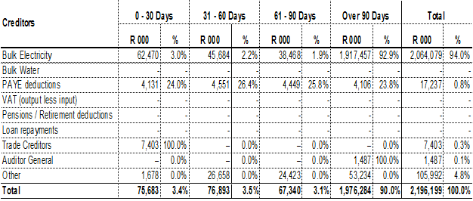
FINANCIAL MANAGEMENT AND ACCOUNTABILITY
(b) Arrears Creditors: 30 June 2017

Slide 94
CONT…FINANCIAL MANAGEMENT AND ACCOUNTABILITY
(c) Operational Deficit: 30 June 2017
The Municipality has a weak collection rate and cannot meet its commitments due to cash flow constraints and concluded the prior financial year with a cash book deficit balance of R10 million.
Budget 2017/18
Analysis on the 2017/18 budget was undertaken by Provincial Treasury indicated the budget was unfunded based on the following financial position:
Operating statement had a deficit of R535 million.
Capital statement - Internally generated funds to fund the capital projects was at R 56 million, which was not a true reflection as the Council did not have any reserves,
Cash flow was at a surplus of R8 million, unrealistic as the Council has projected on the collection rate on 97% and the collection rate as at 30th June 2017 was at 57%

Slide 95
CONT…FINANCIAL MANAGEMENT AND ACCOUNTABILITY
The reserves shows a deficit of R1.2 billion. This means that the Council does not have any reserves on the budget.
Bulk Electricity was budgeted at R579 million, this was not sufficient as the Council’s account with Eskom as at 30 June 2017 was at R2 billion in arrears.

Slide 96
CONT…FINANCIAL MANAGEMENT AND ACCOUNTABILITY
Financial Governance and Oversight
According to the recent most available audited information (2015/2016), the Auditor General South Africa expressed itself as follows on financial governance and oversight in the Municipality;
Stakeholder | Assurance Levels
Municipal Manager | Some assurance
Senior Managers | Some assurance
Internal Audit | Some assurance
Audit Committee | Some assurance
Mayor | Some assurance
Council | Limited assurance
MPAC | Limited assurance

Slide 97
CONT…FINANCIAL MANAGEMENT AND ACCOUNTABILITY
Possible instances of SCM Related Fraud and Corruption
The following sources of high concern were reported from the Municipality’s Management Support Program that concluded in June 2016;
• Lack of a supply chain Management Culture (SCM) in the Municipality
• Inadequate buy-in from Senior management in attempts to correct this culture
• Non-compliance with SCM legislative and regulatory requirements
• Poor accessibility of especially the SCM Manager

Slide 98
CONT…FINANCIAL MANAGEMENT AND ACCOUNTABILITY
Possible instances of SCM Related Fraud and Corruption
Against this background the Municipality appointed a ICT/Security service provider. The original contracted amount of R 5,328,298.64 was exceeded with 75% within the first year of appointment. It is not clear as to why prudent due process in this regard was not followed as contemplated in section 116 (3) of the Municipal Finance Management Act, 2003 (Act No. 56 of 2003). The following payments were made to the service provider;
• Contracted Amount R 5,328,298.64
• Payments made R 9,347,519.20
• Total Overpayment R 4,019,220.56
Given this situation and the prevailing SCM status quo in the Municipality it would be prudent to have all SCM transactions over the past 3 years screened and verified.

Slide 99
COLLAPSE OF SERVICE DELIVERY
There is currently a litigation between Eskom, Harrismith Business Forum and the Municipality due to the electricity cut-off by Eskom for an outstanding debt.
A settlement agreement was concluded and made an order of the court.
The order deals with the establishment of the Task team that comprises of DCOG, National Treasury, MISA, Harrismith Business Forum, Free State COGTA, Free State Treasury and MAP which is chaired by Deputy Minister Parks Tau.
Its main purpose is to deal with all factors affecting electricity supply and interruptions within MAP.
The Provincial Executive Council has agreed on the Public Sector Private Model(PSP) to deal with water and sanitation as well as electricity problems.

Slide 100
COLLAPSE OF SERVICE DELIVERY
Water supply is still a challenge pointing to lack of operation and maintenance of the water and waste water infrastructure.
Service delivery movable assets and equipment are in a poor state and some are attached by the sheriff of the court due to debts owed to various service providers.
State of Municipal roads is at an unacceptable level and inaccessible especially for the emergency services such as police and ambulances.

Slide 101
CHALLENGES
Unfunded budget approval.
Water and Electricity supply.
Tempering of electricity meters and illegal connections.
Revenue collection which is at 40%.
Employee compensation budget which is at 68% when it include overtime.
Illegal promotions and salary adjustments.
Debt write-offs not consistent with Treasury guidelines.
Billing and non compliance with MSCOA.

Slide 102
CONCLUSION
That the Portfolio Committee of Cooperative Governance and Traditional Affairs take note of the Part A and B of the Presentation

Slide 103
Thank you

