Slide 1
FIRST QUARTER PERFORMANCE REPORT (01 APRIL-30 JUNE 2020)
GCIS Presentation
GCIS 1st Quarterly Performance Report 2020/21

Slide 2
Presentation outline
1. Introduction
2. Overview Communication activities in Qr 1
3. Research insights on Quarter 1
4. Executive Summary of APP deliver targets
5. Delayed targets in the App
6. Governance Related Activities
6.1 Establishment
6.2 Employment Equity Stats
6.3 Budget and Expenditure (30 June)
6.4 Covid Communication related Expenditue
6.5 Covid Health Protocol expenditure

Slide 3
1. INTRODUCTION
Communication & Content Management
Treasury Regulations Section 5.3.1 requires Accounting Officer of an institution to establish procedures for quarterly reporting to the Executive Authority to facilitate effective performance monitoring, evaluation and corrective action. These reports serve as early warning for monitoring of performance against the voted funds.
The 2020/21 First Quarter Actual Performance Report provides achievements against the targets set in the Annual Performance Plan that was tabled in March 2020, as directed DPME.
The Performance during this period, also took place during the declared state of disaster. We therefore provide an over view of the communication activities that took place during this period or awareness campaigns on Covid19

Slide 4
2. COVID 19 COMMUNICATION
Focus elements of Communication
President declare a state of disaster and GCIS was tasked to drive communication on Covid19 in this quarter.
Messaging was anchored on education and awareness raising on Covid 19 and the Health Protocol to be adhered to . Four interventions were used
Firstly, President addressing the nation at the total shutdown and the various level of transitioning from level 5,4 and three.
Secondly, a number of cluster media briefings by the different clusters of Ministers to unpack the interventions as spelt out in the regulations;
Thirdly, Paid for advertising that was in multimedia platforms (Radio, television), community raditos, print and digital media advertising
Lastly, , the face to face interaction with communities using partnerships with community based organisations, loudhailing in clustered communities.
Various existing GCIS content platforms were also used to disseminate information on Covid19 such as Gov Website, Vukuzenzele Newspaper, My District , Gov News platform and our 1 hour popular talk show in Community Radio stations.

Slide 5
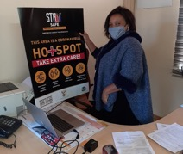
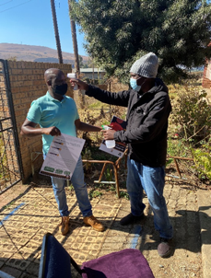
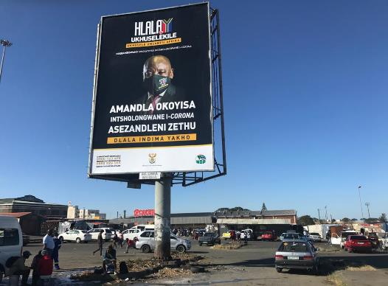
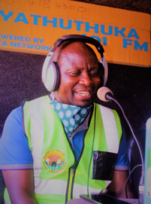
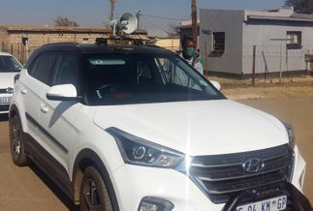
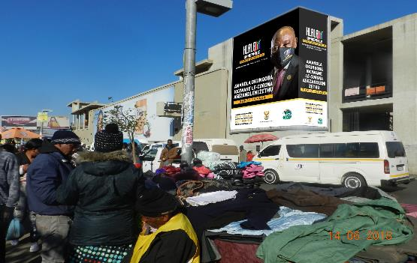
SASSA office at Matsamo Thusong COVID-19 Poster placement
Billboard in Mbizana, opposite Bus and Taxi Rank, main road
GCIS official distributing leaflets during a visit at Ebhudweleni Public School.
37 Statements issued
Mayor of Ndwedwe LM Cllr Chili - interviewed Siyathuthuka FM
2
Stakeholders conducting loud hailing
Billboard at Bara Taxi Rank

Slide 6
3. KEY RESEARCH INSIGHTS 1ST QUARTER RESULTS
93% heard, seen/read about Covid-19
The President is trusted by the population to lead the nation during the pandemic
01
Sub-messages on further preventative messages and government relief measures need further reach especially in lower segments.
1
02
People are aware that they need to play their part in curbing the spread of the virus
2
03
94% news/current affairs
3
Health experts followed by government are the top most trusted sources of information on Covid-19. Confirming the implementation of the government communication strategy.
04
compliance remains a mixed picture, and worse amongst the lower segments
05
83% news/current affairs
5
4
Top two most recalled messages are staying at home and wearing a mask
There is great uncertainty amongst the population about allowing kids to go to school.
Although 70% of the population agree that the ban on alcohol & tobacco has increased illegal trading, 64% think the ban is important and 66% are against people taking government to court.
Great fear of hunger over fear of infection especially amongst the lower segments.

Slide 7
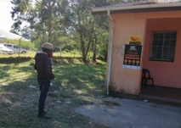
POSTERS AND LEAFLETS
EASTERN CAPE
MPUMALANGA
Constituency Office Centane - COVID-19 Poster placement.
SASSA office at Matsamo Thusong COVID-19 Poster placement
GCIS official distributing leaflets during a visit at Ebhudweleni Public School.

Slide 8
4. SUMMARY OF THE ACHIEVEMENTS
5.1 million copies of Vuk'uzenzele newspaper were produced
113 radio products and services were provided against the target of 60.
7 post-Cabinet briefings and/or statement were issued against the target of 5 as a result of special Cabinet meetings that were held.
30 media briefings were conducted against the target of 25. Additional briefings took place due to COVID-19 briefings being centralised at GCIS.
182 communication forums were held against the target of 57. Provincial offices had daily PROVJOCs and communication task team meetings on COVID
In partnership with National Institute for Communicable Diseases (NICD), 93 communicators were trained against a target of 25 as follows: 8 SIU executives received communication training and 45 communicators received COVID-19 training. Additional 40 communicators in the provinces received COVID-19 training

Slide 9
5. DELAYED TARGETS
Output Indicator | Target April- June 2020 | Output April- June 2020 | Deviation | Reason for Deviation | Corrective Action
Percentage of all compliant invoices paid within 30 days | 100% of all compliant invoices paid within 30 days | 71% (1117 of 1582) of all compliant invoices paid within 30 days | Target underachieved by 29% | At the beginning of April the processing system was not available due to financial year end. The level 5 lock down also impacted on the timeous processing of invoices as the operations was with limited capacity. | SCM will continue to monitor and priorities the processing of invoices
Number of photographic services provided | 120 photographic services provided | 108 photographic services were provided | Target underachieved by 12 | The number of requests decreased as a result of the coronavirus pandemic and national lockdown | It is envisaged that the number of requests may increase as the effects of the virus decrease.
Number of video services provided | 150 video services provided | 147 video services were provided | Target underachieved by 3 | Fewer requests for video coverage were received than anticipated when setting the target as a result of the coronavirus pandemic and national lockdown | The number of requests is likely to increase as the lockdown restrictions are eased.
Number of graphic designs completed | 110 graphic designs completed | 93 graphic designs were completed | Target underachieved by 17 | Fewer requests for graphic designs were received than anticipated as a result of the coronavirus pandemic and national lockdown | It is envisaged that the number of requests may increase as the effects of the virus decrease.

Slide 10
5. DELAYED TARGETS ….continued
Performance Indicator | Target April - June | Preliminary Output April - June | Deviation | Reason for Deviation | Corrective Action
Number of GCIS print products distributed | 6 GCIS print products distributed | 5 GCIS print products were distributed | Target underachieved by 1 | No distribution took place for the Vuk'uzenzele April 2020 B due to lockdown regulations. | -
Number of five-year cluster communication strategies developed | Five cluster communication strategies developed | Four cluster communication strategies were developed | Target underachieved by 1 | The delay is due to COVID-19 as the cluster is currently grappling with COVID-19 and its effects. | We will try to prioritise development of the of the Communication Strategy for the SPCHD cluster as we work on COVID-19.
Number of Cluster Communication Plans (CCP) developed | Five CCPs 2020/21 developed | Four CCPs 2020/21 were developed | Target underachieved by 1 | The delay was due to COVID-19 as the cluster is currently grappling with COVID-19 and it effects. | We will try to prioritise development of the of the CCP as we work on COVID-19.
Number of ICFs held | 3 Internal Communicators’ Forum (ICF) held | No Internal Communicators forum was implemented during this reporting period | Target underachieved by 3 | The implementation of the ICF has been delayed due to COVID-19. The format used to implement the ICF and face to face gatherings have been put on hold to minimise the spread of COVID-19 | Currently reworking the ICF calendar to ensure that its implementation complies with the COVID-19 regulations as it will now be implemented virtually.

Slide 11
5. DELAYED TARGETS ….continued
Performance Indicator | Target April - June | Output April - June | Deviation | Reason for Deviation | Corrective Action
Number of marketing events for Thusong programme held | 65 marketing events for Thusong programme held | 45 marketing events for Thusong programme held | Target underachieved by 20 | 20 below target due to Thusong Centres still closed and 9 vacancies in the provinces | Targets were adjusted (decreased) on the Revised 2020/21 APP

Slide 12
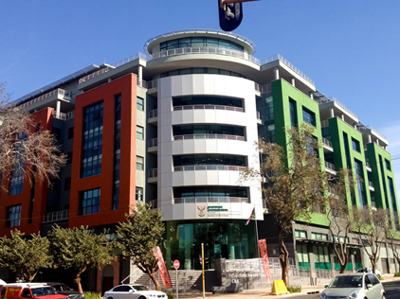
6.1 STAFF ESTABLISHMENT
ORGANISATION
ADDITIONAL POSTS
APPROVED
POSTS:
471
56
3
FILLED POSTS:
421
% OF FILLED POSTS:
89.38%
VACANT POSTS
50
VACANCY RATE
10.62 %
APPROVED: 57
FILLED : 48

Slide 13
6.2 STAFF ESTABLISHMENT PER OCCUPATIONAL CLASSIFICATION
PERMANENT POSTS
Occupational categories | Number of posts | Filled posts | Number of vacant posts | Vacancy rate
Top Management (Salary level 15-16) | 4 | 1 | 3 | 75%
Senior management (Salary 13-14) | 53 | 47 | 6 | 11.32%
Professionally qualified and experienced specialists and mid-management (Salary level 9-12) | 221 | 205 | 16 | 7.24%
Skilled technical and academically qualified workers (Salary level 6-8) | 151 | 137 | 14 | 9.27%
Semi-skilled and discretionary decision making (Salary level 3-5) | 42 | 31 | 11 | 26.19%
Total | 471 | 421 | 50 | 10.62%

Slide 14
6.3 EMPLOYMENT EQUITY STATUS
GENDER
DISABILITY
RACE
AFRICAN:
Target: 75%
Current: 85.27 % (+10.27%)
FEMALE:
Target: 50%
Current 58% (+8%)
Target: 2%
Current: 3.33%
(+1.33)
COLOURED:
Target: 9%
Current: 6.41 % (-2.59%)
MALE:
Target: 50%
Current: 42% (-8%)
INDIAN:
Target : 5%
Current: 3.09% (-1.91%)
WOMEN AT SMS LEVEL :
Target : 50%
Current: 50%
WHITE:
Target: 11%
Current: 5.23 % (-5.77%)

Slide 15
6.7. GCIS 2020/21 TOTAL BUDGET AND OVERVIEW
(30 June 2020)
BUDGET 2020/21 R750 548 000 – 100%
Less: Compensation of Employees (COE) (R295 404 000) – 39%
Less: Appropriations of Public Entities (R219 179 000) – 29%
Less: Contractual/Commitments/Capital (R136 265 000) – 18%
Balance: Operational Costs R 99 700 000 – 14%
86%
Includes R60 m for Covid-19
R99,7m
2

Slide 16
6.8. Budget vs Expenditure – 30 June 2020
PROGRAMME | TOTAL BUDGET | ACTUAL EXPENDITURE | % SPENT
 | R'000 | R'000
PROGRAMME 1: ADMINISTRATION | 171 557 | 42 780 | 25%
PROGRAMME 2: CONTENT PROCESSING AND DISSEMINATION | 445 404 | 133 875 | 30%
PROGRAMME 3: INTERGOVERNMENTAL COORDINATION AND STAKEHOLDER MANAGEMENT | 133 587 | 28 379 | 21%
TOTAL | 750 548 | 205 034 | 27%
Benchmark: 25%

Slide 17
6.8. Budget vs Expenditure – 30 June 2020
ECONOMIC CLASSIFICATION | TOTAL BUDGET | ACTUAL EXPENDITURE | % SPENT
 | R'000 | R'000
COMPENSATION OF EMPLOYEES | 295 404 | 65 394 | 22%
APPROPRIATIONS TO PUBLIC ENTITIES - Brand South Africa - MDDA | 219 179 186 132 33 047 | 73 081 64 819 8 262 | 33% 35% 25%
OPERATIONAL: - Goods and Services - Capital Assets | 235 965 231 962 4 003 | 66 559 65 892 667 | 28% 28% 17%
TOTAL | 750 548 | 205 034 | 27%
Benchmark: 25%

Slide 18
6.9. GCIS 2020/21 COVID-19
(30 June 2020)
Covid-19 Budget R60 Million (85% spent as at 30 June ):
Radio (SABC, commercial and community radio stations) – R16.3 million
Television (SABC, commercial and community tv stations) – R22.1 million
Advertising agencies (appointed through open bid process) – R6 million
Outdoor advertising (Billboards and electronic screens) – R12.8 million
Other (leaflets; posters; branding; wall murals; satellite signals) – R2.8 million
Included in radio spent - around R2 million to community radio stations; R8.5 million to SABC radio stations.
Included in television - around R1.8 million to community television; R11.8 million to SABC television.
Covid 19 Communication Advertisement by other departments:
R4 million to SABC radio and R9.7 million on SABC television channels that GCIS placed with the SABC in respect of media bulk buying campaigns on behalf of other departments on Covid-19.
2

Slide 19
8. GCIS 2020/21 COVID-19
(30 June 2020)
Personal Protective Equipment (PPE’s) and cleaning (Cost implication):
Spend priority | Spent to date
Personal protective equipment (PPE’s) – Masks, gloves | R157 000
Sanitizers | R59 000
Loudhailers (Prov Offices) | R105 000
Panel screens (social distancing at work stations) | R581 000
Disinfecting office space / deep cleaning | R132 000
Digital thermometers | R105 000
TOTAL | R1 139 000

Slide 20
8. GCIS 2020/21 COVID-19
(30 June 2020)
Personal Protective Equipment (PPE’s) and cleaning (Cost implication):
Spend priority | Detail of cost implication
Personal protective equipment (PPE’s) – Masks, gloves – R157 000 | National Treasury service providers listed under Treasury Instruction No 8 of 2019/20 was used to procure the masks: Mask Surgical Face - 2500 at R12.48, total R31 200 (masks were given to staff at head office, provincial offices and during media briefings). GCIS three layer cloth masks - 2000 at R25 each, total R50 000. Head office staff and provincial staff were given 4 masks per official. GCIS branded two layer cloth masks - 1000 at R24,61, total R24 610. Staff at head office and provincial offices were given two per official. Surgical masks - 1000 at R26,65, total R26 650 Gloves (latex) - 20 boxes at R460 per box, total R9 200 Gloves (latex) - 50 boxes at R250 per box, total R12 500 Wipes 25L – 28 containers at unit cost of R112,30, total R3 144. Wipes are used at the pressroom and uditorium during media briefings
Sanitizers / cleaning – R59 000 | National Treasury service providers listed under Treasury Instruction No 8 of 2019/20 was used to procure the masks: 500ml hand sanitizers – 90 boxes at R350 per box, total R31500. Provincial offices were given 10 per province. 5l surface disinfect - 10 containers at R1 074,68 unit cost, total R10 747. Nine were given to provincial offices and one to GCIS Parliamentary office. 5L Sanitisers – 20 containers at R425 per unit cost, total R8 500. Refiling 500ml bottles given to head office staff. Four procurements of R2 000 each (total R8 000) to refill head office staff 500ml bottles
2

Slide 21
8. GCIS 2020/21 COVID-19
(30 June 2020)
Personal Protective Equipment (PPE’s) and cleaning (Cost implication):
Spend priority | Detail of cost implication
Loudhailers (Prov Offices) – R105 000 | Normal procurement process was followed with a minimum of three quotations sourced. 57 loudhailers – used in 57 districts around the country by GCIS Prov communicators Unit cost: R1 842
Panel screens (social distancing at work stations) – R581 000 | Three separate procurement processes, each with a minimum of three quotations: Areas and number of panel screens differ per Section Reception, three entrances, CRC and Finance at R359 130 SCM, Facilities Management and Internal audit at R183 080 Risk and Strategic Unit at R38 650
Disinfecting office space / deep cleaning – R132 000 | Disinfecting two times at Head Office (14 500 square meters); Unit cost at R53 900 9 Provincial Offices disinfected at R24 000 Normal procurement processes were followed with a minimum of three quotations. Cheapest quotation used.
Digital Thermometers – R105 000 | GCIS Head Office entrances. Normal procurement process was used with four quotations - cheapest quotation used: Four digital thermometers with total cost of R29 785 Unit cost: R7 446,25 13 digital thermometers were procured under National Treasury Instruction No 8 of 2019/20 for the provincial offices and GCIS Parliamentary Office Total of R74 750 Unit cost: R5 750.00
2

Slide 22
Thank you
- End -
THANK YOU

