Slide 1
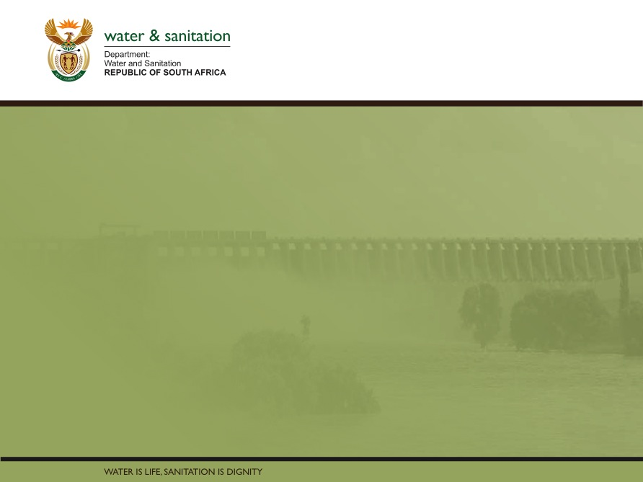
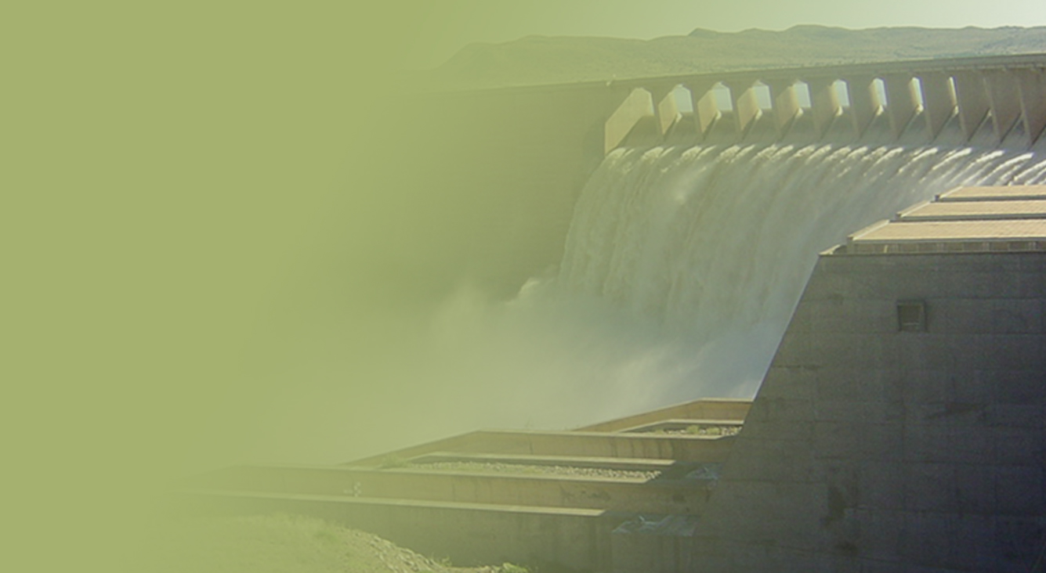
Briefing the Department of Water and Sanitation’s Free State District Implementation Plan
PRESENTATION TITLE
Presented by:
Name Surname
Directorate
Date
Presented by:
Mr M Tshangana
Acting Director-General
25 August 2020

Slide 2
Contents
Purpose………...…………………..…………………...…………………...….……..3
Part 1: Situational analysis………………………………………………………4 - 12
Part 2: Overview of the Free State2020/21 District Implementation Plan targets.…………………………………………………………………………...13 - 46
  Mangaung Metropolitan Municipality
  Fezile Dabi District Municipality
  Lejweleputswa District Municipality
  Xhariep District Municipality
  Thabo Mofutsanyane District Municipality

Slide 3
Purpose
To brief the Portfolio Committee on the Department of Water and Sanitation’s Free State District Implementation Plan for 2020/21

Slide 4
Part 1: Situational analysis

Slide 5





Provincial overview
THE FREE STATE
HAS A TOTAL OF
82 TOWNS
3 PERENNIAL
RIVERS
35%
OF THE TOWNS RELY
ON GROUNDWATER
FS CONTRIBUTES
5.4%
TO THE GROSS DOMESTIC PRODUCT
65%
OF THE TOWNS RELY
ON SURFACE WATER
Special Economic Zones
Maluti-A-Phofung (MAPSEZ)
Strategic key projects in the pipeline:
Xhariep pipeline
MOST TOWNS RELY
ON A MIXURE OF BOTH
MAIN ECONOMIC ACTIVITIES
- Agriculture, - Mining,
- Government & - Tourism

Slide 6
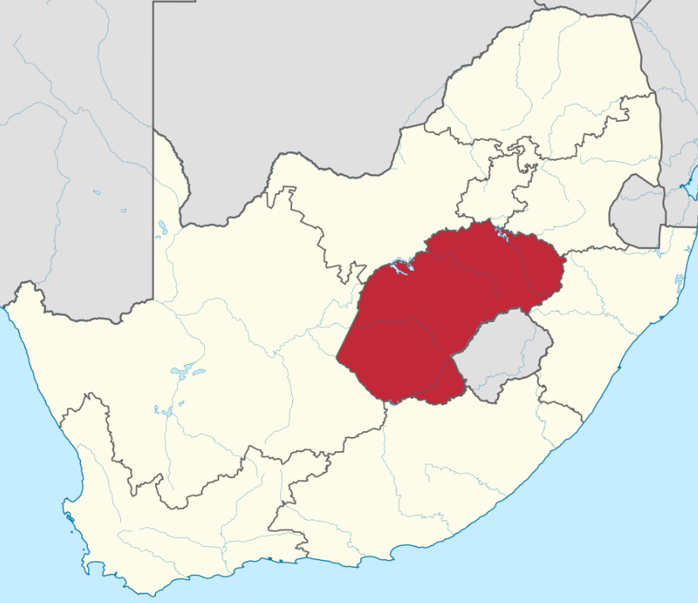




Provincial overview
129,825 km²
3rd LARGEST PROVINCE
With a total area of 129 825 square kilometres, the Free State covers about 10,6% of the country's land area
2 954 300
SECOND SMALLEST
POPULATION
TOTAL OF
960 000
HOUSEHOLDS
21 / Km²
POPULATION
DENSITY
3
AVERAGE
HOUSEHOLD SIZE

Slide 7
Municipal Strategic Self Assessment (MuSSA)
Water Services Development Plans
WSA Name | 2018 | 2019
 | Initiated | Initiated | Draft | Adopted
Kopanong: FS162 | X
Letsemeng: FS161 | X
Mangaung Metropolitan Municipality: MAN | X
Mantsopa: FS196 |  | X
Masilonyana: FS181 |  | X
Metsimaholo: FS204 |  | X

Slide 8
Free State municipalities MuSSA vulnerability index
Lvl Code | Municiplaity | Completion Progress (2019) | Trend | Vulnerability Index (2018) | Vulnerability Index (2019)
FS163 | Mohokare | 100 | Deterioration | 0,38 | 0,44
FS183 | Tswelopele | 100 | Improvement | 0,38 | 0,35
FS194 | Maluti-A-Phofung | 100 | Deterioration | 0,42 | 0,92
FS196 | Mantsopa | 100 | Deterioration | 0,64 | 0,69
FS204 | Metsimaholo | 100 | Deterioration | 0,66 | 0,69
MAN | Mangaung Metropolitan Municipality | 100 | Improvement | 0,68 | 0,66
FS205 | Mafube | 76,52 | Deterioration | 0,72 | 0,83
FS181 | Masilonyana | 31,06 | Deterioration | 0,73 | 1
FS191 | Setsoto | 100 | Deterioration | 0,8 | 0,82
FS162 | Kopanong | 0 | Deterioration | 0,81 | 1
FS192 | Dihlabeng | 100 | Deterioration | 0,82 | 0,84
FS201 | Moqhaka | 100 | Improvement | 0,84 | 0,8
FS184 | Matjhabeng | 26,52 | Deterioration | 0,85 | 1
FS182 | Tokologo | 3,79 | Deterioration | 0,85 | 1
FS161 | Letsemeng | 100 | Deterioration | 0,89 | 0,92
FS193 | Nketoana | 15,15 | Deterioration | 0,9 | 0,97
FS203 | Ngwathe | 100 | Improvement | 0,91 | 0,78
FS195 | Phumelela | 100 | Improvement | 0,94 | 0,89
FS185 | Nala | 50 | Improvement | 1 | 0,96

Slide 9
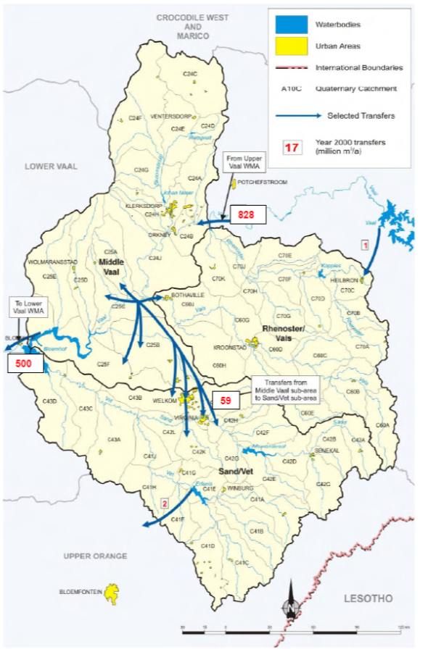
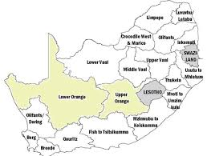
Overview of Middle Vaal and Upper Orange WMA

Slide 10
Provincial implementation plan: District Development model (DDM)
Programmatic areas | Core interventions | Progress
Consultations and Stakeholder Engagements | Communication plan, Broad consultations and workshops, social compacts, investor partnerships & agreements) | Consultations with Districts and Metro were done
Institutionalization Support | Set-up DDM structures, Legitimization, Inaugurations, Protocols, Social Compacts, Building Capacities - Technical Capacity Hubs, ToRs, Core Teams, Institutionalise Reporting Mechanism . | Ministers and Deputy Ministers as champions to each district in FS, MECs and HODs for DDM support. To prepare visit of Champions to the different Districts and Metro.
Planning & Development | Demographic & Socio-economic Profiling Analysis & Prognosis; Economic Positioning; Spatial Re-integration and Catalytic Infrastructure Re-positioning Planning & Funding; Re-prioritization Process, Municipal Governance & Management Refocus, Integrated Services Delivery and Plan. Alignment with IDPs Process Plans approved by Councils during institutionalisation. | Demographic analysis, socio-economic profiling for all Districts and Metro was drafted as per the National Guide to Develop the DDM Plan. COGTA and Provincial Treasury developed DDM Profiles and Plans as a baseline for Districts & Metro in November 2019. Submitted to National COGTA for analysis Catalytic projects per sector department (to focus on the weaknesses of Districts and Metro
Implementation and Monitoring | Developing monitoring dashboard system. The activities include implementation by the TCH and the Municipalities engaging all Sectors, DPME and OTP | Integrated Geo-Spatial Information Dashboard Monitoring System need to be considered by COGTA.

Slide 11
Water and sanitation provincial MIG implementation funding (2020/21)
MIG
Municipality | Number of Sanitation Interventions | Number of Water Interventions | Total Cost Requirements
Dihlabeng LM | 2 | 3 | R 49 757 626,09
Kopanong LM | 3 | 5 | R 29 541 799,46
Letsemeng LM | 4 | 6 | R 30 685 987,82
Mafube LM | 6 | 4 | R 57 979 639,45
Maluti-A-Phofung LM | 10 | 11 | R 293 478 715,61
Mantsopa LM | 2 |  | R 563 235,42
Masilonyana LM | 2 | 7 | R 32 811 620,34
Matjhabeng LM | 14 | 5 | R 118 672 130,21
Metsimaholo LM | 3 | 1 | R 35 516 846,52
Mohokare LM | 3 | 1 | R 27 172 803,35
Moqhaka LM | 4 | 5 | R 36 352 485,07
Nala LM | 1 | 2 | R 3 691 641,00
Ngwathe LM | 2 | 6 | R 68 061 659,61
Nketoana LM | 3 | 3 | R 49 169 679,60
Phumelela LM | 2 | 5 | R 40 338 074,30
Setsoto LM | 5 | 6 | R 91 932 988,62
Tokologo LM | 3 | 3 | R 14 190 139,49
Tswelopele LM | 3 | 1 | R 31 172 703,34

Slide 12
Administration
The Free State has 24 vacant funded posts and are as follow:
- 3 (three) SMS
- 1 (one) MMS
- 5 (five) OSD
- 15 (fifteen) Non-OSD

Slide 13
Part 2.1: Infrastructure projects per District Municipality
Part 2.2: state of WASTEWATER treatment works per district municipality
PART 2: OVERVIEW OF THE FREE STATE 2020/21 DISTRICT IMPLEMENTATION PLAN TARGETS

Slide 14
Part 2.1: Infrastructure projects per District Municipality

Slide 15



Overall funding allocation for MTEF
UPDATE
11
AUGUST
Funding Programme
Allocation 2020/21
Allocation 2021//22
Allocation 2022/23
Total Allocation
RBIG schedule 6B | 737 716 000 | 601 960 000 | 701 898 000 | 2 041 574 000
RBIG Schedule 5B | 219 608 000 | 209 608 000 | 206 790 000 | 636 006 000
Drought (WSIG) | 130 840 000 |  |  | 130 840 000
BEP(WSIG) | 82 038 000 |  |  | 82 038 000
WSIG | 415 636 000 |  |  | 415 636 000
Total allocation in FS | 1 585 838 000 | 811 568 000 | 908 688 000 | 3 306 094 000
2020

Slide 16
2020/21 grant allocation administered by the Province
GRANT ALLOCATIONS 2020/21 ADMINISTERED BY PROVINCE
R1 950 433 972.74 (Annual Average)
BUDGET SIZE
WSAs
DWS
Difference is MWIG focuses on projects linked to backlogs
RRU
WSIG (32.2%)
R628,514 000
)
MIG (18.6%)
R364 595 972,74
RBIG (49.2%)
R957, 324,000
NWRI:
infrastructure
Quick fix
Refurbishment
REGIONAL
Technical
WC/WDM
RETICULATION
BULK
BULK
WATER RESOURCE
solutions
FUNCTION

Slide 17
Summary of 2020/21 grant allocations
Programme | DoRA schedule | Total per programme | Allocation
RBIG | Schedule 5B | 957 324 000,00 | 219 608 000,00
 | Schedule 6B |  | 737 716 000,00
WSIG | Schedule 5B | 628 514 000,00 | 415 636 000,00
 | Schedule 6B |  | 212 878 000,00
MIG | Schedule 5B | 364 595 972,74 | 364 595 972,74
 | Schedule 6B |  | 0
Total |  | 1 950 433 972,74 | 1 950 433 972,74

Slide 18




Regional Bulk Infrastructure Grant (RBIG)
UPDATE
11
AUGUST
District Municipality
Municipality
No. Projects
Allocation
Xhariep | Kopanong, Mohokare | 2 | R 44,000,000
Lejweleputswa | Masilonyana, Tokologo, Tswelopele | 3 | R101,893,000
Fezile Dabi | Metsimaholo, Mafube, Ngwathe | 3 | R117,239,000
Thabo Mofutsanyana | Dihlabeng, Nketoana, Maluti-a-Phofung, Setsoto, Mantsopa | 5 | R208,399,000
Mangaung | Mangaung | 1 | R 80,000,000
2020

Slide 19

Regional Bulk Infrastructure Grant (Covid-19)
UPDATE
11
AUGUST
Municipality
Project
Allocation
Status
Masilonyana | Brandfort Bulk Sewer | R30,074,000 | Planning (appointment of IA)
Nketoana | Lindley Sewer | R47,968,000 | Planning (appointment of IA)
Maluti-a-Phofung | Fika Patso Treatment Works | R34,284,000 | Planning (appointment of IA)
Mantsopa | Mantsopa Water and Sanitation Intervention | R18,660,000 | Planning (appointment of IA)
Mafube | Mafube Water and Sanitation Intervention | R29,685,000 | Planning (appointment of IA)
Setsoto | Marquard and Clocolan Water Supply | R15,000,000 | Planning (appointment of IA)
Phumelela | Warden Treatment Works | R28,709,000 | Planning (appointment of IA)
Various | Various | R41,761,000 | Planning
2020

Slide 20
Water Services Infrastructure Grant (WSIG)
UPDATE
11
AUGUST
District Municipality
Municipality
No. Projects
Allocation
Xhariep | Kopanong, Mohokare, Letsemeng | 8 | R 82,226,000
Lejweleputswa | Masilonyana, Tokologo, Tswelopele, Nala, Matjhabeng | 7 | R 78,000,000
Fezile Dabi | Metsimaholo, Mafube, Moqhaka, Ngwathe | 10 | R 80,825,000
Thabo Mofutsanyana | Dihlabeng, Nketoana, Maluti-a-Phofung, Setsoto, Mantsopa, Phumelela | 13 | R171,585,000
2020

Slide 21
Bucket Eradication Programme (BEP)
UPDATE
11
AUGUST
Municipality
Project
Allocation
Status
Tokologo | Hertzogville BEP | R19, 983,000.00 | Planning ( 0% complete)
 | Dealesville BEP | R20, 000,000.00 | Planning ( 0% complete)
Setsoto | Senekal BEP | R 6, 979,000.00 | Planning ( 0% complete)
Nketoana | Arlington BEP | R20, 931,000.00 | Planning ( 0% complete)
 | Lindley BEP | R14, 747,000.00 | Planning ( 0% complete)
BEP
2020
Setsoto | Clocolan outfall sewer pipeline and pump stations | R19, 983,000.00 | Construction 15% complete
 | Senekal outfall sewer pipeline and pump stations | R50 ,409,000.00 | Construction 9% complete
 | Ficksburg outfall sewer pipeline and pump stations | R13, 381,000.00 | Construction 28% complete
Nketoana | Reitz outfall sewer pipeline and pump stations | R11, 200,000.00 | Planning 50% complete
 | Petrus Steyn outfall sewer pipeline and pump stations | R 5, 288,000.00 | Planning 50% complete
 | Arlington outfall sewer pipeline and pump stations | R41, 084,000.00 | Planning 50% complete
Tokologo | Dealesville outfall sewer pipeline and pump stations | R18, 307,000.00 | Planning 50% complete
RBIG

Slide 22
BEP (cont’d)
Outcomes | Outputs | Output indicators | Estimated performance
 |  |  | 2019/20 | 2020/21
Sanitation backlog systems in formal settlements replaced with adequate sanitation | Bucket Eradication Programme implemented | Number of existing bucket sanitation backlog systems in formal settlements replaced with adequate sanitation services per year | 10 202 Thabo-Mofutsanyana District Clocolan 3 379 Senekal 2 435 Ficksburg 218 Petrus Steyn 960 Reitz 739 Arlington 1 192 Lejweleputswa District Dealesville1 279 | 10 202 Thabo-Mofutsanyana District Clocolan 3 379 Senekal 2 435 Ficksburg 218 Petrus Steyn 960 Reitz 739 Arlington 1 192 Lejweleputswa District Dealesville1 279

Slide 23
Drought Relief projects

Slide 24
Water Services Infrastructure Grant (Drought)
UPDATE
11
AUGUST
District Municipality
Municipality
No. Projects
Allocation
Xhariep | Kopanong, Mohokare | 7 | R16,763,000
Lejwelephutswa | Masilonyana, Tokologo | 3 | R20,000,000
Fezile Dabi | Mafube, Moqhaka | 4 | R14,010,000
Thabo Mofutsanyana | Dihlabeng, Nketoana, Maluti-a-Phofung, Mantsopa, Setsoto | 10 | R80,067,000
2020

Slide 25
Part 2.2 - State of Wastewater Treatment Works per District Municipality

Slide 26
State of Wastewater Treatment Works within WSAs

Slide 27
State of Wastewater Treatment Works within Free State WSAs

Slide 28
XHARIEP DISTRICT
Failing WWTW and Pump Stations
WSA | Name of WWTW |  | Type of Treatment Technology | Impact of failure | Regulation | Intervention required
Letsemeng LM | 1 | Jacobsdal - Overloaded by private abattoir waste and 100% vandalized by community. No easy access into the plant due to illegal dumping site blocking access. | Oxidation Ponds with Bio-Filter. | Pollution of Riet River – Water is abstracted by farmers for irrigation of export crops. | Non-compliance letters | Trade effluent by-laws, Abattoir pre treatment. Municipal inspectors. Refurbishment of WWTWs.
 | 2 | Koffiefontein – Works is vandalized and lack of maintenance. Works is 100% non functional. | 2 x Activated sludge plants operating in parallel. | Pollution of Riet River | Non-compliance letters | Mechanical and electric repairs. Implementation of O&M program.
 | 3 | Luckhoff – The inlet of the works is vandalised and the oxidation ponds are poorly maintained. No Process Controller. | Oxidation Ponds | Pollution of environment and possible risk of ground water pollution | - | Mechanical and electric repair. Ponds to be refurbished and implementation of O&M program by municipality. Appointment of Process Controller is essential.

Slide 29
XHARIEP DISTRICT
Failing WWTW and Pump Stations -Cont.
WSA | Name of WWTW |  | Type of Treatment Technology | Impact of failure | Regulation | Intervention required
Letsemeng LM | 4 | Petrusburg – Poorly maintained and operated by municipality. No Process Controller. No disinfection of the final effluent prior discharge. | Oxidation Ponds | Pollution of environment and possible risk of ground water pollution | - | Ponds to be refurbished and implementation of O&M program by municipality. Appointment of Process Controller is essential.
Mohokare LM | 1 | Zastron - Ponds are poorly maintained; aged sludge accumulation. Inconsistent disinfection. | BNR and Oxidation Ponds | Pollution to Montagu Dam | Non-compliance letters | Ponds to be refurbished and implementation of O&M program by municipality. consistent disinfection of final effluent.
 | 2 | Smithfield - The chorine room is 100% non functional. No disinfection of the final effluent. The mixers in the ASS are not operational. | Activated sludge system and Maturation Ponds | Pollution to Caledon River | Non-compliance letters | Mechanical repair of dosing pumps and mixers. Removal of aged sludge on the PSTs. consistent disinfection of final effluent.

Slide 30
XHARIEP DISTRICT
Failing WWTW and Pump Stations – Cont.
WSA | Name of WWTW |  | Type of Treatment Technology | Impact of failure | Regulation | Intervention required
 | 3 | Rouxville - The pump station is poorly maintained and is overloaded by private abattoir waste resulting to continuous spillage that may possibly affect the quality of the raw water dam. The anaerobic and oxidation ponds are poorly maintained. Bio-filter has not been in operation for years. | Oxidation Ponds with Bio-Filter | Pollution to Caledon River | Non-compliance letters | Trade effluent by-laws, Abattoir pre treatment. Municipal inspectors. Mechanical repair of the bio-filter. Ponds to be refurbished and implementation of O&M program by municipality. Consistent disinfection of final effluent prior discharge.
Kopanong LM | 1 | Reddersburg – Oxidation ponds are acculated with sludge. Pumps and chlorine room are Vandalized. | Oxidation Ponds | Pollution of Riet River | Non-compliance letters | Implementation of O&M program. Refurbishment of Chlorination room. Security needs to be strengthen due to theft & vandalism.

Slide 31
XHARIEP DISTRICT
Failing WWTW and Pump Stations – Cont.
WSA | Name of WWTW |  | Type of Treatment Technology | Impact of failure | Regulation | Intervention required
 | 2 | Edenburg - Works is 100% non functional, Sewerage bypass from the inlet to the stream due to lack of maintenance. Submersible pumps are non-operational. | Oxidation ponds | Pollution of Riet River | Non-compliance letter | Mechanical and electric repairs. Implementation of O&M program. Refurbishment of Chlorination room. Security needs to be strengthen due to theft & vandalism
 | 3 | Gariep - Works is 100% non functional due to lack of maintenance. Bio filter & digester pumps are dysfunctional. | Bio-filter and Oxidation ponds | Pollution of environment | Non-compliance letter | Mechanical and electric repairs. Implementation of O&M program. Refurbishment of Chlorination room.
 | 4 | Fauriesmith – Tertiary pond is leaking, Pumps & chlorine room are vandalized. No disinfection of final effluent prior discharge. | Oxidation ponds | Pollution of environments | Non-compliance letters | Refurbishments of oxidation ponds. Mechanical and electric repairs. Construction of a new chlorine room.

Slide 32
LEJWELEPUTSWA DISTRICT
Failing WWTW and Pump Stations
WSA | Name of WWTW |  | Type of Treatment Technology | Impact of failure | Regulation | Intervention required
Matjhabeng LM | 1 | Hennenman WWTW – Aging infrastructure resulting to WWQ failures. | Activated Sludge | Water is abstracted by farmers for irrigation of crops |  | Refurbishment of WWTW. Municipality to implement adequate O&M Manuals
 | 2 | Phomolong WWTW – Screw pump bearing is broken resulting in sewerage not being able to enter the treatment works. | Activated Sludge | Water is abstracted by farmers for irrigation of crops. | Non-compliance Letters | Urgent repair of screw pump bearing,
 | 3 | Witpan WWTW – Treatment works is over capacitated. | Activated Sludge | Pollution of Witpan pan | - | Refurbishment of Thabong and Theronia treatment works must be prioritised to the relieve pressure on Witpan treatment works.
 | 4 | Thabong WWTW – Entire treatment works has been vandalised and is completely out of operation. | Activated Sludge | Pollution of Witpan pan and Mostert Channel | - | Mechanical & electrical repairs for all processes at treatment works, Appointment of Security to prevent vandalism.
 | 5 | Kutlwanong WWTW – The works is 100% vandalised (cable theft) and is completely non functional. | Activated Sludge | Pollution of Skoonsspruit River | - | Electrical repairs need to be done and proper security needs to be strengthened to prevent further theft of cables.

Slide 33
LEJWELEPUTSWA DISTRICT
Failing WWTW and Pump Stations – Cont.
WSA | Name of WWTW |  | Type of Treatment Technology | Impact of failure | Regulation | Intervention required
Tswelopele LM | 1 | Hoopstad WWTW – Settling tanks not in operation due to malfunctioning of a motor. | Activated Sludge | Pollution of vet river – water is abstracted for irrigation of the golf course | - | Mechanical equipments (e.g. motor) must be repaired.
Masilonyana LM | 1 | Brandfort – Completely not functional. Regular pump station failures. | Oxidation Ponds with PST and bio-filter. | Pollution of Modderiet (Keeromspruit River) | - | Refurbishment of WWTWs and pump station. Ponds needs to be refurbished. Implementation of O&M program.
 | 2 | Winburg - Pump stations not functional. The works is completely vandalised and not operational. The sewage flow into resources. | Activated Sludge System | Pollution of Rietfontein Dam which is the primary raw water source of Windburg WTW. The polluted water is then pumped into the offshore storage called Wolwas 1&2 | - | A project is in place to refurbish the entire plant and pump station.
 | 3 | Theunissen - No chlorination of the final effluent. | Activated Sludge System | Discharge into an unknown stream | - | implementation of O&M program by municipality. consistent in chlorination of effluent.

Slide 34
LEJWELEPUTSWA DISTRICT
Failing WWTW and Pump Stations – Cont.
WSA | Name of WWTW |  | Type of Treatment Technology | Impact of failure | Regulation | Intervention required
 | 4 | Verkeerdevlei - Pump station is completely not operational. sewage flows in an area where boreholes are located; affecting the quality of the groundwater. | Oxidation Ponds | Pollution of environment and possible risk of ground water pollution | - | Pump station and ponds needs to be refurbished. implementation of O&M program by municipality.
Tokologo | 1 | Boshof - No groundwater monitoring system in place. | Evaporation pond system | No discharge | - | Monitor groundwater
 | 2 | Dealsvile - No groundwater monitoring system in place. | Evaporation pond system | No discharge | - | Monitor groundwater
Nala LM | 1 | Bothaville WWTW – Inadequate disinfection. Non operational of aerators and mixers. | Activated Sludge | Pollution of Vals river | - | Mechanical and electric repairs. Implementation of O&M program.
 | 2 | Wesselsbron WWTW – the plant is flooded and 100% non operational. | Activated Sludge | Pollution of Environment and the Community | - | Total refurbishment of plant. Implementation of O&M Program.

Slide 35
FEZILE DABI DISTRICT
Failing WWTW and Pump Stations
WSA | Name of WWTW |  | Type of Treatment Technology | Impact of failure | Regulation | Intervention required
Ngwathe LM | 1 | Parys - Overloaded by private abattoir waste. The PSTs and SSTs are poorly maintained. | Biological filters. | Pollution of Vaal River | Non-compliance letters | Trade effluent by-laws, Abattoir pre treatment. Municipal inspectors. Refurbishment of WWTWs. Consistent disinfection of final effluent.
 | 2 | Koppies - Malfunctioning of aerators and mixers on the ASS. The works receive private abattoir waste. No disinfection of the final effluent. | Activated Sludge System. | Pollution of Renoster River | Non-compliance letters | Trade effluent by-laws, Abattoir pre treatment. Mechanical and electric repairs. Implementation of O&M program. Consistent disinfection of final effluent.
 | 3 | Heilbron - The automated de-gritter, aerators, mixers and arm bridge of the SST are not operational resulting to sludge accumulation in the SST. Ponds are dominated by reeds and aged sludge. | Activated Sludge System. | Pollution of Elandspruit-Water is abstracted for irrigation of Heilbron Golf club and RollBall Club. | Non-compliance letters | Prioritisation of mechanical repairs. Ponds to be refurbished.

Slide 36
FEZILE DABI DISTRICT
Failing WWTW and Pump Stations – Cont.
WSA | Name of WWTW |  | Type of Treatment Technology | Impact of failure | Regulation | Intervention required
 | 4 | Vredefort - Continuous malfunctioning of transfer pumps in the mixing tank. holding pond, drying beds, oxidation and maturation ponds are poorly maintained. The works receive private abattoir waste. | 2x Aeration tanks and Oxidation Ponds | Pollution of an unknown tributary stream of Vaal River. | Non-compliance letters | Maintenance of all types of ponds. Mechanical repair. Consistent disinfection of final effluent prior discharge.
Mafube LM | 1 | Frankfort WWTW – Non-operational bio filters and lack of maintenance of the overall treatment works | Oxidation ponds with biological filters | Pollution of Wilge River | - | Mechanical and electric repairs of bio-filter and settling tanks. Implementation of proper O&M program.
Moqhaka LM | 1 | Kroonstad WWTW –100% non operational. the inlet area is extremely flooded with water. | Activated sludge with bio-filters operating in parallel series | Pollution of Vals River | - | Total refurbishment of treatment works. Implementation of O&M programme

Slide 37
FEZILE DABI DISTRICT
Failing WWTW and Pump Stations – Cont.
WSA | Name of WWTW |  | Type of Treatment Technology | Impact of failure | Regulation | Intervention required
 | 2 | Steynsrus WWTW – uses Pond system that are currently overflowing to the environment. The overflowing effluent is not disinfected. | Pond system | Pollution of Vals River | - | Complete the upgrade of the plant in order for adequate disinfection to take place.
Metsimaholo LM | 1 | Oranjeville WWTW – Entire plant is not operational. No disinfection taking place. | Oxidation pond system with bio-filter | Pollution of Vaal River | Non-compliance Letters | Total refurbishment of treatment works. Implementation of O&M Program. Consistent disinfection of the final effluent prior discharge.
 | 2 | Deneysville WWTW – The Plant is over capacitated. Bio-filters are not operational | Oxidation pond system with bio-filter | Pollution of Vaal River | - | Repairing of electrical and mechanical failures. Awaiting contractor to complete the extension of the plant.

Slide 38
THABO MOFUTSANYANA DISTRICT
Failing WWTW and Pump Stations
WSA | Name of WWTW |  | Type of Treatment Technology | Impact of failure | Regulation | Intervention required
Nketoana | 1 | Reitz - The works is over capacitated and receives wastewater from abattoir. Aerators, automated de-gritter no operational. Ponds are poorly maintained. | Biological filters | Pollution to Langspruit. Water is abstracted by farmers for irrigation of crops and Golf Course. | Non- compliance letters | Prioritization of mechanical faults and maintenance of all the all ponds.
 | 2 | Lindley - The works is 100% completely non functional. Pump Station No.3 is 100% non functional due to malfunctioning of raw sewage pumps; therefore sewage bypass into Vals River. The works is 100% vandalized. By community. | Oxidation ponds | Pollution to Vals River. | Non- compliance letters | Refurbishment of Pump Station no.3 and the infrastructure of the works.

Slide 39
THABO MOFUTSANYANA DISTRICT
Failing WWTW and Pump Stations – Cont.
WSA | Name of WWTW |  | Type of Treatment Technology | Impact of failure | Regulation | Intervention required
 | 3 | Petrus Steyn - The works is poorly maintained. the wastewater bypass from the inlet into oxidation ponds due to malfunctioning of the unit processes. The washing area for the bucket system have cracks resulting to leakages. automated de-gritter at the inlet is not operational due to mechanical faults. Overflowing of sump and humus tanks to the environment. Grey water plant has never in operation. | Biological filters and Oxidation ponds | Pollution to unknown stream | - | Implementation of O &M Manuals. Prioritization of Mechanical repair. The Grey water plant need to be inspected and repaired if necessary in order to serve its purpose.
Phumelela LM | 1 | Warden WWTW – Wastewater bypass from the inlet to the oxidation ponds. The unit process such as bio-filters and settling tanks are out of operation due to mechanical faults. | Bio-filters and Settling Tanks | Pollution of Cornelis River | - | Refurbishment of entire treatment works. Appointment of Security to protect the Municipal infrastructure. Implementation of O&M program.

Slide 40
THABO MOFUTSANYANA DISTRICT
Failing WWTW and Pump Stations – Cont.
WSA | Name of WWTW |  | Type of Treatment Technology | Impact of failure | Regulation | Intervention required
 | 2 | Vrede WWTW – Faulty bio-filters and settling tanks. chorine room is vandalised . | Bio-filters and Settling Tanks | Pollution of Riet River | - | Mechanical and electric repairs of bio-filters and settling tanks. Appointment of Security to protect the Municipal infrastructure. Implementation of O&M program.
Setsoto LM | 1 | Ficksburg WWTW – Entire treatment works is not operational due to vandalism | Activated Sludge System. | Pollution of Caledon River | - | Refurbishment of entire treatment works. Appointment of competent security to prevent theft and vandalism. Implementation of O&M program.
Dihlabeng LM | 1 | Bethlehem WWTW – Treatment works is overloaded. Construction is currently taking place | Activated Sludge | Pollution of Jordan River. Impacts farmers which use the water downstream | - | Construction project needs to be completed

Slide 41
THABO MOFUTSANYANA DISTRICT
Failing WWTW and Pump Stations
WSA | Name of WWTW |  | Type of Treatment Technology | Impact of failure | Regulation | Intervention required
MaP LM | 1 | Harrismith (Wilge) – incomplete project. The Plant is 100% non functional; non-operation of bio-filter, aerators, and ageing sewer pipelines. Electrical cable theft is challenge. | Activated sludge Plant , Bio-filters & Sedimentation tanks | Pollution of Wilge River | Non-compliance letter | Project must be completed. Mechanical and electric repairs must be prioritized. Security need to appointed to protect the municipal infrastructure.
 | 2 | Moeding - Pump stations are dysfunctional & no incoming wastewater. Plant is 100% non functional such as bio-filter. Electrical cable theft & vandalism is a challenge. | Oxidation ponds, Bio-filter | Pollution of Vaal River | Non-compliance letter | Plant should be refurbished and Security need to be strengthened due to theft & vandalism. O&M should be implemented.
 | 3 | Makwane - Plant is 100% non functional, Booster pump station is vandalized, Bio-filter pump is out order. No skilled process controllers. | Oxidation ponds , Bio filter | Pollution of Vaal River | Non-compliance letter | Mechanical and electric repairs. Implementation of O&M program, Security need to be strengthened due to theft & vandalism. Training of process controllers is crucial.

Slide 42
THABO MOFUTSANYANA DISTRICT
Failing WWTW and Pump Stations – Cont.
WSA | Name of WWTW |  | Type of Treatment Technology | Impact of failure | Regulation | Intervention required
 | 4 | Kestell - Plant is 80% non functional; Oxidation ponds are not working properly, bio-filters are blocked, the plant is poorly Operated & Maintaned . | Oxidation ponds, Bio-filters | Pollution of Vaal River | Non-compliance letter
 | 5 | Phuthaditjaba - Works is not operational due to mechanical breakdowns, dysfunctional bio-filters & pump stations. digesters are also blocked | Sedimentation tanks, Bio-filters & digesters | Pollution of Vaal River | Non-compliance letters | Mechanical and electric repairs. Implementation of O&M program.
 | 6 | Tsiame - Works is not operational due to cable theft. Primary sedimentation and bio-filter are still new (never been in operation). The Activated Sludge System is not in operation. | Sedimentation tanks, Bio-filters & Activated sludge system | Pollution of Vaal River | Non-compliance letters | Mechanical and electric repairs. Implementation of O&M program. Security need to be strengthened due to cable theft & vandalism.

Slide 43
THABO MOFUTSANYANA DISTRICT
Failing WWTW and Pump Stations – Cont.
WSA | Name of WWTW |  | Type of Treatment Technology | Impact of failure | Regulation | Intervention required
 | 7 | Elandsriver – pump stations are not able to pump sewage to the works due to cable theft. Emergency dam is full and overflowing to Elands River. | Oxidation ponds | Pollution of Vaal River | Non-compliance letter | Electric repairs, Implementation of O&M program. Security need to be strengthened due to cable theft & vandalism.

Slide 44
MANGAUNG METRO
Failing WWTW and Pump Stations
WSA | Name of WWTW |  | Type of Treatment Technology | Impact of failure | Regulation | Intervention required
Mangaung MM | 1 | Bloemspruit – Plant is poorly maintained; over-loaded by industrial waste. There are mechanical faults such as pumps, valves & motors. Shortage of skilled process controllers. No chlorination of the final effluent taking place. | Sedimentation tanks, Bio-filters, Maturation ponds | Pollution of Modder River | Non-compliance letters | Trade effluent by-laws, Abattoir pre treatment. Municipal inspectors. Refurbishment of WWTWs, alternative WWTW can be used to lower the load.
 | 2. | Thaba Nchu ( Selosesha) - Works is poorly maintained; overloaded by private abattoir waste. There are dysfunctional pumps, & motors of aerators. Shortage of skilled process controllers. No chlorination of final effluent prior discharge. | Activated sludge plant | Pollution of Modder River | Non-compliance letter | Trade effluent by-laws, Abattoir pre treatment. Municipal inspectors. Mechanical and electric repairs. Implementation of O&M program.

Slide 45
MANGAUNG METRO
Failing WWTW and Pump Stations – Cont.
WSA | Name of WWTW |  | Type of Treatment Technology | Impact of failure | Regulation | Intervention required
Mangaung MM | 3. | Botshabelo - Works is poorly maintained; overloaded by private abattoir waste. There are dysfunctional pumps, & motors of aerators. Shortage of skilled process controllers. No chlorination | Activated sludge plant | Pollution of Modder River | Non-compliance letter | Refurbishment of the plant. Trade effluent by-laws. Abattoir pre treatment. Municipal inspectors. Mechanical and electric repairs. Implementation of O&M program. Consistent disinfection of final effluent must be prioritised.
 | 4 | Sterkwater - Incomplete project and the plant is over-capacitated. Poor Operation and Maintenance of the plant. No chlorination taking place. | Activated sludge plant | Pollution of Modder River | Non-compliance letter | Unfinished project should be completed as planned. Implementation of O&M program. Final effluent must be disinfected prior discharge.
 | 5 | Wepener - Works is 100% non functional due to lack of cable theft. Bio-filter pumps are out of order, and Pump station are often out of order. Chlorine room is situated in a flooded area. | Bio-filter and Oxidation ponds | Pollution of Caledon River | - | The contract was appointed to refurbish pump station and plant. Mechanical and electric repairs. O&M must be implemented. Chlorine room should be relocated.

Slide 46
MANGAUNG METRO
Failing WWTW and Pump Stations – Cont.
WSA | Name of WWTW |  | Type of Treatment Technology | Impact of failure | Regulation | Intervention required
Mangaung MM | 6 | Van Stadensrus - Poorly maintained and operated by municipality. Cable theft is a challenge. No skilled process controllers. | Oxidation ponds | Pollution of environment | Non-compliance letter | Implementation of O&M program. Electric cable repairs, Training of process controller is essential.
 | 7 | Soutpan - Poorly maintained and oxidation ponds are full of sludge. No chlorination. | Oxidation ponds | Pollution of environment | - | Desludge of oxidation ponds, Implementation of O&M program, building of chlorine room

Slide 47
Thank you

