Slide 1



The Free State Province
COVID-19 Response Plan
Acting Premier
Ms. MG Qabathe
Portfolio Committee on Cooperative Governance & Traditional Affairs
25 August 2020
Notes:
State Of Readiness

Slide 2

FS COVID-19 PLANS AND READINESS FOR ANTICIPATED PEAK OF THE VIRUS SPREAD IN THE NEXT FEW MONTHS
1. Background
2. FS COVID-19 ( 6 Key Strategic Thrusts)
2.1 Inclusive Health Response Plan
2.2 Provision of Food & Shelter
2.3 Provision of Water & Sanitation
2.4 Enforcement & Compliance Measures
2.5 Economic Recovery Plan
2.6 Governance Recovery Plan
3. Conclusion
Leading Free State Province towards Service Excellence

Slide 3
Background
This Presentation outlines progress on the Contingency Plan that the Free State Provincial Government has embarked upon to mitigate COVID -19 Pandemic Impact in the Province and the Province Readiness for the Anticipated Peak of the Virus Spread.
Leading Free State Province towards Service Excellence

Slide 4
1.INTRODUCTION
Background
On 23 March 2020, President Cyril Ramaphosa announced a new measure to combat the spread of the Covid-19 in South Africa – a three-week nationwide lockdown with severe restrictions on travel and movement, from midnight on Thursday, 26 March, to midnight on Thursday, 16 April.
The first confirmed COVID-19 cases in the Free State were recorded on the 16th March 2020. A large number of people were infected at a church gathering held for four (4) days (10th -15th March 2019) attended by 300 congregants.
Even though it was a challenging task, excellent structured tracing and testing programme was successfully implemented.
Leading Free State Province towards Service Excellence

Slide 5
Covid – 19
Response
Free State Covid-19 Six Strategic Thrusts
Inclusive Health Response Plan
Governance
Plan
Provision of Food & Shelter
Economic
Recovery Plan
Provision of
Water & Sanitation
Enforcement & Compliance
Measures

Slide 6
Cabinet resolved that every province should establish the Coronavirus Command structures at Provincial and District Level. The following provincial functional structures have been established
Established Coordinated Structures
Leading Free State Province towards Service Excellence

Slide 7
Established Coordinating Structures
Provincial Coronavirus Command Council (PCCC) | It is chaired by Premier and consists of members of the EXCO, Chairperson of SALGA, Chairperson of House Traditional Leaders and District Mayors as standing invitees
Provincial Coronavirus Command Centre | Chaired by Director General; co-chaired by Heads: Health and COGTA
Provincial Joint Operational & Intelligence Structure | Chaired by the DDG GOGTA; co-chaired by Chief Director Health and the Deputy Commissioner of Police
District/Metro Coronavirus Command Council (DCCC) | Chaired by District Mayors and all local mayors are members
District Joint Operational & Intelligence Structure | Chaired by District Municipal Managers, and all local Municipal Managers are members
Leading Free State Province towards Service Excellence

Slide 8
Deployment of DDM Ministerial Champions
Table 1. Institutional arrangement:
DISTRICT MUNICIPALITY | NATIONAL POLITICAL CHAMPIONS: | PROVINCIAL POLITICAL CHAMPIONS: | DISTRICT POLITICALCHAMPIONS: EXECUTIVE MAYORS
FEZILE DABI | Deputy Minister:Pinki Kekana | MEC William Bulwane; and MEC Limakatso Mahasa. | Cllr Moeketsi Moshodi
LEJWELEPUTSWA | Minister: Lindiwe Zulu | MEC Sam Mashinini; and MEC Mamiki Qabathe. | Cllr Sebenzile Ngangelizwe
MANGAUNG METRO | Deputy Minister:David Mahlobo; and Deputy Minister:Dekeledi Magadza | MEC Makalo Mohale; and MEC Motshidisi Koloi. | Cllr Olly Mlamleli
THABO MOFUTSANYANA | Deputy Minister:Sdumo Dlamini | MEC Montseng Tsiu; and MEC Thembeni Nxangisa. | Cllr Malefu Vilakazi
XHARIEP | Deputy Minister:Phumulo Masualle | MEC Tate Makgoe; and MEC Gadija Brown. | Cllr. Motshewa Sehanka

Slide 9
Structures Information Chart
All reports from all the local and districts structures are processes by the Provincial Coronavirus Command Centre en-route to PCCC.
The PCCC and DCCC have been meeting weekly for the first two months and subsequently meet fortnightly.
The Provincial Command Centre and all operational structures meet three times a week.
Faith Based organizations are represented in the Provjoc and have partnered with Government in various programmes
Business and Mining Houses are part of DistrictJocs.
Institutions of Higher Learning are represented on both ProvJoc and Command Centre
The FS Disaster Management Centre report on a daily basis via the SRS system to NDMC

Slide 10
First Strategic Thrust
Coordinated Structures Established
Inclusive Health Response Plan
Leading Free State Province towards Service Excellence

Slide 11
Health Approach
After the first cases of 16th March 2020 were confirmed, these progressed to 34,136 cumulative cases with 20,641 (60%) recoveries and total deaths 582 (the provincial case fatality rate is 1.7%) as of 22nd August 2020.
The Department established a Command Centre to oversee all COVID-19 response activities and to also serve as a platform for daily information gathering and sharing, chaired by the HOD and the DDG (Clinical Services) and attendance mandatory for all members.
It consists of streams that include Clinical, Human resource, logistics, support services, Emergency Medical Services, Forensic Services and Partnerships. Meetings are held to discuss all confirmed cases and to guide case investigation, contact tracing and M&E for containment and prevention of further spread of COVID-19.
Daily provincial surveillance reports are compiled to ensure all that all citizens are updated with the current covid-19 information.

Slide 12
Health Approach
Evidence Driven
Strategies and Implementation
Epidemiological analysis
Targeted interventions
Mapping of cases & contacts
Vulnerability Index
Movement Data
Population Demography
Impact of easing of lockdown and current shift
Rigorous analytics (GIS etc.)
Analysis of testing data
Mortality Surveillance
Progression of Contact Tracing in the Free State
Origin and clustering
Intensive case finding
Targeted approached in resource low environments
Postmortem testing of corpses
Refining testing strategies
Free State Strategy
Centralised repository
Data lake supported by processes
Quality information
FSDOH Command Structure
Health Systems reengineering
Organisational Structure
Data Management

Slide 13
OVERALL STRATEGIC RESPONSE
The thrust of the Department’s strategy to halt the transmission of SARS-CoV-2 in the Free State and mitigate the impact of COVID-19 on the health and wellbeing of the citizens of the Free State Province was focused on the following key priorities:
  Strengthen the health sector coordination and governance for COVID-19 response in the FS
  Strengthen health information and surveillance systems for COVID-19 at provincial level to monitor trends, guide policy actions and swift responses at local levels.
  Ensure health system readiness against the epidemiological curve, including the enhanced capacity of facilities to mount effective COVID-19 response

Slide 14
OVERALL STRATEGIC RESPONSE
  Effectively engage the community and communicate the public health risks of COVID-19 and the related mitigation measures in various settings
  Establish and/or reconfigure clear continuum of care pathways for COVID-19 response
  Scale-up Infection Prevention and Control (IPC) measures as per national guidelines in isolation, treatment facilities and at public spaces and communities
  Enhance screening capacity at key ports of entry and augment the environmental health
  Departmental intersectoral collaboration with partners to support the COVID-19 response

Slide 15
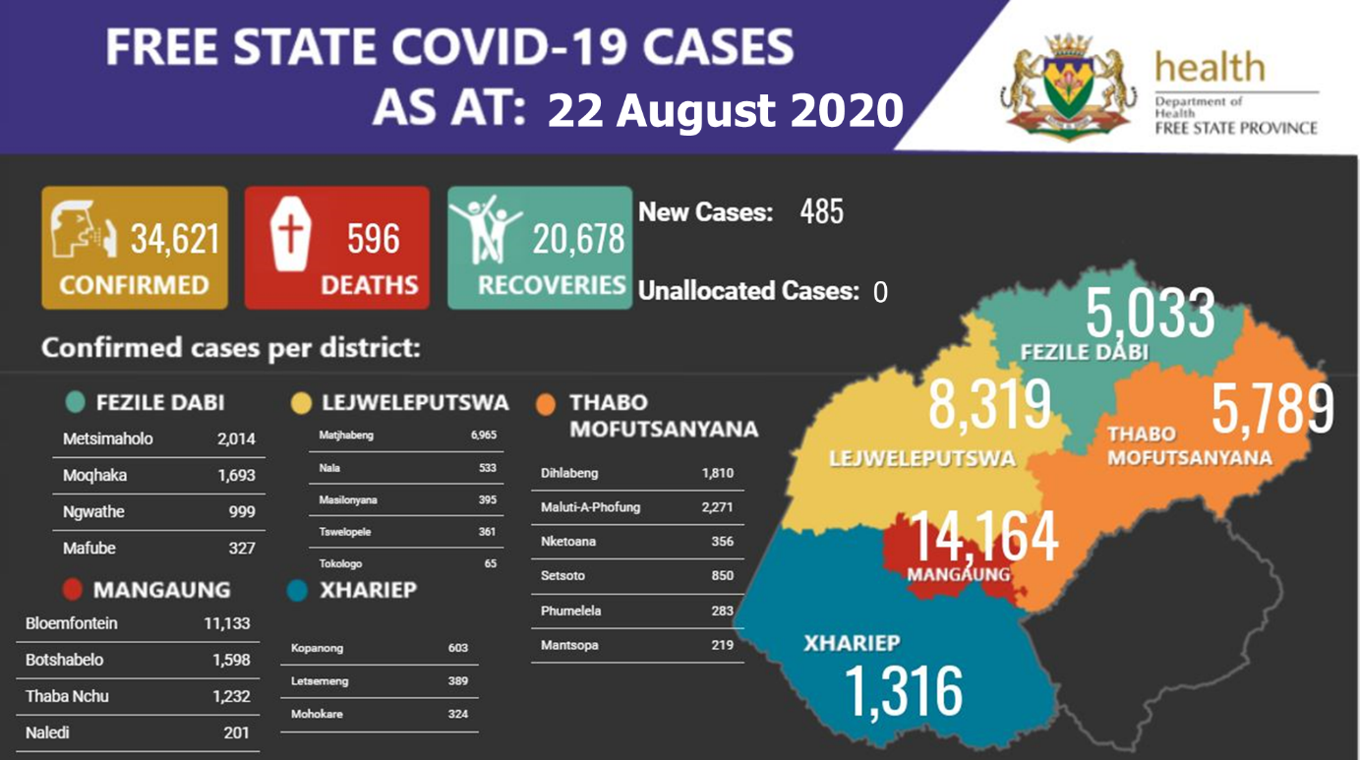

Slide 16
PROVINCIAL HIGHLIGHTS
New Cases:
  There are 485 new cases:
  229 in Mangaung Metro, 48 in Fezile Dabi, 72 Thabo Mofutsanyana, 110 in Lejweleputswa, 26 in Xhariep
Total confirmed COVID-19 cases:
  34,621 with
  20,678 (60%) recoveries
  Highest number of infections are between ages 50-59 years
  Although more females are infected (61%; 20868/34436),
  The prevalence among the <20 years is 10.8% (3745/34621)
Total Deaths:
  596 deaths reported
  Highest number reported in Lejweleputswa District.
  The provincial case fatality rate is 1.7%
  more proportion of deaths are recorded among males (51%; 302/596)
  Highest number of deaths reported are between 55-64years

Slide 17
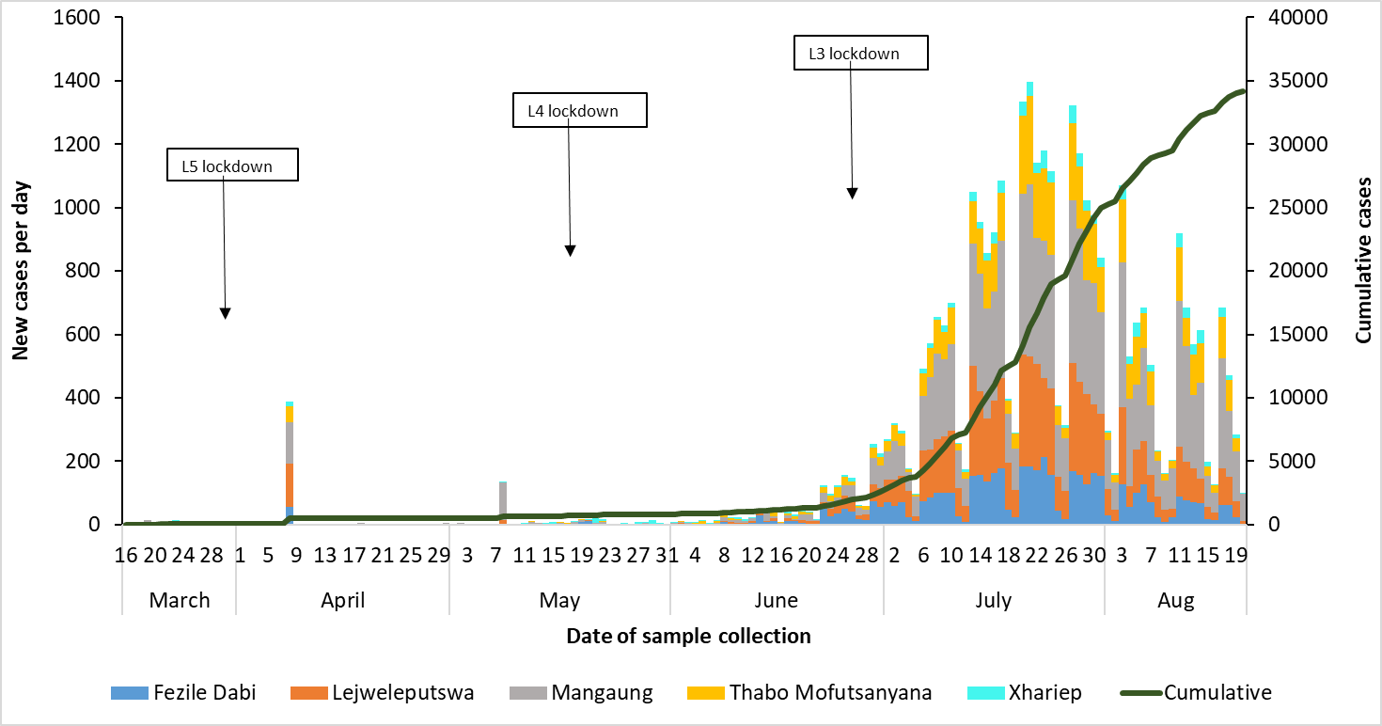
EPICURVE
L2 Lockdown

Slide 18
DISTRIBUTION OF DEATHS BY DISTRICTS
District | Total confirmed cases | Total deaths | Case fatality rate (%)
Fezile Dabi | 5033 | 71 | 1.4
Lejweleputswa | 8319 | 207 | 2.5
Mangaung | 14164 | 197 | 1.4
Thabo-Mofutsanyana | 5789 | 102 | 1.8
Xhariep | 1316 | 19 | 1.4
Unknown | 0
Total | 34621 | 596 | 1.7

Slide 19
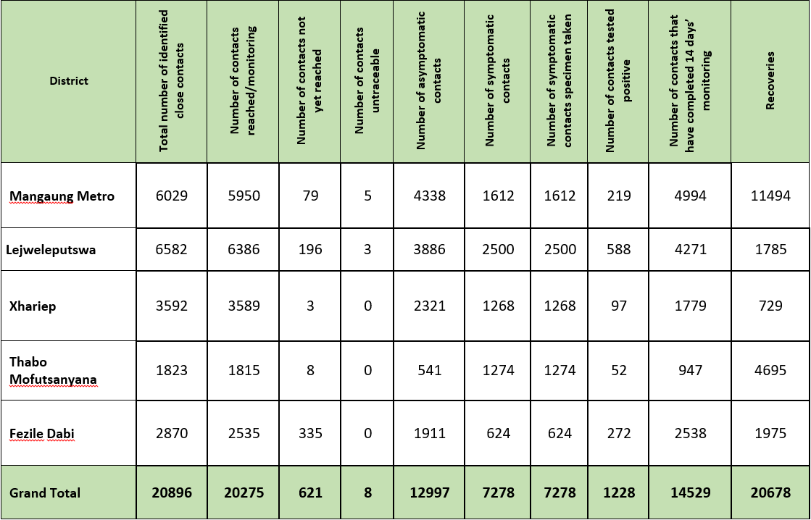
CONTACT TRACING AND MONITORING

Slide 20
LAB TESTS
 | Total tests |  |  |  | New tests
Province | No. tests | Percentage tested | No. positive | Percentage test positive | No. new tests | Percentage tested | No. positive | Percentage test positive
Eastern Cape | 398538 | 11% | 84700 | 21.3% | 1880 | 6% | 250 | 13.3%
Free State | 220333 | 6% | 36506 | 16.6% | 1992 | 7% | 488 | 24.5%
Gauteng | 1178075 | 33% | 204804 | 17.4% | 9040 | 30% | 903 | 10.0%
Kwazulu-Natal | 611390 | 17% | 104369 | 17.1% | 4128 | 14% | 572 | 13.9%
Limpopo | 77998 | 2% | 9945 | 12.8% | 635 | 2% | 97 | 15.3%
Mpumalanga | 131125 | 4% | 26916 | 20.5% | 1227 | 4% | 227 | 18.5%
North West | 91053 | 3% | 20304 | 22.3% | 1073 | 4% | 167 | 15.6%
Northern Cape | 43848 | 1% | 7316 | 16.7% | 858 | 3% | 181 | 21.1%
Western Cape | 548668 | 16% | 109448 | 19.9% | 3158 | 10% | 371 | 11.7%
Unknown | 234039 | 7% | 37580 | 16.1% | 6569 | 21% | 445 | 6.8%
Grand Total | 3535067 | 100% | 641888 | 18.2% | 30560 | 100% | 3701 | 12.1%
Lab type | Total tests | No. positive | % test positive | New tests | No. positive | % test positive
Public | 141354 | 18240 | 12.9 | 1293 | 315 | 24.4
Private | 78979 | 18266 | 23.1 | 699 | 173 | 24.7
Total | 220333 | 36506 | 16.6 | 1992 | 488 | 24.5

Slide 21

BOMIS
FSDOH Information Systems innovation in response to Outbreak Management

Slide 22
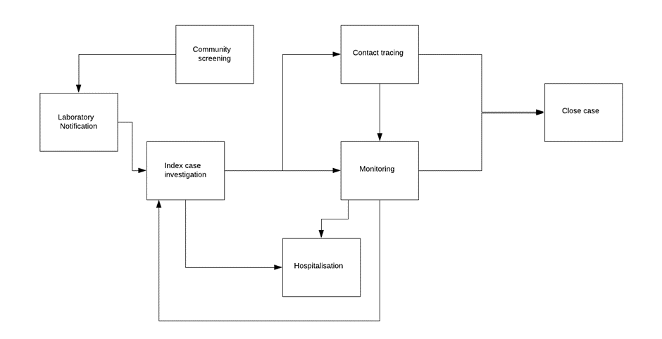






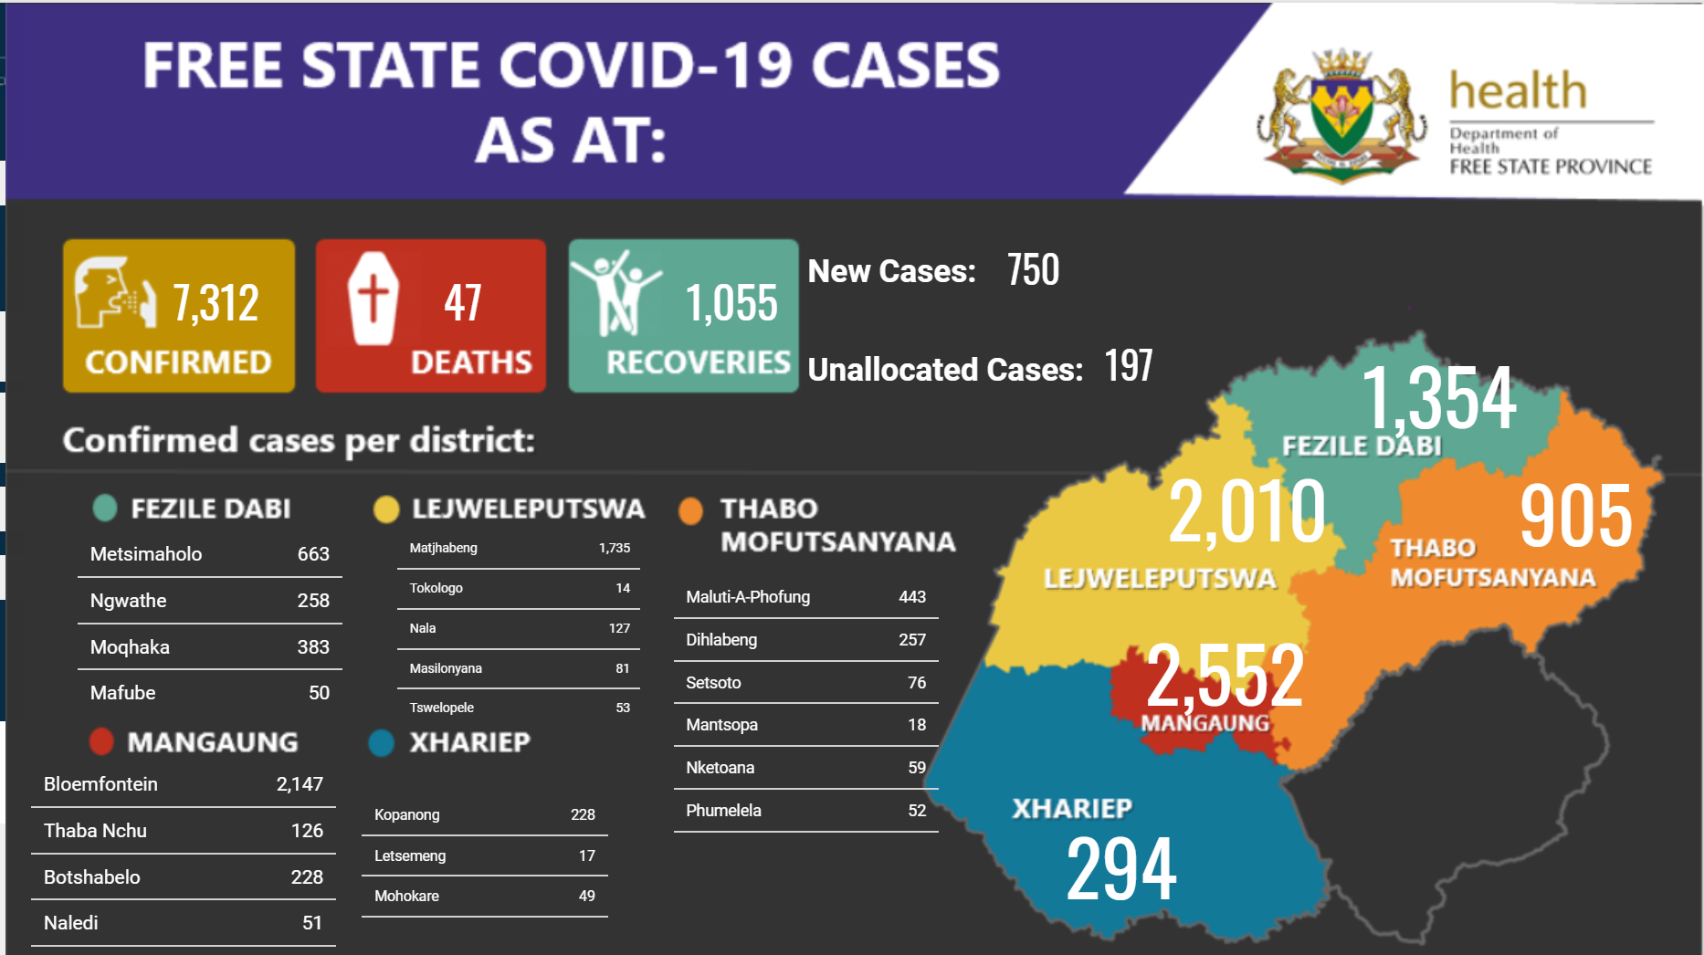


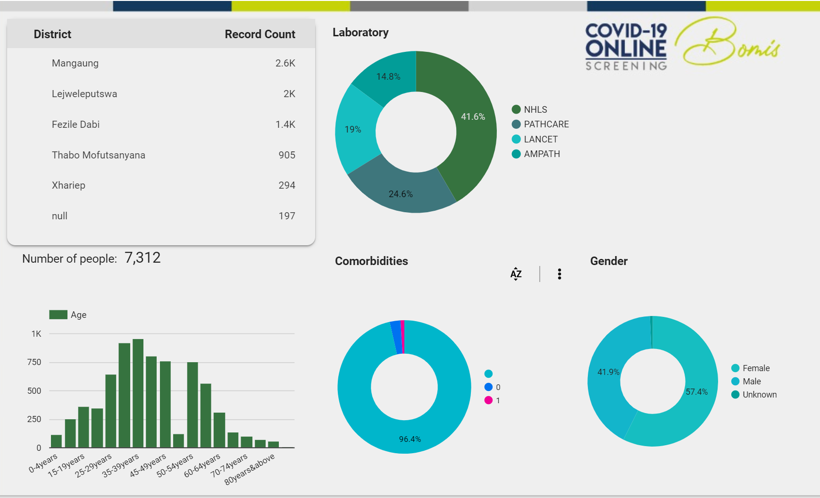
FREE STATE COVID-19 INFORMATION SYSTEMS FLOW
Track and Trace
NMC
Examples of processes
DATCOV

Slide 23

GO.DATA
Progress:
G
Xhariep
Training of data capturers, district champion, clinicians and DRT completed | Go Live = 27 June 2020
G
Fezile Dabi
Training of data capturers and district champion completed | DRT training scheduled for 17 July 2020 | Go Live = 20 July 2020
A
Mangaung
Training of data capturers and district champion completed | DRT training scheduled for 20 July 2020 | Go Live = 24 July 2020
4x Laptops
4x Smartphones
8x Tablets
2x Desktops
1x Projector
4x LTE Modems
R
Thabo Mofutsanyana
Training of data capturers and district champion completed | DRT training scheduled for 21 July 2020 | Go Live = 27 July 2020
R
Lejweleputswa
Training district champion completed | DRT training not yet scheduled | Go Live = 31 July 2020

Slide 24
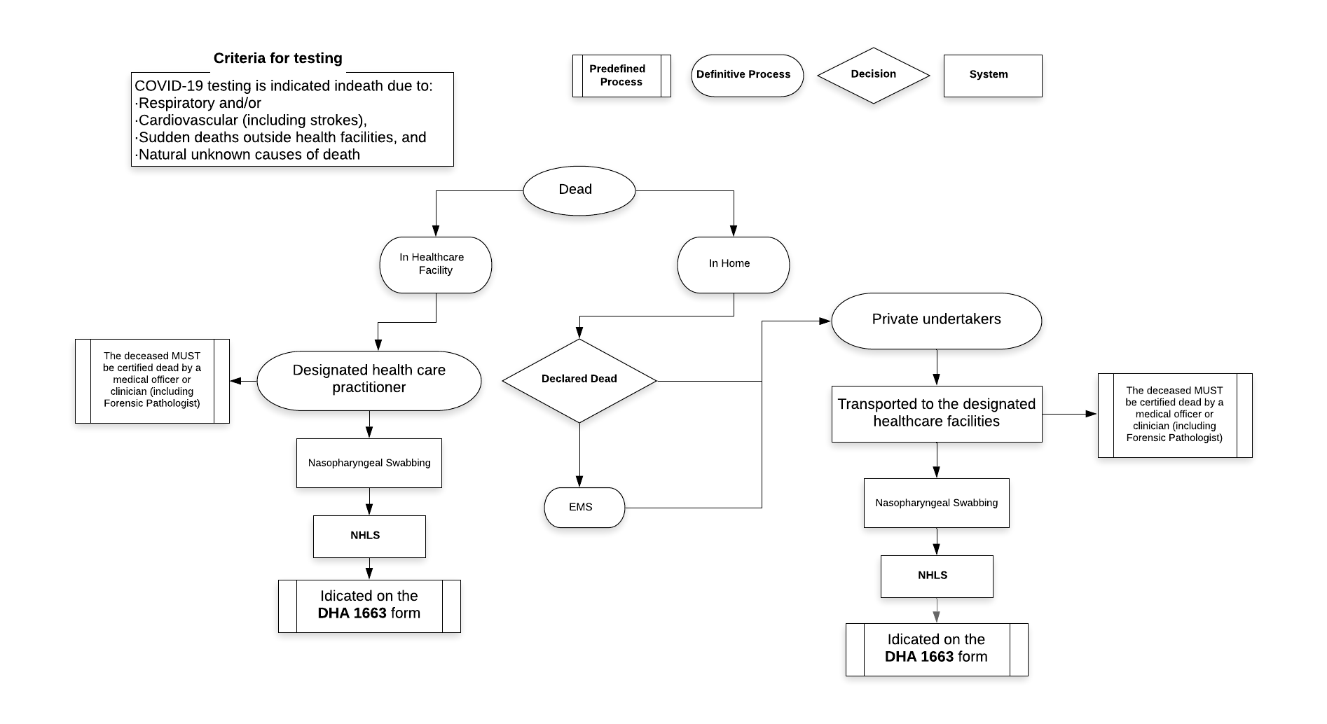
Mortality Surveillance Process

Slide 25
Challenges in implementing various interventions
  The logistics and safety of Health Care Workers conducting screenings in the community.
    Certain community members were not allowing the screeners into their households.
  COVID-19 placed an additional burden on the current staff compliment of the Department, including the need to reprioritise and repurpose some health care services.
    E.g. Healthcare workers been infected leading to closure of facilities
  Cluster-based infections, such as those in churches, funerals, workplaces and schools fuelled the increasing number of new cases in the Province.
  Testing capacity of the laboratories
    shortage of reagents due to global constraints
    Resulting in delayed turnaround time

Slide 26
Quarantine Sites Status

Slide 27
Beds: Public and Private Hospitals
Institution | No. Beds | Occupied | Available
Public Hospital | 567 | 234 | 333
Private Hospital | 510 | 337 | 173
Total | 1 077 | 571 | 506

Slide 28
COVID-19 Cases

Slide 29
DCS Status Report as at 19 August 2020
Screening of Inmates (Sentenced & Remand Detainees)
MANAGEMENT AREAS | NUMBER OF INMATES SCREENED | NUMBER OF INMATES ISOLATED | NUMBER OF INMATES TESTED COVID-19 POSITIVE (18.08.2020) | NUMBER OF INMATES TESTED COVID-19 POSITIVE (CUMULATIVE) | NUMBER OF DEATHS | NUMBER OF RECOVERIES (CUMULATIVE)
Bizzah Makhate | 2675 | 0 | 0 | 1 | 0 | 0
Groenpunt | 1467 | 1 | 1 | 15 | 0 | 13
Grootvlei | 1862 | 0 | 0 | 8 | 0 | 4
Goedemoed | 1101 | 0 | 0 | 0 | 0 | 0
Mangaung | 2729 | 0 | 0 | 14 | 1 | 6
Grand Totals | 9834 | 1 | 1 | 38 | 1 | 23
9
6
168
21
Leading Free State Province towards Service Excellence

Slide 30
DCS Status Report as at 19 August 2020
Screening of Correctional Officials
MANAGEMENT AREAS | NUMBER OF OFFICIALS SCREENED | NUMBER OF OFFICIALS TESTED POSITIVE FOR COVID-19 (17.08.2020) | NUMBER OF DEATHS DUE TO COVID-19 CUMULATIVE | NUMBER OF RECOVERIES CUMULATIVE | NUMBER OF OFFICIALS TESTED POSITIVE FOR COVID-19 (CUMULATIVE)
Regional Office | 44 | 0 | 0 | 7 | 9
Bizzah Makhate | 623 | 0 | 0 | 25 | 102
Groenpunt | 473 | 0 | 1 | 53 | 91
Grootvlei | 380 | 0 | 1 | 5 | 56
Mangaung | 229 | 3 | 1 | 19 | 57
Goedemoed | 243 | 0 | 1 | 11 | 25
Grand Totals | 1992 | 3 | 4 | 120 | 340
9
6
168
21

Slide 31
Challenges in implementing various interventions
  The centrality of the province also has its own challenges, due to inter-provincial travelling and the neighbouring countries.
  The district specific challenges are attended to in the COVID-19 designated forums that happen on regular basis
    For example: mines in Lejweleputswa
    Districts bordered by other provinces with high COVID-19 prevalence
  Rapid rise in cases complicated case management
    low index engagement
    delays in contact tracing
    low monitoring rate of index and contacts

Slide 32
Lessons learnt from intervention measures implemented
  Mass social gatherings, e.g. church meetings are potential key clusters for COVID-19 infections.
  Self-quarantine and isolation of COVID-19 cases and contacts was found to be ineffective, mainly due to inadequate social distancing and non-compliance to infection prevention and control measures to combat the virus.
  Essential industries that were open during the different levels of lockdown posed a risk for cluster formation
  The importance of inter-sectoral collaboration through the PROVJOC, e.g. security for the Community Health Workers (CHWs).
  Mass community screening for COVID-19 did not yield a sufficient positivity rate and the approach was changed to targeted screening and testing.
  Incorporating data validation strategies within the formal information flow process.

Slide 33
Lessons learnt from intervention measures implemented
Rapid response in aggressively investigating cases, tracing all the contacts of people that tested positively for COVID 19 resulted in limiting the spread of infection.
Implementation of facility isolation and quarantine of both cases and contacts that were unable to self-isolate/quarantine was effective in curbing the spread of infections.
Initially it was crucial for identifying and testing eligible contacts by testing all corpses of people that died of respiratory and cardiovascular conditions.
Early and continuous community engagement is significant in establishing public compliance with regard to the outbreak.
The interoperability across various systems and information flow is pivotal in establishing an effective response.
Decentralizing the response to ward level, utilizing WBOTs to strengthen the response and increase capacity during the surge.

Slide 34
Second Strategic Thrust
Coordinated Structures Established
Provision of Food & Shelter
Leading Free State Province towards Service Excellence

Slide 35
Partnership & Food Distribution
Coordinated Structures Established
To date 66 501 of food parcels have been distributed as follows:
2 482 Food Parcels distributed from the Departmental Equitable Share
11 500 Food Parcels distributed from the National Department of Social Development & Solidarity Fund
  4 120 Food Parcels distributed from DSD Equitable Share through Community Nutrition and Development Centres
  10 450 Food Parcels distributed by SASSA
  1 110 Food Parcels distributed by NPOs funded by National Lotteries Commission (including food parcels for 407 Homeless Individuals at the shelters)
  29 345 Food Parcels distributed by Mangaung Metro & District Municipalities
  860 Food Parcels distributed by Old Mutual
  491 Food Parcels distributed by Red Cross
  4 376 Food Parcels donated by Meals on Wheels
  1 500 Food parcels distributed by METAD in partnership with TRANSNET
  200 Food parcels distributed by Harmony Gold Mine
  76 Food parcels distributed by Marematlou Training Institution
  82 Food parcels distributed by ADRA

Slide 36
Provision of Shelters
Coordinated Structures Established
District | Shelter | Beneficiaries during level 5 &4 | Beneficiaries during level 3
Fezile Dabi | Mimosa Gardens | 34 | 11
 | Corny Island School | 13 | 5
 | Nyakallong Hall | 34 | 35
Lejweleputswa | Toronto Hall | 13 | 4
 | Kgotsong Hall | 8 | closed
Thabo Mofutsanyana | Makwane Youth Centre | 24 | 19
 | Dihlabeng Show-grounds | 32 | 17
Mangaung Metro | Tierport ( Camp Side) | 78 | 23
 | Kagisanong Hall | 42 | 36
 | Norman Dubell Hall | 11 | 6
 | Samsom Sefithi Hall | 43 | 8
TOTAL | 12 | 332 | 164
Leading Free State Province towards Service Excellence

Slide 37
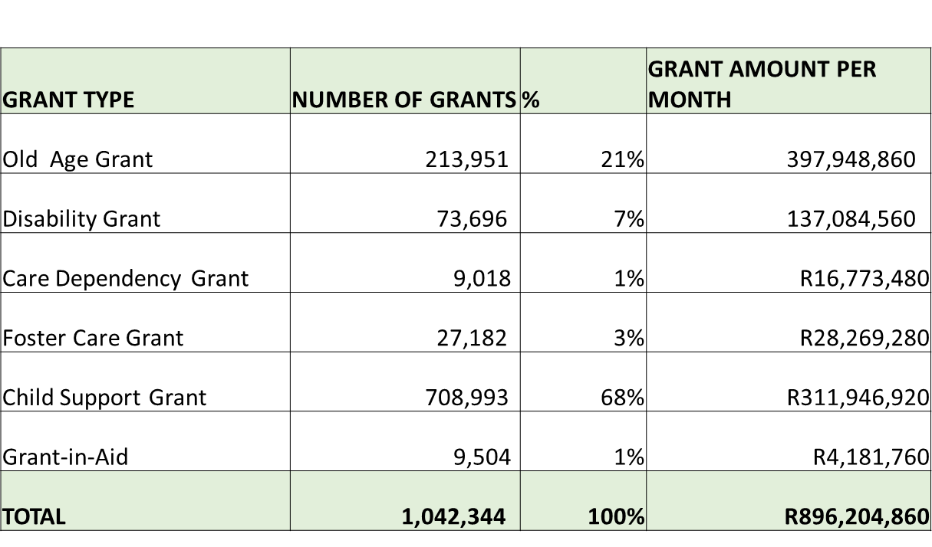
  FREE STATE SOCIAL GRANTS PER GRANT TYPE AS AT 31 JULY 2020 (SASSA)

Slide 38
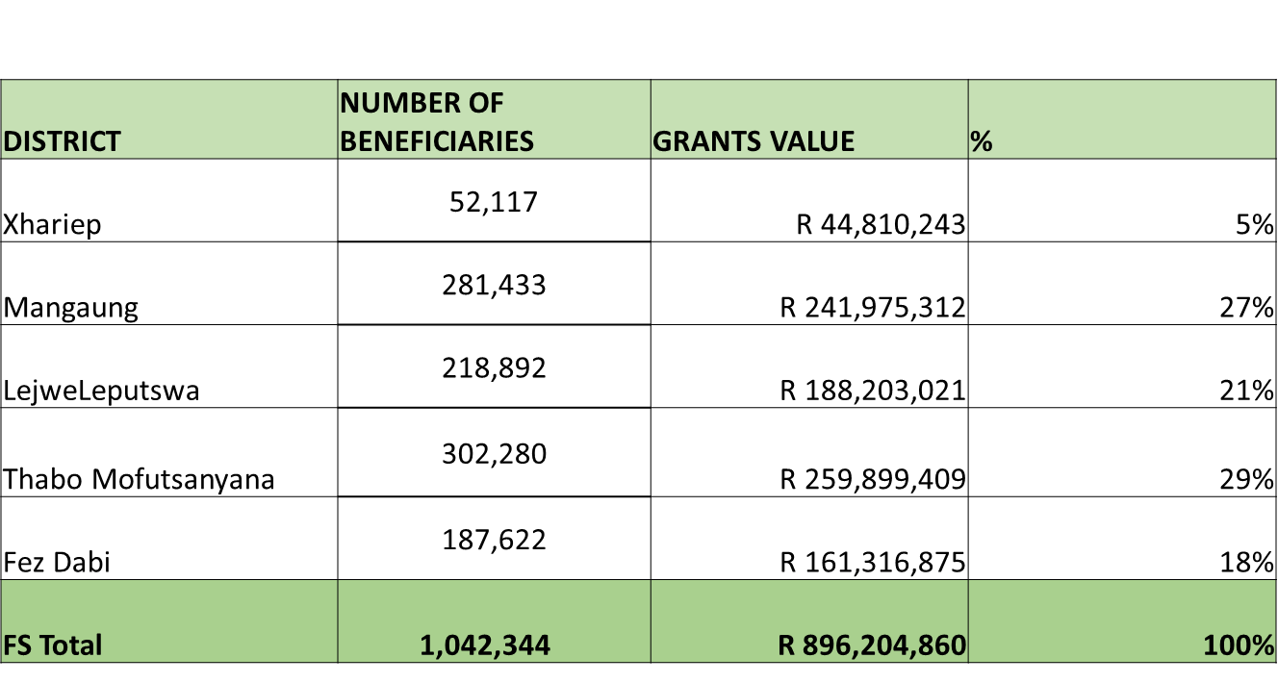
  FREE STATE SOCIAL GRANTS PER DISTRICT AS AT 31 JULY 2020 (SASSA)

Slide 39
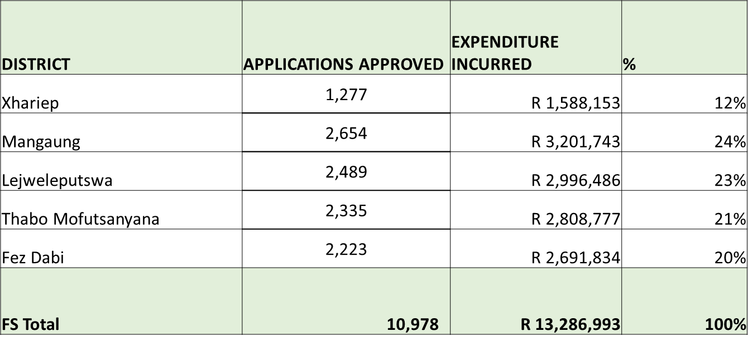
  SOCIAL RELIEF OF DISTRESS FOOD PARCELS DISTRIBUTION AS AT 31 JULY 2020 (SASSA)

Slide 40
  R350 UNEMPLOYMENT GRANT
457,517 APPLICCATIONS RECEIVED AS AT 17 AUGUST 2020
  DECLINED = 160,640 (35%)
  APPROVED = 296, 877 (65%)
    FEMALES = 98,108
    MALES = 198,769
TOTAL PAID = 223,655 (75% of approved applications)
  164,795 (74%) paid through SAPO
  58,832 (26%) paid through other banks)
PERSONS WITH DISABILITIES = 52,528 (11% of approved applications)

Slide 41
SHELTERS IN THE PROVINCE: GENDER BASED VIOLENCE
_{DISTIRCT} | _{TOWN} | _{SHELTER}
_{Lejweleputswa} | _{Welkom} | _{Goldfields Advise Organisation}
 | _{Bothaville} | _{Phelononofa}
_{Thabo Mofutsanyana} | _{Qwa-Qwa} | _{Thusanong Advice Centre}
 | _{Bethlehem} | _{Bethlehem Child Welfare}
_{Mangaung} | _{Wepener} | _{Child Welfare}
 | _{Bloemfontein} | _{Reahola Safe House}
_{Fezile Dabi} | _{Parys} | _{Tumahole}

Slide 42
Summary of Gender Based Violence
Coordinated Structures Established
PERIOD | NO. OF PLACEMENTS | COMMENT
APRIL/MAY/JUNE ( Shelter services) | 60 | During level 4&5 services were restricted and therefore clients were attended to in shelters.
JULY-AUGUST to date( Shelter services) | 45 | Most cases placed were of domestic violence and sexual offenses.
JULY: Counselling services. | 269 | Psychosocial support services rendered by social workers in victim support centres with all types of cases reported. Most cases during level 3 were on protection orders including family mediation services.
August: Counselling services. | 102 | Reporting in this month is affected by closing of offices as a result of a high rate of covid -19 reported cases in the Department.
Leading Free State Province towards Service Excellence

Slide 43
INTERVENTION OF TRADITIONAL LEADERSHIP ON COVID-19 PANDEMIC
Coordinated Structures Established
There has been collaboration programme of traditional leaders, Government and stake-holders to distribute food parcels and PPEs in traditional communities.
Traditional leaders have assisted in ensuring that their communities observe COVID-19 regulations, especially on funerals and cultural activities.
The Free State House of Traditional Leaders was instrumental in the process of suspending initiation schools.

Slide 44
Third Strategic Thrust
Coordinated Structures Established
Provision of Water & Sanitation
Leading Free State Province towards Service Excellence

Slide 45
Provision of Water & Social Distancing
Coordinated Structures Established
Free State Human Settlements together with Water and Sanitation have prioritized the following COVID-19 interventions;
  Access to water in priority informal settlements with water shortages;
  Fast tracking of upgrading informal Settlements to aid social distancing;
  Provision of personal hygiene products to poor households within identified informal settlements in the Free State;
In the case of 29 densely populated informal settlements nation-wide, the FS focused on Caleb Motshabi for the provision of water.
Leading Free State Province towards Service Excellence

Slide 46
Response – Access to Water
Coordinated Structures Established
FOCUS AREA | PROVINCIAL RESPONSE
Access to water including areas with water shortages | The distribution of the tanks has been made in high risk informal settlements with no access to potable water and those with limited access to augment their supplies. To date, the following progress has been realized: 2 622 water tanks procured; 1 991 of these have been delivered across the province Rand Water & Sedibeng Water are the appointed service providers 118 water trucks have been procured and delivered.
Leading Free State Province towards Service Excellence

Slide 47
Response – Access to Water
Coordinated Structures Established
Local Municipality (LM) | Delivered | Installed/In Use | Permanent Installation | Water Trucks Delivered
Xhariep District
Mohokare | 20 | 17 | 15 | 3
Kopanong | 12 | 12 | 12 | 1
Letsemeng | 15 | 15 | 15 | 3
Lejweleputswa District
Masilonyana | 22 | 22 | 22
Tokologo | 26 | 26 | 26 | 2
Matjhabeng | 45 | 45 | 0 | 5
Nala | 20 | 20 | 15 | 2
Tswelopele | 13 | 13 | 13 | 2
Fezile Dabi District
Ngwathe | 111 | 111 | 101 | 9
Mafube | 22 | 19 | 19 | 4
Moqhaka | 12 | 12 | 12 | 4
Metsimaholo | 22 | 22 | 22 | 1
Thabo-Mofutsanyana District
Setsoto | 34 | 34 | 34 | 2
Mantsopa | 36 | 31 | 31 | 2
Dihlabeng | 62 | 62 | 62 | 4
Nketoana | 22 | 19 | 17 | 2
Phumelela | 61 | 61 | 40 | 7
Maluti A Phofung | 1349 | 675 | 673 | 61
Mangaung Metro
Mangaung | 87 | 87 | 72 | 4
Total | 1991 | 1303 | 1201 | 118
Leading Free State Province towards Service Excellence

Slide 48
Fourth Strategic Thrust
Coordinated Structures Established
Enforcement & Compliance Measures
Leading Free State Province towards Service Excellence

Slide 49
Status of Law Enforcement in the Province
Since the inception of the lockdown (Day 151 of Level 2) 37 966 people in total have been arrested for different violations. The arrests can be broken down per district as follows
District | Number
Thabo Mofutsanyana | 7 056
Mangaung Metro | 11 578
Lejweleputswa | 3 846
Fezile Dabi | 3 940
Xhariep | 2 493
Leading Free State Province towards Service Excellence

Slide 50
Adherence to the Lockdown Regulations:
The Province is stable despite some communities continuing to disregard lockdown Regulations The Law Enforcement Agencies continue to patrol the areas where contravention of Lockdown Regulations are being detected. The Province have came up with a strategy to distribute food parcels in order to limit instability and chaos in the distribution of food parcels. The Province is monitoring illegal movements at the Ports of Entry at ongoing basis.
Leading Free State Province towards Service Excellence

Slide 51
Fourth Strategic Thrust
Coordinated Structures Established
Economic Recovery Plan
Leading Free State Province towards Service Excellence

Slide 52
FS Economic Recovery Initiatives
On 21 April 2020, President announced a R500 billion stimulus package to respond to the pandemic. Presidency announced a Three-Phased Recovery Response to Covid-19 Tourism Relief fund (R200m) Applications are still being processed; applications closed on 31st May 2020 Applicants from FS: 246, Approved: 143 approved to date (figure to be update with new data as it becomes available) NYDA Applied: 257 Approved: 65 DSBD/SEFA Spazashop Support Programme ( R10 024 000); Applications 72; Approved applications: 13 Debt Relief Fund: 42 Approved Applications (total R11 324 225) Payment Holiday support: 9

Slide 54
Relief Funding for Athletes and Artists
CATEGORY | APPLICATIONS RECEIVED | APPLICATIONS RECOMMENDED | UNIT AMOUNT PERSON | AMOUNT PER CATEGORY
Federations | 14 | 14 | R 100 000.00 | R 1 400 000.00
Athletes | 70 | 41 | R 10 000.00 | R 410 000.00
Coaches | 36 | 18 | R 10 000.00 | R 180 000.00
Technical | 114 | 114 | R 10 000.00 | R 1 140 000.00
NPO’s | 4 | 2 | R 20 000.00 | R 40 000.00
Grand Total | 238 | 189 |  | R 3 170 000.00

Slide 55
Relief Funding for Arts & Culture
CATEGORY | APPLICATIONS RECEIVED | DECLINED | RECOMMENDED | STILL UNDER VERIFICATION | AMOUNT
Artists relief | 784 | 424 | 360 @ R6000.00 per individual | 153 Due to payment -207 | R 2 160 000.00
4IR Digital | 83 | 49 | 32 –paid according to proposal and recommendation of adjudicators. List is attached |  | R 1 999 774.92
Grand Total |  |  |  |  | R 4 159 774. 92

Slide 56
SPENDING PERFORMANCE
  Free State Provincial Government Total Order Worth - R396 161 748.00
The Free State Province is to date committed to spend R396 161 748 towards COVID-19 PPE Procurement. A total of 53% (R208 621 67.10) of the total has been paid out to suppliers who delivered ordered COVID-19 PPE related procurement. It must be noted that 47% (R187 540 074.90) of COVID-19 PPE commodities and services are still to be delivered and paid for. The Free State based suppliers will benefit to the tune of R 328 703 451.40 which is 83% of the total.
COVID-19 SPEND PER DEPARTMENTS
DEPARTMENTS | COMMITMENT | EXPENDITURE | TOTAL | PERCENTAGE
AGRIC | R70 300.00 | R374 500.00 | R444 800.00 | 0.11%
COGTA | R0.00 | R928 476.00 | R928 476.00 | 0.23%
DESTEA | R17 174 064.00 | R12 559.89 | R17 186 623.89 | 4.34%
EDU | R496 550.08 | R0.00 | R496 550.08 | 0.13%
FSPT | R101 929 147.66 | R136 196 481.49 | R238 125 629.15 | 60.11%
HEALTH | R52 495 693.61 | R22 388 127.53 | R74 883 821.14 | 18.90%
HS | R0.00 | R20 313.17 | R20 313.17 | 0.01%
PREMIER | R0.00 | R3 380 862.76 | R3 380 862.76 | 0.85%
PRT | R0.00 | R12 000.00 | R12 000.00 | 0.00%
PWI | R14 819 623.05 | R37 574 374.81 | R52 393 997.86 | 13.23%
SACR | R0.00 | R1 428 835.00 | R1 428 835.00 | 0.36%
SOC-DEV | R554 696.50 | R6 305 142.45 | R6 859 838.95 | 1.73%
Grand Total | R187 540 074.90 | R208 621 673.10 | R396 161 748.00 | 100.00%
55

Slide 57
FS Covid-19 PPE Expenditure
Leading Free State Province towards Service Excellence

Slide 58
FS Covid-19 PPE Expenditure
Leading Free State Province towards Service Excellence

Slide 59
Covid-19 Expenditure & Benefits
Provincial Treasury procured on behalf of all departments, including Education, Health and Social Development, however departments also procured on their own.
Repurposing of Grants will also cushion the province against COVID-19 impact (To date R286 million for Health has been repurposed).
R19 million of Social Development under social relief includes R4 million for 92 Social workers appointed to assist with COVID-19
R11 million for SACR relates to artists and sporting codes (R6 million and R5 million respectively)
Leading Free State Province towards Service Excellence

Slide 60
Fourth Strategic Thrust
Coordinated Structures Established
Governance
Recovery Plan
Leading Free State Province towards Service Excellence

Slide 61
Return To School Initiatives
On the 23rd July 2020, the President announced that all public schools would close for 4 (four) weeks: 27th July 2020 to 23rd August 2020.
  Exceptions: Grade 12: To reopen on 3rd August 2020
      Grade 7: To reopen on 11th August 2020
To be noted: The sector successfully managed the Phased-in Approach in June after the Covid-19 forced closure in March 2020
The following grades were successfully phased in without major challenges:
  Grades 7 and 12; and
  Grades 6 and 11
The sector is at same stage now: Phase-in approach for:
  Grade 12: 3 August 2020 and
  Grade 7: 11 August 2020
  The rest of grades will be phased in as explained herein
Leading Free State Province towards Service Excellence

Slide 62
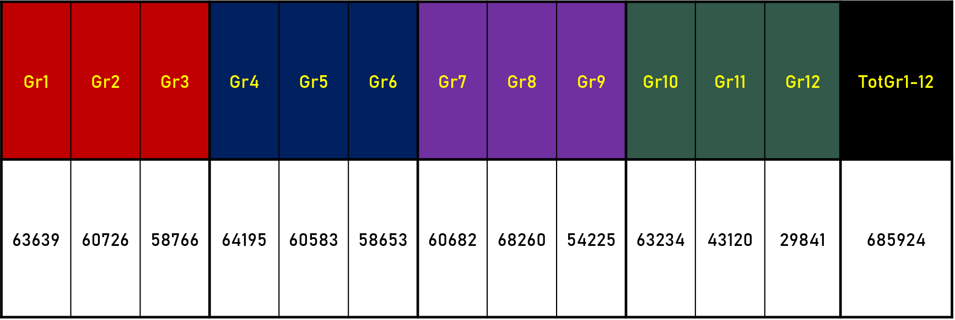
Return To School Initiatives
Planning, Preparing and Managing the Phase-In of Learners and Grades
Total leaners in the Free State
Leading Free State Province towards Service Excellence

Slide 63
Return To School Initiatives
Grade | Commencement | Total Number
12 | 03 August 2020 | 29 841
7 | 11 August 2020 | 60 682
11 | 24 August 2020 | 43 120
6 | 24 August 2020 | 58 653
Total |  | 192 296
Leading Free State Province towards Service Excellence

Slide 64
Return To School Initiatives
WEEK | GRADE | SPECIAL SCHOOLS
Week 1 | 27-31 July 2020 | Break
Week 2 | 3 -7 August 2020 | School of Skills – Year 4 learners
Week 3 | 11 -14 August 20 | N/A
Week 4 | 17-21 2020 | All Teachers report to prepare for the return of all learners
Week 5 | 24 August 2020 | Schools of Skill : Year 1; Year 2 and Year 3. Schools with Learners with Severe and profound Intellectual Disabilities( LSPID) Year 1; Year 2; Year 3. Schools with Learners with Severe Intellectual Disabilities( LSID) Grade R; Grade 1; Grade 2; Grade 3 and Final Year ( occupational) and; Schools with Autistic learners; Junior group (below 13 years); Senior Group ( 13 years and above) and final year (18 years and above )
Leading Free State Province towards Service Excellence

Slide 65
Challenges In the Educational Sector
The sector was faced with challenge of defraying the costs of additional cleaners and screeners at schools to meet the obligations set out by NATJOINTS in combating COVID- 19.
The sector had to appoint additional 2 241 cleaners and 2 241 screeners (4482 in total) in order to enforce the Directions and protocols that were issued to combat or mitigate COVID-!9 at all our schools and related facilities. Both the cleaners and screeners we appointed at a flat-rate of R2 500 per month.
The sector was granted approval to re-purpose various conditional grants, in particular the Education Infrastructure Grant (EIG), for the purpose of employing additional screeners and cleaners.
That the current projections for the employment of these screeners and cleaners is not financially affordable beyond the current 3 months period
Leading Free State Province towards Service Excellence

Slide 66
Challenges In the Educational Sector
78 schools have been vandalised during lockdown and 48 of them have been repaired, others are work in progress.
During schools holidays the School Nutrition Programme suffered a setback of average 20% of leaners who arrived at school to collect food.
Social distancing was also a problem particularly in hostels were Schools make use of Bunker-Beds.
The number of approved Teachers with comorbidities (1 676) and has a direct impact on time-tabling.
Leading Free State Province towards Service Excellence

Slide 67
Latest statistics on COVID 19 Cases in Schools
DISTRICT | TOTAL NUMBER OF CASES THAT TESTED POSITIVE: Since Lockdown 26 March 2020 – 14 August 2020
 | LEARNERS | TEACHERS | NON-TEACHING | TOTAL
FEZILE DABI | 104 | 165 | 23 | 292
LEJWELEPUTSWA | 85 | 479 | 60 | 624
MOTHEO | 167 | 307 | 86 | 560
THABO MOFUTSANYANA | 116 | 213 | 44 | 373
XHARIEP | 19 | 38 | 5 | 62
TOTAL | 491 | 1 202 | 218 | 1 912
+

Slide 68
Mitigating Strategy In the Educational Sector
The matter of school disruptions was attended to through ProvJoints structures with collaboration with the SAPS.
COSAS was engaged to address their challenges.
Public Quality Learning and Teaching Campaign programmes were undertaken during August to revive school attendance.
To help with social distancing, rotation model of grades in schools have been introduced.
  Preparation for NSC has commence and same teachers are used in between grades 10 to 12 to lessen volume of participants.
  Leaners and teachers with comorbidities have been provided with resource packs and tablets with subject material.

Slide 69
Mitigating Strategy In the Educational Sector
      Cleaning and disinfecting all facilities everyday
      All schools have a COVID -19 file
      100 % distribution of Cloth Masks for all learners ( 2 Cloth Masks per learner)
      Every school has put a process in place to sanitise isolation areas after occupation by learner/staff with suspected COVID-19 symptoms and have adequate functional water supply.
      Adequate functional ablution facilities
      Windows , doors and classroom are in proper condition
      Single entrance to the school to ensure that all learners, teachers and officials of Department are screened
Leading Free State Province towards Service Excellence

Slide 70
Mitigating Strategy In the Educational Sector
Service Providers have been appointed in line with the number of learners as per the Phased in Return to school.
The number of markers the province plans to appoint is 2 171. This number is inclusive of all the levels of marking personnel and is based on the fact that the number of marking days will be increased from 10 to 14 days.
Leading Free State Province towards Service Excellence

Slide 71
Mitigating Strategy In the Educational Sector
STATISTICAL SUMMARY OF TIMETABLING MODEL
No | District | Circuits in each District | Schools in each Circuit | TIMETABLE MODELS |  |  |  |  | Unclassified
 |  |  |  | Traditional Unchanged | Daily Rotation | Weekly Rotation | Platooning | Hybrid
1 | Fezile Dabi | 10 | 154 | 3 | 47 | 69 | 2 | 31 | 2
2 | Lejweleputswa | 10 | 207 | 29 | 98 | 32 | 6 | 42 | 0
3 | Motheo | 12 | 291 | 41 | 83 | 44 | 6 | 103 | 14
4 | Thabo Mofutsanyana | 16 | 342 | 35 | 132 | 43 | 22 | 104 | 6
5 | Xhariep | 3 | 63 | 2 | 26 | 8 | 3 | 24 | 0
Province |  | 51 | 1057 | 110 | 386 | 196 | 39 | 304 | 22
70
Notes:
70

Slide 72
COGTA Coordination
The department is responsible for overall Disaster Management coordination through the provincial Disaster Management Centre. The department in consultation with SALGA developed various Standard Operating Procedures for implementation of the lockdown regulations in municipalities, for an example; Audit of municipal land for cemeteries Monitoring of funerals Phasing-in of municipal employees Reporting of COVID-19 cases Coordination of departmental war rooms The department is working with DBSA and MISA to support infrastructure interventions in municipalities.

Slide 73
Communication Strategy For Covid-19 Awareness
Consistency of messaging
Repetition of the message – one message, many voices
PCCC continues to engage communities daily on both national and community media platforms
A team of communicators is monitoring misleading messages and promptly issues factual message
Society is also being encouraged to change behaviour in the fight against Covid-19
Leading Free State Province towards Service Excellence

Slide 74
Challenges and Resolutions of the PCCC
CHALLENGES | RESOLUTIONS
Build a resilient provincial government with strong health system in preparation for NHI | Earmark all forms Infrastructure and Human Resources invested for COVID -19 surge for the implementation of Universal Health Access i.e. NHI
Municipalities to maintain consistent water supply in various towns including informal settlements | Ensure implementation of District Municipal Model including inculcating effective and efficient management of funds and provision of quality service.
Public Health measures to be instituted within the communities. | Ensure that factors that influence diseases in the community e.g. provision of clean water, removal of sewage and refuse, overcrowding and aninmal and insect vector of diseases are eliminated

Slide 75
Challenges and Resolutions of the PCCC
CHALLENGES | RECOMMENDATIONS
Education faced additional costs for constant cleaning of toilets and assistance with screening, sanitising personnel and learners. | Reach an Agreement with relevant Departments to utilize various EPWP and CWP from other programmes to offset budgetary pressure in Education
Better coordination of procurement processes between various departments and municipalities | Foster a practical intergovernmental relations mechanism to plan, budget and implement jointly.
Frequent closuse of work accommodation/offices whenever there is detection of confirmation of Covid-19 infection | Drafted Document on disinfection OF Buildings produced and SOP to be discussed with Organised Labour.
Harmonising Gender Based Violence programme with other related programmes such as Victims of rape and Child Abuse . | Ensure coordination and collaboration of Justice, Health and Social Development.

Slide 76
CONCLUSION
Our task is to continue to ensure coordination of Provincial Government Departments, Municipalities and other stakeholders to respond to Post COVID-19 challenges of poverty, unemployment and inequality particularly amongst women, youth and people living with disabilities.
The current planning is fragmented and duplicated in some instances, resulting in wastage and financial mismanagement..
The implementation of District Develop Model is catalytic and an opportunity in aligning plans and resources at our disposal through the development of “One District, One Plan and One Budget”.

Slide 77

END.
THANK YOU.

