Slide 1
STATE OF OR TAMBO DISTRICT MUNICIPALITY
Presentation to the CoGTA Portfolio Committee
Presenter: Ms SV Gelderblom
Time: 09H00
Date: 20 August 2020
Virtual Meeting

Slide 2
PRESENTATION LAYOUT
Purpose
Introduction
Governance
Municipal Administration
Financial Management
Service Delivery
COVID-19 Interventions
Recommendations

Slide 3
PURPOSE
To brief the Portfolio Committee on Cooperative Governance and Traditional Affairs (CoGTA) on the status of OR Tambo District Municipality.

Slide 4
INTRODUCTION
OR Tambo District Municipality is one of 6 District Municipalities in Eastern Cape Province, that has been classified as a category C2 municipality.
The OR Tambo District is largely a rural municipality – approx. 93% of residents live in rural settlement areas. It comprises of five (5) Local Municipalities:
King Sabata Dalindyebo
Mhlontlo
Nyandeni
Port St Johns
Ingquza Hill

Slide 5
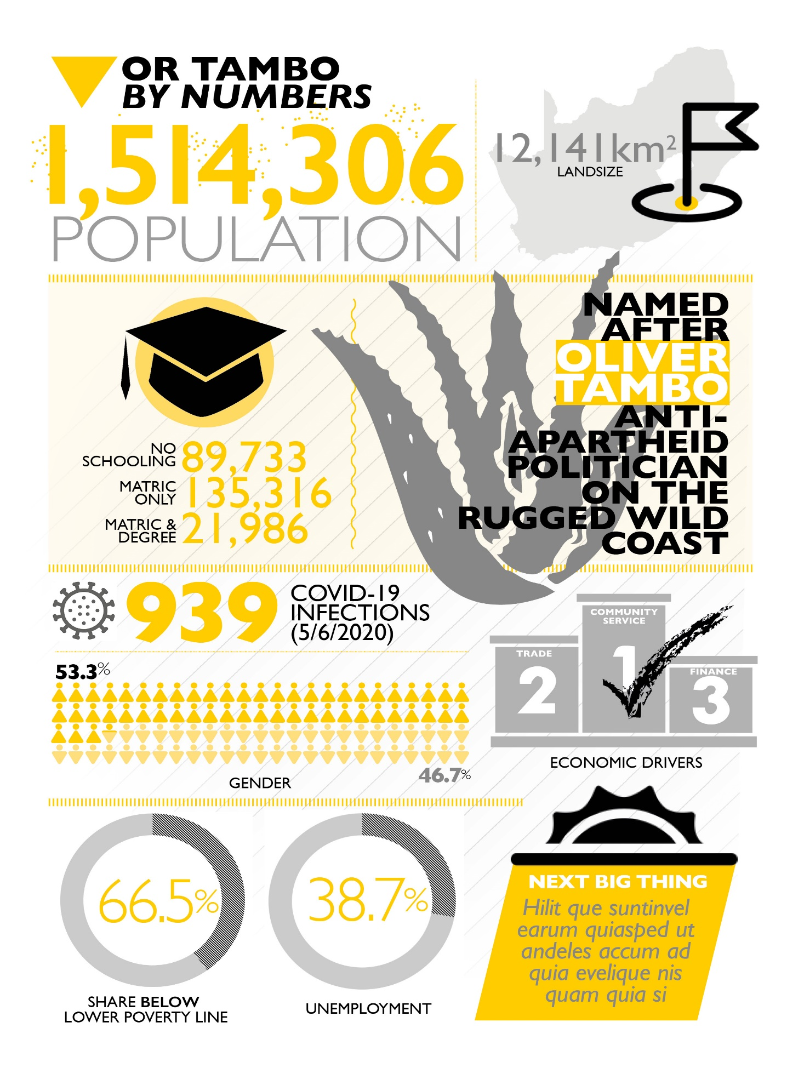

Slide 6
GOVERNANCE
Composition of Council: ANC 18, DA 1, COPE 1, African Independent people 1, EFF 1, APCCI 1 and AIC 1.
Controlling Party: ANC
Executive Mayor: Ms T Sokhanyile
Deputy Executive Mayor: Mr R Z Nogumla
Speaker: Mr Nkompela
MPAC Chairperson:Cllr Nonkosi Peping
Chief Whip: Cllr W Ngozi
The relationship between councillors and municipal administration:
Office of the Council Chief Whip established a political committee called Troika, constituted by the Executive Mayor, Speaker and Council Chief Whip.
This committee is coordinated and chaired by the Council Chief Whip and can when deemed necessary invite the Municipal Manager to the meeting.
This committee provides strategic leadership for the district municipality to be able to effectively utilize the resources to achieve its objectives.
The main function of this committee is to ensure political stability in the institution.
The relationship between the political leadership, TROIKA and administration is sound.

Slide 7
GOVERNANCE
The District constitute of 72 Council members and is governed by ANC.
An approved Council Calendar regulates the sitting of Council meetings and Council Committee meetings.
Council failed to hold ordinary Municipal Council meeting in accordance with section 18(2) of the Municipal structures Act, to execute their objectives in accordance with section 152 of the Constitution and the provisions of section 28 and 72 of the Municipal Finance Management Act.
The Non Sitting of council improved since the adoption of the Separation of Powers Model and Municipal Oversight Model,
In addition to the compliance report, the Council sits quarterly for the tabling and adoption of Oversight Reports from Section 79 Committees for each department.

Slide 8
GOVERNANCE
The Audit Committee has an oversight responsibility over Internal Audit, Risk Management and Performance Management.
Audit Outcomes for the past five years:
The OR Tambo District received a Qualified audit opinion for five consecutive years 2014/2015, 2015/2016, 2016/17, 2017/18 and 2018/19.
The Ntinga OR Tambo DM Agency received a Unqualified audit opinion for the period of 2014/2015, 2016/2017, 2017/2018 and 2018/2019 and Clean Audit Opinion for 2015/2016 financial year.

Slide 9
GOVERNANCE
The Council has adopted the budget and IDP for 2020/2021.
Litigations are disclosed in the annual financial statements of the municipality.
Municipality has appointed a panel of attorneys to deal with all litigations.
The municipality has seven active cases amounting to a cost of R33 million.
The cases are related to non payment of services rendered, Labour cases, breach of contract, damages suffered due to loss of life, damages suffered due to non-payment and interdicts.
The municipality had historic litigations that are being resolved now, causing an inflation in the litigations register.

Slide 10
Over the years the district has been perceived as a corrupt institution due to its non compliance of among others MFMA. As a result it had experienced the following:
Lost trust from the communities,
Tarnished by labour unrest,
Instability in the Senior Management Positions.
Towards the end of the last term, the District capacitated risk and fraud as well as compliance units.
This yielded to the development of policy frameworks, procedures, awareness sessions as well as the establishment of the fraud hotline,
The Council established the MFMA Section 32 Committee to investigate the irregular expenditure (which subsequently have been handed over to the MPAC).
Individuals who had been found to be transgressing have been subjected to disciplinary processes and consequence management are undertaken.
The District is in the process of establishing a Municipal Disciplinary Board in line with regulations.

Slide 11
MUNICIPAL ADMINISTRATION
Executive Management
DESIGNATION LEVELS | TOTAL NUMBER OF POSTS | POST FILLED | POST FILLED (%)
MUNICIPAL MANAGER | 1 | 1 | 100%
SECTION 56 POSTS | Director in the office of Municipal Manager Director- Office of Executive Mayor Director-Legislature Director- Community Service Director-Human Settlement Director-Internal Audit Director - Technical Services Director-Infrastructure Services CFO Director- Rural Economic Development and Planning Director- Cooperative Services | 11 | 100%
TOTAL | 12 | 12 | 100%

Slide 12
MUNICIPAL ADMINISTRATION
All levels
The total number of positions is 2352 (excludes EPWP and contract workers)
1 249 positions has already been filled as at February 2020
103 positions are vacant as at February 2020 (46% vacancy rate)
Of the filled posts 506 are females and 743 are males

Slide 13
FINANCIAL MANAGEMENT (AG REPORT)
The AG report for 2018/19 highlighted non-compliance with finance and governance legislation. Some key findings that were expressed by the AG are as follows:
Irregular expenditure incurred by the municipality in contravention of the Supply Chain Management process not detected and appropriately disclosed in the financial statements, an amount of R1.4 billion could not be determined.
The municipality lack systems and process to ensure commitments on correspondence of amounts are correctly disclosed. There was no determination whether adjustment of an amount of R408 million was necessary.
The Municipality did not recognise all its property, plant and equipment in accordance to GRAP17.
Bulk water losses of R11.1 million were incurred which represent 31% of 47% of the total bulk water purchased.
Material losses of R345.7 million were incurred as a result of write off of irrecoverable service debtors.
Non-payment of service providers within 30 days as required by Section 65 of MFMA.

Slide 14
FINANCIAL MANAGEMENT (AG REPORT) CONT..
Non-compliance with preparation of financial statements in accordance with the requirements of Section 122 (1) of MFMA.
Lack of effective internal control systems in place on asset management as required by section 63 (2) of the MFMA.
Lack of internal control systems for leadership to monitor the implementation of policies and procedures to support the achievement of credible reporting and compliance with legislative requirements.
Lack of consequence management due to Unauthorised, Irregular and Fruitless and Wasteful expenditure not being investigated
Non-Compliance with SCM regulations and Preferential Procurement Policy Framework Act.
Performance with respect to MIG, RBIG and WISG not evaluated within two months after the end of financial year, as required by DORA
Investigation on fraudulent appointment of contract workers in 2010 is still underway.

Slide 15
FINANCIAL MANAGEMENT
TOTAL ADJUSTED BUDGET
OPERATIONAL: R1 618 438 000
CAPITAL: R1 123 228 000
3RD Quarter YEAR TO DATE EXPENDITURE
OPERATIONAL: R745 028 000
CAPITAL: R427 654 000

Slide 16
FINANCIAL MANAGEMENT
2020/21 LOCAL GOVERNMENT EQUITABLE SHARE ADJUSTMENT
2020/21 Main Allocation | Adjustment | 2020/21 Adjusted Allocation | Adjustment as % of main allocation
R'000 | R'000 | R'000
918 991 | 115 347 | 1 034 338 | 12,55

Slide 17
SERVICE DELIVERY
OR Tambo has a fully fledged Project Management Unit consisting of engineers and project managers.
In the O.R. Tambo the minimum service level for water is regarded as water supply facility within 200m of dwelling delivering at least 25liters per person per day 6kl/hh/month in the case of yard or house connections.
The Statistics South Africa: Community Survey 2016 (Stats SA, 2016b), reveals that, 40% of households had access to potable water (household connections, communal stands and water tankers) and 77% had access to flush, Ventilated Pit Latrines and chemical toilets.

Slide 18
SERVICE DELIVERY
Water situation:
The OR Tambo District Municipality is a Water Services Authority (WSA) and Water Services Provider (WSP).
47,3% of the population (141 453) have access to above minimum service levels (piped (tap) water inside dwelling/institution, Piped (tap) water inside yard, Piped (tap) water on community stand: distance less than 200m from dwelling/institution)
52,7% of the population (157 320) have access to below minimum service levels
28,2% of the population (84 139) have no access to piped (tap) water.
The primary focus of the district is to implement water services projects in order to address the backlogs and improve the socio-economic environment of the district.

Slide 19
SERVICE DELIVERY
SANITATION:
The OR Tambo District Municipality is responsible for the provision of sanitation services in the district.
21% or 64 059 of the population have access to above minimum service levels ( Flush toilet connected to sewerage, septic tank, chemical toilet or VIP)
79% or 234 793 of the population have access to below minimum service levels of sanitation
6% or 18 763 of the population have no access to toilets.
The primary focus of the district is to implement sanitation projects in order to address the backlogs and improve the quality of life of the district citizens.

Slide 20
SERVICE DELIVERY
State of municipal infrastructure:
State of municipal roads- the municipal roads are in poor conditions due to lack maintenance, the roads are a competence of local municipalities in OR Tambo district.
State of water and sanitation services - the municipality is a drought stricken area, high water and sanitation backlogs and due to lack of maintenance there are a high number of non-functional water schemes.
Sanitation – backlog in sanitations in all areas and lack of maintenance of sewer pump stations and vandalism.
The Infrastructure and Technical Unit has developed an operation and maintenance plan to service water and sanitation infrastructure.

Slide 21
SERVICE DELIVERY
OR Tambo’s asset renewal is being implemented based on the individual scheme operations and maintenance plans.
Regulatory assessments report are continuously conducted by DWS as a custodian of water services (this addresses non compliance).
Asset renewals are also implemented on an ad-hoc basis when infrastructure fails.
The District has a credible Water Safety Plan and Risk Abatement Plans.
The District has developed an reliability assessment report with clear interventions for repairs, maintenance and refurbishment.
A detailed asset management plan is not in place, however the repairs and maintenance team conducts quarterly asset verification assessments. This assists the District with repairs, maintenance and refurbishment plans.

Slide 22
MIG FUNDING
The municipality received an amount of R633 395 for MIG during the 2019/2020 financial year.
Only R386 954 (61.09%) of the allocated R633 395 million was spent as at 30 June 2020.
The status of reprioritisation as 25 July 2020 shows tat the municipality has 26 projects at a cost of R57 225 000. It has since reprioritised water projects i.e Boreholes, sewer mains and pump stations.
Allocation for the past three years:

Slide 23
ANTI-CORRUPTION AND FRAUD
During early July 2020, allegations of corruption relating to Covid-19 Relief Funds at the OR Tambo District Municipality were leaked in various social media platforms. Invoices from a company called Phathilizwi Training Institute for a Covid-19 door-to-door awareness campaign with a total amount of R4, 8 million were leaked.
The Directorate for Priority Crimes Investigations (DPCI-commonly known as the Hawks) is investigating a number of allegations of corruption and related offences at the OR Tambo District Municipality including allegations pertaining to the COVID-19 Relief Funds.
In the main, allegations pertain to service providers paid for work which was never done. The estimated amount involved of all investigations by the Hawks is R208 million (loss). Investigations are still underway, the case number is CAS 64/07/2020.
Allegations pertaining to COVID-19 are being investigated by the team dedicated to the Relief Fund Investigations.

Slide 24
ANTI-CORRUPTION AND FRAUD
On 21 May 2020, the Municipal Manager of OR Tambo District Municipality received an invoice from Phathilizwi Training Institute related to door-to-door awareness campaign on COVID-19 allegedly conducted in various Local Municipalities with an expenditure of R3 036 000.00 (million).
On 26 May 2020, a second invoice bearing an amount of R1 821 600.00 (million) for the door-to-door awareness campaign allegedly conducted in six (6) Local Municipalities was received by the Municipal Manager.
The Municipal Manager refused to pay the two (2) invoices as the processes followed were not COVID-19 compliant. It appears that no services were rendered in relation to the two invoices.
The search and seizure operation at the municipality was conducted on 03 July 2020.

Slide 25
ANTI-CORRUPTION AND FRAUD
The MEC for Cooperative Governance and Traditional Affairs in the province received information that there were alleged irregular payments made by the municipality to the companies listed below:
Following the allegations, the MEC instituted an investigation in terms of Section 106 of the Local Government Municipal Systems Act, 2000 (Act 32 of 2000) on 17 June 2020.
COMPANY | AMOUNT
Ruwacon | R12 622 000
Gcinasonke Construction | R10 361 500
Khwalo Construction | R9 990 000
Valotone | R2 503 467
Phoenix Tanks | R1 040 314
Amatola Water | R28 020 506, R91 182 757 R14 800 930 Total R134 004 1930

Slide 26
ANTI-CORRUPTION AND FRAUD
In order to decrease the level of corruption and fraud cases the municipality has undertaken to implement the following procedures:
Procedures are provided in terms of which employees and councillors may without fear of reprisals, disclose information relating to suspected or alleged criminal or other irregular conduct.
Policies and strategies are in place setting out the Council’s approach and commitment to the prevention, deterrent and detection of fraud and corruption.
A policy on declaration of conflict of interest by staff is in place. Incidents of suspected corruption are reported via the Presidential Hotline. Over the year under review the municipality initiated the processes for the development of its fraud hotline.
Already the district had conceptualised the approach, developed specification and advertised the tender for the independent provider to manage, monitor, report and investigate fraudulent matters reported to the hotline.

Slide 27
ANTI-CORRUPTION AND FRAUD
Further to the reflected processes, the OR Tambo District municipality had also executed the following:
Fraud awareness sessions have been held with staff across the departments who are by nature prone to fraud such as SCM, HR; Human settlements and Community services. A plan for fraud prevention has been developed.
Workshop on the policies have been conducted.
The risk management unit is working with labour relations to ensure that staff has signed the code of conduct.
The institution has an internal audit unit who on an annual basis conduct annual audit awareness in areas of high risks.
The district municipality established its Municipal Disciplinary Board (MDB) to deal with financial irregularities.
The MDB is functionally and currently dealing with irregular expenditure as was referred by the Council.

Slide 28
SUPPORT FROM SETOR DEPARTMENTS /SOE’s
Provincial and National Treasury | National COGTA
The District is central in the national and provincial government, as such there are numerous areas of support provided. The district municipality is a non-delegated municipality, it is supported by National Treasury on various areas that include:- Budgeting and financial reporting Performance management Institutionalization of financial reform ( mSCOA System) Implementation of Division of Revenue Act Risk management and internal audit MFMA implementation | COGTA provides support in relation to:- Governance and institutional matters implementation of the Back to basic policy imperatives Coordination of the District Development Model ( DDM) The Geographic Information System on ESRI. The municipality and the department are having deliberations on further support in this area of expertise. CoGTA and MISA has identified OR Tambo District for implementation of the Private Sector Participation (PSP) model and discussions have commenced to identify projects for implementation. SALGA provided support on the following areas:- Institutional arrangements Job evaluation Labour matters Financial management

Slide 29
SUPPORT FROM SETOR DEPARTMENTS /SOE’s
MISA SUPPORT
MISA provides support to the OR Tambo District on the following areas:- Development and implementation of Operations and Maintenance plans; Regional Management Support Contract project that is currently developing standard operation & maintenance for the WSA’s WWTW and WTW plants they are operating; MISA together with ECCOGTA are supporting OR Tambo with MIG registrations and project management of MIG projects; Standardize the infrastructure designs and construction methodologies and develop or review its standard design details for its infrastructure developments; Review the current Integrated Waste Management Plans in order to comply with legislation and to assess the conditions of the waste disposal sites/landfill site in the OR Tambo District.

Slide 30
RECOMMENDATIONS
It is recommended that the Portfolio Committee on Cooperative Governance and Traditional Affairs (CoGTA) notes the status report provided for OR Tambo District Municipality.

Slide 31
END
Thank You

