Slide 1

RESPONSE PLAN FOR THE
NORTHERN CAPE
PROVINCE
20 August 2020 @ 19h00-22h00

Slide 2
PURPOSE
  To present the Portfolio Committee on Cooperative Governance and Traditional Affairs in Parliament with the COVID-19 response plan for the Northern Cape Province.
  This presentation will cover responses from:
      Provincial Command Council
      Health
      Education
      COGHSTA
      SOCIAL Development
      SASSA

Slide 3
PROVINCIAL COMMAND COUNCIL
INTEGRATED GOVERNANCE AND COORDINATION
On the 19 March 2020 the Premier of Northern Cape Dr. Zamani Saul convened a meeting with Provincial Executive Council; Director General and all HODs to discuss precautionary measures of the outbreak of COVID -19 within the Province.
Established a Provincial Command Council (PCC) under the leadership of the Premier, which is convened every Friday.
Technical teams were established, to plan, implement and monitor those measures legislated and beyond, to mitigate the impact of the pandemic on the people of the Province, namely:
  The Provincial Joint Committee was established with all affected sectors, ensured a holistic and structured manner to ensure resources are utilised optimally. It is led by DG and meets every Monday, Wednesday and Friday.
  The Co-Chairs are the SAPS Provincial Commissioner; State Security Agency and Acting HOD of Health, which is the lead department for combating the spread COVID-19 in the Province.

Slide 4
PROVINCIAL COMMAND COUNCIL
INTEGRATED GOVERNANCE AND COORDINATION
Five District Joint Operational Committees led by Executive Mayors of District Councils, which submit reports to the PROVJOINTS and the Provincial Disaster Management Centre.
The Provincial Disaster Management Centre, in turn, submits daily COVID-19 reports to National Disaster Management Centre through the Nerve Centre and the Situation Reporting System (SRS).
The Provincial Disaster Management Centre has created a WhatsApp Group in order to communicate and receive reports on COVID-19 from five Heads of District Disaster Management Centres.
A Municipal Manager Forum has also been established, and meets weekly on Tuesdays.

Slide 5
NORTHERN CAPE COVID-19 EXPENDITURE
DEPARTMENT | SUM OF PAYMENT AMOUNT
Health | 54,146,138.00
Office of The Premier | 610,233.32
Provincial Treasury | 158,773.68
Sport, Arts and Culture | 281,756.30
COGHSTA | 866,043.65
Social Development | 1,323,042.50
Economic Development | 1,041,978.25
Environment and Nature Conservation | 647,706.11
Education | 24,866,356.59
Transport, Safety and Liason | 1,466,972.38
Agriculture | 2,201,207.00
Roads & Public Works | 3,699,974.18
Grand Total | 91,310,181.96
* Excludes social relief fund (DSD)
TOTAL EXPENDITURE INC. SOCIAL RELIEF | 127,815,180.31

Slide 6
NORTHERN CAPE COVID-19 EXPENDITURE
Social Development Social Relief | Payment Amount
Provincial (food parcels) | 14,895,000.00
Provincial (Other expenditure | 176,885.60
Frances Baard District | 3,307,501.20
Pixley Ka Seme District | 3,904,429.80
ZFM District | 6,028,446.98
Namakwa District | 3,603,450.00
JTG District | 3,575,734.77
Non -procurement expenditure _ Honoraria | 1,013,550.00
 | 36,504,998.35

Slide 7
THE END
of the
Provincial Command Council Presentation

Slide 8



Slide 9
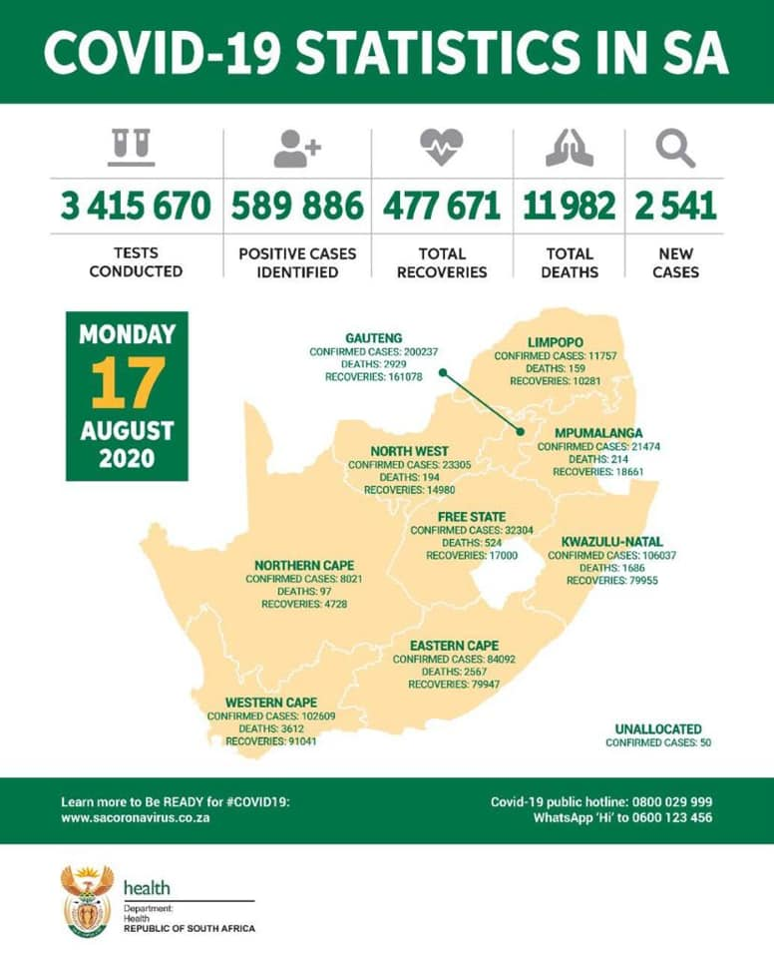

Slide 10
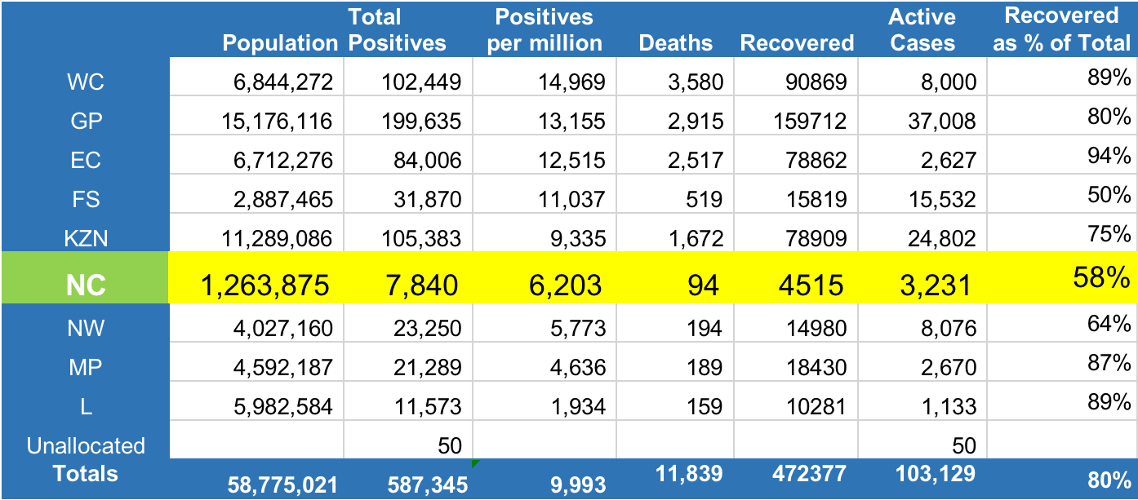
COVID-19 Case Statistics: Provincial comparisons
(16 August 2020)

Slide 11
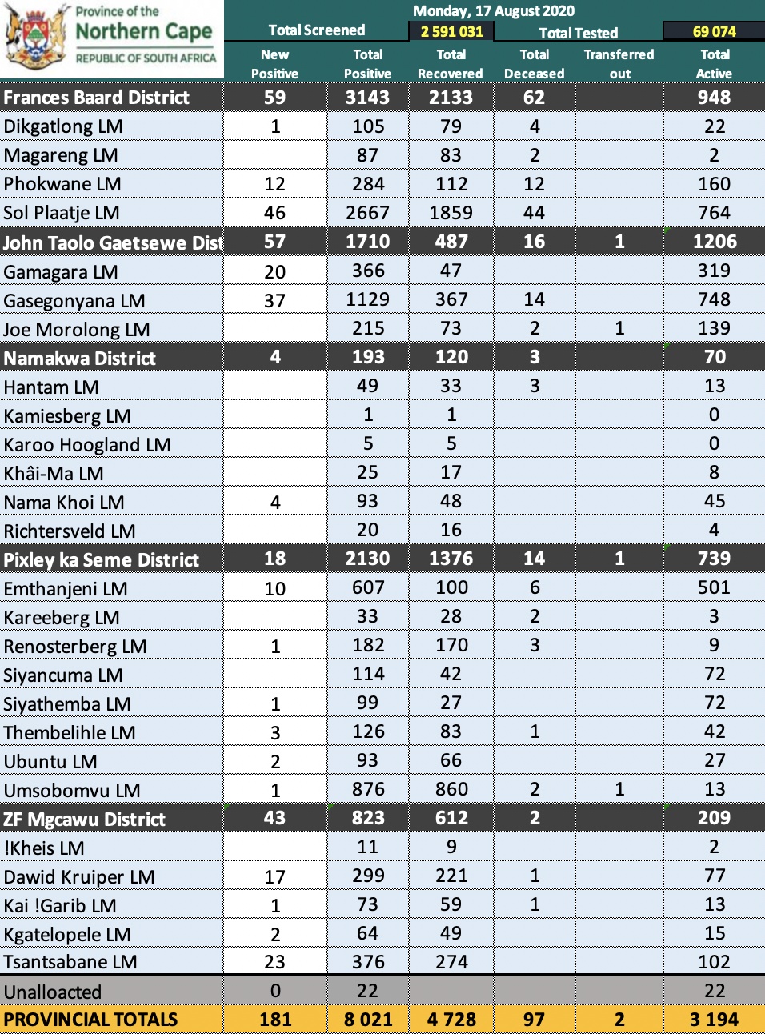
Today’s Data Set:
How it is Generated
Samples taken by clinicians (private & public)
Patient forms completed by clinician – the accuracy of this determines the accuracy of final data set
Sample and form sent to certified laboratories (private & public)
Data and laboratory result transferred to NICD
Analysts, biostatisticians and epidemiologists clean up data and allocate against provinces
Data released around 2pm each day to Department of Health, Ministry of Health and Provincial M&E team
M&E team adds additional data to the data set (e.g. District and Local Municipality information) and puts into table format
Minister releases information publicly that evening
Provincial Department posts the information to social media
Even after publishing the data continues to be corrected and updated

Slide 12
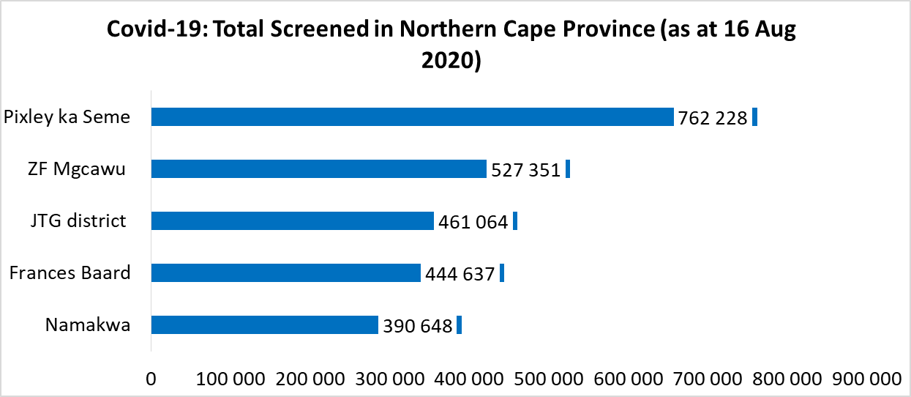
Covid-19: Screening (16 Aug 2020)
The number of people screened to date is almost 2.6 million

Slide 13
Covid-19: Testing analysis (16 Aug 2020)
District | Population | Tests Done Week Ending 09 Aug 2020 | Tests Done Week Ending 16 Aug 2020 | Weekly Tests | % Population Tested 16 Aug 2020 | Test per 100 000
Frances Baard | 381 570 | 24655 | 27701 | 3046 | 7.3% | 7 260
JT Gaetsewe | 245 820 | 8398 | 9690 | 1292 | 3.9% | 3 942
Namakwa | 113 474 | 1264 | 1471 | 207 | 1.3% | 1 296
Pixley ka Seme | 213 104 | 18277 | 20088 | 1811 | 9.4% | 9 426
ZF Mgcawu | 265 867 | 7656 | 8685 | 1029 | 3.3% | 3 267
NC Total | 1 219 835 | 60250 | 67635 | 7385 | 5.5% | 5 545
 |  |  | Unallocated = 1 372
Tests conducted between weeks ending 9 and 16 August is 8 757.
This represents 5.5% of the total population (or 5 545 per 100 000 population)

Slide 14
Covid-19: Distribution by Age
The median age among Covid-19 cases is 41 years, the age group 30 – 39 years constitute a higher proportion followed by 40 – 49 years.

Slide 15
Covid-19: Distribution by Sex (14 Aug 2020)

Slide 16
Covid-19: Hospitalisation trends
 | General beds |  | High care beds |  | Intensive care beds |  | Total
 | Public | Private | Public | Private | Public | Private
05 Jul | 4 | 4 | 0 | 0 | 0 | 4 | 12
12 Jul | 6 | 6 | 0 | 1 | 0 | 6 | 19
19 Jul | 4 | 6 | 0 | 0 | 15 | 6 | 31
26 July | 37 | 21 | 1 | 8 | 2 | 7 | 76
02 August | 16 | 25 | 1 | 10 | 7 | 11 | 70
09 August | 36 | 57 | 2 | 0 | 7 | 22 | 124
16 August | 37 | 42 | 5 | 0 | 8 | 15 | 107

Slide 18
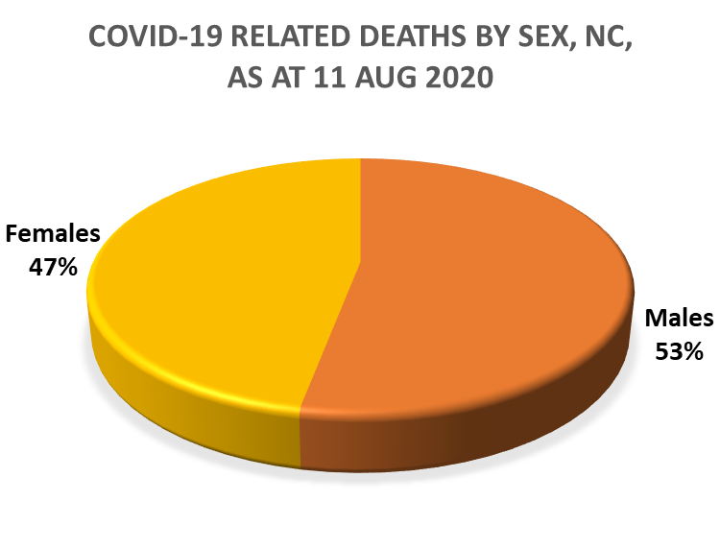
COVID-19: Deaths Analysis (16 Aug 2020)
District Municipality | Total Cases | No. of Covid-19 Deaths | Case Fatality Rate (%)
Frances Baard | 2 672 | 59 | 1.4%
JT Gaetsewe | 1 459 | 16 | 0.9%
Namakwa | 160 | 3 | 1.9%
Pixley ka Seme | 1 933 | 14 | 0.7%
ZF Mgcawu | 630 | 2 | 0.3%
Total | 6 854 | 94

Slide 19
COVID-19: Mortality trend (16 Aug 2020)
The number of Covid-19 related deaths jumped from 5 in June, 38 in July and to 94 by mid-August

Slide 20
COVID-19: Mortality by Age & Sex (16 Aug 2020)
Males constitute a higher percentage in the age group 50 – 80 yrs. while women are much higher in younger age groups. The median age is 61 years with the youngest person to have died of Covid-19 complications being 23 years and the oldest at 87 yrs. Most deaths are between 50 – 69 yrs age group

Slide 21
COVID-19: Mortality and Co-morbidity (16 Aug 2020)
Comorbidity* | Total Cases | (%)
Diabetes | 56 of 94 | 60%
Hypertension | 35 of 94 | 37%
Renal Failure | 15 of 94 | 16%
Cardiovascular | 12 of 94 | 13%
Some of the deceased had more than one comorbidity, hence the number here cannot be totalized

Slide 22
Covid-19: Covid-19 Among Staff (14 Aug 2020)
Staff Category | no.
Nurse | 101
EMS Personnel | 8
Pharmacist | 6
Medical Officer | 24
CHW | 36
Other | 125
Allied Worker | 10
Prov Office | 7
Total | 317
By 14th August 2020, the number of healthcare workers infected increased from 252 (11 Aug) to 317, still majority being nurses

Slide 23




Prevalence, Incidence and Hotspots
Prevalence is the cumulative total of people who tested positive since the inception of the epidemic (Total positive)
Incidence is the number of new people testing positive during a specific period. In the case of COVID-19 it has been determined by WHO and the SA DoH that the infective period is up to 10 days
Therefore the incidence shown here is the number of new positive tests in the past 10 days per 100 000 population

Slide 24


Actions required at Very High Risk
Strict controls over movement of people, especially across municipal and provincial borders
Positive cases must be isolated for 10 days after symptoms subside
Symptomatic contacts must be isolated and tested
Asymptomatic close contacts, including all household members, must be quarantined and tested
The community must be actively screened within a radius of 100 metres of all positive people, for a period of fourteen days.
Guarantee sanitary hygienic conditions in the community, including systematic collection of solid waste every 2-3 days, correct removal of liquid waste, sufficient supply of clean water for cleaning and consumption
STOP ALL PUBLIC GATHERINGS
SOCIAL DISTANCING OF 2 METRES
COMPULSORY USE OF FABRIC FACE MASKS AT ALL TIMES

Slide 25
Covid-19: Week-on-Week % Change of New Cases
During the week 10 – 16 Aug, there’s been a slight increase in % increase of new cases week-on-week comparative analysis. The only district where there was a decline in new cases compared to new cases reported on the week ending 9th August is John Taolo Gaetsewe

Slide 26
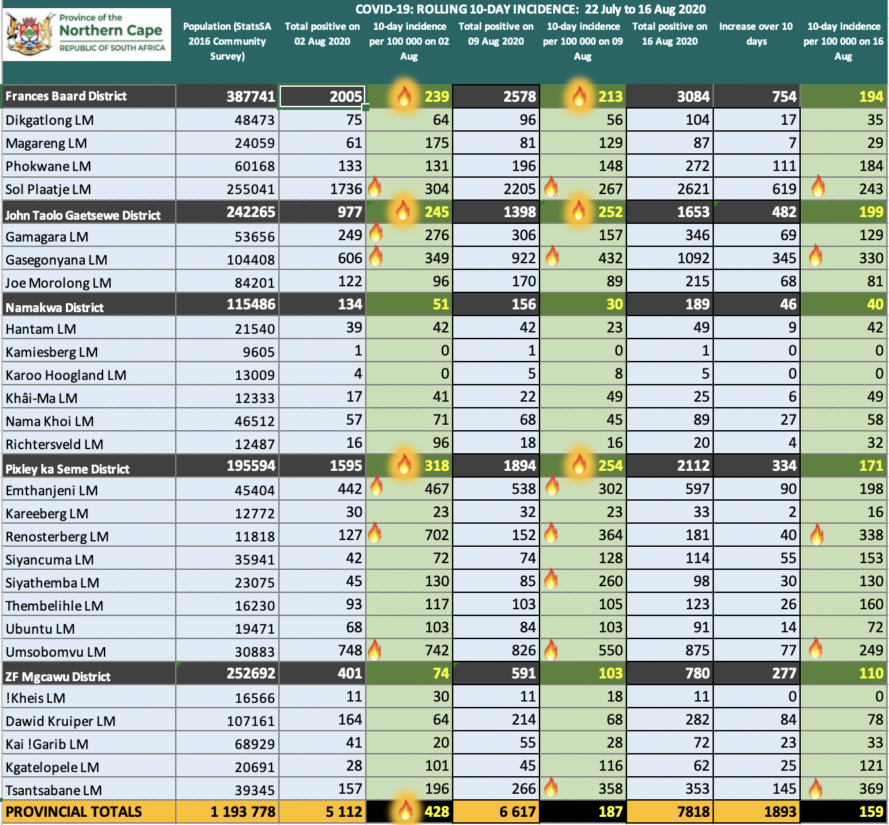
Incidence of COVID-19 over past 10 days
= greater than 200 per 100 000

Slide 27
Identification & Activation of Quarantine sites
The role of Department of Roads & Public Works is to identify facilities available to the Department of Health, who in turn assess and confirm suitability as a quarantine site
The Department of Public Works is responsible for Protocol Agreements with other spheres of government such as Local Government, for the utilization of their facilities e.g. Resorts and nature reserves
The priority is to activate State-owned facilities before private facilities in order to maximise budget availability.
A quarantine site is only activated by the Department of Health when there is a need to admit people
The Department of Health also supports other Departments e.g. DSD which recently had to quarantine 35 children and their minders, after some staff members had tested positive for Covid-19

Slide 28
Availability of Quarantine site
The Northern Cape DoH currently has 26 Quarantine facilities ready for use, with a target of 1295 beds – of these, 12 facilities have been activated due to need
Every district has at least one activated quarantine site, with the exception of Pixley Ka Seme
The challenge in Pixley ka Seme occurred during a surge where many test results came back after ten 10 days, when the need for quarantine was no longer appropriate
The private sector Merino Inn in Colesberg in Pixley ka Seme (60 beds) has subsequently been approved should need arise
A few quarantine sites are sponsored by the private sector for utilisation (particularly in John Taolo Gaetsewe and ZF Mgcawu districts)

Slide 29
List of Quarantine Sites (1)
NAME OF EARMARKED QUARANTINE FACILITY (State-Owned/Mine Sponsored/Private) | Target # | Assessed Yes/No | Activated √/× | NORTHERN CAPE
Frances Baard |  |  |  | Number of Beds
Harmony Home – Kimberley |  | √ | √ | 60
West End Hosp - Kimberley |  | √ | × | 40
Transka Resort- Warrenton |  | √ | √ | 186
Warrenton Cultural Centre- Warrenton |  | √ | × | 50
Rekaofela Resort-Barkley West |  | √ | × | 220
Platfontein Lodge- 15km outside Kimberley |  | √ | × | 11
District Total Sites & beds | 6 | 6 | 2 | 567
Pixley Ka Seme**
Rolfontein Nature Reserve - Vanderkloof |  | √ | × | 10
Merino Inn -Colesberg |  | √ | × | 60
De Aar Army Base- De Aar |  | X | × | 14
District Total Sites & beds | 3 | 2 | 0 | 84**
John Taolo Gaetsewe
Second Eye Holiday Resort- 10km outside Kuruman |  | √ | √ | 8
Tshwaragano Nurses Home- 20km outside Kuruman |  | X | × | 42
Mapoteng - (Sishen/ Kumba) |  | √ | √ | 200
Hotazel Guest House (SOUTH 32) - Hotazel |  | √ | × | 18
Eldorado Hotel (ASSMANG) -Kuruman |  | √ | √ | 35
District Total Sites & beds | 5 | 4 | 3 | 303

Slide 30
List of Quarantine Sites (2)
ZF Mgcawu
Die Eiland Nature Reserve- Upington |  | √ | √ | 53
Postmasburg Hotel (Mine Initiative)- Postmansburg |  | √ | √ | 37
Augrabies Park- Augrabies |  | X | × | 18
Majestic Lodge |  | X | × | 11
loveLife Centre –Grobblershoop |  | X | × | 12
Postmasburg Field Hospital (Mine Initiative)-Postmansburg |  |  | × | 42
Danielskuil Youth Hostel (Idwala Mine) - new |  | X | × | 70
District Total Sites & beds | 7 | 2 | 2 | 243
Namakwa
Springbok Caravan Park-- Springbok |  | √ | √ | 20
Nababeep CHC |  | √ | √ | 44
Alexander Bay CHC |  | √ | √ | 20
Loeriesfontein CHC |  | √ | √ | 6
Williston CHC |  | √ | √ | 8
District Total Sites & beds | 5 | 5 | 5 | 98
TOTAL BEDS | 26 | 19 | 12 | 1295
*NB: Additional Sites and Beds still being sourced for Pixley Ka Seme. Currently SCATEC SOLAR is engaging the Department for a possible 50-bed facility at Phillipstown. This will bring the total for Pixley Ka Seme to 134 beds

Slide 31
COVID-19: Hospital Bed planning (1)
NDOH advises that during the peak surge, non-urgent and non-emergency admissions will be postponed
Up to 85% of beds will be made available for admitting patients with COVID-19-related illnesses
Oxygen delivery systems (such as nasal prongs and Constant Positive Airway Pressure [CPAP], should be available as required for patients admitted to high care and general beds
ICU, including ventilation, will be required for the most critically ill patients

Slide 32
COVID-19: Hospital Bed planning (2)
The Department is basing its bed planning on the “NDoH Dr Crisp Model” for hospital bed needs
  2 076 General beds + 634 High care beds = 2 710
  72 Intensive care beds
Currently available beds (based on 85% of beds being utilized for COVID-19 related admissions during peak surge):
  2 234 General and high care beds
  64 Intensive care beds:
Additional beds under consideration
  Up to 1 257 general & high care beds
  Up to 55 intensive beds

Slide 33
National COVID-19 Epi Model (NCEM)
South Africa's first case recorded 5 March 2020, with confirmed cases increasing to 1,353 by 31 March
National COVID-19 Epi Model (NCEM) Dashboard developed by RSA COVID-19 Modelling Consortium to provide interactive projections of estimated COVID-19 cases, hospitalisations and deaths
Projections generated using mathematical modelling simulations based on RSA data and using parameter estimates jointly agreed by the Modelling Consortium

Slide 34
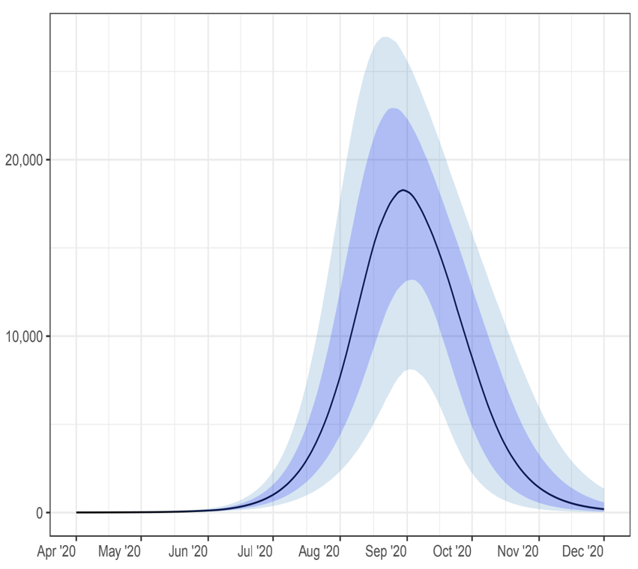
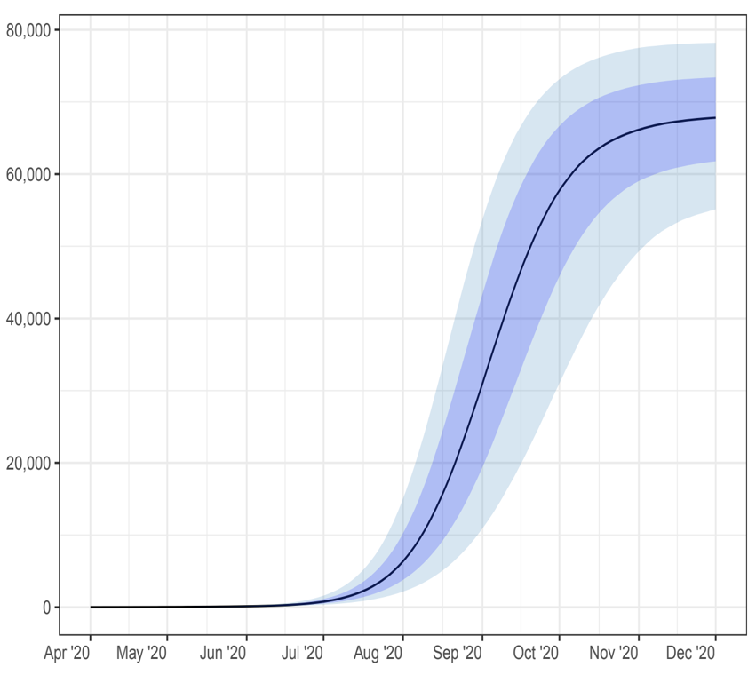
NC Projected Active Cases
NCEM
Daily
Cumulative

Slide 35
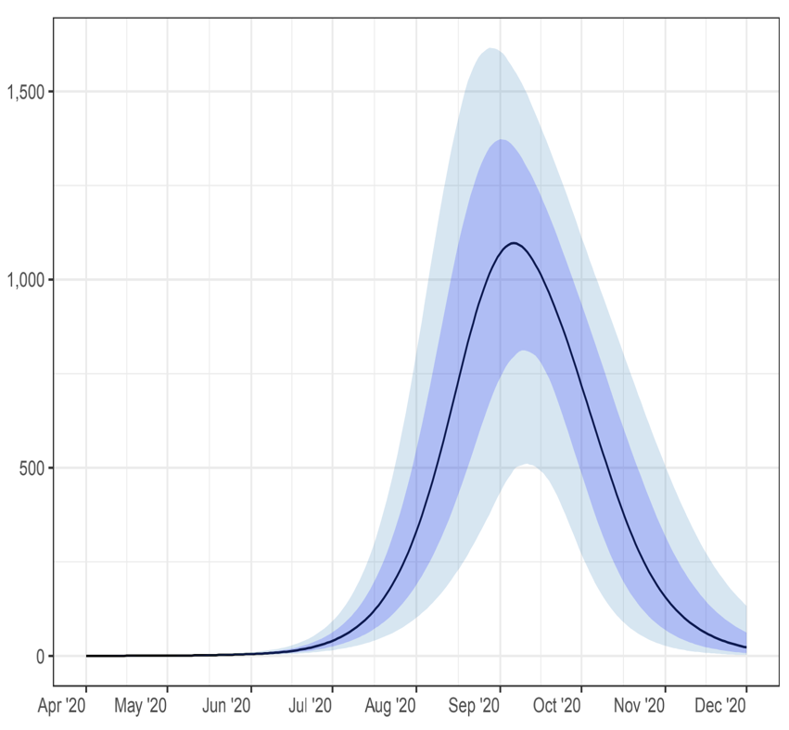
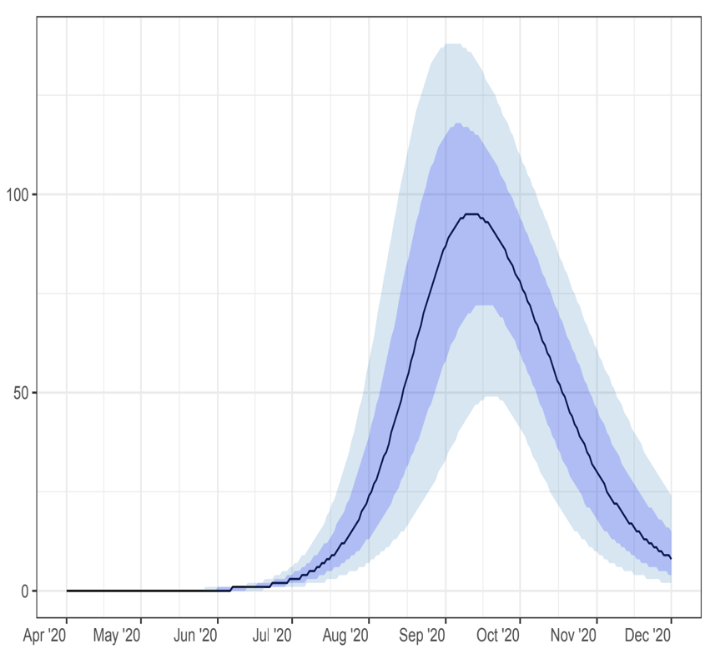
NC Projected Hospital bed needs
NCEM
Non-ICU
ICU

Slide 36
Funeral Undertakers and Mortuary Capacity
District | Total facilities (NCDoH + private) | Capacity | Coffins *
Namakwa | 15 | 113 | 75
Frances Baard | 38 | 541 | 190
ZF Mgcawu | 8 | 129 | 40
Pixley ka Seme | 15 | 131 | 75
John Taolo Gaetsewe | 11 | 147 | 55
Total | 87 | 1061 | 435
* The number of coffins are based on 5 coffins per facility. Facilities mostly don’t store many coffins on site; coffins stored are mainly for display

Slide 37
COVID-19: Environmental Health Services & Pixley ka Seme
MEC for Health and MEC for Cooperative Governance will approach the Office of the Premier to lead a process at resolving this situation
Notes:
The MEC responsible for local government (COGHSTA) must ensure the effective rendering of municipal services of which Municipal Health Services is a vital, basic service.
The MEC for Health is ultimately responsible for health services in the Northern Cape. Municipal Health Services (Environmental Health Services rendered at municipal level) is included in the definition of "health services" in the National Health Act, 2003.
SALGA may also be able to assist as it is responsible for overseeing effective local government / governance in the areas of jurisdiction of its members.

Slide 38
MID-TERM BUDGET:
REPRIORITISATION
R396.8m
Provincial top up on equitable share
R100m
Reprioritisation of HIV conditional grant
R76.6m
Reprioritisation from Equitable share
R51m
Shifted from other conditional brants
R6.2m
From Disaster Relief Fund

Slide 39
SPENDING
ALLOCATION
R181M
Additional staff
R18m
Oxygen capacity for inpatients
R80.5M
Additional inpatient structures
R130.8m
Medical equipment
R72m
Quarantine/Isolation facilities

Slide 40
PPE Orders Placed, Received & Paid Report

Slide 41
COVID-19: Contract Nursing appointments (12 mth)

Slide 42
THE END
of the Health
Presentation

Slide 43

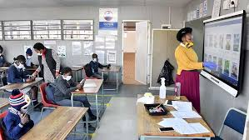
PROVINCIAL COMMAND COUNCIL

Slide 44
OUTLINE OF PRESENTATION
EDUCATION COVID-19 RESPONSE PLAN
  1.1 CURRICULUM RECOVERY STRATEGIES
  1.2 SUPPORT TO LEARNERS EXEMPTED FROM SCHOOL ATTENDANCE
  1.3 IMPLEMENTATION OF DIFFERENTIATED TIMETABLE
  1.4 NATIONAL SCHOOL NUTRITION PROGRAMME (NSNP)
  1.5 PROVISION OF LEARNER TRANSPORT
  1.6 ASSESSMENT AND EXAMNINATIONS
  1.7 MONITORING THE USE OF MASKS
  1.8 STANDARD OPERATING PROCEDURES
RESOURCING OF COVID-19 INTERVENTIONS
PRESSURE POINTS AND SERVICE DELIVERY LIMITATIONS
  3.1 LEARNER AND TEACHER ATTENDANCE
  3.2 DISRUPTIONS AT SCHOOLS
  3.3 INFRASTRUCTURE CHALLENGES AT SCHOOLS
  3.4 COMPLIANCE OF HOSTEL FACILITIES
  3.5 TEACHER CO-MORBIDITIES
  3.6 COVID-19 CASES AT SCHOOLS
PARTNERSHIPS
READINESS TO RECEIVE LEARNERS ON 24 AUGUST 2020

Slide 45
1. NCDoE RESPONSE PLAN TO COVID-19

Slide 46
1.1. CURRICULUM RECOVERY STRATEGIES

Slide 47
Curriculum Recovery Strategies
The framework for curriculum recovery centres around the following:
a) Extension of teaching and learning time
  For Grades 7 and 12 who are expected to attend school everyday.
  All other grades will have options for differentiated timetabling modules
  b) Curriculum interventions:
  Curriculum trimming and reorganisation has been concluded and mediation of the revised Annual Teaching Plans (ATPs) has been conducted through different platforms of communication.

Slide 48
ON-SITE SUPPORT FOR TEACHERS AND LEARNERS
Extra-Classes (Afternoon , Saturday, etc.)
Spring Camps (Extended for learners not incubated)
Weekend Lock-In Sessions (for 5 high enrolment subjects)
E-learning solutions (Integration training)
Provision of learning support materials through electronic and Print Media (past question papers, exemplar formal assessment tasks, a booklet focusing on study methods and accelerated learning for Grade 10-12 learners)
Communities of Practice (COPs) working sessions for educators (development of standardised lessons and assessments)
Teacher Development Activities (e.g. support for high number of novice teachers and temporary teachers to be appointed)
Itinerant /Lead Teacher Programme (Specialist teachers outside of the system who assist novice teachers)
Psycho-Social Support is provided to both learners and teachers.

Slide 49
1.2. SUPPORT TO LEARNERS EXEMPTED FROM SCHOOL ATTENDANCE

Slide 50
SUPPORT TO LEARNERS EXEMPTED FROM SCHOOL ATTENDANCE
To ensure academic support to learners with comorbidities, learners with other ill-health, those exempted from attending school and those learning through virtual/online platforms, the Northern Cape Department of Education (NCDOE) has developed Learner Support Packages for each subject in all grades to ensure continued learning.
The Learner Support Packages have been developed to be Self-Study Packages that should be accessible and are easy to follow (written) instructions
The packages come with a memorandum for each subject to assist teachers. These memoranda for each subject may only be given to learners as part of corrections after the completion of marking by the teacher in preparation for feedback to learners
The Learner Support Packages are currently printed and will be distributed to all Districts by next week

Slide 51
SUPPORT TO LEARNERS EXEMPTED FROM SCHOOL ATTENDANCE…2
Learners and parents will be expected to get their packages at schools and other platforms that will be communicate to parents.
Local Radio Station lesson broadcasts have been extended beyond school re-opening for both GET and FET identified subjects with reviewed time slots
All Grade 12 learners to receive devices in order to access digitised lessons.
Digitised lessons will be done in collaboration with TeachSA
Furthermore, the University of Stellenbosch, in collaboration with the Department of Science and Innovation, issued laptops to 40 Grade 12 Top-Achieving Mathematics and Science learners and tablets to 40 Grade 11 Top-Achieving Mathematics and Science learners.
These devices will be loaded monthly with 10gig of day-time data and 20gig of night-time data in order for learners to access the virtual platforms of curriculum material.
The NCDOE in collaboration with donors is exploring the possibility of providing all Grade 12 learners with tablets to assist with revision of subject content.

Slide 52
READING AND THE UTILISATION OF DBE WORKBOOKS
In addition to the Learner Support Packages, schools are expected to ensure that learners are provided with the workbooks for additional work. Guidance on how parents can assist learners with the workbooks has been put on HRMS. Schools are requested to provide parents with these guidelines
In addition to the workbooks guidelines, ‘Tips to Parents on Reading’ have also been issued in the same platform (HRMS). The expectation is that schools will also assist in ensuring that parents have access to these tips. The tips provide parent with easy to follow activities that they can do with learners at home to inculcate the love for reading as well as reading with understanding whilst having fun.

Slide 53
1.3. IMPLEMENTATION OF DIFFERENTIATED TIMETABLE

Slide 54
IMPLEMENTATION OF DIFFERENTIATED TIMETABLE
Options chosen by schools to mitigate social distancing challenges
DISTRICT | ALL LEARNERS RETURN | PLATOONING | ALTERNATING DAYS PER WEEK | BI-WEEKLY ROTATIONAL ATTENDANCE | HYBRID MODEL | TOTAL
Frances Baard | 18 | 4 | 84 | 10 | 10 | 126
Pixley Ka Seme | 22 | 2 | 41 | 9 | 12 | 86
Namakwa | 21 | 7 | 24 | 3 | 18 | 73
John Taolo Gaetsewe | 3 | 5 | 134 | 2 | 28 | 172
ZF Mgcawu | 0 | 0 | 9 | 2 | 87 | 98
TOTAL | 64 | 18 | 292 | 26 | 155 | 555

Slide 55
1.4. NATIONAL SCHOOL NUTRITION PROGRAMME (NSNP)

Slide 56
TOTAL LEARNERS BENEFITTING FROM NSNP
(AS PER APPROVED 2020/21 NSNP BUSINESS PLAN)
DISTRICT | LEARNERS FED
Frances Baard | 81 295
John Taolo Gaetsewe | 72 232
Namakwa | 19 604
Pixley ka Seme | 43 816
ZF Mgcawu | 50 480
TOTAL | 267 427

Slide 57
FEEDING OF LEARNERS
NUMBER OF LEARNERS BEING FED WHO ARE BACK AT SCHOOL
  GRADE 7 = 13 103
  GRADE 12 = 6 024
  TOTAL = 19 127
NUMBER OF LEARNERS BEING FED WHO ARE NOT YET BACK AT SCHOOL:
  COOKED MEALS FROM SCHOOL = 65 108
  FOOD PARCELS (MONTHLY) = 7 119
  TOTAL = 72 227

Slide 58
1.5. PROVISION OF LEARNER TRANSPORT

Slide 59
PROVISION OF LEARNER TRANSPORT
Total number of learners in the Province benefitting from Learner Transport at Public Ordinary Schools
  Before COVID-19, 24 544 learners were transported in the Northern Cape.
  224 operators were contracted to transport these learners with 619 vehicles (buses, mini- and midi-buses) across 408 routes.
  The country went into lockdown on 26 March 2020 because of Covid-19, which means that no schooling took place.
  When the schools re-opened, only the Grade 7 and Grade 12 returned.
  Consequently, as from 8 June 2020 a total number of 1 559 Grade 7 learners and 1954 Grade 12 learners were transported.
  On 6 July 2020, the next cohort of learners returned, namely, the Grade 6 and Grade 11 learners.
  Altogether 7 668 learners were transported as from 6 July 2020.

Slide 60
PROVISION OF LEARNER TRANSPORT…2
Measures in place to ensure health, safety, physical distancing requirements are met.
  All operators have been issued with disinfectant material and sanitizers to ensure that learners are safe on the vehicles.
  In addition to this, the NCDOE is also busy conducting monitoring inspections to ensure that the safety requirements are met on the learner transport vehicles.
  Dedicated Learner Transport Officials have also been appointed at the different district offices who are also conducting daily monitoring visits to all the routes.
Total number of learners in the Province benefitting from Learner Transport in Public Schools for Learners with Special Education Needs
  The current allocations to nine (9) Special Schools include allocations for learner transport, which is provided by the school itself. (However, the need is bigger than the allocation)
  Two (2) schools for Learners with Special Needs were identified to benefit from the learner transport programme, namely the Learamele Special School in the John Taolo Gaetsewe District (37 learners) and the Kleinzee Special School in the Namakwa District (102 learners).
  Currently only the learners of the Kleinzee Special School are transported monthly to the hostel after a formal request. A needs assessment will be conducted in Learamele Special School.

Slide 61
PROVISION OF LEARNER TRANSPORT..3
Modalities and number of transport facilities for Learners with Special Education Needs
  The learners of the Kleinzee Special School are transported on four (4) routes with 2 minibuses, 1 midibus and 1 large bus.
  Four (4) operators have been appointed on these 4 routes.
  These learners do not require modified/special adapted transport.

Slide 62
PROVISION OF LEARNER TRANSPORT…4
Observing of physical distancing in Learner Transport
  With the phasing in of Grades 7 and 12, and again Grades 6 and 11 on 6 July 2020, the transport of the learners were dealt with in terms of the Transport Regulations of 4 May 2020, which were advertised in Government Gazette No: 43272
  In terms of the mentioned Transport Regulations minibuses and midibuses were allowed to carry only 70% of their licensed loading capacity. Large buses were only allowed to transport 50% of their licensed capacity.
  For the phasing in of these grades it was only on certain routes where additional transport was required due the fact that fewer learners could be accommodated on the vehicles.
  On 22 July 2020, amended Transport Regulations were published in the Government Gazette No: 43538.
  The new regulations permitted learner transport operators to load their vehicles to 100% of the licensed loading capacity.
  This means that all the seats can be occupied.
  However, it is still required of operators to disinfect their vehicles and that the hands of learners and the driver are sanitized before they board the vehicle.
  It is mandatory of all learners and drivers to wear face masks.
  Interdepartmental montoring are in place to ensure compliance

Slide 63
PROVISION OF LEARNER TRANSPORT…5
District | Need (Before Covid-19) | Actual No. of Learners Transported (Before Covid-19) | (Actual No. of Grade 7 & 12 Learners Transported)
Frances Baard | 5 036 | 5 028 | 509
John Taolo Gaetsewe | 11 574 | 9 396 | 1 731
Namakwa | 1 625 | 1 205 | 143
Pixley Ka Seme | 2 278 | 2 193 | 201
ZF Mgcawu | 6 770 | 6 722 | 929
Total | 27 256 | 24 544 | 3 513

Slide 64
1.6. ASSESSMENT AND EXAMINATIONS

Slide 65
Examinations and Assessment
A revised plan to accommodate the merging of the May/June 2020 and Oct/Nov 2020 external exam has been developed.
Various plans were put in place to provide for the enrollment numbers that increased from the average of 14 000 to 24 371 as well as to accommodate COVID-19 Protocols.
The Oct/Nov 2020 registration data will be finalized towards the end of August 2020.

Slide 66
Examinations and Assessment…2
No internal June exam was conducted however a school based Preparatory Examination will be conducted for Grade 12 starting 14 September until the end of September.
Some parts of the School Based Assessments (SBA) are excluded e.g. June and controlled tests to focus on alternative forms of assessment.
Revised timetables and details were issued to all stakeholders and candidates.

Slide 67
Examinations and Assessment…3
The number of examination centres has increased from 134 to 163 to accommodate all the candidates for the merged examination. Given the magnitude of the examination, more writing space will be required.
10 additional district based community based writing centres will be established.
The increased number of centres will necessitate the appointment and utilisation of more invigilators and more monitors with a ratio of 1:20
All Grade 12 educators will be used as invigilators and private Invigilators will invigilate the part time candidates

Slide 68
Examinations and Assessment…4
NSC / SC external examination commences on 5 November 2020 and concludes on 15 December 2020.
Computer Application Technology (CAT) and IT Practical question papers and Life Orientation Common Assessment Task written in the week of the 19th October 2020.
Large enrolment subjects, i.e. Mathematics and Mathematical Literacy and English HL and FAL are written on the same day but in different sessions.
Marking centres will be increased from 3 to 5 to host 1 158 markers to comply with COVID-19 protocols.
Marking will commence on 3 January 2021 and conclude on 16 January 2021.
Tentative date for the release of results: 21 February 2021 (Minister); 22 February 2021 (schools).

Slide 69
Examinations and Assessment for Grades 1 -11
All School Based Assesssment (SBA) requirements for Term 1 must be completed by each school.
The 2020 June Examinations are excluded across all grades but the final, summative examinations will be administered.
The Grade 12 Preparatory Examination will be written at all schools from the 14th of September until the end of September 2020.
Where possible, written tests that constituted part of the SBA tasks excluded in favour of alternative forms of assessment tasks, such as, projects, assignments, case studies, etc., that will enable the assessment of knowledge, skills and competencies that cannot be assessed in the written examinations.

Slide 70
Examinations and Assessment for Grades 1 -11…2
The Department released 3 assessment instructions for the Further Education and Trainin (FET) Phase to provide clarity to schools on the different aspects of the management of the School Based Assessments in the COVID-19 environment.
The PED also established a working group in the General Education and Training (GET) Phase to share, update and monitor progress with the implementation of Circular S2 of 2020 and the addendum as well as the practical guidelines for teachers during the COVID-19 pandemic.

Slide 71
1.7. MONITORING THE USE OF MASKS

Slide 72
Monitoring of Use of Masks at School
The School COVID-19 Core Orientation Team (SCCOT) will be responsible for the orientation and monitoring of the utilization of masks by learners and all staff members at public ordinary and special schools.
Life Orientation teachers, as part of the School COVID-19 Core Orientation Team (SCCOT) will also assist with the monitoring of the use of masks by learners and staff.
Screeners will assist with the periodic monitoring throughout the day.
Teachers will be expected to do ground duty during breaks to monitor the use of masks by learners.
Class and subject teachers will, at all times monitor the utilization of masks in the classroom.

Slide 73
Mechanism to deal with non-compliance
Schools will be advised to always have extra disposable masks for learners not arriving at school with masks.
Learners arriving without a mask will also be given a letter for the parents/guardians emphasizing the importance of wearing a mask to school.
A school must keep a register of learners who were supplied with extra disposable masks to prevent learners repeatedly arriving at school without a mask.
A warning will be given to learners arriving three times without a mask and parents will be informed that the learner will be prevented from entering the school premises for non-compliance.

Slide 74
1.8. STANDARD OPERATING PROCEDURES

Slide 75
MEASURES IN PLACE TO DEAL WITH INCONSISTENT APPLICATION OF SOPS IN SCHOOLS
The Province has not yet received the latest version of the revised Standard Operating Procedures.
Last version of SOP communicated to all schools via HRMS.
Tshela Consulting was appointed to orientate SGB and SMT members on the DBE SOP for teachers, support staff and learners. Virtual training was conducted on 3-5 June 2020 in all districts.
  Frances Baard District: 76 out of 126 schools trained
  Pixley ka Seme District: 70 out of 87 schools trained
  ZF Mgcawu District: 98 out of 98 schools trained
  John Taolo Gaetsewe District : 100 out of 172 schools trained

Slide 76
MEASURES IN PLACE TO DEAL WITH INCONSISTENT APPLICATION OF SOPS IN SCHOOLS…2
Tshela Consulting loaded training docs on USB and delivered to all districts.
All schools were provided with a USB containing the SOP and presentation. Remaining schools at attending virtual training advised to use documents to orientate SGB and SMT members.
Screeners ensure compliance with SOP as it relates to screening, wearing of masks, sanitizing of hands and general hygiene practices in bathrooms and during feeding.

Slide 77
MEASURES IN PLACE TO DEAL WITH INCONSISTENT APPLICATION OF SOPS IN SCHOOLS…3
The School SMT ensure consistent application of the SOP amongst staff and learners.
Inconsistent application will be dealt with per relevant legislature when Reported – EEA educators, PSA Regulations support staff.
SGBs will be advised to amend Learner Code of Conduct to deal with COVID-19 violations.

Slide 78
2. RESOURCING OF COVID-19 INTERVENTIONS

Slide 79
COVID-19 RESOURCING

Slide 80
3. COVID-19 PRESSURE POINTS AND SERVICE DELIVERY LIMITATIONS

Slide 81
3.1. LEARNER AND TEACHER ATTENDANCE

Slide 82
AVERAGE DAILY LEARNER ATTENDANCE
11 – 14 AUGUST 2020
DISTRICT | Grade 7 |  |  | Grade 12
 | Enrolment | Present | % Present | Enrolment | Present | % Present
Frances Baard | 7185 | 3624 | 50,43 | 4300 | 3387 | 78,77
John Taolo Gaetsewe | 5047 | 2784 | 55,15 | 2598 | 1930 | 74,30
Namakwa | 1788 | 1393 | 77,91 | 841 | 735 | 87,45
Pixley Ka Seme | 4069 | 1775 | 43,61 | 1515 | 1178 | 77,79
ZF Mgcawu | 4747 | 2296 | 48,37 | 2324 | 1703 | 73,26
TOTAL | 22836 | 11871 | 51,98 | 11577 | 8933 | 77,16

Slide 83
AVERAGE DAILY TEACHING AND NON-TEACHING STAFF ATTENDANCE
11 – 14 AUGUST 2020
DISTRICT | EDUCATOR ATTENDANCE |  |  | PSA STAFF ATTENDANCE |  |  | SCREENERS ATTENDANCE
 | Total Staff | Present | % Present | Total Staff | Present | % Present | Total Staff | Present | % Present
Frances Baard | 3016 | 1485 | 49,24 | 618 | 458 | 74,11 | 547 | 475 | 86,88
John Taolo Gaetsewe | 1651 | 1074 | 65,07 | 353 | 287 | 81,32 | 379 | 333 | 87,86
Namakwa | 744 | 464 | 62,31 | 203 | 172 | 84,96 | 206 | 182 | 88,00
Pixley Ka Seme | 1289 | 752 | 58,38 | 297 | 243 | 82,04 | 278 | 256 | 91,82
ZF Mgcawu | 1767 | 856 | 48,45 | 326 | 260 | 79,95 | 359 | 308 | 85,91
TOTAL | 8466 | 4631 | 54,70 | 1796 | 1421 | 79,12 | 1769 | 1553 | 87,80

Slide 84
3.2. DISRUPTIONS AT SCHOOLS

Slide 85
DISRUPTIONS OF SCHOOLS
FRANCES BAARD DISTRICT
No. | School | Date of disruptions | Reason for disruptions | Mitigating / Actions taken
1 | Beacon Primary | 16 July 2020 | Screeners stayed away from work | Screeners were engaged and agreed to return to work on 20 July 2020.
2 | Letshego Primary | 17 July 2020 | Screeners stayed away from work | Screeners were engaged and agreed to return to work on 20 July 2020.
3 | DL Jansen Primary | 20 July 2020 | SADTU instructed teachers to isolate for 14 days. | SADTU was engaged and the school was back to normal on 11 August 2020.
4 | Dikgatlong High | 16,17 & 20 July 2020 | COSAS and community closed school and threatened the staff | Staff reported for duty but learners only returned to school on 21 July 2020.
5 | Francis Mohapanele Primary | 16,17&20 July 2020 | COSAS and community closed school and threatened the staff. | Staff reported for duty but learners only returned to school on 21 July 2020.
6 | Endeavour Primary | 13 July 2020 | Screeners stayed away from work | Screeners were engaged and reported for duty on 23 July 2020.
7 | Northern Cape Agricultural | 20 July 2020 | Screeners stayed away from work | Screeners were engaged and reported for duty on 21 July 2020.

Slide 86
DISRUPTIONS OF SCHOOLS
FRANCES BAARD DISTRICT….2
No. | School | Date of disruptions | Reason for disruptions | Mitigating / Actions taken
8 | Kgabang Primary | 06 July 2020 | Community disrupted the school | SGB and departmental engagement ensured that teachers and leaners returned to school on 11 August 2020.
9 | Delportshoop Intermediate | 20 July 2020 | Parents prohibited learners from attending school, alleging that learners’ lives were at risk. | Schooling was back to normal as from 11 August 2020.
10 | Delportshoop Combined | 20 July 2020 | Parents prohibited learners from attending school, alleging that learners’ lives were at risk. | Schooling was back to normal as from 03 August 2020.

Slide 87
DISRUPTIONS OF SCHOOLS
FRANCES BAARD DISTRICT…3
No. | School | Date of disruptions | Reason for disruptions | Mitigating / Actions taken
11 | Venus Primary | 6 July 2020 | SGB issued letter to parents on 3 July 2020, requesting them not to send learners to school because of the sanitation challenges | Circuit Manager engaged with SMT and SGB members on 8 July 2020 Agreement reached that the toilets are sufficient for the current phased in grades at the school (Gr3,6 and 7) Mobile toilets were delivered at the school over the weekend of 10 July 2020. The situation at the school was back to normal as from 13 July 2020.
12 | Rietrivier Primary | 13 July 2020 | Parents gathered on the morning of 13 July 2020 and submitted a letter stating their fears for their children's health and safety, refusing to send learners back to school and insisted the school be closed, because 10 teachers were in contact with a positive case. | Local clinic was contacted. Educators who were in contact with the confirmed positive case were requested to self-isolate. Although there were no positive cases at the school, the school was disinfected in an attempt to assure parents that the environment was clean and safe. Teachers reported for duty as from 14 July 2020 and the learners returned to school as from 11 August 2020.

Slide 88
DISRUPTIONS OF SCHOOLS
NAMAKWA DISTRICT
No. | School | Date of disruptions | Reason for disruptions | Mitigating / Actions taken
1 | Matjieskloof Intermediate | 13-17 July 2020 | Parents refused to send their learners to school out of fear of perceived positive COVID-19 case. | District Director met with the SMT, educators and SGB members to address the concerns raised. The administration block at the school was disinfected on Sunday 19 July 2020. The school re-opened on Monday 20 July 2020.

Slide 89
DISRUPTIONS OF SCHOOLS
PIXLEY KA SEME DISTRICT
No. | School | Date of disruptions | Reason for disruptions | Mitigating / Actions taken
1 | RD Williams Primary | 6 July 2020 | Community protested against the 2nd phasing in of learners, citing water challenges and fear for the safety of their children. | The Circuit Manager met with the School Governing Body and the Principal met with the parents. The matter was resolved and learners returned to the class on 7 July 2020.

Slide 90
DISRUPTIONS OF SCHOOLS
ZF MGCAWU DISTRICT
No. | School | Date of disruptions | Reason for disruptions | Mitigating / Actions taken
1 | Westerkim Primary | 20 -21 July 2020 | Parents refuse to send their children to the school before the school is disinfected. | Municipality disinfected the school and the learners returned to school on 11 August 2020.

Slide 91
PROVINCIAL SUMMARY OF
DISRUPTIONS OF SCHOOLS
District | Number of Disruptions
Frances Baard | 12
John Taolo Gaetsewe | 0
Namakwa | 1
Pixley ka Seme | 1
ZF Mgcawu | 1
Total | 15

Slide 92
MEASURES IN PLACE TO CURB SCHOOL DISRUPTIONS
Regular engagement with stakeholders through the QLTC Programme
These stakeholders include, among others:
  Labour Unions
  Student Structures
  SAPS
  SGB Associations
  Distribution of pamphlets, flyers, etc.
  Political engagement with communities

Slide 93
3.3. INFRASTRUCTURE CHALLENGES AT SCHOOLS

Slide 94
VANDALISED SCHOOLS
Corrective Maintenance was conducted at 107 schools that were vandalized during the lockdown period
DISTRICT | NUMBER OF SCHOOLS | NUMBER OF SCHOOLS REPAIRED | ALLOCATED
FRANCES BAARD | 38 | 10- Work In Progress 28 - Work Completed | R 1 800 036,90
JOHN TAOLO GAETSEWE | 13 | 8 - Work In Progress 5 - Work Completed | R 924 475,00
NAMAKWA | 10 | 4 - Work In Progress 6 - Work Completed | R 176 800,00
PIXLEY KA SEME | 27 | 19 - Work In Progress 8 - Work Completed | R 759 292,50
ZF MGCAWU | 19 | 6 - Work In Progress 13- Work Completed | R 2 311 717,00
TOTAL | 107 | 47 - Work In Progress 60- Work Completed | R 5 972 321,40

Slide 95
PROGRESS ON VANDALISED SCHOOLS
The vandalised schools have increased to 107 schools
Schools continue to fix vandalised projects through their maintenance budget on the school allocations
Where projects are major, the department conducts repairs on behalf of the schools.
Of the 107 schools that have been vandalized, work at 60 schools are now completed and 47 is in progress.
None of the vandalism projects are prohibitive for schools reopening.
All work is expected to be completed on 24 August 2020.

Slide 96
MEASURES IN PLACE TO DEAL WITH VANDALISM IN SCHOOLS
The strengthening of the NC School Safety Implementation Protocol between the DOE, DTSL and SAPS on the Prevention of Crime and Violence in all Schools. This Protocol guides the collaborative governmental approach to deal with school safety.
As per the Protocol:
  All schools have been linked to police stations
  A police officer (Adopt-a-Cop) has been assigned to each school to assist with crime prevention programmes.
  Implementation of context-specific crime prevention programmes
DTSL (as oversight body of SAPS) has been engaged to mobilise SAPS to include targeted schools in regular patrols to deter break-ins and vandalism.
Through the intervention of PROVJOINT, the MEC of Finance announced an allocation of R1.5 million for the installation of alarm systems in “hotspot” schools in the province.

Slide 97
SCHOOLS CURRENTLY CLOSED DUE TO WATER AND SANITATION CHALLENGES
No | School | Reasons | Status | Mitigation
1 | Ga-Ta-Lwatlou Middle School | Water and dilapidated structure | Contractor on site 2-3 weeks to complete Grade 7,8,9 20 learners affected | Consultation with the communities in progress for the move of the learners to Ba-Galotlhare.
2 | Ikakanyeng High School | Water and dilapidated structure | Contractor on Site, 2 weeks to complete Grade 11,12 50 learners affected | Learners moved to Ikemeleng School. Teaching and learning on track
3 | Bareki Primary | Water and dilapidated structure | Contractor on site, 1,5 weeks to complete, Grade 6 20 learners affected | Consultation with the communities in progress for the move of the learners to Perth.
4 | Dr EP Lekhela | Water Reticulation, Ablution Facilities | Contractor instructed to finalise work before the 24 August 2020. | Grade 12 returned successfully. Work to be expedited.

Slide 98
3.4. COMPLIANCE OF HOSTEL FACILITIES

Slide 99
HOSTELS IN THE PROVINCE PER DISTRICT
District | Public Ordinary School Hostels | Special School Hostels | Total School Hostels | Hostels not Ready for all Boarders | Reasons
Frances Baard | 9 | 3 | 12 | 2 | Lack of essential personnel (2 Special Schools)
JT Gaetsewe | 5 | 1 | 6 | 3 | Over-crowding
Namakwa | 16 | 1 | 17 | 5 | Over-crowding
Pixley ka Seme | 19 | - | 19 | 5 | Over-crowding
ZF Mgcawu | 16 | - | 16 | 5 | Over-crowding
TOTAL | 65 | 5 | 70 | 20

Slide 100
VACANCIES AT SCHOOL HOSTELS
There are currently 256 support staff vacancies at hostels.
District | Cleaner/Household Aide/General Worker | Handyman | House Mother / House Father | Food Services Supervisor | Food Services Aid | Laundry Aid | Nurse | Nursing Assistant | Total
Frances Baard | 3 | 5 | 7 | 5 | 6 | 2 | 0 | 1 | 29
John Taolo Gaetsewe | 5 | 5 | 6 | 5 | 5 | 2 | 1 | 2 | 31
Namakwa | 2 | 12 | 19 | 11 | 14 | 3 | 0 | 0 | 61
Pixley ka Seme | 9 | 14 | 22 | 14 | 14 | 4 | 0 | 0 | 77
ZF Mgcawu | 6 | 10 | 17 | 10 | 10 | 5 | 0 | 0 | 58
Total | 25 | 46 | 71 | 45 | 49 | 16 | 1 | 3 | 256

Slide 101
HOSTEL READINESS AND CHALLENGES
The basic sanitation and hygiene packages ordered were delivered to all 70 hostels, with some critical special essential protective equipment for the five special school hostels still outstanding.
All 11 public special schools has resume teaching and learning but only one (1) of the five (5) is open as at 12 August 2020 – due to a combination of factors: the already shortage in personnel is exacerbated by the absence of replacements for those employees with comorbidities / underlying medical conditions
Onsite auditing of all 65 public ordinary school hostel was conducted. According to this Audit Report all 70 hostels combined have the capacity to house 10045 learners, but currently (2020) accommodate 5 336 learners (54%).
The two guiding Directions for determining occupancy readiness of hostels in order to ensure compliance with health, safety, and social distancing requirements - in terms of the Directions of 23 June 2020 – are:
    Every school, hostel or office must comply with the social distancing; and requirement of at least 1.5 meters, as prescribed in the Regulations; and
    School facilities must operate at 50% or less of their capacity at any given time.
In terms of the above directions the combined learner total in hostels will be in excess with 496 (boarders).
Alternative arrangements for excess boarders (340), if Soc. Dist. is gained through 50% of normal capacity, will have to be sought in 11 of the 65 ordinary public school hostels and for excess learners in each of the five special school hostels (156)
The biggest challenge faced by almost all hostel is the absence of the minimum required personnel.
The total number of critical vacant posts is 256.

Slide 102
MITIGATING MEASURES FOR HOSTELS
The following four (4) schools are situated in towns with more than one school hostel (Carnarvon High, Carnarvon High, Duineveld High, SC Kearns High and Saul Damon High), and could manage to easily mitigate the issue of social distancing.
All other seven (7) public ordinary hostels are located in rural towns without alternative / second hostels (Rietfontein Gekombineerde Skool, Kgotatsano Primary School, Hoërskool Groblershoop, Volop Intermediate School, Sonskyn Intermediate School, Van Zylsrus Intermediêre Skool and Kitlanyang Primary School).
Learner Transport is an option for excess learners from these rural towns, but except for Kitlanyang Primary School (46), Hoërskool Groblershoop (64) and Kgotatsano Primary School (56) the number of combined excess learners in the other schools is 31 – making it near impossible to establish routes.
Given the current trend of less learners returning to hostels, we anticipate that more from these rural hostels will ‘’even out’’ the excesses.
Despite the above projection schools are busy adjusting their plans in accordance with the regulations and directions.

Slide 103
3.5. TEACHER CO-MORBIDITIES

Slide 104
Consolidated Information on Teacher Co-Morbidities
District | No. of Schools where Co-Morbidities have been registered | Total Applications | No. of Concessions Approved as at 31 July 2020 | Number of applications declined | Number of disputes | Concession Applications referred to the District Office by Schools
Frances Baard | 117 | 742 | 587 | 25 | 0 | 130
John Taolo Gaetsewe | 102 | 386 | 136 | 136 | 0 | 114
Namakwa | 43 | 198 | 59 | 139 | 0 | 0
Pixley ka Seme | 93 | 221 | 145 | 66 | 0 | 10
ZF Mgcawu | 55 | 497 | 183 | 314 | 0 | 0
Total | 410 | 2 044 | 1 110 | 680 | 0 | 254
To date no formal disputes have been registered by educators where the concession application was declined.
Challenges are experienced with the Health Risk Manager for the second opinion for the 254 concession applications. The Department is working on alternative plans to address this.

Slide 105
SUSTITUTE EDUCATORS REQUIRED BASED ON APPROVED CONCESSIONS GRANTED
District | Number of substitutes required | Number of schools affected | Cost implication for six months
FRANCES BAARD | 587 | 117 | R120 922 000.00
JOHN TAOLO GAETSEWE | 136 | 102 | R28 016 000.00
NAMAKWA | 59 | 43 | R12 154 000.00
PIXLEY KA SEME | 145 | 93 | R29 870 000.00
ZF MGCAWU | 183 | 55 | R37 698 000.00
TOTAL | 1 110 | 410 | R228 660 000.00

Slide 106
READINESS CHALLENGES IN TERMS OF TEACHERS
Challenges | Mitigating Actions
NCDOE is currently experiencing challenges to source a second opinion from the Health Risk Manager (HRM). They have indicated that the Department will be required to liaise with the DPSA to grant permission for them to process assessments since it is not part of their current contract. | The Department has written a formal letter to the Department of Health in the Province to assist with the assessments in the absence of the Health Risk Manager.
Sourcing of educators who match the required post profile is problematic since the Language of Learning and Teaching (LOLT) in the Northern Cape is predominantly Afrikaans. | The Department developed a database of retired and qualified unemployed educators to address this challenge.

Slide 107
READINESS CHALLENGES IN TERMS OF TEACHERS…2
Challenges | Mitigating Actions
Sourcing substitute educators to teach in rural areas is proving difficult due to lack of amenities | The Department is offering rural incentives to attract and retain qualified educators in rural areas.
Funding for the additional substitutes required remains a big challenge in the Province. | The Department is engaging Provincial Treasury for additional funding.

Slide 108
3.6. COVID-19 CASES AT SCHOOLS

Slide 109
PROVINCIAL SUMMARY
CONFIRMED COVID-19 CASES AT SCHOOLS
AS AT 17 AUGUST 2020
District | Number of schools affected | Number of schools still closed | No. of Educators | No. of Learners | No. of PSA Staff | No of Screeners | No of Food Handlers | Total number of cases | Provincial total | % NCDOE positive cases / Province cases | No. of fatalities | Provincial total | % Fatalities / Province fatalities
Frances Baard | 53 | 0 | 64 | 32 | 7 | 4 | 2 | 109 | 2933 | 3,71% | 2 | 59 | 3,38%
John Taolo Gaetsewe | 38 | 7 | 41 | 14 | 2 | 0 | 1 | 58 | 1578 | 3,67% | 1 | 16 | 6,25%
Namakwa | 1 | 0 | 0 | 0 | 0 | 1 | 0 | 1 | 178 | 0,56% | 0 | 3 | 0. 00%
Pixley ka Seme | 29 | 0 | 35 | 43 | 4 | 3 | 6 | 91 | 2009 | 4,52% | 1 | 14 | 7,14%
ZF Mgcawu | 6 | 0 | 4 | 15 | 0 | 0 | 0 | 19 | 724 | 2,62% | 0 | 2 | 0. 00%
Total | 127 | 7 | 144 | 104 | 13 | 8 | 9 | 278 | 7422 | 3,74% | 4 | 94 | 4,25%

Slide 110
AVERAGE NUMBER OF DAYS SCHOOLS ARE CLOSED AFTER A POSTIVE COVID-19 CASE
Schools are on average closed for 3 – 5 days depending on the time it takes to thoroughly clean the school.

Slide 111
HOW IS THE CLOSURE MANAGED?
The principal informs the Circuit Manager of a positive case at the school.
The Circuit Manager informs the District Director.
The District Director then consult the DoH about the positive case/s and obtain a recommendation for the closure/non-closure.
The District then request permission from head office for the temporary closure of the school.
Once permission is obtained, the staff, parents and learners are accordingly informed.
The areas of contamination are thoroughly cleaned with bleach and the school would then reopen after the cleaning has been done.

Slide 112
4. PARTNERSHIPS

Slide 113
4.1. QLTC PROGRAMMES

Slide 114
QLTC STRUCTURES ESTABLISHED AND FUNCTIONAL
Provincial Structure:
  A very active Provincial QLTC Steering Committee meeting regularly
  Only one meeting held in January 2020 before National State of Disaster
  To continue with virtual meetings, the next ons scheduled for 19 August 2020
District QLTC Structures:
Namakwa District:
  District QLTC launched late 2019 and since then 20 School QLTC structures launched, and 13 are functional.
John Taolo Gaetsewe District:
  District structure launch with the assistance of the NECT during 2019
  QLTC structure is functional and all stakeholders actively involved results. Circuit QLTC Structures launched 15 School QLTC structures.

Slide 115
QLTC STRUCTURES ESTABLISHED AND FUNCTIONAL…2
Pixley Ka Seme:
  District structure launch with the assistance of the NECT during 2019 and still fully functional
  7 School QLTC structures launched, with only 3 functional
ZF Mgcawu District:
  District structure launch with the assistance of the NECT during 2019
  Challenges experienced with the launching of school structures due to staff shortages
Frances Baard District:
  No District QLTC launced yet
  Challenges experienced due to staff shortages

Slide 116
PUBLIC EDUCATION PROGRAMMES CONDUCTED BY QLTC
Provincial QLTC
  Collaboration and Partnership to strengthen social compact
  Partnership on 24 Flights with Pilot Olerato Majoro to take 72 learners throughout the Province on air and motivating them to become Pilots and study Aviation (Ongoing)
  NGO Caro Care foundation – restore the dignity of young girls (Sanitary Dignity Packs)
  Read to Lead Campaign, GBV, Radio Engagements, QLTC Opinion Piece on School Vandalism, 2021 Online Admission.
John Taolo Gaetsewe District:
  Online admission program involving many stakeholders that include sister department such as DSD, SAPS and mining companies such as Kumba, Blackrock and JTG development Trust
Namakwa District:
  Service delivery days with reference to HIV and AIDS and TB campaign. Examples SA van Wyk High School ,Witbank Primary school
  Advocacy on COVID-19 Health Guidelines

Slide 117
PUBLIC EDUCATION PROGRAMMES CONDUCTED BY QLTC…2
Frances Baard District:
  QLTC Addressing Learner Attendance in Ritchie and Windsorton communities: Parents and stakeholders Psycho-Social Support Social Support to Stakeholders and Grade 12 Learners on COVID- 19 Positive Mood/ Advocated for School Safety, FBD Social Development to assist Child Headed Households. GBV
Pixley Ka Seme District:
  Back to School, Matric Second chance, ID Campaign for 16years old, Sanitary towel to indigent girl learners IEC - Voter Education, Cleaning of school, CWP/EPWP. Uniform and school bursaries. Child headed households .Health and hygiene program.

Slide 118
IMPACT OF QLTC PROGRAMMES IN THE COMMUNITIES
JTG District is a shining example as an improved District where stakeholders hold hands with the department. It is heart warming to hear all the Mayors call themselves QLTC Champions including the Traditional Leaders and Councillors.
Namakwa –Safeguarding of schools against vandalism - role of South African Police Service (SAPS) community policing forum, ( GPF) Women Against Crime (WAC) and Youth against crime ( YAC) as critical role players in the QLTC structures.
EPWP roll out to support cleaning and greening of schools. QLTC standard Agenda item on the District IGR chaired by the District Mayor.
House visits conducted to homes of matriculants in support teaching and learning as well as recommendation on conduciveness of learning environments.
Frances Baard: Provincial QLTC Support - Greenpoint HS learners School performing improvement from under performing to performing. Ritchie/ Windsorton Communities to enjoy more coordinated support from Ward Councillors, SAPS, CPF, Interfaith Based Organizations Pastors leading moral regeneration. Adoption of Schools by CDWs Dr EP Lekhela
Pixley Ka Seme: District QLTC Coordinator invited QLTC standard Agenda Item at District IGR. Monwabisi HS/Umso High School. Reduce learner absenteeism ,improve learner self esteem, discipline, perfomance. Strengthen parental and community involvement.

Slide 119
5. READINESS TO RECEIVE LEARNERS ON 24 AUGUST 2020

Slide 120
5.1 Grades who return on 24 August 2020
Grade | Date returned | Learner Enrollment | % of learner population | Teachers
R | 24 August 2020 | 21 175 | 6,93% | 628
1 | 24 August 2020 | 28 723 | 9,41% | 796
2 | 24 August 2020 | 26 940 | 8,82% | 767
3 | 24 August 2020 | 25 703 | 8,42% | 741
4 | 24 August 2020 | 28 545 | 9,35% | 2 903
6 | 24 August 2020 | 24 606 | 8,06% | 2 970
9 | 24 August 2020 | 21 643 | 7,09% | 742
10 | 24 August 2020 | 23 648 | 7,75% | 3 019
11 | 24 August 2020 | 15 771 | 5,16% | 2 636
TOTAL |  | 216 754 | 71,0%

Slide 121
5.2 READINESS OF FACILITIES
The Department has a focused plan on water, sanitation and vandalism projects across the districts
Focus is also placed on general safety and health hazards for learners. This includes the upgrades on electricity, ablution blocks and nutrition centers
A total of 15 hostels (3 per district) have been identified to be upgraded for
  Hosting Grade 12 learners for dedicated intervention programmes
  Relegate and rationalize the learner transport budget
  Particular focus on the upgrade on Special Needs School Hostels
  The Department conducts continuous monitoring through various stakeholders to stay abreast of infrastructure challenges

Slide 122
5.3 CLEANERS AND SCREENERS
The Department appointed a total of 645 Cleaners in Schools and in Offices.
These Cleaners were appointed on SL2 in schools where vacancies existed prior to Covid-19.
However, since the declaration of co-morbidities and the application for concessions 255 cleaners in schools declared co-morbidities and are at home.
A total number of 2134 Screeners were appointed in schools and offices across the province.
The Province is in the process of recruiting Screeners for hostels and learner transport. The funding for the stipend will be sourced from ETDP SETA.

Slide 123
5.4 LEARNERS WITH SPECIAL EDUCATION NEEDS
SANTAM sponsored specialised sanitizing material as well as COVID-19 guidelines training to all special schools
All special schools have screeners for the schools except for the hostels
Re Tlameleng has appointed screeners who know South African Sign Language. Sadly no visors/screen masks have been provided for the learners and staff yet
All special schools have indicated number of educators and cleaning staff with commodities
Two schools of skills NJ Heyns and Kleinzee are read for the opening
The hostels will not be opening due to lack of staff to support and provide for learners
Re Ttlameleng has deregistered the four (4) learners in Grade 12
Learamele has not yet opened the school due to infections at the school
The three Secure Care Centres George Kekana, Marcus Mbetha and Mimosa Place of Safety have all indicated their readiness for reopening on 24 August 2020

Slide 124
5.5 DEVIATION FROM PHASED RETURN TO SCHOOLS
NR | DISTRICT | SCHOOL | TYPE OF SCHOOL | GRADES | PHASED-IN DATE
1 | Frances Baard | St Patrick CBC School | Independent | 1; 2; 4; 5; 6; 8; 9; 10 &11 | 10 June 2020
 |  |  |  | 3 | 11 June 2020
2 | Frances Baard | Kimberley Islamic School | Independent | R – 6 | 22 June 2020
3 | Frances Baard | Sunsetkids College | Independent | R – 6 | 22 June 2020
4 | Frances Baard | Staats Primary School | Public | 1; 2 & 3 | 06 July 2020
5 | Frances Baard | Eureka Primary School | Public | 1; 2 & 3 | 06 July 2020

Slide 125
5.5 DEVIATION FROM PHASED RETURN TO SCHOOLS…2
NR | DISTRICT | SCHOOL | TYPE OF SCHOOL | GRADES | PHASED-IN DATE
6 | Frances Baard | Hartswater High | Public | 10 & 11 | 17 August 2020
7 | Frances Baard | Diamantveld High | Public | 10 & 11 | 11 August 2020
 |  |  |  | 8 & 9 | 17 August 2020
8 | John Taolo Gaetsewe | Kalahari High | Public | 10 | 16 July 2020
9 | John Taolo Gaetsewe | Kathu Primary | Public | 4 | 13 & 14 July 2020
 |  |  |  | 5 | 8 & 9 July 2020
10 | John Taolo Gaetsewe | Kathu High | Public | 11 | 11 August 2020
 |  |  |  | 10 | 17 August 2020
11 | ZF Mgcawu | Martin Oosthuizen High | Public | 8 | 06 July 2020
 |  |  |  | 9 & 10 | 03 August 2020

Slide 126
5.6 COVID-19 ESSENTIALS
Number of learners who still require COVID 19 essentials
  A total of 100 251 learners in Grades 4,5,8 and 9 have not yet received their cloth face masks.
  Deliveries for these grades is taking place from Wednesday 19 August 2020
Date of procurement and date of delivery of outstanding COVID 19 essentials
  The department has current stock of 63,000 masks
  The shortfall of masks on Grade 4,5,8 and 9 amounting to 144,000 is being received from suppliers from Wednesday 19th of August 2020
  Bleach, sanitizers and soap will also be delivered to schools in the week beginning 24th of August 2020

Slide 127
5.6 COVID-19 ESSENTIALS…2
Mechanisms are in place to ensure that schools don’t run out of COVID 19 essentials
  Telephonic enquiries are regularly made to a number of schools to assess school’s usage
  Electronic surveys are also completed by schools
  Additional contingency stocks are also kept at District Offices to assist schools that have challenges
Plans for Special Schools in terms of COVID 19 essentials
    Regular check ups on our special schools are made to establish whether they have sufficient suppliers
    Regular top-ups of PPE are made to schools to ensure continuity

Slide 128
THE END
of the Education
Presentation

Slide 129

COGHSTA

Slide 130

CONTENTS
Department:
Co-operative Governance, Human Settlements &
Traditional Affairs
Northern Cape
COGHSTA
Departmental COVID-19 Interventions
Traditional Community COVID – 19 Interventions
Municipal COVID-19 Interventions
Storage tanks and water trucks
MIG Expenditure

Slide 131

DEPARTMENTAL – COVID 19 PANDEMIC IMPLICATIONS
SOL PLAATJE MUNICIPALITY - LERATO PARK:
58 stand pipes erected at 200m radius, of which they are all commissioned
PHOKWANE MUNICIPALITY - NKANDLA:
Nkandla Sanitation vip (Excavation 436, Bottom 282 and top 117)
Water tanks delivered and operational.
Sanitisers delivered per household for 500.
KHAI-MA MUNICIPALITY - WITBANK:
Sanitation (vip) to 14 households – the contractor has been appointed.
The other 76 households have access to sanitation.
Department:
Co-operative Governance, Human Settlements &
Traditional Affairs
Northern Cape
COGHSTA

Slide 132
DEPARTMENTAL – COVID 19 PANDEMIC IMPLICATIONS
Municipality | Settle ment | Planned Intervention | Time frame | Budget | Expenditure | Progress | Status
Phokwane | Nkandla | Supply & installation of 15 x 10 000lt Water Tanks | 3 weeks | R1 140 903.50 | R1 083 858.00 | 15 water tanks supplied & installed | Completed
Phokwane | Nkandla | Supply & installation of 500 VIP toilets | 3 months | R9 801 519.00 | R6 183 433.36 | Excavations: 500 Tops: 400 Bottoms: 454 Accessories: 400 Happy letters: 0 | Contract end date 28 August 2020
Sol Plaatje | Lerato Park | Installation of 50 Temporary Communal Water Supply | 3 weeks | R3 968 991.16 | R3 090 177.38 | 50 temporary communal water taps completed | Completed
Department:
Co-operative Governance, Human Settlements &
Traditional Affairs
Northern Cape
COGHSTA

Slide 133
DEPARTMENTAL – COVID 19 PANDEMIC IMPLICATIONS
Intervention | No. of beneficiaries | Disaggregation of Beneficiaries | Total budget allocation per intervention (R’000) | Immediate outcomes
Oversight on Disaster Management Act 57 of 2002 Provincial disaster Management Centre | 5 districts Municipalities | Frances Baard DM, John Taolo Gaetsewe DM, Pixley Ka Seme DM, ZF Mqcawu DM and Namakwa DM | N/A | Ensuring that the Province and District municipalities submit the Covid 19 plans for containment of the virus. Ensuring that the District municipalities submit their business plan for covid 19 grants
Establishment of district and Local Joint Committees/Command Councils | 5 Districts Municipalities | Frances Baard DM, John Taolo Gaetsewe DM, Pixley Ka Seme DM, ZF Mqcawu DM and Namakwa DM | N/A | Curbing the spread of COVID-19 Pandemic
Department:
Co-operative Governance, Human Settlements &
Traditional Affairs
Northern Cape
COGHSTA

Slide 134
DEPARTMENTAL – COVID 19 PANDEMIC IMPLICATIONS
Intervention | No. of beneficiaries | Disaggregation of Beneficiaries | Total budget allocation per intervention (R’000) | Budget spent on intervention | Immediate outcomes
Administer the Disaster Relief Grants – allocated provincially | Provincial Department of Health | All District and Local Municipalities | R 6 224 000 | Awaiting expenditure reports | Procurement of personnel protective equipment – Surgical gloves, Surgical masks, N95 Respiratory Masks, Aprons, Goggles, Facial Shield Masks, Disposable gowns and Biohazard bags
Department:
Co-operative Governance, Human Settlements &
Traditional Affairs
Northern Cape
COGHSTA

Slide 135
DEPARTMENTAL – COVID 19 PANDEMIC IMPLICATIONS
Intervention | No. of beneficiaries | Disaggregation of Beneficiaries | Total budget allocation per intervention (R’000) | Budget spent on intervention | Immediate outcomes
Monitoring of the Municipal Disaster Relief Grant allocated to the province (R3 137 000 – as per DORA) | 5 District Municipalities | Frances Baard, John Taolo Gaetsewe, PIXLEY Ka Seme, ZF Mqcawu Namakwa | FB- R662 000 JTG R518 000 PKS- R682 000 ZFM-645 000 NAM- 630 000 | N/A | An amount of R3 137 000 from the Municipal Disaster Relief Grant is allocated to all District and Local Municipalities across the province. Sanitation, Decontamination of specific selected municipal spaces, PPE, Hygiene packs and Waste Management to alleviate the spread and impact of COVID- 19. The province submitted the reporting monthly template to the municipalities to enable them to submit expenditure report
Department:
Co-operative Governance, Human Settlements &
Traditional Affairs
Northern Cape
COGHSTA

Slide 136
DEPARTMENTAL – COVID 19 PANDEMIC IMPLICATIONS
The R3 137 000 grant was mainly used from the Municipal Disaster Relief Grant which is allocated to all local and district Municipalities across the province to assist on:
  Sanitation, Decontamination of specific selected municipal spaces, PPE, Hygiene packs and Waste Management to alleviate the spread and impact of COVID-19 Pandemic.
The Provincial Disaster Centre coordinated and facilitated the Provincial Disaster Relief Grant for immediate response to COVID-19 within the Health Sector and they received an amount of R6 224 000.
The Provincial Disaster Management Centre coordinated and facilitated Drought Relief funding for the amount of R300 Million which was given to the Department of Water and Sanitation after the Provincial State of Drought Disaster was declared by the Honorable Premier. The purpose of the funding was drilling of boreholes, refurbishment of water infrastructure and construction of new pump house and installation of new bulk pipeline. Sedibeng Water has been appointed as the implementing Agent and they are reporting directly the department of Water and Sanitation.

Slide 137
DEPARTMENTAL – COVID 19 PANDEMIC IMPLICATIONS
The National Treasury has approved Municipal Disaster Grant funding to mitigate the spread of COVID-19 Pandemic to the tune of R3 137 000.
This grant was distributed as follows:
Frances Baard R662 000,
John Taolo Gaetsewe R518 000,
Pixley Ka Seme- R682 000,
ZF Mqcawu R 645 000; and
Namakwa District Municipality R630 000.

Slide 138
COVID-19 DONATIONS FROM SOUTH 32 TO TRADITIONAL LEADERS
The following items donated Traditional Leaders to combat the spread of COVID-19 pandemic.
5 thermometers
Hand soaps
Sanitizers
Disinfectants
These items are meant for distribution to the 8 traditional councils and 2 sub offices in the JTG. The total amount spent is R150 000.

Slide 139
FRANCES BAARD DISTRICT
MUNICIPAL COVID 19 PANDEMIC INTERVENTIONS

Slide 140
Work Stream 1:
Screening, Testing, Tracing and Clinical Case Management.
Objective | Activities | Target Area | Number of cases tested positive | Number of active positive cases | Number of deceased | Number of recovered cases
Early detection of Covid-19 symptomatic cases. | Activate active case finding and events–based surveillance for influenza-like illness. | Phokwane | 126 | 92 | 1 | 33
 |  | Sol Plaatje | 1 678 | 1 193 | 14 | 471
 |  | Dikgatlong | 73 | 39 | 4 | 30
 |  | Magareng | 59 | 46 | 0 | 13
 |  | Total | 1 936 | 1 370 | 19 | 547
Department:
Co-operative Governance, Human Settlements &
Traditional Affairs
Northern Cape
COGHSTA

Slide 141
Work Stream 1:
Screening, Testing, Tracing and Clinical Case Management.
Objective | Activities | Magareng | Phokwane | Dikgatlong | Sol Plaatje
Effective monitoring measures to ensure compliance with medical, nutritional and psychosocial care. | Establish and maintain functional Tracer Teams in all Local Municipalities. | 1 Tracer Teams | 1 Tracer Teams | 3 Tracer Teams | 3 Tracer Teams
Screen all patients and members visiting public health facilities | Screen all road users at the established roadblocks | 17 045 | No roadblock | No roadblock | 16 347
 | Screen all persons who access public health facilities | 19 410 | 40 758 | 31 377 | 102 404
Department:
Co-operative Governance, Human Settlements &
Traditional Affairs
Northern Cape
COGHSTA

Slide 142
Work Stream 2:
Safety, security and compliance
Daily Deployments
All Stations: 164 Members on duty
DoH - 6
SANDF: 50
Provincial/Municipal Traffic - 3
Situation Report:
Motor Vehicles stopped and searched: 262
Persons stopped and searched: 742
Vehicle Check Point (VCP’s): 4
Funerals monitored: 28
Unlicensed liquor outlets closed: 0
Department:
Co-operative Governance, Human Settlements &
Traditional Affairs
Northern Cape
COGHSTA

Slide 143
Work Stream 3:
Human resource development.
Objective | Activities | Target Area | Targeted Number | Number Trained
Build capacity of the state to respond properly to the challenges of Covid-19. | Train officials on Covid-19 | Magareng LM | All officials | 95
 |  | Sol Plaatje LM | All officials | 131
 |  | Phokwane | All officials | 15
 |  | Dikgatlong | All officials | 28
 | Train officials on Infection Control and Prevention | Magareng LM | All officials | 27
 |  | Sol Plaatje LM | All officials | 59
 |  | Phokwane | All officials | 31
 |  | Dikgatlong | All officials | 27
Department:
Co-operative Governance, Human Settlements &
Traditional Affairs
Northern Cape
COGHSTA

Slide 144
Work Stream 4:
Infrastructure, logistics and operations support.
Objective | Activities | Local Municipality | Name of Facility | Targeted Number | State of Readiness
Establish proper logistical support systems for the admission of patients who may require accommodation for quarantine and isolation. | Prepare beds for admissions in the public health facilities | Magareng | Warrenton Community Health Centre | 2 | Completed
 |  | Phokwane | Jan Kempdorp Community Health Centre | 2 | Completed
 |  |  | Connie Voster District Hospital | 1 | Completed
 |  | Dikgatlong | Prof ZK Matthews District Hospital | 2 | Completed
 |  | Sol Plaatje | West End Hospital | 134 | 36 beds are ready for utlisation
 | Prepare a Quarantine Site. | Magareng | Transka Resort | 220 | Ready
Department:
Co-operative Governance, Human Settlements &
Traditional Affairs
Northern Cape
COGHSTA

Slide 145
STORAGE TANKS AND WATER TRUCKS PROGRESS
LOCAL MUNICIPALITY | NUMBER OF TANKS ALLOCATED BY RW/SW | TOTAL TANK STANDS | STANDS COMPLETE | IN STORAGE | TEMPORARY INSTALLATION | TANKS IN USE | PERMANENT INSTALLATION | NUMBER OF WATER TRANKERS ORIGINALLY ALLOCATED | TRUCKS WITH DRAWN | WATER TANKERS CURRENTLY ON SITE
Phokwane | 54 | 51 | 51 | 0 | 4 | 51 | 47 | 4 | 0 | 4
Sol Plaatje | 110 | 105 | 105 | 0 | 0 | 105 | 105 | 18 | 12 | 6
Magareng | 31 | 31 | 31 | 0 | 0 | 31 | 31 | 4 | 0 | 4
Dikgatlong | 61 | 61 | 61 | 0 | 1 | 61 | 60 | 7 | 1 | 6
Total | 256 | 248 | 248 | 0 | 5 | 248 | 243 | 33 | 13 | 20
Stands completed
Stands under construction

Slide 146
MIG EXPENDITURE AT END JUNE 2020
Municipality | Allocation 2019/20 | Amount transferred | Actual expenditure reported on MIG-MIS to Prov MIG | % of transferred spent (MIS) | Balance of MIG allocation (000.00) | Re-Prioritized Project Allocation | Comments
Phokwane | 14 285 000 | 14 285 000 | 20 208 280.88 | 23% | 10 983 685.59 | Re-prioritized 12.48 million for Ganspan WWTW and related bulk infrastructure | Late registration of projects due to challenges related to section 139
Dikgatlong | 25 714 000 | 25 714 000 | 9 946 488.93 | 79% | 5 505 719.12 |  | The mun. received extra R6 187 000. Reported on the MIS for June 2020. MIS issues reported to helpdesk - payments duplicated on the system
Magareng | 26 163 000 | 26 163 000 | 3 301 314.41 | 23% | 16 216 511.07 |  | Verification process. Challenges with Sports project which did not meet MIG criteria. Reported on the MIS but exp not verified yet. Previous payments not moved to June as required.

Slide 147
J. T. GAETSEWE DISTRICT
COVID 19 PANDEMIC INTERVENTIONS

Slide 148
COVID 19 PANDEMIC INTERVENTIONS
JOE MOROLONG
The Municipality developed a Covid-19 plan and submitted it to the JTG Technical JOC
  Project team is composed of the MM and all senior managers
  The Plan included the role of the project team and what specifics that need to be done to contain the virus, education and awareness to staff members, risk identification and measures to be taken to reduce chances of being exposed to the virus
Meetings were held with EXCO on a periodical basis to report the progress of the implementation plan. The Municipality also attended weekly JOC meetings at the District Municipality.
Essential staff was identified as follows per Department and were given PPE (Masks, gloves and sanitizers)
  Office of the MM (5)
  Technical Services (30)-(Churchill, Hotazel, Heuningvlei and Vanzylsrus)
  Budget and Treasury Office (14)
  Corporate Services (9)
  Community Services (15) (Churchill: 5, Hotazel: 5 and Vanzylsrus: 5)
  Planning and Development (4)
The Municipality has so far spent a total of R515 489 on Covid 19 as follows:
  PPE R270 372
  Disinfeciton R245 117

Slide 149
COVID-19 PLANS/REPORTS
GASEGONYANA
1. Covid-19 Committee established meeting on a weekly basis
2. Covid-19 Compliance Officer appointed during level 4.
3. PPE Service Providers appointed on a panel of service providers for Covid-19.
4. Municipal officials report to work on a rotation basis in compliance with Covid-19 regulations of social distancing.
5. Municipal official are screened everyday whey they report to work and wearing of mask is compulsory.
6. When there is reported case, specific floor or parts of the building is closed for disinfection.

Slide 150
FOOD PARCELS, BLANKETS AND SANITIZER PACKS
Municipality received food parcels from Government, NGOs, Mining houses and Businesses
INSTITUTION | NUMBER | DATE
Department of Social Development | 1 234 (For Soup Kitchen beneficiaries) food parcels | 15 April 2020
Khumani Mine | 30 + 40 food parcels | 9 April 2020, 9 June 2020
Kumba Iron Ore | 250 + 1 000 = 1 250 food parcels | 21 April 2020
SIOC – CDT | 500 + 700= 1 400 food parcels | 24 April 2020 , 8 May 2020
Hope Missionaries | 100 + 150 food parcels | 2 May 2020, 9 June 2020
4 Arrows | 50 food parcels
Kudumane Manganese Resources | 150 food parcels | 18 July 2020
Kudumane Manganese Resources | 200 (Blankets) | 18 July 2020
Kumba Iron Ore | 6000 sanitizer packs and 6000 masks

Slide 151
COVID 19 PANDEMIC INTERVENTIONS
JOE MOROLONG
A number of the mines assisted with donations and two mines (Assmang Blackrock Mine & UMK Mine) have committed to procure two Water Trucks and will be delivered soon.
218 visitors have been screened.
178 employees have been screened.
5 positive cases reported amongst our staff members, and sadly we have 1 casualty out of the 5 cases.
No cases have been reported so far amongst Councilors.

Slide 152
STORAGE TANKS AND WATER TRUCKS PROGRESS
LOCAL MUNICIPALITY | NUMBER OF TANKS ALLOCATED BY RW/SW | TOTAL TANK STANDS | STANDS COMPLETE | IN STORAGE | TEMPORARY INSTALLATION | TANKS IN USE | PERMANENT INSTALLATION | NUMBER OF WATER TRANKERS ORIGINALLY ALLOCATED | TRUCKS WITH DRAWN | WATER TANKERS CURRENTLY ON SITE
Joe Morolong | 221 | 221 | 221 | 0 | 8 | 221 | 213 | 12 | 2 | 10
Ga Segonyana | 85 | 82 | 82 | 0 | 0 | 82 | 82 | 6 | 1 | 5
Gamagara | 50 | 50 | 50 | 3 | 0 | 47 | 47 | 5 | 3 | 2
Total | 356 | 353 | 353 | 3 | 8 | 350 | 342 | 23 | 6 | 17
Stands completed
Stands under construction

Slide 153
MIG EXPENDITURE AT END JUNE 2020
Municipality | Allocation 2019/20 | Amount transferred | Actual expenditure reported on MIG-MIS to Prov MIG | % of transferred spent (MIS) | Balance of MIG allocation (000.00) | Comments
Gasegonyana | 53 302 000 | 53 302 000 | 49 199 721.9 | 92% | 4 102 278 | No challenges reported
Joe Morolong | 60 025 000 | 60 025 000 | 57 316 990.5 | 95% | 3 834 554.47 | Re-prioritisation of projects delayed the implementation
Gamagara | 11 853 000 | 11 853 000 | 8 018 445.53 | 68% | 2 708 009.5 | None complying on reporting, therefore difficult to track challenges

Slide 154
NAMAKWA DISTRICT
COVID 19 PANDEMIC INTERVENTIONS

Slide 155
COVID 19 PANDEMIC INTERVENTIONS
Currently 99% of the workforce are at work
Employees are screened on a daily basis and are provided with masks and sanitiser
No entry is allowed to our premises with out masks and consumers are screened
Our offices are sanitised on Monday’s , Wednesdays and Friday’s

Slide 156

COVID 19 Status Report

Slide 157
COVID 19 PANDEMIC INTERVENTIONS
Mass Screening and Testing still proceeding
Delay in reporting of numbers as a result of testing being done outside of the district and province
  Vedanta mine committed to purchase a testing station
  Meeting to be scheduled with stakeholders to seek financial assistance

Slide 158
STORAGE TANKS AND WATER TRUCKS PROGRESS
LOCAL MUNICIPALITY | NUMBER OF TANKS ALLOCATED BY RW/SW | TOTAL TANK STANDS | STANDS COMPLETE | IN STORAGE | TEMPORARY INSTALLATION | TANKS IN USE | PERMANENT INSTALLATION | NUMBER OF WATER TRANKERS ORIGINALLY ALLOCATED | TRUCKS WITH DRAWN | WATER TANKERS CURRENTLY ON SITE
Kamiesberg | 18 | 18 | 18 | 0 | 0 | 18 | 18 | 4 | 0 | 2
Richtersveld | 12 | 12 | 8 | 4 | 0 | 8 | 8 | 0 | 0 | 2
Nama Khoi | 8 | 8 | 8 | 0 | 0 | 8 | 8 | 1 | 0 | 1
Khai-Ma | 10 | 10 | 10 | 0 | 0 | 10 | 10 | 0 | 0 | 0
Hantam | 0 | 0 | 0 | 0 | 0 | 0 | 0 | 0 | 0 | 0
Karoo Hoogland | 0 | 0 | 0 | 0 | 0 | 0 | 0 | 0 | 0 | 0
Total | 48 | 48 | 44 | 4 | 0 | 44 | 44 | 5 | 0 | 5
Stands completed
Stands under construction

Slide 159
MIG EXPENDITURE AT END JUNE 2020
Municipality | Allocation 2019/20 | Amount transferred | Actual expenditure reported on MIG-MIS to Prov MIG | % of transferred spent (MIS) | Balance of MIG allocation | Re-Prioritized Project Allocation | Comments
Richtersveld | R 7 338m | R 7 338m | R 597 659,59 | 0% | R 6 740 340,41 | No project for re-prioritization of funds | The municipality has incurred expenditure however not yet reported on MIG-MIS. Current commitment on sanitation project
Nama Khoi | R 14 593m | R 14 593m | R 7 613 170,25 | 52% | R 6 979 829,75 | No project for re-prioritization of funds | Municipality has current commitments on water, sanitation and roads projects which are currently under implementation.
Kamiesberg | R 11 553m | R 11 553m | R 7 792 570,20 | 67% | R 3 760 429,80 | No project for re-prioritization of funds | Municipality’s commitment for the current year on water, sports and roads projects

Slide 160
MIG EXPENDITURE AT END JUNE 2020
Municipality | Allocation 2019/20 | Amount transferred | Actual expenditure reported on MIG-MIS to Prov MIG | % of transferred spent (MIS) | Balance of MIG allocation | Re-Prioritized Project Allocation | Comments
Hantam | R 9 760m | R 9 760m | R 10 313 829,32 | 106% | -R 553 829,32 | No project for re-prioritization of funds | Municipality exhausted their MIG allocation for 2019/20 FY
Karoo Hoog land | R 8 087m | R 8 087m | R 7 502 194,49 | 93% | R 584 805,51 | No project for re-prioritization of funds | Municipality’s current commitment on water project
Khai-Ma | R 7 773m | R 7 773m | R 0,00 | 0% | R 7 773 000,00 | Committed R7m for re-prioritization | Did not report for March 2020 on the MIS.
Total: | R 59 104m | R 59 104m | R 33 819 423,85 | 57% | R 25 284 576,15

Slide 161
PIXLEY KA SEME DISTRICT
COVID 19 PANDEMIC INTERVENTIONS

Slide 162
STORAGE TANKS AND WATER TRUCKS PROGRESS
LOCAL MUNICIPALITY | NUMBER OF TANKS ALLOCATED BY RW/SW | TOTAL TANK STANDS | STANDS COMPLETE | IN STORAGE | TEMPORARY INSTALLATION | TANKS IN USE | PERMANENT INSTALLATION | NUMBER OF WATER TRANKERS ORIGINALLY ALLOCATED | TRUCKS WITH DRAWN | WATER TANKERS CURRENTLY ON SITE
Thembelihle | 5 | 5 | 4 | 1 | 0 | 4 | 4 | 1 | 0 | 1
Umsobomvu | 16 | 16 | 16 | 0 | 0 | 16 | 16 | 0 | 0 | 0
Renosterberg | 4 | 4 | 4 | 0 | 0 | 4 | 4 | 1 | 0 | 1
Emthanjeni | 8 | 8 | 8 | 0 | 0 | 8 | 8 | 2 | 1 | 1
Ubuntu | 9 | 9 | 9 | 9 | 0 | 0 | 0 | 0 | 0 | 0
Siyancuma | 40 | 38 | 38 | 0 | 0 | 38 | 38 | 4 | 1 | 3
Siyathemba | 6 | 6 | 6 | 0 | 0 | 6 | 6 | 0 | 0 | 0
Kareeberg | 7 | 7 | 7 | 0 | 0 | 7 | 7 | 2 | 0 | 2
Total | 95 | 93 | 92 | 10 | 0 | 83 | 83 | 10 | 2 | 8
Stands completed
Stands under construction

Slide 163
MIG EXPENDITURE AT END JUNE 2020
Municipality | Allocation 2019/20 | Amount transferred | Actual expenditure reported on MIG-MIS to Prov MIG | % of transferred spent (MIS) | Balance of MIG allocation (000.00) | Re-Prioritized Project Allocation | Comments
Ubuntu | 9 970 000 | 9 970 000 | 935 497. 4 | 9% | 9 034 502.6 | Re-prioritised 4.84 m for Victoria West bulk water project and Merriman | Verification process. Bulk water project implemented by the district mun. Late implementation due to late approval of re-prioritised funds
Umsobomvu | 11 490 000 | 11 490 000 | 8 502 208.6 | 74% | 2 987 791.36 |  | No challenges reported except the break due to COVID-19
Emthanjeni | 21 710 000 | 21 710 000 | 10 372 121 | 48% | 11 337 879 | Late re-priotisation | Delays on project implementation due to late approval of re-prioritised funds
Kareeberg | 8 038 000 | 8 038 000 | 4 276 813.95 | 53% | 3 761 186.05 |  | Did not report for June. The municipality were trained but still

Slide 164
MIG EXPENDITURE AT END JUNE 2020
Municipality | Allocation 2019/20 | Amount transferred | Actual expenditure reported on MIG-MIS to Prov MIG | % of transferred spent (MIS) | Balance of MIG allocation (000.00) | Re-Prioritized Project Allocation | Comments
Siyancuma | 16 608 000 | 16 608 000 | 7 647 047.00 | 46% | 8 960 953 | Late re-prioritization | Late approval of re-prioritised funds. Did not report for June. Funds used for operational purposes
Siyathemba | 19 829 000 | 19 829 000 | 9 829 000 | 50% | 10 000 000 | Re-prioritised 12.26 million | Received extra 10 million.
Renosterberg | 7 480 000 | 7 480 000 | 2 786 751.34 | 37% | 4 693 248.66 |  | Implementation delays due to COVID-19 and material supply. Did not report for June.
Thembelihle | 9 449 000 | 9 449 000 | 0 | 0% | 9 449 000 | Re-prioritization | None compliant with reporting.

Slide 165
Z. F. MGCAWU DISTRICT
COVID 19 PANDEMIC INTERVENTIONS

Slide 166
PUBLIC HEALTH AND INFECTIONS CONTAINMENT FOCUS AREAS AND KEY ELEMENTS
FOCUS AREA | ELEMENT
Screening | Screening Teams present
 | Screening Tools available
 | PPE availability
 | Total Cases Screeened
 | Total Cases Referred for Testing from Screening
Testing | Number of Testing Sites
 | Availability of testing kits
 | Turnaround time for testing results
Contact Tracing | Contact tracing teams available
 | Contact tracing tools
Health Care Capacity | Hospital Beds Available
 | ICU Beds Available
 | PPE availability
 | Frontline Staff Protocol in place

Slide 167
PUBLIC HEALTH AND INFECTIONS CONTAINMENT FOCUS AREAS AND KEY ELEMENTS
FOCUS AREA | ELEMENT | COMMENT
Compliance with applicable Restrictions | Public Transport: Taxi and Bus loading Capacity | Yes
 | No Mass Gatherings | Yes
 | Limited Exercise period | Yes
 | Limited Sale of Alcohol and Tobacco | Not allowed
Access to Water and Sanitation | Water and sanitation system intact and adequate | Informal areas are supplied with potable water by using off JoJo tanks & Water tankers.
 | Water tanks/tankers provided | Yes
 | Security in place | Yes – no vandalism was reported in our District .
Community Communication and Engagement | Community awareness campaign | Yes – training programmes by EHP, Communication officers, Disaster Management Unit, SAPS, SASSA & the Department of Health.
 | Community engagement structures in place | Yes – Ward Councillors, Ward committees , Neighbour helping Neighbour
Front Line Staff Health and Safety | Covid-19 Risk communication package provided | Yes PPE distributed with training material.
 | Front Line staff protocol in place | Yes

Slide 168
SOCIAL IMPACT MEDIATION FOCUS AREAS AND KEY ELEMENTS
FOCUS AREA | ELEMENT | COMMENT
Mitigation of the impact of loss of household incomes, increased poverty and lack of access to services | Adequate provision of food parcels (Number of eligible people who have received as a proportion of those that have applied) | 6900 food parcels – distributed by Department of Social Development.
 | Adequate access to Social Relief for Distress (SRD) grants (Number of eligible people who have received as a proportion of those that have applied) | Yes – implemented by DSD
Ensuring equitable access to education and online learning | Schools and Colleges in the District are COVID-19 compliant | Yes
 | Learners have access to online learning | Not all learners have access to online facilities.
 | There is wide internet coverage in the district | Not all municipal areas have wall-to-wall coverage.
Reducing vulnerability and prioritising the poor | Adequate provision of homeless shelters (Resourced homeless shelters with basic provisions in place and suitable for people in need) | All municipalities reported availability of homeless shelters: Tsantsabane, Kgatelopele, Kai !Garib & !Kheis.
 | Interventions in place to manage GBV including shelters | Office of Executive Mayor in Cooperation with The Office the Premier (MRM) are responsible. Function is to assist victims of GBV.
 | Interventions in place for psychosocial support (hotlines, counselling) | Yes
 | Adequate provision of support for people with disability | Not fully effective

Slide 169
ECONOMIC IMPACY MEDIATION MEASURES FOCUS AREAS AND KEY ELEMENTS
FOCUS AREA | ELEMENT |  | COMMENT
Promoting Awareness and Access to Economic Relief Measures | UIF RELIEF
 | Employers/employees have access to UIF Relief Measures | 1 520 received from employees, 2 538 payments made by the Department, Amount payed out: R11 090 337.00
 | SPAZA SHOP AND GENERAL DEALERS RELIEF SCHEME AND SMME RELIEF FACILITY
 | Small Business have access to Department of Small Business Development Relief Schemes | 83 Spaza Shops submitted to the National Department Small Business Development

Slide 170
STORAGE TANKS AND WATER TRUCKS PROGRESS
LOCAL MUNICIPALITY | NUMBER OF TANKS ALLOCATED BY RW/SW | TOTAL TANK STANDS | STANDS COMPLETE | IN STORAGE | TEMPORARY INSTALLATION | TANKS IN USE | PERMANENT INSTALLATION | NUMBER OF WATER TRANKERS ORIGINALLY ALLOCATED | TRUCKS WITH DRAWN | WATER TANKERS CURRENTLY ON SITE
Dawid Kruiper | 22 | 22 | 22 | 0 | 0 | 22 | 22 | 1 | 0 | 1
Kheis | 10 | 10 | 10 | 0 | 0 | 10 | 10 | 1 | 0 | 1
Tsantsabane | 50 | 50 | 50 | 0 | 10 | 50 | 40 | 5 | 3 | 2
Kgatelopele | 15 | 15 | 15 | 0 | 0 | 15 | 15 | 1 | 0 | 1
Kai!Garib | 45 | 45 | 39 | 0 | 6 | 45 | 39 | 5 | 0 | 4
Total | 142 | 142 | 136 | 0 | 16 | 142 | 126 | 13 | 3 | 9
GRANT TOTAL | 897 | 884 | 873 | 17 | 29 | 867 | 838 | 84 | 24 | 59
Stands completed
Stands under construction

Slide 171
MIG EXPENDITURE AT END JUNE 2020
Municipality | Allocation 2019/20 | Amount transferred | Actual expenditure reported on MIG-MIS to Prov MIG | % of transferred spent (MIS) | Balance of MIG allocation (000.00) | Re-Prioritized Project Allocation | Comments
Kai Garib | 22 416 000 | 22 416 000 | 11 146 261 | 50% | 11 269 738 | Re-priorised 13.17 m for Kakamas & Keimoes sewer pump stations | None compliance with reporting, therefore difficult to track challenges. The municipality has a record of using funds for unintended purpose
!Kheis | 10 691 000 | 10 691 000 | 4 363 187.91 | 41% | 6 327 812.9 |  | Reporting challenges
Tsantsabane | 15 542 000 | 14 921 000 | 9 729 892.53 | 63% | 5 812 107.47 | Re-prioritised | Verification process
Kgatelopele | 20 042 000 | 20 042 000 | 9 017 860.31 | 45% | 11 024 139.69 |  | Received R12m MIS issues
Dawid Kruiper | 34 090 000 | 34 090 000 | 33 418 284.81 | 98% | 671 715.19 |  | No challenges
TOTAL NC | 457 801 000 | 455 700 000 | 294 563 062.91 | 64% | 163 235 957

Slide 172
THE END
Of the COGHSTA
Presentation
COGHSTA

Slide 173



Slide 174
LAYOUT
Purpose
Situational Analysis for Food Security in the Province
Strategy: Initial Period of Lockdown
Household Distribution per District to date
Revised Current Strategy
Partnerships
Budget / Expenditure
Lessons Learnt / Challenges Experienced
Shelters for the Homeless
Collaboration with Municipalities and Challenges at Shelters

Slide 175
PURPOSE
To present the Portfolio Committee on Co-Operative Governance and Traditional Affairs in Parliament with the status of food distribution and shelters in the Northern-Cape during the Covid-19 lockdown period.

Slide 176
SITUATIONAL ANALYSIS FOR FOOD SECURITY IN THE PROVINCE
Northern Cape has the second highest levels of food insecurity in the country
11,3% of Population - severe inadequate access to food – 38 646 households
21% of Population -inadequate access to food - 71 820 households
Approximately 110,000 HH in need of food security (Stats SA 2018)
According to the General Household Survey, 2018 (Stats SA) approximately 47 626 households on the Northern Cape, are experiencing hunger
It is the 47 626 cohort – households experiencing hunger – that we have been focussing on primarily during the Lockdown period
Our focus on these households was also guided by what the budgetary allocation permits and not based on the need as it is difficult to fully appreciate the extent of the need at this stage
As a result of COVID- 19 Food Security situation exacerbated

Slide 177
STRATEGY: INITIAL PERIOD OF LOCKDOWN (April to July 2020)
Suspension of pre COVID-19 strategy of providing cooked meals through funded NPO’s as all NPO’s forced to close
Strategy changed to provision of food parcels to vulnerable households, in partnership with SASSA, Local Government and Private Sector donors –
Defined criteria -target households with no income

Slide 178
HOUSEHOLD DISTRIBUTION PER DISTRICT TO DATE
Districts | #food parcels distributed | #people reached (1:5)
Frances Baard | 25 106 | 102 780
Pixley ka Seme | 8 030 | 43 380
Namakwa | 7 281 | 32 305
John Toalo Gaetsewe | 7 801 | 38 855
ZM Mgcawu | 9 918 | 45 840
Total | 58 136 | 263 160
Note: Includes Donations

Slide 179
REVISED CURRENT STRATEGY
National Government introduced an expansive social relief of distress package that introduces various cash transfer measures for the poor and vulnerable
Introduced comprehensive SASSA social relief of distress package to address hunger through increasing the amount of pensions and child grant allocations, and introduction of the SASSA Covid-19 grant of R350
NC province considered revised strategy – act as safety net to address food security for those households that “fall through the cracks”

Slide 180
REVISED CURRENT STRATEGY Continued
Given the above, revised strategy to address hunger is two-fold:
Primarily Food Provision through DSD funded NPO’s. Reopen NPO’s funded for food provision. Includes Community Nutrition Development Centres (CNDC’s), Nutrition Centres (soup kitchen), and Older Persons Service Centres.
A total of 143 Food Projects located in poverty pockets in the Province . In addition, a total of 14 Older Persons Service Centres in the Province
Plan to open mid September, and put in place all safety protocols to mitigate effect of COVID-19
Provided food to approximately 31 000 people per day for 5 days a week in pre COVID- 19 Period. Expect influx of numbers and will increase funding to NPO’s accordingly

Slide 181
REVISED CURRENT STRATEGY Continued
Application based Social Relief of Distress support programme.
To augment the wider SASSA SRD package and to look at those “households falling through the cracks”
NC advocating for Voucher Programme to qualifying HH, to replace food parcels. Will however maintain an element of food parcels in areas where vouchers will not work
Target Households in un serviced areas i.e. where no food provision through NPO’s
Targeting HH with an average income below R350 per family member, thus taking into account size of household
Value of voucher/food parcel R600

Slide 182
PARTNERSHIPS
Solidarity and National DSD
Islamic Relief
Mahlasedi Foundation
Church of the Latter Day Saints
Independent Power Producers
Mining Companies
Wildeklawer
Old Mutual
CRC
Other Private Sector Companies

Slide 183
BUDGET/EXPENDITURE
Social Relief of Distress Budget increased by R33,7 million in order to cover costs for procurement of 37 853 food parcels.
Reprioritised Budget within Department’s existing allocation.
Cost Per Food Parcel – standardised at R900. Subsequent reduced because of budget constraints to R600.
Followed SCM processes and appointed 282 SMME’s throughout Province.
For revised strategy, received additional R20 million from Provincial Treasury through Adjustment Budget Process including PPE.
Follow SCM process – tender process for R20 million.

Slide 184
LESSONS LEARNT / CHALLENGES EXPERIENCED
Government in general overwhelmed by the emergency food parcel distribution, and not able to scale up fast enough to reach everyone needing food.
Challenges of supplier capacity to deliver the quantities required and long delays in supplier delivery.
There were time delays in delivering food to the right household on time.
In addition to this the provision of food parcels has raised issues around dignity, has become expensive and was putting pressure on the NC DSD’s budget.
Food parcel distribution has also attracted community and political dynamics.
Also the lack of integration and our dependency on others.
Food parcels donations, the uncoordinated manner in which donor organisations distributed food parcels and the risk of double-dipping; and

Slide 185
LESSONS LEARNT / CHALLENGES EXPERIENCED
Food Voucher Programme not digitalised yet – remains work in progress.
Inadequate budget provision – notwithstanding the reprioritisation of departmental budget and the additional allocation of R 20 million from Provincial Treasury, to respond adequately to the need, the budget is not sufficient. Engagements with National DSD ongoing.

Slide 186
SHELTERS FOR THE HOMELESS
DISTRICT | NUMBER OF SHELTERS | BENEFICIARIES | COSTS INVOLVED
JT Gaetsewe | 1 | 1 | R 2 900
Frances Baard | 2 | 34 | R259 446
ZF Mgcawu | 3 | 24 | R134 984
Pixley Ka Seme | 2 | 11 | R 39 276
Namakwa | 4 | 17 | R 47 700
All the residents at these shelters have been re-unified with family members or were assisted to return to their homes in other Provinces. There is currently no need for the shelters to be operational, but they can be re-opened if the need arise

Slide 187
SHELTERS FOR THE HOMELESS
SERVICES RENDERED
The following services were rendered at shelters
  Physical care in the form of ablution and sleeping facilities
  Three meals per day
  Referral for medical care if necessary
  Psychosocial support
  Re-unification with families
  Life-skills training and spiritual support
  Recreational activities

Slide 188
Collaboration with Municipalities and Challenges at Shelters
Poor discipline of some residents who did not adhere to the rules and often left the shelters only to return later.
Persons suffering with mental health and substance abuse problems were also admitted and were difficult to control. Support from Department of Health was limited.
Department of Social Development took responsibility for locating and equipping shelters, except for Namakwa where Municipalities availed buildings for this purpose.
The building used in Upington was of a very poor standard and complaints were received from the Commission for Human Rights regarding the living conditions. According to the Municipality there were no alternative accommodation available in Upington and DSD has to spend R 112 942 just to make the building safe and liveable.
The operation of the shelters was mainly done with the assistance of volunteers, who received a stipend of R3500 per month.

Slide 189
THE END
of the
Social Development Presentation

Slide 190


Slide 191
Purpose
The purpose of this presentation is to update the COGTA Portfolio Committee on South African Social Security Agency (SASSA) intervention to the COVID-19 pandemic, and includes information on:
Social Relief of Distress (SRD) - Food parcels
Social Grants Top-up
Re-instatements of lapsed Disability related grants
Special COVID-19 SRD Grants (R350)
Social Grants in Payment – July 2020
Payments interventions
Way forward

Slide 192
SRD (Food Parcels)
A budget of R12 200 000 was allocated to the Region for SRD.
Budget utilized to procure food parcels distributed in April and May 2020:
District | Food parcels procured | Food parcels Issued | Cost implication
Frances Baard | 1352 | 1352 | R1 473 091.90
ZF Mgcawu | 1950 | 1950 | R2 382 531.75
Pixley ka Seme | 2927 | 2927 | R3 512 152.65
Namakwa | 2523 | 2523 | R2 985 580.82
John Taole Gaetsewe | 1744 | 1744 | R2 072 991.73
Region | 10 496 | 10 496 | R12 426 348.92

Slide 193
Social Grants Top-up
Child Support Grant:
May 2020: Grant amount (R445) plus R300.00 per child
June – October 2020: Grant amount plus R500.00 per care-giver
Other Grant Types:
May – October 2020: Grant amount plus R250.00 per beneficiary
Old Age Grant - R1860 plus R250.00
Disability Grant - R1860 plus R250.00
War Veteran Grant - R1880 plus R250.00
Foster child grant - R1080 plus R250.00
Care Dependency Grant - R1860 plus R250.00

Slide 194
Re-instatements of lapsed Disability related grants
Due to the temporary suspension of medical assessment services the following lapsed social grants were programmatically re-instated from last date of payment and will be in payment until December 2020:
Temporary Disability Grants lapsed from February 2020;
Permanent Disability Grants lapsed from February 2020;
Care Dependency Grants lapsed from February 2020;
Validity of medical assessments extended from 3 months to 6 months

Slide 195
Re-instatements of lapsed Disability related grants
Lapse Period | No Re-instated | Financial Implication (May – July 2020)
February 2020 | 1903 | R 10 917 109.73
March 2020 | 1454 | R5 741 891.88
June 2020 | 11 | R20 460.00
July 2020 | 6 | R10 876.00
Total | 3374 | R16 693 711.61

Slide 196
Total applications as at 17 August 2020
Total applications as at 17 August 2020
Province | Female | Male | Total
Eastern Cape | 412046 | 731415 | 1143461
Free State | 169581 | 287936 | 457517
Gauteng | 674099 | 1197950 | 1872049
KwaZulu Natal | 647881 | 1204245 | 1852126
Limpopo | 402175 | 727304 | 1129479
Mpumalanga | 259276 | 466469 | 725745
North West | 212045 | 372173 | 584218
Northern Cape | 71318 | 119887 | 191205
Western Cape | 332534 | 425332 | 757866
Total | 3180955 | 5532711 | 8713666

Slide 197
Total applications as at 17 August by application channel
Province | Email | USSD | Web | Whatsapp | Total
Eastern Cape | 319 | 965554 | 44574 | 133014 | 1143461
Free State | 854 | 367816 | 31860 | 56987 | 457517
Gauteng | 3454 | 1357615 | 179802 | 331178 | 1872049
KwaZulu Natal | 1696 | 1507735 | 113237 | 229458 | 1852126
Limpopo | 819 | 938164 | 82012 | 108484 | 1129479
Mpumalanga | 469 | 609652 | 36679 | 78945 | 725745
North West | 335 | 494354 | 29908 | 59621 | 584218
Northern Cape | 127 | 159322 | 10916 | 20840 | 191205
Western Cape | 1371 | 572341 | 54387 | 129767 | 757866
Total | 9444 | 6972553 | 583375 | 1148294 | 8713666

Slide 198
Covid SRD applications by age group as at 17 August 2020
Age group | Female | Male | Grand Total
Under 20yrs | 370544 | 386383 | 756927
20-24 | 797051 | 1197099 | 1994150
25-29 | 462537 | 1034475 | 1497012
30-34 | 287602 | 837582 | 1125184
35yrs | 47716 | 149753 | 197469
36-39 | 175687 | 510200 | 685887
40-44 | 205417 | 475479 | 680896
45-49 | 239134 | 374659 | 613793
50-54 | 283444 | 297966 | 581410
55-59 | 299603 | 257371 | 556974
60 and above | 12218 | 11742 | 23960
Unknown | 2 | 2 | 4
Grand Total | 3180955 | 5532711 | 8713666

Slide 199
Total approved as at 17 August 2020
Province | 2020 May | 2020 June | 2020 July
Eastern Cape | 606750 | 677751 | 740590
Free State | 236536 | 267704 | 296877
Gauteng | 961372 | 1092580 | 1187226
KwaZulu Natal | 998067 | 1139515 | 1244673
Limpopo | 600807 | 700878 | 776584
Mpumalanga | 365209 | 425334 | 470537
North West | 294042 | 341674 | 382917
Northern Cape | 80833 | 93054 | 107728
Western Cape | 281104 | 325053 | 369891
Total | 4424720 | 5063543 | 5577023

Slide 200
Total approved for July 2020 by gender as at 17 August 2020
Province | Female | Male | Total
Eastern Cape | 232632 | 507958 | 740590
Free State | 98108 | 198769 | 296877
Gauteng | 385979 | 801247 | 1187226
KwaZulu Natal | 395971 | 848702 | 1244673
Limpopo | 242804 | 533780 | 776584
Mpumalanga | 151918 | 318619 | 470537
North West | 122668 | 260249 | 382917
Northern Cape | 33903 | 73825 | 107728
Western Cape | 139355 | 230536 | 369891
Total | 1803338 | 3773685 | 5577023

Slide 201
Total paid as at 17 August 2020 by Region & Bank name (for June and July 2020 payments)
BANK NAME | EC | FS | GP | KZN | LP | MP | NW | NC | WC | TOTAL
ABSA | 6564 | 4389 | 16036 | 11847 | 8184 | 5772 | 7070 | 1268 | 4881 | 66011
AFRICAN BANK | 292 | 268 | 1496 | 1107 | 336 | 416 | 326 | 35 | 198 | 4474
ALBARAKA BANK | 1 |  | 31 | 55 | 2 |  |  |  | 16 | 105
BANK OF ATHENS | 1 |  | 2 |  |  |  |  |  |  | 3
BIDVEST BANK | 210 | 160 | 848 | 668 | 267 | 224 | 220 | 28 | 287 | 2912
CAPITEC BANK | 96704 | 39371 | 208350 | 150539 | 145437 | 78567 | 45966 | 15178 | 59558 | 839670
DISCOVERY BANK LTD | 6 |  | 46 | 29 | 3 | 4 | 5 |  | 9 | 102
FINBOND MUTUAL BANK | 6 | 17 | 15 | 24 | 4 | 2 | 2 | 2 | 9 | 81
FINBOND NET1 | 1 |  |  | 1 | 1 |  |  |  |  | 3
FNB | 10994 | 6500 | 29069 | 21596 | 16197 | 8077 | 8331 | 1708 | 5916 | 108388
GRINDROD BANK LIMITED | 45 | 18 | 15 | 550 | 7 |  | 9 | 1 | 3 | 648
INVESTEC PRIVATE BANK | 5 |  | 22 | 1 | 1 |  | 1 |  | 4 | 34
ITHALA | 6 | 1 | 4 | 2915 |  | 1 |  |  | 2 | 2929
MERCANTILE BANK LIMITED |  | 1 | 4 |  |  |  |  |  | 1 | 6
NEDBANK | 7177 | 2148 | 18087 | 17119 | 7766 | 4329 | 2930 | 377 | 4882 | 64815
SA POST BANK | 427435 | 164795 | 615957 | 692452 | 397980 | 248825 | 206060 | 56009 | 185276 | 2994789
SASFIN BANK | 3 |  | 3 | 1 |  |  |  |  | 1 | 8
STANDARD BANK | 7743 | 4308 | 17973 | 19218 | 9032 | 6639 | 5465 | 1994 | 5159 | 77531
TYME BANK LIMITED | 3204 | 1651 | 27865 | 14475 | 4457 | 2652 | 2462 | 157 | 1537 | 58460
Total | 560397 | 223627 | 935823 | 932597 | 589674 | 355508 | 278847 | 76757 | 267739 | 4220969

Slide 202
Total rejected by reason as at 12 August 2020 (for May applications)
Province | Total declined | UIF | Socpen | SARS | NPR | Persal | Persol | NSFAS | Age
Eastern Cape | 287527 | 146047 | 60329 | 146789 | 47583 | 3025 | 11 | 18545 | 850
Free State | 110601 | 54760 | 24189 | 56836 | 14519 | 1297 | 9 | 8781 | 289
Gauteng | 497766 | 283413 | 80634 | 302659 | 55533 | 3767 | 51 | 29807 | 1618
KwaZulu Natal | 429217 | 199172 | 70479 | 229349 | 65625 | 8426 | 16 | 36391 | 1011
Limpopo | 221766 | 104755 | 51001 | 105502 | 31201 | 2710 | 17 | 22426 | 451
Mpumalanga | 168744 | 91327 | 33586 | 93478 | 20417 | 1643 | 11 | 12798 | 284
North West | 133219 | 69644 | 32216 | 72985 | 14887 | 2831 | 14 | 8040 | 335
Northern Cape | 55817 | 34740 | 15841 | 31183 | 4727 | 634 | 5 | 2684 | 91
Western Cape | 269389 | 183497 | 56685 | 177663 | 20144 | 1218 | 23 | 11574 | 1002
Total | 2174046 | 1167355 | 424960 | 1216444 | 274636 | 25551 | 157 | 151046 | 5931
% |  | 53.7% | 19.5% | 56.0% | 12.6% | 1.2% | 0.0% | 6.9% | 0.3%

Slide 203
Total rejected by reason as at 12 August 2020 (for June 2020 applications)
Province | Total declined | UIF | Socpen | SARS | NPR | Persal | Persol | NSFAS | Age
Eastern Cape | 322884 | 60138 | 67020 | 144023 | 46765 | 3289 | 14 | 21335 | 1856
Free State | 123818 | 22978 | 27102 | 54972 | 14278 | 1405 | 9 | 9844 | 571
Gauteng | 549741 | 126359 | 89843 | 294366 | 54320 | 4075 | 57 | 32899 | 2991
KwaZulu Natal | 479302 | 97987 | 80546 | 219425 | 63871 | 9129 | 19 | 39955 | 1948
Limpopo | 267285 | 47942 | 58311 | 104852 | 31046 | 2910 | 21 | 25915 | 1074
Mpumalanga | 196323 | 38699 | 38369 | 92279 | 20179 | 1780 | 12 | 14304 | 653
North West | 152699 | 26465 | 36035 | 71474 | 14658 | 3055 | 14 | 9069 | 735
Northern Cape | 62578 | 12104 | 17511 | 30815 | 4349 | 685 | 8 | 3105 | 180
Western Cape | 299557 | 75076 | 61683 | 179270 | 18451 | 1299 | 26 | 12816 | 1513
Total | 2454187 | 507748 | 476420 | 1191476 | 267917 | 27627 | 180 | 169242 | 11521
% |  | 23.4% | 21.9% | 54.8% | 12.3% | 1.3% | 0.0% | 7.8% | 0.5%

Slide 204
Implementation Challenges
Prolonged verification and Validation processes,
Incorrect/ incomplete applications
Unbanked applicants,
Cellphones not registered in the names of the applicants – impossible to effect mobile money transfers,
Notifications are sent to lost or faulty cellphones, therefore not reaching the applicants,
Insufficient funds at SAPO branches,
Inadequate number of tellers,
Non performance of queue management,
Social Distancing Measures not observed,
Lack of dignity packages, like water, ablution facilities, chairs etc

Slide 205
Implementation challenges
Unruly and violent clients,
Lack of assistance by SAPS and SANDF regarding crowd control and enforcement of COVID 19 regulations,
Incapacity of SAPO to pay material number of clients,
Uninvited applicants causing unnecessary congestion

Slide 206
Social Grants in Payment – July 2020
Grant Type | No of Beneficiaries | Financial Implication
Old Age | 71 204 | R130 853 482.00
Old Age (75 years) | 21 101 | R38 950 869.00
War Veteran | 1 | R1880.00
Permanent Disability | 34 467 | R63 904 154.00
Temporary Disability | 13 958 | R25 848 242.00
Foster Child | 8370 | R11 958 960.00
Care Dependency | 5950 | R11 446 440.00
Child Support | 177 749 342 425 Children | R142 899 680.00
Grant in Aid | 16 866 | R7 421 040.00
Total | 349 679 | R433 284 747.00

Slide 207
Payment Interventions
Payment dates moved to the 3rd of the month to avoid month-end rush
Split payments according to grant type:
Day 1: OAG and linked grants
Day 2: DG and linked grants
Day 3 & 4: CSG, CDG and FCG grants
Payment monitoring at ATMs, Merchants, SAPO and Cash pay-points by SASSA, SAPO, NDA volunteers, SAPS, Department of Health to enforce social distancing

Slide 208
THE END
Of the SASSA
Presentation

Slide 209
CONCLUSION
  It is recommended that the Portfolio Committee on Cooperative Governance and Traditional Affairs notes the COVID-19 response plan from the Northern Cape Province.

