Slide 1

DR BEYERS NAUDE LOCAL MUNICIPALITY EC101

Slide 2

Briefing of COGTA Standing Committee
19TH AUGUST 2020
09H00
VIRTUAL MEETING

Slide 3
Table of Contents
Purpose
Background
Governance
Financial Status Report
Covid-19 Impact on Revenue
Consequence Management
Audit Action Plan
Conclusion

Slide 4
Purpose
The purpose is to brief the Portfolio Committee on Corporative Governance and Traditional Affairs (COGTA) on the status of Dr Beyers Naudé Local Municipality

Slide 5
Background
The Dr. Beyers Naudé Local Municipality was established by merging the erstwhile Camdeboo, Ikwezi and Baviaans Local Municipalities.
The Municipality was officially established on 3 August 2016 after the Local Government Elections.
The municipality incorporates the towns of Nieu Bethesda, Graaff-Reinet, Aberdeen, Jansenville, Klipplaat, Steytlerville, Willowmore with Graaff-Reinet being the Seat.
The municipality covers an area of 28,653 square kilometers,
The municipality has a population of 79,291 residents.
The municipality consists of 14 Wards and 27 Council Members

Slide 6
Background
The Dr. Beyers Naudé LM consists of the following management/service areas
  Willowmore, Steytlerville, Baviaanskloof, Rietbron
  Jansenville, Klipplaat, Waterford
  Graaff-Reinet
  Aberdeen
  Nieu Bethesda

Slide 7
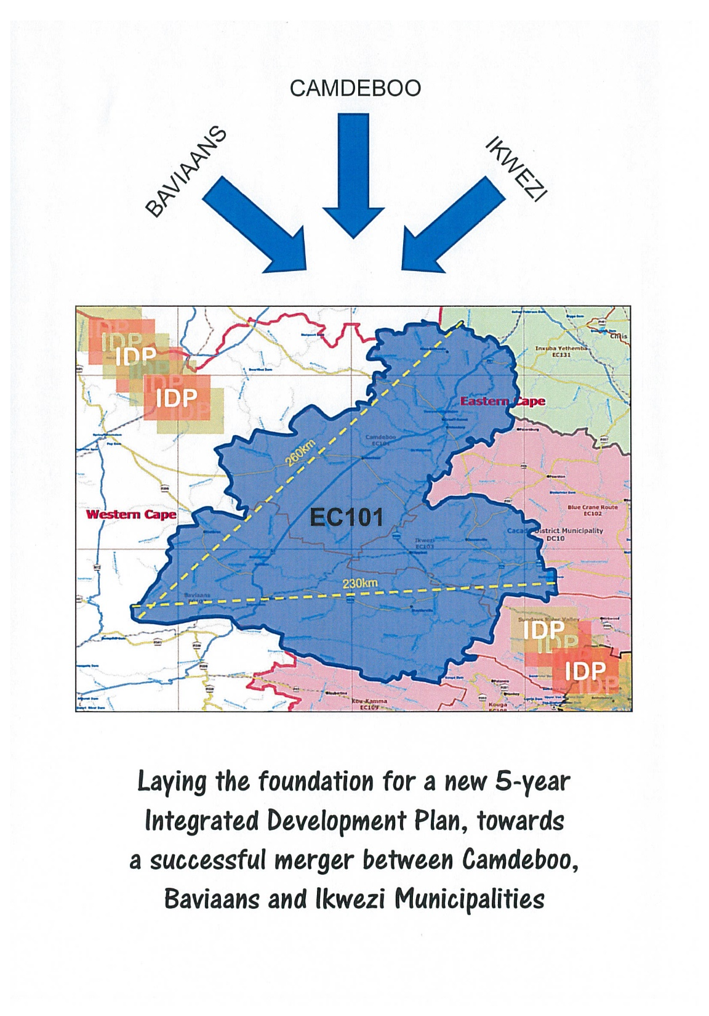
Background
Geographically, Dr. Beyers Naudé LM makes up more than 49% of the Sarah Baartman District Municipality’s landmass, with a low population density of 2.8 persons per km².

Slide 8
Background
Statistics
Total population | 82197*
Unemployment Rate | 28%**
Youth unemployment Rate | 33%**
Number of Households | 20784*
Average Household Size (persons) | 3,8*
* According to STATSSA Community Survey
* According to STATSSA Community Survey

Slide 9
Governance
The Municipal Council consists of 27 members as per the Section 12 Notice.
Mayor: Cllr. Deon de Vos (Full-time)
Speaker: Cllr. Thembisa Nonnies (Full-time)
Collective Executive Committee:
Cllr. Deon de Vos
Cllr. Pieter Koeberg (Engineering & Planning)
Cllr. Notizi Vanda (Community Services)
Cllr. Eldridge Ruiters(Corporate Services)
Cllr. Ewald Loock (Finance)

Slide 10
Governance
Council and the Executive Committee has met on a regular basis since the inaugural meeting. Committees meet regularly as per year planner
A Council policy Workshop was held on 21 May 2018 where the Rules of Order of Council, HR and Financial Policies, have been dealt with.
These policies were approved by Council on 29 May 2018 and the HR Policy were reviewed and approved by Council on 28 June 2019.

Slide 11
Governance
An Audit Committee has been appointed and meet on a quarterly basis.
An Internal Audit Steering Committee has been established chaired by the Accounting Officer.
The purpose of this committee is for management to discuss the internal audit reports submitted to the audit committee.
An MPAC Committee has been established and is meeting regularly

Slide 12
Governance
The Municipal Manager and Directors have been appointed:
  Municipal Manager: Dr. E.M. Rankwana
  Director: Corporate Services: Ms. Z. V. Kali
  Director: Engineering and Planning: Mr. B Arends
  Director: Community Services: Mr. G. W Hermanus
  Chief Financial Officer: Mrs. H. Kok

Slide 13
Financial Status Report

Slide 14
Financial Position
The Budget and IDP for 2020/21 was approved by Council on 13 July 2020.
The municipality is utilizing the Promun financial system and has implemented mSCOA.
Primary bank account – Standard Bank
All departments under Finance have been centralized and is located in Graaff-Reinet
One of the main areas of concern relates to the financial resources available to deliver services and address historical financial challenges of the erstwhile municipalities.
DBNLM has inherited outstanding creditors amounting to R65.3 million. These are debts owed to Eskom, SALGA, AG, among others.

Slide 15
Financial Position
Ikwezi Municipality
Creditor | Total
Eskom | 15 446 997.65
Sars | 134 766.03
Auditor-General | 6 566 433.06
Salga | 1 574 000.00
Bytes (Financial system) | 756 794.86
Other creditors | 7 023 533.45
Total | 31 502 525.05

Slide 16
Financial Position
Baviaans Municipality
Creditor | Total
Eskom | 4 132 843.00
Pension Funds | 207 161.00
Compensation Fund | 138 694.00
Auditor-General | 8 890 146.00
Salga | 2 526 678.00
Bytes (Financial system) | 1 328 544.00
Other creditors | 2 128 408.00
Total | 19 352 474.00

Slide 17
Financial Position
Camdeboo Municipality
Creditor | Total
Eskom | 10 851 483.43
Auditor-General | 124 525.21
Other creditors | 3 432 556.42
Total | 14 408 565.06

Slide 18
Financial Position
Total inherited debt of Dr. Beyers Naudé LM
Creditor | Total
Eskom | 30 431 324.08
Auditor-General | 15 581 104.27
Pension funds | 207 161.00
Salga | 4 100 678.00
SARS | 134 766.03
Bytes Financial Systems | 2 085 338.86
Other creditors | 12 723 191.87
Total | 65 263 564.11

Slide 19
CURRENT ASSETS VS CURRENT LIABILITIES – 30 June 2019
The information presented below is taken from the unaudited figures of the 2018/19 Financial year
*Unspent conditional grants at June 2019 relates mostly to the drought grants for which roll over was approved. Spending was done during the 2019/20 financial year.

Slide 20
CURRENT ASSETS VS CURRENT LIABILITIES
Current Assets = 62 034 092;Current Liabilities = 218 740 591
The norm current ratio is 2:1 for assets versus liabilities
Current municipal ratio is 0.28:1 (unaudited results for 2019/20 shows a current ratio of 0.14:1).
The municipality has no cash backed reserves
The main contribution is the high creditors balance for the municipality and low cash levels.

Slide 21
CREDITORS MANAGEMENT
Total trade creditors outstanding at year end amounted to R240 million.
This amount increased by R65 million from the 2018/19 financial year which ended on R175 million.

Slide 22
CREDITORS MANAGEMENT
The top creditors:
CREDITOR NAME | CURRENT | 30 DAYS | 60 DAYS | 90 DAYS+ | TOTAL LOCAL
ESKOM HOLDINGS LTD. | 16,163,587 | 8,531,823 | 8,380,151 | 91,947,091 | 125,022,651
SARS PAYE | 3,772,709 | 1,039,835 | 1,143,619 | 2,944,553 | 8,900,716
SALGA | - | - | 1,767,250 | 4,770,123 | 6,537,373
Department of Transport | 709,043 | - | 554,678 | 5,062,779 | 6,326,500
Auditor General | 89,788 | 109,276 | 65,752 | 5,345,898 | 5,610,713
Pension Funds | 2 180 441,65 | 2 180 441,65 | 2 180 122,41 | 2 196 758,61 | 8 737 764 ,32

Slide 23
ANALYSIS OF INCOME
Billing
MONTH | BILLING | RECEIPTS
JULY | 57 296 682,00 | 13 701 424,00
AUGUST | 15 819 685,74 | 24 866 160,69
SEPTEMBER | 14 304 856,98 | 16 915 271,77
OCTOBER | 14 235 185,87 | 18 728 834,09
NOVEMBER | 16 345 422,15 | 17 924 024,38
DECEMBER | 9 452 836,89 | 9 576 378,07
JANUARY | 16 434 556,08 | 13 051 716,62
FEBRUARY | 11 585 839,34 | 13 479 283,74
MARCH | 12 286 683,80 | 12 947 512,82
APRIL | 12 134 484,65 | 12 396 116,43
MAY | 21 857 858,22 | 18 981 912,73
JUNE | 12 208 432,36 | 13 965 972,99
TOTAL FOR 2019/20 FINANCIAL YEAR | 213 962 524,08 | 186 534 608,33
Collection rate | 87,18%

Slide 24
ANALYSIS OF INCOME
Grants
Grant @30 June 2020 | Amount gazetted | Amount Received YTD | Expenditure YTD | Available Funds | % spent on allocation received
RBIG | 6 000 000 | 4 123 361 | 4 123 361 | 0 | 100,00%
EPWP | 1 251 000 | 1 251 000 | 1 251 000 | 0 | 100,00%
FMG | 4 000 000 | 4 000 000 | 4 000 000 | 0 | 100,00%
Equitable Share | 90 876 000 | 90 806 000 | 90 806 000 | 0 | 100,00%
Fire Grant | 1 451 273 | 519 320 | 1 451 273 | -931 953 | 279,46%
Seta Grant | 314 608 | 434 270 | 88 267 | 346 002 | 20,33%
MIG | 20 608 000 | 20 608 000 | 19 784 365 | 823 635 | 96,00%
Health | 1 992 694 | 1 429 650 | 1 053 864 | 375 786 | 73,71%
Library Grant | 2 446 480 | 2 308 000 | 2 560 764 | -252 764 | 110,95%
Office of the Premier | 4 210 000 | 4 209 676 | 4 209 676 | 0 | 100,00%
Water service infrastructure grant | 7 000 000 | 7 000 000 | 7 000 000 | 0 | 100,00%
Cogta Grant - Drilling of Boreholes | 6 400 000 | 6 388 392 | 6 388 392 | 0 | 100,00%
COVID 19 MDRG ALLOCATION | 1 132 000 | 1 132 000 | 824 114 | 307 886 | 72,80%
TOTAL | 147 682 055 | 144 209 668 | 143 541 075 | 668 593 | 99,54%
ROLL OVER GRANT 2018 2019 |  | Amount | Expenditure YTD | Available Funds | % spent on allocation received
DROUGHT RELIEF GRANT | 24 068 000 | 24 068 000 | 24 068 000 | 0 | 100,00%

Slide 25
ANALYSIS OF EXPENDITURE
An analysis of the expenditure for 2019/20 revealed the following:
Employee Cost – R163 629 214:
The Remuneration as % of Total Operating Expenditure ratio was 35%.
Although this ratio is in line with the norm guidelines from National Treasury it should be considered that the municipality traded at a loss for the financial year.
The deficit was R68 million.
If employee cost should be considered as a percentage of revenue, the ratio is 43%
In approving the 2020/21 budget council has resolved that the organogram of the municipality has to be reviewed in order to make it cost effective

Slide 26
ANALYSIS OF EXPENDITURE
Remuneration of Councillors – R9 649 467
Remuneration of Councillors are paid in terms of the Upper Limits recommended by National Government
However, the municipality received only R5,7 million to assist with the remuneration of Councillors and Ward Committees.
Total cost for remuneration of Councillors amounted to R9 649 467 whilst ward committee cost amounted to R700 468 for the 2019/20 financial year.

Slide 27
ANALYSIS OF EXPENDITURE (Continued)
Finance Cost – R13 198 478
An amount of R13 198 478 is disclosed in the Annual Financial Statements.
From this amount R8 643 478 relates to interest accrued on overdue accounts of creditors.
    R4 166 361 -Eskom
    R3 711 989 -SARS
    R612 892 - Cape Retirement Fund
    R214 327 - other smaller creditors.
Due to the financial situation of the municipality creditors cannot be paid within the legislated 30 days.

Slide 28
ANALYSIS OF EXPENDITURE (Continued)
Bulk Purchases from Eskom – R93 023 855
Bulk purchases for the 2019/20 financial year amounted to R93 million.
The municipality is charged seasonal tariffs leading to higher winter accounts
Municipality pays penalties to Eskom as a result of the maximum demand that is exceeded on a monthly basis in Jansenville.
The Notified Maximum demand needs to be upgraded but due to the financial constraints, the upgrade cannot be done currently.
The matter has been raised with Eskom on numerous platforms. Unfortunately it has not been resolved as yet

Slide 29
ANALYSIS OF EXPENDITURE (Continued)
Operational Cost – R50 376 587
Chemicals required for the treatment of water amounted to R1 million for the year
Auditors fees amounted to R5,9 million
Motor vehicle expenses amounting to R5 million relates to fuel, motor vehicle licenses and motor vehicle tracking systems. This is an average cost of R417 000 a month.
Municipal service charges amounted to R12,9 million
Consumables amounted to R5,9 million
Communication related cost amounted to R4,3 million for the year
Subsistence and Traveling costs amounted to R2.8 million.

Slide 30
ANALYSIS OF EXPENDITURE (Continued)
Contracted services – R19 011 811
Contracted services relates mainly to security cost for the year and amounted to R6.7 million - this expense was necessitated by the vandalism of council property by unknown members of the community
Other outsourced services for repairs and maintenance, financial system and AFS compilation related to the previous financial year amounts to R6,2 million.
Costs related to contractors and consultations amounts to R5,9 million.

Slide 31
Challenges Experienced
Historical creditors were inherited on amalgamation which are still being paid
The average monthly billing of DBNLM is R13m as a result of not billing at cost reflective tariffs (selling rate less than bulk purchase rate)
The monthly salary expense amounts to R13m
Outstanding creditors as at 31 March 2019 amounts to R136m
Redundant pre-paid electricity meters needs to be replaced
No cost of supply study was initially undertaken. The SBDM assisted the municipality in completing a cost of supply study. A phased approach is now being followed in implementing correct tariffs.
Losses in KWH is currently at 22%

Slide 32
Continue…
Discussions between DBNLM and Eskom revealed that cost saving tariffs is available, but ESKOM requested a deposit that municipality cannot afford
Jansenville is charged monthly penalties for exceeding of Notified Maximum Demand.
No payment received for Wheeling agreement from 1994 to 01 March 2018
According to ESKOM there was a Gentlemen agreements in place but NO payments were received.

Slide 33
UNAUTHORISED EXPENDITURE – 30 June 2019
Reconciliation of Unauthorized Expenditure
Opening balance 182,219,561
Add: Current year additions 124,204,689
Total 306,424,250
Unauthorized expenditure will be investigated by MPAC with recommendations to Council with regard to consequence management

Slide 34
IRREGULAR EXPENDITURE – 30 June 2019
Reconciliation of Irregular Expenditure
Opening balance 141,266,174
Add: Current year additions 24,192,942
Total 165,459,116
An amount of R79m related to Former Ikwezi where MPAC and PT investigated and recommended to council for write-off. This amount was written off in the 2019/20 financial year
A further amount of R10m was also referred to Internal audit to validate and report submitted to MPAC for further investigation and consideration
Any additional Irregular expenditure will be investigated by MPAC with recommendations to Council with regard to consequence management

Slide 35
FRUITLESS AND WASTEFUL EXPENDITURE – 30 June 2019
Reconciliation of Fruitless and Wasteful Expenditure
Opening balance 8,431,856
Add: Current year additions 7,813,364
Total 16,245,220
Details of Current year Fruitless and Wasteful Expenditure
Interest charged by Eskom 5,618,377
SARS penalties and interest 1,665,155
Interest charged by Auditor-General 208,986
Interest charged by SALA Pension fund 162,272
Other 158,574
Total 7,813,364
Fruitless and wasteful expenditure will be investigated by MPAC with recommendations to Council with regard to consequence management

Slide 36
COVID-19 IMPACT ON REVENUE
The Covid-19 pandemic had an immediate impact on the ability of the municipality to maintain the revenue levels.
The expected year on year increase was not achieved and a downward trend in revenue during the lockdown period is noted in the analysis below:

Slide 37
Loss of income for the period March 2020 to June 2020 as a result of Covid-19 pandemic | R10 146 910,93
Total loss of income as a result of under collection on actual billing | R6 423 774,83
TOTAL LOSS OF INCOME FOR THE PERIOD MARCH 2020 TO JUNE 2020 | R16 570 685,76

Slide 38
* Unspent Balance – Awaiting approval from MEC of COGTA to utilize money for purchase of a vehicle (refuse truck)

Slide 39
CONSEQUENCE MANAGEMENT
Policy is in place and implemented accordingly

Slide 40
TURNAROUND PLAN AND URGENT INTERVENTION: TECHNICAL/FINANCE IMMEDIATE ACTION
METERING
The DBNLM appointed a Service provider to do :
  - Cost of supply study
  Tariff restructuring to ensure cost reflective tariffs for implementation in the 2019/2020 financial year subject to NER approval
  A service provider has been appointed to replace the proprietary (Plessey meters) pre-payment meters electricity meters in Aberdeen, Willowmore, Jansenville (these meters are high risk for the municipality and leads to financial losses)
  All large electricity points are being inspected to ensure upgrades have been taken care-off and financial information is updated
Three phase electricity meters are being inspected to ensure no by-pass
Electricity meters are being checked and calibrated every 7 years to ensure metering is not in or against client benefit or to loss of municipality

Slide 41
TURNAROUND PLAN AND URGENT INTERVENTION: TECHNICAL/FINANCE IMMEDIATE ACTION
We are in the process of converting pre-paid meters above 80 Amp in Willowmore, Steytlerville and Jansenville
Credit Control Strictly implemented except for the period March 2020 – July 2020
Pressure is brought on all Government Departments owing the Municipality, to pay accounts urgently
WHEELING AGREEMENTS
DBNLM requested ESKOM to make back dated payments to the bulk account with all arrears on wheeling agreement since 1994 (23 years)
Historical debt and current interest be ringfenced and excluded from the bulk account

Slide 42
POST AUDIT ACTION PLAN
Presentation is attached as Annexure B

Slide 43
CONCLUSION
Emanating from the presentation it is obvious that the historical debts have crippled the amalgamated municipality
For the municipality to survive, cost of supply findings have to be implemented without fear or favor
The organizational structure has to be revisited as a matter of great urgency
The question of the wheeling agreement with ESKOM has to be finalized as a matter of extreme urgency

Slide 44
THANK YOU

