Slide 1
SAMHS Health System and Plan for the MTEF Period & National Repair and Maintenance Programme for Hospitals and Sickbays Portfolio Committee on Defence and Military Veterans, National Assembly: Briefing by DOD (SAMHS) on their Health System and Plan for the MTEF Period; and Repair and Maintenance Programme for Hospital and Sickbays Nationally - Wednesday, 19 August 2020 10:00 – 13:00
Office of the Surgeon General
Maj Gen (Dr) N Ndhlovu
Deputy Surgeon General

Slide 2
Assumptions and Constraints
Assumptions. With respect to the Health System, the Portfolio Committee wants to know:
The alignment of the SAMHS MTEF plan with the DOD Strategic Plan
How the SAMHS is structured and functions
The SAMHS outputs and challenges
Service Delivery Improvement (SDI) programme in the MTEF
Constraint. With respect to the Repair and Maintenance Programme (RAMP)
Log Division is the process owner of Repair and Maintenance of SANDF facilities including hospitals and sickbays
Detailed information to be provided at a later stage by the Log Division
Constraint. No text (word) document due to time constraints

Slide 3
Aim
To update the Portfolio Committee on Defence and Military Veterans on the South African Military Health Services (SAMHS)’s Health System, MTEF Plan and the RAMP

Slide 4
Scope
Military Health System (MHS)
Orientation
Strategic alignment
Service delivery challenges
Service Delivery Improvement (SDI) programme
SDI programme challenges
MTEF Plan
RAMP
Quo Vadis?
Questions

Slide 5
MH HEALTH SYSTEM

Slide 6
Orientation
Surgeon General (SG)
MH Support Fmn
MH Training Fmn
Area MH Fmn
Tertiary MH Fmn
Mobile MH Fmn
5 MH Base Hospitals
3 Hospitals
2 RegF Med Bn Gp
83 Sickbays
4 Institutions
3 ResF Med Bn Gp

Slide 7
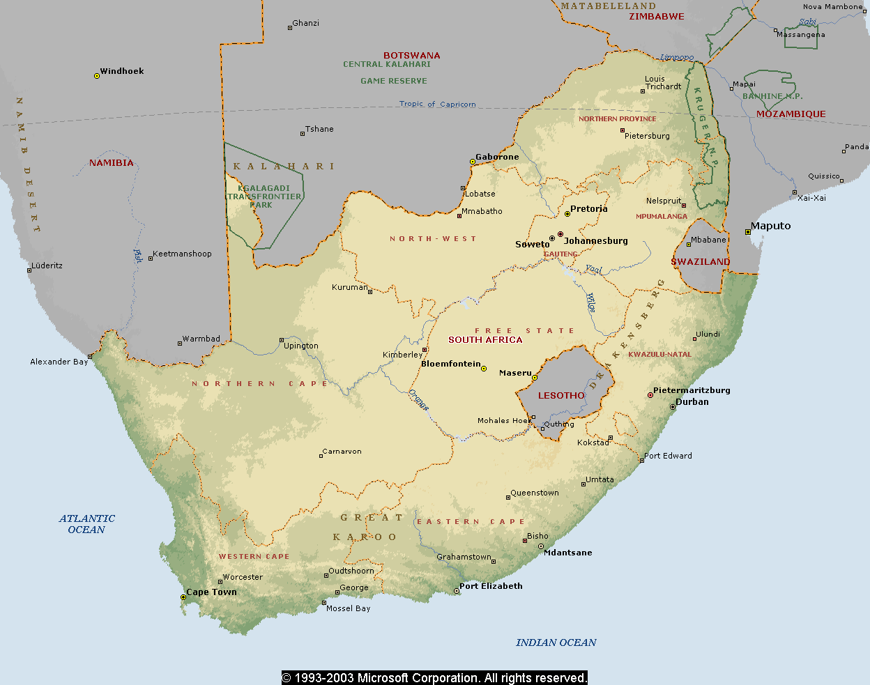
Orientation
2 SAI Bn
4 SAI Bn
15 SAI Bn
Art School
10 Art Regt
14 Art Regt
Int School
Int Regt
10 SAI Bn
Afb Makado
Eng School
1 SAI Bn
1 Para Bn
Armour School
Tk Regt
Armour Car Regt
Afb Bloemspruit
7 SAI Bn
5 RR
Afb Hoedspruit
CTC Lohatla
Afb Wkf
3 SAI Bn
ADA School
10 ADA Regt
21 SAI Bn
Eng C Regt
8 SAI Bn
Afb Durban
SAN Saldanha
5 SAI Bn
4 RR Langebaan
Field Eng Regt
Afb Langebaanweg
9 SAI Bn
Afb Ysterplaat
14 SAI Bn
6 SAI Bn
TVOS
Inf School
SAN Simonstown

Slide 8
Orientation 03
Total Patient Population 176 483
Regular Force (RegF) (61 218)
RegF dependants (71 884)
Active Reserve Forces (A-ResF)
RFMCF members (28 028)
Military Veterans & Dependents (17 457)
Other (1 822)

Slide 9
Strategic Alignment
Vision. A healthy military community
Mission. To sustain the SANDF by providing quality health services for the full range of military operations (Force Health Protection); and to sustain the health of members of the SANDF, their families and others eligible for healthcare by the SAMHS (Force Health Sustainment)
Purpose. To provide prepared and supported health capabilities and services for the defence and protection of South Africa.
Output. To ensure prepared and supported health capabilities and services by providing a health support capability of five medical battalion groups and one specialist medical battalion group, for deployed and contingency forces; and a comprehensive, multidisciplinary military health service to a projected patient population of 302 000 members per year

Slide 10
Strategic Alignment 02
Outcomes. The SAMHS must ensure the following primary outcomes:
Combat Readiness. Improved readiness ensuring that the total military force is ready to deploy and that the medical force is ready to deliver health care at anytime, anywhere in support of the full range of military operations, including humanitarian missions.
Population Health Improvement. Improve the health of the military population by reducing the generators of ill health and by encouraging healthy behaviour and decreasing the likelihood of illness through focused prevention and the development of increased resilience.
High Responsiveness to Patient Non-Medical Needs. Enhance the patient experience of care by providing a care experience that is patient and family centered, compassionate, convenient, equitable, and safe and always of the highest quality.
Affordable and Best-Quality Military Healthcare. Reduce the per capita cost of care by creating value focusing on quality, eliminating waste and reducing unwarranted variation; considering the total cost of care over time, not just the cost of an individual health care activity.

Slide 11
Strategic Alignment 03
MOD & MV MTEF Priorities and C SANDF Focus Areas
Organisational Renewal Direction (Restructuring of the SANDF). Commenced with several work studies to address the SAMHS structural deficiencies.
Renovation of DOD Facilities. The SAMHS Facilities Maintenance and Development Plan is being implemented
Strategic Resource Direction (Development and maintenance of the strategic reserves)
Funding challenges to maintain medical stock levels, ie SAMHS Risk is inability to sustain medical stock levels and critical reserves.
COVID-19 has re-emphasized the necessity of National Humanitarian Crisis Relief Reserves – the SAMHS intends to lobby the National Disaster Coordination Centre for the development of such reserves

Slide 12
Strategic Alignment 04
MOD & MV MTEF Priorities and C SANDF Focus Areas
Human Resource Renewal Direction (Implementation of the Human Resource Strategy). The challenge to recruit, appoint and retain Health Care Professionals (HCPs) and critical support personnel is a complex issue requiring tactical, operational and strategic interventions in the short- to long-term.
Force Protection. Service Delivery Improvement initiatives are all aimed at enhancing Force Health Protection
Border Safeguarding. Initiated Building for the Future efforts by training Operational Emergency Care Practitioners (OECPs) for the Reserve Force for possible employment as OECPs by the Border Management Authority.

Slide 13
Service Delivery Challenge (SDC)
In the past decade, the SAMHS has experienced a perceived albeit scientifically undetermined decline in the quality and responsiveness (to patients’ expectations) of its healthcare services as well as a quantifiable escalation in the cost of its healthcare service delivery. The perception is endemic amongst the SAMHS’s patients and to an extent, amongst the Command Cadre of the South African National Defence Force (SANDF)
Is the challenge facing the SAMHS delivering the best-quality and a highly responsive MH service within the constraints of the available resources?

Slide 14
SDC 02
The challenge manifests as sub-optimal HR productivity; sub-optimal operating and capital budget ratios; escalating medico-legal claims and expenditure; patients’ dissatisfaction with the profile of the SAMHS’s facilities; patients’ complains about service delivery standards; and the SAMHS’s inability to optimally protect, promote, improve, and maintain the health of the military community.
The challenge emanates from the MHS delivery model; the HR balance and management; the distribution of the healthcare facilities; sub-optimal supply chain management; inadequate healthcare monitoring system and tools; sub-optimal knowledge management; and budgetary constraints.

Slide 15
SDC 03 Healthcare Delivery Model
Funder and Provider Role. The SAMHS does not have the capability to manage its role as a funder of outsourced healthcare services because it has not been structured for that role. The SAMHS’s outsourcing of some services, is foreseen to continue in the medium- to long-term because:
It is arguably not cost effective for the SAMHS to have the capability to deliver all needed health interventions, eg a heart transplant capability in all its three hospitals
The national health infrastructure is and should be viewed as the 5th line of military healthcare service delivery in support of the 1st to 4th line of military healthcare service delivery
Comprehensiveness of the MHS Healthcare. There is no health service in the world that is able to provide all needed and wanted healthcare services to all patients as and when required, the SAMHS has not specified the attributes of its concept of “comprehensive services”
Operational versus Base-Oriented Health Support. The SAMHS is structured for Operational Health Support (OpHS) however most of its resources are consumed by BoHS.

Slide 16
SDC 04 HR Resource Balance
SAMHS Total Workforce Composition (June 2019)
SAMHS’s members who do not have a direct interaction with the patient (HCSPs) constitute 43% of the total SAMHS workforce; and the operational frontline healthcare providers, ie medical officers (MOs), nursing officers (NOs), and operational emergency care practitioners (OECPs), constitute 21% of the total workforce.

Slide 17
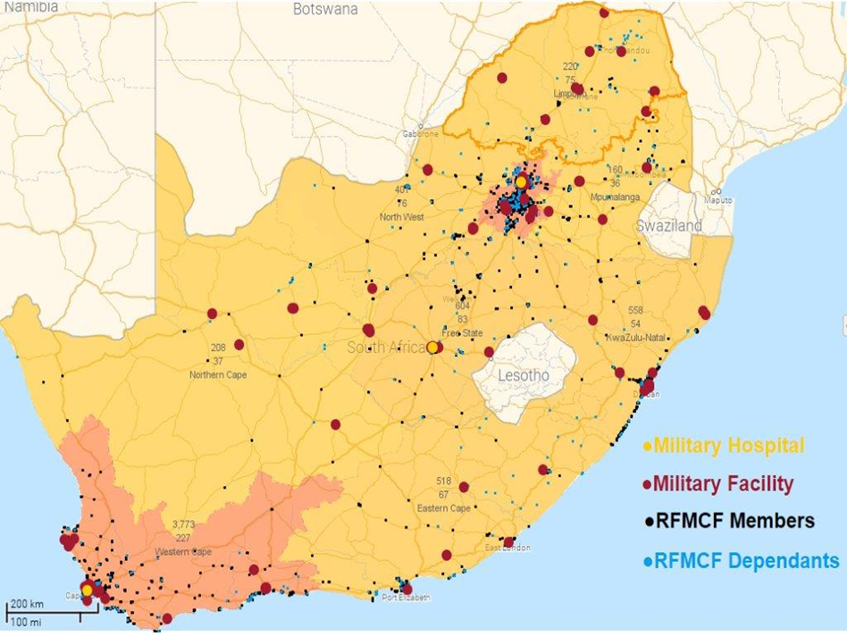
SDC 05 Distribution of the SAMHS Facilities

Slide 18
SDC 06 Distribution of the SAMHS Facilities
Distribution affects affordability and quality
Affordability
The SAMHS have to “contract or outsource” healthcare services to other providers at an additional cost
The distances between the SAMHS’s facilities and the patients’ abode increases the patients’ cost of access to the SAMHS’s treatment and hospitalisation facilities
Best-Quality. The SAMHS cannot ensure that patients who cannot access its facilities are assured the best-quality healthcare service, ie patients in urban areas have access to private and public healthcare facilities whereas patients in rural areas mostly have access to public healthcare facilities that have their own healthcare service delivery challenges.

Slide 19
SDC 07 Health Supply Chain Management (SCM)
Based on Relationship between Functions and Objectives of a Health System WHO (2000)

Slide 20
SDC 08 Health Supply Chain Management (SCM)
Stock-outs, main medical equipment outages, buy-outs and outsourcing of healthcare services are symptoms and signs of sub-optimal:
Demand Management. Demand mis-management manifests in the SAMHS as:
Patients erroneously believing that their medical “wants” are equivalent to their medical “needs”
Over-stocking of medical matériel in some facilities whilst other facilities, at the same time, are outsourcing due to shortages of the same medical matériel
Over-servicing of patients as evidenced by poly-pharmacy and questionable diagnostic procedures
Unplanned rationing of access to healthcare services manifesting as long waiting-lists and waiting-times for healthcare services
Logistic and Procurement Management

Slide 21
SDC 09 Sub-Optimal Knowledge Management

Slide 22
SDC 10 Sub-Optimal Knowledge Management
The deficit manifest as:
Sub-Optimal Healthcare Standardisation. This manifests as variability in the affordability, quality and outcomes of healthcare services in an institution or amongst HCPs in the institution (micro-level); and amongst institutions (macro-level).
Sub-Optimal Command and Control Continuity. This manifest mainly as a failure in the implementation of institutional programmes consequent to succeeding commanders’ misunderstanding of and/or disagreement wrt the utility of ongoing programmes; and/or succeeding commanders not having the wisdom (knowledge, experience and insight) to implement the programmes.
Sub-Optimal Research Programmes. In the absence of a clear understanding of the knowledge gaps, any research undertaken is not beneficial to the organisation.

Slide 23
SDC 12 Sub-Optimal Monitoring and Evaluation
In order to improve the health profile of the military community, the SAMHS must generate resources mostly through converting its allocated budget into human capital, physical infrastructure, social infrastructure, matériel and knowledge in a cost effective and efficient manner. The elements that must be measured are therefore the efficiency and effectiveness of the command and control, leadership and management of the SAMHS.

Slide 24
SDC 13 Sub-Optimal Monitoring and Evaluation
The SAMHS must optimise its monitoring of:
The efficiency and effectiveness of the SAMHS in generating human capital especially processes such as human resource planning and development.
The efficient and effective development and management of the physical and social (stakeholder) infrastructure of the SAMHS.
The efficient and effective development and preservation of SAMHS’s finances, matériel and knowledge (knowledge management).
The accessibility, availability and quality of its health and non-health interventions.
The outcomes of its health and non-health interventions for the individual and the military community.
The productivity of its human resources.
The efficiency and effectiveness of its supply chain.
The efficiency and effectiveness of its knowledge management.
The security of its physical and non-physical assets.

Slide 25
SDC 14 Budget Constraints
In the short-term, an increase in the budget allocation is remote hence the SAMHS must focus in the cost and number of health programmes, and in generating additional non-budgetary revenue
The budget allocation of the SANDF reflects the government’s perception of the security, economic, political, and diplomatic value of the SANDF. The management of that perception to the advantage of the SANDF is the responsibility of the SANDF
The budget allocation of the SAMHS reflects the SANDF’s perception and experience of the value of the military health services. The management of that perception and experience to the advantage of the SAMHS is the responsibility of the SAMHS

Slide 26
SDI Programme
Managed Health Care. To contain the cost of outsourcing and ensure an affordable and best-quality service, the SAMHS must implement MHC. MHC will also enable the SAMHS to develop a Medical Schemes-like administrative capability; define “comprehensive services”; and determine services that should be provided in-house, insourced or outsourced.
Re-Structuring the Healthcare Delivery Model. The SAMHS’s service delivery model must be targeted at the Operational Health Effectiveness (OpHE) of the SANDF. The dual mission concept must be abandoned and the SAMHS’s structure must be based on a people- and patient-centered MH delivery model rather than the current functional structuring

Slide 27
SDI Programme 02
The SAMHS must identify health gaps and specialise in capabilities that will close those gaps and generate revenue for the SANDF. The SAMHS must:
Specialise in national mass and disaster management.
Resuscitate its expertise/leadership in aviation and maritime medicine.
Develop a health systems management and innovation capability.
Develop a zoonotic disease management and animal/livestock health capability as a “Support to the People” project.
Identify health technology gaps, acquire such technology and make it available to the private and public sectors on a fee-for-service basis.
Develop unique clinical medicine capabilities (eg hyperbaric medicine) and make such capabilities and expertise available to the private and public sectors on a fee-for-service basis.

Slide 28
SDI Programme 03
Asset Management. The major contributor to the SAMHS’s affordability and best-quality attributes is the SAMHS’s planning, organising, control and leadership exercised on its asset base. The SAMHS’s most important assets are its patient population and its members.
Monitoring and Evaluation (M&E). The COGs of the SAMHS’s challenge have failure of control as a major factor and the failure of control is consequent to the fact that the SAMHS does not have current and relevant information wrt its health actions.

Slide 29
MTEF MH PLAN

Slide 30
MH Programme
The purpose of the programme is to provide prepared and supported health capabilities and services for the defence and protection of South Africa.
The output of the programme is to ensure prepared and supported health capabilities and services by providing:
A health support capability of five medical groups, including one specialist medical battalion group, for deployed and contingency forces.
A comprehensive, multi-disciplinary military health service to a projected patient population of 302 000 members per year.

Slide 31
MH Sub-Programme
Strategic Direction.
Mobile Military Health Support.
Specialist/Tertiary Military Health Service.
Area Military Health Service.
New Military Health Support Capability.
Military Health Training Capability.

Slide 32
Situation Analysis
The SAMHS is still seized with the quadruple burden of disease, ie HIV/AIDS and TB, the high maternal and child mortality, injuries/accidents/violence and non-communicable diseases.
Demands within the mandate of the SAMHS, however, continues to outstrip the financial, logistical and human resources.
Level of over-expenditure is expected to increase year-on-year. Wage creep and medical inflation (9-10%) mostly responsible for over-expenditure.

Slide 33
Situation Analysis 02
Human resource expenditure difficult to contain as specialised skills are required to decrease cost of medical outsourcing. HR budget cuts impacts on the mandate of the SAMHS and compound the current strategic risks. Maneuverability within HR budget constrained – impact on the utilisation of Reserve Force members to address SAMHS structural deficiencies.
Medical technology challenging to sustain in spite of optional funding.

Slide 34
Situation Analysis 03
Strategy Drivers
General
Climate change – Harsh climate / environmental hazards
Disease profile changes and re-emerging diseases
Intra-state conflict
New weapons such as improvised explosive devices and biological weapons
International non-conventional threats (including piracy)
External Threats
Communicable diseases including Covid-19
Dangerous substances contact/abuse
Uncontrolled/deliberate physical force
Non-communicable diseases
Malicious behaviour/mental health

Slide 35
Situation Analysis 04
Strategy Drivers
Internal
Health Care Providers
Stock and Equipment
Infrastructure (fixed and mobile)
Command and Control
Management Information
Health Intelligence / epidemiology
R&D

Slide 36
Strategic Issues
To be ready for the Future (Defence Review), SAMHS must address the following strategic issues:
Acquire and retain health care practitioners
Upgrade/re-establishment of military health facilities
Adaptation of main medical equipment to meet the envisaged Battle Space/SADC.AU. This must be done in such a way that intra-operability is achieved
Retain conventional, rapid deployable, self-sustained, technological compatible, operational military health capability, with multi-environment capabilities (sea, land, air, tropic, desert and urban)

Slide 37
Strategic Issues 02
Develop support strategy, doctrine and capabilities for non-conventional operations in a multi-environment that are technological compatible and rapid deployable
Research, develop and train a multi-environmental multi-skilled combat ready force
Develop long distance health deployable systems, unique SAMHS platforms/equipment, evacuation lines and sustainment systems to address future health threats
Plan to pre-position health care facilities on long evacuation lines, including maritime platforms

Slide 38
Strategic Issues 03
Develop inter-departmental cooperation and health care capabilities for long-term reconstruction capabilities
Strive for inter-operability with regional partners (language, capabilities, etc)
Develop social support systems, including NGO cooperation skills (Gift of the Givers)
Establish research and epidemiological capabilities to develop and monitor sensors and triggers for health profiles, including animal health

Slide 39
Performance Information
Projected number of health care activities: 2 140 550
Percentage compliance with DOD training targets: 80% (648)
Number of Medical Battalion Groups (Regular and Reserves) prepared according to force requirements: 4
Number of Specialist Medical Battalion Groups: 1
Projected number of health assessment activities: 50 000
Number of medical support activities at the 88 geographic health care facilities based on the demands for services: 8 000
Percentage of Combat Ready SANDF Capabilities: 100%

Slide 40
Financial
8
7.4
7.5
7.2
7
6
5.4
5.6
5.9
5
4
Budget Cost
Full Cost
3
2
1
0
FY20/21
FY21/22
FY22/23

Slide 41
Financial 02
FY 2020/21
FY 2021/22

Slide 42
Financial 03
PROJECTED BUDGET SHORTFALLS
Main Cost Drivers
1. Human Resources
2. Medical Outsourcing
3. Pharmaceuticals
4. Fuels and Rations

Slide 43
Financial 04
Budget Allocation versus Actual Requirement
SAMHS baseline allocation is approximately 10% of the DOD budget.
SAMHS budget allocation not aligned with increased health cost:
Increase in cost of health care outsourcing 9% per annum.
Deviation in consumables, pharmaceuticals on average 4% per annum.
Challenge to appoint additional human resources, ie health care practitioners, as wage creep reduces operating allocation.
Current baseline allocation does not allow for sufficient capital renewal: less than 2%
Reduced ability to invest in medical technologies.

Slide 44
RENOVATION
AND
MAINTENANCE PROGRAMME

Slide 45
Conclusion
The performance of the SAMHS was satisfactory despite the financial risk. However, it must be highlighted that the unique situation facing the SAMHS, namely; that of a continuous increase in its footprint resulting in an increased demand for healthcare services, will impact negatively on the budget and on service delivery.
The SAMHS continues to render healthcare services amidst the strategic risks. The delivery of a comprehensive healthcare service is, however, negatively affected by the budget allocation of the SAMHS. The compulsory budget baseline reductions over the three financial years from FY2020/21 to 2022/23 will exacerbate the insufficient budget allocation risk of the SAMHS. The strategic risks of the SAMHS impact on all the objectives and outputs across the five sub-programmes of the SAMHS. The challenges and strategic risks have exacerbated the operational readiness and the sustainment of healthcare service delivery.

Slide 46
Thank You

