Slide 1
NATIONAL ECONOMIC DEVELOPMENT AND LABOUR COUNCIL
(NEDLAC)
PRESENTATION
Portfolio Committee For Employment and Labour:
Performance Review For
Quarter 3 and 4 (2019/20)
19 AUGUST 2020

Slide 2
TABLE OF CONTENTS
INTRODUCTION
PERFORMANCE PER PROGRAMME: QUARTER 3 & 4 2019/20
RISKS AND REMEDIAL ACTIONS
FINANCIAL OVERVIEW
2

Slide 3
Introduction
This report covers the period from:
1 October to 31 December 2019 : Quarter 3
1 January to 30 March 2020: Quarter 4
Beginning of period significant management instability
End of period, co-incided with beginning of Covid19 pandemic and a very different set of activities of Nedlac
Nevertheless majority of performance targets were met

Slide 4
REPORT ON PERFORMANCE QUARTER 3 2019-20

Slide 5
OVERVIEW OF PERFORMANCE FOR QUARTER 3
Nedlac had 15 planned performance indicators as per the Annual Performance Plan for Quarter 3.
14 planned indicators were achieved representing the 93% achievement.
1 Target was not achieved. (See challenges and remedial action slide).
1 Target set for Quarter 4 relating to the conclusion of Nedlac Report on the Integrated Resource Plan was achieved in Quarter 3, earlier that planned on the APP as it was tabled in the earlier period by Government.
The tables below provide summary of performance per Programme and Per Strategic Objectives.

Slide 6
2019/20 PERFORMANCE PER PROGRAMME QUARTER 3
Programme | Quarterly Planned Indicators | Planned Targets Achieved | Targets achieved but not planned for in the Quarter | Not Achieved | Overall Achievement (%)
1: Administration | 5 | 5 | 0 | 0 | 100%
2: Core Operations | 7 | 6 | 1 | 1 | 86%
3. Constituency Capacity Building Funds | 3 | 3 | 0 | 0 | 100%
Summary of Performance | 15 | 14 | 1 | 1 | 93%
.

Slide 7
2019/20 PERFORMANCE PER STRATEGIC OBJECTIVE QUARTER 3
Strategic Objectives | Indicators Reporting in Quarter 3 | Achieved | Targets achieved but not planned for in the Quarter | Not Achieved | Overall Achievement
Effective governance and strategic leadership | 1 | 1 | 0 | 0 | 100%
Provision of efficient and reliable back office support services | 1 | 1 | 0 | 0 | 100%
Improved facilities management | 1 | 1 | 0 | 0 | 100%
Strengthening organisational culture and performance | 2 | 2 | 0 | 0 | 100%

Slide 8
2019/20 PERFORMANCE PER STRATEGIC OBJECTIVE QUARTER 3 cont:
Strategic Objectives | Indicators Reporting in Quarter 3 | Achieved | Targets achieved in Q3 but not planned for this Quarter | Not Achieved | Overall Achievement
Effective engagement on draft policy and legislation within the framework of the Nedlac Act, Constitution and Protocols | 3 | 3 | 0 | 1 | 66%
Conclude matters under consideration within the framework of the Section 77 Protocol | 1 | 1 | 0 | 0 | 100%
Conclude matters under consideration within the framework of the NEDLAC Protocol | 0 | 0 | *1 | 0 | 100%
Promote social dialogue through communication, information and capacity building | 2 | 2 | 0 | 0 | 100%
Compliance with the Nedlac Policy on Constituency Capacity Building Budgeting and Expense | 3 | 3 | 0 | 0 | 100%
Total number of Indicators | 15 | 14 | 1 | 1 | 93%

Slide 9
SUMMARY OF KEY ISSUES – QUARTER 3
Key issues addressed in this period include the following:
Draft ICT Strategic plan was developed to ensure that the ICT environment for Nedlac is responsive to the business needs and supports achievement of the set strategic objectives as outlined in the 2020/21-2024-25 Strategic Plan.
Engagements and recommendations made by the Public Finance and Monetary Policy Chamber on State Expenditure Framework and Road Accident Fund Scheme.
The consideration of the Section 77 notice lodged by the Congress of the South African Trade Unions on the State of Public Transport in the Western Cape was concluded.
Engagements by Exco on measures to address challenges of the State Owned enterprises and with much focus on electricity supply.

Slide 10
QUARTER 3 CHALLENGES AND REMEDIAL ACTION ON PERFORMANCE
One target not achieved in terms of the APP
Target | REASON FOR VARIANCE | REMEDIAL ACTION
Progress report submitted to MANCO on the Decent Work Country Programme (DWCP). | Progress report for quarter 2 of 2019/20 was supposed to be submitted to Manco meeting of 28 November 2019. The meeting was replaced by a Special Exco due to the urgency thereof. | Reports for Manco to be submitted to Exco if Manco meetings have been cancelled or replaced by Special Exco. Consequence management to be implemented for non-complying staff members.

Slide 11
REPORT ON PERFORMANCE QUARTER 4 2019-20

Slide 12
OVERVIEW OF PERFORMANCE FOR QUARTER 4
Nedlac had a total of 16 planned performance indicators for Quarter 4 as per the Annual Performance Plan (APP) of the 2019/20 financial year.
14 planned indicators were achieved representing 88% achievement.
2 Target were not achieved. (See challenges and remedial action slide).
The tables below provide summary of performance per Programme and Per Strategic Objectives.

Slide 13
2019/20 PERFORMANCE PER PROGRAMME QUARTER 4
Programme | Quarterly Planned Indicators | Planned Targets Achieved | Targets achieved but not planned for in the Quarter | Not Achieved | Overall Achievement (%)
1: Administration | 4 | 3 | 0 | 1 | 75%
2: Core Operations | 9 | 8 | 0 | 1 | 89%
3. Constituency Capacity Building Funds | 3 | 3 | 0 | 0 | 100%
Summary of Performance | 16 | 14 | 0 | 2 | 88%
.

Slide 14
2019/20 PERFORMANCE PER STRATEGIC OBJECTIVE QUARTER 4
Strategic Objectives | Indicators Reporting in Quarter 3 | Achieved | Targets achieved but not planned for in the Quarter | Not Achieved | Overall Achievement
Effective governance and strategic leadership | 1 | 1 | 0 | 0 | 100%
Provision of efficient and reliable back office support services | 1 | 1 | 0 | 0 | 100%
Improved facilities management | 0 | 0 | 0 | 0 | N/A
Strengthening organisational culture and performance | 2 | 1 | 0 | 1 | 50%

Slide 15
2019/20 PERFORMANCE PER STRATEGIC OBJECTIVE QUARTER 4 cont:
Strategic Objectives | Indicators Reporting in Quarter 4 | Achieved | Targets achieved in Q3 but not planned for this Quarter | Not Achieved | Overall Achievement
Effective engagement on draft policy and legislation within the framework of the Nedlac Act, Constitution and Protocols | 7 | 6 | 0 | 1 | 86%
Conclude matters under consideration within the framework of the NEDLAC Protocol | 1 | Achieved in Q3 | 0 | 0 | N/A
Promote social dialogue through communication, information and capacity building | 2 | 2 | 0 | 0 | 100%
Compliance with the Nedlac Policy on Constituency Capacity Building Budgeting and Expense | 3 | 3 | 0 | 0 | 100%
Total number of Indicators | 16 | 14 | 0 | 2 | 88%

Slide 16
KEY ISSUES IN QUARTER 4
Key issues addressed in this period include the following:
Establishment of the Nedlac Covid-19 Rapid Response Task Team. The task team and its sub-committees has played a significant role in the development measures to mitigate against the impact of Covid19 and lockdown on the lives and livelihoods of South Africans. E.g. Covid TERS.
Consideration of the report by the Labour Market Chamber, arising from the engagement on challenges encountered by the CCMA and recommendations made by the Chamber to address the identified challenges.
Appointment of the new Chief Financial Officer and Executive Director. This has brought the much needed stability in the leadership of the institution.

Slide 17
CHALLENGES EXPERIENCED AND REMEDIAL ACTION IN QUARTER 4
Two targets not achieved in terms of the APP
Target | REASON FOR VARIANCE | REMEDIAL ACTION
60% of developmental training courses identified in line with the organisational workflow assessment attended by staff, based on available budget. | The achievement of this target depended on having the organisational workflow assessment concluded in Quarter 2 and subsequently, 60% of developmental training conducted in Quarter 4. Nedlac had initially planned that the Organisational Workflow assessment would be conducted by external service provider. It was then identified that the workflow assessment needed to be aligned to the outcome of the review of Nedlac’s role and Founding Documents by the Governance Task Team, which had not been concluded by the end of the financial year and it is still underway. | Process to review founding documents, organizational workflow assessment and staff training to be expedited in 2020/21 Financial Year.

Slide 18
CHALLENGES EXPERIENCED AND REMEDIAL ACTION IN QUARTER 4
Two targets not achieved in terms of the APP
Target | REASON FOR VARIANCE | REMEDIAL ACTION
Finalise Nedlac Report on draft legislation within 6 months of being tabled at Nedlac. | The Nedlac Report on Companies Amendment Bill could not be concluded within 6 months. This target was not achieved as due to coordination challenges encountered internally and subsequent delays during the sign-off stage of the Report. | Interventions to improve coordination by relevant staff member have been initiated.

Slide 19
Presidential Job Summit Progress Quarter 3 and 4 (1)
Commitment | Progress
TERS for companies in distress | Through CCMA facilitated processes, 21 846 jobs were saved. TERS is now managed by a Single Adjudication Committee with payments processed within 16 days from the point of adjudication.
Changes to export tax to reduce job loss | Minister of Finance announced in the budget speech that government is aware that unfair trade practices have put some key industries under pressure. However no change to date
E-visas & unabridged birth certificates to make it easier to visit SA | Pilot launched on the 25th November in Kenya and completed. The system was to be tested in India, Nigeria and China but impacted on by Covid19 pandemic. Directive issued stating that unabridged birth certificate is not required for visa exempt countries
Critical skills | DHET, DTIC, DHA and DEL engaged and agreed a process to review the critical skills list and determine how best to accelerate critical skills visas for industries that are critical for growth.
EPWP National Youth Service Programme | DPWI has trained a total of 7 159 learners. However funding and placement of learners that completed their training remains a challenge.
Notes:
.

Slide 20
Presidential Job Summit Progress Quarter 3 and 4 (2)
Commitment | Progress
Agriculture | A blended finance scheme (BFS) for land redistribution was discussed. Shared. The department has committed R2 billion (R200m from DRDLR, R880m from DAFF and R1 billion from Land Bank) to pilot the implementation of the BFS over a MTEF (2020-2024).
Pharmaceuticals | Several initiatives have been underway to understand how best the timeframes for addressing backlogs in the regulation of new drugs can be reduced.
Clothing, textiles, leather and footwear | The Master Plan was completed and signed by all parties on 6 November 2019 at a Presidential Investors’ Conference.
Automative value chain | South Africa's Automotive Master Plan (SAAM) and the post-2020 APDP amendments have been finalised and are now being implemented.
Waste | Waste exclusion authorisations were issued by the Minister of DEFF during January and February 2020 enabling the initiation of waste beneficiation projects
Business Processing Services | The jobs impact of the programme remains above target. Since the Jobs Summit up until December 2019, 17 824 new jobs have been created.
Notes:
.

Slide 21
Presidential Job Summit Progress Quarter 3 and 4 (3)
Commitment | Progress
Water licenses | Quarterly meetings continued to unblock water use license application issues.
Demand led training | DHET has put demand led training into their Service Level Agreement (SLA) with SETAs. This focus on flexible and agile training will enable new entrants to be absorbed into employment.
Pathway management | Harambee/NYDA/Department of Employment and Labour, DHET working collectively on prototype sites for pathway management
Just transition | The Minister of DEFF confirmed that the PCCCC will be established and will become a key platform to facilitate South Africa’s ‘just transition’ to a low-carbon economy.
Township and village economies | National Treasury has provisionally allocated R600m for the Township and Rural Enterprise Fund in 2021/22 financial year, subject to certain conditions to be met. KYB enterprise incubator: 622 ECD enterprises launched; 8 new businesses launched since January 2020. 66 ECD enterprises brought into the government net through DSD registration; 12 ECD enterprises receiving sustainable government funding.
Notes:
.

Slide 22
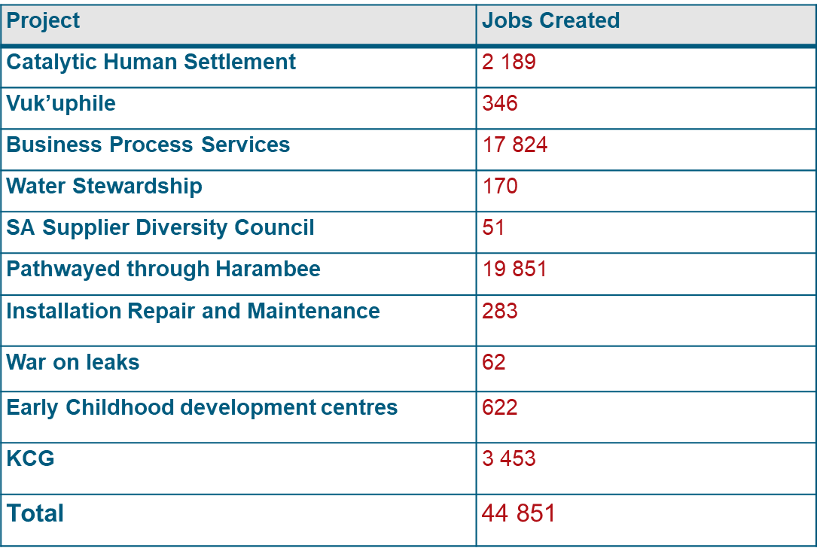
Job numbers as at end of Q4

Slide 23
RISKS AND REMEDIAL ACTION
23

Slide 24
STRATEGIC RISKS
.
Key risk | Mitigation measures | Risk Rating
Founding documents which guide the work of Nedlac have not undergone a comprehensive review, leading to a misalignment between the current operating environment and demands of the country. | Work is underway by the Governance Task Team to review the Nedlac Act, Constitution and Protocols. However progress is slow. | Medium
Emerging risks: Energy instability Covid19 pandemic | Required increased levels of social dialogue – negotiated social compact on Eskom and set up Covid19 Nedlac Rapid Response Team | High

Slide 25
OPERATIONAL RISKS
Key risks | Mitigation measures | Risk Rating
Inability to maintain an efficient and effective financial management systems leading to adverse audit findings | Continuous enhancement of internal control through the implementation of recommendations as suggested by assurance providers. This will be performed through the implementation of the audit action plan. | Medium
Inability to maintain a capable workforce leading to non-performance in line with Nedlac protocols | Continuous training and development initiatives for staff | Medium
Inefficient and ineffective information technology platforms | Development, approval and implementation of the information technology strategy | High
Inability to create an enabling and safe working environment | Intensify Occupational, health and safety initiatives aimed at compliance and promoting safety in the workplace. | High
Inability to timeously fulfil the mandate of the organisation | Implement dispute resolution mechanisms by timeously escalating challenges to senior structures to resolve bottlenecks/challenges where they arise. Set meeting dates in advance and ensure proper coordination. | ` Medium

Slide 26
FINANCIAL OVERVIEW QUARTER 3 & 4
26

Slide 27
REVENUE SUMMARY Q3 AND Q4
Income | Q3 | Q4
Transfer (recognised) | 30 555 750 | 40 741 000
Interest Received | 1 068 844 | 1 430 446
Sundry Income | 133 672 | 165 861
Conditional grant (recognised) | 2 104 670 | 3 574 947
Total | 33 862 936 | 45 912 254

Slide 28
REVENUE NOTES: QUARTER 3
As at the end of quarter 3 of the 2019/20 financial year, Nedlac has recorded total income of R33 862 936 which is made up of:
Grant received from Department of Employment and Labour of R30 555 750 (R10 185 250 has been received but will be recognised in the 4th quarter),
Interest received from call account of R1 068 844,
Sundry income of R133 672, and
Job Summit conditional grant recognised of R2 104 670.
Budgeted income was R31 149 000.

Slide 29
REVENUE NOTES: QUARTER 4
As at the end of quarter 4 of the 2019/20 financial year, Nedlac has recorded total income of R45 912 254 which is made up of:
Grant received from Department of Employment and Labour of R40 741 000
Interest received from call account of R1 430 446,
Sundry income of R165 861, and
Job Summit conditional grant recognised of R3 574 947.

Slide 30
EXPENDITURE SUMMARY QUARTER 3
Programme | Q3 ‘000
Administration | R21 242
Core Operations | R5 451
Capacity Building | R1 377
Total | R28 070
Overall against budget, Nedlac had a surplus of R5.7 million.
Contributing to the surplus is the release of Job Summit deferred income and implementation of employee benefits in the 4th quarter.
The cash balance as at 31 December 2019 was R27.5 million.

Slide 31
EXPENDITURE NOTES QUARTER 3
Key to highlight in terms of expenditure is:
Total Employee costs amounted to R10 600
Depreciation was higher than budgeted due to the revision of the useful life of asset
Consulting fees expenditure was driven by Job Summit related activities, Comprehensive Social Security work and research for the Labour Market Chamber.
Legal fees were relating largely to the disciplinary cases of both former ED and CFO.

Slide 32
EXPENDITURE SUMMARY Q4
EXPENSES | R‘000
Employee related costs | 24 820
Depreciation and amortisation expense | 1 782
General expenses | 17 344
TOTAL EXPENSES | 43 946
For quarter 4, Nedlac has a surplus of R1,9 million.
The cash balance as at 31 March 2020 is R16,9 million.
***Year end annual financial statement disclosure (unaudited)

Slide 33
EXPENDITURE NOTES QUARTER 4
Key to highlight in terms of expenditure is:
Total Employee costs amount to R24 820
Depreciation is higher than budgeted due to the revision of the useful life of the assets
Additionally 4th quarter consulting fees included urgent legal consultations related to the establishment of COvid19 TERS for the Covid 19 Nedlac Rapid Response Team
Further legal fees related to the ongoing disciplinary cases of both former ED and CFO.

Slide 34
Conclusion
Nedlac performed well under difficult circumstances
Third and fourth quarter could not have anticipated the changes including shift to online meetings, remote working and the need to respond rapidly the health and economic crises facing South Africa, but work done in these quarters put Nedlac on a footing to do so.

