Slide 1
The National Environmental Management: Air Quality Act (39) of 2004
The Legal Framework, Tools and Systems
Presentation: Dr Thuli Khumalo
Chief Director: Air Quality Management
National Air Quality Officer

Slide 2
Presentation Outline
Legal Framework:
Air Pollution Prevention Act (45) of 1965
NEM: Air Quality Act (39) of 2004
Legislative Developments
State of Air in South Africa: 2007 – 2018
National Air Quality Indicator
Conclusion

Slide 3
Air Pollution Prevention Act (45) of 1965 - APPA
1965 to 2005: approach to air quality management in South Africa was informed and driven by the Atmospheric Pollution Prevention Act (Act No. 45 of 1965) (APPA)
APPA was regarded ineffective as it had not defended South Africa’s air quality from the emergence of various air pollution “hotspots” around the country.
Specifically focused on individual source emissions – no consideration of the accumulative impacts of emissions
No consideration of ambient air quality and associated human health
Government’s Integrated Pollution and Waste Management Policy (IP&WM, 2000): requiring a new approach to air quality governance - an approach that used improved ambient air quality as the objective for governance.
APPA was broadly regarded as being outdated and un-constitutional
Non-conformity with:
Constitution of the Republic of South Africa Act, 1996
National Environmental Management Act, 1998
Promotion of Administrative Justice Act, 2000
Promotion of Access to Information Act, 2000

Slide 4
NEM: Air Quality Act (39) of 2004 – AQA
The National Environmental Management Air Quality Act (39) “AQA” was established in 2004. On 9 September 2005, under section 64(1), read with section 64(2) of the AQA, the Minister of Environmental Affairs and Tourism, determined 11 September 2005 as the date on which the AQA, with the exclusion of sections 21, 22, 36 to 49, 51(1)(e), 51(1)(f), 51(3), 60 and 61.
Distinct shift from exclusively source-based air pollution control to holistic and integrated effects-based air quality management
Focuses on adverse impacts of air pollution on the ambient environment
Sets standards for pollutant levels in ambient air
Sets emission standards to minimise the amount of pollution that enters the atmosphere

Slide 5
NEM: Air Quality Act (39) of 2004 – AQA - Objectives
Give effect to Section 24(b) of the Constitution of SA, 1996
To protect the environment – reasonable measures for: the protection and enhancement of the quality of air in the Republic;
The prevention of air pollution and ecological degradation; and
Securing ecologically sustainable development while promoting justifiable economic and social development

Slide 6
Repeal of the APPA
Minister’s notice bringing the remainder of the NEM: AQA into operation, namely, sections 21, 22, chapter 5, 51(1)(e), 51(1)(f), 51(3), 60 and 61 was published on 26 March 2010
31 March 2010: publication of the full Section 21 Notice

Slide 7
Implementation of the National Environmental Management: Air Quality Act (39) of 2004

Slide 9
S7: National Framework
Section 7(1) of the AQA - the Minister must, within two years, by notice in the Gazette, establish a National Framework (NF)
The NF serves as a blueprint for air quality management and aims to achieve the air quality objectives as described in the preamble of the AQA

Slide 10
Air Quality Governance

Slide 11
Air Quality Management Governance
MINMEC:
Minister and MECs of Environment
MINTECH:
Director General and Head of Departments of Environment in Provinces
MINTECH Working Group 2
National (NAQO Chairs), Provinces, SAWS, District Municipalities, Metropolitans
Provincial Air Quality Officers Forum (PAQO Chair): All authorities

Slide 12
S8: AQ Monitoring and Information Management
Minister must, in the NF, establish national standards for municipalities and provinces to monitor ambient air quality, among other requirements, in order to report compliance with ambient air quality standards.
Different spheres of government have invested in continuous air pollution monitoring hardware across the country to meet this objective – List available in pack

Slide 13
S9: National Ambient Air Quality Standards
The AQA defines air quality that is not harmful to health and well-being through national ambient air quality standards
In essence this represents acceptable levels of pollution beyond which the people are deprived of their Section 24 right is to air that is safe and not harmful to their health and well-being
Reflects the continuous improvement approach of the AQA

Slide 14
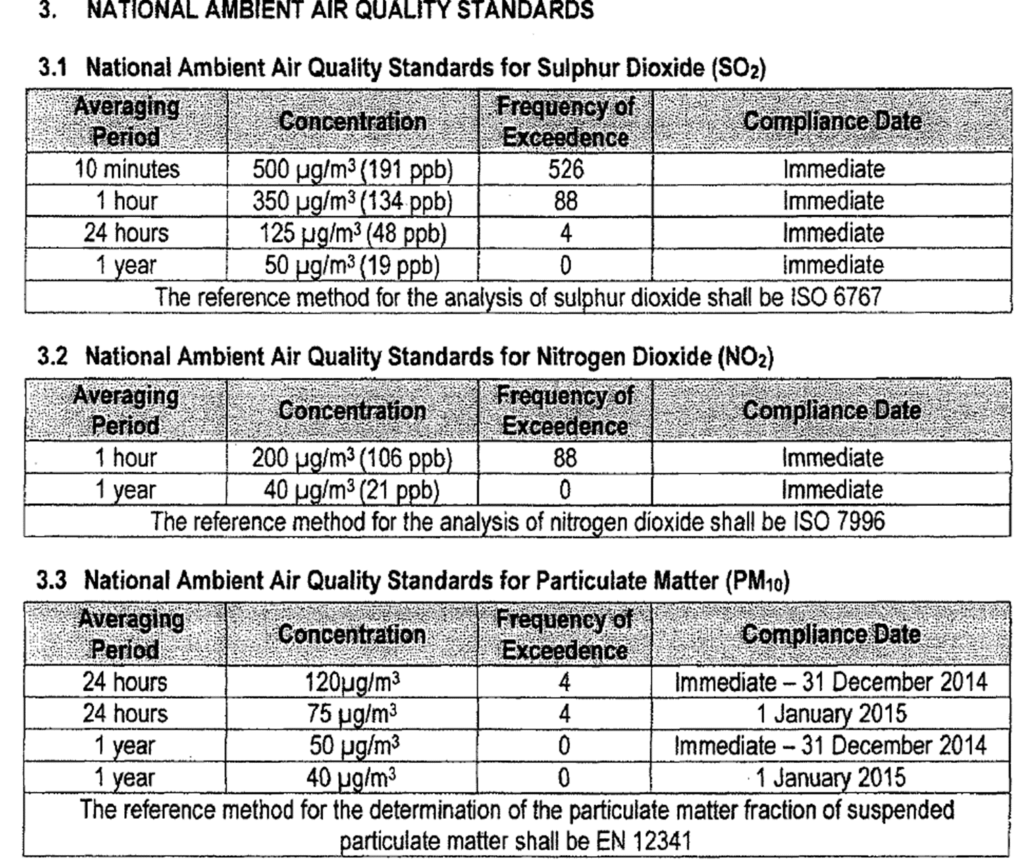

Slide 17
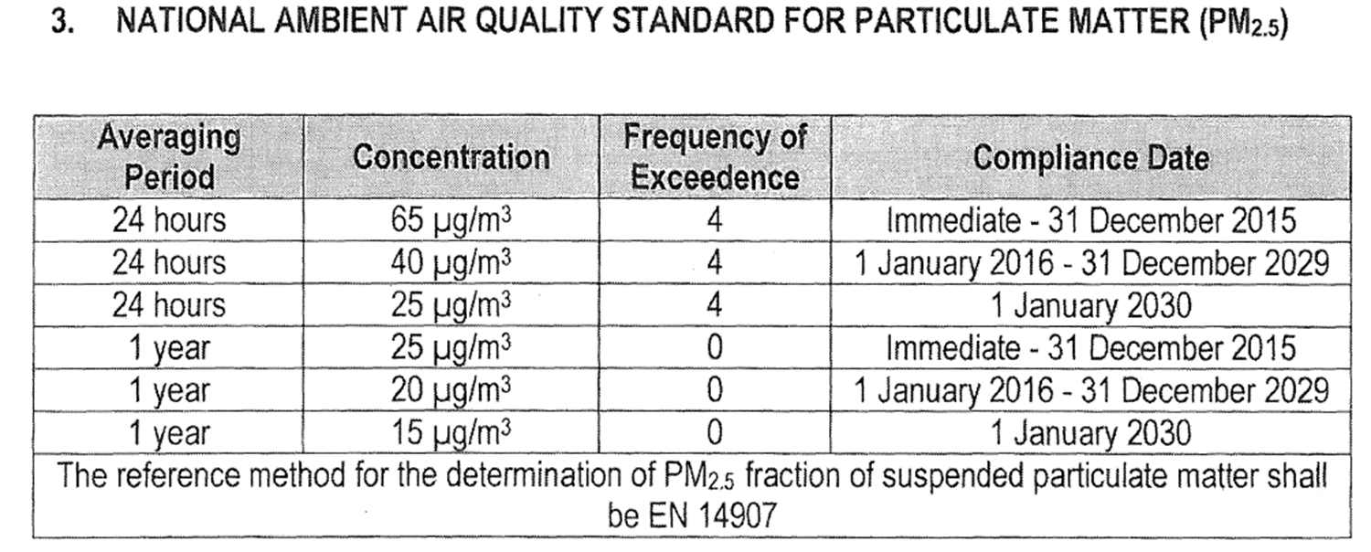
Section 10 and 11 provide for the establishment of provincial and local ambient air quality standards respectively with the provision that such standards “may not alter any such national standards for the province or municipality except by stricter standards...”

Slide 18
S14: Appointment of Air Quality Officers
Minister, MEC and each municipality must designate an official within their jurisdictions and such persons must be responsible for co-ordinating air quality management in their respective spheres.
Air Quality Officers Functions are further stipulated in the National Framework.
National Air Quality Officer: Chief Director – Air Quality Management

Slide 19
S15: Air Quality Management Plans
Development of air quality management plans (AQMPs).
15 (1) provinces and national departments’ requirements to establish and implement AQMPs
15 (2) municipalities to do the same and include their AQMPs in their integrated development plans (IDPs).

Slide 20
S16 & 17 AQMPs
Section 16 stipulates the contents of the AQMPs and section 17 deals with the reporting requirements of the AQMPs.
The NF serves as the Department’s AQMP
AQMP manual to guide the development and management of AQMPs in 2007 and this manual was revised in 2011

Slide 21
Purpose of AQMPs
Identify all air pollution sources
Develop a baseline report of the status quo
Set air quality management objectives or “desired state”
Identify resources required to get to the desired state
Implement, monitor and report against the AQMP

Slide 22
S18: National Air Quality Priority Areas
Declaration of Priority areas:
Ambient standards are being exceeded
Minister or MEC reasonably believes that such may be the case
Criteria:
National: crosses provincial boundaries or MEC requests Minister
Provincial: within a provincial boundary

Slide 23
S19-20: Management and Regulations of Priority Areas
AQMP must be established following a consultative and participatory process
Regulations may be developed to enforce the AQMP
To date 3 priority areas have been declared and action is underway to address the problems:
Vaal Triangle Airshed Priority Area (VTAPA)
Highveld Priority Area (HPA)
Waterberg-Bojanala Priority Area (WBPA)

Slide 24
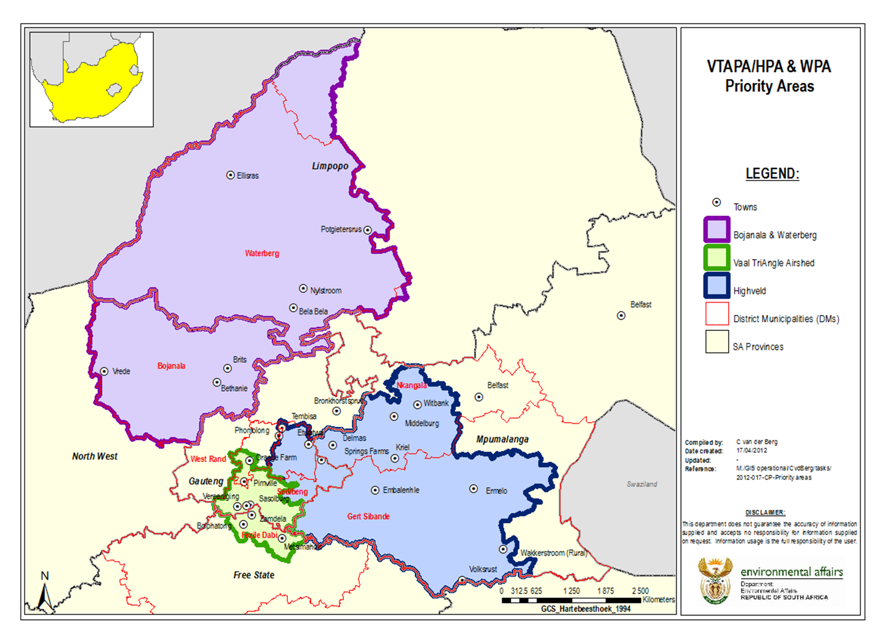

Slide 25
Main Air Pollution Sources in the Priority Areas
Domestic Burning of Dirty Fuels in highly populated areas
Dust and Gaseous Emissions from Mining Operations
Industrial Emissions (various industrial complexes) – APPA consequences
Vehicle Tail-Pipe Emissions

Slide 26
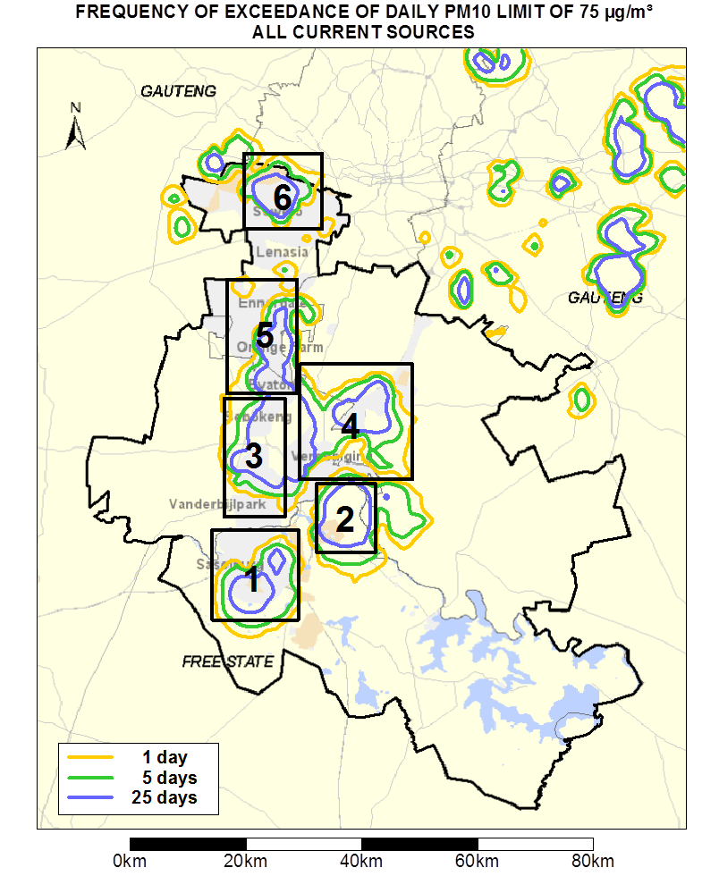
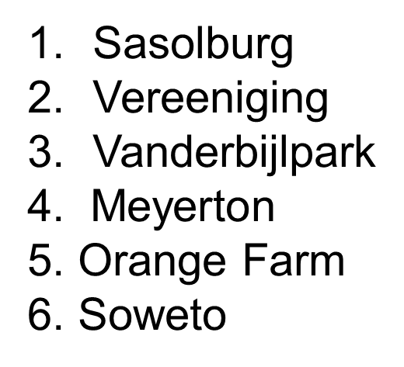
Hotspots in the VTAPA

Slide 27
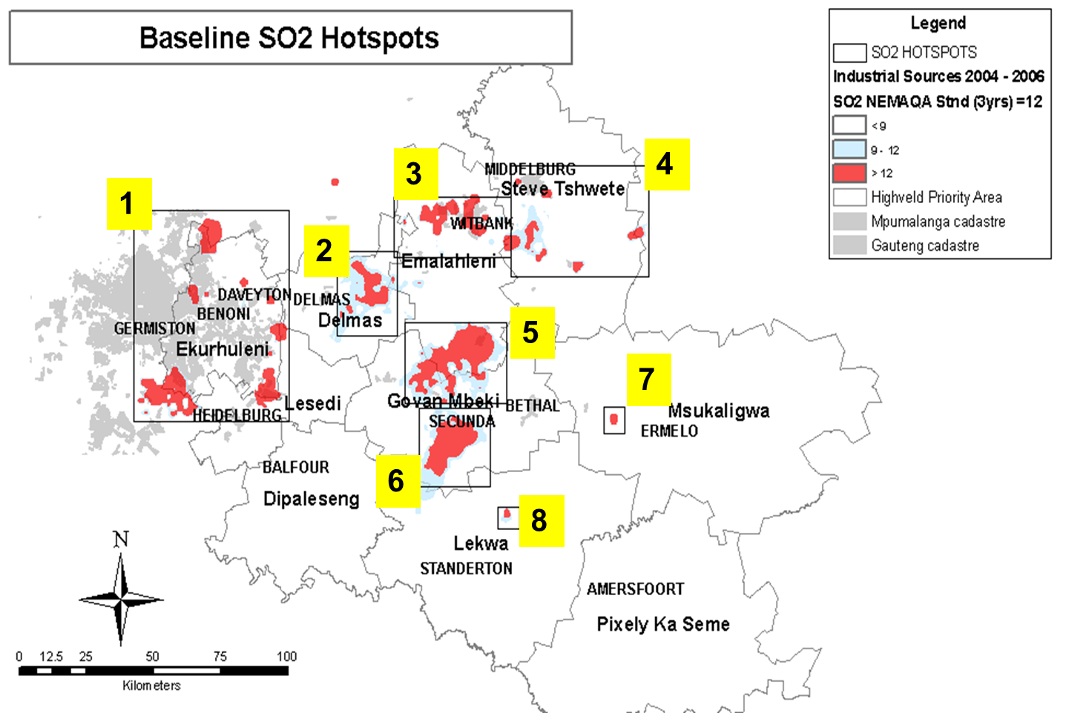
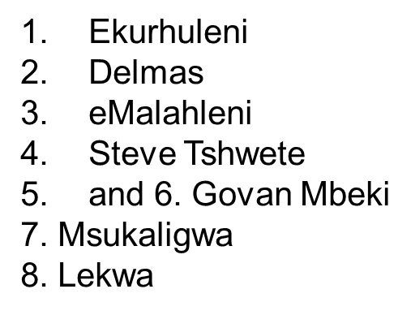
SO2 Hotspots in the HPA

Slide 28
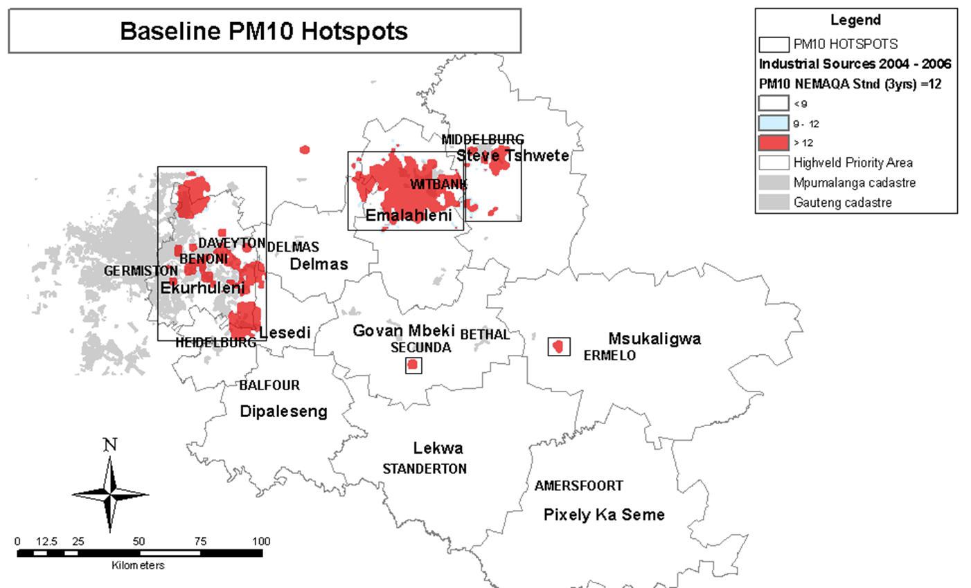
PM10 Hotspots in the HPA

Slide 29
S21: Industrial Emission Limits
S21 provides for the Minister on MEC to publish a list of activities which result in atmospheric emissions and to also define associated minimum emission standards for those activities.
The consequence of the listing is prescribed in section 22 requirement of an Atmospheric Emission License to operate
Licensing Authorities defined in S36 (Minister and MEC NEW AELAs)
S37-S47 deals with AEL processes

Slide 30
S23 – S25: Declaration of Controlled Emitters
Declaration of controlled emitters:
Significant sources in terms of cumulative impacts but as single pollution units do not cause major problems
Do not require an AEL and EIA to operate
Currently (small boilers, temporary asphalt plants); in process small scale char and charcoal plants
Partnership with the SABS has been used successfully in the implementation of these sections as well as S9

Slide 31
S29: Pollution Prevention Plans
Minister or MEC may declare any substance contributing to air pollution as a priority pollutant
Current work:
Draft Notice to declare Greenhouse Gases as priority pollutants
To require mitigation plans according to country’s international commitments
To enable monitoring, evaluation and reporting against those mitigation plans
Finalization awaiting design of carbon budgets

Slide 32
Other Regulations: Dust Control
The purpose of the regulations is to prescribe general measures for the control of dust (settleable particulate matter) in all areas.
Differentiation is made between residential areas and non-residential areas
Empowers the Air Quality Officer to hold “polluters” accountable
These regulations cover sources such as mine dumps and mining generated dust, among others.

Slide 33
Model Air Quality Municipal By-Laws
Model Air Quality Management by-law for easy adoption and adaptation by Municipalities – Established in February 2009.
Regulating air pollution within the area of the municipality’s jurisdiction and provide a legal and administrative framework to deal with localised sources of air pollution such as sugar-cane burning

Slide 34
Regulations Prescribing the AEL Processing Fee Calculator:
Draft Regulations were Published in terms of Section 53(o) and section 37,44,45 & 47 read with section 57(1) of AQA.
The purpose:
To prescribe the atmospheric emission licence processing fee calculator
To regulate the administrative process of determining the prescribed processing fees and the prescribed processing fees bands, as contemplated in Chapter 5 of NEM: AQA.

Slide 35
Atmospheric Emission Licensing Form
Purpose:
To prescribe the format of the application form for atmospheric emission licences and the format of the atmospheric emission licences
To regulate the administrative processes for the processing, consideration and decision of applications for atmospheric emission licences and for matters pertaining thereto.
To provide for matters pertaining to the implementation of the atmospheric emission licensing system

Slide 36
Air Dispersion Modelling Regulations
The draft regulations published on 11 July 2014 (Notice 589, Government Gazette No.37804) in terms of Section 53 of AQA.
The purpose of these regulations is to regulate air dispersion modelling for regulatory processes to enable authorities to “compare apples to apples”

Slide 37
Non-Conventional Sources of Air Pollution
Strategy to Address Air Pollution in Dense Low-Income Settlements
Difficult to control: cannot use command and control
Massive impact – breathing zone
Lack of alternative energy sources
Require government concerted effort
Strategy developed and approved by Cabinet:
Implementation process underway
Integrated Strategy on the Control of Vehicle Emissions
Impacts on air pollution and climate change
Socio-economic issue
Also at breathing zone
Requires concerted government effort (clean fuels, emissions testing, public transport)
Green Transport Strategy

Slide 38
State of Air: 2007-2018
Minimum Data Requirements:
Sampling locations representing regional, urban, neighbourhood, and source-oriented spatial scale
Long sampling periods and durations that represent range of source contribution conditions
Sampling site measuring criteria pollutants
Sampling sites generating an average data recovery of 75% and above

Slide 39
Monitoring Stations Included
City of Cape Town
eThekwini Metropolitan Municipality
City of Johannesburg
City of Ekurhuleni Municipality
City of Tshwane
Vaal Triangle Priority Area
Highveld Priority Area
Waterberg Priority Area
Provincial:
Mpumalanga
Western Cape
North West and Limpopo
Eskom, Sasol and Richards Bay Clean Air Association

Slide 40
PM₁₀ vs PM_{2.5}– Vaal Triangle Airshed Priority Area (VTAPA)

Slide 41
PM₁₀ vs PM_{2.5}– Highveld Priority Area (HPA)
Notes:
Hendrina and Middelburg did not meet the 75% data recovery requirement

Slide 42
PM₁₀ vs PM_{2.5} – Waterberg-Bojanala Priority Area (WBPA)

Slide 43
SO₂ – VTAPA

Slide 44
SO₂ – HPA

Slide 45
SO₂ – WPA

Slide 46
PM10 – City of Johannesburg

Slide 47
PM10 – City of Cape Town
Notes:
Generally, there has been an improvement of PM10 in all the stations since the start of the monitoring, however, from 2014 there has been a steady increase of PM10

Slide 48
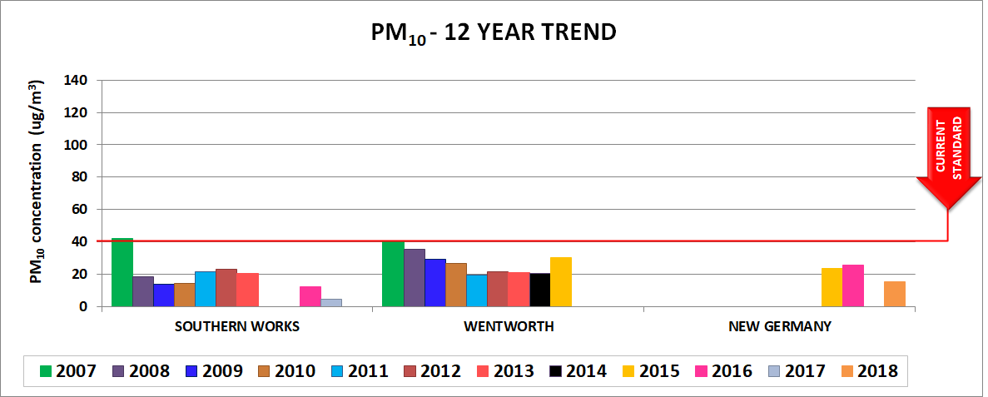
PM10 – City of eThekweni

Slide 49
PM10 – Western Cape

Slide 50
PM10 – Mpumalanga
Notes:
Regionally influenced stations

Slide 51
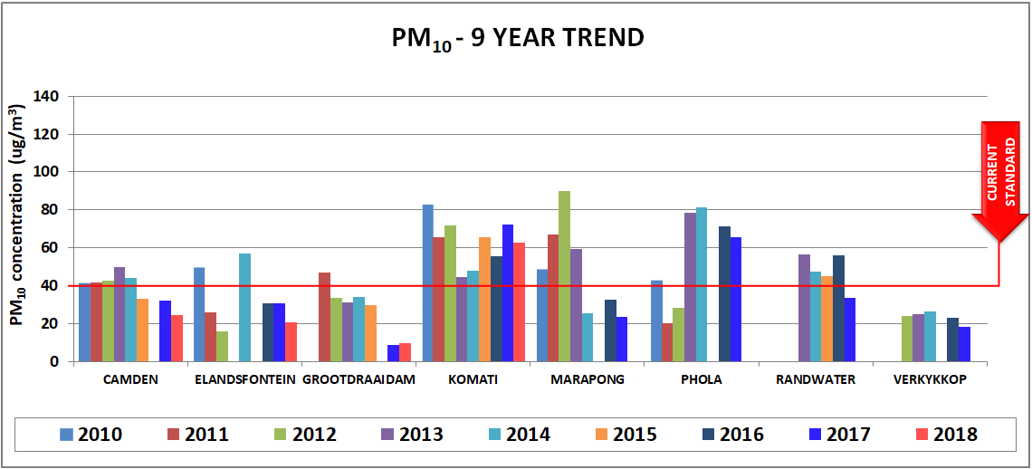
PM10 – Eskom
Notes:
Marapong, Phola, Randwater and Verkykkop 2018 data did not meet the 75% data recovery requirement

Slide 52
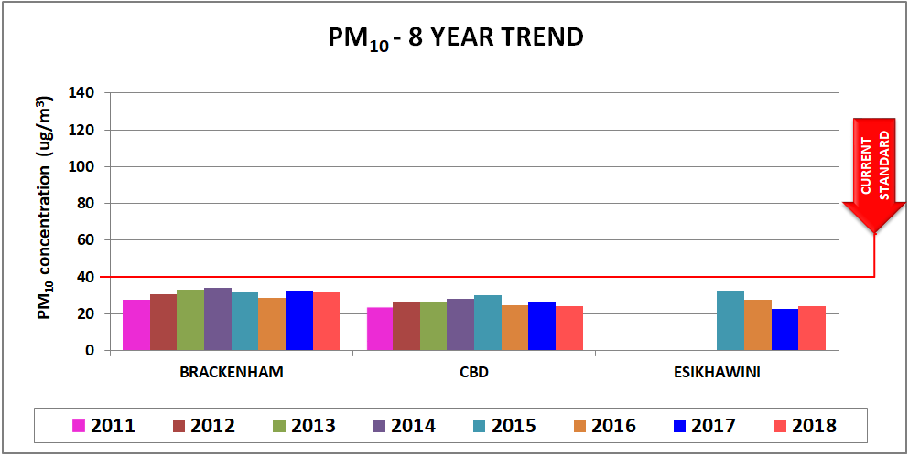
PM10 – Richard Bay Clean Air Association

Slide 53
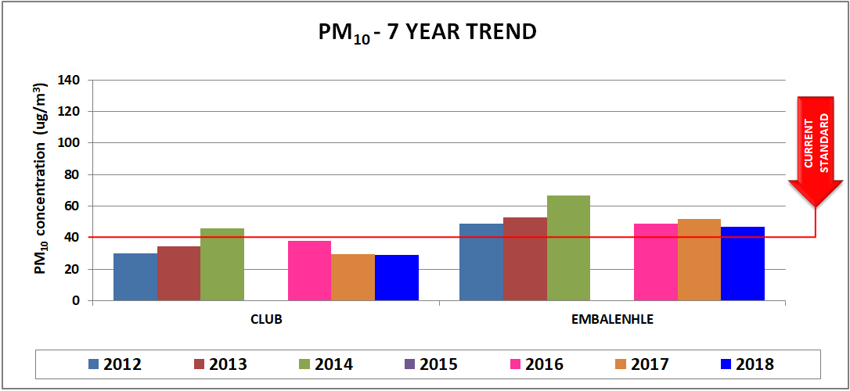
PM10 – Sasol

Slide 54
SO2 – City of Cape Town
Notes:
Only Bothasig and Wallacedene have met data the 75% data recovery requirement

Slide 55
SO2 – Mpumalanga

Slide 56
PM10 – Eskom

Slide 57
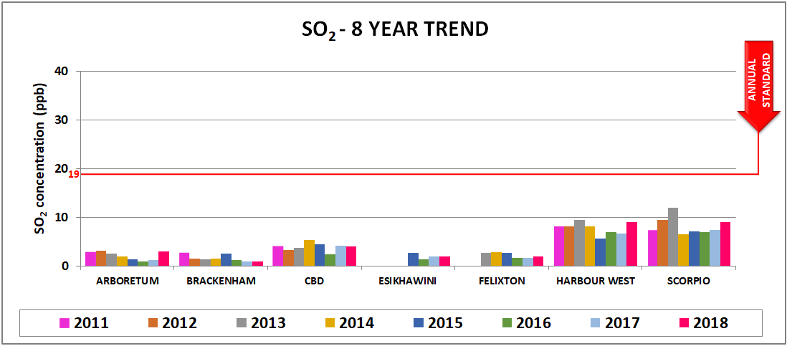
SO2 – Richard Bay Clean Air Association

Slide 58
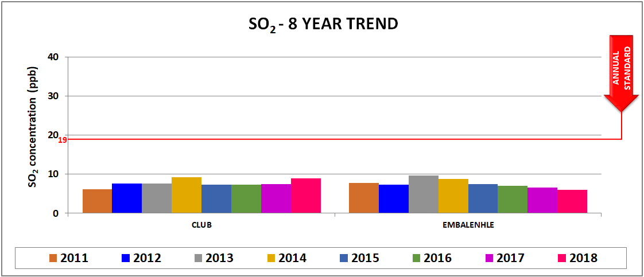
SO2 – Sasol

Slide 59
National Air Quality Indicator

Slide 60
The National Air Quality Indicator (NAQI)
Purpose:
To monitor the state and trend of air ambient quality in South Africa.
To monitor the efficacy of air quality interventions: policies, regulations, AQMPs...
Principles:
Simple but not simplistic
Credibility
Transparency and complexity
Accuracy and reproducibility
Sensitivity

Slide 61
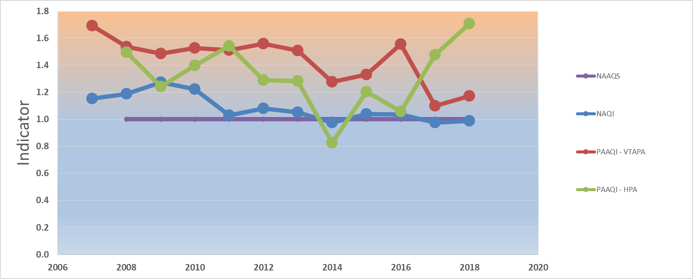
National and PA Air Quality Indicators
HPA = 1.71
VTAPA = 1.17
NAQI = 0.99
Notes:
This is the recalculated NAQI based on the discussions you had with Peter for the DMPE indicators.
Based on all these graphs shown, we have defined a NAQI to show the national trends of PM10 and SO2 against the NAAQS. When the NAQI is above 1, the air quality is poor as a national overview. When the NAQI is below 1 and decreasing, we can confidently say that national the air quality is improving.

Slide 62
Interventions in Monitoring Networks Challenges
Power Failures – installing Uninterrupted Power Supply (UPS) systems across stations to reduce equipment damage and improve data recovery during power failures
Vandalism and security risks – adding armed response and additional security at stations
Capacity – national intervention in managing 43 NAQI stations for a period of 5 years while building capacity at municipal and provincial level until 2022
South African Weather Service - managing 18 priority area stations since 2011

Slide 63
Conclusions – 2018 State of Air Report
PM is still the greatest national cause for concern in terms of air quality due to numerous pollution sources but climatic conditions are also a major factor;
Continued and increased national provincial and local action is required in order to bring particulate concentrations down to acceptable levels;
By virtue of non-compliance to the national annual ambient air quality standards, one can conclude that many South Africans may be breathing air that is harmful to their health and well-being especially in the priority areas;
Even with all of this, international examples are showing us that we are in the right path towards pollution reduction, however, major policy shifts in all areas and in particular in the energy, mining and transport sectors are critical to achieve clean air goals.

Slide 64
Overall Conclusion
Continued implementation of the AQA and its National Framework
Improvement of Air Quality in the National Priority Areas
The asset management system of the (South African Air Quality Information System (SAAQIS) which is hosted by the South African Weather Services (SAWS) was established to ensure management efficiencies in air quality monitoring
There is live reporting of State of Air with the Air Quality Index

Slide 65
THANK YOU!

