Slide 1
STATE OF POLOKWANE LOCAL MUNICIPALITY
Presentation to the CoGTA Portfolio Committee
Presenter: Mr M Mogale
Time: 09H00
Date: 18 August 2020
Virtual Meeting

Slide 2
PRESENTATION OUTLINE
Purpose of the presentation
Problem Statement/Introduction
Socio-economic Status
Education
Governance & Municipal Capacity
Financial Management
Service Delivery Status
Key Challenges
COGTA Support to Polokwane LM
Factors hampering service delivery
Strengths and Opportunities
Conclusion
Recommendations

Slide 3
PURPOSE OF THE PRESENTATION
The purpose of the presentation is to:
Provide an overview of the state of Polokwane Local Municipality (LM)
Indicate the support provided by COGTA to Polokwane LM
Identify strengths and opportunities

Slide 4
PROBLEM STATEMENT/INTRODUCTION
Polokwane LM serves as the economic hub of Limpopo, Province and has the highest population density in the Capricorn District.
The municipal spatial pattern reflects that of the historic apartheid city model, characterized by segregate settlement
Situated on the outskirts in several clusters are less formal settlement areas, which are experiencing enormous influx from rural urban migration trends.
These areas are in dire need of upgraded services and infrastructure, both social and engineering, and are struggling to cope with the informal influx of more and more people who want access to an improved quality and standard of living.
It is also experiencing water supply challenges impacting on its ability to provide reliable water to its ratepayers.
The Municipality has obtained qualified audit opinion for the past three consecutive years and is not able to collect revenue optimally to fund its service delivery programes.
The migration to a new financial management system is expected to improve performance of its operations
Notes:
Since 2016, Kannaland Municipality has improved drastically through the following:
The Council leadership, which resulted in the removing of certain officials who were later investigated for many acts of corruption.
There was a general improvement of governance and financial management, as well as the implementation of projects and addressing issues, e.g. the payment of debt to ESKOM.

Slide 5
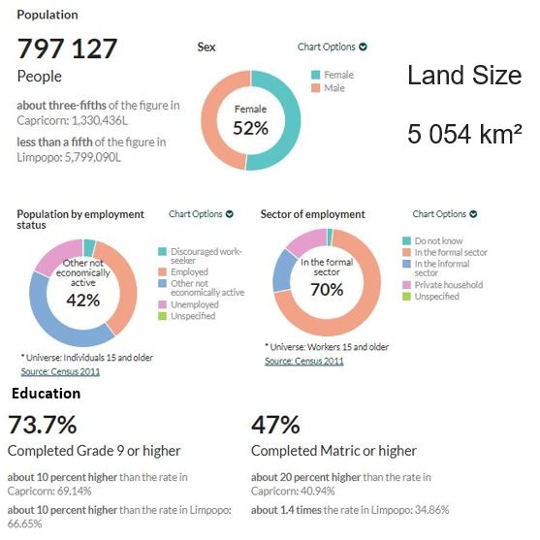
SOCIO ECONOMIC STATUS Cont…

Slide 6
SOCIO-ECONOMIC STATUS
Poverty:
In 2017, there were 498 000 people living in poverty, an increase from 485 000 in 2007.
Economic active population:
Polokwane Local Municipality's EAP was 308 000 in 2017, which is 37.92% of its total population of 812 000, and roughly 71.49% of the total EAP of the Capricorn District Municipality. From 2007 to 2017, the average annual increase in the EAP in the Polokwane Local Municipality was 3.84%, which is 0.36 percentage points higher than the growth in the EAP of Capricorn's for the same period.

Slide 7
SOCIO-ECONOMIC STATUS
Largest number of jobs in 2019
In Polokwane Local Municipality the economic sectors that recorded the largest number of employment in 2017 were the community services sector with a total of 65 700 employed people or 25.8% of total employment in the local municipality.
The trade sector with a total of 65 400 (25.7%) employs the second highest number of people relative to the rest of the sectors.
The electricity sector with 2 370 (0.9%) is the sector that employs the least number of people in Polokwane Local Municipality, followed by the mining sector with 3 390 (1.3%) people employed.

Slide 8
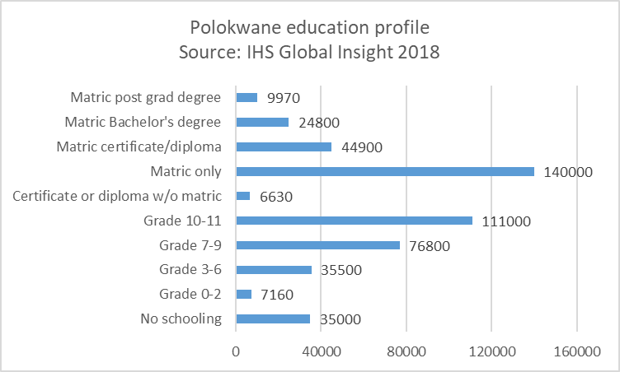
EDUCATION
Within Polokwane Local Municipality, the number of people without any schooling decreased from 2007 to 2017 with an average annual rate of -0.81%, while the number of people within the 'matric only' category, increased from 93,600 to 140,000. The number of people with 'matric and a certificate/diploma' increased with an average annual rate of 4.91%, with the number of people with a 'matric and a Bachelor's' degree increasing with an average annual rate of 5.08%. Overall improvement in the level of education is visible with an increase in the number of people with 'matric' or higher education

Slide 9
ECONOMIC DRIVERS
Economic drivers
Community services (31.8%)
Trade sector (22.1%)
Finance (21.%)
Per capita income:
The per capita income in 2017 is
R 47,200 which is higher than both the Limpopo (R 37,100) and of the Capricorn District Municipality (R 40,000) per capita income but lower than that of the South Africa as a whole which is R 57,200.
Sector | %
Agriculture | 1%
Mining | 6%
Manufacturing | 4%
Electricity | 3%
Construction | 4%
Trade | 22%
Transport | 7%
Finance | 21%
Community services | 32%
Total | 100%

Slide 10
GOVERNANCE & MUNICIPAL CAPACITY
Polokwane is a category B Municipality with an Executive Mayoral System combined with a Ward Participatory System as provided for in the section 12 Notice of the Municipal Structures Act, Act of 2000, as gazetted by the Limpopo Provincial Government
The Municipality is constituted by 90 Councillors members (ANC 50, EFF 27, DA 10, COPE 1, VF PLUS 1) and the African National Congress is the governing party.
Functionality of governance structures:
There is stability in the Municipality and all the Council structures are functional .
Council and the Mayoral Committee meet on a regular basis since the inaugural meeting.
An Audit and Performance Committee has been established and meet on a quarterly basis.
MPAC Committee has been established and is meeting regularly.
IDP Representative is meeting regularly
All the senior management positions have been filled

Slide 11
FINANCIAL MANAGEMENT
All the budget passed by the Municipality for the past five years were funded.
On the 1st April 2019, the Municipality changed the financial system from SAMRAS, following numerous challenges with the system which contributed to the previous years of negative audit outcomes, to Munsoft. This change was implemented in order to among other very important benefit:
Improve revenue management .
Improve credit control, thus improving debtors collection.
Full compliance with Mscoa.
Address prior AGSA findings on revenue.
Ultimately improve customer care.
NB: The processing of the 2018/2019 FY financial statements by the Auditor General was delayed and the audit outcome was only released in June 2020.
33 000 prepaid water meters has been installed in Polokwane and seshego and 10 000 consumers still remaining on conventional .
10 000 prepaid electricity meters installed in Polokwane and Seshego and 4 500 consumers still remaining on conventional.
The Council has resolved to put prepaid water meters in Mankweng Township as part of revenue enhancement strategy.

Slide 12
Auditor General’s perspective
Audit outcomes – last 3 financial years
The municipality received qualified audit opinions for three consecutive financial years 2016/17, 2017/18 and 2018/19.
The Auditor-General report for 2018/19 reflects the following areas of non-compliance with legislation:
Revenue Estimates for the second year in succession.
Commitments
Long delayed projects not disclosed
Cash and Cash Equivalents
The IDP and Budget was approved for 2020/2021.
There was no special adjustment budget to authorise the previous year’s unauthorised expenditure

Slide 13
USE OF CONSULTANTS
Financial year 2017/18 | Financial year 2018/19
R233 million | R103 million
Significant Projects With Consultants PMU Support Management. Smart metering. Housing projects. Asset management. Accounting. System migration. Power bank feasibility. Fleet management assessment and feasibility.

Slide 14
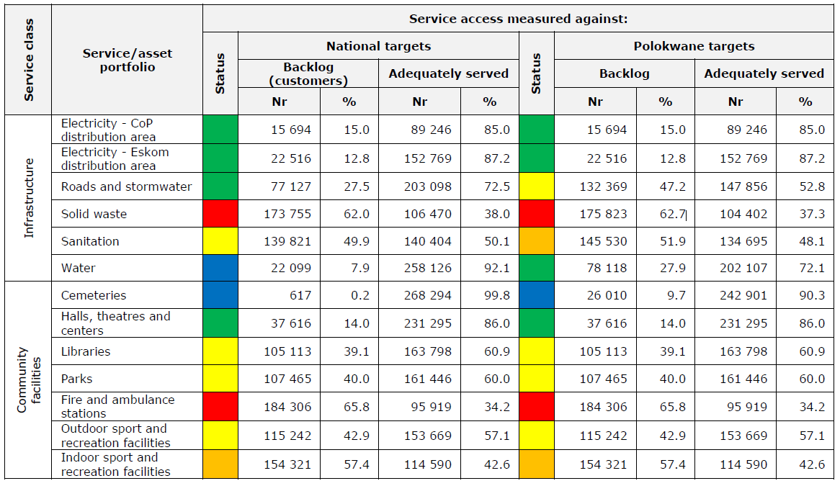
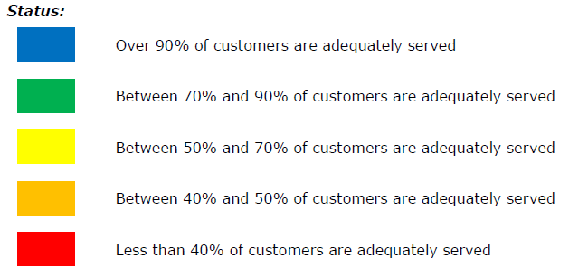
CURRENT STATE OF MUNICIPAL SERVICES PROVISION
Source: City of Polokwane – Strategic Asset Management Plan (SAMP) 2018 to 2047
Notes:
Infrastructure – solid waste is the basic service that is least adequately served. This is mostly due to large rural areas within the Municipality. Waste collection is a day today activity in the City, Seshego, Mankweng, and Sebayeng Townships. Municipal trucks collect waste once a week at residential areas/suburbs/Townships and daily at businesses and industrial areas. A plan is contemplated to roll out this service to rural areas also.
Sanitation – also not adequately served: In rural areas households are providing their own infrastructure which does not adhere to basic LOS. Rural household sanitation projects are recommended.
Roads and stormwater backlog: Due to the establishment of new developments both formal and informal settlements coupled with the recent incorporation of part of Aganang Municipality into Polokwane Municipality

Slide 15
POLOKWANE WATER SUPPLY
The main water supply sources currently supplying water to Polokwane City are the following:
Resource Name | Licensed Supply (Ml) | Expected Average supply to the city (Ml) | Current supply to the city (Ml)
Polokwane Boreholes | 6,9 | 5,5 | 2,8
Pilgrimshoop | 1,2 | 1,2 | 1,2
Dap Naude | 18 | 14 | 14
Seshego Dam | 2 | 1 | 1
Ebenezer | 44 | 21,6 | 16,8
Olifantspoort | 60 - 90 | 26,7 | 20,9
Total | 132-162 | 70,0 | 56,7
NB: The current water demand is approximately 98 Ml/d. The table above indicates that the expected water supply is 70 Ml/d and the Municipality is only receiving 56,7 Ml/d. Therefore, the current water volume supplied to the City has a deficit of approximately 40 Ml/d. The Deficit is increasing as the dams run dry and the Municipality have to ramp up water restrictions.

Slide 16
REGIONAL WASTE WATER TREATMENT PLANT
For the purposes of increasing the capacity of the Waste Water Treatment Plants to support current and future development ,the municipality is currently in a process of building:
New Regional waste water treatment.
Seshego Waste Water Treatment Plant
Mankweng Waste Water Treatment Plant
Refurbishment of the Waste Water plants
Secured funding from Regional Bulk Infrastructure Grant

Slide 17
BUS RAPID TRANSPORT – SYSTEM CHALLENGES
System Challenges
The launch of the BRT system was anticipated for later in the year.(Not yet Done)
There were negotiation delays with the Taxi Industry which affected expenditure .
One contractor was appointed on a multi-year basis to complete all BRT infrastructure.
Taxi Industry compensation constitutes one of the largest expenditure drivers. Delays in the in VOCA negotiations subsequently delayed negotiations/payments in compensation
The contractor applied for business rescue and has been liquidated. This has greatly hampered expenditure on the entire grant.
The city is currently engaged in a process of terminating the contractor and a new one will be appointed promptly.
Leeto la Polokwane will be Unsustainable for the City
COGTA/MISA to engage DOT and develop mitigation plans.

Slide 18
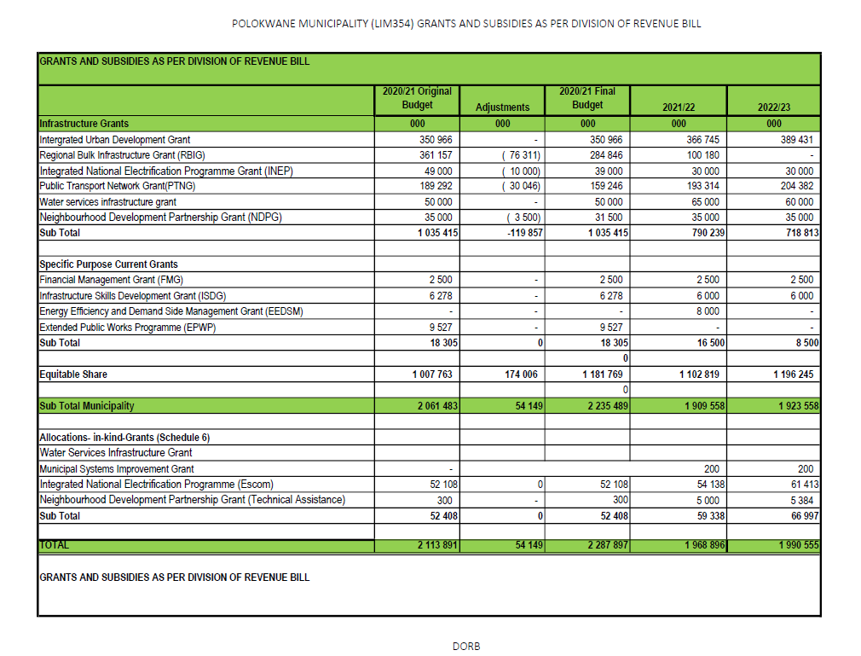

Slide 19
PROGRESS WITH IMPLEMENTATION OF THE ICM SUPPORT PROGRAMME
The Intermediate Cities Support Programme has been implemented in partnership with the Swiss State for Economic Affairs and the World Bank.
Implementation methodology was developed and tested in two municipalities i.e. Polokwane and uMhlathuze
Support is provided for the implementation of the programme focused on:
spatial planning – development/ review of SPLUMA compliant Spatial Development Frameworks,
Infrastructure delivery and management - this included development of Standard Operating Procedures, Infrastructure Procurement Plans.
Institutionalisation of long term infrastructure planning through development of capital expenditure frameworks - MISA to further support with implementation of the CEFs.
New grant (Integrated Urban Development Grant - IUDG) mechanisms were introduced through the DoRa in February 2018 – Polokwane Municipality was a pilot of the new grant and still is the grant recipient.
Through the IUDG, Polokwane Municipality has received just over R20million as an incentive.

Slide 20
IMPLEMENTATION SUPPORT - KNOWLEDGE SHARING
Peer Learning Network established to facilitate learning exchange between 6 ICMs with an intention to expand after testing phase.
Polokwane is one of the 6 municipalities that are members of the Learning Network
Participating cities acting as living labs on sustainable urban development and long term infrastructure planning;
All projects chosen as test cases in the Learning Network have a special focus on mainstreaming climate change response, urban safety and innovative citizen engagement as cross-cutting themes.
MISA: In the 2020/21 FY, MISA is supporting Polokwane Municipality with the development of systems and processes for the assessment of performance of municipal electrical network

Slide 21
FACTORS HAMPERING SERVICE DELIVERY
Challenges do exist regarding the capacity of bulk infrastructure services with specific reference to wastewater treatment works, water storage and water works.
Uncoordinated allocation of new settlement in rural areas by traditional authorities has a major impact on municipal planning and budgeting.
Lack of Institutional Capacity in the following areas; PMU & Engineering
Lack of maintenance plans for sewer infrastructure
Energy/Electricity Capacity Shortfall – the municipality will not be able to sustain future developments unless new programme are implemented
Illegal connection and bridging of electricity is contributing to electricity losses.
Providing and maintaining the local roads at an acceptable standard which ensures accessibility at all times.
Challenge of storm water management and control

Slide 22
GENERAL REMARKS
The Municipality experienced a turbulent transition prior to the 2016 Local government election but there is stability both political and management level.
The Municipality implemented successfully the prepaid meters for both water and electricity in Polokwane and Seshego and this program has enhanced the revenue stream.
The implementation of the Bus Rapid Transport program requires to be tightened up.
There’s an opportunity to take over the electricity supply from ESKOM in the township, such as Mankweng, which will enable the municipality to improve revenue in the rural areas.

Slide 23
STRENGTHS
Compliant community consultative processes (IDP)
Sound and sustainable fiscal and financial management
Good investment rate (Internal rate of return on allocation of resources)
Sound governance
COP 17 compliant (Green/ Cleanest City award & Arbour award)
Water Service Authority
Electricity License Authority City/Seshego that creates stable revenue from electricity
Provincial Sporting and Recreation Hub (sporting games, indigenous games, rural sports, festivals, arts and culture, Mayoral Road race, Mayoral Charity Golf, Mapungubwe)
Land availability within urban edge
Only Municipality in the province with Social Housing Institution (SHI) and designated restructuring zone.
Accredited Level 1 & 2 Housing provider
SPLUMA Compliant.
Only Municipality in the province with Integrated Geographic Information System

Slide 24
OPPORTUNITIES
Broad revenue base (potential to collect from total of 239 116 households) , revised valuation roll and bulk contributions
Potential for various hubs to be established: Economic, political, logistics, sporting and recreation hubs in Limpopo (Tourism, Gateway to Africa, capital city, provincial offices, International Airport, sporting games, festivals, arts and culture, Mapungubwe)
Available land for development

Slide 25
THREATS
Lack of sustainable water sources for current and future demand
Rapid Population growth (Services, CBD growth, informal settlement, crime, uncontrolled Influx Urban Decay,)
Climate change (Natural disasters)
Service protests
The risk of contaminating ground water in rural areas due to huge backlog of pit latrine that is not according to the approved standards.

Slide 26
RECOMMENDATIONS
That COGTA continues to provide support through MISA and IUDG;
THAT COGTA/MISA and DWS collaborate with the provincial government to develop long term plans for water supply to the Municipality.
That the Municipality review and finalize their revenue enhancement strategy to improve the income stream.
That the District Development Model be ramped up by mobilizing national and private sector to support the Municipality on major infrastructure programs.
That the Municipality continue on the trajectory of reducing their dependence on consultants.

Slide 27
END
Thank You

