Slide 1
THE NATIONAL ENVIRONMENTAL MANAGEMENT BIODIVERSITY ACT, ACT NO 10 of 2004
Portfolio committee briefing
18-08-2020

Slide 2
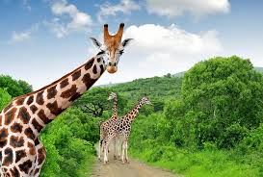
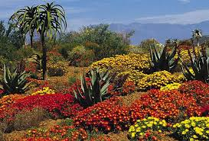
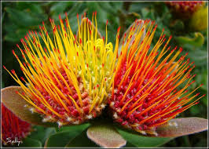
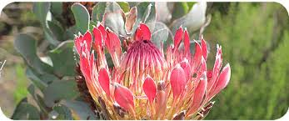
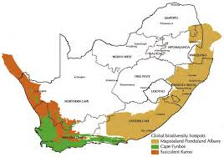
Conservation of SA’s Biological Diversity
SOUTH AFRICA’s BIODIVERSITY
South Africa is one of the mega diverse countries in the world, and the only country to contain an entire floral kingdom.
In comparison with most other parts of the world, South Africa’s biodiversity is still in good condition.
Biodiversity offers multiple opportunities for economic development and improving human well-being.
This natural wealth is threatened by growing human populations and their demands on the environment.
Key Drivers of biodiversity loss – land use change, alien and invasive species, over exploitation & climate change.
South Africa’s faunal diversity is high relative to the land surface area.
BIODIVERSITY SECTOR CONTEXT
SPECIES DIVERSITY AND ECOSYSTEMS
South Africa is a home to an estimated:
5.8% of the global total of mammal species (close to 300 species),
8% of bird species (more than 800 species recorded),
4.6% of reptile species (288 species) and
5.5% of the world’s known insect species
Biodiversity management policy and legislation has undergone profound changes in the past decades.
Paradigm shift from protectionist to conservation and sustainable use.
Recognition of the ecosystem approach while still maintaining elements of species level responses.
Recognition of the role of communities within the environments they occupy.
Recognition of biodiversity as a key contributor to the economy as well as environmental goods and services.
Achieving sector goals results in natural tensions between often polarized stakeholders.
DEFF has to take all perspectives into account and align them with national imperatives in developing and implementing policies.
Also hosts 3 globally recognized biodiversity hotspots
Cape Floral Kingdom
Succulent Karoo
Maputaland-Pondoland-Albany centre of endemism

Slide 3
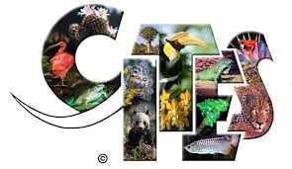
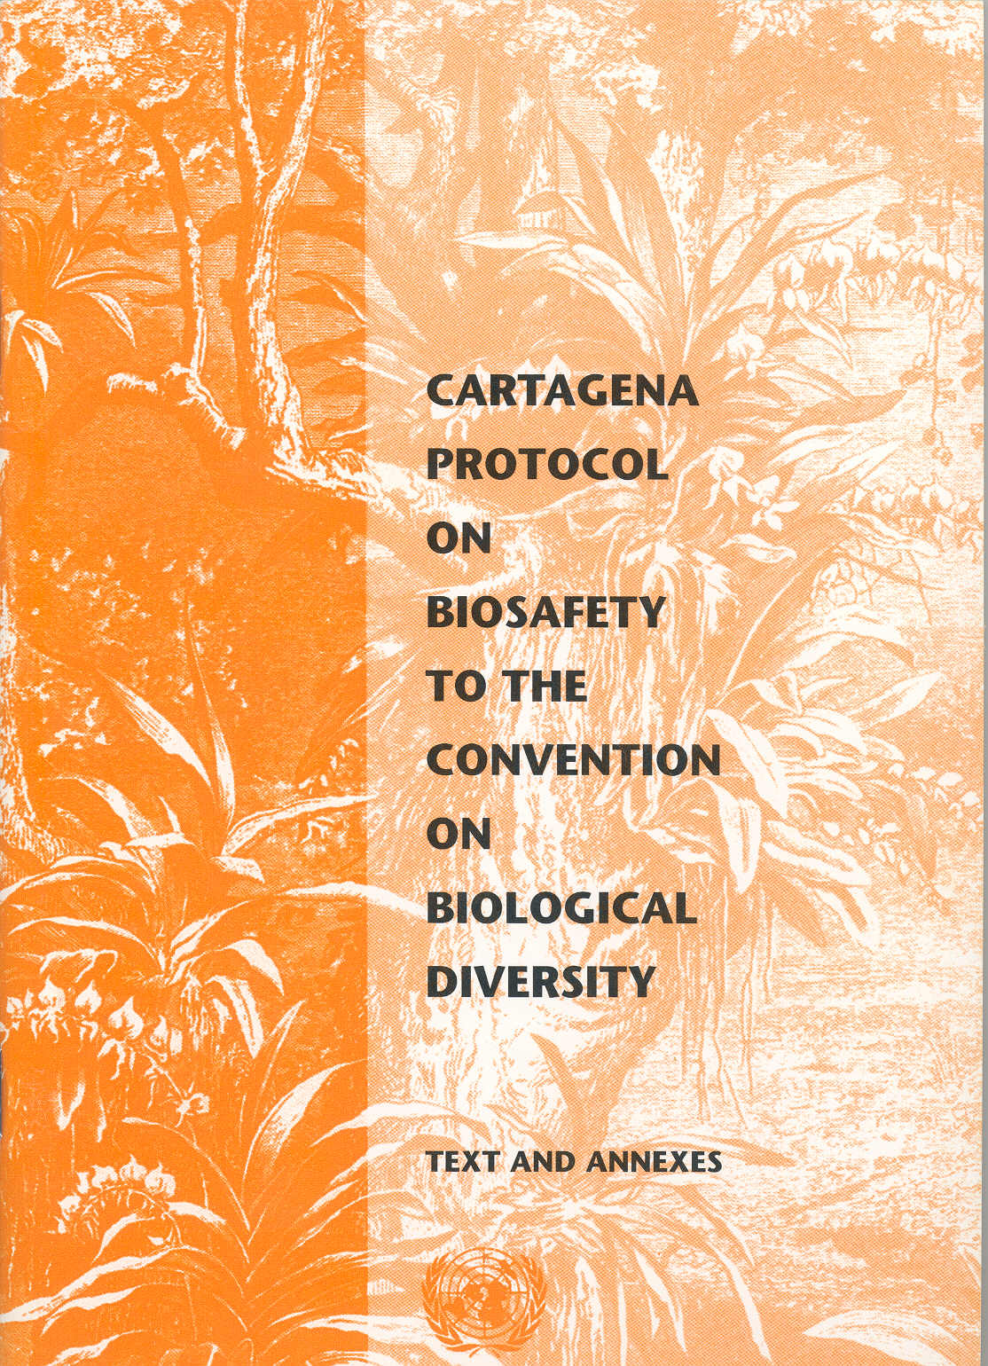
INTERNATIONAL CONTEXT
1. CONVENTION ON BIOLOGICAL DIVERSITY (CBD) SA ratified in 1996
5. CMS SA ratified in 1991
Conservation, sustainable use of, and the fair and equitable sharing of the benefits arising out of the utilisation of genetic resources
1.1 Cartagena Protocol on Biosafety (CBD) - safe handling, transport and use of living modified organisms (LMOs) resulting from modern biotechnology that may have adverse effects on biological diversity, taking also into account risks to human health
1.2 The Nagoya Protocol on Access to Genetic Resources and the Fair and Equitable Sharing of Benefits Arising from their Utilization (CBD) - promotes sharing of benefits with countries of origin of genetic resources and their associated traditional knowledge.
To conserve terrestrial, marine and avian migratory species throughout their range; management and sustainable use of migratory species
5.1 African-Eurasian Migratory Waterbirds Agreement
To take co‑ordinated measures to maintain migratory waterbird species in a favourable conservation status or to restore them to such a status.
6. WHC SA ratified in 1997
To ensure the protection, conservation and presentation of the cultural and natural heritage
2. RAMSAR CONVENTION ON WETLANDS SA ratified in 1975
Conservation and wise use of all wetlands through local, regional and national actions and international cooperation, as a contribution towards achieving sustainable development throughout the world..
3. UNCCD SA ratified in 1992
To combat desertification and mitigate the effects of drought in countries experiencing serious drought and/or desertification, particularly in Africa.
4. CITES SA ratified in 1975
To regulate International Trade in Endangered Species of Wild Fauna and Flora.

Slide 4
DEFF Foundational Mandate
DEFF 15 YEAR REVIEW
CONSTITUTIONAL MANDATE (SEC 24) 3 Sustainable Development Elements
Social - environment – not harmful to health or well-being; “…while promoting justifiable social dev”
Environmental – protect the environment, for the benefit of present and future generations, through legislative / other measures that –
prevent pollution and ecological degradation;
promote conservation; and
Economic – secure ecologically sustainable development and use of natural resources while promoting justifiable economic development.”
3 broad phases:
1994 – 1999 – Transition & paradigm shifts
Clarifying the mandate and setting the green agenda
Initiation of CONNEP process
Paradigm shift from “protectionist” to “conservationist” sustainable use
Implementation of Macro-Economic Strategy: long-term vision for a democratic South Africa.
1999 – 2004 – Policy & Law reform
World Summit on Sustainable Development
Law Reform
Initiated tools make legislation work
Institutional review – scope of department broadened
2004 – 2008 – Building capacity and implementation instruments
Moving towards implementation of comprehensive suite of legislation
Disjuncture/misalignment between plans and capacity in all spheres of government
Oversight of public entities
Regulatory Functions – moving from policy development to compliance and enforcement, monitoring and evaluation
DEFF 15 YEAR REVIEW
The Consultative Environmental Policy Process (CONNEPP), 1994-1996
The National Environmental Management Policy, 1996
The National Environmental Management Act (Act No. 107 of 1998)
BIODIVERSITY & CONSERVATION
NEM: Biodiversity Act 2004

Slide 5
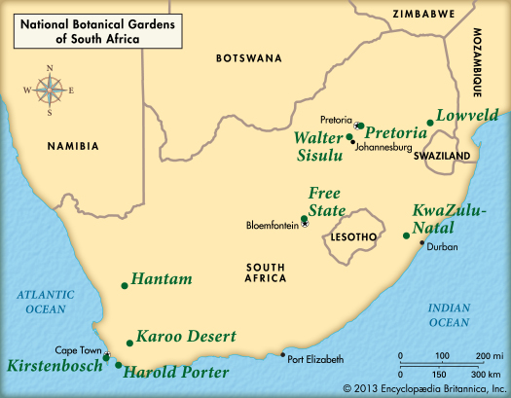
NEMBA 2004
CHAPTER 2: ESTABLISHMENT OF SANBI
CHAPTER 1: OBJECTIVES
The objectives of this Act are-
(a) within the framework of the National Environmental Management Act, to provide for-
(i) the management and conservation of biological diversity within the Republic and of the components of such biological diversity;
(ii) the use of indigenous biological resources in a sustainable manner; and
(iii) the fair and equitable sharing among stakeholders of benefits arising from bioprospecting involving indigenous biological resources;
(b) to give effect to ratified international agreements relating to biodiversity which are binding on the Republic;
(c) to provide for co-operative governance in biodiversity management and conservation; and
(d) to provide for a South African National Biodiversity Institute to assist in achieving the objectives of this Act.
The functions of SANBI, amongst other things, are:
To monitor and report regularly to the Minister on:
Status of Biodiversity in South Africa; and
Impacts of GMO’s that has been released into the environment
To coordinate and promote the taxonomy of South Africa’s biodiversity
To coordinate and implement programmes for the:
rehabilitation of ecosystems; and
prevention, control or eradication of listed invasive species

Slide 6
NATIONAL BIODIVERITY FRAMEWORK (NBF)
CHAPTER 3: BIODIVERSITY PLANNING AND MONITORING
The purpose of this Chapter is:
To provide for integrated & co-ordinated biodiversity planning:
National Biodiversity Framework
Bioregions & Bioregional Plans
Biodiversity Management Plans for Ecosystems
Biodiversity Management Plans for Species
To provide for monitoring the conservation status of various components of South Africa’s biodiversity
To promote biodiversity research
Contents of the NBF:
(1) The national biodiversity framework must-
(a) provide for an integrated, co-ordinated and uniform approach to biodiversity management by organs of state in all spheres of government, nongovernmental organisations, the private sector, local communities, other stakeholders and the public;
(b) be consistent with-
(i) this Act;
(ii) the national environmental management principles; and
(iii) any relevant international agreements binding on the Republic;
(c) identify priority areas for conservation action and the establishment of protected areas; and
(d) reflect regional co-operation on issues concerning biodiversity management in Southern Africa.
(2) The national biodiversity framework may determine norms and standards for provincial and municipal environmental conservation plans.
CHAPTER 3: IMPLEMENTATION UPDATE
To this effect the following tools were developed and published:
National Biodiversity Framework-August 2009
Bioregions and Bioregional Plans
Guidelines regarding the determining bioregions and the preparation of and publication of bioregional plans -March 2009
Biodiversity Management Plans for Ecosystems
Norms and standards for biodiversity management plans for Ecosystems -February 2014
Biodiversity Management Plans for Species
Norms and standards for biodiversity management plans for species -March 2009
BIOREGIONAL PLANS
Contents of bioregional plans
A bioregional plan must-
(a) contain measures for the effective management of biodiversity and the components of biodiversity in the region;
(b) provide for monitoring of the plan; and
(c) be consistent with-
(i) this Act;
(ii) the national environmental management principles;
(iii) the national biodiversity framework; and
(iv) any relevant international agreements binding on the Republic

Slide 7
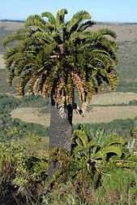
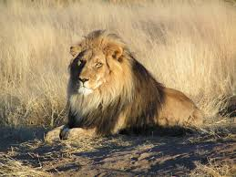
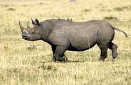
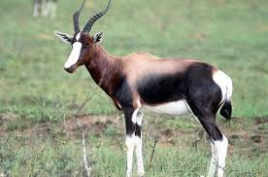
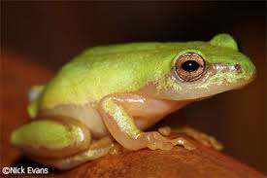
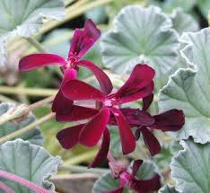
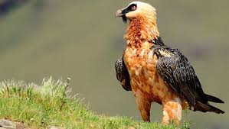
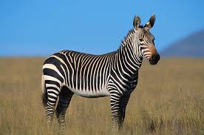
BIODIVERSITY MANAGEMENT PLANS FOR SPECIES
Section 43 of NEMBA provides for any person or organ of state and organisation to submit to the Minister for consideration a BMP for:-
An ecosystem:
listed in terms of section 52; or
which is not listed in terms of section 52 but which does warrant special conservation attention;
An indigenous species
Species listed in terms of the Biodiversity Act
Species not listed in terms of section 56 by require national interventions
A migratory species to give effect to the Republic’s obligations in terms of an international agreement binding on the Republic.
PUBLISHED BIODIVERSITY MANAGEMENT PLANS
To this effect the following BMP for the following species were developed and published:
11 Critically endangered cycads species and four endangered cycads species
Bearded vulture
Pickersgill
Pelagonium
African Lion
Cape Mountain Zebra
Black Rhino
Bontebok

Slide 8
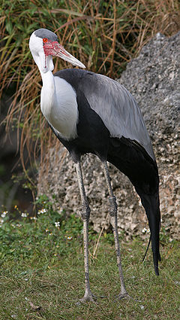
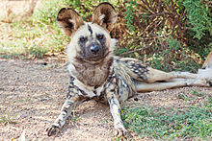
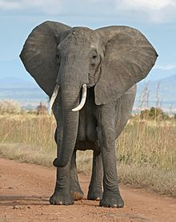
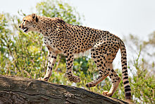
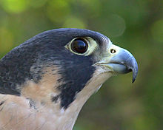
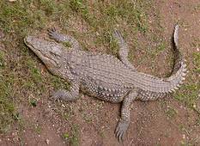
CHAPTER 4: THREATENED OR PROTECTED ECOSYSTEMS AND SPECIES
CHAPTER 4: IMPLEMENTATION UPDATE
The purpose of this Chapter is:
1. To provide for the protection of threatened or protected ecosystems to ensure maintenance of their ecological integrity
Listing of Ecosystems:
Critically endangered- undergone severe degradation &subject to an extremely high risk of irreversible transformation
Endangered- undergone degradation & not critically endangered
Vulnerable- High risk of undergoing significant degradation & not critically endangered or endangered
Protected- High conservation value
2. To provide for the protection of threatened or protected species to ensure their survival in the wild
Listing of Species:
Critically endangered- Extremely high risk of extinction in the wild in the immediate future
Endangered- High risk of extinction in the wild in the near future & not critically endangered
Vulnerable- Extreme high of extinction in the wild in the medium-term future & not critically endangered or endangered
Protected- High conservation value
To this effect the following tools were developed and published:
Threatened or protected species (TOPS) list and regulations published-February 2007
Norms and Standards for the management of elephants in South Africa-February 2008
Prohibition relating to domestic trade in rhino horn -February 2009
Norms and standards for the marking of rhinoceros and rhinoceros horn -July 2009
CITES regulations-March 2010
Prohibitions relating to cycads -May 2012
National list of ecosystems that are threatened and in need of protection-December 2012
Draft regulatory measures for the regulation of domestic trade in rhino horn-June 2020

Slide 9
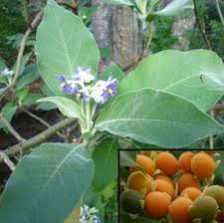
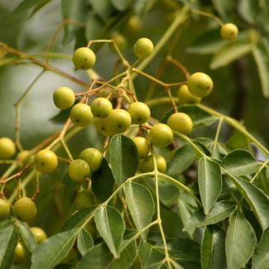
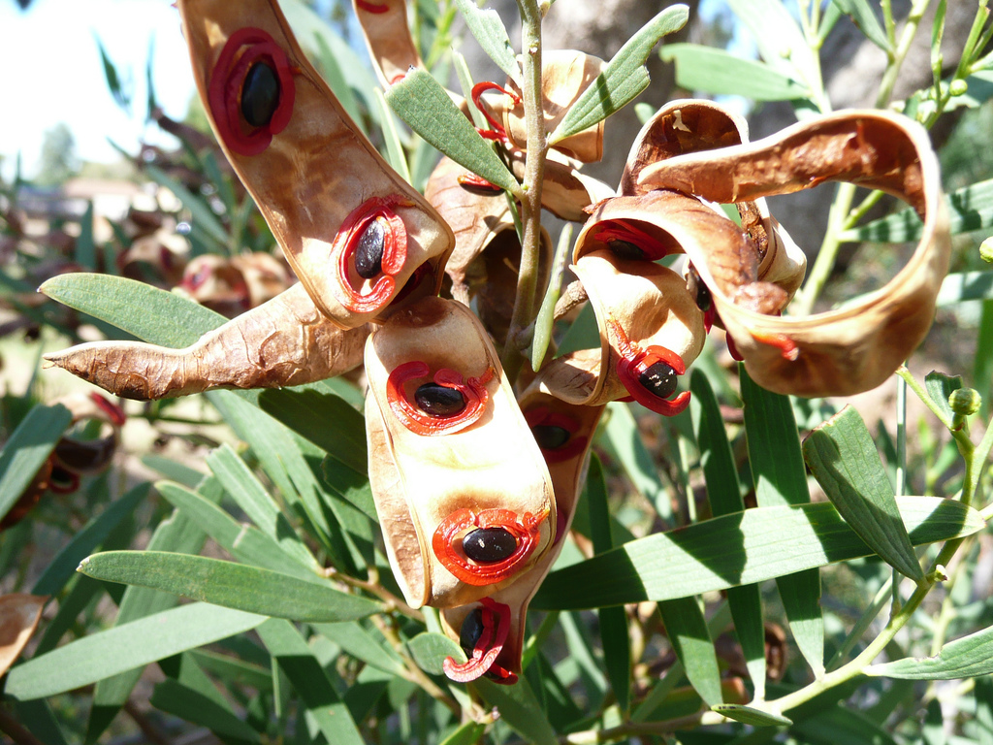
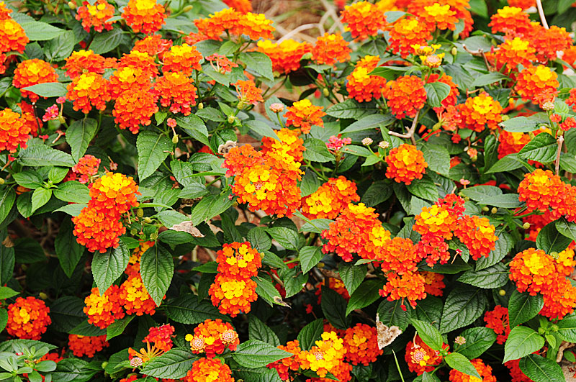
CHAPTER 5: SPECIES & ORGANISMS POSING POTENTIAL THREATS TO BIODIVERSITY
CHAPTER 5: IMPLEMENTATION UPDATE
The purpose of this Chapter is:
To prevent the unauthorized introduction and spread of alien species and invasive species to ecosystems and habitats where they do not naturally occur
To manage and control alien species and invasive species to prevent or minimize harm to the environment and to biodiversity
To ensure that environmental assessment for purposes of permits in terms of Genetically Modified Organisms Act, 1997 (Act No. 15 of 1997), are conducted in appropriate cases in accordance with Chapter 5 of the National Environmental Management Act
To this effect:
Alien and invasive species regulations published in 2014
SANBI AIS Monitoring programme to monitor and report on the status of all listed invasive species is established

Slide 10
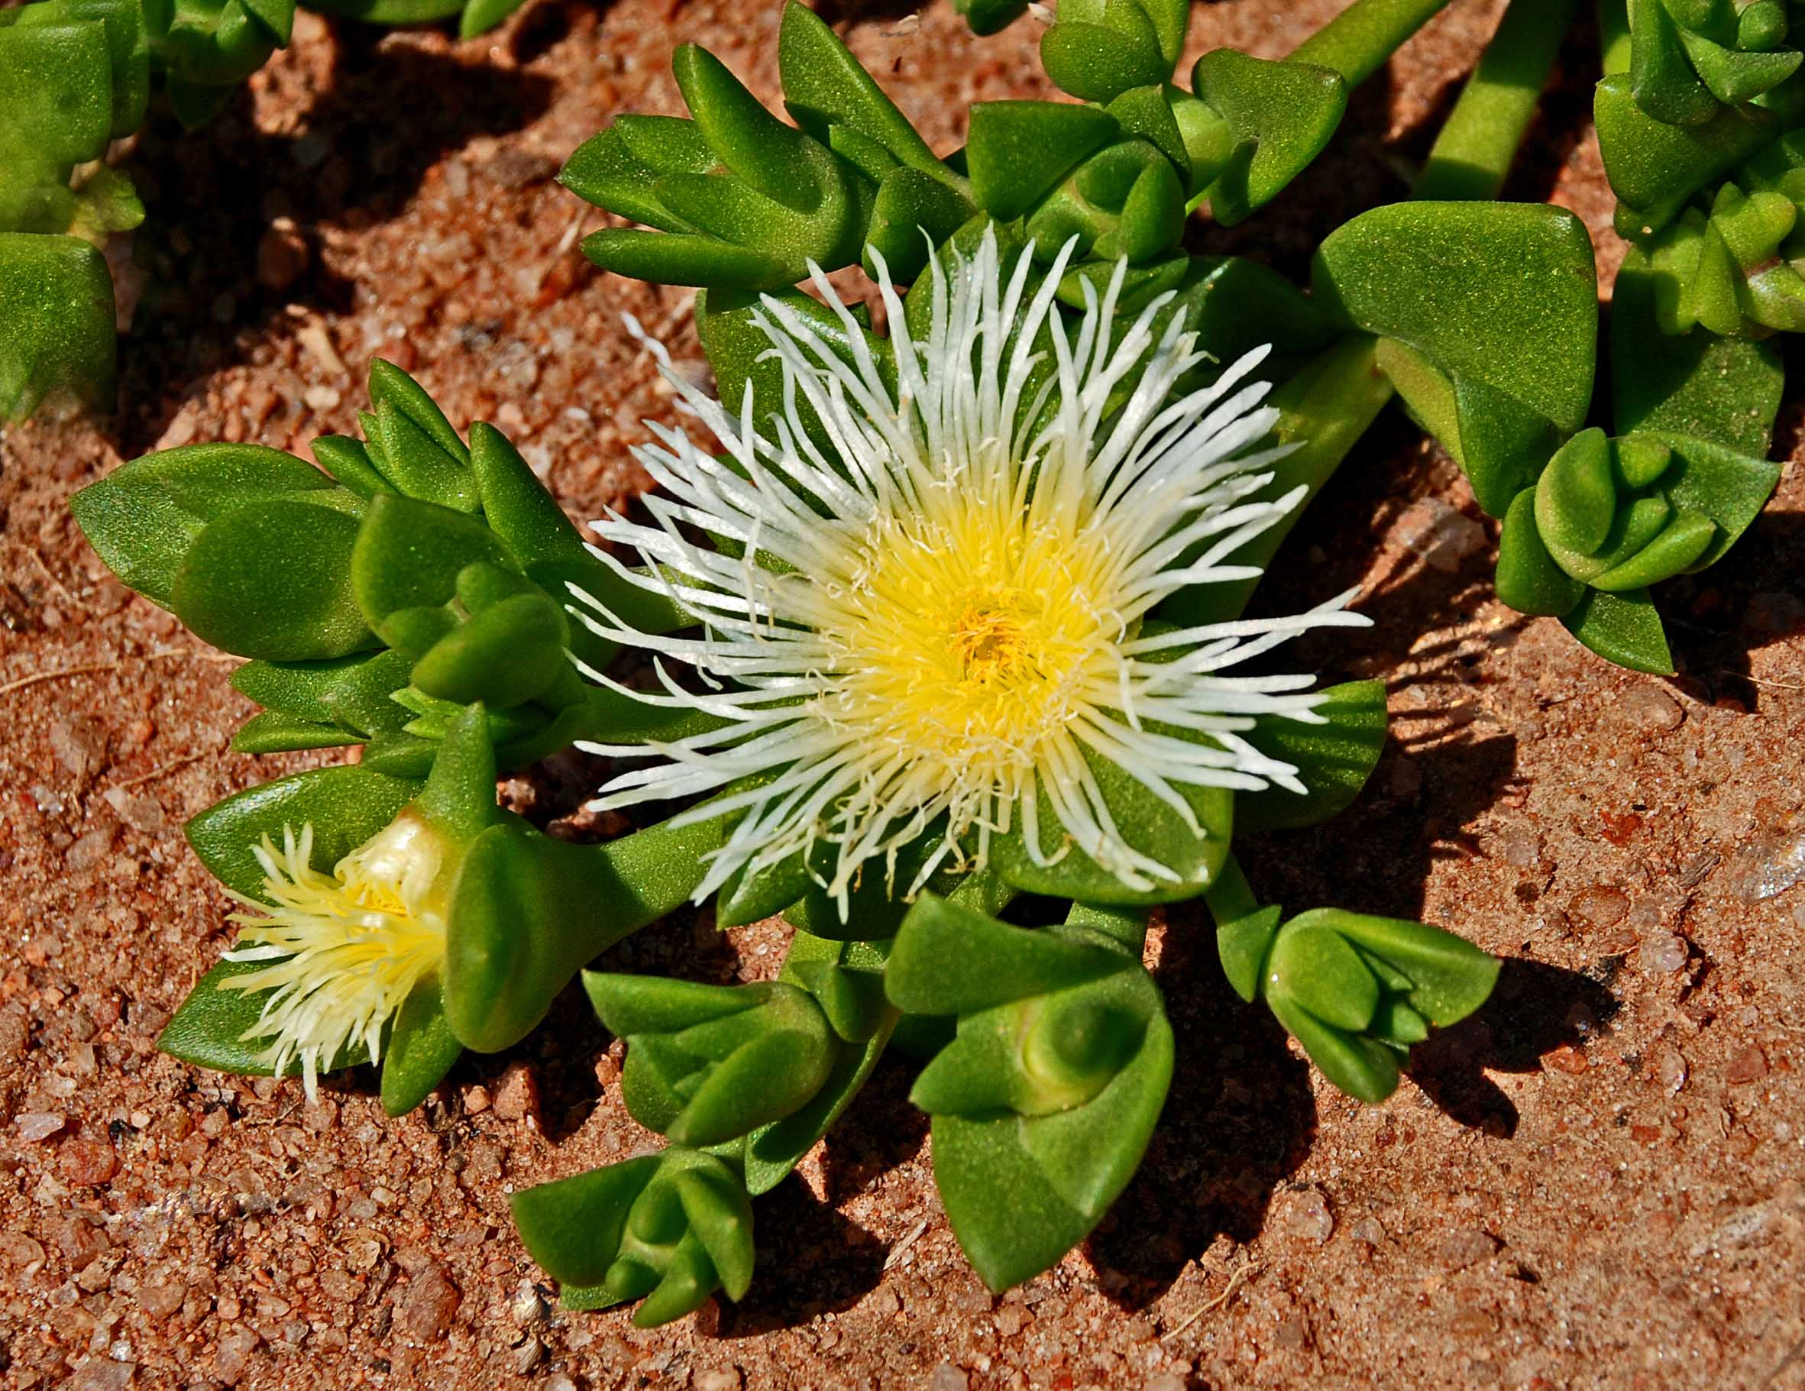
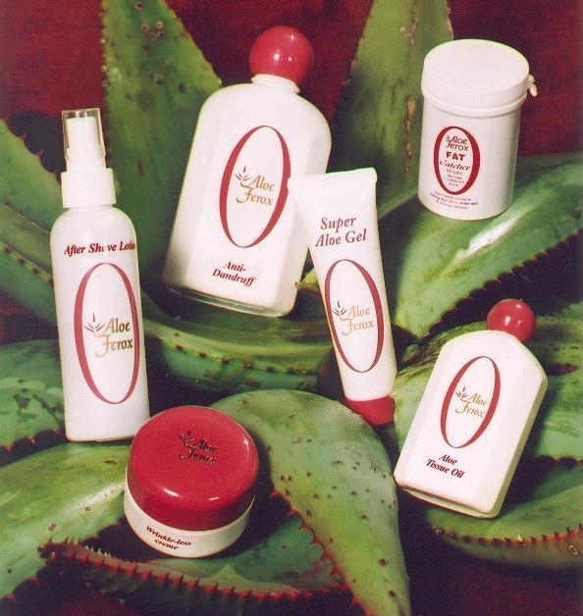
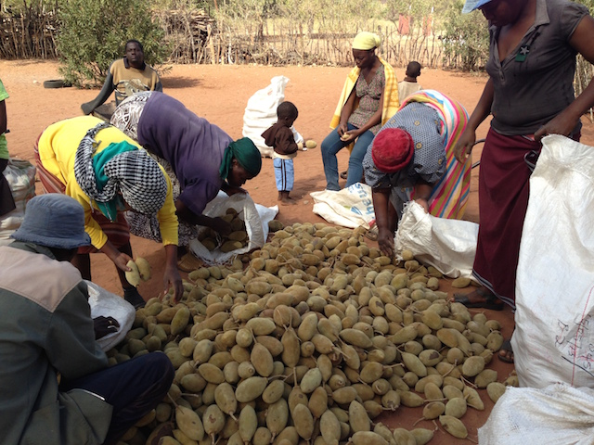
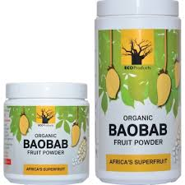
CHAPTER 6: BIOPROSPECTING ACCES AND BENEFIT SHARING
CHAPTER 6: IMPLEMENTATION UPDATE
The purpose of this Chapter is to :
Regulate bioprospecting involving indigenous biological resources
Regulate export from the Republic of indigenous biological resources for purposes of bioprospecting
Provide for a fair and equitable sharing of benefits arising from bioprospecting involving commercial utilization of indigenous biological resources and associated traditional knowledge
Ensure that the nation’s indigenous biological resources are developed and utilized in an ecologically sustainable manner while promoting social and economic development, in particular in the areas where the indigenous biological resources and associated traditional knowledge is accessed
To this effect the following tools were developed and published:
Regulations on Bioprospecting, Access and Benefit Sharing-2008
Establishment of the National Bioprospecting Advisory Committee in 2009
South Africa’s BABS Regulatory Framework: Guidelines for providers, users and regulators-2012
National Biodiversity Economy Strategy-2015
This Chapter seeks to :
To redress the injustice of the past in order to achieve socio-economic development goals ~ fair & equitable benefits sharing.
To provide regulatory framework for bioprospecting / biotrade activities ~ attain conservation and sustainable utilization of indigenous biological resources ~ Permitting System.
To provide obligatory requirements to the regulated sectors to recognize existing traditional knowledge on the usefulness of indigenous biological resources ~ Benefit Sharing Agreement.
To provide obligatory requirements to the regulated sectors to seek permission from the land owners to access/collect indigenous biological resources ~ Material Transfer Agreement and Benefit Sharing Agreement.
To implement international ABS regulatory obligations adopted by South Africa.

Slide 11
THANK YOU!
Mr Shonisani Munzhedzi
Branch Biodiversity and Conservation
Department of Environment, Forestry and Fisheries
Tel: 012 399 9171 | Mobile: 076 400 0637
Website: http://www.environment.gov.za
Address: The Environment House, 473 Steve Biko Road, Arcadia, Pretoria, 0083

