Slide 1
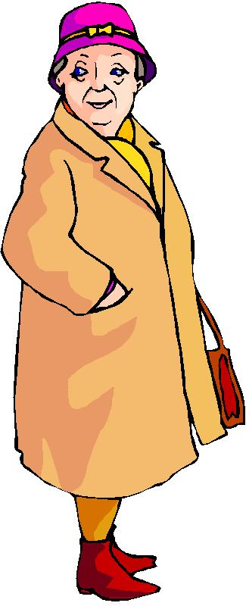
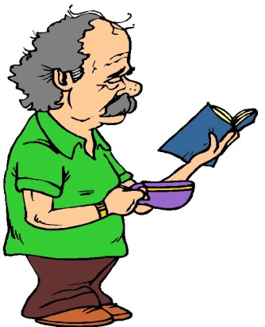
--Presentation--
Theme
Protection of the Vulnerable

Slide 2
“Every life matters, every life is precious…”
- Tedros Adhanom (Head of WHO)
The WCOPF would firstly like to extend our heartfelt condolences to all those who have lost family members and friends due to COVID-19.
We would also like to extend our gratitude to the first responders, essential employees, public health leaders, physicians and scientists who are continuing to work tirelessly to treat COVID-19 patients, protect vulnerable populations, and minimise the spread of
the virus

Slide 3
While COVID-19 is affecting everyone, vulnerable persons are disproportionately affected by it. The critical issue is the rights and wellbeing of the vulnerable.
Due to the nature of our work, our presentation will focus on the affects of COVID-19 on
OLDER PERSONS.
This pandemic is not going to leave us any time soon, therefore we must respect the wellbeing of older persons.

Slide 4
Older persons have come out of retirement in response to this virus. They are assisting in health facilities, running soup kitchens, in many instances, without any assistance from poverty alleviation organisations.
They deserve to be
respected and applauded!

Slide 5
THE CHALLENGES THAT OLDER PERSONS FACE
JOB LOSSES – Due to family members losing their jobs, more and more people are relying on SASSA beneficiaries to sustain them. Parents who relied on the children to supplement their SASSA grant, now have to assist their children
LONELINESS – Since there are no gatherings at churches or mosques, older persons are experiencing feelings of loneliness.

Slide 6
THE CHALLENGES THAT OLDER PERSONS FACE
SERVICE CENTRES CLOSED – In many cases this was the only interaction that older persons had with their peers. Older persons residing in Service Centre Facilities were already isolated two weeks before the national lockdown. Visitors are not allowed and they may not leave the facility.
Although their physical needs are seen to, the isolation is impacting on their emotional well-being.

Slide 7
THE CHALLENGES THAT OLDER PERSONS FACE
SAVINGS BECOME DEPLETED – Older persons who do have some money saved have to use it to sustain the family.
SAFETY AND SECURITY – Older persons are scared. No vaccine is available and fake news is contributing to the uncertainty.
FOOD SECURITY – Exclusion of SASSA beneficiaries as recipients of food parcels placed an even greater burden on the older persons who have become the only means of household income.

Slide 8
Engagements with a focus group of residential facility managers revealed the following
It should be noted that some facilities are managing better than others even though the managers interviewed are all from facilities who received financial support from the Department of Social Development.
The support / assistance from DSD is not sufficient. Although the residential facilities received R15000,00 from DSD for PPE, staff who tested positive for COVID-19 must be replaced and it becomes a challenge due
to lack of funds.

Slide 9
Engagements with a focus group of residential facility managers revealed the following
ISOLATION FACILITIES – Not all residential facilities have isolation facilities. And even those who manage to ensure that there are isolation facilities, do not have adequate staff to man them.
The staff is emotionally, physically and mentally distraught and it affects the well-being of the older persons.
Carers are trained to perform certain duties and when
older persons test positive it is expected of them
to do duties outside their job description
which is not fair.

Slide 10
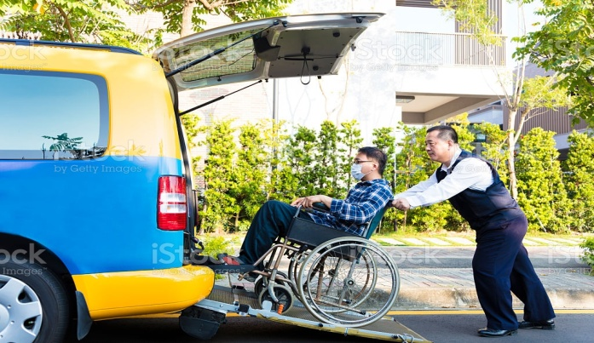
Engagements with a focus group of residential facility managers revealed the following
TRANSPORT – Some of the facilities have to pay for private transport of staff members to minimise the risk of infection.
PERSONAL PROTECTIVE EQUIPMENT (PPE) – Not all facilities received the PPE as was promised and had to buy their own. Residential facilities cannot operate as usual because of the lack of PPE. The residential facility is an extension of the Provincial Hospital and
should receive the necessary PPE.

Slide 11
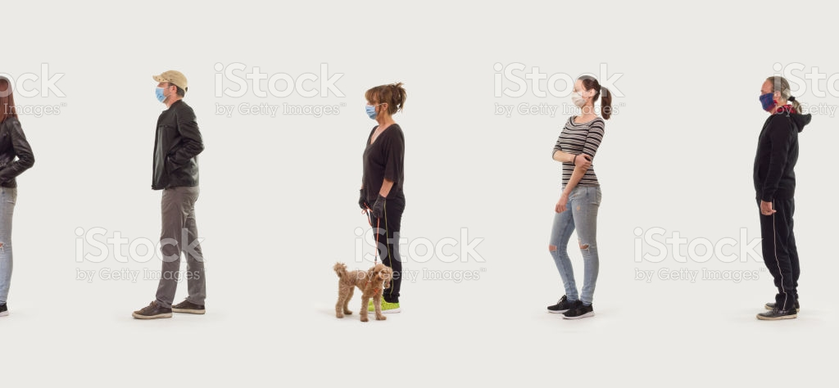
Engagements with a focus group of residential facility managers revealed the following
MENTAL ILL-HEALTH (Dementia) – Observations made by some of the managers who were interviewed indicated that dementia had accelerated due to social interaction being stopped .
COVID-19 LOCKDOWN REGULATIONS – There are those older persons who have no one to run their errands. They are compelled to leave the safety of their homes to go to the bank, the shop and the municipality. This is a big risk since people do not all abide to the lockdown regulations of social distancing, wearing masks, etc.
And these people get away with it!

Slide 12
WCOPF’s CONCERNS
1
We found that the re-evaluation of persons on Disability Grants could not take place due to staff shortages. This means that the burden (of households ) rest solely on the shoulders of older persons in whose care these people are often left while parents are working or occupied elsewhere. We recommend that DSD interact with Health to facilitate a process whereby we can overcome this obstacle

Slide 13
WCOPF’s CONCERNS
2
Also , people in receipt of social assistance do not qualify for Food Hampers, but it is precisely these responsible persons that keep the households going. It also seem that hampers do not always land at the most needed spots.

Slide 14
WCOPF’s CONCERNS
3
It is important to note that Older Persons, who are vulnerable, put themselves at risk to keep our communities stable out of a duty of care, although it is not their responsibility.

Slide 15
WCOPF’s PLAN OF ACTION
1
As soon as we became aware of the pandemic outbreak, the Chairperson of the WCOPF cancelled all scheduled meetings and advised all members to close Service Centres and cease all club activities until further notice.
He also asked Service Centres to donate all perishable food to soup kitchens or to under-privileged community
members to avoid wastage in case food went
bad.

Slide 16
WCOPF’s PLAN OF ACTION
2
Board Members in the various Regions started operating feeding schemes for older persons and children as well as unemployed community members. Some of the Board Members are currently still engaged in these activities (especially in the Cape Metropole)

Slide 17
WCOPF’s PLAN OF ACTION
3
The WCOPF Board of Directors are holding virtual meetings and is in the process of building the capacity of regional forum members to do likewise. WCOPF will support the Regional Forums with their virtual meetings as far as possible.

Slide 18
WCOPF’s PLAN OF ACTION
4
The WCOPF intends to actively seek funding in order to reproduce 1000 booklets of the COVID-19 Protocol Manual for distribution throughout the Western Cape (especially in the Rural Areas)!

Slide 19
WCOPF’s PLAN OF ACTION
5
Actively seek funding in order for 1000 hygiene packs / buckets consisting of the following items -
1 x 10 Litre White Bucket
2 X Cloth Mask
6 x Sunlight Soap Bar
2 x 750ml Bleach
1 x 100ml Sanitizer
A5 Information Pamphlet
The intention is to distribute these hygiene packs/buckets together with the Protocol Manual. Partners have already been identified and approached in this regard.

Slide 20
RECOMMENDATIONS
1. Training of all staff re: COVID-19
2. Make funding available for proper PPE
3. Counselling / Debriefing sessions for staff members
4. Regular information sessions to residents re: COVID-19
Home based carers who are at home due to the
lockdown could be utilised to assist in Residential Facilities in their areas.
6. Intersectoral collaboration will be the key to all challenges and beneficial to older persons.

Slide 21
CLOSING REMARKS
COVID-19 did not cause the challenges faced by Older Persons on a daily basis. However, COVID-19 has caught us unaware and unprepared. We should all learn from this and ensure that we are not “taken by surprise” ever again!
Taking Older Persons issues to heart become the new normal. We should encourage younger people to become more involved with older persons and, in so doing, bridge the generation gap.

Slide 22
D
A
N
K
I
E
E
N
K
O
S
I

