Slide 1
Annual Crime Situation
1 April 2019 to 31 March 2020
Secret

Slide 2
HIGHLIGHTS ON THE 4 BROADCATEGORIES MAKING UP THE 17 COMMUNITY-REPORTED SERIOUS CRIMES AND THE 4 CATEGORIES OF CRIMES DETECTED AS A RESULT OF POLICE ACTION
TEN-YEAR TREND
Secret
1
Notes:
-6 314
-43 030

Slide 3
17 COMMUNITY-REPORTED SERIOUS CRIMES: TREND OVER 10-YEAR PERIOD

Slide 4
CONTACT CRIMES: TREND OVER 10-YEAR PERIOD

Slide 5
OVERVIEW CRIMES AGAINST WOMEN AND CHILDREN:
CONTACT CRIME CATEGORIES COMPARISON
Crime category | 2015/2016 | 2016/2017 | 2017/2018 | 2018/2019 | 2019/2020 | Count diff | % change
Contact crimes ( crimes against women)
Murder | 2 780 | 2 639 | 2 930 | 2 771 | 2 695 | -76 | -2,7%
Sexual offences | 39 580 | 37 392 | 36 731 | 36 597 | 31 100 | -5 497 | -15,0%
Attempted murder | 3 325 | 3 328 | 3 554 | 3 445 | 3 214 | -231 | -6,7%
Assault GBH | 56 969 | 51 956 | 53 263 | 54 142 | 50 859 | -3 283 | -6,1%
Common assault | 84 091 | 78 090 | 81 142 | 82 728 | 83 202 | 474 | 0,6%
*Total contact crimes | 186 745 | 173 405 | 177 620 | 179 683 | 171 070 | -8 613 | -4,8%
Sexual offences
Rape | 33 467 | 31 370 | 30 981 | 30 626 | 25 801 | -4 825 | -15,8%
Sexual assault | 3 373 | 3 671 | 3 621 | 3 771 | 3 481 | -290 | -7,7%
Attempted rape | 2 090 | 1 643 | 1 614 | 1 712 | 1 382 | -330 | -19,3%
Contact sexual offences | 650 | 708 | 515 | 488 | 436 | -52 | -10,7%
Total Sexual Offences | 39 580 | 37 392 | 36 731 | 36 597 | 31 100 | -5 501 | -15,0%
Crime Category | 2015/2016 | 2016/2017 | 2017/2018 | 2018/2019 | 2019/2020 | Count Diff | % Change
CONTACT CRIMES ( crimes against children)
Murder | 1 019 | 839 | 985 | 1 014 | 943 | -71 | -7,0%
Sexual Offences | 26 514 | 24 677 | 23 488 | 24 387 | 22 070 | -2 317 | -9,5%
Attempted murder | 1 061 | 936 | 1 059 | 1 184 | 1 137 | -47 | -4,0%
Assault GBH | 8 772 | 7 589 | 7 562 | 7 815 | 7 506 | -309 | -4,0%
Common assault | 10 686 | 10 211 | 10 446 | 10 829 | 10 692 | -137 | -1,3%
Total Contact Crimes | 48 052 | 44 252 | 43 540 | 45 229 | 42 348 | -2 881 | -6,4%
Sexual Offences
Rape | 21 121 | 19 079 | 18 336 | 18 586 | 17 118 | -1 468 | -7,9%
Sexual Assault | 3 509 | 3 986 | 3 706 | 4 451 | 3 727 | -724 | -16,3%
Attempted rape | 716 | 590 | 662 | 562 | 586 | 24 | 4,3%
Contact sexual offences | 1 168 | 1 022 | 784 | 788 | 639 | -149 | -18,9%
Total Sexual Offences | 26 514 | 24 677 | 23 488 | 24 387 | 22 070 | -2 317 | -9,5%
N:B Figures of crimes against women and children in the table are inclusive of unfounded counts. These figures should regarded as preliminary as the verification through physical docket were not finalised due to Covid 19.

Slide 6




CAUSATIVE FACTORS : SOME CATEGORIES OF CONTACT CRIME
 | Common Assault | Assault GBH | Attempted Murders | Murders | Total
Causative Factors
Arguments/ Misunderstanding (not related to domestic) | 37 876 | 31 699 | 2 974 | 3 447 | 75 996
Domestic related | 21 344 | 14 907 | 923 | 1 482 | 38 656
Retaliation / Revenge | 3 126 | 2 674 | 526 | 782 | 7 108
Robbery (house/ Business/ Street) | 271 | 1 146 | 2 841 | 1 061 | 5 319
Vigilantism / Mob justice | 595 | 1 867 | 224 | 1 202 | 3 888
Gang-related | 40 | 97 | 1 248 | 905 | 2 290
Rape-related | 380 | 401 | 50 | 82 | 913
Bullying at School | 546 | 345 | 19 | 9 | 919
Prison Fight | 474 | 390 | 10 | 3 | 877
Taxi-related | 248 | 68 | 149 | 271 | 736
Self defence | 286 | 65 | 44 | 58 | 453
Factional Fighting | 115 | 203 | 19 | 43 | 380
Public / Service Delivery Protest | 230 | 63 | 51 | 9 | 353
Labour Related | 193 | 63 | 11 | 35 | 302
Witch Craft Related | 46 | 139 | 3 | 9 | 197
Illicit mining | 6 | 11 | 100 | 80 | 197
Muthi Related | 76 | 18 |  | 2 | 96
Antagonism towards Foreigners | 22 | 36 | 9 | 8 | 75
Politically Motivated | 19 | 12 | 8 | 21 | 60
Ethnic Conflict / Racism | 38 | 19 | 1 |  | 58
Secret
N:B Figures in the table are counts of cases where causative factors could be determined during the analysis. The unknowns or unmentioned due to circumstance of the crime are not included .

Slide 7
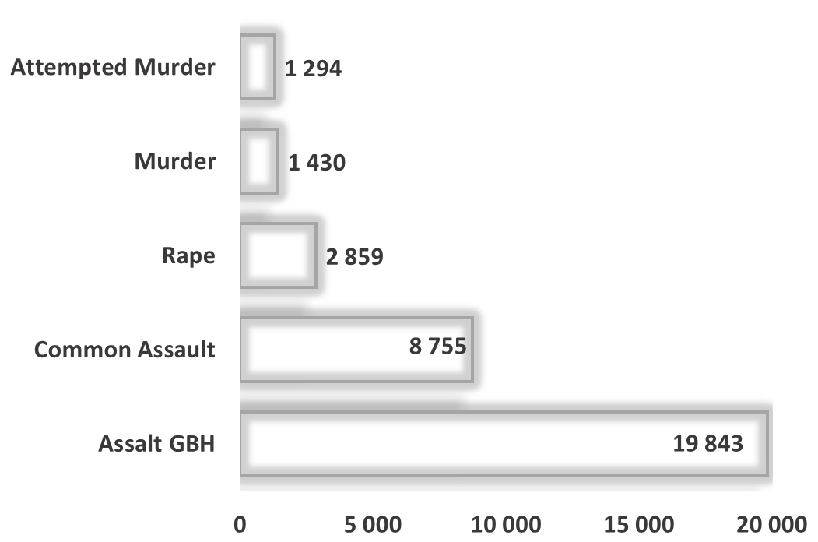


CONTACT CRIME : LIQUOR AND DRUG RELATED OFFENCES
94 273 cases of driving under the influence of alcohol and/or drugs were detected by police during the current financial year 2019/2020
Confirmed liquor cases attributing to counts of contact crimes
In the past ten years
759 904 cases
of driving under the influence of alcohol and/or drugs were detected.
170 510 cases were detected in 2019/2020 financial year
In the past ten years approximately
2 .3 Million cases
of drug related crime were detected.
Confirmed cases at Liquor outlets
Shebeen/ Tavern / Pub/ Night clubs/Bar | Rape | Common Assault | Assault GBH | Attempted Murders | Murders
 | 348 | 6 298 | 11 128 | 838 | 844
Secret

Slide 8

PLACE OF OCCURRENCE : SOME CATEGORIES OF CONTACT CRIME
Place of occurrence | Rape | Common Assault | Assault GBH | Attempted Murders | Murders
Residences of perpetrator/ victim (including residence known by victims/ perpetrator e.g. family/friends/ neighbours) | 18 231 | 33 933 | 29 751 | 4 754 | 5 522
Public place e.g. Street/Open field/ Recreational centre/ Park/ Beach / Parking area / Abandoned building | 7 940 | 25 438 | 30 272 | 7 735 | 9 714
Liquor outlets (Shebeen/ Tavern / Pub/ Night club / Bottle Store | 348 | 6 298 | 11 128 | 838 | 853
Business premises (e.g. Mall/ restaurants /work place / Office Park / Entertainment Centre e.g. Movie Theatre, Gambling Facility | 260 | 4 829 | 2 988 | 1 122 | 467
River / Lake / Pool / Dam | 70 | 3 943 | 126 | 13 | 88
Educational institutions (Schools, universities, college, Day Care Facilities) | 380 | 1 784 | 1 178 | 64 | 52
Agricultural Land e.g. Farm / Plot / Small Holding | 161 | 397 | 711 | 128 | 166
Bus Stop / Taxi Rank | 43 | 744 | 463 | 73 | 85
Mode of Transport e.g. Bus / Car / Plane / Boat / Ship / Taxi | 352 | 387 | 261 | 458 | 232
Petrol Station | 5 | 400 | 269 | 60 | 33
Railway Premises e.g. Track / Station | 76 | 317 | 125 | 45 | 73
Leisure premises e.g. Hotel / Guest house / BnB/ Motel / Holiday resort | 167 | 373 | 133 | 20 | 27
Government Premises / Building e.g. Home Affairs | 16 | 261 | 159 | 32 | 27
Mining Area | 18 | 18 | 36 | 87 | 60
Secret
N:B Figures in the table are counts of cases where place of occurrence could be determined during analysis. The unknowns or unmentioned due to circumstance of the crime are not included .

Slide 9
HIGHLIGHTS ON THE MURDER : TEN YEAR TREND
Secret

Slide 10
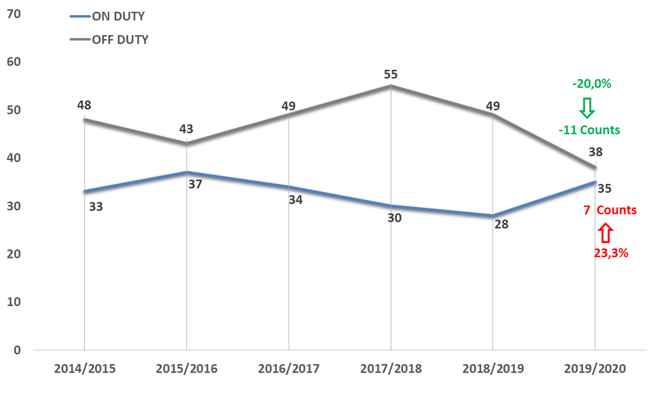
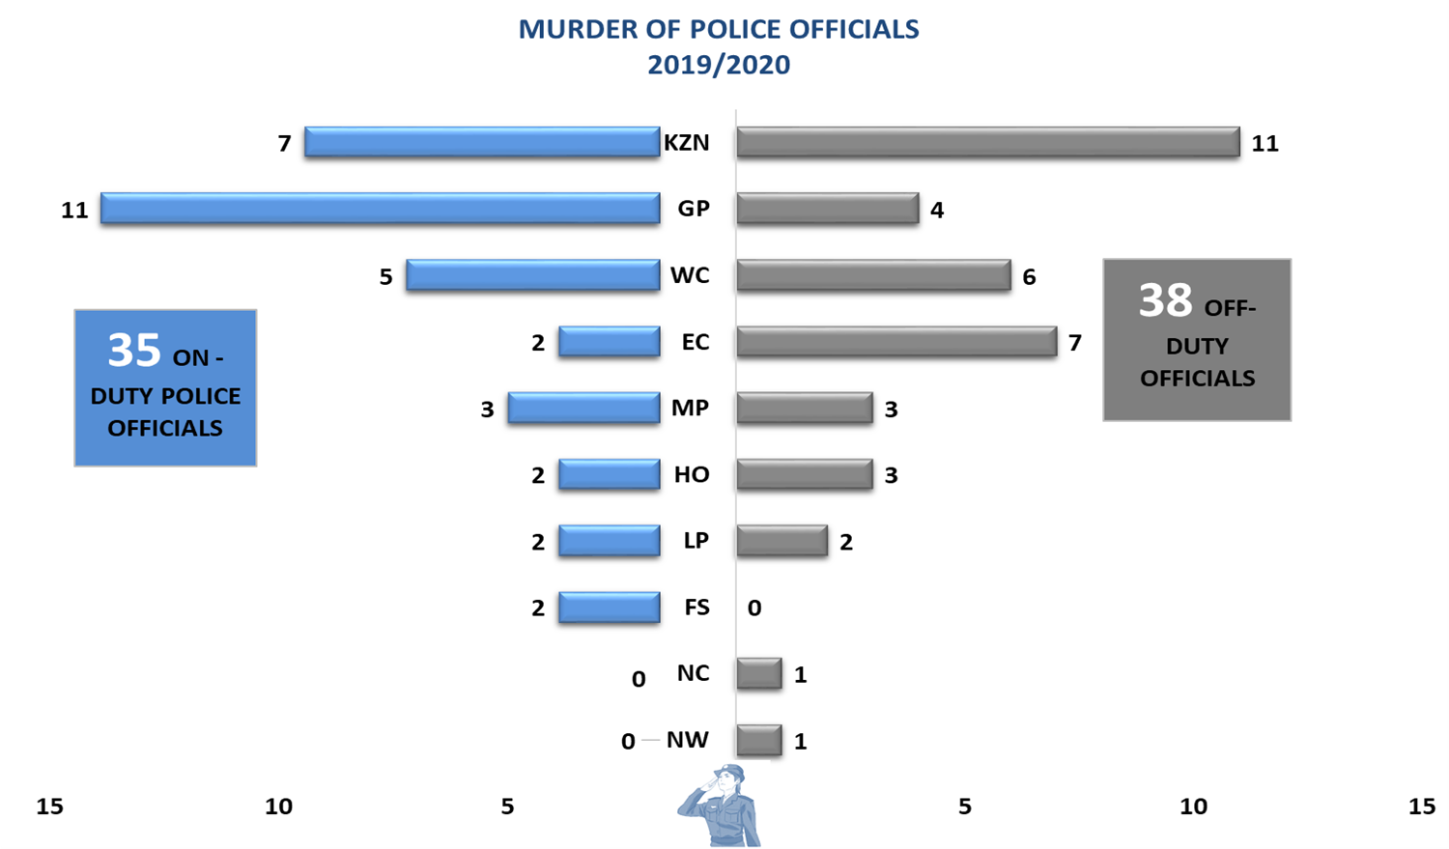
MURDER : POLICE OFFICIALS
Total 2019/2020 = 73

Slide 11
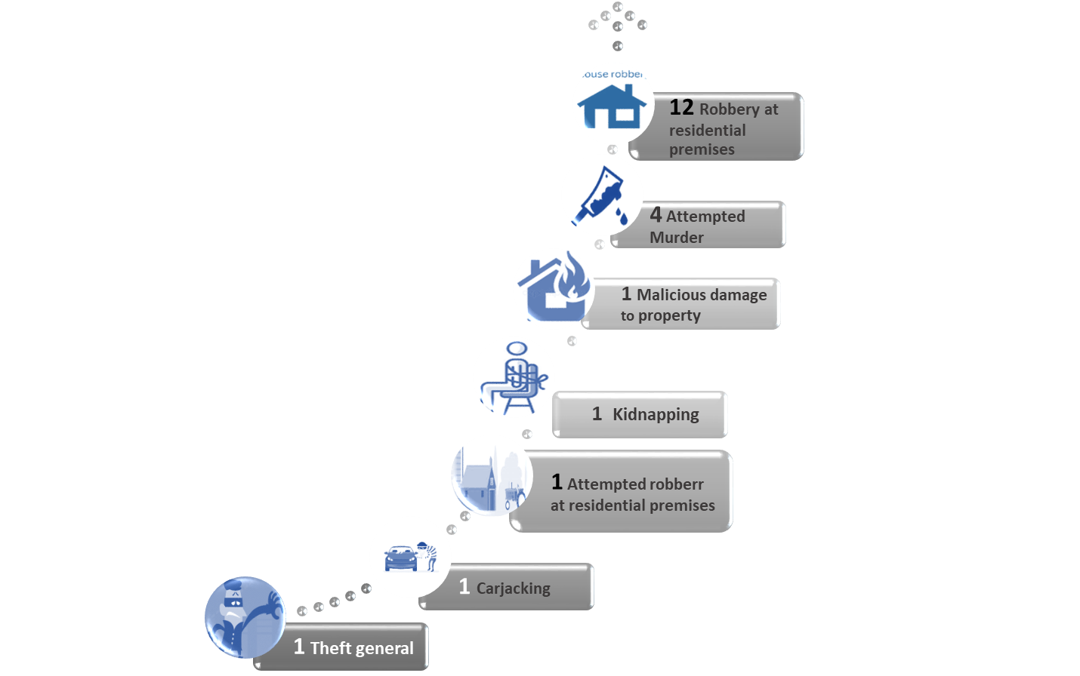
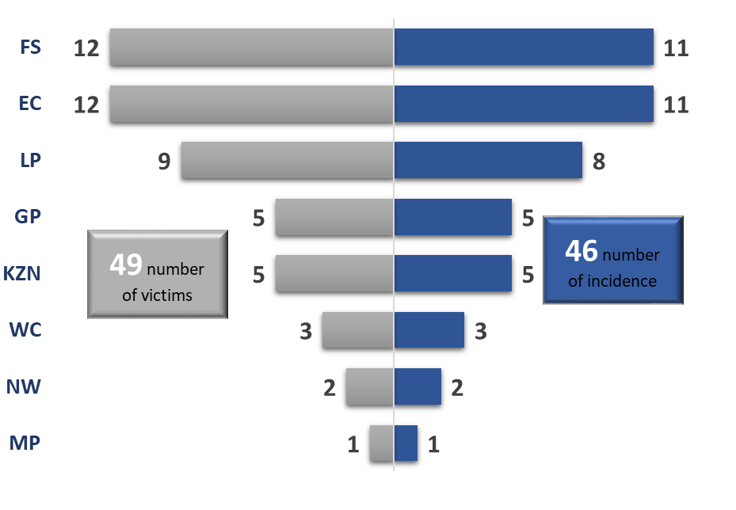
MURDER : VIOLENCE ON FARMS AND SMALL HOLDINGS
Other crimes that occurred during the commission of farm murders
Secret

Slide 12
HIGHLIGHTS ON THE TRIO CRIMES
Secret

Slide 13
HIGHLIGHTS ON STOCK-THEFT
Secret

Slide 14
THANK YOU

