Slide 1
PROGRESS REPORT ON TAFELKOP HOMELESS MAN RAISED BY THE PORTFOLIO COMMITTEE OF CO-OPERATIVE GOVERNANCE AND TRADITIONAL AFFAIRS
31 July 2020

Slide 2
BACKGROUND
The Portfolio Committee will recall that on the 14th of May 2020, the Committee raised a question of Mr Cele who appeared on SABC News with no proper housing.
An investigation was conducted to see how Mr Cele can be assisted.

Slide 3
Collaboration
The Mayor of eThekwini, Cllr Kaunda collaborated with ThembaNjilo Foundation by building a home for Mr Cele.
We also partnered with private sector to provide furniture and other basic household items such as bed linen.

Slide 4
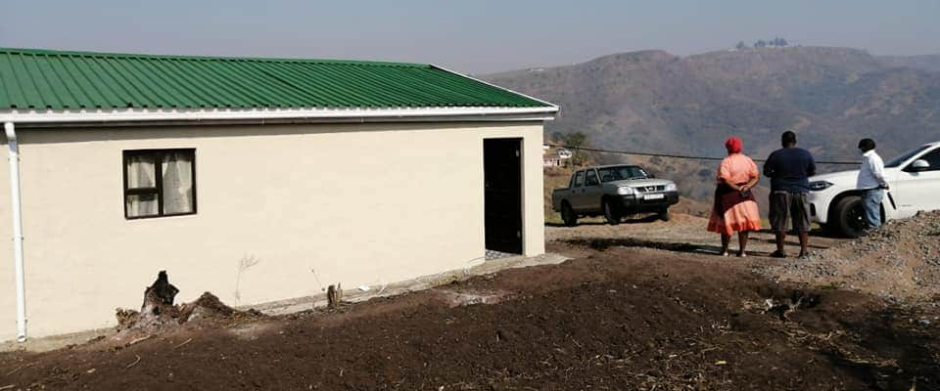
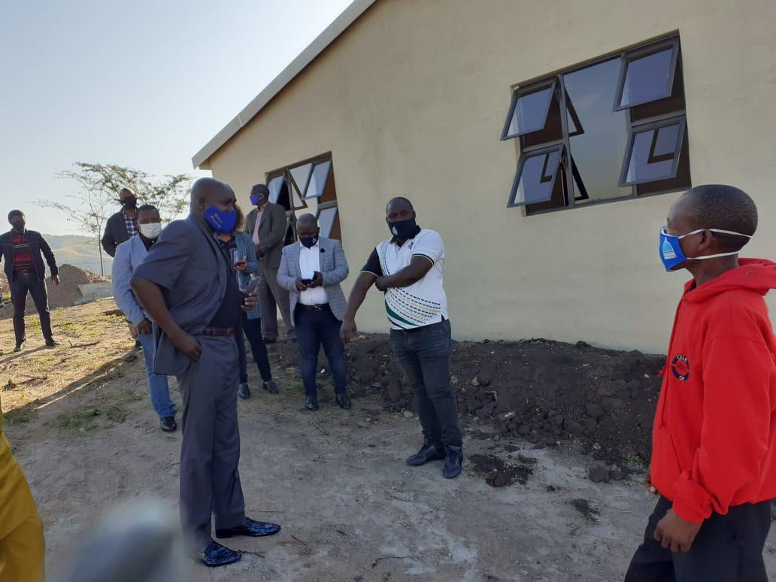
The House has been built

Slide 5
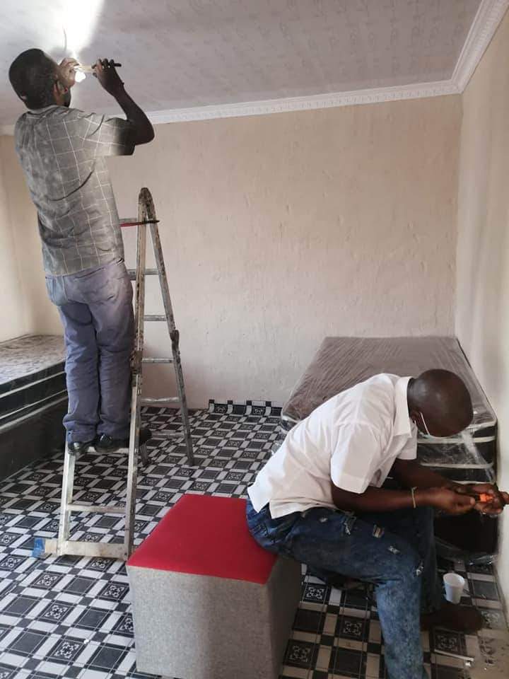
All Basic Services have been connected

Slide 6
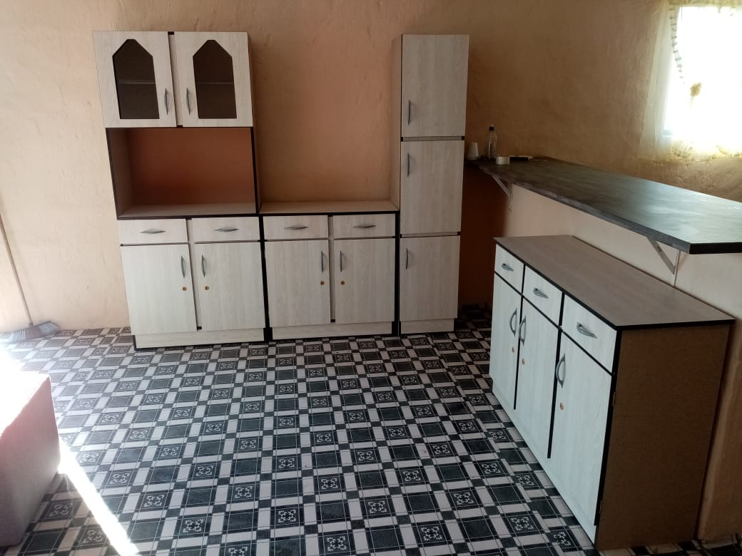
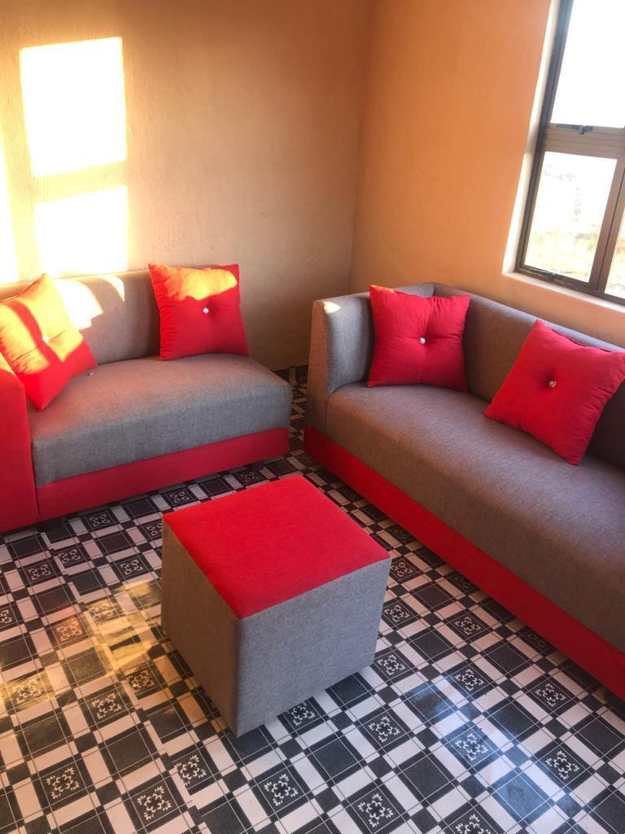
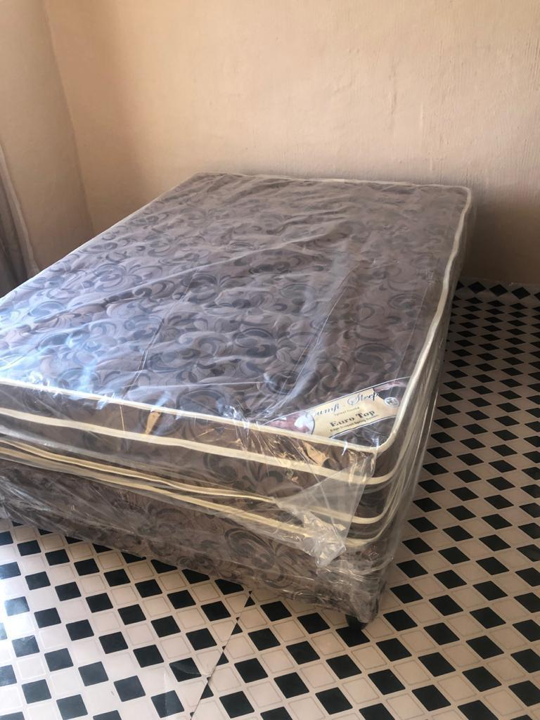
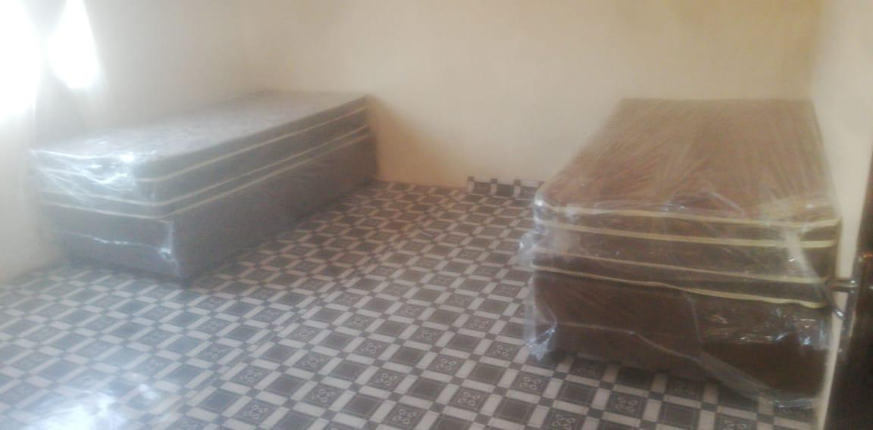
Furniture fitted

Slide 7
An Official Handover
There will be an official handover of the house to Mr Cele in two weeks.

Slide 8
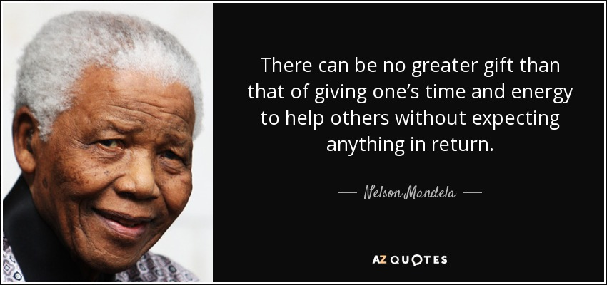
THE END

