Slide 1

JOINT PORTFOLIO COMMITTEE MEETING ON 2020/21WATER BOARD TARIFFS

Slide 2
Table of Content
Purpose of the presentation
Background
Reflection on the legislative process
Reflection of the 2020/21 tariffs
Water Provision costs
Approved tariffs and implications
Roadmap
Responses to PC questions of 2 June 2020
Way forward

Slide 3
Purpose of the Presentation
To present a joint reflect on the approved Water Board tariffs and process
To respond to the question raised during the Portfolio Committee dated 02 June 2020

Slide 4
OBJECTIVES OF THE PRESENTATION
  Underscore the importance of water during Covid19
  Highlight Tariff Legislative process and implications
    Section 42 of the MFMA
    Circular 23 of the MFMA
    Bulk Water Agreement
  Indicate Proposals to remedy the implications Tariff Analysis for the past 3 years
  Propose Short – Medium and Long Term Solutions
  5. Joint PC to consider suggested Recommendations
  6. Give clarity on questions raised by members

Slide 5
Background
Water Boards are Schedule 3A entities of PFMA, they are supposed to be self sustainable
In their operation, water boards must strive to be financially viable in terms of section 34 of the Water Services Act.
The tariffs are cost reflective, and based on prudent budget process
The tariff process was concluded on 13 March 2020 as per Sec 42 MFMA and circular 23, whereas the state of disaster (due to Covid 19) was declared on the 26th March 2020.
The impact of Covid 19 on the economy is acknowledged and the Department is considering options on how to factor it in future tariff processes

Slide 6
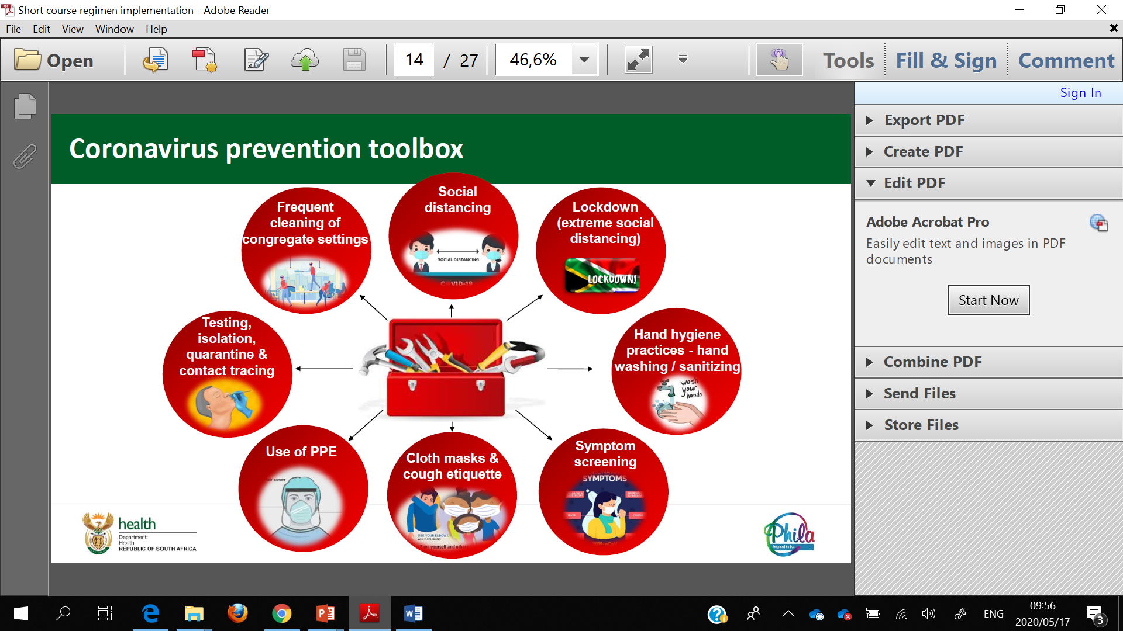
Covid 19 Implications for the Water Sector
The water sector is facing unchartered challenges due to this pandemic and the response requires a collective approach
Macroeconomic Projection - the South African economy is likely to go into further recession as a result of the coronavirus; current forecast are at economic contraction of 6.6% due to the pandemic (NT: Source). Local governments will be affected by customers struggling to pay property rates and service charges as unemployment continues to rise.
Lockdown Impact - a temporary disruption to revenue collections is expected across all municipalities – with local governments not operating at full capacity during the lockdown – weighing on their liquidity profiles
Lower collection rates will lead to a rise in bad debts provision, and thus a decline in municipalities' operating balances over the next 1-2 fiscal years.

Slide 7
Covid 19 Implications for the Water Sector (2)
Decline in municipalities operating balances have the same or more impact on the water boards.
The whole of government has had to reprioritise and revise its objectives and projections. Water boards are integral to the water value chain and the curbing of the COVID19 epidemic.
A collective effort will continuously be sought to ensure that both water boards and municipalities remain sustainable within the Covid-19 constraints. and beyond.

Slide 8
RESPONSE TO COVID 19 – BY WATER THE WATER SECTOR
Total of 548 ML of water delivered from 28 March 2020 to 7 June 2020. The growth from last week is 70 ML.
Growing need for water is clear implying greater demand which justifies the need to increase the supply of bulk water.

Slide 9
Reflection on the legislative process governing the tariff process and the approvals
The MFMA and Circular 23 provides for the legislative process governing the tariff consultation process and the approvals thereof.
The Act requires national or provincial organs of state to make submissions to their executive authorities in terms of PFMA for any intention to amend the tariffs.
This procedure applies where the organ of state supplies bulk resource to municipalities for purposes of a municipal service.
The water boards have requested for comments from SALGA and Treasury in terms of MFMA s42(2) within 40 days in the meaning of the MFMA.
SALGA and National Treasury made comments and engaged with water boards to have the comments sufficiently responded to.
In case any comment is not accepted, a water board must justify why the comment is not accepted.
The current framework does not have a provision for a deadlock breaking mechanism in the event there is disagreement exist between a water board and SALGA or NT or both on the basis of the comments.

Slide 10
Reflection on the legislative process governing the tariff process and the approvals (2)
  In terms of MFMA s42(3)(d), the water board must on making a submission to the executive authority explain how the SALGA & NT comments have been taken into account
  The tariffs are approved once in a year (MFMA s42(5)) for it to apply on that same year if tabled on or before 15 March, any failure to table on the stipulated time will defer the implementation of the tariff to the following year.
  The Executive Authority to water boards as per s28 of the Water Services Act has made a determination and tabled the 2020/21 bulk water tariffs in Parliament on 13 March 2020. The Minister of Human Settlements, Water and Sanitation has complied with s42(4) of the MFMA in tabling the tariff to take effect by 1 July 2020
  The legislative framework further does not spell out any further Parliamentary processes after tabling on or before the 15th of March each year. But to communicate the approved tariffs to Municipalities.

Slide 11
CONSULTATION PROCESS
PROCESS ACTION | DATE | BY WHOM | COMPLIANCE | RESPONSE
Consultation with Municipalities Circular 23 of the MFMA | Oct- Nov | Water Boards |  | None attendance by some municipalities
Consult with SALGA Section 42 of the MFMA | No later than 1 Dec | Water Boards |  | Some compliance – lack of compliance in terms of section 42 (3) (d)
Written Comments to Water Boards | 25 Jan | SALGA |  | Compliant
Lodge pricing amendments with Parliament | Feb – March | DWS |  | Compliant
Parliament “approval” and bulk provider notifies Municipalities of price increase | 15 March | DWS |  | Compliant
Municipalities table draft budgets before Council | No later than 31 March | Municipalities |  | Compliant

Slide 12
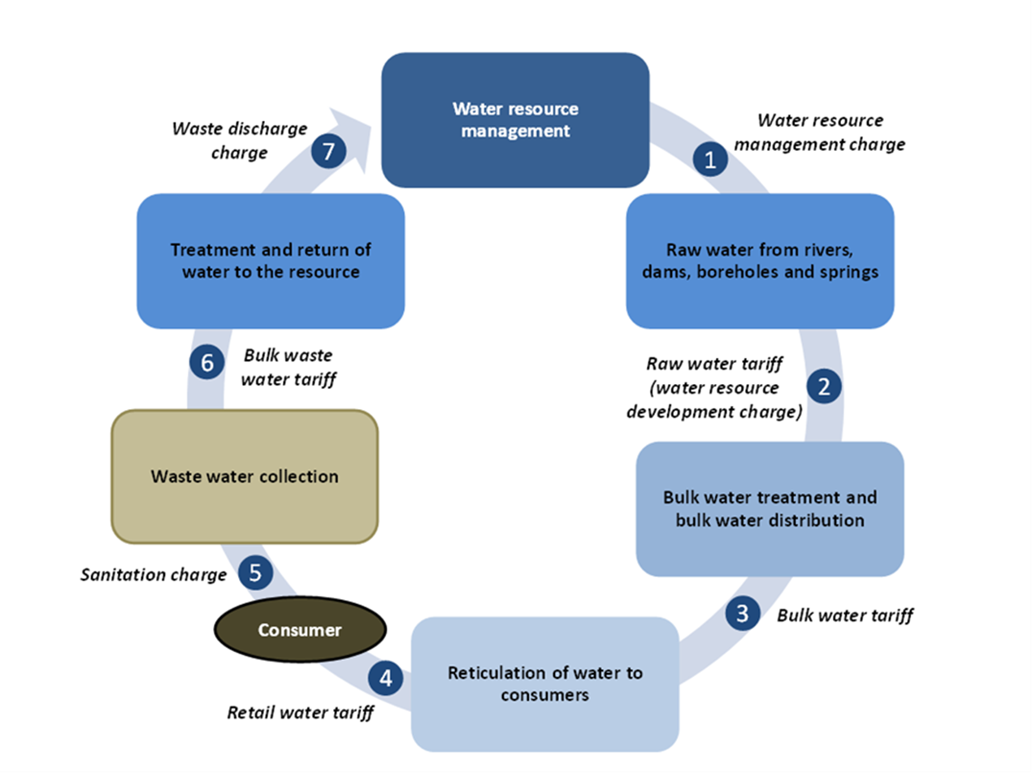
Tariffs in the water value chain

Slide 13
CONTEXT: Institutional Delivery and Tariff Approval in the water value chain
DEPARTMENT HUMAN SETTLEMENTS, WATER AND SANITATION
1st Tier
National security of supply
Mandated by National Water Act 38 of 1998
Tariffs determined through: Pricing Strategy
Approver: Minister
Tariffs to be tabled in Parliament in terms of section 42 MFMA
2nd Tier
Regional supply to WSA’s (municipalities)
Mandated by the Water Services Act 108 of 1997
Tariff: Norms and Standards
Approver: Board and Minister
BULK PROVIDERS
(Water Boards)
3rd Tier
Local service delivery and customer management
Mandated by the Constitution, Water Services Act, Municipal Systems Act and Municipal Structures Act
Tariff: Norms and Standards
Approver: Council
MUNICIPALITIES
(Water Services Authorities)
13
Post -Tabling of bulk tariffs, Parliament’s role is not clearly defined in the legislative & policy framework in relation to approval of bulk raw, bulk potable nor retail/municipal tariffs

Slide 14
Summary of Tariff Increases (Figures Based on Water Board proposals 2020/21)
PROVINCE | MUNICIPALITY | AVERAGE % TARIFF INCREASE | AVERAGE TARIFF INCREASE (R) | MINISTER/PARLIAMENT | SALGA VERDICT
EC | Amatola | 8,28% | 0.72
FS | Bloem | 9% | 0.70
LP | Lepelle | 8.5% | 0.74
NW | Magalies | 9% | 0.71
KZN | Mhlathuze | 7.18% - 9.37% | 0.45
WC | Overberg | 8% | 0.95
GP | Rand | 6.6% | 0.67
NW | Sedibeng | 7.5% | 1.17
KZN | Umgeni | 9.6% | 0.69
Legend: Green: Supported/Approved
Red: Not Supported

Slide 15
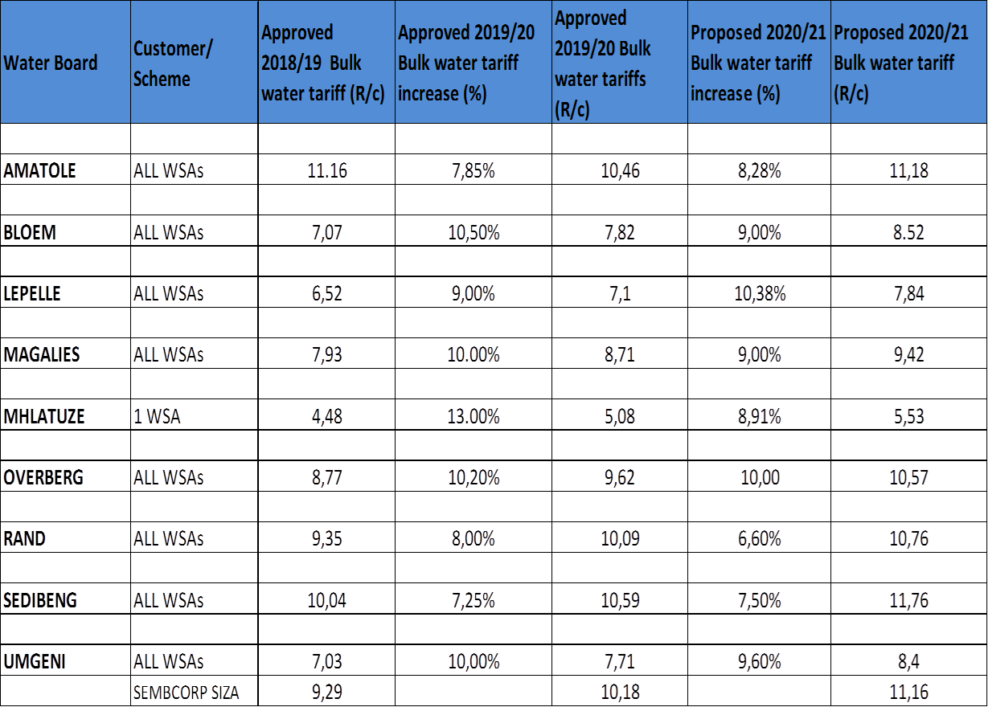
Water Board Tariff Increases

Slide 16
Timeline of the Water Value Chain
In conclusion, only water boards are impacted by a tariff revision.
The additional burden on water boards will cause significantly higher tariffs in the coming financial years
It will lead to the postponement of crucial capital expenditure programmes
This will place further burden on the ability of water boards to supply water.
1st April 2020
1st July 2020
1st April 2021
1st July 2021
DWA / TCTA Raw Water
Water Boards Tariffs
Eskom
Local Municipality Tariffs
1st April 2020
These costs were already implemented from 1st April 2020.
Water Boards are already being billed on these new costs.
They constitute between 15% to 50% of the total costs faced by water boards.
In addition, Eskom and NERSA are still debating over further energy tariff increments arising from 2018 – 19 Eskom recovery.
1st July 2020
Local municipalities have already tabled their tariffs to their councils. These will be implemented on 1st July 2020; after comprehensive consultation with their customers.
As local government, their tariffs are reviewed by local government and letters sent to customers.
Therefore, even if water boards revise their tariffs, these benefits are unlikely not benefit households.
In fact, this will create a bigger difference between the reduced tariff for Water Boards and local municipality tariffs that will remain unchanged.

Slide 17
Water Provision Costs
Throughout the water value chain water - Entities generally incur costs from the same cost factors;
Raw Water, Electricity, Labour; Depreciation and Chemicals are the 5 major cost factors ranked from highest to lowest in the water board space
Raw Water, Electricity & Labour, are mostly increasing by rates above inflation and are beyond the control of the Water boards
Raw Water purchases are demand driven and the natural resource that is to be transformed.
  Inaccurate demand forecasting has cost implications.
  The condition of infrastructure from the point where water leaves the purification plant also determine the amount of water loss that will be incurred regardless of whose infrastructure it is. These increases cost for water boards, though they are revenue losses for municipalities.
Not all water boards source Electricity solely from Eskom. Other sources are municipalities and intermediaries – who’s charges are far higher than Eskom. Water boards do balances out the over projections in the following year’s proposal.
Labour’s salary increases are determined in the bargaining councils through agreements between the organised labour and the industry. Default in the implementation is a high risk for the delivery of water.

Slide 18
Water Provision Costs (2)
  Chemicals are mostly imported from international markets directly or indirectly through a local supplier, the local price is highly influenced by the Exchange Rates that are always fluctuating.
  Depreciation depends on the amount and condition of the infrastructure that the water board operates,
  Over the past 3 years, the above cost factors increased by above inflation rates
  These costs together constitute almost 60% of the total costs of water boards.
  Though the pricing might be aimed at cost recovery and cost recovery tariffs are charged all the time, without sufficient revenue collection the objective is defeated.
  Water boards are sitting with debtors more than 300 days making billions of Rands; with almost all 9 water boards being owed something by municipalities for various reasons.
  Water boards with huge amounts of debts owed are unable to raise loans in the financial markets,

Slide 19
Water Provision Costs (3)
The applications for increasing borrowing limits in the environment dominated by debt will liquidate the entities and National Treasury is careful under the current economic conditions. (Negative economic growth and downgrading facing the country)
Water boards include in their costs debt impairments, however it does not help where customers are not paying.
With Covid-19 the expectation is the increase in the debt amidst the effort of government at Inter Ministerial levels.

Slide 20
Top 5 WATER BOARDS cost factors from 2017/18-21

Slide 21
Top 5 WATER BOARDS cost factors from 2017/18-21

Slide 22
Approved tariffs and Implications (1)
PROCESS
The 2020/21 bulk water tariff process commenced in October 2019 and concluded on 13 March 2020 with the tabling of the tariffs in Parliament.
Stakeholders as required by the legislation were consulted within their specifically defined timeframes except Mangaung and Mantsopa municipalities which could not be available for the consultations with Bloem Water.
Sufficient and critical comments were made with a requirement that the comments must not only be responded to but appropriately addressed in the refining of the tariff proposal prior the Minister’s determination. Water boards are expected to finally explain how they took the comments into account in the tariff amendment and demonstrate such to the National Treasury; SALGA & the affected municipalities.
The Economic and Social Regulation within DWS conducted an independent analysis analyses which resulted in required adjustments of proposed tariffs in view of the findings and comments made. (Mhlathuze; Lepelle & Magalies had adjustments made e.g in their drought tariff & some projections; Rand Water stepped drought tariff was not considered in the final determination , Magalies was instructed to revise the model they are using towards uniform tariffs)
Some findings are the same amongst NT; SALGA & DWS and it is in the best interests of the sector to have then appropriately addressed. E.g: The factoring of the proceeds from projections of the previous cycle are done. The challenge is how the information is presented.

Slide 23
Approved tariffs and Implications (2)
PROCESS
During consultations all the stakeholders have a right to either commend or object anything in terms of their findings in the tariff proposals in the interest of fairness; sustainability & affordability of the services to the consumers.
The water boards that receives the comments have an obligation to consider the comments such that the objections are also addressed.
SALGA and NT makes comments all the time on each proposal and water boards responds to the comments. Only the sufficiency of the response is questionable.
As far as possible, given the timeframe DWS will pursue the appropriate comments. On satisfactory resolution thereof, the proposals are recommended for approval.

Slide 24
Approved tariffs and Implications (3)
SALGA consolidated comments:
SALGA normally submits consolidated comments where they state whether they support or don’t support the tariffs proposed. These generally come through a bit too late in the process whereas the individual comments are the ones to which water boards respond.
DWS normally consolidates all substantive comments that were not addressed before the tariffs are approved (including SALGA comments). Then addresses these through the feedback sessions with water boards in preparation for the next tariff cycle.
There is a sign of progress in the manner in which tariff processes are handled. The improvements may not yet be where the stakeholders want them to be; but there is significant progress.

Slide 25
DEVELOPED 3 SCENARIOS TAKING INTO ACCOUNT
THE FOLLOWING 5 ELEMENTS (1)
Constitutional Rights
  Everyone has rights to access to sufficient water and therefore access may not be denied.
2 Legislative Regime
  The tariff regime is completely legislated with its processes and timelines (MFMA; Water Services Act; Norms and standards for tariffs & MFMA Circular 23)
  Water Boards 2020/21Tariffs were approved and tabled in Parliament by the Executive Authority (Minister) on 13 March 2020
  The Water Boards process was completed prior the declaration of the Covid-19 disaster though implementation takes place in the middle of the disaster.
  Municipal 2020/21 draft budgets were considered in May and Final budgets to be passed by end June
  Both Municipal and Water Boards Approved tariffs will be effected on 1 July 2020

Slide 26
DEVELOPED 3 SCENARIOS TAKING INTO ACCOUNT
THE FOLLOWING 5 ELEMENTS (2)
3 Financial Factors
  Due to COVID-19 there is under recovery of revenue due to the impact of the pandemic on all sectors of the economy.
  Increase in water demand to appropriately respond to COVID-19 directives puts more pressure on municipal budgets in the absence of sufficient funding and any relevant support.
  Under the COVID-19 environment service providers are financially strained due to the stress in the economic activities and the forecasted economic performance.
Operationally Factors
  Developed 3 Options to mitigate the risks
5 Implications
  Implications of different scenarios

Slide 27
IMPLICATIONS
(Scenario 1 – Implementing Approved Tariffs )
No. | FACTOR | CONSUMER | MUNICIPALITIES | WATER BOARD | DEPARTMENT
1 | Financial | Affordability will be an issue given the state of the economy and potential increase in unemployment | Increase in non-payment given the current circumstances and observed payment levels | Increase in non-payment given the current circumstances and observed payment levels Increased debtor days and debtor’s book | Increase in non payment given the current circumstances and observed payment levels
2 | Operational | High consumption levels | Sustaining the Infrastructure Increase in non revenue water | Sustaining the Infrastructure Meeting the annual demand as planned, | Sustaining the Infrastructure
3 | Legal | Relaxed credit control under the circumstances | Relaxed credit control measures under the circumstances | Relaxed credit control measures under the circumstances | Relaxed credit control measures under the circumstances

Slide 28
IMPLICATIONS
(Scenario 1 – Implementing Approved Tariffs )
Overall Implications for the sector
  Escalating Debt levels due to non payment across the value chain
  Enforcement of credit control might lead to protests at municipal levels
  Covid-19 relief necessary to mitigate for loss of income by consumers
Proposed Intervention
  Campaign to maintain current water consumptions levels
  Consider introducing Incentive to good paying and water usage customers

Slide 29
IMPLICATIONS
(Scenario 2 – No tariff Increase across the value chain)
No. | FACTOR | CONSUMER | MUNICIPALITIES | WATER BOARD | DEPARTMENT
1 | Financial | Relief to customers | Loss of Revenue | Loss of Revenue | Loss of Revenue
2 | Operational | Increase in consumption | Sustaining the Infrastructure | Sustaining the Infrastructure Postpone urgent projects | Sustaining the Infrastructure
3 | Legal | No credit control | Only at mid term budget adjustments | Section 42 (5) we need interpretation | Non compliant with the pricing strategy

Slide 30
IMPLICATIONS
(Scenario 2 – No tariff Increase across the value chain)
Overall Implications for the sector
  1st tier is already implementing a new tariff since April while 2nd tier’s tariffs are already approved
  Loss of revenue for the year under review
  Huge increases in the 2021/2022
  Risk providing reliable services
Proposed Intervention
  Quantifying Revenue loss
  Approach Solidarity Fund for relief
  Approach the National Corona Command Council

Slide 31
IMPLICATIONS
(Scenario 3 – Revised Tariff Review )
No. | FACTOR | CONSUMER | MUNICIPALITIES | WATER BOARD | DEPARTMENT
1 | Financially | Some relief to customers Payment might increase | Loss of Revenue | Loss of Revenue | Loss of Revenue
2 | Operationally | High consumption levels | Sustaining the Infrastructure Increase in non revenue water | Sustaining the Infrastructure | Sustaining the Infrastructure
3 | Legally | Relaxed credit control under the circumstances | Relaxed credit control measures under the circumstances | Relaxed credit control measures under the circumstances | Relaxed credit control measures under the circumstances

Slide 32
IMPLICATIONS
(Scenario 3 – Revised Tariff Review )
Overall Implications for the sector
  Partial Loss of revenue
  “Huge” Increases in the 2021/22 Financial
  Interruption in services
Proposed Intervention
  Quantify revenue loss
  Approach Solidarity Fund for relief
  Approach the National Corona Command Council to fund the balance

Slide 33
SUMMARY OF THE 3 SCENARIOS
The Sector to weight all scenarios given the current circumstances departing from the default position represented by scenario 1 but where alternative funding is possible.
All the scenarios have revenue implications and require funding support especially during the covid-19 periods to minimize the accumulation of debt in an already debt laden sector
water boards already have their capital and maintenance projects plans concluded for the year which led to scenario 1 tariff request.
Water boards which are funding the projects from borrowing have already concluded commitments with lenders.
Scenario 2 & 3 would if adopted at higher levels without supplementary funding other than tariff revenue will leave O & M compromised and has will have adverse impact in meeting the current and future increased demand for water services in the future,
As part of coved-19 concessions, DWS has already requested for relaxation in the implementation of the institutional credit control measures to prevent possible protests.
DWS is and will continue to do everything possible leading the sector through the covid-19 path with minimum difficulties in accessing water without leading the providing institutions into bankruptcy.
The sector may quantify the loss of revenue due to covid-19 and put proposals for funding to maintain stability to sustain the supply of water during this difficult times in order to deflate the cost recovery tariffs of water services provision.

Slide 34
PROPOSED INTERVENTIONS
GOING FORWARD

Slide 35
AREAS OF INTERVENTIONS
POLICY AND LEGISLATION | INSTITUTIONAL
CORPORATE GOVERNANCE | FINANCIAL

Slide 36
Quadrant 1 – Immediate to Short Term (0-2 years)
Policy and Legislation | Outcome
Water costing and pricing Policy Regime (Norms & Standards for tariffs and Pricing Strategy are already under review) | Common costing model/s parameters and pricing sensitive to geographical spaces
Multi- year tariff determination ( Already included in Norms & Standards and Pricing Strategy) | Tariff certainty (floor and ceiling approach) Reduction in yearly consultation process
Develop guidelines for drought tariff for the sector – to provide transparency on setting drought tariffs (part of the draft Norms & Standards but transitional policy guidelines are considered) | Policy guidance on the implementation of drought tariffs
National Policy framework of funding raw and potable bulk infrastructure programmes | Differentiated approach in the infrastructure development that considers socio – economic and subsidy instruments
The interpretation of s42(5) of the MFMA | Common understanding-Immediate discussion between the stakeholders who are party to the tariff processes
Debt Management policy regime (draft debt management strategy for the value chain exists and pending consultation for finalising) | Management of the debtors book across the value chain
Regulatory instruments (Chief Directorate: Economic & Social Regulation exist; Business Case for Regulator in place; public consultations with public entities in the country done – department in review of the establishment beyond incubation within DWS) | Accountability and transparency
Amendments of the Water Services and National Water Acts respectively to reflect the current environment. | Enabling environment for the sector to thrive

Slide 37
Quadrant 2 Short to Medium Term (3-5 years)
Institutional | Outcomes
Institutional Reform (Economies of scale) | Cost Effective institutions and economies of scale
Benchmarking of how all institutions are performing along the value chain | Performance report with clearly defined indicators
Establish a water sector regulatory mechanism – to manage disputes between parties impartially. (Under the CD: Economic and Social Regulation – there is a dispute resolution process which is followed when disputes / objections are lodged – can be developed further) (MFMA s44 process is also an option to be considered (further discussions with NT to be held) | Establish a water sector regulatory mechanism – to manage disputes between parties impartially
Water Sector IGR | Collaboration to improve water sector’s vision and mission

Slide 38
Quadrant 3 Short to Medium Term (3-5 years)
Financial | Outcomes
Subsidy and funding instruments ( worth noting: 2019/20 municipalities had 65.35 % of revenue from grants while water boards had 100% revenue raised from service charges with no grants) | Equitable subsidy mechanism/s based on identified needs
Establish a National programme for non-revenue water mitigation | Water losses kept within acceptable norms and standard (benchmark)
Cost drivers benchmarks | Cost containment
Debt Management approach | Management of debtors books
Water Costing and Pricing (Revenue collection) | Cost reflective tariff and revenue collection instruments
Infrastructure investment | Investment policy regime
Cost of basic service vs equitable share | Cost reflective equitable share formulae

Slide 39
Sources of Funding for the sector
Taxes (property rates)
Tariffs
Transfers
(Capex)
Financial M arkets
Debt owed TO Municipalities as at June 2019
Total Debt R165.5b,
(R50.2b on water services)
Household R118.6b
Business R24.7b
Government R10.3b
Municipalities
Water Boards
Municipalities
Water Boards
Municipalities
Municipalities

Slide 40
Payment Levels
Source: HH Survey Stats SA 2018

Slide 41
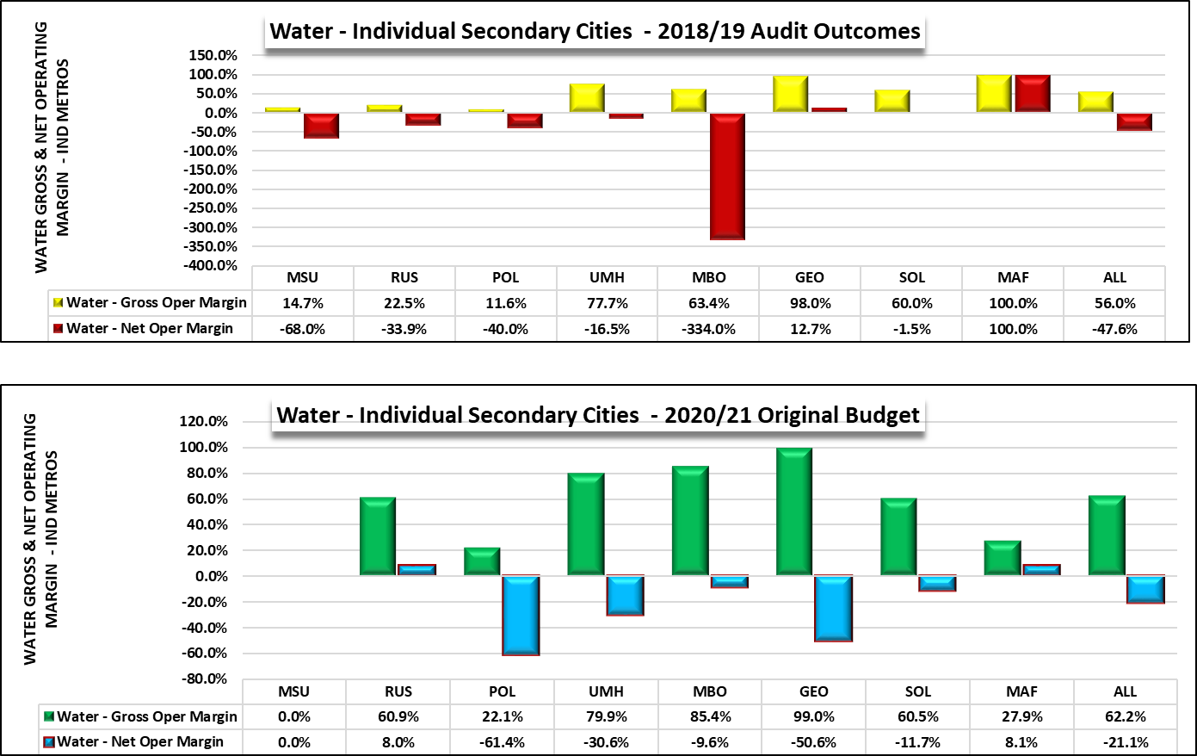
Water Gross and Net Operating Margins – Secondary Cities (National Treasury Benchmark Exercise)

Slide 42
Quadrant 4 – Short to Medium Term (3-5 years)
Corporate Governance | Outcomes
Agreements between Municipalities, Water Boards and DWS | Sound Relationship
Sound Corporate Governance | Improved decision making and relationship

Slide 43
RESPONSES TO QUESTIONS RAISED ON 2 JUNE 2020

Slide 44
Why ordinary citizens are not part of the stakeholders to be consulted by water boards during tariff determination:
Bulk or Water board’s tariff consultation process is directed by Section 42 of the Municipal Finance Management Act (Act 56 of 2003) (MFMA) differing from the municipal tariff consultation which is broadly directed by Chapter 4 of the Municipal Systems Act (Act 32 of 2000) which is done via community participation
The MFMA in s42 requires the water board to consult with the municipality; SALGA & National Treasury
The assumption is that the end-users are represented by the municipality within whose jurisdiction they reside.

Slide 45
Inconsistency of tariffs for the different water boards:
The Minister with concurrence from the Minister of Finance prescribes norms and standards for tariffs from time to time. (S10(1) of Water Services Act 108 of 1997), for Water Boards S34 of the Water Services Act outlines parameters for tariff setting and modeling
The difference in the sizes of the water boards; geographical locations; quality and availability of raw water; requirement and source of energy; volume (water demand) and the size of supply area are attributes of the difference in the tariffs.
Because of these dynamics, the department consider each proposal of a Water Board (WB) individually given its operating environment both their institutional viability and water resource sustainability
Is there a single method in determining the tariffs and why the outcomes are different?
The norms and standards provide a framework within which tariffs at both bulk and retail water services are determined.
The norms and standards also provide for factors that should be considered as cost drivers whose costs should be recovered by the tariff (labour; raw water; electricity; chemicals; repairs and maintenance; depreciation; overheads; capital and finance cost).

Slide 46
  Inconsistency of tariffs for water boards:
  How does the department coordinate the tariff setting?
The role of the department is to promulgate norms and standards for tariffs that direct entities in the water services sector in tariff setting and to regulate the entities,
After the water boards have determined the tariffs, the department evaluate the tariffs in terms of legal compliance, the economic and financial viability, affordability of such tariff, in relations to the broader socio-economic impact. The department also monitor that submissions are made to SALGA and National Treasury and matters raised are responded to by each water board.
  Water board should disclose their method of determining the tariff.
All the water boards’ tariffs are the same in terms of the factors that should be considered in the determination as per the framework although for the reasons above the tariffs will never be equal.
Because of these dynamics, the department considers each proposal of a Water Board (WB) individually given its operating environment in terms of both institutional viability and water resource sustainability

Slide 47
Transparency and consistency of the tariff determination process:
Water boards are public entities which account in terms of the Public Finance Management Act (Act 1 of 1999) and the Water Services Act (Act 108 of 1997)
The tariff process is conducted in compliance with Section 10 of the Water Services Act; Section 42 of the MFMA; Section 10 norms and standards and Circular 23 in terms of the MFMA
The involvement of National Treasury; SALGA; DWS and the customer municipalities in consultations are meant to achieve the transparency and consistency of the tariff process. The legislation provides processes that water boards must adhere to A – Z which have implications if not complied with.
  -Water boards should disclose their method of determining the tariff.
  Each water board shares the financial model used to calculate tariffs with the department, SALGA & NT (comprising of all cost drivers, projected revenue based on water demand, financial projection (income statement, cash flow, balance sheet etc).
  Each water board annually tables to the minister their 5 year corporate business plans which are appraised by DWS, SALGA & NT..

Slide 48
Above inflation tariff proposed:
The main objective of the water board tariff is to recover the cost of the provision of the water services to the customer municipalities thereby servicing debts & loans; allowing for expansion; achieving labour peace and sustainable provision of services
Section 42(3)(b)(ii) of the MFMA provides that an indication of how the ‘national government’s inflation targets and other macroeconomic indicators’ have been taken into account in the determination of the tariff.
The inflation target projected for 2020/21 at an average 5.5% measured at Consumer Price Index. This index is utilized for projecting the cost of each cost factor for the delivery of bulk water services, while there is still a need to strengthen balance sheet in order to fund CAPEX requirement in particular for the areas with service backlogs.
Labour costs however always increase by CPI + from the agreements with organized labour in the sector, Eskom electricity at 8.1% increase as per Nersa MYPD
Electricity costs will also increase should the volume of water pumped increase.

Slide 49
Above inflation tariff proposed (2)
The CPI figure will be mainly applicable to other purchases like chemicals and repairs. The cost of a factor as reflected mainly shows the contribution of the factor cost in the total cost/ the contribution of the factor into the tariffs not necessary the rate of increase against CPI
Total labour cost means employee salary increase added to salaries of new staff; chemicals being CPI increase added to cost of increased chemical quantities; electricity being the Eskom added to municipal electricity at a rate added to increased demand for electricity.
Since the price is involving quantities/volumes which are not static but moving, the tariff rate of increase will hardly reflect any relation to inflation increase without unpacking it into building blocks.

Slide 50
Why is drought tariff inconsistently applied, why DWS not provide a uniform method of determining a drought tariff:
Drought is real and hard hitting where it is experienced. Municipalities will suffer failure to meet demand of residents and it distorts the budget.
Restrictions imposed by the department on abstraction are applied indiscriminately in all affected schemes in order to postpone the total shortage of water at least until resources are recharged.
Water services is a volume based business, reduction in the volumes available for distribution has negative cash flow implications. With declared drought, water boards are expected to revise budgets to align with the available volumes and determine the tariff on that basis.
There is an interim measure that could apply in case a water board faces volume restrictions due to drought which has been shared with water boards pending the finalization of the revised norms and standards
Drought tariff is the only available tool to compensate water boards for revenue losses due to drought as compared with municipalities may receive a relief from National/ Province or both.

Slide 51
Water charges (tariffs) are determined annually, why is
DWS not adopting a multi year water charge system (tariff).
  The Pricing Strategy for raw water charges and the norms & standards for water services tariffs are currently under review
  The draft documents adopts the multi year tariff approach.
  Water Sector does not have an independent Regular like energy sector. What are the plans to establish and expedite the independent Regulator not continue with internal Economic Regulator
  The Department is reviewing the functionality of the Economic Regulator. Stakeholders will be consulted in due course

Slide 52
A school and Clinic in Moses Kotane does not have water to wash hands and this will results in the spread of covid-19.
Magalies Water provides bulk water services to Moses Kotane Municipality (Water Services Authority) which has authority in the area of jurisdiction within which the school and the clinic are located
The supply of water services to the clinic and the school is therefore the responsibility of municipality and must ensure that every resident or potential resident has access to at least basic level of water services.
Magalies Water may supply the water services to the residents of the municipality only if requested by the municipality (WSA) by means of a Service Level Agreement .
For covid-19 the department has an initiative in which water tanks are distributed to communities which do not have access to water services.

Slide 53
Inefficient debt management continues to incapacitate the water sector thus having a bearing on the ability of municipality to service their water board debt and high tariff increase will exacerbate this problem. City of Cape Town increase their tariff by 4.5% and has high collection rate, what are the underlying reasons for tariff increase of between 6%-12% by water boards.
Non payment for services is a culture that has become rife in the Republic and has rippling effect in the delivery of services especially in rural communities.
As at April 2020, municipalities owed water boards over R10.8 billion and water boards owed the Water Trading Entity R6.1 billion as at March 2020
The only source of revenue for water boards water sales as they do not receive grants from government. In very rare cases water boards have been bailed out by the state to relieve them off their cash flow problem.
Due to nonpayment by municipalities, some infrastructure maintenance is defaulted and may become expensive later. Some water boards’ balance sheet disqualifies them to secure loans from the markets and lack of funding may create backlogs in capital development and renewals.
To enable cost recovery, tariffs increase may be seen to higher at such levels.

Slide 54
Could DWS provide example of how pricing strategy was used during disaster.
The Pricing Strategy is a policy to determine charges / tariffs. The charges are determined and approved once per year.
The disaster was declared after the charges were approved, thus they could not be changed.
Government needs to look at other means to subsidise the currently applicable charges and tariffs.
The department did not include charge for forestry why?
According to the current pricing strategy, Forestry is exempted from paying the Water Research Levy only. They are billed for Water Resource Management Charges
What are the challenges relating to implementation of waste water charge?
The Waste Discharge Charge System has not been finalised yet. As soon as it is finalised, it will be implemented. Provision for such changes has been made in the revision draft pricing strategy.

Slide 55
Have DWS through depreciation build the reserves for bulk water provision?
No – all the money is allocated to projects per financial year
DWS is increasing their tariff why did they not include parliament as a stakeholder in their consultation?
The current consultation process for Raw Water Charges is in three phases, where stakeholders in all user categories are consulted:
- Provincial Consultations
- Sector Specific Consultations, and
- National Consultation
Parliament as an oversight body was not included as a stakeholder

Slide 56
What measures are the department taking to prevent the contamination of water resource, in Eastern Cape and Mpumalanga in some municipalities the water is not healthy for human consumption, what is the department doing about it.
Pollution of water resources is a concern and the Department has identified mining and local government (wastewater treatment works) as major contributors. Interventions underway are multi-pronged including:
Enforcement – The Department initiated a special operation with IUCMA in 2019 to investigate WWTWs in Mpumalanga. The operation is on-going and findings have been communicated to Minister of COGTA, SALGA. MISA is also working with the Department to deal with dysfunctional WWTWs polluting water resources.
The Department has open criminal and civil cases for municipalities that have are failing to deal with their WWTWs

Slide 57
The Department continues to offers infrastructure grants to municipalities to deal with WWTWs challenges.
Anti-pollution Task Team has been established to deal with pollution technology, monitoring, regulation and enforcement.
5. Proactively on an annual basis the Department monitors high risk (WWTWs operation at or above design capacity).
The main challenge is that the Department is engaged in protracted court processes with polluters seeking court intervention to compel water users to do what they are legally obliged to do. The Department does not have resources to fix ailing WWTWs infrastructure across the country.

Slide 58
UMGENI WATER DIRECTED QUESTIONS.
Operating Environment
There is a need to put water delivery at the centre of the developmental agenda:
Need to accurately predict the future demand as it influences the tariff setting;
Take cognisance of the rural development especially Household consumption (increasing from traditional 25 litres per person per day to 100 litres and up to 25 litres;
Appreciate economic development emanating from water services delivery, thus a need for rural development of water provision;
Urgent need to invest in sustainable water provision and the entire water delivery value chain;
Need to continue investing in Research and Development
Investing in water resources development for future demand is of paramount importance
Industrialisation of climate change cognisant water solutions;
Creating awareness and culture of payment of services by residents.
Resulting in resilient, sustainable water sector and industry.

Slide 59
UMGENI WATER DIRECTED QUESTIONS.
Employee and Executive Remuneration Costs increase by 12 to 13%
The purported increase is not an increase in remuneration rate
The increase in salary is estimated at 7% (as per the Bureau of Economic Research indexes at the time of tariff setting)
The total increase takes into account additional head count to cater for the new areas of operation and new plants commissioned, i.e. Uthukela District Municipality and Mshwathi Bulk Water Supply Scheme
The salary increase of Executives are determined by DWS and are not part 13% as said.
For 2019/2020, there has been zero salary increase for Executives.
Energy price increase of 14.6% higher than NERSA approved increase
At the time of tariff setting, Eskom had indicated that an intention to increase its tariff by 16.6% and 16.7% for 2020 and 2021 respectively.
Any downward adjustment will be factored in, in the following tariff cycle.
At the time of tariff setting, UW prudently applied the worst case scenario so as to have a fully cost reflective tariff set.

Slide 60
UMGENI WATER DIRECTED QUESTIONS.
Tender under appeal
The matter is sub-judice as it currently in courts (awaiting judgement)
The appellant did admit they did justly failed the functionality thus failed to show the capability required to execute such a complex project.
The appellant however contests that all tenderers who tendered did not have the capacity to execute.
The fact that the appellant quoted approximately R600 million below the engineering estimate further indicates that they did not understand the magnitude of the project.
Over the years there has been a trend of lowballing by contractors and threaten with Variation orders and terminations in the middle of the projects and/or filing for Business Rescue when they fail to execute and penalties are imposed. UW has to balance “cheap” with quality, timely and on budget execution, and it starts at the tendering stage.
UW proactively requested that the court arbitrate on the matter rather than opposing the interdict application in order to expedite the implementation of the project

Slide 61
BLOEM WATER RESPONSE
The tariff cover O & M expenditure, refurbishment, loan repayments and Capex funding.
Labour cost are in anticipation of an increase by the Amanzi Bargaining
Raw water cost are major cost driver projected by DWS to be above inflation.
Bloem water volumes are restricted due to drought thus limiting its revenue.
Bloem Water procures electricity from different sources (Eskom ,Megaflex, Ruraflex, etc.) at variable cost hence the projection.
Bloem Water does not have borrowing limits and its compel to fund its CAPEX through tariffs.
Bloem Water’s liquidity is impacted by non-payment of service by Municipalities .

Slide 62
AMATOLA WATER RESPONSE
Anticipated increase in electricity input cost for 2020/2021 is per NERSA media statement at 8.2% well above CPI
Under recovery of 1.05% in Electricity Bulk Water Tariff for the 2019/2020 financial year due to late approval by NERSA of the electricity tariff increase.
Amanzi Bargaining Council agreement with SAMWU is under discussion currently with a projected 10% wage demand well above CPI.
DHSWS raw water increases set between 0% and 16.5% which is well above CPI.
Amatola Water does not receive any equitable share/ grant funding to subsidise late/non-payment by municipalities
Amatola Water currently owed R230 million (R204 million by Amathole District Municipality) which continues to escalate and impacts negatively on cashflows.
Amatola Water does not have reserves for capital replacement and these can only be financed from revenues to be generated from tariff increases.

Slide 63
RECOMMENDATIONS
The Joint PCs
  Notes work done by the sector in response to COVID 19
  Notes that the Tariff consultation and approval process unfolded as per legislative requirement
  Notes the 3 scenarios and implications
  Support quantification of financial implication of each scenario 3
  Endorse the establishment of a water regulatory mechanism (regulator)
  Endorse the development of uniform costing and pricing models and methodologies across the value chain
  Support the development of a multi year tariff regime
  Support the proposed short to medium term interventions in a quest to address some of the water sector challenges raised by SALGA
  Be kept abreast on the implementation of suggested interventions

Slide 64
THANK YOU

