Slide 1
Briefing to the Joint Standing Committee on Financial Management of Parliament : 2020/21 Revised Annual Performance Plan
28 July 2020

Slide 2
2020/21 Annual Performance Plan and Budget
6th Parliament strategy
Draft 2020/21 APP and Budget
Special adjustments appropriation
Revised 2020/21 APP and Budget

Slide 3
2020/21 6th Parliament strategy
6th Parliament Policy Priorities and Strategic Plan tabled on 27 February 2020,
Strengthening oversight and accountability as main priority, requiring the following:
more time for committee oversight work,
greater Member capacity-building and empowerment,
improvement of research and analysis to provide deeper insights, and
ensuring effective public involvement, petitions and submissions.

Slide 4
2020/21 6th Parliament strategy
Impact 2030
Reduce poverty, unemployment and inequality
Outcome 2024
Increase government’s responsiveness & accountability
Improved oversight over
budget legislation
Outputs
Constituency oversight work
Committee oversight work
Plenary oversight work
Activities
Individual Member activities
Deeper scrutiny
More effective involvement
More effective recommendations
Questions, debates, statements
Oversight plan
Time for committees
Enhanced Member capacity
Deeper insights
Public submissions
Inputs
Change in programme
Capacity-building Programmes
Better analysis, synthesis
Public info and access
Better tracking, monitoring
Data and systems
Technology & social media

Slide 5
2020/21 Draft APP and Budget
Draft 2020/21 APP and Budget presented in May 2019, and tabled in June 2019.
This APP serves as transitional instrument, as it was presented and tabled before the finalisation of the 6th Parliament strategy.
The revision was delayed to accommodate the special adjustments appropriation,
Revised 2020/21 APP and Budget were tabled on 16 July 2020.

Slide 6
2020/21 Adjustments appropriation
The President declared a national state of disaster, on 16 March 2020, in order to set measures dealing with the effects and impact of the Covid-19 pandemic.
The Minister of Finance tabled a special adjustments appropriation on 24 June 2020.
The 2020/21 budget for Vote 2 was downward adjusted by R 80 million.
Further downward adjustments could be expected over the 2020/21 to 2022/23 Medium Term Expenditure Framework.

Slide 7
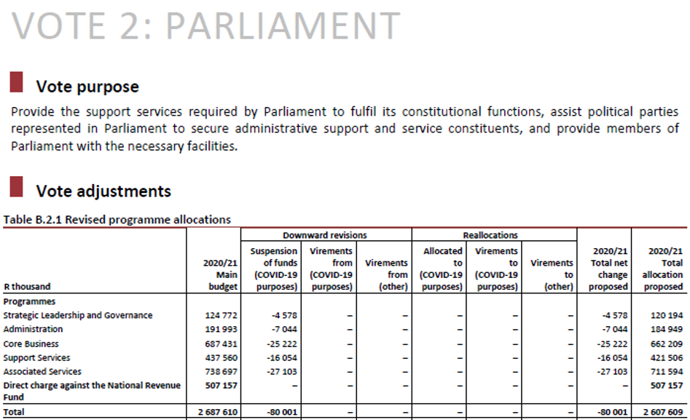

Slide 8
2020/21 Situational analysis
Impact of Covid-19 pandemic on Parliament:
As GDP growth and tax revenue decreases, Parliament’s budget will come under downward pressure,
Disrupt Parliament's old style of work, bring about health and security risks,
Could cause process disruptions and further resource constraints,
May catapult institution forward, using technology, and making it more relevant and accessible,
Forces institution toward greater efficiency.
Other constraints and risks are being amplified by pandemic impacts.

Slide 9
2020/21 Budget structure
The new strategy of the 6th Parliament required a new budget structure for the APP,
Changes to the 2020/21 budget structure could not be effected,
The revised APP uses the existing budget structure,
Budget structure dictates performance information,
Utilise existing performance indicators for 2020/21,
However, future indicators can already be tracked (usefulness indicators)

Slide 10
2020/21 Budget structure
Programme 1: Strategic Leadership and Governance
Political leadership, governance and institutional policy, communication and co-ordination, oversee development and implementation of strategic plan, annual performance plan and budget, Parliamentary Budget Office and Office: ISD.
Programme 2: Administration
Strategic leadership support and management, institutional policy and governance, development programmes for Members, management and administration, internal audit and financial management, and the Registrar of Members’ Interests.
Programme 3: Core Business
Procedural and legal advice, analysis, information and research, language, content and secretarial and legislative drafting services for meetings of the National Assembly, National Council of Provinces and their committees. Provide public education, information and access to support public participation. Provide analysis, advice and content support for parliamentary international engagement.
Programme 4: Support Services
Provide institutional communication services, human resource management, information communication technology, institutional support services and Members’ support services.
Programme 5: Associated Services
Provide travel, communication and other facilities for Members of Parliament to fulfill their duties as elected public representatives. Provide financial support to political parties represented in Parliament, their leaders and constituency offices.

Slide 11
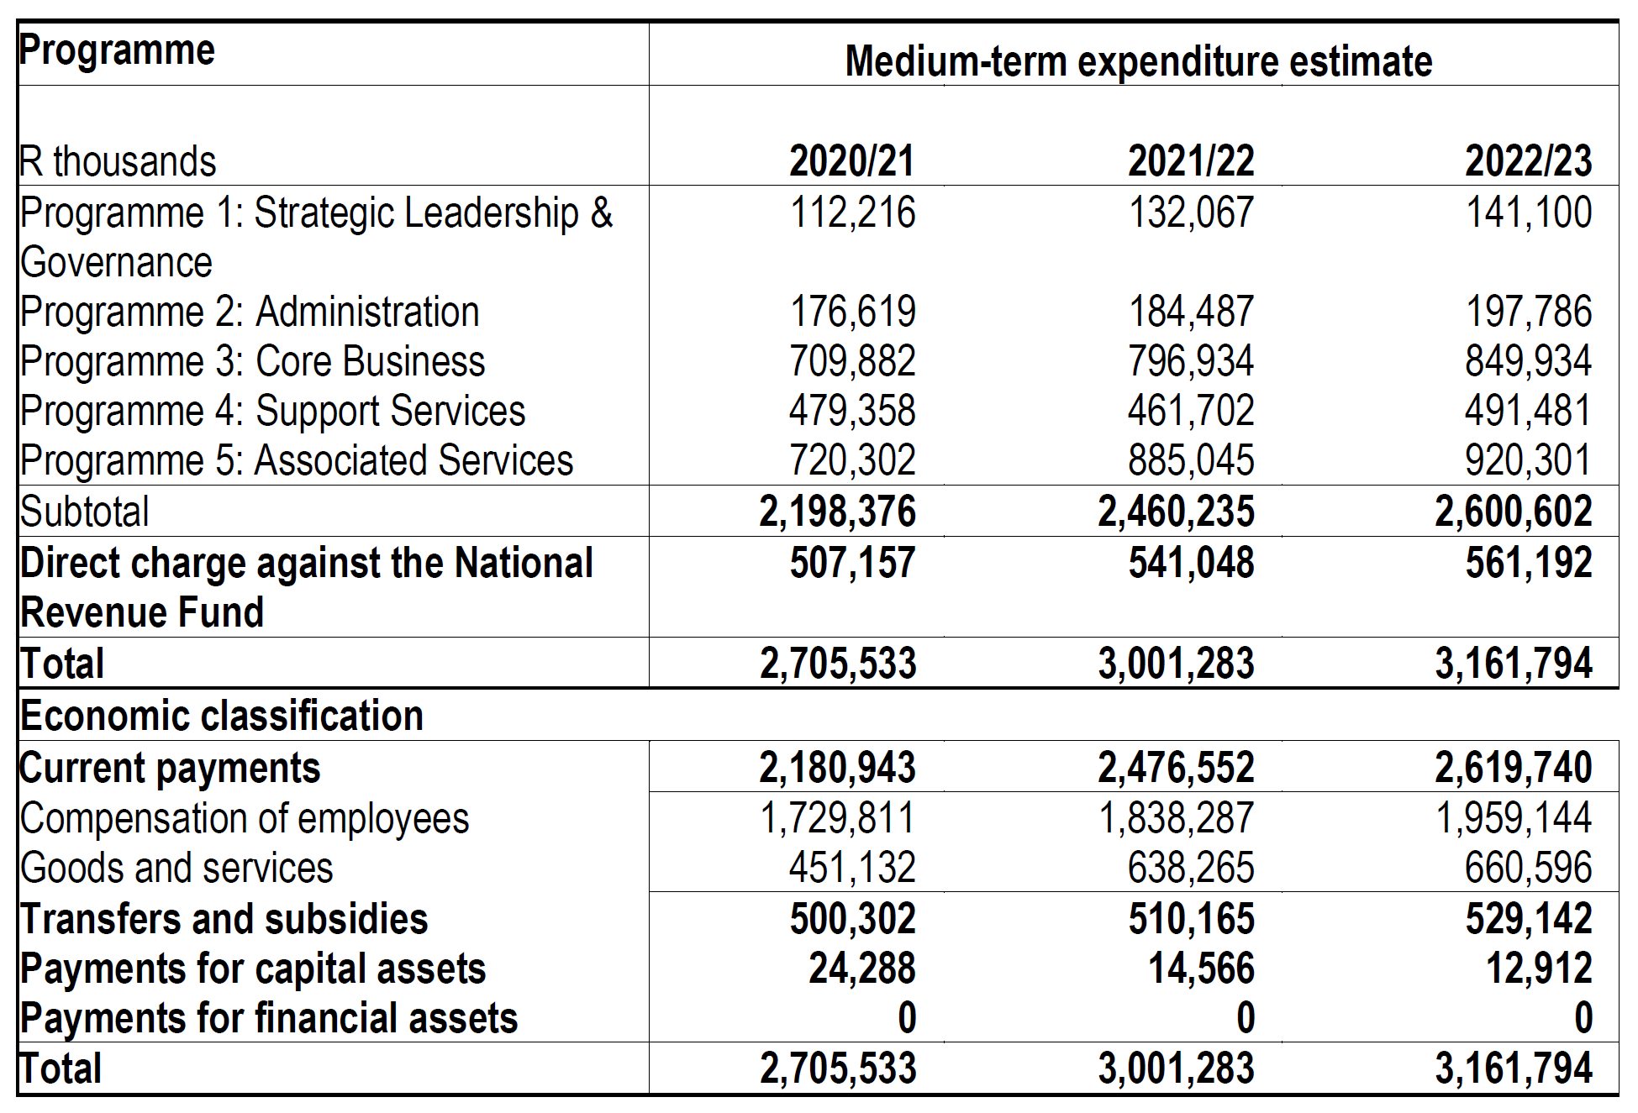
2020/21 Adjusted budget

Slide 12
2020/21 Programme performance information
2024 MTSF measures included,
Existing indicators were retained for 2020/21 due to budget structure, but will be transitioned out to Operational Plans in 2021,
Indicators on the programme of Parliament inserted,
Advisory and information services use the Service Charter indicator, but will be transitioned to measure usefulness in future,
Support services will also transition to using usefulness measurements.

Slide 13
2020/21 Outcome measurements
Parliament’s 2024 outcome goal: to increase government’s responsiveness and accountability.
The 2019-2024 Medium-Term Strategic Framework (MTSF) enable Parliament to monitor the overall performance of government.
The 2019-2024 MTSF has set out 7 priorities, 81 outcomes with 561 indicators.
Parliament must scrutinize and assess government’s performance.

Slide 14
2020/21 MTSF 2019 – 2024 outcomes

Slide 15
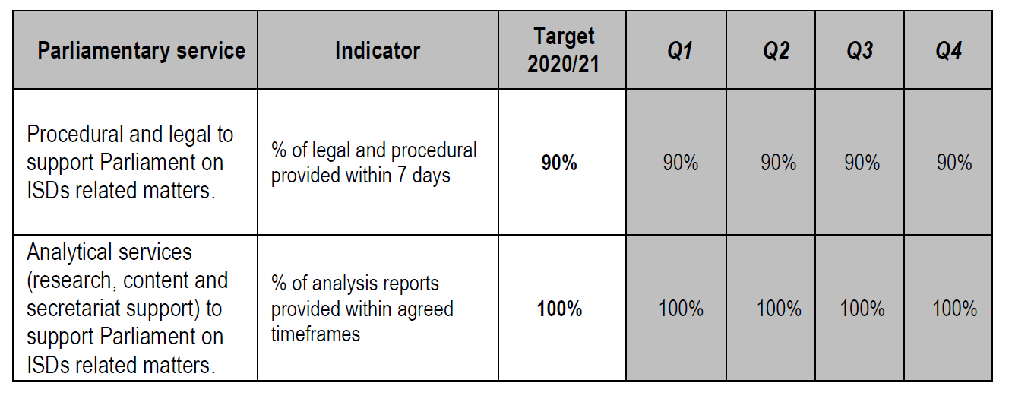
Programme 1 Strategic Leadership and governance
Includes: Office of the Speaker, Office of the Chairperson, Office of Institutions Supporting Democracy, Parliamentary Budget Office (transfer), Treasury Advice Office

Slide 16
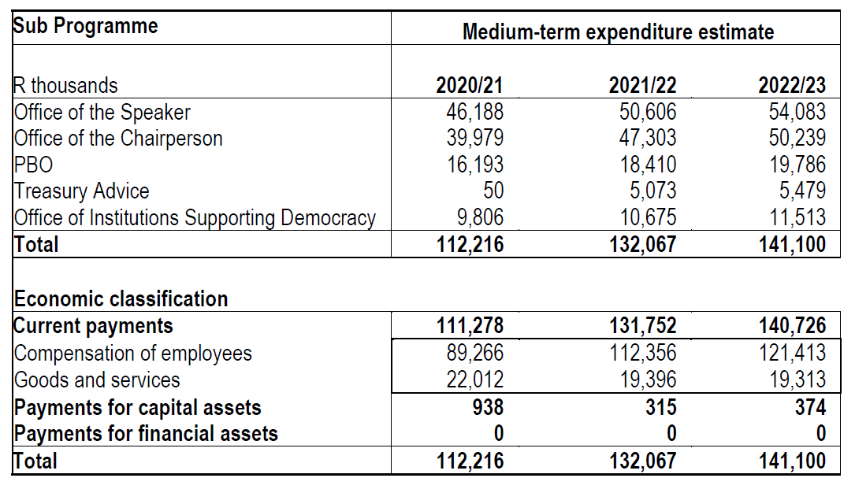
Programme 1: Proposed expenditure

Slide 17
Programme 2 Administration
Includes: Office of the Secretary to Parliament, Strategic Management and Governance, Finance Management Office, Internal Audit, Legislative Sector Support, Registrar of Members’ Interests.
Members capacity-building programmes

Slide 18
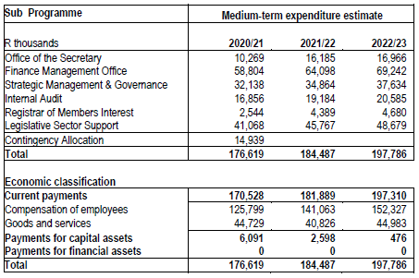
Programme 2: Proposed expenditure

Slide 19
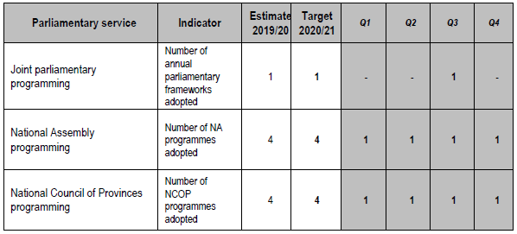
Programme 3 Core Business
Includes: National Assembly, National Council of Provinces, Core Business Support, Knowledge and Information Services, International Relations and Protocol.
Parliamentary programme

Slide 20
Programme 3 Core Business
Advisory and information services
Public involvement

Slide 21
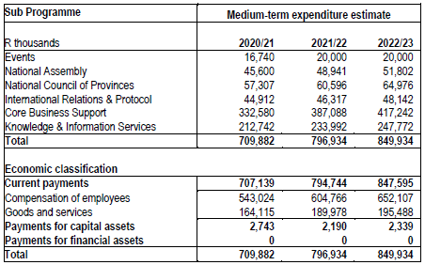
Programme 3: Proposed expenditure

Slide 22
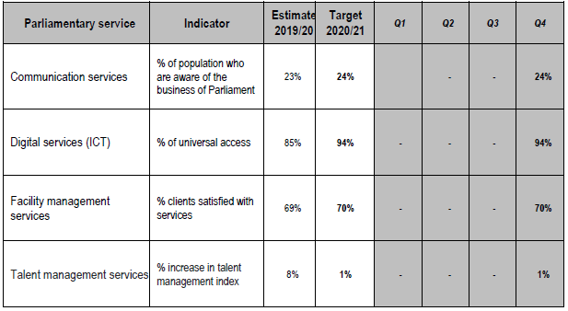
Programme 4 Support Services
Includes: Human resources, ICT, Institutional support services, Parliamentary communication services, Members’ support services.

Slide 23
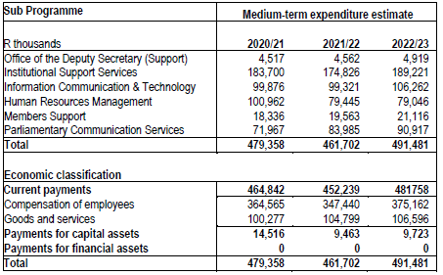
Programme 4: Proposed expenditure

Slide 24
Programme 5 Associated services
Provide travel, communication and other facilities for Members of Parliament to fulfil their duties as elected public representatives.
Provide financial support to political parties represented in Parliament, their leaders, and constituency offices.

Slide 25
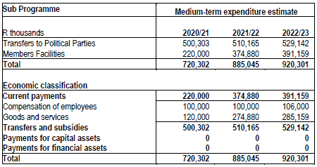
Programme 5: Proposed expenditure

Slide 26
2020/21 Mid-year adjustments appropriation
Further downward adjustments could be expected over the 2020/21 to 2022/23 Medium Term Expenditure Framework,
Management developed three scenarios to shape possible responses,
Accordingly the 2020/21 APP will be revised in November 2020,
The draft 2021/22 APP will be revised in March 2021.

Slide 27
End

