Slide 1
PROGRESS REPORT ON PROJECT VISIT BY NATIONAL PORTFOLIO COMMITTEE ON AGRICULTURE, LAND REFORM AND RURAL DEVELOPMENT
27 JULY 2020
GROWING KWAZULU-NATAL TOGETHER
#PHEZ’KOMKHONO

Slide 2
GROWING KWAZULU-NATAL TOGETHER
NDUMO B
NO. | RECOMMENDATIONS BY PORTFOLIO COMMITTEE | PROGRESS TO DATE
1 | The Department has to draw-up a turnaround strategy to fix all the challenges raised by project beneficiaries. | The task team has been established. Service provider has been appointed with contract value of 1.9 million rand to assist farmers with maintenance of pump station. The project commended in July 2020 and is expected to be completed by September 2020.
2 | In terms of the title deed the committee advised that the Department consult the Deeds office to source documentation regarding the utilization of land by farmers of Ndumo. As the land is under Ingonyama Trust, the Lease Agreement should be issued per cooperative to be able to access funding from the bank | The engagements of cooperatives and Ingonyama Trust is ongoing.
2
#PHEZ’KOMKHONO

Slide 3
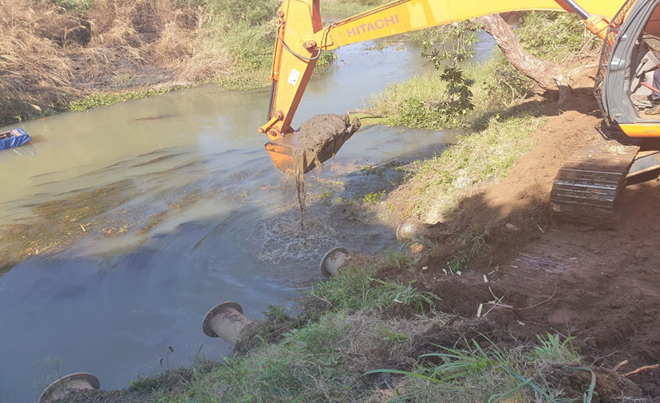
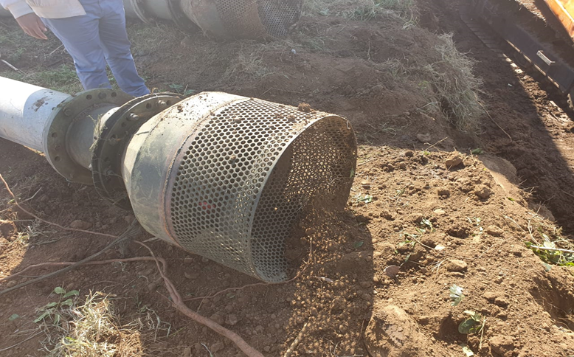
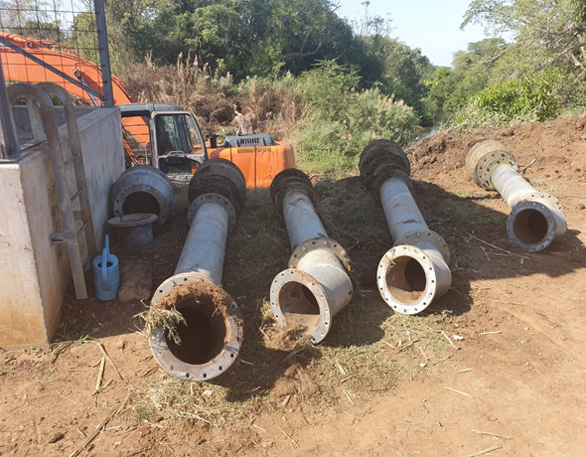
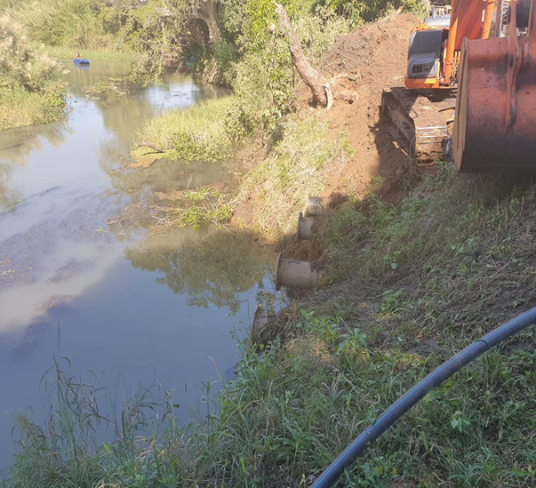
GROWING KWAZULU-NATAL TOGETHER
Below is the picture of machinery working on maintenance of irrigation and replacement of pumps and dredging at the river.
3
#PHEZ’KOMKHONO

Slide 4
GROWING KWAZULU-NATAL TOGETHER
NDUMO B
NO. | RECOMMENDATIONS BY PORTFOLIO COMMITTEE | PROGRESS TO DATE
3 | Alternative sources of energy because electricity / diesel seemed to be too expensive | The beneficiaries have mobilized assistance from a private company in partnership the University of Johannesburg to sponsor the design of solar system to be installed at the pump station. Installation of solar panel in the pack house and storage facility is currently underway. The investigations to alternative energy source shall commence once pump station maintenance intervention is complete. This is to allow the irrigation to operate as per original plan so that engineers can to proper studies of operations.
4 | Align the produce with Quality Standards that is required by the market. Trainings are needed for those quality standards. | MOU signed by DARD and submitted to PPECB for signature.
4
#PHEZ’KOMKHONO

Slide 5
GROWING KWAZULU-NATAL TOGETHER
COASTAL CASHEWS
NO. | RECOMMENDATIONS BY PORTFOLIO COMMITTEE | PROGRESS TO DATE
1 | Meetings to update beneficiaries on the progress of the farm should be convened | The meetings are ongoing
2 | Involvement of youth is compulsory in the project | The training programme was going to be part of the comprehensive business plan which was due to take place in March 2020 but halted by national lockdown.
3 | Upgrading the farm up to the level that will assist in-service training students
5
#PHEZ’KOMKHONO

Slide 6
GROWING KWAZULU-NATAL TOGETHER
COASTAL CASHEWS
NO. | RECOMMENDATIONS BY PORTFOLIO COMMITTEE | PROGRESS TO DATE
4 | Government intervention is required on the issue of the farm paying annual fee of R30 000 to Ngonyama trust (the amount was said to be posing financial burden to Project owners) | The Department invited local Inkosi to further engage Ingonyama Trust Board on this issue .
5 | Development of business plan that will cater for all project requirements | The scheduled meeting between the province and national officials to develop a comprehensive business plan was interrupted by COVID 19.
6 | Since the project is unique, of large scale and addresses the issue of job creation in the area, it should be treated as priority project by both National and Provincial government
6
#PHEZ’KOMKHONO

Slide 7
GROWING KWAZULU-NATAL TOGETHER
AMANDLENTUTHUKO
NO. | RECOMMENDATIONS BY PORTFOLIO COMMITTEE | PROGRESS TO DATE
1 | DARD to engage the mine and discuss the matter regarding continuation of the project | The scheduled meeting on the 12th September 2019 took place. The Community Development Officer of iTendele Mine attended a meeting and inform the meeting that the site is not affected by mining activities and the project can continue as planned.
2 | DARD should form part of discussions pertaining to proposed area development projects including mining development
7
#PHEZ’KOMKHONO

Slide 8
GROWING KWAZULU-NATAL TOGETHER
AMANDLENTUTHUKO
NO. | RECOMMENDATIONS BY PORTFOLIO COMMITTEE | PROGRESS TO DATE
3 | Project implementation should be initiated on site 2 since the site is big enough and is far from the prospective mining operations | The project was presented and approved through internal project approval process of the department . A total budget of R4 million was allocated over two consecutive financial year, started in 2019/20. Activities undertaken: Steelpipes for holding pens purchased Storage facility steel structure and footing installed Cattle scale purchased Hire dozer for site levelling Construction of borehole still underway Bulk building material purchased Expenditure to date is R 1 180 000. The balance of the budget will procure the following: Combo tractor with front end loader Construction of storage facility Handling facility with lading ramp Production inputs (weaners, medicine and vaccines)
8
#PHEZ’KOMKHONO

Slide 9
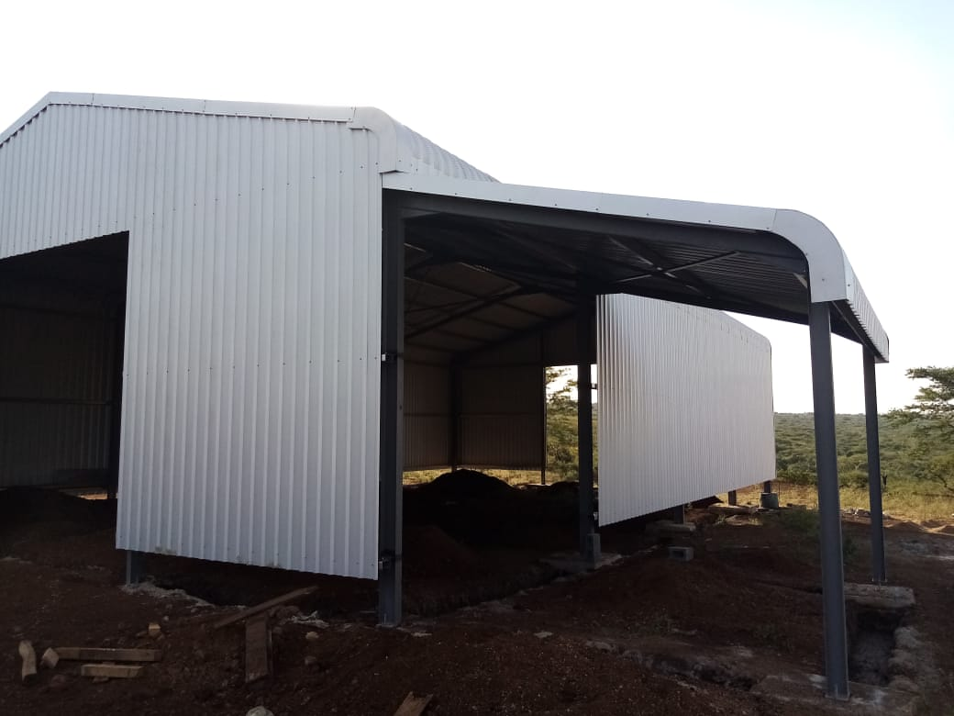
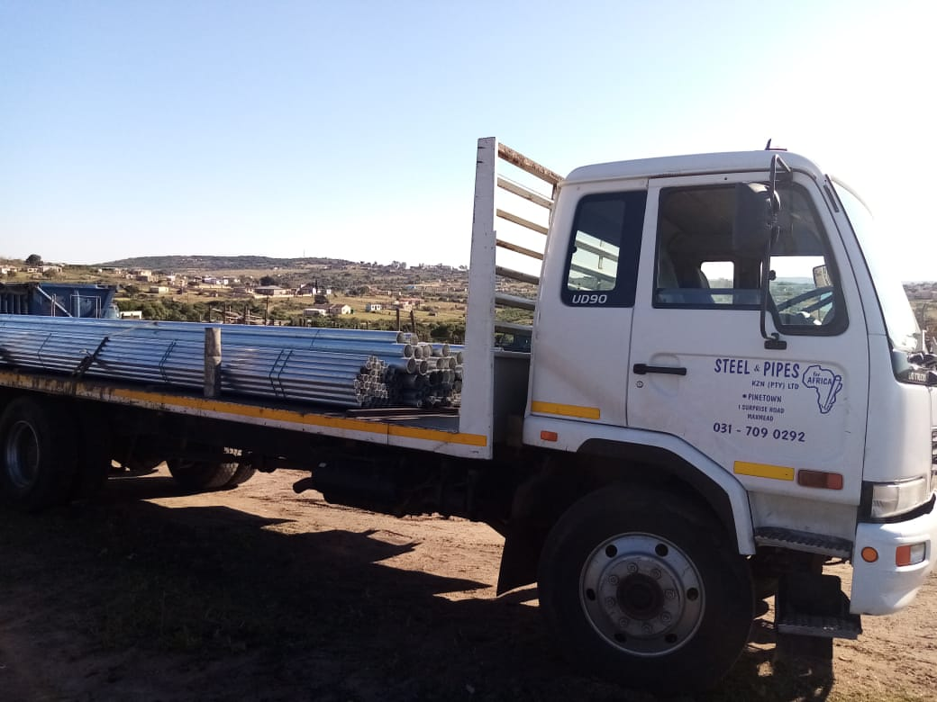
GROWING KWAZULU-NATAL TOGETHER
AMANDLENTUTHUKO - Below is the picture of storage facility during construction and truck delivering steel pipes to erect animal holding pens.
9
#PHEZ’KOMKHONO

Slide 10
GROWING KWAZULU-NATAL TOGETHER
EMPANGISWENI TRUST PROJECT
NO. | ITEM | COST ESTIMATE | PROGRESS TO DATE AND EXPENDITURE
1 | ESKOM OUTSTANDING | R 250 000 | The beneficiary had challenges in getting the total eskom bill for the amount owed by the farm. It was established that ESKOM has a record of 15 accounts for this farm.
2 | ESKOM BILL FOR 8 MONTHS TILL END OF MARCH 2020- | R 680 000
3 | ELECTRIC CABLE FROM TRANSFORMER TO PUMP HOUSE AND VANDALISED SWITCH GEAR | R 105 000
4 | CHEMICALS FOR DYING TREES | R 350 000 | R 211 919.16
5 | FERTILIZER FOR DYING TREES | R 700 000 | R 1 620 447.75
10
#PHEZ’KOMKHONO

Slide 11
GROWING KWAZULU-NATAL TOGETHER
JABULA ZONDI TRADING
NO. | RECOMMENDATIONS BY PORTFOLIO COMMITTEE | PROGRESS TO DATE
1 | The farmer, Mr Zuma complained about the houses on the farm which had no roof | The project was presented and approved through internal project approval process of the department . A total budget of R2 million was allocated over two consecutive financial year, started in 2019/20. The project is currently under implementation and it will be completed during the current financial year. The following activities are underway: Boundary Fencing 10KM, Borehole & Reservoir Rehab, Crush Pen Construction & Dip, Breeding Cows = 40, Breeding Goats = 70, Trailer, Firer Fighter & Chain Saw and Bailer Equipment
2 | The farmer requested assistance with 150 cattle, bailer maker machine and renovation of reservoirs
3 | The farmer requested assistance to plant yellow maize for his livestock.
11
#PHEZ’KOMKHONO

Slide 12
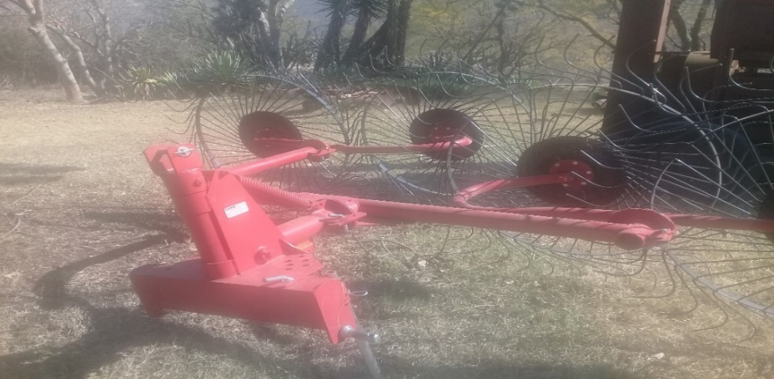
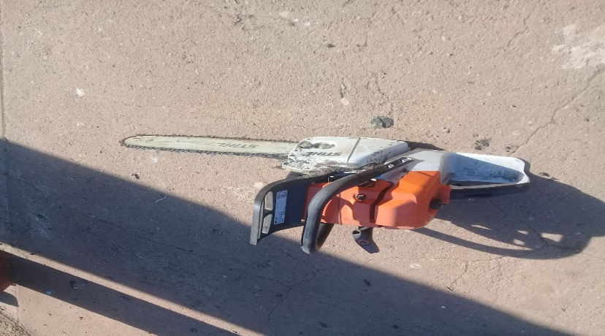
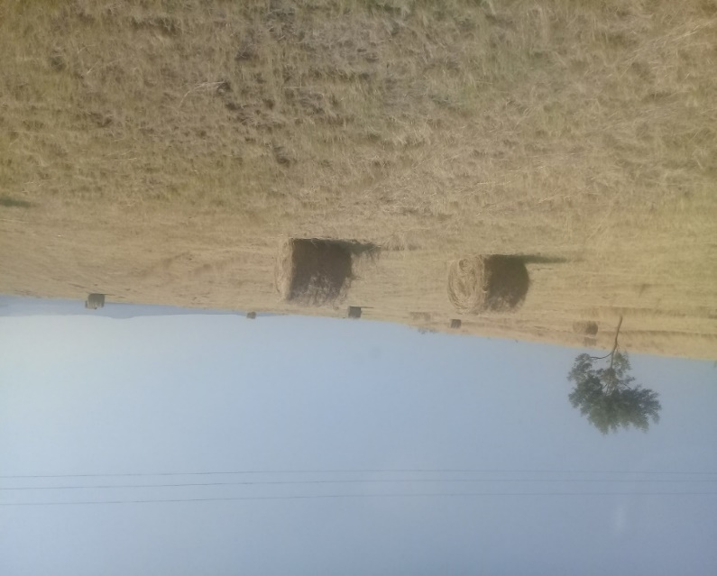
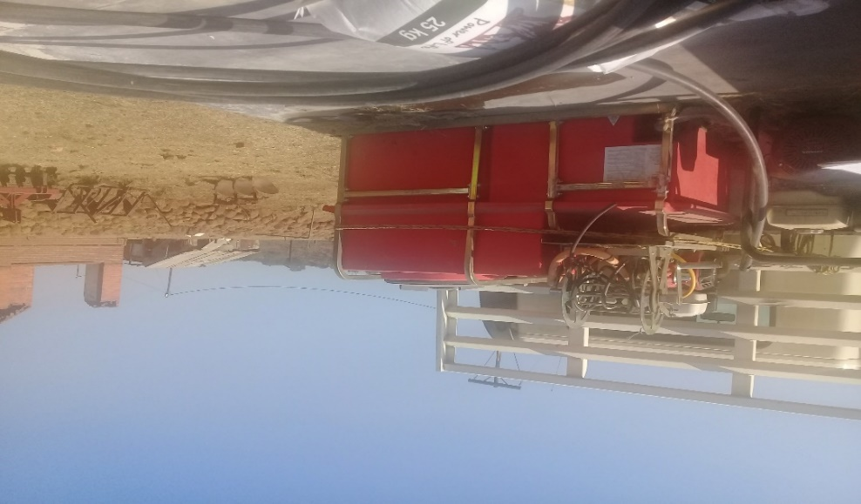
GROWING KWAZULU-NATAL TOGETHER
JABULA ZONDI LIVESTOCK PROJECT PICTURES
Jabula Zondi’s Implements Purchased
12
#PHEZ’KOMKHONO

Slide 13
GROWING KWAZULU-NATAL TOGETHER
AMANGCOLOSI COMMUNITY TRUST
NO. | RECOMMENDATIONS BY PORTFOLIO COMMITTEE | PROGRESS TO DATE
1 | The correct land use pattern was questioned following three commodities (maize, Kiwi and community garden) being farmed. | Natural resources assessment is in progress and the report is expected to be issued in September 2020.
2 | One farmer raised the concern of the dam being dry and this negatively affects their community garden | Due to budgetary constraints, scooping of a Dam is pending although the plans are all in place for procurement.
13
#PHEZ’KOMKHONO

Slide 14
GROWING KWAZULU-NATAL TOGETHER
ZAMOKUHLE CPA
NO. | RECOMMENDATIONS BY PORTFOLIO COMMITTEE | PROGRESS TO DATE
1 | Farmers requested fencing for grazing Camps and for their arable land | Farm assessment was conducted to ascertain the requirements of the farm. A detailed business plan compilation is in progress. The supply of maize seed and fertilizer for 10 ha including mechanization services has been incorporated into 2020/21 mechanization implementation plan. Training plan was developed and started but interrupted by COVID 19.
2 | Farmers requested Mechanisation Support and Agricultural Inputs
3 | Farmers requested a Dip tank and Vaccines
4 | Portfolio members suggested that the beneficiaries should be provided with training or capacity building
14
#PHEZ’KOMKHONO

Slide 15
THANK YOU

