Slide 1
MEETING OF THE SELECT COMMITTEE ON LAND REFORM, ENVIRONMENT, MINERAL RESOURCES AND ENERGY (NATIONAL COUNCIL OF PROVINCES)
MHSC’s Response to COVID-19 Pandemic in the SAMI
28 July 2020
MHSC CEO: THABO DUBE

Slide 2
PRESENTATION OUTLINE
Legislated MHSC Mandate
Role of MHSC in the SAMI
Strategic Priorities 2020/2021
Covid19 Statistics
MHSC Response to COVID-19 – Going Forward
2

Slide 3
LEGISLATED MINE HEALTH AND SAFETY COUNCIL MANDATE
Advise the Minister on all occupational health and safety issues in the mining industry including legislation, research and promotion.
Review and develop legislation for recommendation to the Minister (Focus on Regulations).
Oversee research in relation to health and safety in
the mining industry.
Liaise with other bodies concerned with health and
safety issues (MQA, State Departments and various
Stakeholders).
Promote health and safety culture in the mining industry.
3

Slide 4
STRATEGIC PRIORITIES 2020/21
Customer Perspective
Internal Process Perspective
Learning & Growth Perspective
Financial Perspective
CP01
Liaise with statutory bodies, strategic partners and stakeholders on matters relating to OHS
Provide advice to the Minister on health and safety matters in the South African Mining Industry and communities affected by mining
CP02
CP03
Promote a culture of health and safety in the SAMI through engagement, communication, participation and dissemination of OHS best practices
IP01
IP02
To improve MHSC compliance and implementation of good corporate governance
Ensure MHSC Information is adequately managed and secured
IP03
IP04
To ensure ICT infrastructure is available to facilitate implementation MSHC core systems Integration and automation
Leverage on the fourth industrial revolution for improvement of OHS in the SAMI and internal effectiveness
Ensure best Human Capital management practices that will support the achievement of highly skilled, motivated and capable MHSC employees, Council Advisory Committees and Council
LG01
FP01
Ensure financial sustainability of MHSC
FP02
Ensure efficient and effective financial management
4

Slide 5
The COVID-19 Pandemic
Jan 2020
‘Severe Acute Respiratory Syndrome Coronavirus 2’ (SARS-CoV-2) was confirmed as the causative agent of ‘Coronavirus Disease 2019’ or COVID-19.
Jan 2020
Transmission was initially assumed to occur primarily via respiratory droplets from coughs and sneezes within a range of about 1.8 meters
March 2020
The WHO declared COVID-19 as a public health emergency of international concern in January 2020, and later in March 2020 declared it a global pandemic
March 2020
June 2020
In March 2020, The President of South Africa declared a national state of disaster on COVID -19, in terms of the Disaster Management Act. This was followed by several restrictions (which includes the COVID-19 risk adjusted strategy with different alert levels) aimed to curb the disease
The MHSC reviewed the APP to indicate projects that will assist the SAMI in combating the scourge of COVID-19.
5

Slide 6
COVID-19 MHSC’s Response in the SAMI
Mining Industry Reported COVID-19 Cases
Out of the total 385 reporting mines, accounting for 428 154 employees:
Total Employees Screened : 315134
Total Employees Tested : 33 580
Total Positive Cases : 7953
Total Active Cases : 3731
Deaths : 73
Total Recovered Cases : 4149
Source: Minerals Council of South Africa
6

Slide 7
COVID-19 MHSC’s Response in the SAMI
Strategic Objective | APP Initiative | COVID-19 related initiative | Facilitation Plan
CP01-Provide advice to the Minister on health and safety matters in the South African Mining Industry and communities affected by mining | Legislative Programme | Guiding Principles on the Prevention and Management of COVID-19 in SAMI Return To Work (RTW) Guidelines through DMRE | Notices and Guidelines communicated via the DMRE MHSC facilitating communication through website, emails and social media platforms
 |  | Guideline for the compilation of a mandatory code of practice for the prevention, mitigation and management of COVID-19 outbreak | Guideline Promulgated on 17 May 2020 Widely disseminated and workshops held to facilitate understanding Q&A sessions continuing with national developments
The MHSC reviewed its 2020/2021 Annual Performance Plan and readjusted its budget
to include measures that would be put in place to assist in curbing the spread of COVID-19
7
Notes:
In light of the health threat that the COVID-19 Pandemic poses to the South African Mining Industry, the South African Parliament requesting entities to review their Annual Performance Plan (APP) and submit to the DMRE for onward approval by the Parliamentary Portfolio Committee (PPC). The APP review was to indicate projects that will assist the SAMI in combating the scourge of COVID-19.

Slide 8
COVID-19 MHSC’s Response in the SAMI
Strategic Objective | APP Initiative | COVID-19 related initiative | Facilitation Plan
CP01-Provide advice to the Minister on health and safety matters in the South African Mining Industry and communities affected by mining | Implement the Recommendations on the Approved Legislative Advisory Notes | COVID-19 data reporting by the SAMI to provide most updated data Section 11.5 Investigations | MOHAC finalized reporting forms and explanatory note Reporting will be on MHSC’s ‘OHS Milestones and COVID-19 reporting Portal’-MHSC website
 | Costed Research Programme | 4 Research Topics for MHSC Consideration for 2020/2021: Assessment of applicable control measures to protect employees from COVID-19 in the SAMI Awareness/promotional material on COVID-19 Pandemic Investigate methods to detect the presence of SARS-COV-2 virus and other viruses on surfaces and in air in the mining environment. Investigate recovery rate of Mine employees from COVID-19 in different working places at South African Mines | Topics to be considered and approved by Council for Minister’s advice Projects to be completed within 3 months to provide advice to the SAMI Dissemination to take place at various virtual platforms
8

Slide 9
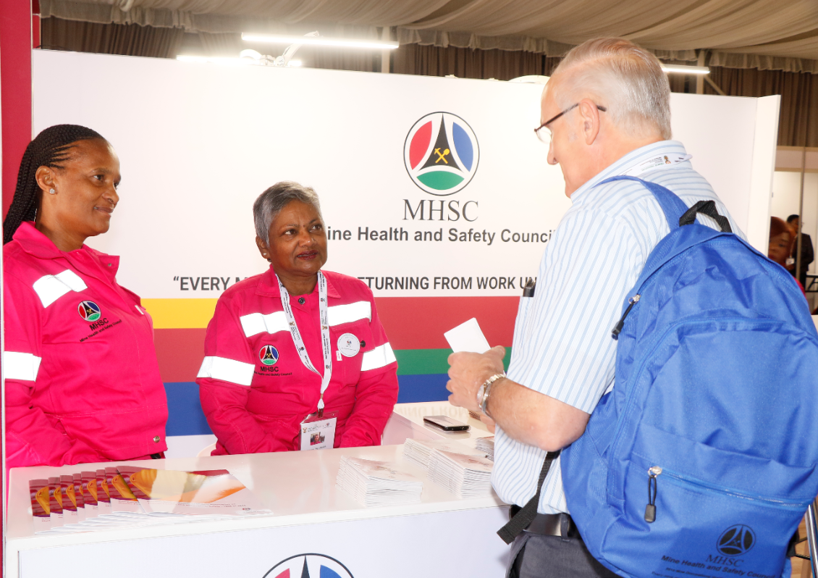
COVID-19 MHSC’s Response in the SAMI
Strategic Objective | APP Initiative | COVID-19 related initiative | Facilitation Plan
CP01-Provide advice to the Minister on health and safety matters in the South African Mining Industry and communities affected by mining | Review the State of Health and Safety Performance in the SAMI and Advice the Minister on Relevant Interventions. | Reviews to be done from analysis of the COVID-19 reports that will be extracted from the OHS Milestones and COVID-19 Reporting Portal | Reports to be analyzed once the portal is operational. DMRE and the Minister to be advised accordingly on adherence to regulations and recommendations thereof
CP02-Promote a culture of health and safety in the SAMI through engagement, communication, participation and dissemination of OHS best practices | Dissemination strategy | Share MHSC COVID-19 related outcomes/ measures with various stakeholders | Presentation at various platforms to facilitate implementation i.e (MMPA, SAIMM, RTFs) Continual updating of COVID-19 related data on the MHSC website
9

Slide 10
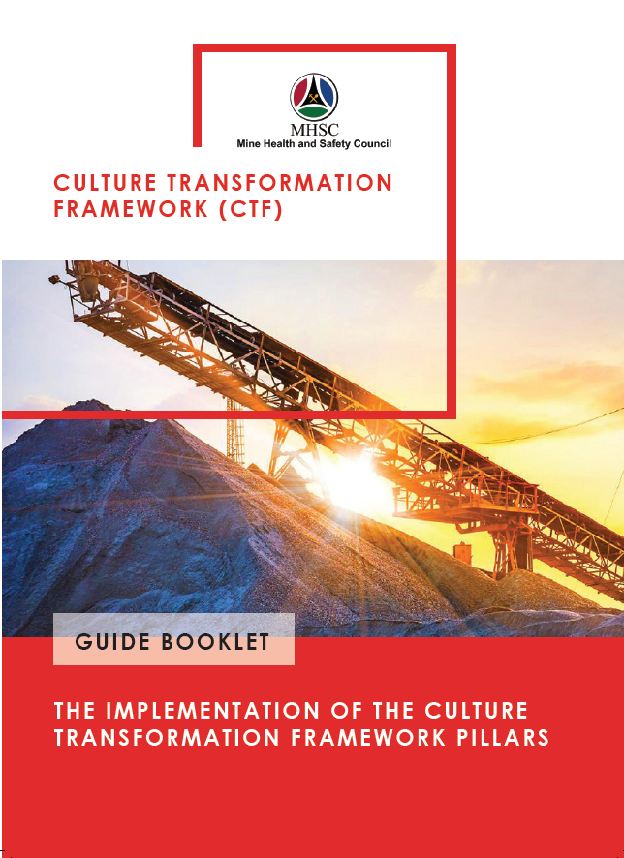
COVID-19 MHSC’s Response in the SAMI
Strategic Objective | APP Initiative | COVID-19 related initiative | Facilitation Plan
CP02-Promote a culture of health and safety in the SAMI through engagement, communication, participation and dissemination of OHS best practices | Dissemination Strategy | Virtual Engagements and Dissemination | Optimizing the use of virtual platforms for dissemination of OHS outcomes and initiatives Meetings and workshops rescheduled to be held virtually. Virtual Books/Pamphlets and Promotional Material on the MHSC Website, Emails and Social Media
CP03-Liaise with statutory bodies, strategic partners and stakeholders on matters relating to OHS | Implement the revised strategic partners’ collaboration programme | Collaborate with MHSC Strategic Partners and Statutory Bodies on Measures to Curb COVID-19 | MOHAC COVID-19 Task team facilitating engagements
 |  | Collaboration with DMRE, CGS, MHSC FoG Task Team Rockburst/ Seismicity Adhoc Committee. | Committee established on the 23rd April 2020, Provides Weekly Reports on Seismicity Trends in the SAMI following ramp-up of Production at Mines
10

Slide 11
MHSC’S RESPONSE TO COVID-19 – Going Forward
THE NEW NORMAL POST COVID-19
OHS Research
Assess the capacity and capability of mining infrastructure
Develop/Review Guidelines
Review incident reporting form to provide real time data on COVID-19
BCP
Online stakeholder engagements
ICT Infrastructure
Reducing impact of job losses
Develop and implement OHS training programme with MQA through the recently established CETM
Financial sustainability
Investigate practical measures for physical distancing
Review previous research initiatives that can be used to combat COVID-19
MHSC APP with Capability of contact tracking
Diversify revenue generation sources
Provide guidelines on safe RTW procedure
Provide guidelines on hygiene and occupational medicine measures
Creation of SMS portal for instant messaging
Use of social networks and media
Radio stations broadcasting
MHSC APP
Virtual Events and Meetings
Video Conferencing Platform for All MHSC Stakeholders
Automation and online approvals
Reskill mine workers for the new normal and the new world of work using 4IR Programme Initiatives
Identity partners to co-fund research
Implement cost cutting measures
Obtain royalties through generation of IP from research
Continuous Review of New Measures Locally and Globally on COVID19
11

Slide 12
COVID-19 MHSC’s Response in the SAMI
Daily and Consolidated Weekly Reporting Forms Developed.
Explanatory notes to Guide to Users on how to Use the Reporting Tool Developed
COVID-19 Audit Tool has been Developed and has been Disseminated to all the Regional Offices for Implementation
The total number of mine inspections and audits that were conducted as at the end of June 2020 was 1681. The enforcement measures were taken where necessary by the Inspectors to order compliance with the provisions of the MHSA.
12

Slide 13
STRIVING FOR ZERO HARM
EVERY MINEWORKER RETURN HOME UNHARMED EVERYDAY

