Slide 1
Submission on the
2020 Adjustments
Appropriation Bill
by Equal Education, SECTION27, and
Equal Education Law Centre
24 July 2020
Notes:
option one for front slide

Slide 2
Introduction
EQUAL EDUCATION
EQUAL EDUCATION LAW CENTRE
SECTION27
A membership-based, democratic movement of learners, parents,teachers and community members advocating for the provision of both an equal and quality education in South Africa
A public interest law centre that seeks to develop and use the law to protect, promote and advance human rights
A public interest law centre using legal advocacy to advance an equitable and quality basic education

Slide 3
OVERVIEW
We would like to draw the Committees’ attention to the deprioritisation of basic education funding, which is accelerated in the Supplementary Budget, including the Adjustments Appropriation Bill.
Focus areas covered are:
Basic Education funding trends prior to COVID-19
Main takeaways from the 2020 Supplementary budget
Why is basic education not a front line department?
Transparency and Oversight
Recommendations

Slide 4
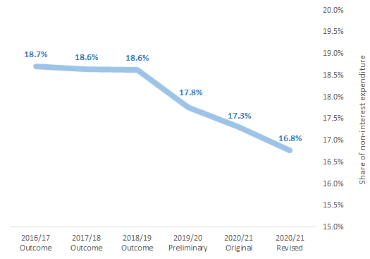
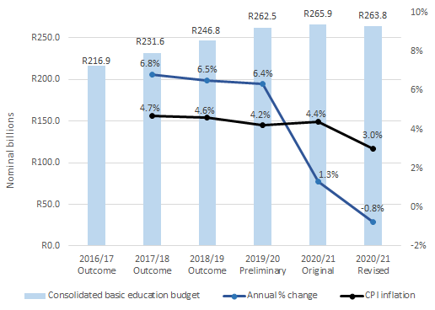
Basic Education funding trends prior to COVID-19
Share of non-interest expenditure allocated to basic education Consolidated basic education budget, annual % change
compared to CPI inflation
Notes:
I can speak to this slide.(daniel)
Will ad lib on 1. The Spaull et all research, 2. Infrastructure being targeted for cuts

Slide 5
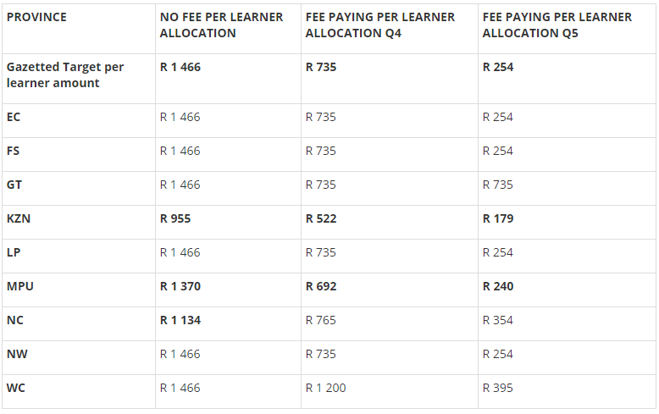
Basic Education funding trends prior to COVID-19
Per learner allocation for the 2020 school year for quintile 1-3 (no fee), quintile 4 and quintile 5 schools in each province
Notes:
The provinces not funding schools at minimum per learner levels

Slide 6
2. Main takeaways from the 2020 Supplementary Budget
The Department of Basic Education’s budget has been cut by R2.1 billion
R5.1 billion was reprioritised, mainly from infrastructure
No fiscal support to finance COVID-19 relief efforts
Basic education is not deemed to be a ‘frontline sector’

Slide 7
Changes to the basic education budget
 | 2020/21 Original / Main Appropriation | Utilisation of unspent funds. Virements & shifts | Suspension of funds | Reallocation of funds | Net change in appropriation | 2020/21 Adjusted Appropriation
Department of basic education | R25 328 232 | R0 | -R7 245 198 | R5 150 000 | -R2 095 198 | R23 233 034

Slide 8
Where are the cuts coming from ?
The funding reductions come from longer term investments
infrastructure (-R1.7 billion net)
support for maths, science and technology (-R68 million)
HIV/AIDS Life Skills (-R59.6 million)
And affect the core service delivery requirements of the sector
school budgets (e.g. -45% in Limpopo)
Notes:
For many poor schools, where funding barely covers (or in some cases, does not cover) all essentials needed, this is not an option. Schools have been forced to choose between COVID-19 essentials, such as sufficient water and extra desks to ensure social distancing, and paying the electricity bill.

Slide 9
Changes in infrastructure spending under the 2020 Supplementary budget
The Supplementary Budget cuts overall national funding to school infrastructure grants by a net R1.7 billion. This includes:
A R2.2 billion reduction of the EIG,
A R600 million reallocation from the EIG to the SIGB for the provision of temporary water supplies to schools,
A R60 million reduction of the SIGB.
A further R4.4 billion is reprioritised within the EIG in order to provide financing for the DBE’s COVID-19 response.

Slide 10
National School Nutrition Programme
The NSNP was not allocated any additional funds in the Supplementary Budget.
Instead, R50 million of existing funds from the programme were reprioritised to provide for COVID-19 necessitated sanitation measures in the preparation and distribution of meals
The NIDS-CRAM studies show a marked rise in poverty and hunger levels in households since April 2020, due to the lockdown precipitated by COVID-19.
The North Gauteng High Court has confirmed that a failure to roll out a nutritious meal a day to eligible learners, irrespective of whether they are learning at home or at school, is a retrogressive measure and an egregious infringement of children’s rights to education and basic nutrition
The NSNP budget may need to be increased in October to ensure meals can be provided to all learners, by alternative means if necessary.
Notes:
The R50 million was justified as “savings”
EE also did a research survey …

Slide 11
3. Why is basic education is not deemed to be a “frontline sector”?
The DBE received instructions from National Treasury that:
basic education is not considered a “COVID-19 frontline department”;
that it is therefore considered a “ donor department ” within which funding should be sacrificed to support COVID-19 frontline departments
Ultimately a mandatory reduction required of R2.1 billion was required from DBE.
The SANDF and SAPS - were deemed to be frontline services and saw a combined increase in funding of R6.7 billion in the Supplementary Budget

Slide 12
Why basic education should be a frontline sector
Schools are at the center of many communities and on the frontline of community safety.
Schools should be considered as sites of support for the Departments of Health in a national COVID-19 prevention response.
Schools are important public spaces where, in the normal course, over 9 million learners receive a daily nutritious meal, which is essential for their health and learning.
If schools don’t receive sufficient support it will jeapordise their reopening. This will have devastating effects on learners right to basic education.

Slide 13
4.Transparency, Participation and Oversight in the Budget Process
Many budget reprioritisations have been made at the cost of the long-term fulfilment of the right to basic education, rather than due to savings. In light of this we request
These tradeoffs are discussed and debated openly and publicly.
That the public has early and unfettered access to information and assumptions which underpin them.
That the Committees call for revised school infrastructure plans from the DBE. Stemming from a needs-based assessment of the current state of school infrastructure
We therefore call on the committees to support a call for improved transparency of rationale, and underpinning documents, in advance of the tabling of the budget.
Notes:
needs-based assessment of the current state of school infrastructure. This should include information on the state of infrastructure in each province, the long term impact of infrastructure cuts to school infrastructure, and learner safety.
In addition we request information on what criteria the DBE used to determine which infrastructure projects to cancel or postpone due the cutting and reprioritisation of funds.

Slide 14
5. Recommendations
Advocate for the basic education sector to be deemed a frontline service in the fight against COVID-19.
Advocate for the basic education sector to receive additional funds to support its COVID-19 response, including funds from the fiscal relief package.
Demand that minimum per learner funding thresholds are met for the remainder of the 2020 school year, especially to no-fee schools.
The National Treasury implements a system to monitor provincial COVID-19 expenditure.
.

Slide 15
5. Recommendations
Consider the need to provide additional funding to the NSNP programme to cover new COVID-19 related sanitising and safety needs as well as the increased need resulting from the challenges brought about by the pandemic and lockdown
Monitor key decisions in the lead up to the MTEF planning process, discourage further cuts and ensure that peoples’ views on this process are put forward
Support advocacy calling for improved transparency of rational, assumptions and underpinning documents, and public participation earlier in the budget process
.

Slide 16
Thank you
EQUAL EDUCATION
Jane Borman
jf.borman@gmail.com
SECTION27
Daniel Mclaren
mclaren@section27.org.za

